Slide 1
Risk in case of Failure during Cold-Bore to Coil Hipot
Cold Bore is grounded during operation, therefore we need to do Hipot to Coil at 3680 V
After Cold Bore installation
Magnet was exposed to helium, and there may be trapped helium inside coils

Slide 2
Proposed plan:
Keep Cold Bore electrically isolated
Connect to Ground: Coils, Heaters, Magnet Structure
Charge Cold Bore to 3680 V
Pros: in case of failure (i.e. discharge through the coil), no damage is expected to the insulation coil-heater or coil-structure
Cons: see next slide

Slide 3
Risk in case of failure:
If Cold Bore insulation is damaged close to a coil-pole, there may be a discharge to the pole and through the coil-pole insulation.
It may result in damage to the coil-pole insulation
➔ We need to ground the poles during this Hipot

Slide 4
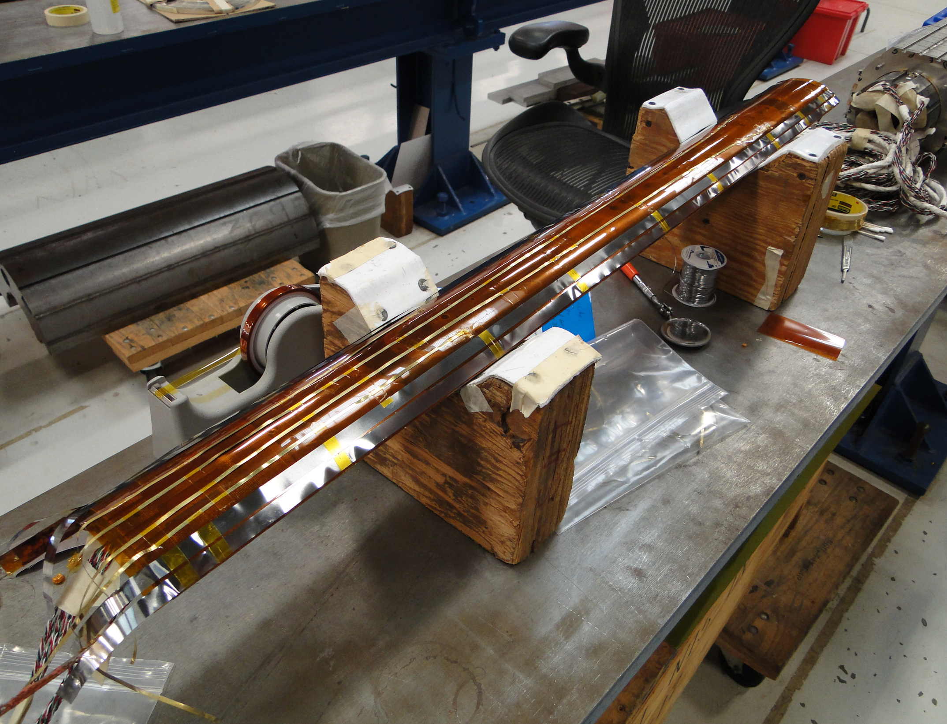

Slide 5
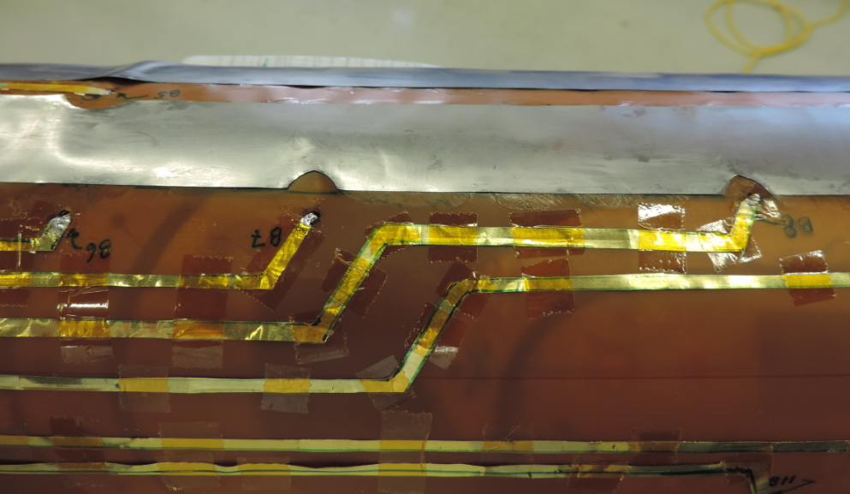
Dimensions:
Thickness: 2 mil foil and 2 layers of 1 mil tape. (~4-5 mils)

Slide 6
Is it possible to have a temporary wire going though the yoke holes?
Other ideas?

