Slide 1
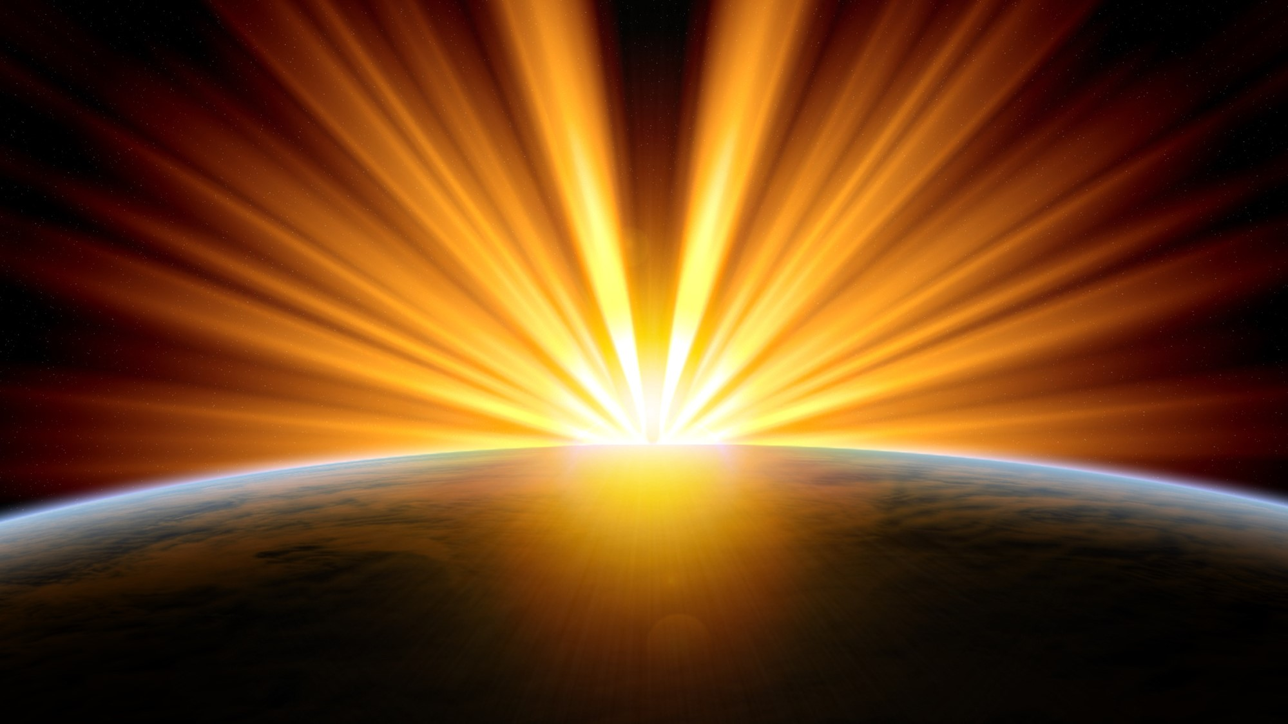
1905
A Space-time odyssey
Mehreen Sultana

Slide 2

BUT FIRST, Let’s define some TERMS
Velocity
Acceleration
Force
Inertia

Slide 3

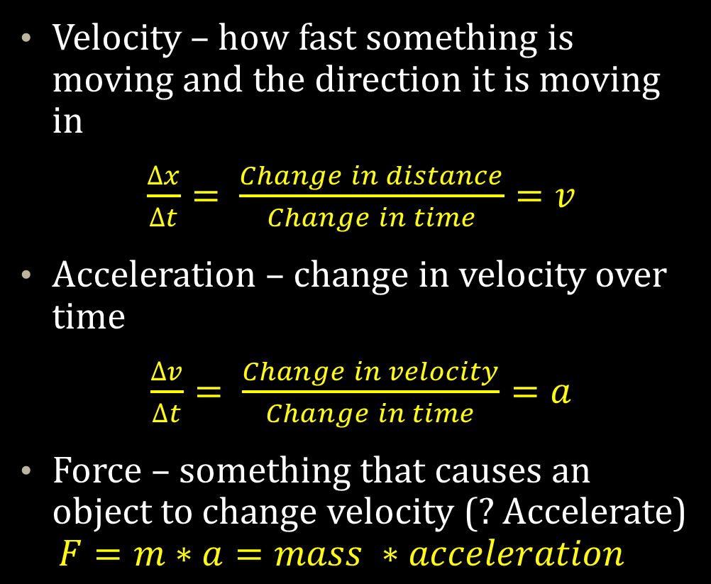
MOTION – FROM NEWTONIAN MECHANICS
Velocity – how fast something is moving and the direction it is moving in
$\frac{∆x}{∆t}= \frac{Change in distance}{Change in time}=v$
Acceleration – change in velocity over time
$\frac{∆v}{∆t}= \frac{Change in velocity}{Change in time}=a$
Force – something that causes an object to change velocity (? Accelerate)
  $$F=m∗a=mass ∗acceleration$$

Slide 4
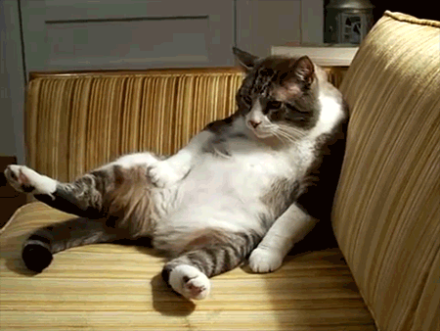
ADVANCED MOTION
Inertia – Defined in Newton’s First Law
  “The vis insita, or innate force of matter, is a power of resisting by which every body, as much as in it lies, endeavours to preserve its present state, whether it be of rest or of moving uniformly forward in a straight line.”
  Philosophiae Naturalis Principia Mathematica, Isaac Newton
  An object in motion stays in motion and an object at rest stays at rest unless acted upon by an external forcee
NATURE DOES NOT LIKE CHANGE.

Slide 5
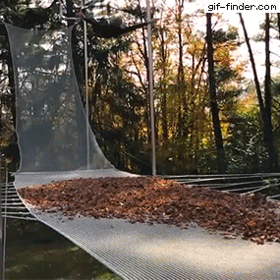
INERTIA!
FORCE!
ACCELERATION!
VELOCITY!

Slide 6

BUT FIRST, Let’s define some TERMS (PART 2)
Event
Observer
Frame of Reference
Inertial Frame of Reference
Relative (relativity)
Invariance (?)

Slide 7
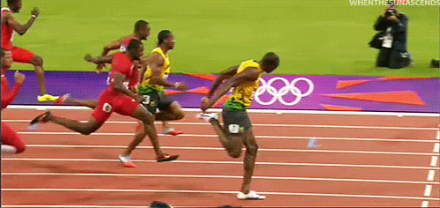
RELATIVE MOTION
Event: something that happens at a place, at some time
Observer: You (?), Something that observes and measures the event
Observer
Event

Slide 8
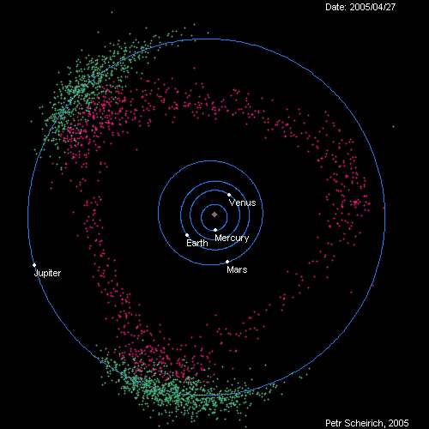
RELATIVE MOTION
Frame of Reference: a system of measuring when and where an event happens
  We are still now. But we are always moving with respect to everything else in the solar system!
Inertial Frame of Reference: frame of reference in which the object has zero acceleration. a = 0
  It’s when the object is still or moving at a constant speed

Slide 9
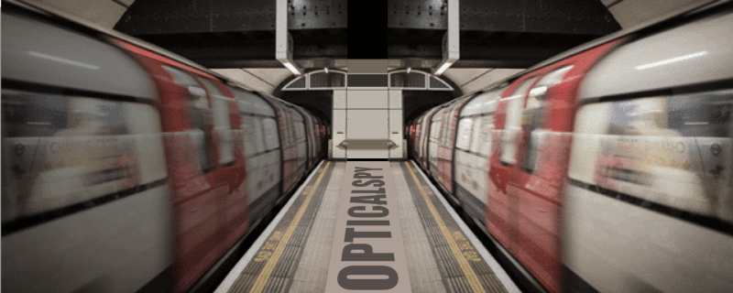
RELATIVE MOTION
Relative (relativity): with respect to something… a measurement you make in one reference frame compared to another reference frame
Invariance (invariant):
  Stuff that doesn’t change when you change reference frame
  Sitting in subway train and not knowing for a moment who’s moving. The train next to you or your train?

Slide 10

Newtonian Relativity
The laws of physics (mechanics) are the same for any observer moving at constant speed.
Is there a preferred (best) reference frame that underlies all the other ones?

Slide 11
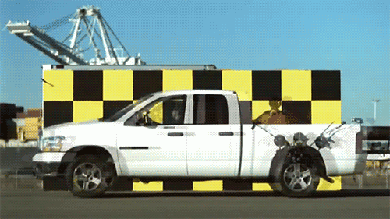
Relative Motion – “WITH RESPECT TO … ”

Slide 12
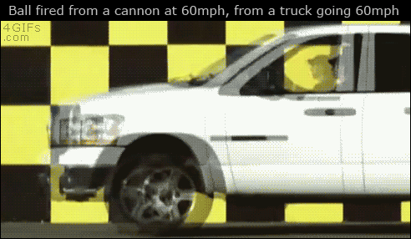
Relative Motion – “WITH RESPECT TO … ”
From our point of view
(Frame of Reference)
V_{truck} = - 60 mph
V_{ball} = 60 mph
V_{truck} + V_{ball} = 0 mph!
Galileo’s Law of Addition of Velocities

Slide 13
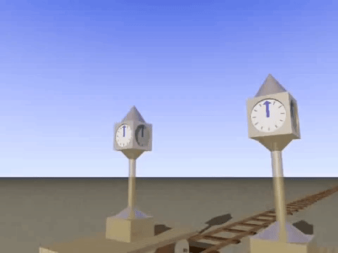
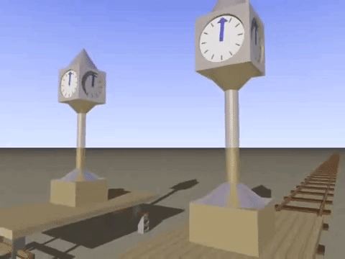
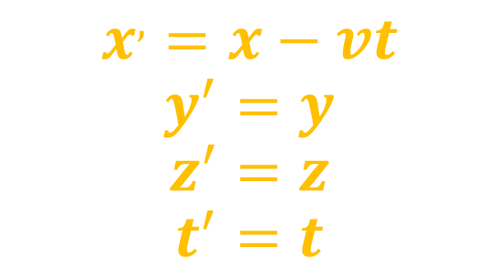
Galilean TRANSFORMATION
Stationary observer
Moving observer
$$x^{,}=x−vt$$
$$y^{′}=y$$
$$z^{′}=z$$
$$t^{′}=t$$
According to Galilean relativity, time is assumed to be the same for both.

Slide 14
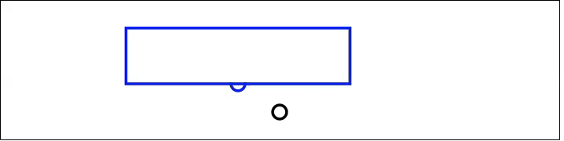

Galilean Relativity
Train car (box)
Telegraph pole (circle)
When the center of the train car reaches pole, a light is flashed.
When does the light reach each end of the car?
(police car, inside vs outside)
Stationary Observer
(Outside train car)
Moving Observer (inside train car)
http://www.physics.nyu.edu/~ts2/Animation/special_relativity.html#

Slide 15
What is LIGHT?
Draw me a picture of how light is traveling through this room
Draw how it would reflect off clothes.
( I pick a student to come up and draw on the chalkboard. They will listen to the ideas other students bring up and try to draw a picture of how light travels and how we see colors. Or I can draw the picture based on what the students say. Or I can have each student draw a picture on a sheet of paper. )
(The idea is to get them to think about light and how light moves through space. How it interacts with particles. How these interactions lead to what we see)

Slide 16
SO…WHAT IS LIGHT?
Draw how you think light travels.
Where is it coming from?
What is it going through?
Get together in groups of (5-10?) and come up with a drawing that explains what light is and how it moves.
Person from each group comes up to the board and draws.

Slide 17
SO…WHAT IS LIGHT?
Form groups of 5-6 people
Pick a group representative to answer for the group
Notes:
Draw how you think light travels in this room. Start with a light bulb. How is light coming out of this bulb? What does it do next? How does it travel from this room? What is it made of? What does it go through? What is it reflected off of?

Slide 18
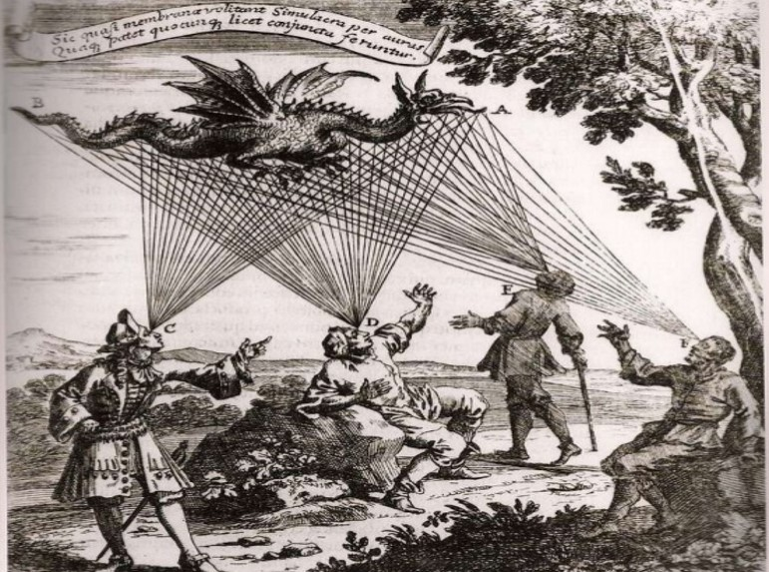
EMISSION THEORY
Aristotle and Plato believed light rays came out of our eyes.
A study in 2002 claimed as much as 50% of adults believe the same.
Physics tells a different story.
Fundamentally misunderstanding visual perception: Adults' belief in visual emissions.
Winer, Gerald A.; Cottrell, Jane E.; Gregg, Virginia; Fournier, Jody S.; Bica, Lori A.
American Psychologist, Vol 57(6-7), Jun-Jul 2002, 417-424.http://dx.doi.org/10.1037/0003-066X.57.6-7.417

Slide 19
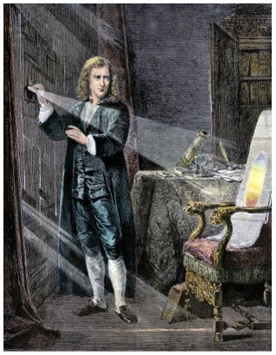
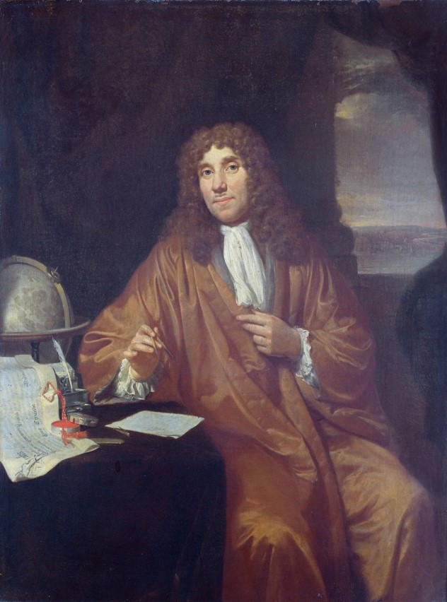
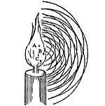

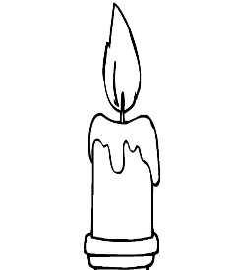
Light is a corpuscle!
Light is a wave!
Isaac Newton
1642-1727
Christian Huygens
1629-1695

Slide 20
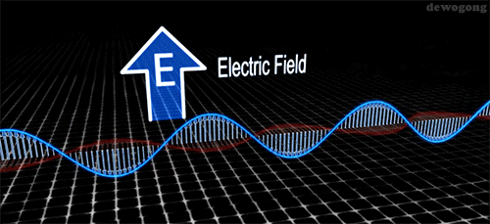
Maxwell’s LIGHT (1862)
Light as electromagnetic radiation (em wave)

Slide 21
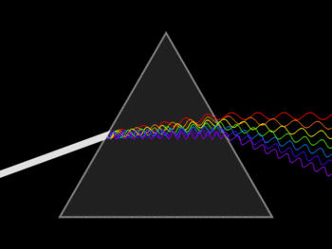
Maxwell’s LIGHT
Light as electromagnetic radiation (em wave)
Four formulas that unite electricity and magnetism

Slide 22
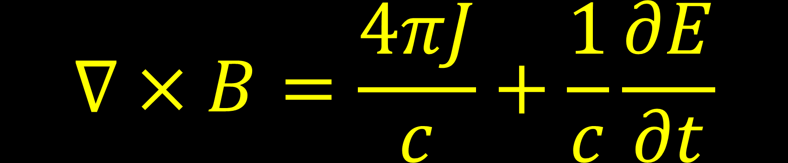

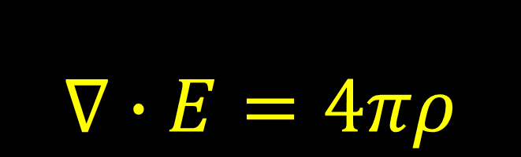
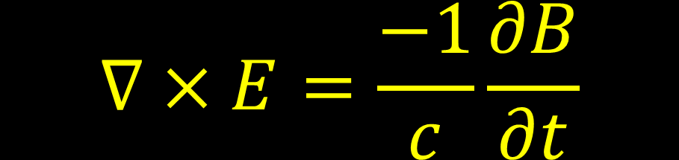
Maxwell’s LIGHT
$$∇∙E=4πρ$$
$$∇∙B=0$$
Light as electromagnetic radiation (em wave)
Four formulas that unite electricity and magnetism
$$∇×E=\frac{−1}{c}\frac{∂B}{∂t}$$

Slide 23
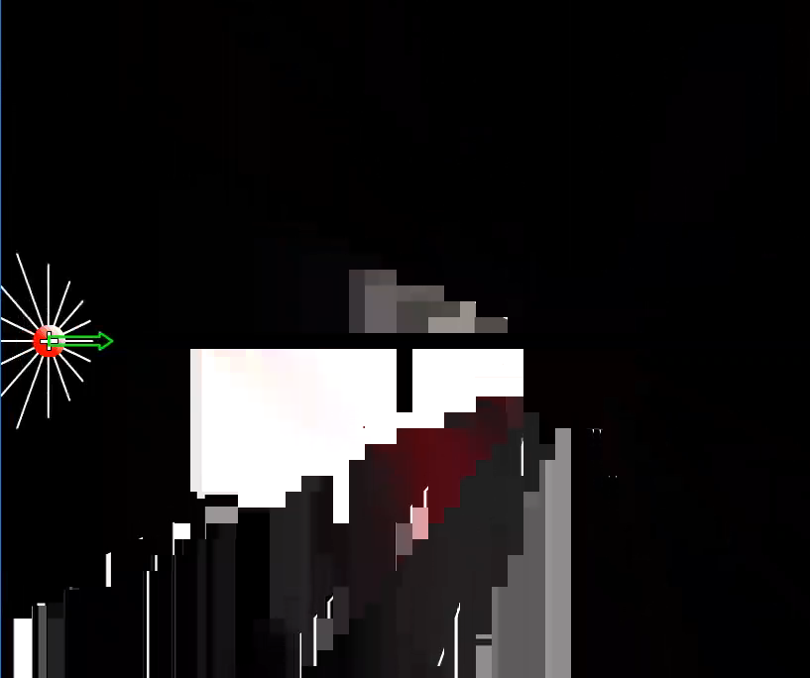


$$∇∙E=4πρ$$
Gauss’s Law
$∇∙E$ : Electric field added up over some surface is proportional to the charge inside the volume surrounded by the surface
No forces attracting you or repelling you if you’re the only charge in the block.

Slide 24
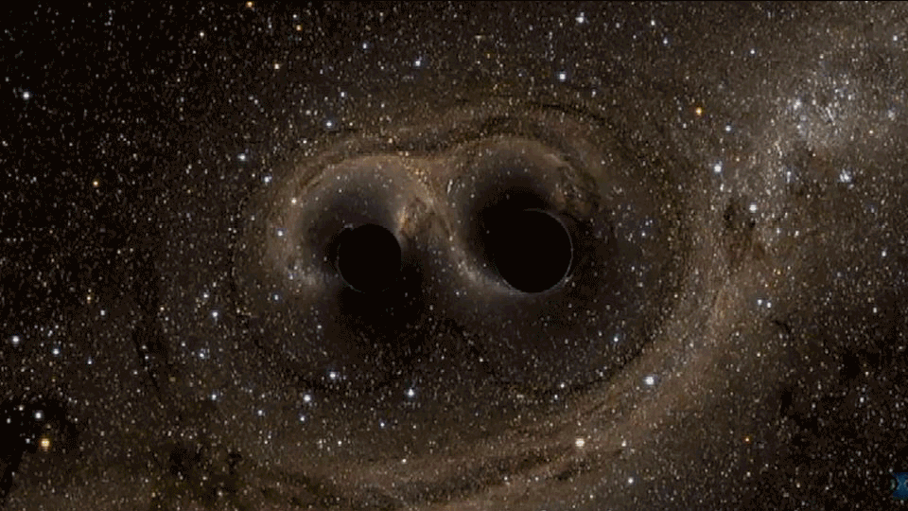


$$∇∙E=4πρ$$
WOULD BE HUGE FOR A BLACK HOLE!
Gauss’s Law for Gravity? Same pattern exists! (but not with E)
$F= \frac{GM×m}{r^{2}}$

Slide 25
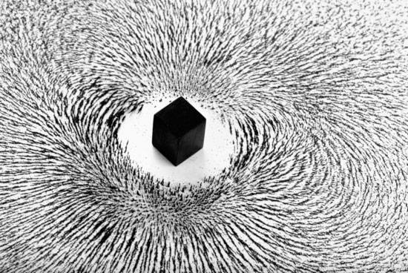
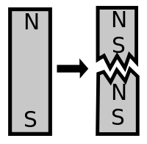
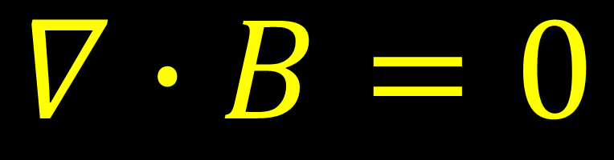
$$∇∙B=0$$
No magnetic charge like electric (+ / -)
Could be wrong
If you find a magnetic monopole, instant Nobel Prize!

Slide 26
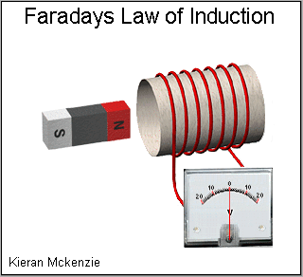
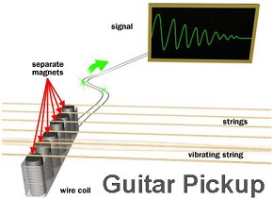
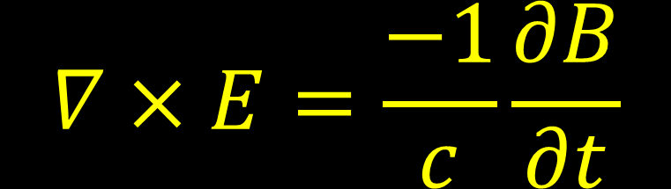
$$∇×E=\frac{−1}{c}\frac{∂B}{∂t}$$
Changing magnetic field creates a current
The negative sign is important (Lenz’s Law)
  Keeps you from getting an infinite field
  Nature does not like change
Core piece of modern tech!
  Pick up coil in electric guitar

Slide 27
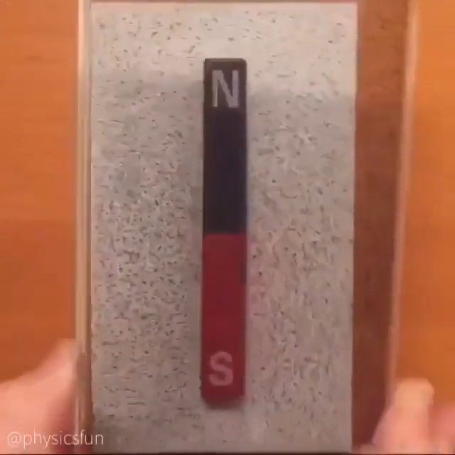
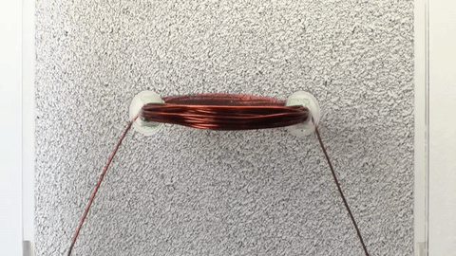
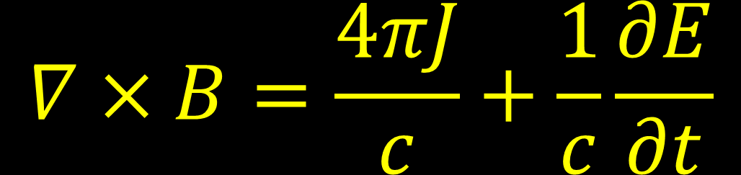
$$∇×B=\frac{4πJ}{c}+\frac{1}{c}\frac{∂E}{∂t}$$
Ampere’s Law?
Symmetry in Physics
Moving Charges (current) create magnetic field
Electromagnet
Permanent magnet creating a magnetic field

Slide 28
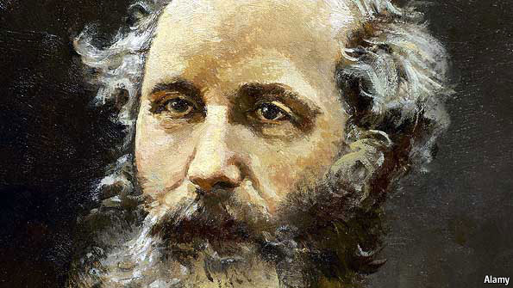

Think about THIS…
Whatever frame of reference, the same laws of physics apply.
Maxwell’s Equations are laws of Electromagnetism. And you can derive the speed of light from this.
$$c ≈3.00 ×{10}^{8}\frac{meters}{second}$$
So in all frames of reference, the speed of light has to be same!
But in Newtonian and Galilean Relativity, there is no rule that says light has only one maximum speed.
Light travels 300,000 kilometers in a second!

Slide 29

Galilean Relativity
If light reaches one end of the train first, it’s going faster than what we know to be the speed of light.
How can this be?!
Are Newton and Galileo wrong?

Slide 30
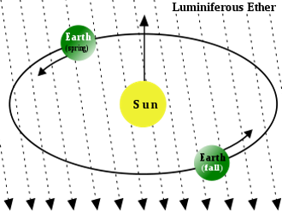
Well… if LIGHT IS A WAVE, THEN LIGHT MUST BE traveling through SOMETHING
Invisible
Infinite
Unchanging
IMAGINE PLANKTON (earth) FLOATING IN THE OCEAN

Slide 31
MAYBE With Respect to THE ETHER…
Velocity of light is constant
And we don’t have any problems with Electromagnetism

Slide 32

Whatever it is, it’s traveling through SOMETHING
HOW CAN YOU TEST THIS?
HOW FAST IS PLANKTON MOVING IN THE WATER?

Slide 33
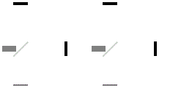
1887 – Albert MICHELSON and EDWARD MORLEy
Goal: detect relative motion of matter through ether
  How fast is Earth moving relative to the unchanging ether?
Expectation: velocity of light should differ if the measuring instruments are also moving relative to the ether
Interferometer (look that up later)
Measure velocity by looking at interference patterns.

Slide 34
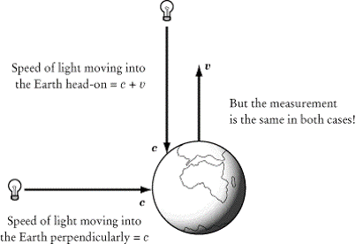

Slide 35


They looked at the pattern Light Made
The observer could mark the position of one spot.
Measured shifts in these light pattern as they rotated the table their instruments were on.

Slide 36
The Experiments on the relative motion of the earth and ether have been completed and the result decidedly negative. The expected deviation of the interference fringes from the zero should have been 0.40 of a fringe – the maximum displacement was 0.02 and the average much less than 0.01 – and then not in the right place. As displacement is proportional to squares of the relative velocities it follows that if the ether does slip past the relative velocity is less than one sixth of the earth’s velocity.
— Albert Abraham Michelson, 1887
Difference is measured but too small to conclude existence of a “unchanging” ether. Speed of light same even with equipment moving.
19th century scientists, saw light traveling as a wave but what is it traveling through? MM proved it’s not traveling through anything.
You can work out the math here:
ClickMeForScience!

Slide 37

SO WHEN IT COMES TO LIGHT…

Slide 38



Light
Electricity
And
Magnetism
Newtonian
Mechanics

Slide 39
BUT WHEN IT COMES TO LIGHT…
MAXWELL’S EQUATIONS DO NOT WORK IN NEWTONIAN WORLD!
Addition of velocities -> Expect to see light speed greater than c! But we don’t see that.

Slide 40

PHYSICS SEEMS TO BE STUCK…

Slide 41
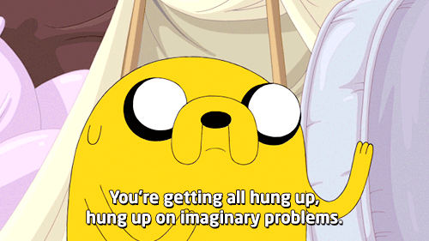
1905: EINSTEIN TO THE RESCUE!
Published Theory of Special Relativity (ignores ether)

Slide 42

Let’s turn on a flashlight

Slide 43


observer
$$v_{light}=c$$

Slide 44


$$v_{spaceship}=0.9c$$
What do people on the spaceship see?
Wow!
$$v_{light}=c$$

Slide 45
$$v_{spaceship}=0.9c$$
Both observe see same speed of light from the flashlight
:O
$$v_{light}=c$$

Slide 46


$$v_{spaceship}=0.9c$$
$$v_{blue}$$
How fast is the blue light for observer on the ground?
Ooo
$$v_{light}=c$$

Slide 47

$$v_{spaceship}=0.9c$$
$$v_{blue}=c$$
c!
Wow!
$$v_{light}=c$$

Slide 48
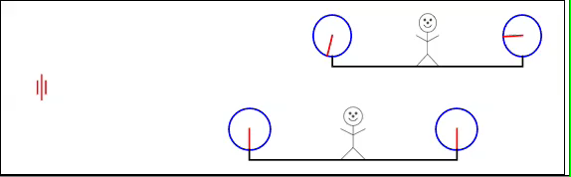
Remember Galilean Relativity?
According to Galilean relativity, time is assumed to be the same between all frames of reference.
WHAT IF IT ISN’T?
Moving Observer
(train car)
Stationary Observer (pole)
Imagine clocks that use light to keep time
We call this a “light clock”

Slide 49
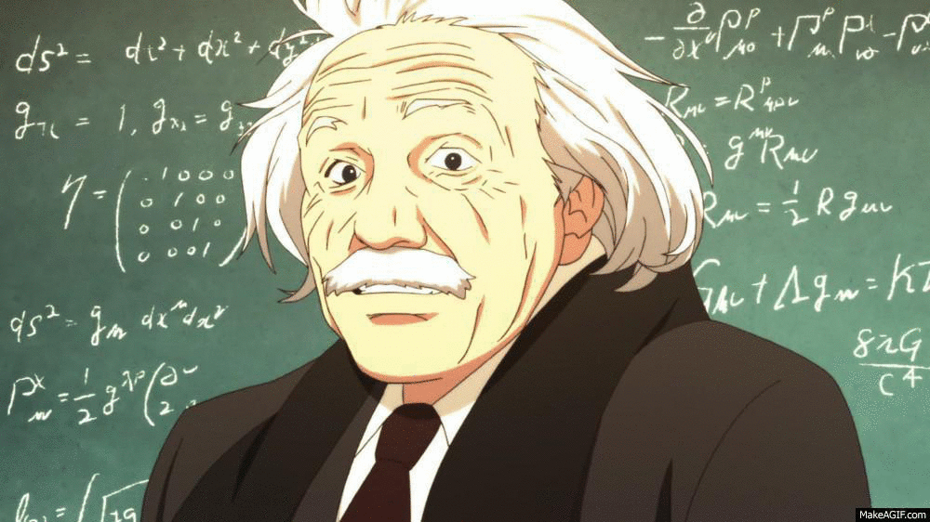
SPECIAL POSTULATES FOR A VERY SPECIAL RELATIVITY
The laws of physics are the same in all inertial frames of reference
The speed of light in free space has the same value in all inertial frames of reference

Slide 50




A static observer on the ground has a light clock.
A “tick” in time is when light leaves and comes back.
Recall velocity: $v= \frac{∆x}{∆t}$
Apply that to this situation: $c=\frac{d}{∆t}$
$∆t_{0}=\frac{2d}{c}$
what we will call proper time
$$d$$
detector
mirror

Slide 51


Second observer is in a moving spaceship with another light clock
Observer outside the ship sees the second light clock moving
detector
mirror
d
v
Space ship moving with velocity v < c

Slide 52


Second observer is in a moving spaceship
Outside Observer sees new distance that light travels
detector
mirror
d
y
v
We know how fast the spaceship is moving.
So we know how fast the light clock is moving. v

Slide 53

Second observer is in a moving spaceship
Outside Observer sees new distance that light travels
detector
mirror
$$y$$
d
v
$v=2\frac{y}{∆t}→\frac{v∆t}{2}=y$

Slide 54

Second observer is in a moving spaceship
Outside Observer sees new distance that light travels
detector
mirror
d
$$v\frac{∆t}{2}$$
d’
v
v increases the distance light has to travel in the detector.

Slide 55


Second observer is in a moving spaceship
Outside Observer sees new distance that light travels
detector
mirror
$$v\frac{∆t}{2}$$
d
$$c\frac{∆t}{2}$$
v
We know speed of light is constant.
If speed doesn’t change, but the distance changes…

Slide 56


Second observer is in a moving spaceship
Outside Observer sees new distance that light travels
detector
mirror
d
$$v\frac{∆t}{2}$$
$$c\frac{∆t}{2}$$
v
Then, the time$, ∆t$, has to change also.
$∆t$ is not the same as $∆t_{0}$

Slide 57




We have to use the Pythagorean Triangle!
d
$$v\frac{∆t}{2}$$
$$d^{′}=c\frac{∆t}{2}$$
$$a^{2}+b^{2}=c^{2}$$
$$x^{2}+y^{2}=z^{2}$$
$$d^{2}+ {\left(v\frac{∆t}{2}\right)}^{2}={\left(c\frac{∆t}{2}\right)}^{2}$$
z
y
x

Slide 58




$$v\frac{∆t}{2}$$
d
You guys can do Algebra, right?
Solve for $∆t$
$$c\frac{∆t}{2}$$
$$a^{2}+ b^{2}= c^{2}$$
$$d^{2}+ {\left(v\frac{∆t}{2}\right)}^{2}={\left(c\frac{∆t}{2}\right)}^{2}$$
$$∆t= \frac{2d}{c\sqrt{1−\frac{v^{2}}{c^{2}}}}$$
Can’t go Faster than speed of light!!!

Slide 59




$$∆t= \frac{2d}{c\sqrt{1−\frac{v^{2}}{c^{2}}}}$$
LET’S SIMPLIFY!
$$γ= \frac{1}{\sqrt{1−\frac{v^{2}}{c^{2}}}}$$
$$∆t= \frac{2d}{c}γ$$
Lorentz Factor
$$1<γ<∞$$

Slide 60




$$∆t= \frac{2d}{c}γ$$
Remember ?
$$∆t_{0}=\frac{2d}{c}$$
$$∆t_{0}=\frac{2d}{c}$$
$$∆t=∆t_{0}γ$$

Slide 61





$$v_{spaceship}=v$$
$∆t=$Time in the spaceship
NOT SAME AS TIME ON GROUND!!
Wow!
$$∆t=∆t_{0}γ$$
$∆t_{0}$= Time on the ground for static observer

Slide 62


THIS IS TIME DILATION!
$$∆t=∆t_{0}γ$$
Time slows down inside the spaceship!

Slide 63

TIME ISN’T THE SAME IN ALL REFERENCE FRAMES!!

Slide 64




Distance to Alpha Centuari
Nearest Star
4.4 Light Years
$$∆t=∆t_{0}γ$$

Slide 65

Distance to Alpha Centuari
Nearest Star
4.4 Light Years
If we had a spaceship that flew at v = 0.5c
To reach the nearest star system from point of view of Earth
8.8 $Years$

Slide 66

Distance to Alpha Centuari
Nearest Star
4.4 Light Years
If we had a spaceship that flew at v = 0.5c
$$γ= \frac{1}{\sqrt{1−\frac{v^{2}}{c^{2}}}}=1.16$$
$$∆t=∆t_{0}γ=8.8 years ∗1.16=10.16 Years$$
To reach the nearest star system from point of view of Earth
$$10.16 Years$$

Slide 67

What about DISTANCE?
Proper Time: $∆t_{0}$
Time from the frame of reference at rest relative to two events (Shortest Possible Time)
Proper Length: $L_{0}$
Distance from the frame of reference at rest to the object you are measuring (Longest Possible Distance)

Slide 68



Distance to Alpha Centuari
Nearest Star
4.4 Light Years
Towards Alpha Centauri at 0. 5c
José
María
José is at rest relative to Alpha Centauri. So he measures Proper Length
Leaving earth at 0. 5c

Slide 69

Distance to Alpha Centuari
Nearest Star
4.4 Light Years
Towards Alpha Centauri at 0. 5c
José
María
The proper length is 4.4 Light Years
Leaving earth at 0. 5c

Slide 70
Distance to Alpha Centuari
Nearest Star
4.4 Light Years
Towards Alpha Centauri at 0. 5c
José
María
María is not at rest relative to Alpha Centauri.
She is at rest relative to the start place and at rest relative to the end place.
Leaving earth at 0. 5c

Slide 71
Distance to Alpha Centuari
Nearest Star
4.4 Light Years
María
Towards Alpha Centauri at 0. 5c
José
María sees proper time.
Both see the same speed v = 0.5c
Leaving earth at 0. 5c

Slide 72

Distance to Alpha Centuari
Nearest Star
4.4 Light Years
María
Towards Alpha Centauri at 0. 5c
José
Both see the same speed v = 0.5c
$$v= \frac{L_{0}}{∆t}= \frac{L}{∆t_{0}}$$
Leaving earth at 0. 5c

Slide 73

Distance to Alpha Centuari
Nearest Star
4.4 Light Years
María
Towards Alpha Centauri at 0. 5c
Both see the same speed v = 0.5c
$$\frac{L_{0}}{∆t}=\frac{L_{0}}{∆t_{0}γ}= \frac{L}{∆t_{0}}$$
$$\frac{L_{0}}{∆t_{0}γ}= \frac{L}{∆t_{0}}$$
José
Leaving earth at 0. 5c

Slide 74

Distance to Alpha Centuari
Nearest Star
4.4 Light Years
María
Towards Alpha Centauri at 0. 5c
Both see the same speed v = 0.5c
$$\frac{L_{0}}{∆t_{0}γ}= \frac{L}{∆t_{0}}$$
$$L_{0}= \frac{L ∆t_{0} γ}{∆t_{0}}$$
José
Leaving earth at 0. 5c

Slide 75

Distance to Alpha Centuari
Nearest Star
4.4 Light Years
María
Towards Alpha Centauri at 0. 5c
José
Both see the same speed v = 0.5c
$$\frac{L_{0}}{∆t_{0}γ}= \frac{L}{∆t_{0}}$$
$$L_{0}=Lγ$$
Leaving earth at 0. 5c

Slide 76

Distance to Alpha Centuari
Nearest Star
4.4 Light Years
María
Towards Alpha Centauri at 0. 5c
José
Both see the same speed v = 0.5c
$$L_{0}=Lγ$$
Maria’s measured distance is
$$L_{0}=4.4 Light Years =Lγ$$
= 3.8 Light Years!
Leaving earth at 0. 5c

Slide 77
Distance to Alpha Centuari
Nearest Star
4.4 Light Years
I experience shorter distance!
María
Towards Alpha Centauri at 0. 5c
José
Both see the same speed v = 0.5c
$$L_{0}=Lγ$$
Maria’s measured distance is
$$L_{0}=4.4 Light Years =Lγ$$
= 3.8 Light Years!
Leaving earth at 0. 5c

Slide 78


Distance to Alpha Centuari
Nearest Star
4.4 Light Years
María
Towards Alpha Centauri at 0. 5c
José
This is Length Contraction!
Leaving earth at 0. 5c
$$L_{0}=Lγ$$

Slide 79

And shorter time!
Distance to Alpha Centuari
Nearest Star
4.4 Light Years
María
Towards Alpha Centauri at 0. 5c
Maria’s measured distance is
$$L=3.8 LY$$
Maria’s measured time is
$$∆t= ∆t_{0}γ=\frac{3.8 Light Years}{∆t_{0}}$$
$$∆t_{0}=2.76 Years$$
José
Leaving earth at 0. 5c

Slide 80

DISTANCE ISN’T THE SAME IN ALL REFERENCE FRAMES!!

Slide 81
$$∇×B=\frac{4πJ}{c}+\frac{1}{c}\frac{∂E}{∂t}$$
Remember Ampere’s Law?
Electromagnet
Permanent magnet creating a magnetic field

Slide 82

+
-
Copper wire consists of positive ions and free charges (electrons) moving around
Make this A cylinder

Slide 83
+
-
When there are equal number of positive charges and negative charges, then the wire is neutral.
No attraction or repulsion.

Slide 84

+
-
+
If there was a positive ion outside.. What would it experience?

Slide 85

+
Electrons moving
+
It wouldn’t experience any force since the wire is neutral.
Even if the negative charges were moving (a current flowing through the wire)

Slide 86
+
Electrons moving
+
But a moving outside charge would experience repulsion.
How do we account for that force?

Slide 87
+
Electrons moving
Based on Ampere’s Law, we say it’s a magnetic force from the magnetic field generated by the current. From our perspective.

Slide 88
Positive ions moving
+
But from the perspective of the free charges...
They are static.
NO CURRENT.
Only observe an electric field.

Slide 89

Electromagnets are a consequence of Special Relativity!
Whether you see Electric or Magnetic Field depends on Frame of Reference!
https://www.youtube.com/watch?v=1TKSfAkWWN0

Slide 90

Light
Electricity
And
Magnetism
Newtonian
Mechanics
Special
Relativity

Slide 91

Speed of light is same in all reference frames!
But perception of time and space changed dramatically!
Newton’s Laws are good approximation at “small” speeds.

Slide 92

THANKS TO…
Dr. Bob Bernstein
Soon to be Dr. Anne Norrick
Dr. Elliot Mcrory
Dr. Sowjanya Gollapinni
Dr. Minerba Betancourt
Soon to be Dr. José Sepulvéda
Dr. Google
Professor Youtube
Fermilab Library

Slide 93
THANKS TO…
http://www.diegosanches.com/pixel-art-1 Scientist Pixel Gifs
https://www.youtube.com/user/diggitydev Amazing Physics explanations
https://www.youtube.com/user/sixtysymbols Short videos about every physics topic ever
https://www.youtube.com/user/minutephysics Physics under a minute
And sooo many other websites that had animations and videos I borrowed from.
Also Cartoon Network for the cartoons. They’re great.

Slide 94


Light
Electricity
And
Magnetism
Newtonian
Mechanics
Special
Relativity

Slide 95

Don’t think of Time and Space as separate things.
WE ARE EXPERIENCING SPACE-TIME.

