Slide 1
Neutrinos
Saturday Morning Physics
Leo Aliaga
Fermilab
April 8, 2017

Slide 2
Standard Model and Neutrinos

Slide 3
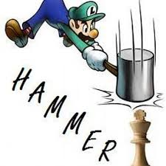
Elementary Particles
Leptons
What does elementary mean?
e
charge: -1
e
electron
Quarks
e
u
charge: +2/3
neutron
up
d
u
d
charge: -1/3
d
protons = 2 up and 1 down
u
down
d
u
proton

Slide 4
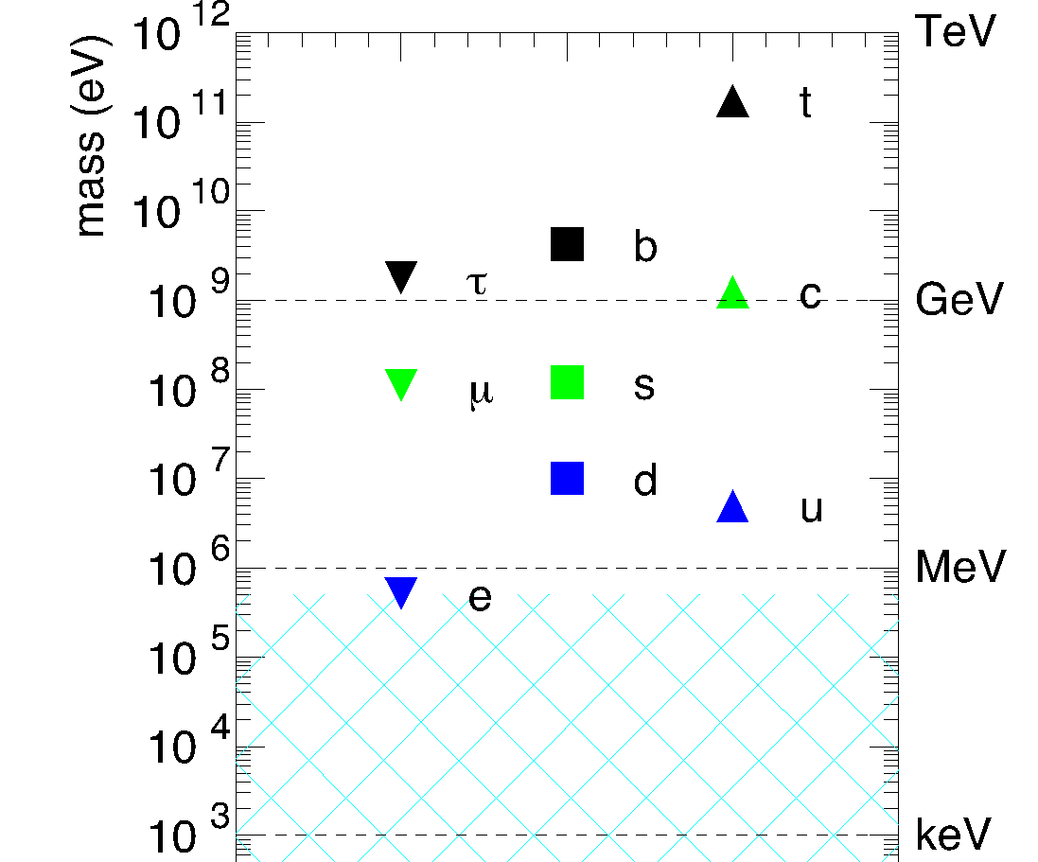
Partial Standard Model of Elementary Particles
Leptons
The difference between the generations is the MASS!
e
^{μ}
^{τ}
electron
muon
tau
1ST GENERATION
2ND GENERATION
3RD GENERATION
u
c
t
up
charm
top
Quarks
d
s
b
down
strange
bottom

Slide 5
The Fundamental Forces of the Universe Influence the Behavior of Particles!
Thanks to the electromagnetic force, we can’t walk through walls!

Slide 6
The Fundamental Forces of the Universe Influence the Behavior of Particles!
How about the weak force?
Let’s take a detour first….
Nature Can Produce Particles!!!

Slide 7
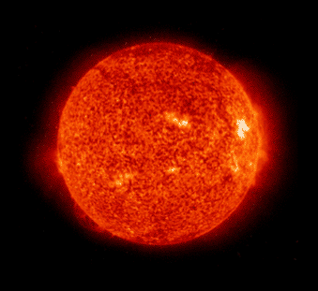
The sun is an ultimate nuclear fusion reactor!
Nuclear Fusion
p
p
NEUTRINOS
p
n
e
ν

Slide 8
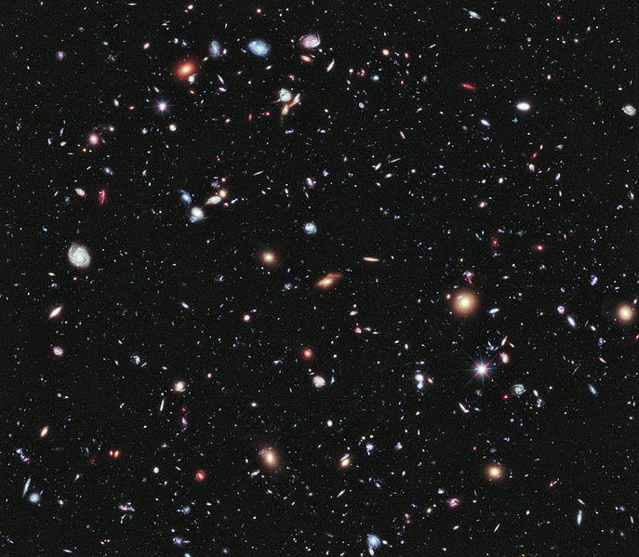
Neutrinos emitted from the
Sun, other stars, and
including the
BIG BANG
are traveling through out
SPACE!!

Slide 9
Millions and millions and millions of neutrinos are also passing through
YOU
at this very MOMENT!
~ 65 billion of neutrinos / cm² / sec from the Sun.
Neutrino flux: ν/ cm2 / sec

Slide 10
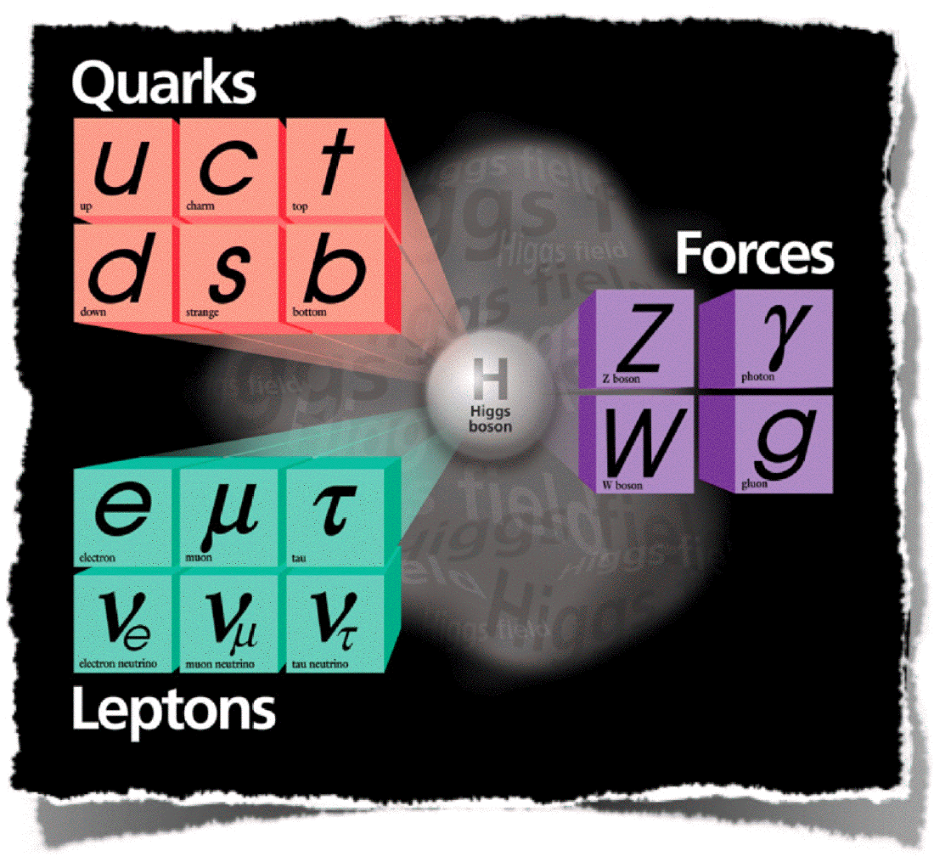
The Complete Picture
Will talk just indirectly about this particles
Will not talk about The God particle.
This lecture focuses on this section of the picture.

Slide 11
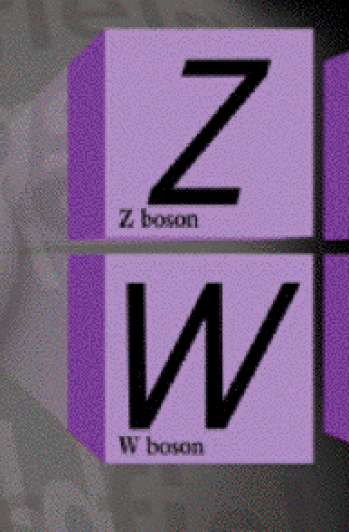
3 neutrinos types (flavors):
no charge, only interact by weak force
2 mediators of weak force
charge:
0
charge:
+-1
What are neutrinos?
What is the Weak force that influences the nature of neutrinos?
Why are neutrinos SO important?

Slide 12
The Discovery of the Neutrino

Slide 13
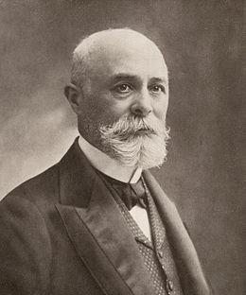
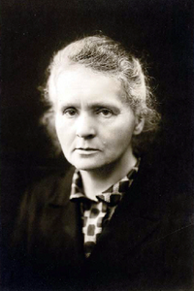
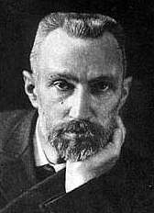
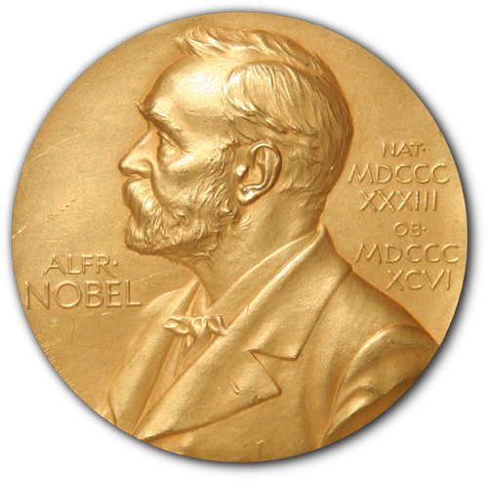
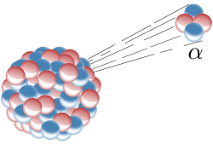
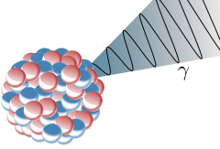
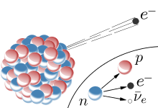
Antoine Henri Becquerel
Marie Curie and Pierre Curie
The pioneers of radioactive decay
Radioactive Decay
unstable atomic nucleus loses energy by emitting particles
transforms an atom into a different type of atom or into a lower energy
Alpha Decay
Gamma Decay
2 protons
Beta Decay
2 neutrons
photons
electron

Slide 14
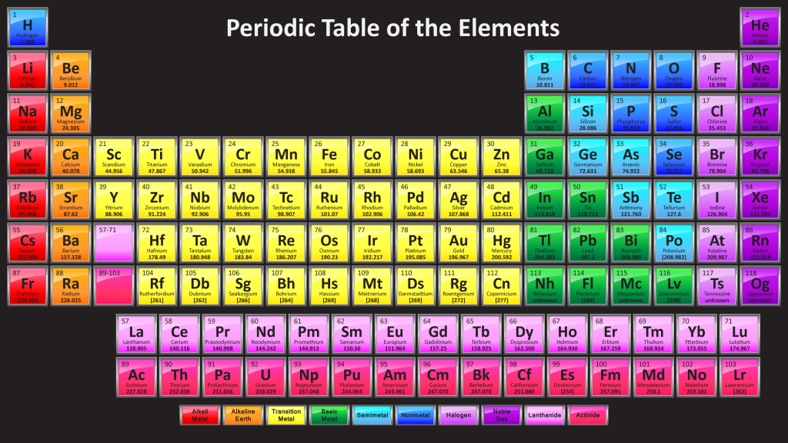
Studying Beta Decay
Rhodium
Palladium
Electron (Beta Particle)
98,652.876 MeV/c²
98,649.196 MeV/c²
0.511 MeV/c²
The numbers are the mass.
Speed of light
electron kinetic energy: 98652.876 – 98649.196 – 0.511 = 3.169 MeV.
Law of Conservation of Energy
E = mc² = mass x (speed of light)²,
where the mass is equivalent to a form of stored energy, E
Gives the amount of energy to convert mass into energy.

Slide 15
Expected Energy Spectrum of the Beta Particle
Measured Energy Spectrum of the Beta Particle
Number of events
Number of events
Beta particle energy ( MeV)
3.169 MeV
Beta particle energy ( MeV)
3.169 MeV
Could it be possible?
Does the Beta Decay Violate the Law of Energy Conservation?

Slide 16
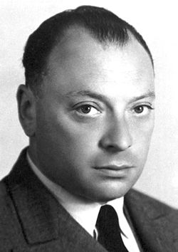
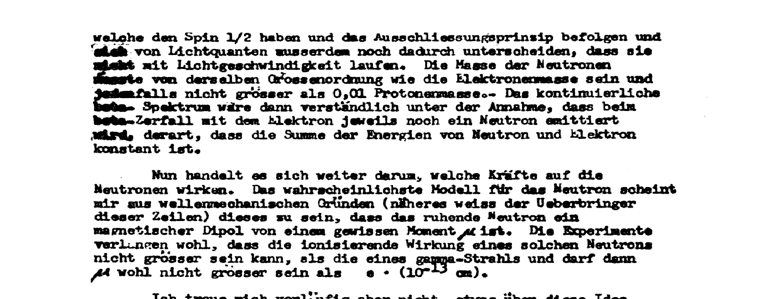
In 1930, Wolfgang Pauli proposed that another particle (a neutral particle, a particle that can not be detected) is emitted along with the electron.
However, Pauli was skeptical about the proposal.
In fact, on Dec. 4, 1930, Pauli wrote a letter to a conference organizer proposing the idea of a neutral particle. Instead of attending the conference, he decided to go to a DANCE.

Slide 17
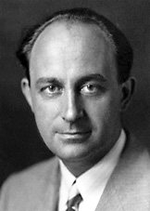
In 1933, Enrico Fermi brought the particle into reality.
Fermi’s theory showed that the neutron (also bound in the nucleus) decays into a proton and simultaneously emits an electron and a neutrino.
The WEAK FORCE turns the neutron into a proton.
Fermi’s theory is called the “four-point beta decay”.
proton
neutron
electron
neutrino

Slide 18
Back to the Beta Decay
Measured Energy Spectrum of the Beta Particle
Number of events
Beta particle energy ( MeV)
3.169 MeV
Palladium
Electron (Beta Particle)
Neutrino
Rhodium
Energy is shared between the particles.

Slide 19
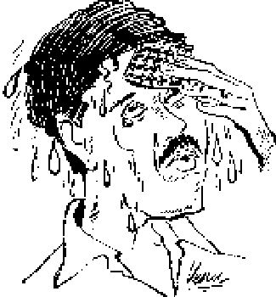
Fermi’s theory of energy remains conserved.
A new particle, the neutrino, is proposed.
Next step is to detect the neutrino.

Slide 20
Finding the Neutrino

Slide 21
Nature has many symmetries

Slide 22
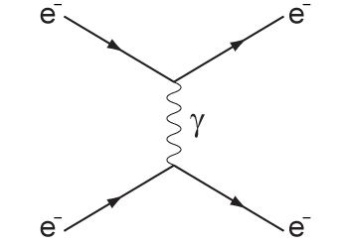
Symmetry in Interactions
e⁻
e⁺
e⁻
e⁺
e⁻
e⁻
time

Slide 23
Symmetry Plays a Fundamental Role in Particle Physics
Time Reversal
Any particle interaction that occurs forward in time can also occur backwards.
electron
electron (+), which is named the positron
neutron
neutrino
proton
neutrino
proton
Beta-Decay
neutron
Inverse Beta-Decay
We can DETECT the neutrino by the inverse beta-decay.

Slide 24
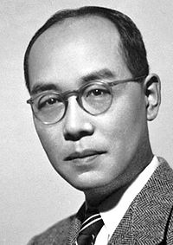
The weak force and neutrinos
In 1936, Yukawa proposed the W boson.
The carrier of the WEAK FORCE.
The weak force is one of the four fundamental forces of nature.
Weak force is 10,000 times weaker than the electromagnetic force.
neutron
proton
W⁻
electron
neutrino

Slide 25
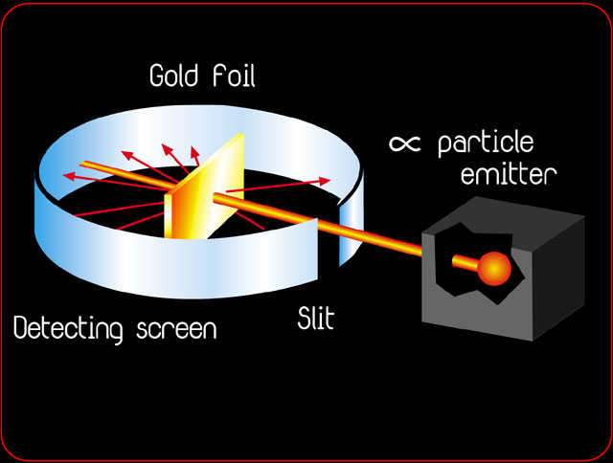
Physicists Use Scattering Experiments to Understand and Discover Particles
Scattering experiments measure the cross-section of a particle interaction.
Cross-section is the number of counts in which the particle interacts with another particle.
Units of cross-section:
area (cm²)

Slide 26
positron
To observe the neutrino, scientists needed to detect the signatures of the positron and neutron.
neutrino
proton
neutron
is a positive charged electron → interacts via the electromagnetic force → interaction results in emission of gamma rays
e⁺
positron
n⁰
looking inside the neutron
is an uncharged nucleon
neutron
an atomic nucleus can capture a neutron → strong force binds the neutron in the nucleus to create a heavier particle → the heavier particle is unstable → emits gamma rays to become stable
d
u
d

Slide 27
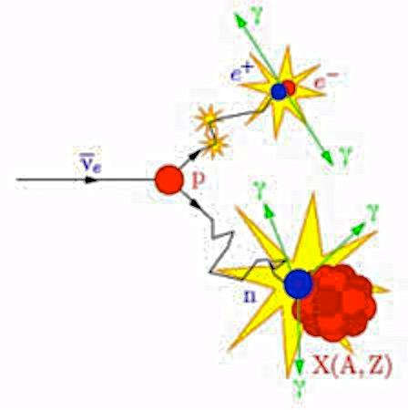
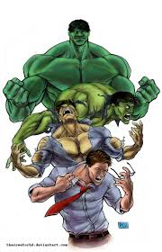
positron
neutrino
signature of the inverse beta decay
proton
neutron
Gamma Rays
The HULK is unstable.
Bruce Banner is stable.

Slide 28
One would think that finding the signature of the neutrino will be easy.
Physicists calculated the cross-section of the inverse beta-decay to be less than 10⁻⁴⁴ meters x meters.
What does that mean? What is the rate?
Solar Neutrinos can travel up to a light year of lead before interacting (MeV scale).
Neutrinos at Fermilab can travel up to 200 earths before interacting((GeV scale))
Neutrinos
1GeV = 10³ MeV
= 10⁹eV

Slide 29
Neutrino interactions are extremely rare !
Need an intense source of neutrinos!
(more neutrino per area per time, higher flux)

Slide 30
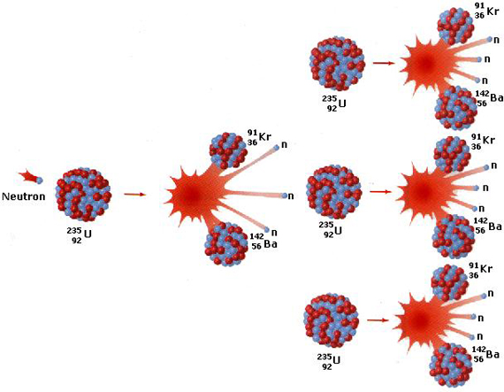
In 1934, Fermi was developing nuclear fission, artificial radioactivity. He bombarded heavy elements with slow neutrons.

Slide 31
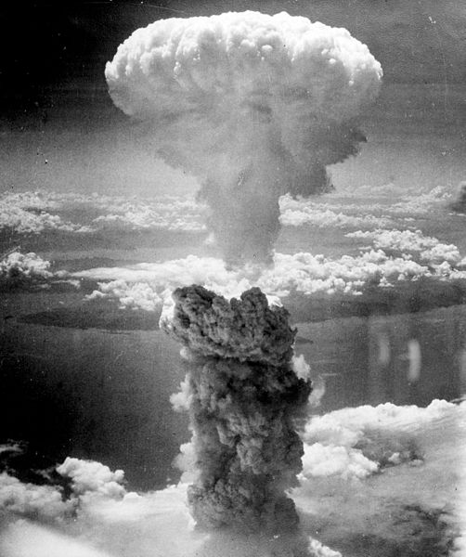
Fermi’s colleague Leo Szilard understood the military application of nuclear fission.
Both Fermi and Szilard recruited Albert Einstein to write a letter to President Franklin D. Roosevelt to encourage him to fund their work.
The Manhattan Project was put into action in 1942.
The most brilliant physicists of the era working together constructed the first atomic bomb!

Slide 32
After World War II, scientists aim to extend the knowledge of frontier particle physics.
From the explosion products of the nuclear bomb, scientists were given a manufactured nuclear reactor.
Lets do some Science!!!
Neutrons are unstable particles.
Neutrons decay via beta decay.
Remember:
Beta decay is the emission of an electron and neutrino.
electron
neutron
proton
neutrino
Beta-Decay
Nuclear reactors were expected to produce neutrino beams on the order of 10¹²-10¹³ neutrino / sec / cm² .

Slide 33
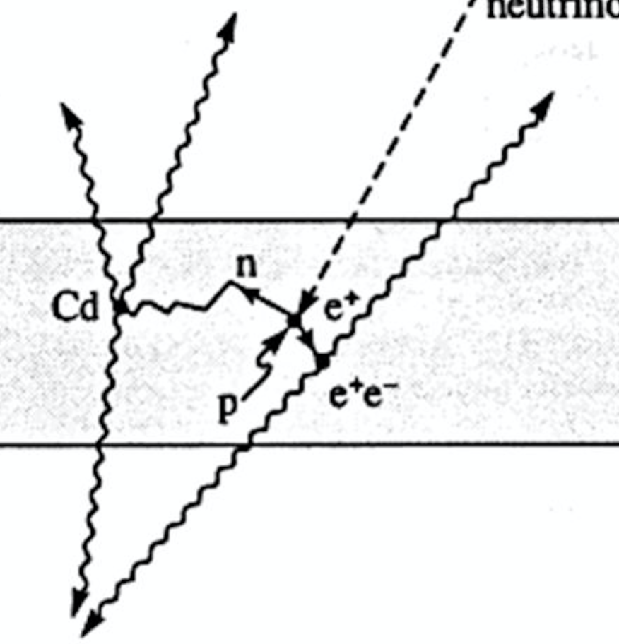
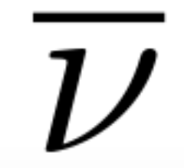
Project Poltergeist
Two decades later, a team lead by Clyde L. Cowan and Frederick Reines designed an experiment to detect neutrinos.
Uses neutrinos from nuclear fission.
Neutrinos interact with a proton via inverse beta decay
Detects the outgoing particles from the neutrino interaction.

Slide 34
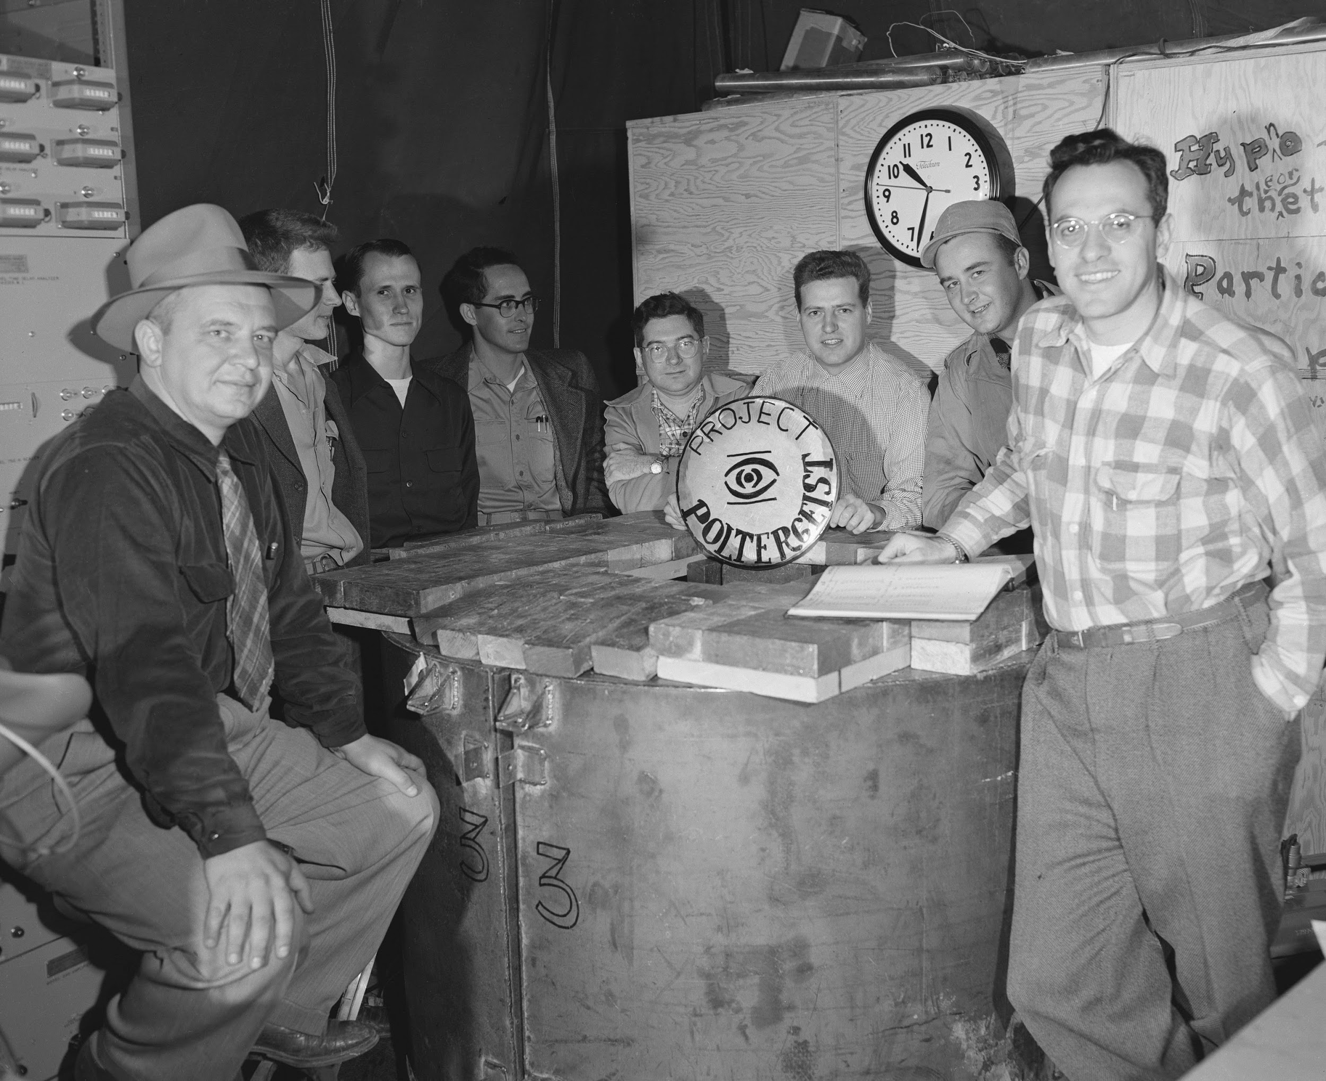
Project Poltergeist
Results (1956)
Neutrinos are observed at a rate of 0.56 counts per hour!
Reines
Cowan
We were able to produce and measure neutrinos here, on Earth!!!

Slide 35
What about using neutrinos emitted from the Sun...
In the late 1930s, physicists developed the solar model.
The solar model mathematically describes the nuclear fusion reactions that are occurring in the Sun’s core.
Solar neutrinos are given to us for free!
We should take advantage of them.
And maybe learn a thing or two about the universe!

Slide 36
30 years after neutrinos were postulated...

Slide 37
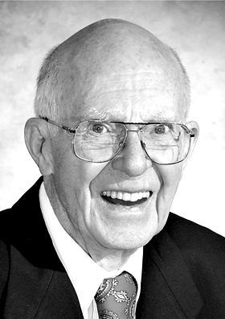
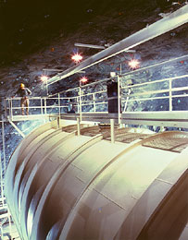
In 1961, Ray Davis confirmed the detection of solar neutrinos. The Homestake Experiment used solar neutrino interactions to convert Chlorine-37 into radioactive Argon-37.
After correcting for detector effects and using the Solar Model prediction, the Davis’ group expected to see one solar neutrino per day.
However, they only saw one solar neutrino every fourth day.
ν_{e}
ν_{e}
ν_{e}
ν_{e}
ν_{e}
ν_{e}
Where did all of the neutrinos go?
ν_{e}
ν_{e}
ν_{e}
ν_{e}
ν_{e}
ν_{e}
ν_{e}
ν_{e}
ν_{e}
ν_{e}
ν_{e}
ν_{e}
ν_{e}
ν_{e}
ν_{e}
ν_{e}
ν_{e}
ν_{e}
ν_{e}
ν_{e}
ν_{e}
ν_{e}
ν_{e}
ν_{e}
ν_{e}
ν_{e}
ν_{e}
ν_{e}
Homestake Mine
Lead, SD, USA

Slide 38
Our measurement is wrong
Our understanding of how our detector behaves is wrong
Where did all of the neutrinos go?
Our understanding of how neutrinos behave is wrong
Our understanding of the way neutrinos are created in the sun is wrong

Slide 39
What have we learned thus far about neutrinos?
Neutrinos do not have charge!
Neutrinos only interact by the weak force.
Neutrinos are difficult to detect!
Neutrinos maybe massless.
The expected number of solar neutrinos is missing.

Slide 40
The Mysteries of Neutrinos

Slide 41
NEUTRINO EXPERIMENTS
NEUTRINO THEORIES

Slide 42
The muon was discovered (1936) before the muon neutrino.
?
muon is a 2nd generation of the electron
π → μ ν
There must be a 2nd generation of the neutrino.
Eventually, physicists discovered that there exist two types of neutrinos.
So, how many generations of neutrinos do exist?
e
μ
νe
νμ

Slide 43
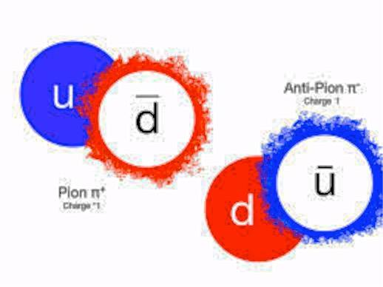
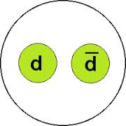
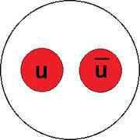
What is a Pion (π)?
Pions
A particle made from a quark and anti-quark pair.
There are three types of pions.
π
π⁻
π⁰
π⁺

Slide 44
So, how many generations of neutrinos do exist?
e
μ
...
νe
νμ

Slide 45
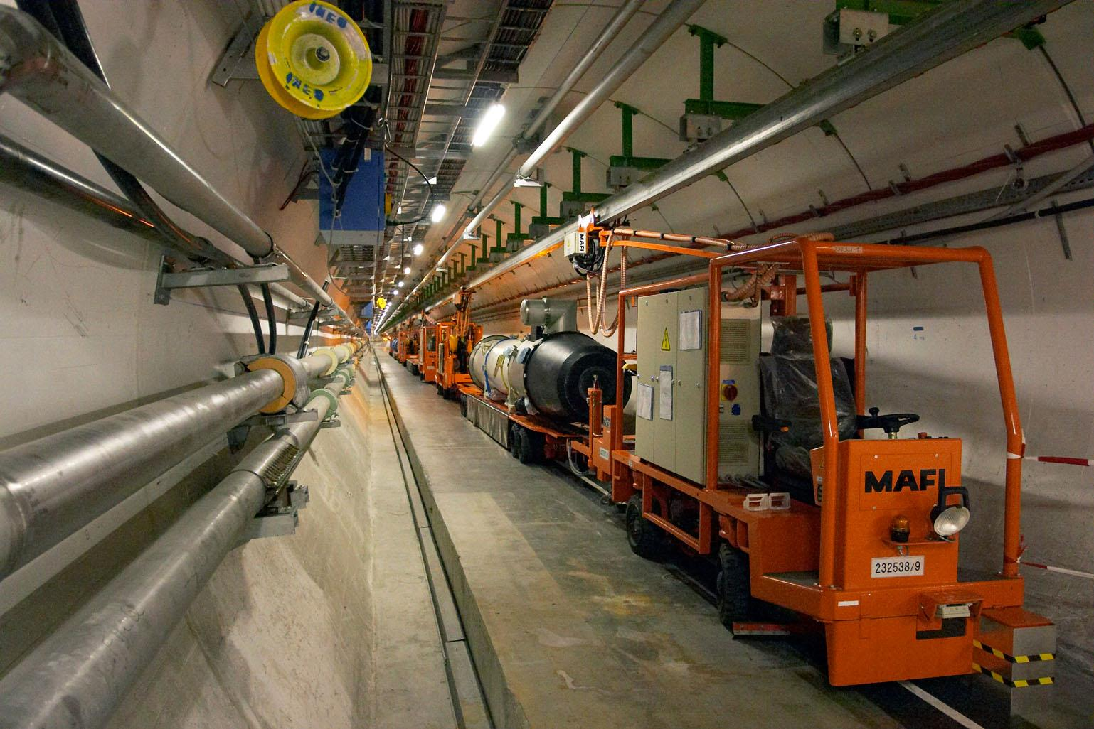
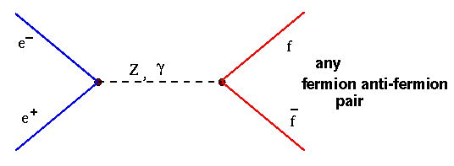
Physicists worried about the number of generations.
The best measurement comes from studying the decay of Z boson
→ measured 3 generations
e⁻
f
e⁺
f
Where f = quarks, leptons, neutrinos.

Slide 46
Recap: Leptons
Discovered in the mid 1970s
e
μ
τ
electron
muon
tau
ν_{e}
ν_{μ}
ν_{τ}
electron
neutrino
muon
neutrino
tau
neutrino
Discovered in 2000 at Fermilab
DONUT experiment
3rd generation!!!!
OK! do we have everything??

Slide 47
e
μ
τ
νe
νμ
ντ
Particle physics proposed that the measured neutrinos are NOT REAL particles!
In fact, the real neutrinos ν₁, ν₂, ν₃ mix to create the flavor neutrinos, ν_{e}, ν_{μ}, ν_{τ} !
The real neutrinos, ν₁, ν₂, ν₃ have a well defined mass.

Slide 48
Wait….
So, the neutrinos that scientists have detected are a mixture of real neutrinos?

Slide 49
Neutrino Oscillations
Neutrinos created with a specific flavor can evolve into a different flavor at a later time.
Diagram shows the probability of changing to another type of neutrino as a function of time.
ν_{e}
ν_{μ}
ν_{e}
ν_{e}
ν_{μ}
ν_{e}
ν_{μ}
ν_{μ}
ν_{e}
ν_{e}
ν_{e}
ν_{e}
ν_{e}
ν_{μ}
ν_{μ}
ν_{μ}
ν_{e}
ν_{e}
ν_{e}
ν_{e}
ν_{e}
ν_{e}
ν_{e}
ν_{e}
ν_{e}
ν_{e}
ν_{e}
ν_{e}
ν_{μ}
ν_{μ}
ν_{e}
ν_{e}
ν_{e}
ν_{μ}
ν_{e}
ν_{e}
ν_{e}
ν_{e}
ν_{e}
ν_{μ}
ν_{e}
ν_{e}
ν_{μ}
ν_{μ}
ν_{e}
ν_{e}
ν_{e}
ν_{e}
ν_{μ}
ν_{μ}
ν_{e}
ν_{e}
ν_{e}
ν_{e}
ν_{e}
ν_{e}
ν_{e}
ν_{e}
ν_{μ}
ν_{e}
ν_{e}
ν_{μ}
ν_{μ}
time

Slide 50
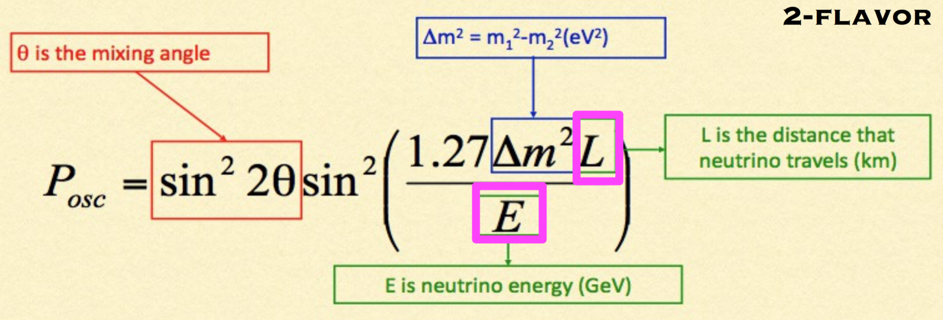
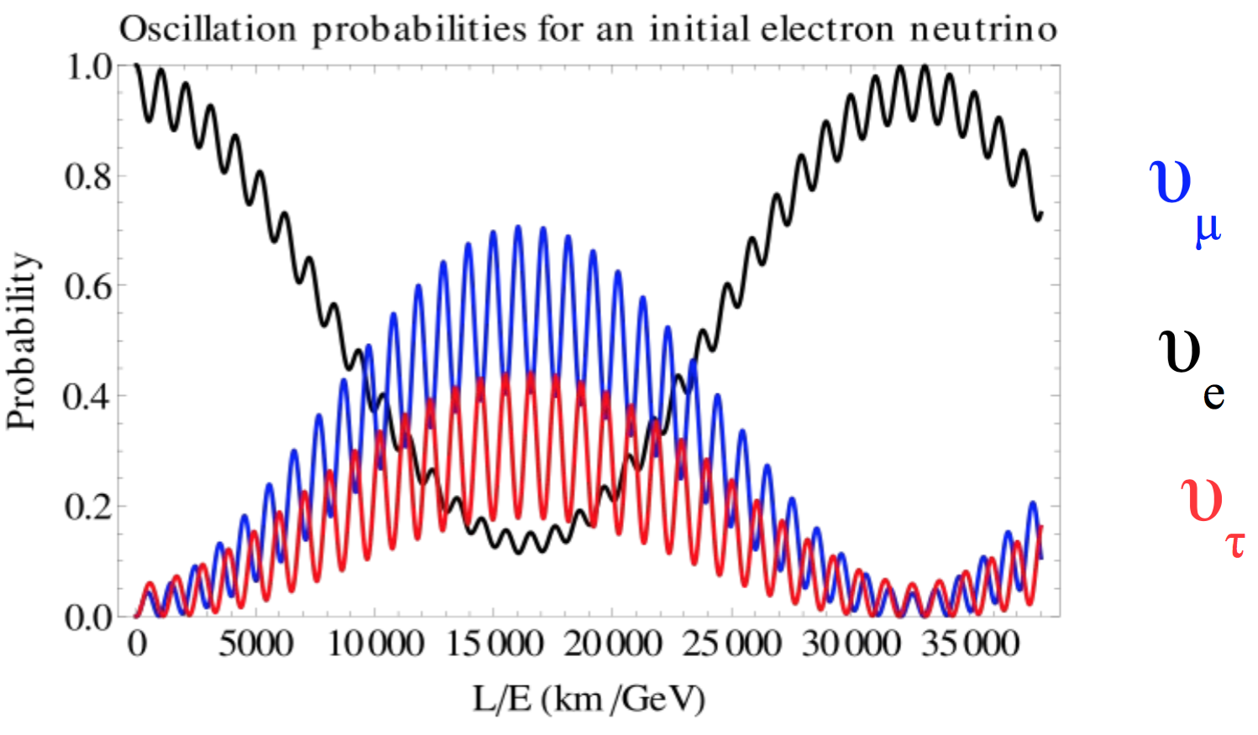
Neutrino Oscillations
Oscillation probability
f(L/E)

Slide 51
Understanding the Behavior of Neutrinos

Slide 52
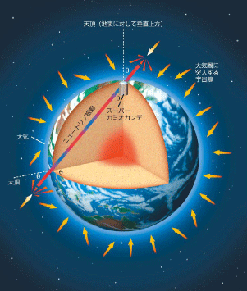
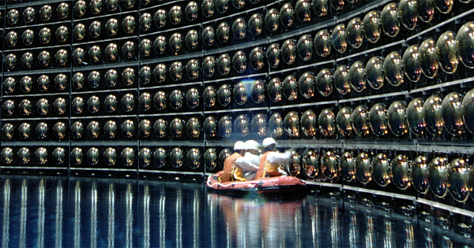
In 1998, Super–Kamiokande (Japan) announced the finding of neutrinos with non-zero mass.
Study neutrino oscillations using atmospheric neutrinos.
Atmospheric neutrinos produced by the decay of particles resulting from interaction of particles with the Earth’s atmosphere.

Slide 53
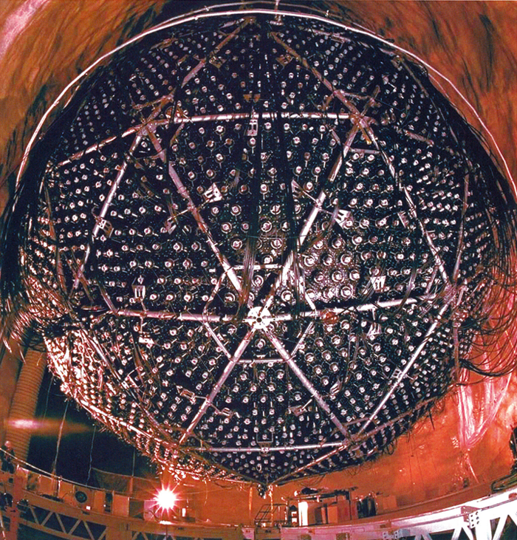
In 2001, the results from Sudbury Neutrino Observatory (Canada) solved the mystery of the missing solar neutrinos puzzle.
SNO announced that the total number of all neutrino flavour agrees with the Solar model.

Slide 54
40-year Puzzle Solved
What is the Source of the Missing Solar Neutrinos?
e
μ
τ
νe
νμ
ντ
Can neutrino oscillations explain the missing solar neutrinos?
By the time the neutrinos enter the Earth’s atmosphere, the electron neutrinos COULD BE changing flavour.

Slide 55
Neutrino experiments.
So far, there are 4 types/sources of experiments:
Solar
Natural sources
Atmospheric
Reactor
Artificial sources
Accelerator
Let’s talk about it

Slide 56
Accelerator Neutrinos Strategy
Generate neutrinos from accelerators
To have two functionally identical detectors
Oscillation probability = differences between measured and expected without oscillation

Slide 57
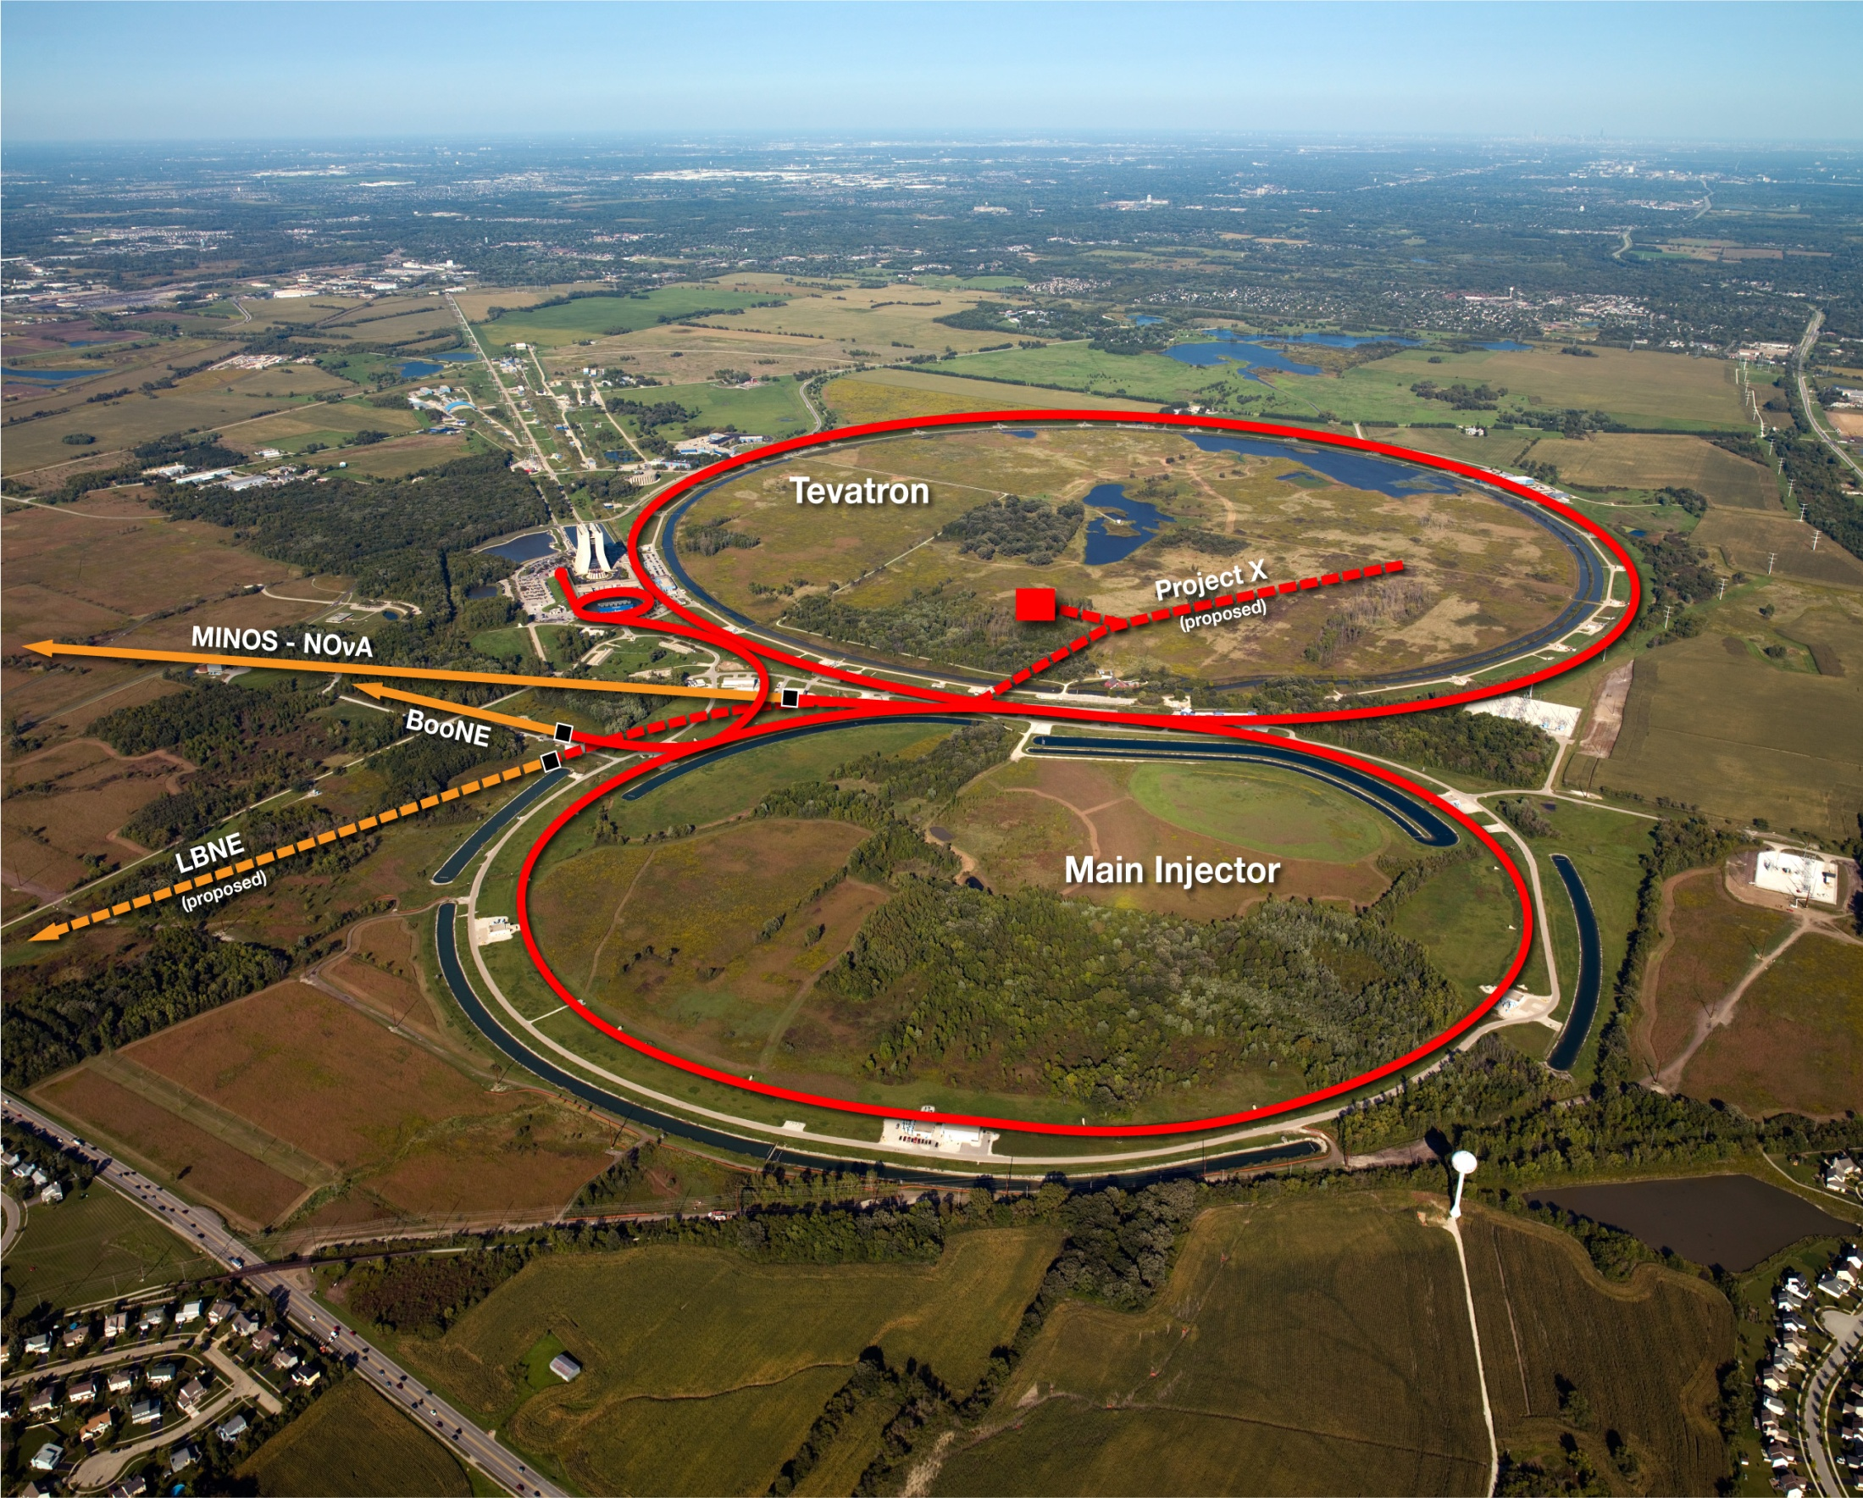
Fermilab Accelerator Complex
LINAC
Booster
Neutrino beams:
BNB
NuMI
Future: LBNE

Slide 59
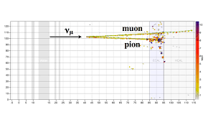
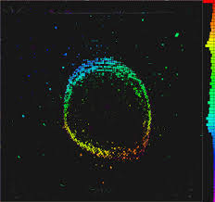
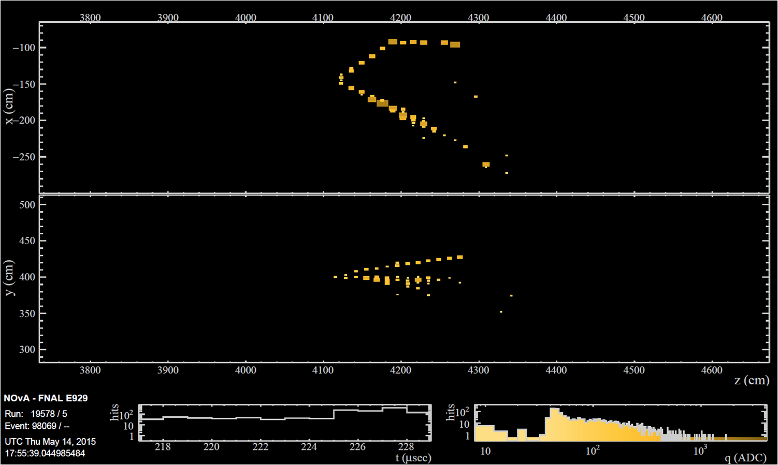
What do the detectors see?
ArgoNeuT
MINERvA
MiniBooNE
NOvA

Slide 60
muons
target
Beam of protons
pions
muon
neutrinos
Carbon
pion
muon
proton
W
neutrino
particles

Slide 61
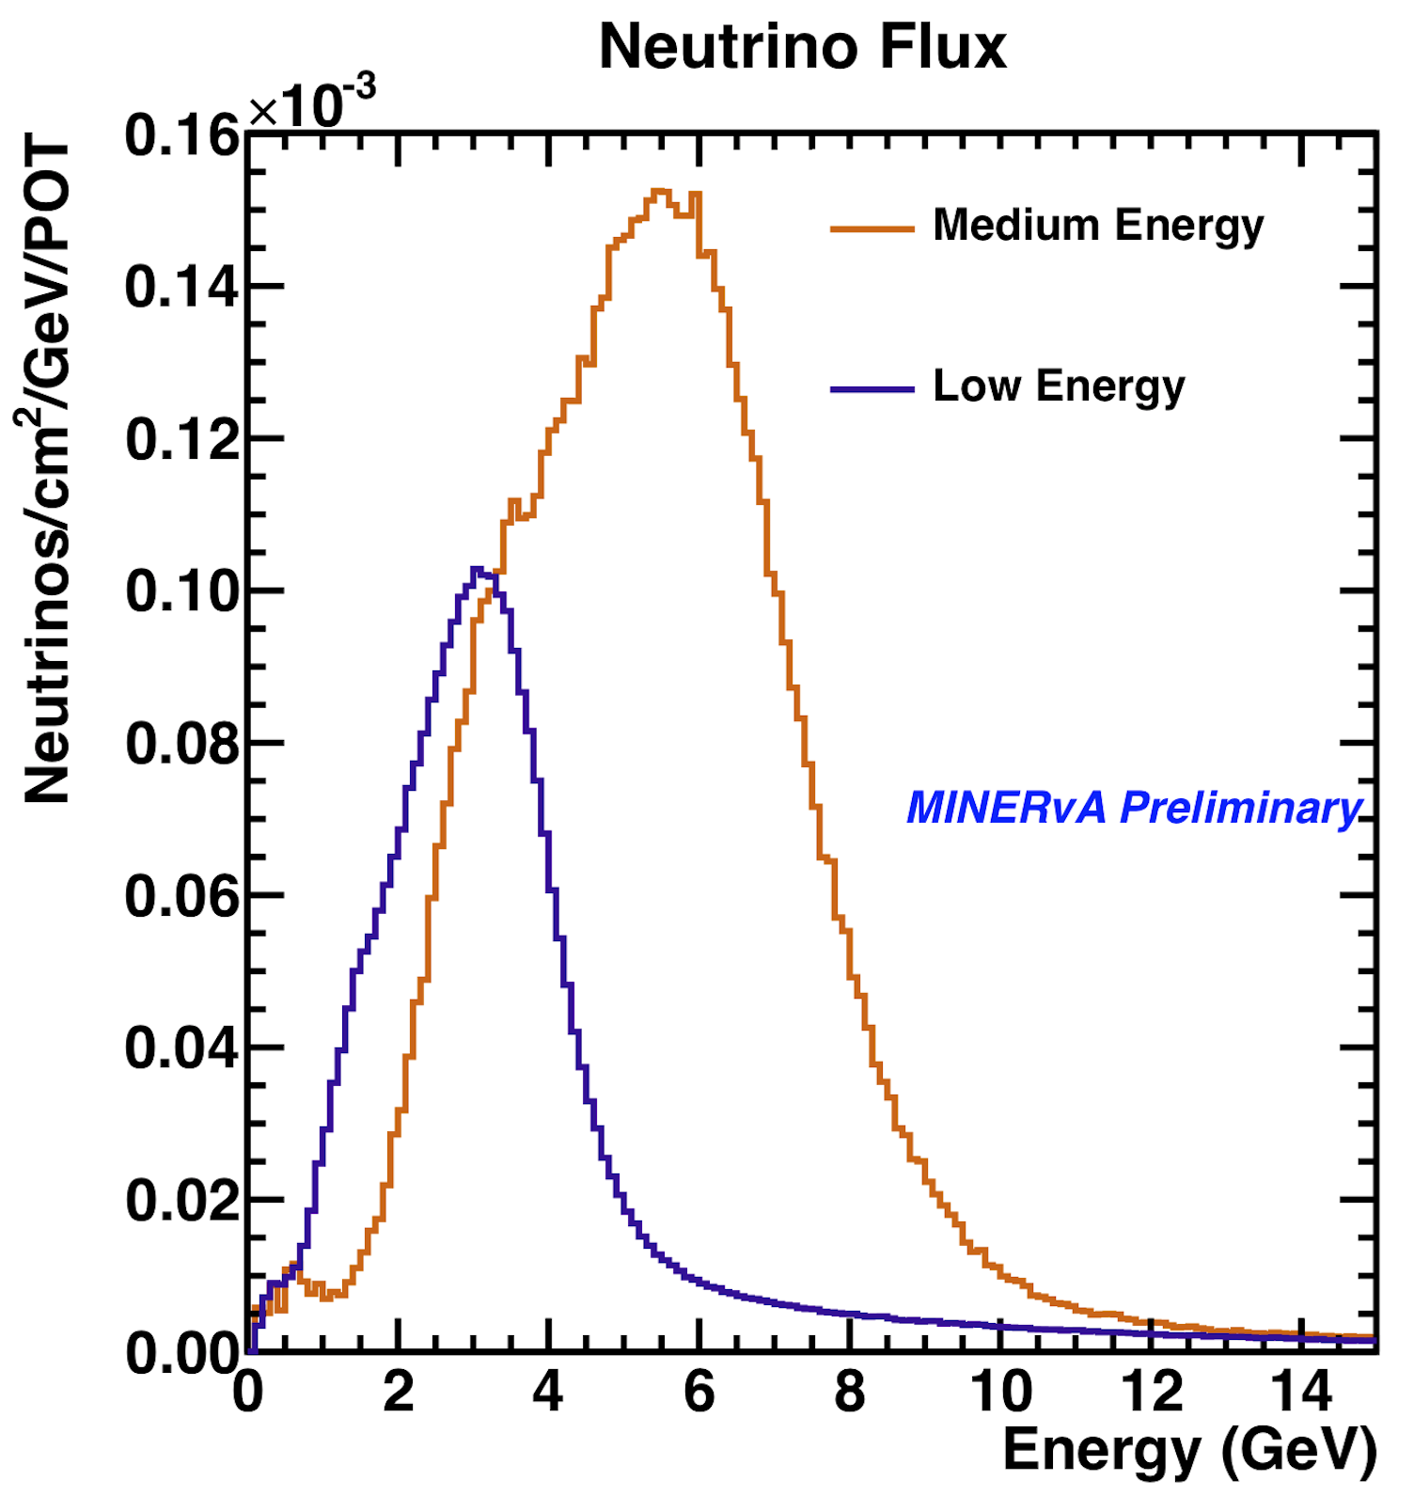
NeUtrinos at the Main Injector
Currently, 5x10¹³ protons on target (POT) every 1.3 sec
~ same amount of neutrinos

Slide 62
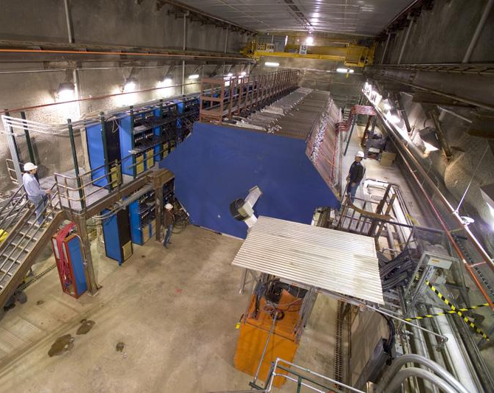
Front View of the MINOS Near Detector
The detector records information about the particles from neutrino interactions.
ν_{μ}
100 meters underground
ν_{μ}
ν_{μ}
ν_{μ}
ν_{μ}
ν_{μ}
ν_{μ}
ν_{μ}
ν_{μ}
ν_{μ}
ν_{μ}

Slide 63
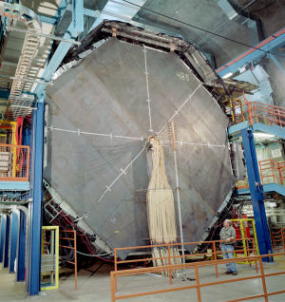
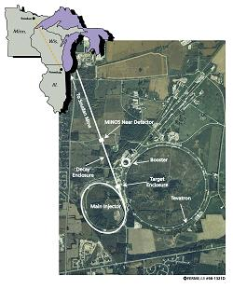
Front View of the MINOS Far Detector
716 meters underground
ν_{μ}
ν_{τ} ν_{e}
735 km (450 miles)
Soudan, MN
Batavia, IL

Slide 64
RECAP
We are able to characterize some of the properties of the neutrino:
Three generations of neutrinos.
The flavour neutrinos are mixture of the real neutrinos.
Neutrinos have mass.
Neutrinos have small mass.
Neutrinos oscillate.
….

Slide 65
Why is it important for physicists to build more large detectors to understand neutrinos?

Slide 66
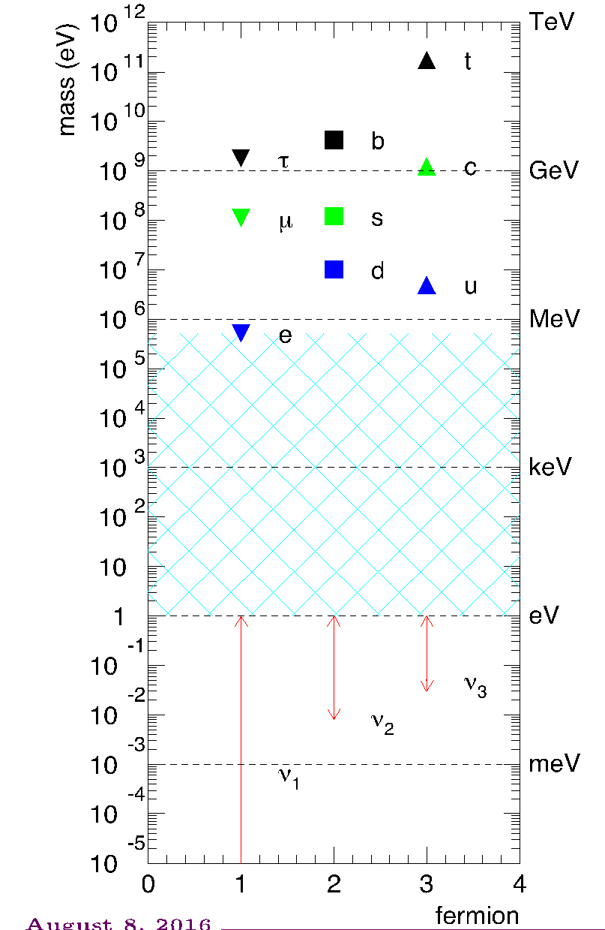
Neutrinos have mass.
BUT.. Why are the neutrinos SO light?
There is a very popular theory floating around.
BUT REALLY…
We do NOT know!

Slide 67
Neutrinos have mass.
The Standard Model is not complete
Evidence that there are MANY behaviors in nature that we do not understand.

Slide 68
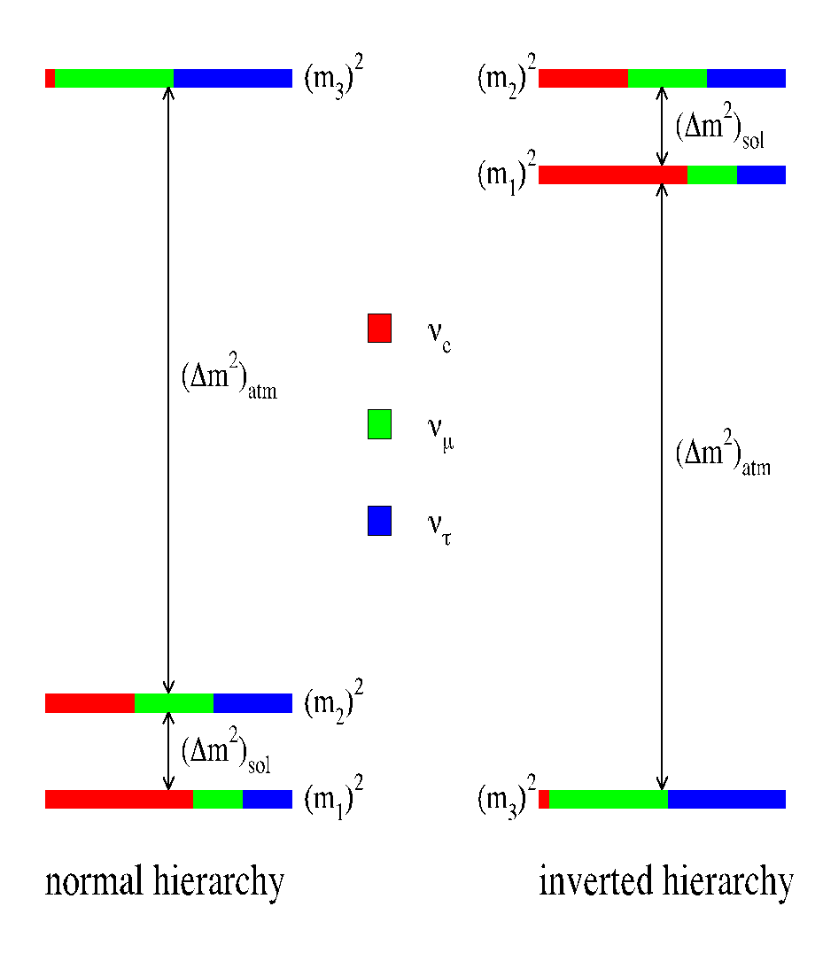
Remember, the neutrinos that scientists have detected are a mixture of real particles...
Do not know the ordering of the masses?
We do not know if the real neutrino ν₃ consists of more ν_{μ} or ν_{τ}.
All we know is the difference between the masses.

Slide 69
Recap
Current measurements of the fundamental properties of neutrinos show that we do not fully understand the universe.
There exists new detector technology to answer many of the unknown questions.

Slide 70
The rate of neutrino interactions is SO small.
Therefore, large detectors composed of heavy atoms are needed.
Argon
Carbon
Iron
Oxygen

Slide 71
with new technology comes new challenges
Some challenges:
neutrino flux determination, reconstruction, incomplete theoretical models, cross-sections, etc..
The Future of Neutrinos: DUNE
Deep Underground Neutrino Experiment

Slide 72
What do neutrino physicists want?
charged lepton
neutrino
nucleon
nucleon

Slide 73
What do neutrino physicists have?
charged lepton
neutrino
nucleus
nucleon
many nucleons
nucleon and pions
nucleon and many pions
nucleon and many other type of particles
nothing
Very difficult to calculate

Slide 74
An Example of a Neutrino Interaction
ν_{μ}
μ⁻
W
π⁺
Δ⁺⁺
p

Slide 75
Nobel Prize in 2015 for Discovering Neutrino Oscillations
Takaaki Kajita
Arthur B. McDonald
Super - Kamiokande
SNO

Slide 76
Thanks for your attention….
any question?

Slide 77
Backup

Slide 78
Everything is Composed of Particles!
Hydrogen
Oxygen
quarks
Hydrogen
nucleus

Slide 79
The Fundamental Forces of the Universe Influence the Behavior of Particles!
Electromagnetic.
Strong.
Weak.
Gravitational.
Not part of the Standard Model…

Slide 80
The Fundamental Forces of the Universe Influence the Behavior of Particles!
e -
e +
Mediator: gamma (૪)
e +
e-
The electromagnetic force
Acts upon electrically charged particles
Keeps the electrons bound and orbiting around the atomic nucleus

Slide 81
The Fundamental Forces of the Universe Influence the Behavior of Particles!
neutron
Mediator: gluon (g)
d
u
d
u
proton
d
u
The strong nuclear force
Holds the nucleus together
Range of the force is 0.000000000000001 meters

Slide 82
What is the energy of 1 MeV?
The energy of a flying mosquito is 1,000,000,000,000 electron volts,
where 1 MeV = 1,000,000 electron volts.
= 1.6 x 10⁻¹³ Joules.
It is high energy for an elementary: for an electron at rest, it will make it to move at 0.94c .

Slide 83
Neutrino - nucleus cross-section needs to be accurately determined
Particularly MINERvA is a Fermilab cross-section dedicated experiment.
But in general all other Fermilab neutrino experiment also have cross-section studies.

Slide 84
Another mystery
After Fermi published his beta-decay theory, Ettore Majorana derived a theory to suggest that the neutrino may be its own anti-particle. Means that the neutrino and anti-neutrino are the same.

Slide 85
Remember THIS Guy!
He predicted that the neutrino and anti-neutrino are exactly the same.
This is important because …
Big Bang created equal amount of matter and anti-matter.

Slide 86
Remember THIS Guy!
He predicted that the neutrino and anti-neutrino are exactly the same.
Making precision measurements of the properties of neutrinos bring us a step closer to uncovering the biggest mysteries of the universe!
We are in a new ERA of Neutrino Detectors

Slide 87
This measurements is happening right now...
published Jan 20, 2017
arXiv:1701.05891

Slide 88
Why is it so complicated?
The neutrino has to collide with a nucleon under various scenarios.....
The environment of the nucleus is a BEAST!
Also, there is a pion cloud surrounding the nucleus.
The inside of a nucleon really looks like this!!!
3 valence quarks, sea of quarks, and particles called gluons holding them together.
nucleon bound with another nucleon

Slide 89
Why is it so complicated?
The outgoing hadrons have to exit this complicated environment.
On the way out of the nucleus, the hadron can undergo various interactions with spectator nucleons.
The detector will see many, one, or no hadrons.

