Slide 1
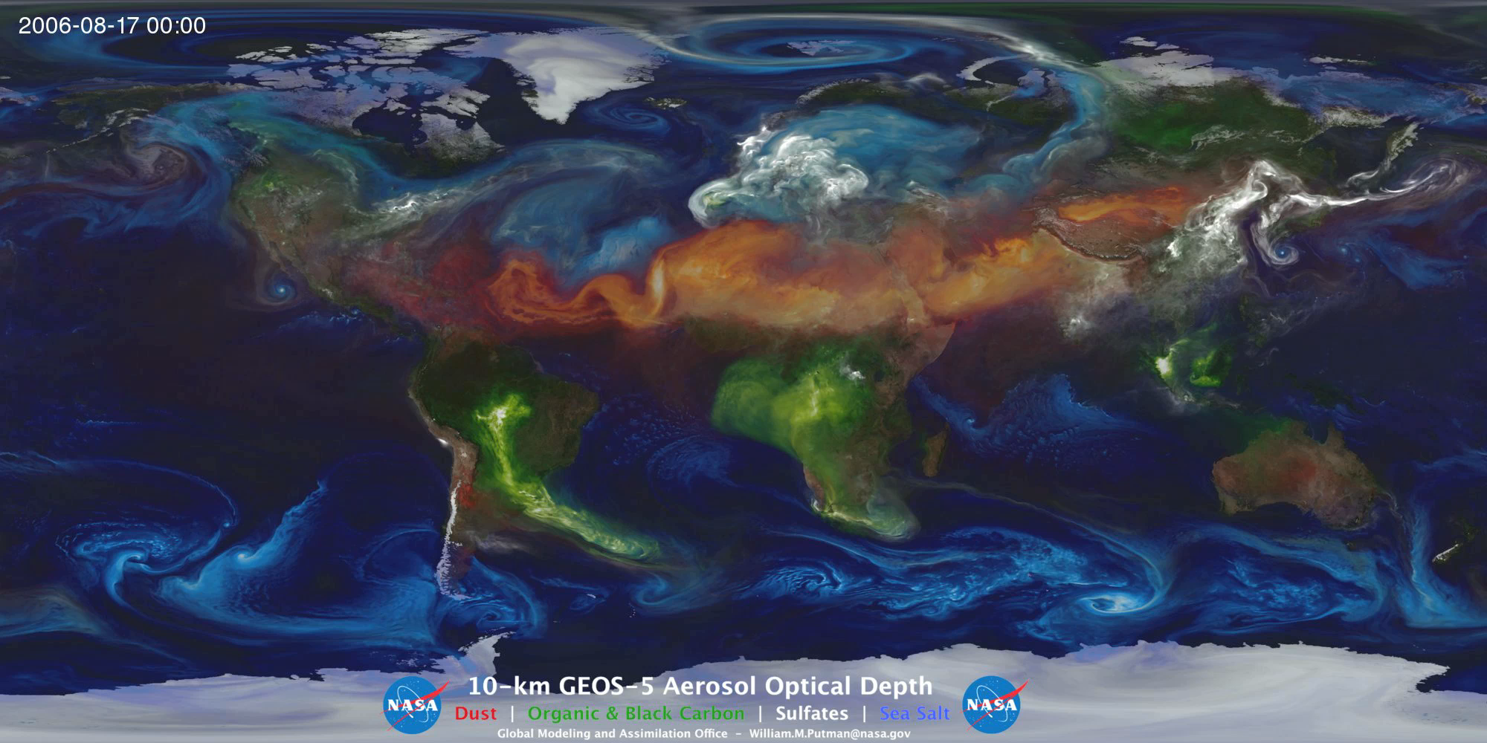
Saturday Morning Physics - April 29, 2017
The Science of Climate Change
Dr. Erik Ramberg, Fermilab
Notes:
FEEL FREE TO INTERRUPT, BUT MAY WANT TO WAIT UNTIL THE END, TO SEE THE WHOLE ARGUMENT.

Slide 2
A Few Key Concepts to Walk Away With:
The Earth’s climate is predictable
The 2 major climate control knobs are:
  The amount of sunlight that is reflected-ICE & DUST !
  The amount of heat that is trapped -CO2 !
Global temperature is still rising and ice sheets are still melting. There is no pause in the Greenhouse Effect.
Mankind has turned off the Ice Ages

Slide 3

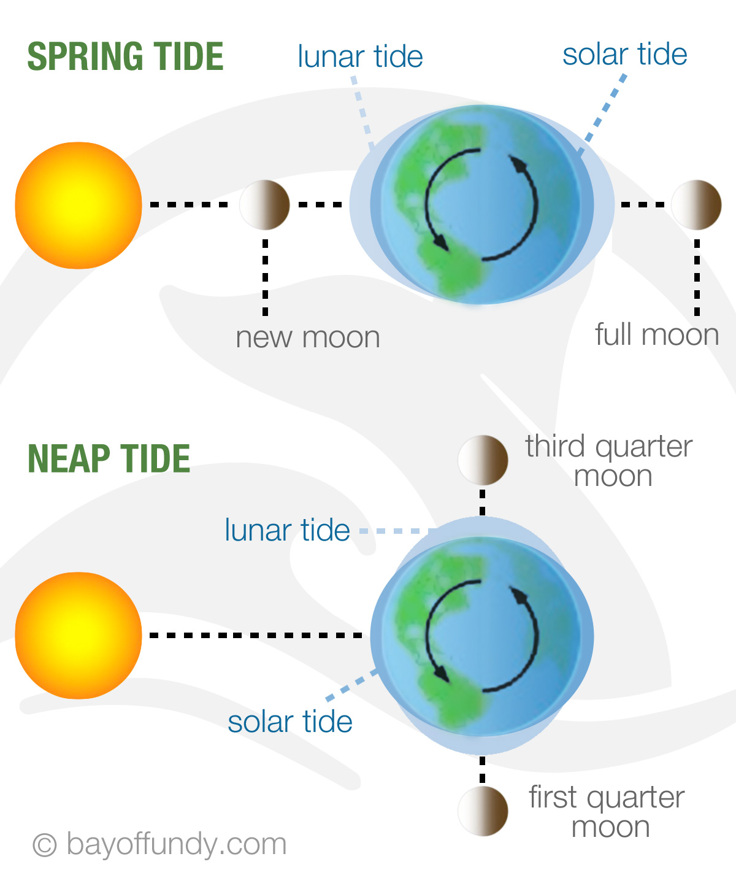
An Analogy about Predicting Climate:
Nobody can predict what the height of any given wave will be at the seashore:
But the timing and magnitude of the tides (the ‘average height’) is quite predictable:
Similarly, it is hard to predict the Earth’s temperature for any given year, but the slow, steady change of its’ climate is quite predictable

Slide 4
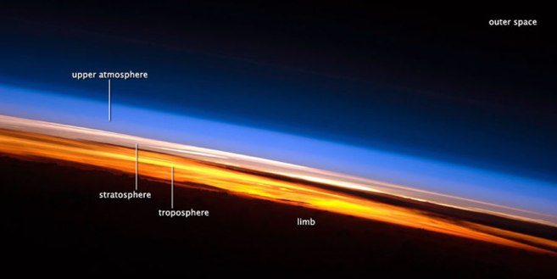
Q: How far is it to outer space?
A: 25 miles
B: 60 Miles
C: 280 Miles
D: 500 miles

Slide 5
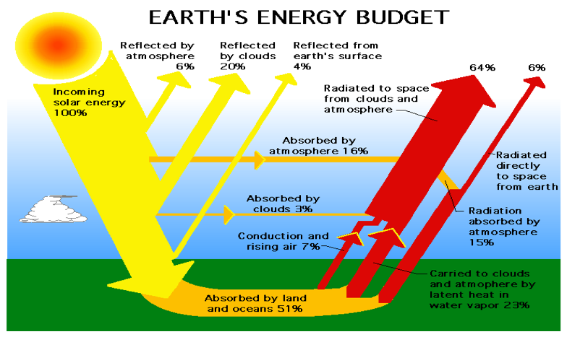
Energy flow in the Earth system
Earth’s Surface
Without normal greenhouse gases in our atmosphere:
0º F
On Earth’s surface
With normal greenhouse gases in our atmosphere:
60º F
On Earth’s surface

Slide 6
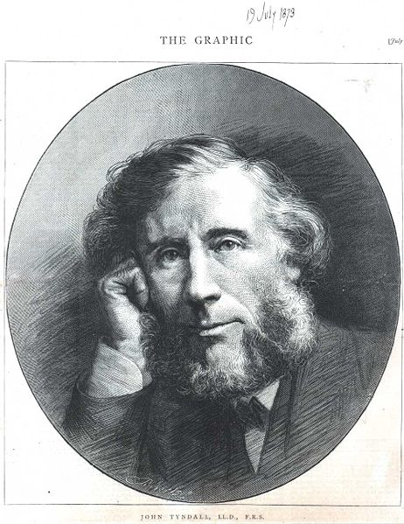
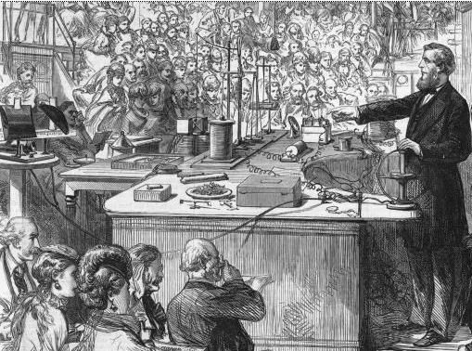
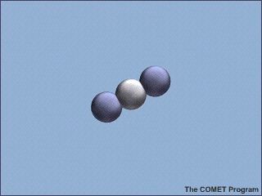
CO₂ absorbs infrared light by bending and stretching its chemical bonds and then re-emits infrared in all directions.
(Discovered by John Tyndall in 1865)
Tyndall showed that water vapor (H₂O) and methane (CH₄) trap heat also
All 3 gases cause trapping of some of the infrared heat coming from the surface of the Earth:
… the Greenhouse Effect !

Slide 7
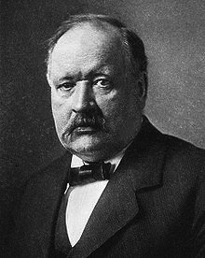
Greenhouse Effect predicted in 1896 by Nobel prize winner Svante Arrhenius:
“.. any doubling of the percentage of carbon dioxide in the air would raise the temperature of the earth's surface by 4° …”
Guess what? His predictions still hold up today, 118 years later!
Doubling of CO₂ is expected to raise temperatures between 2.5-4 degrees

Slide 8
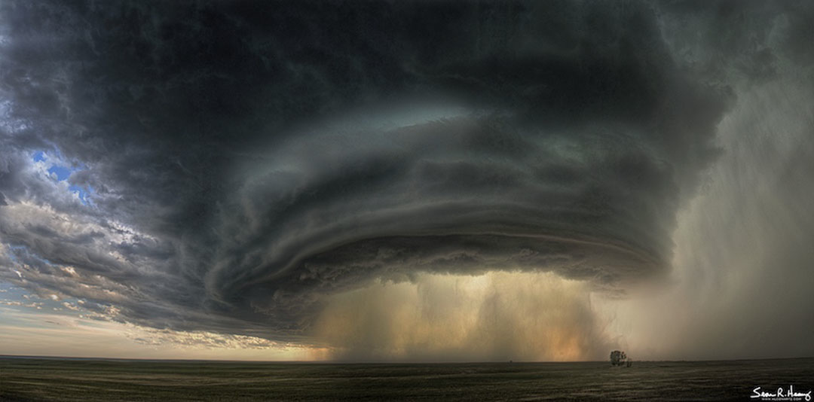
Water vapor in the atmosphere falls out in about a week
Q: How long does additional CO2 change the atmosphere?
A: 5-15 Weeks
B: 1-2 years
C: 40-50 years
D: 500-1000 years

Slide 9
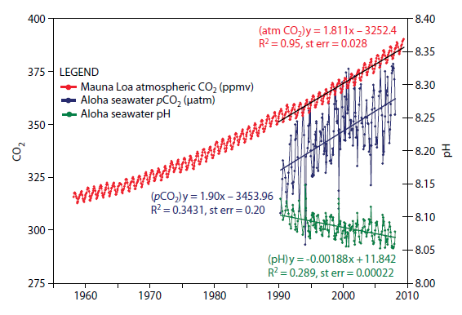
CO₂ in the Ocean
CO₂ in the Atmosphere
The ‘Keeling curve’
Mankind’s use of fossil fuel is causing the CO₂ concentration in the atmosphere to rise significantly. Isotopes show this is fossil based CO₂.
The ‘missing’ CO₂ is going into the ocean
This is actually less than what we predict from industrial processes. Where is the rest of the CO₂?
The ocean is getting significantly more acidic as a consequence.

Slide 10
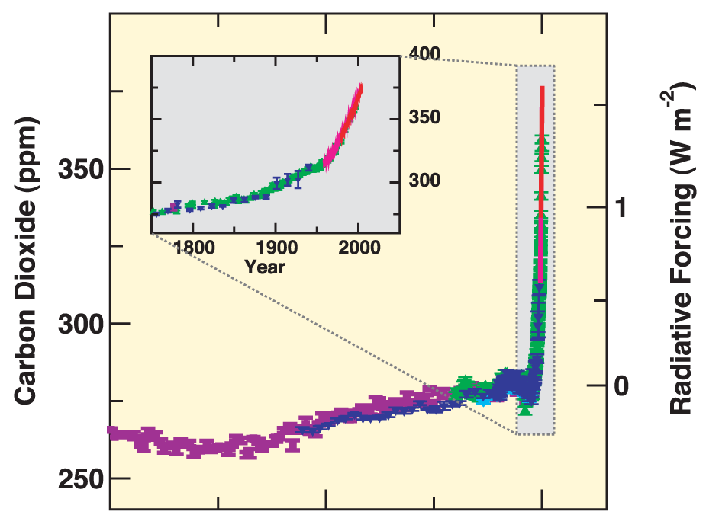

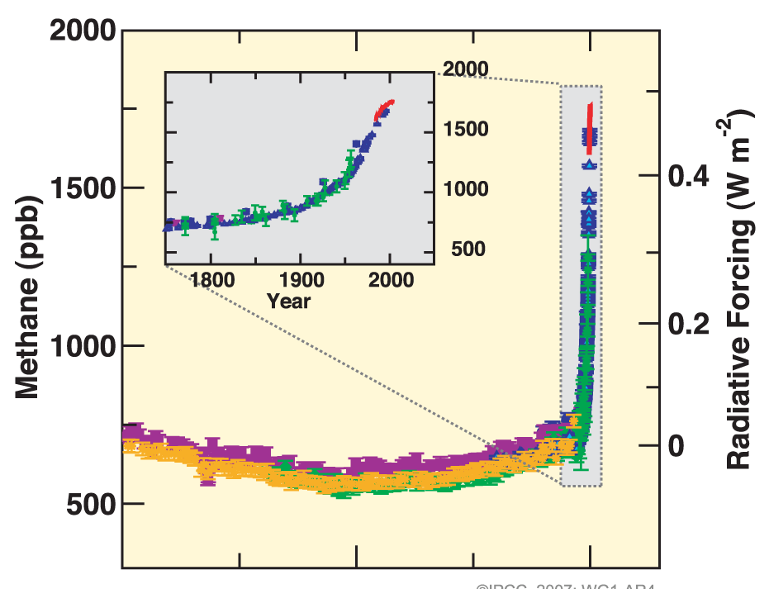

CO₂ and other Green House Gases (GHG) are now the dominant elements of climate forcing,
CO₂
Methane
Source: IPCC AR4

Slide 11
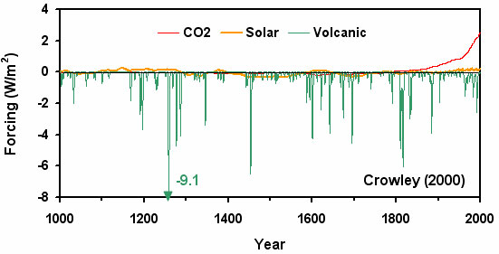
Forces acting on the climate
Volcanoes have a big effect on climate, but last for a very short time
Variations in sunlight are small
The biggest effect on the climate is the blanket of CO2 we are putting up into the atmosphere

Slide 12
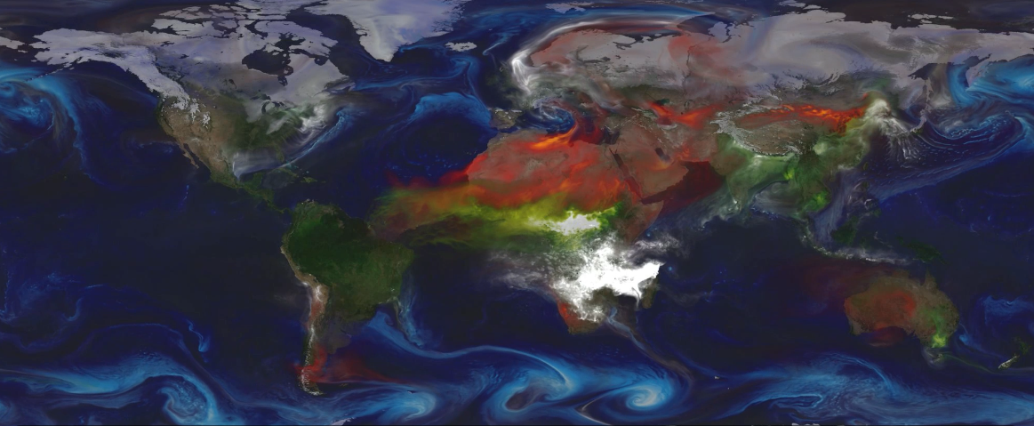
Volcano Exploding in Madagascar
Volcanic dust (an ‘aerosol’) has a powerful cooling effect on climate.
But, like water, the aerosols fall out of the atmosphere - in about 1-2 years

Slide 13
The Sloooow Change in Climate
Humans!
Azolla event
Zachos et al. (2001)
50 million years ago Earth was hot and ice-free (~12 degrees hotter).
The change of CO2 in prehistory was ~1 ppm every 10,000 years
The change of CO₂ now is ~1 ppm every 8 months
Notes:
13

Slide 14
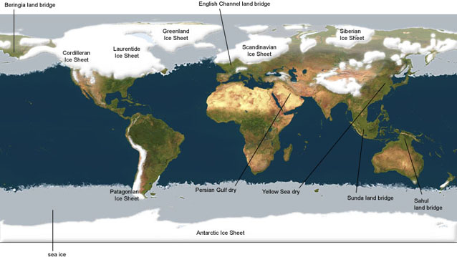

Ice Sheets During Last Ice Age
Ice Sheets Now
Two important changes that accelerate the freezing:
1) High reflectivity from the new ice
2) The cooling ocean absorbs CO₂

Slide 15
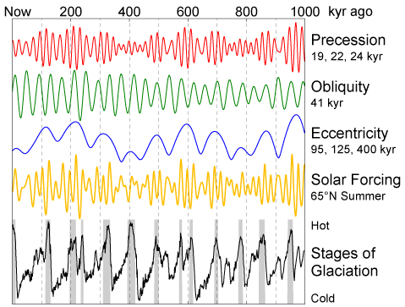
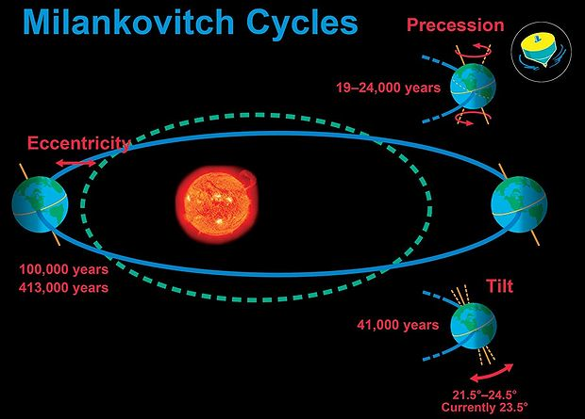
Milankovitch Cycles
These cycles occur because of the various wobblings of the Earth’s orbit
They happen over a period of tens of thousands of years.
The small changes in sunlight are amplified by the new ice and triggers the Ice Age.

Slide 16
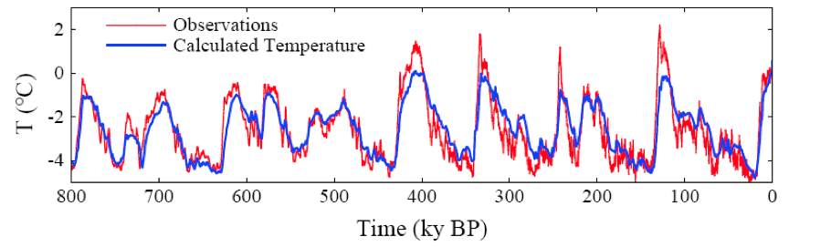
The Ice Age Climate is Predictable
(Using Vostok ice core)
We understand all the cycles and bumps of the last 800,000 years.
From this data, we now know that mankind will likely shut off the Ice Ages forever. (Yay!)
Unfortunately, we will likely start climbing up the temperature curve back into the Eocene Era. (Boo!)

Slide 17
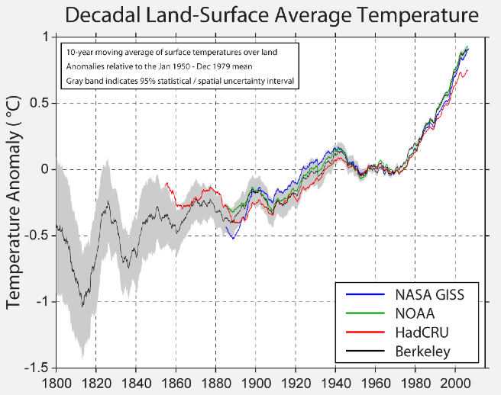
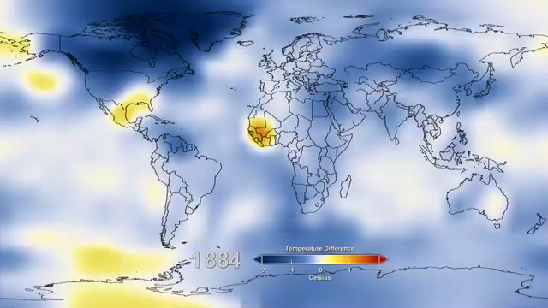
NASA Gridded Mean Surface Temperatures Over 125 years
1940-1970 was a time of a lot of aerosols in the atmosphere

Slide 18
Q: The increase of heat into the atmosphere, ocean and land (compared to pre-industrial times) is equivalent to 4 Hiroshima size bombs…
A: every year
B: every month
C: every day
D: every second
Please go home and calculate this number yourself.

Slide 19
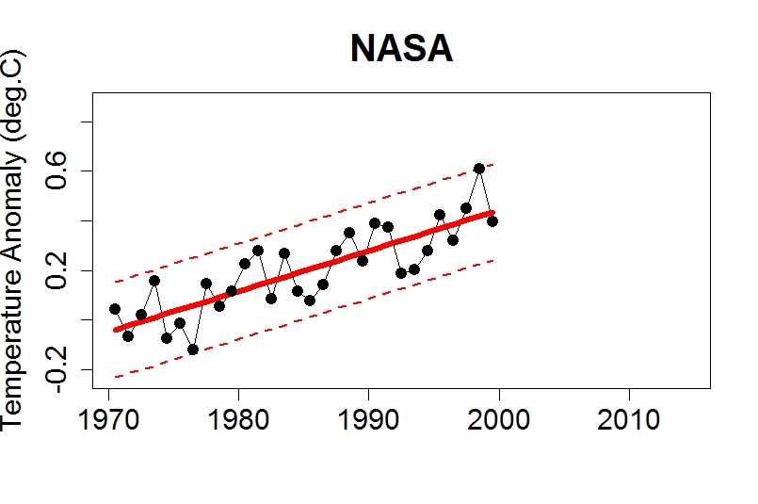
The famous ‘PAUSE’ in global warming
Take NASA’s data on global temperatures up to the year 2000:

Slide 20
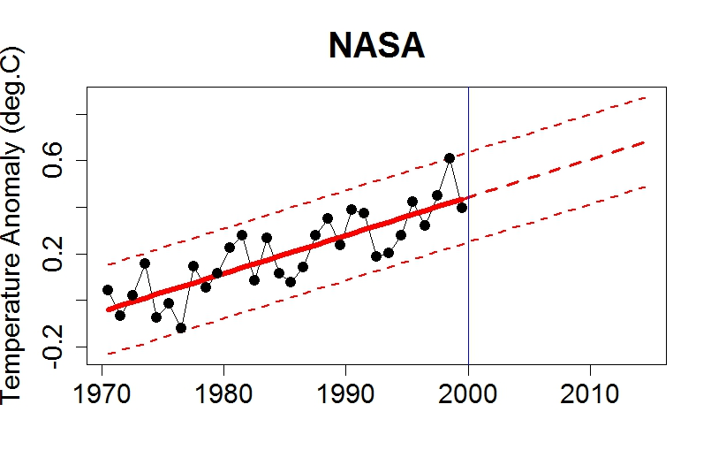
The famous ‘PAUSE’ in global warming
Extrapolate trend to the year 2014:

Slide 21
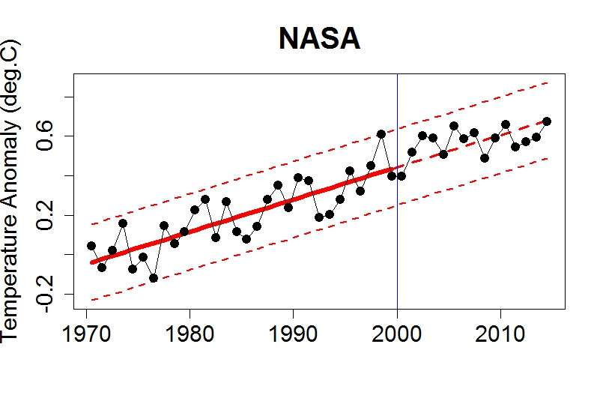
The famous ‘PAUSE’ in global warming
Add the data since 2000. A ‘Pause’ never occurred
*
2016
*
2015

Slide 22
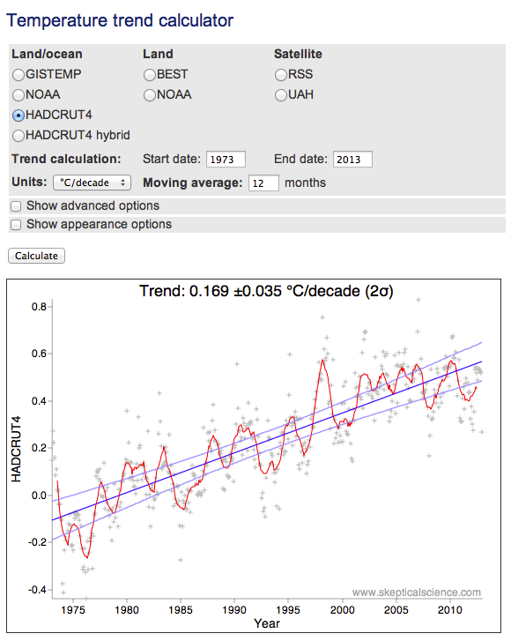
An excellent trend calculator
(skepticalscience.com)

Slide 23
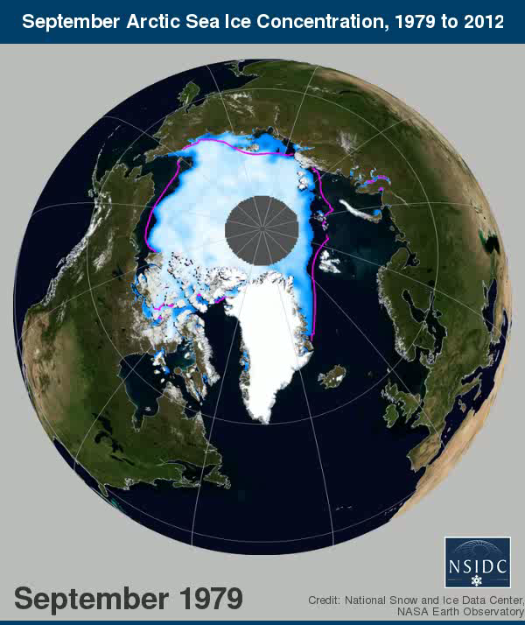
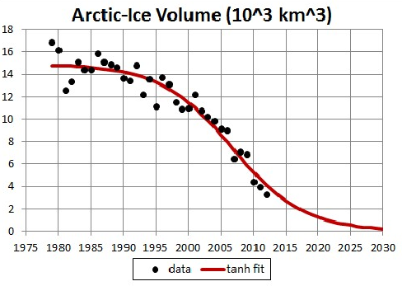
Pay attention to ice volume, not area. Most of the melting is due to thinning of ice.
These maps show that we are rapidly transitioning to a world without permanent Arctic Ice
A Consequence of the Enormous increase in Ocean Heat - Melting Ice !
September Arctic Ice Volume (10³ km³)

Slide 24
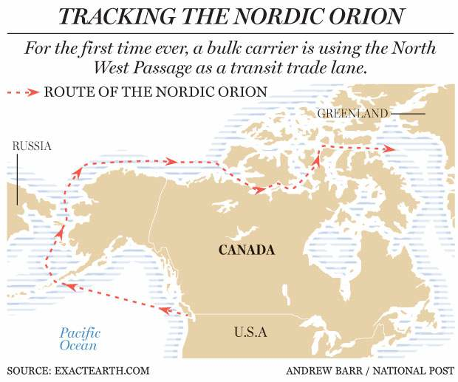
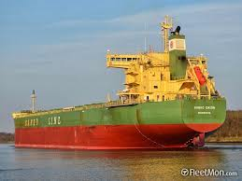
Navigating the Northwest Passage
Finding a navigable route from Europe to Asia, across the North polar region, had been the dream of adventurers for several hundred years

Slide 25
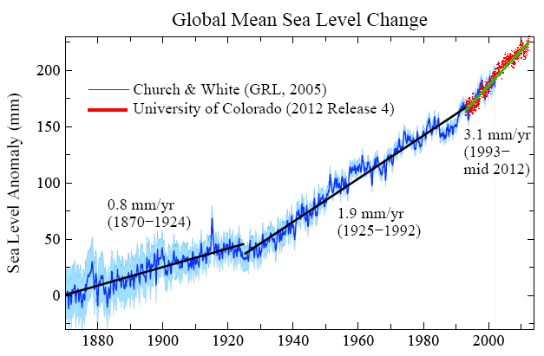
Most of the sea level rise is due to the warming of the ocean.
Melting ice sheets will continue to contribute to sea level rise.

Slide 26
Simple Sea Level Extrapolation, Using Historical Data, Not Models
Pliocene
3 Myr ago
100
Eocene
40
Myr
ago
50
Global T Change
(°C)
Today
-10
-5
0
3
5
-50
From this simple extrapolation of data, the eventual sea level rise may be 50 meters!
Last Glacial
-100
Maximum
20
kyr
ago
-150
Sea Level
(meters)
Source: David Archer, U.C.

Slide 27
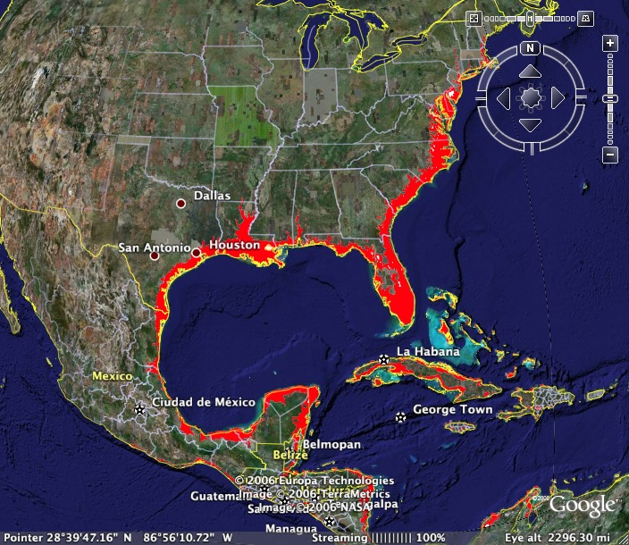
Map of Rise of Sea Level
Q: This map shows a rise of sea level of about:
A: 1 meter
B: 20 meters
C: 50 meters
D: 80 meters

Slide 28
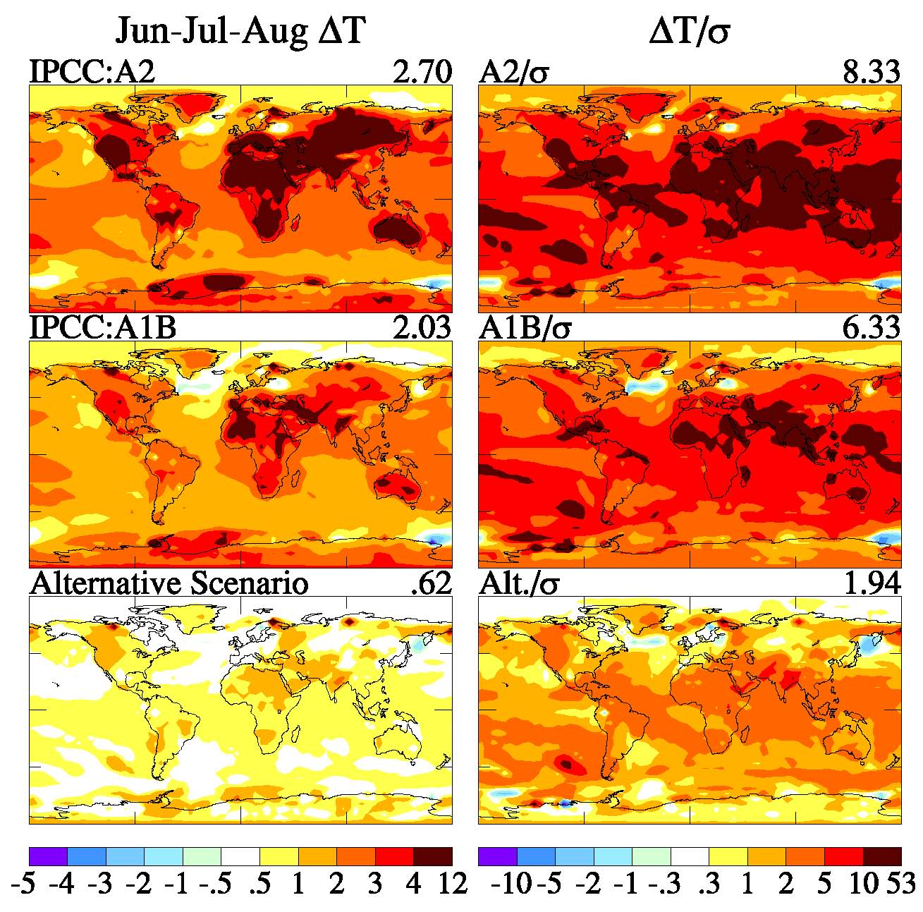
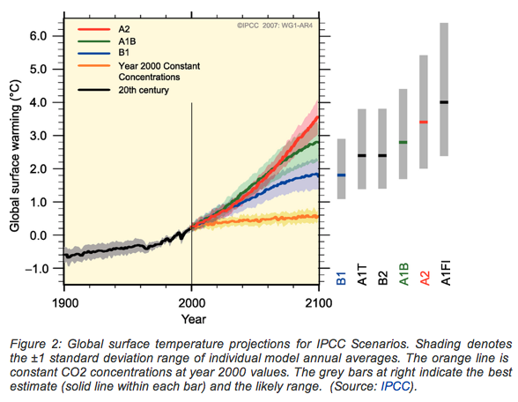
Predicted 2000-2100 Temperature Change
We don’t know how hot it is going to get, since we don’t know how fast carbon emissions will rise.

Slide 29
Summary
Climate on Earth is predictable
The two main ‘knobs’ that control our climate are:
  CO₂ in the atmosphere
  Reflectivity of the planet
Man made CO₂ emission from fossil fuels is the dominant climate force now and is predicted to lead to a 5º F rise in temperature compared to pre-industrial times.
Temperature measurements are very clear that the global temperature has risen already about 2.7º F and that the greenhouse effect has not stopped.

Slide 30
Climate Science is for everyone
Feel free to email me about the wonderful world of climate science
RAMBERG@FNAL.GOV
But for the best information, please contact the real experts at:
NOAA – National Oceanic and Atmospheric Administration
NASA – National Aeronautics and Space Administration
AGU – American Geophysical Union
EPA – Environmental Protection Agency
APS – American Physical Society
NAS – National Academy of Sciences

Slide 31

Here is what change looks like!
James Hansen was the head of the climate branch of the NASA Goddard Institute for Space Studies.
Since the 1980’s he has been giving a clarion call for action.
He recently quit NASA to devote full time to environmental advocacy.
“Every major national science academy in the world has reported that global warming is real, caused mostly by humans, and requires urgent action. The cost of acting goes far higher the longer we wait — we can’t wait any longer to avoid the worst and be judged immoral by coming generations.”
James Hansen, New York Times, May 9, 2012
What kind of courageous act can you perform? That’s easy:
Learn and Vote

Slide 32
Thank you so much for your kind attention !
Any more questions?

Slide 33
A Bunch of Extra Slides !

Slide 34
BEST final result
(HadCRU does not include Arctic regions!)
Strong warming signal showing no sign of slowing and fits profile of CO2 emission
1940-1970 was a time of a lot of aerosols in the atmosphere

Slide 35
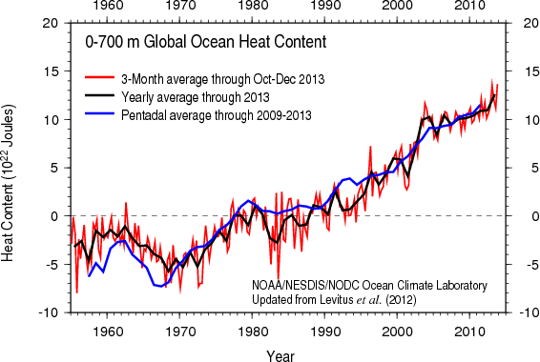
Results on Upper 700 meters heat content
The heat energy flowing into the oceans is equivalent to exploding 4 Hiroshima atomic bombs every second, 24 hours a day, 365 days per year.

Slide 36
An excellent trend calculator
(skepticalscience.com)

Slide 37
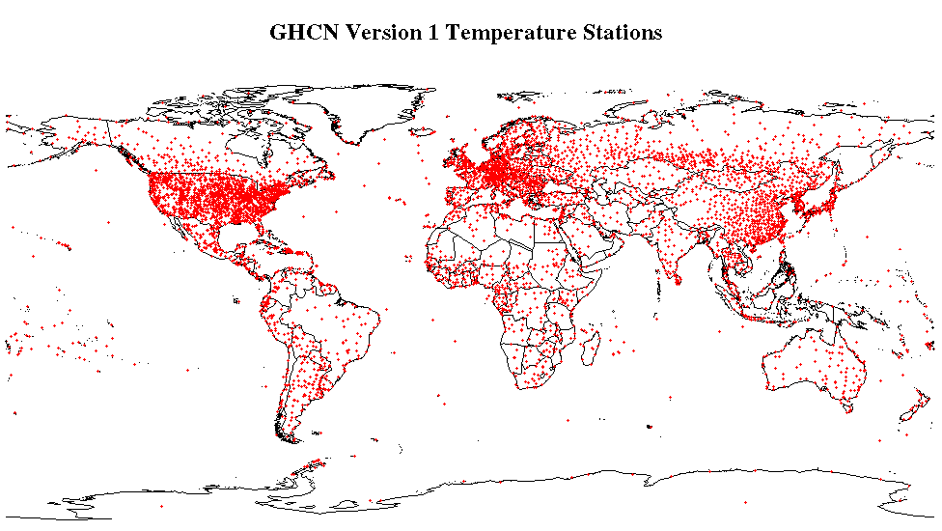
Managed by National Climatic Data Center
~7000 temperature stations
Used for reconstructions of global temperatures
by NCDC and GISS (Goddard Institute for Space Studies)
Oldest continuous record started in 1701.
We Don’t Need More Temperature Sensors:
Only 200 temperature stations, equally spaced, would give enough information to calculate the mean temperature of the Earth

Slide 38
Corrections to the data
  Imagine you kept track of your checking account and got tired of recording each penny spent. Instead, you round up to the nearest dollar all entries starting midway during the year
  At the end of the year, your true balance will be affected by your systematic change in behavior
Most of the temperature sensors were changed from afternoon reading time to morning time and need to be corrected for that effect.

Slide 39
Simple Sea Level Extrapolation, Using Historical Data, Not Models
Pliocene
3 Myr ago
100
Eocene
40
Myr
ago
50
Global T Change
(°C)
Today
-10
-5
0
3
5
-50
From this simple extrapolation of data, the eventual sea level rise may be 50 meters!
Last Glacial
-100
Maximum
20
kyr
ago
-150
Sea Level
(meters)
Source: David Archer, U.C.

Slide 40
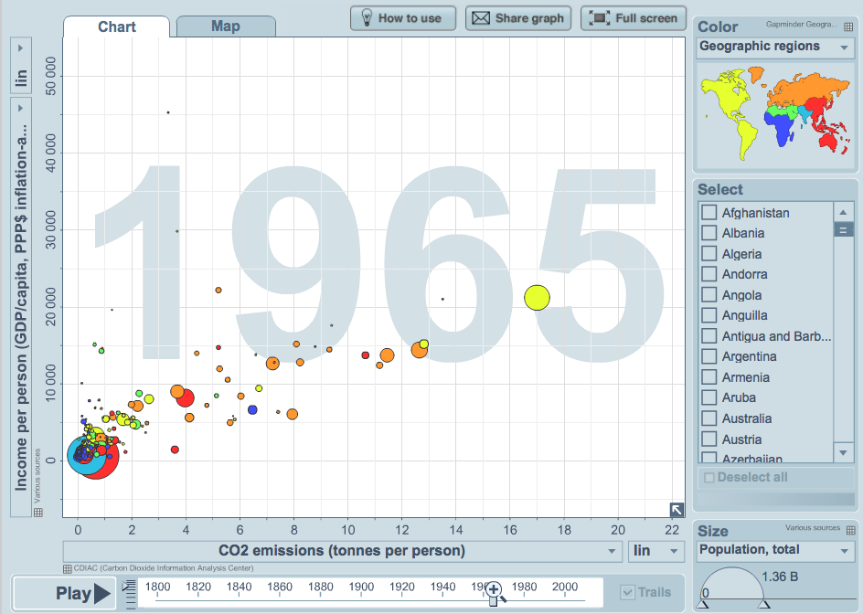
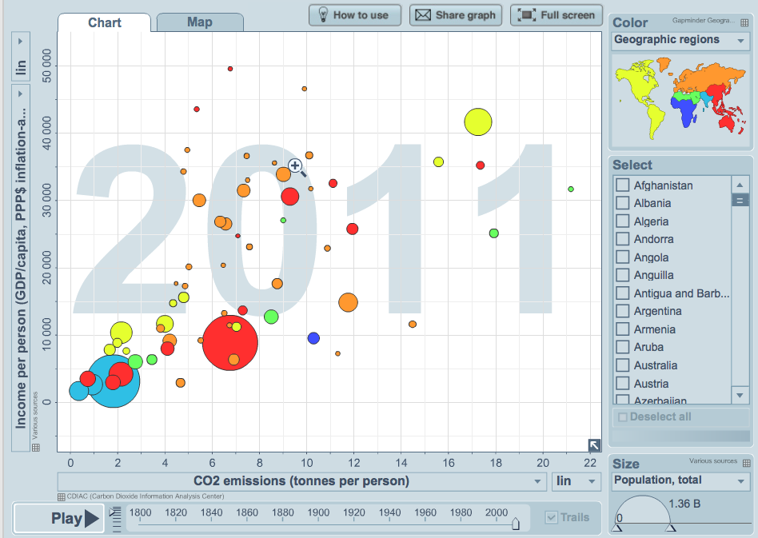
The Economic Imperative for Burning Carbon
Wealth per person
CO₂ emissions per person
Gapminder.org

Slide 41
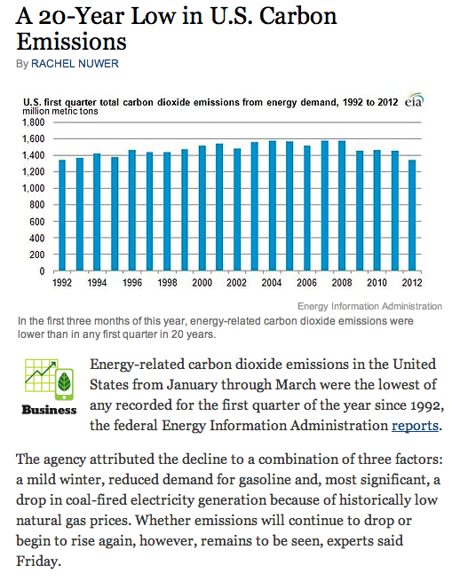
Natural Gas: 1100 lbs C/MWh
Oil: 1600 lbs C/MWh
Coal: 2200 lbs C/MWh
Natural gas is very much more efficient than coal. If we wish to reduce CO₂ emission, switching generation plants to natural gas can be a good start.

Slide 42
Here is what change looks like!
James Hansen was the head of the climate branch of the NASA Goddard Institute for Space Studies.
Since the 1980’s he has been giving a clarion call for action.
He recently quit NASA to devote full time to environmental advocacy.
“Every major national science academy in the world has reported that global warming is real, caused mostly by humans, and requires urgent action. The cost of acting goes far higher the longer we wait — we can’t wait any longer to avoid the worst and be judged immoral by coming generations.”
James Hansen, New York Times, May 9, 2012

Slide 43
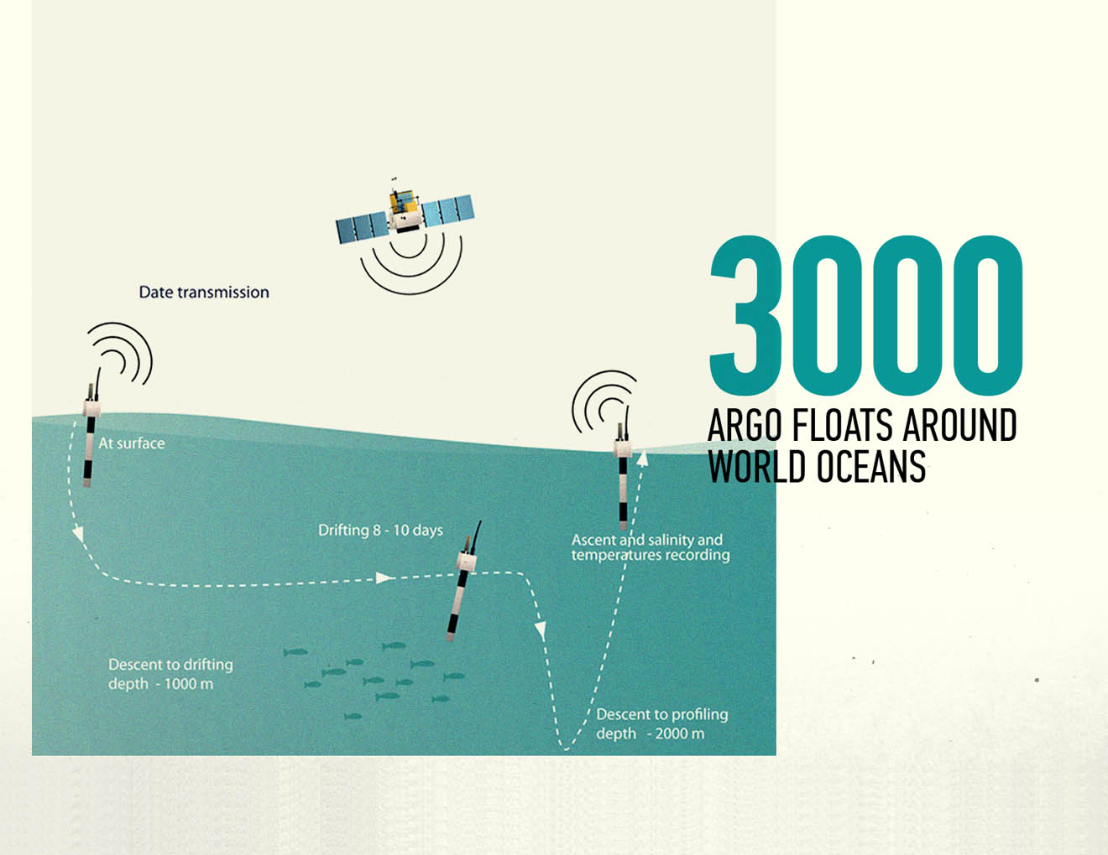
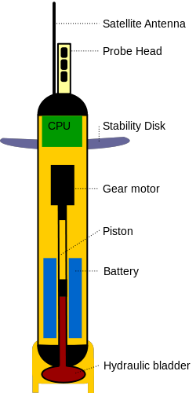
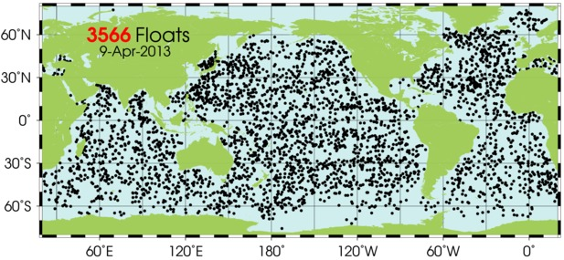
ARGO buoy’s measurement of ocean’s energy imbalance

Slide 44
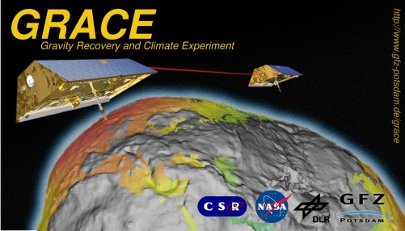
Determining Ice Sheet Mass by Satellite
GRACE is a pair of polar orbiting satellites, monitored by GPS, which can make systematic studies of the gravity field of the Earth
This has been an extraordinarily useful facility, in many fields of study, one of which is studying the amount of ice that is resident in Greenland and Antarctica.

Slide 45
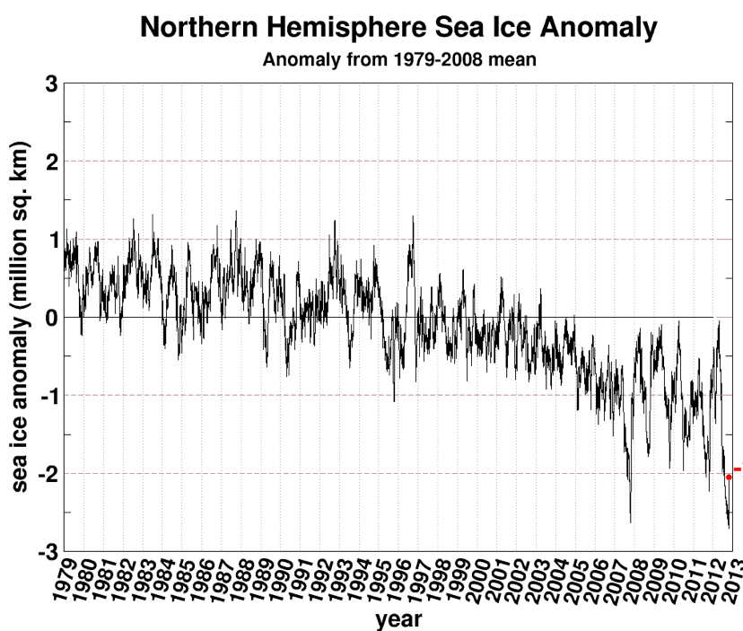
Arctic Sea Ice Area
Sea ice area reached a new summer minimum in 2012
Re: Cryosphere Today

Slide 46
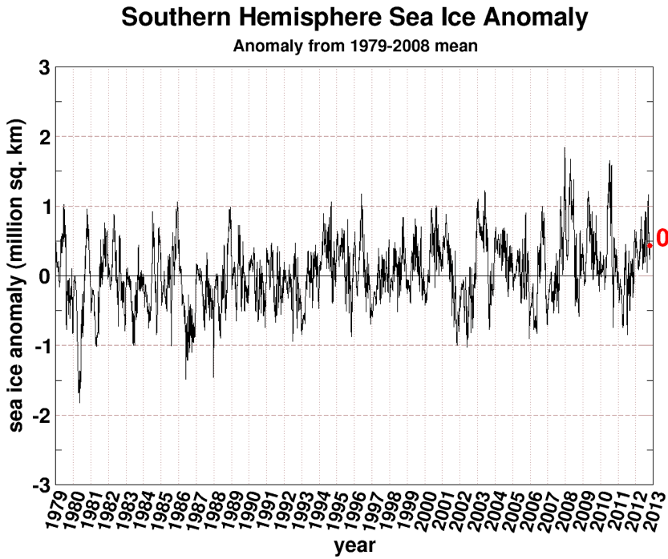
Antarctic Ice Area
- Antarctica is buffered by an extremely large land ice mass
There is a modest increase in sea ice area, but this does not match Arctic losses
Re: Cryosphere Today

Slide 47
Energy flow in the Earth system
This is what changes when you increase or decrease the albedo.
This is what changes when you add greenhouse gases, like CO₂.

Slide 48
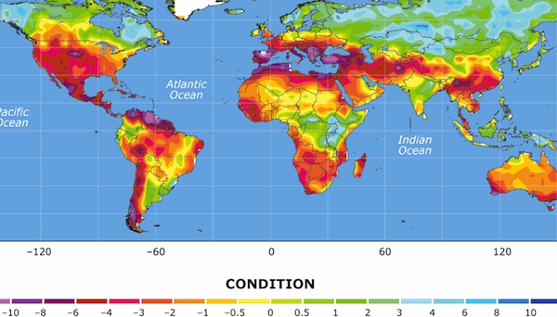
Much of the land surface may experience semi-permanent drought
(Palmer drought index)
U.S. ‘Dust Bowl’ condition (1930)
(Dai, 2011)

Slide 49
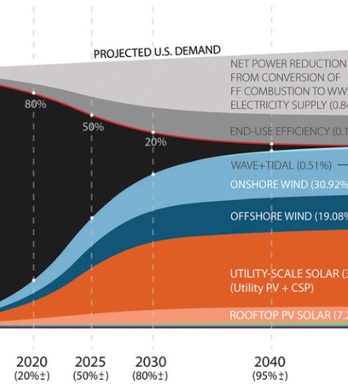

Slide 50
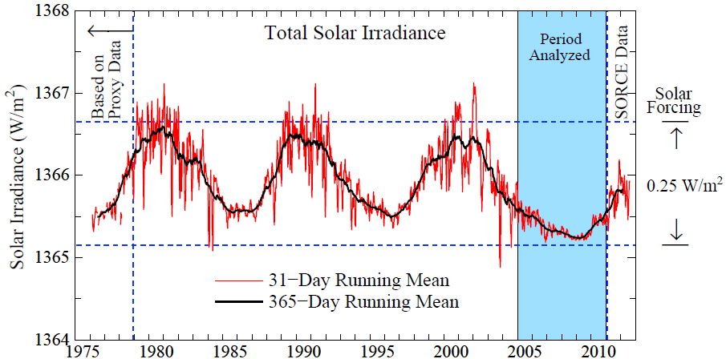
Variations in Solar Output on the Short Time Scale are Irrelevant
Surface Averaged Solar Forcing
Reference: Fröhlich, C. and J. Lean, Astron. Astrophys. Rev., 12, pp. 273--320, 2004. http://www.pmodwrc.ch/pmod.php?topic=tsi/composite/SolarConstant
Notes:
Let me make note of the assertion that the world could be headed into colder times because of changes on the sun, because that misconception has been spread widely.
Solar irradiance has been measured since the late 1970s, and the solar irradiance remains at or near a prolonged solar minimum, which is deeper than the prior measured minima. This is data of Frohlich and Lean through the end of September.
These solar irradiance variations do not have any known relation with the shorter period oscillations of Pacific Ocean temperature. In a few moments I show quantitatively that the effect of the sun is not negligible on longer time scales (the time scale of the 10-12 year solar cycle and longer time scales), but it is much smaller than the climate forcing due to human-made greenhouse gases.

Slide 51
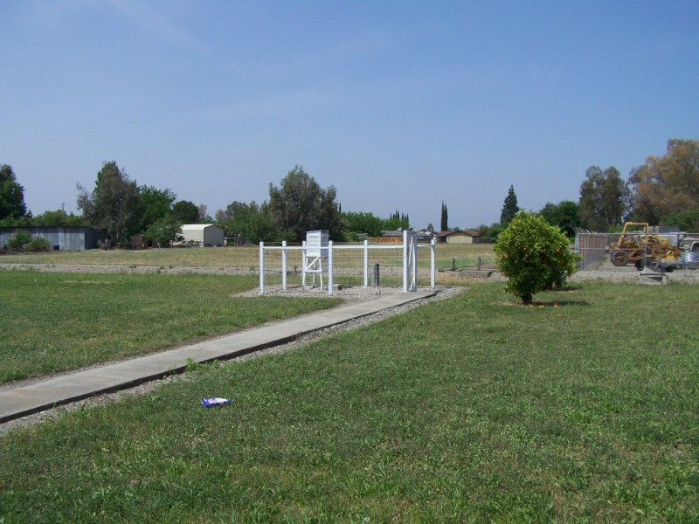
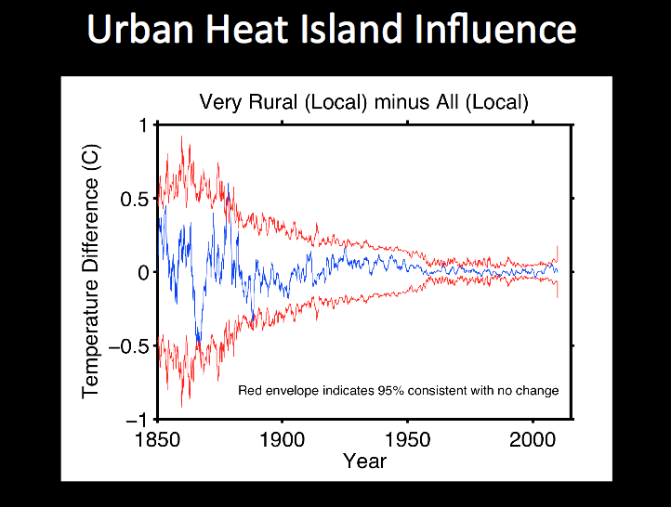
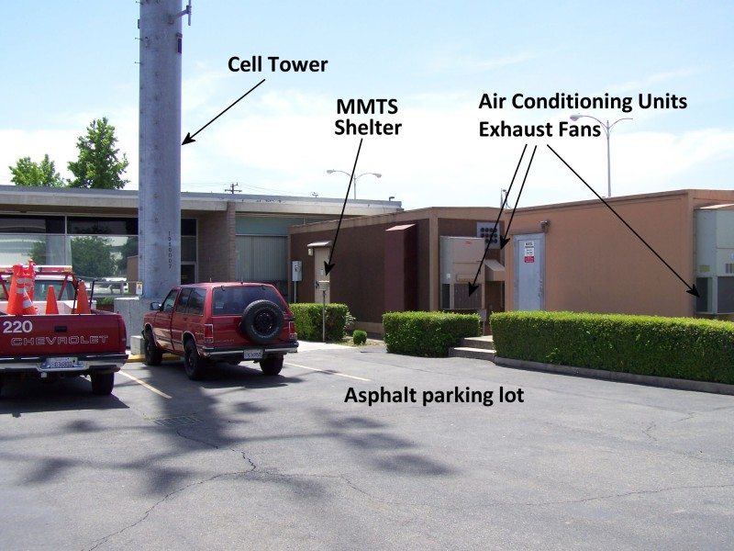
No urban vs rural systematic effect exists
Rural sited meteorological station
Blue curve is difference between good stations and bad stations –
There is no difference !
Urban sited meteorological station

Slide 53
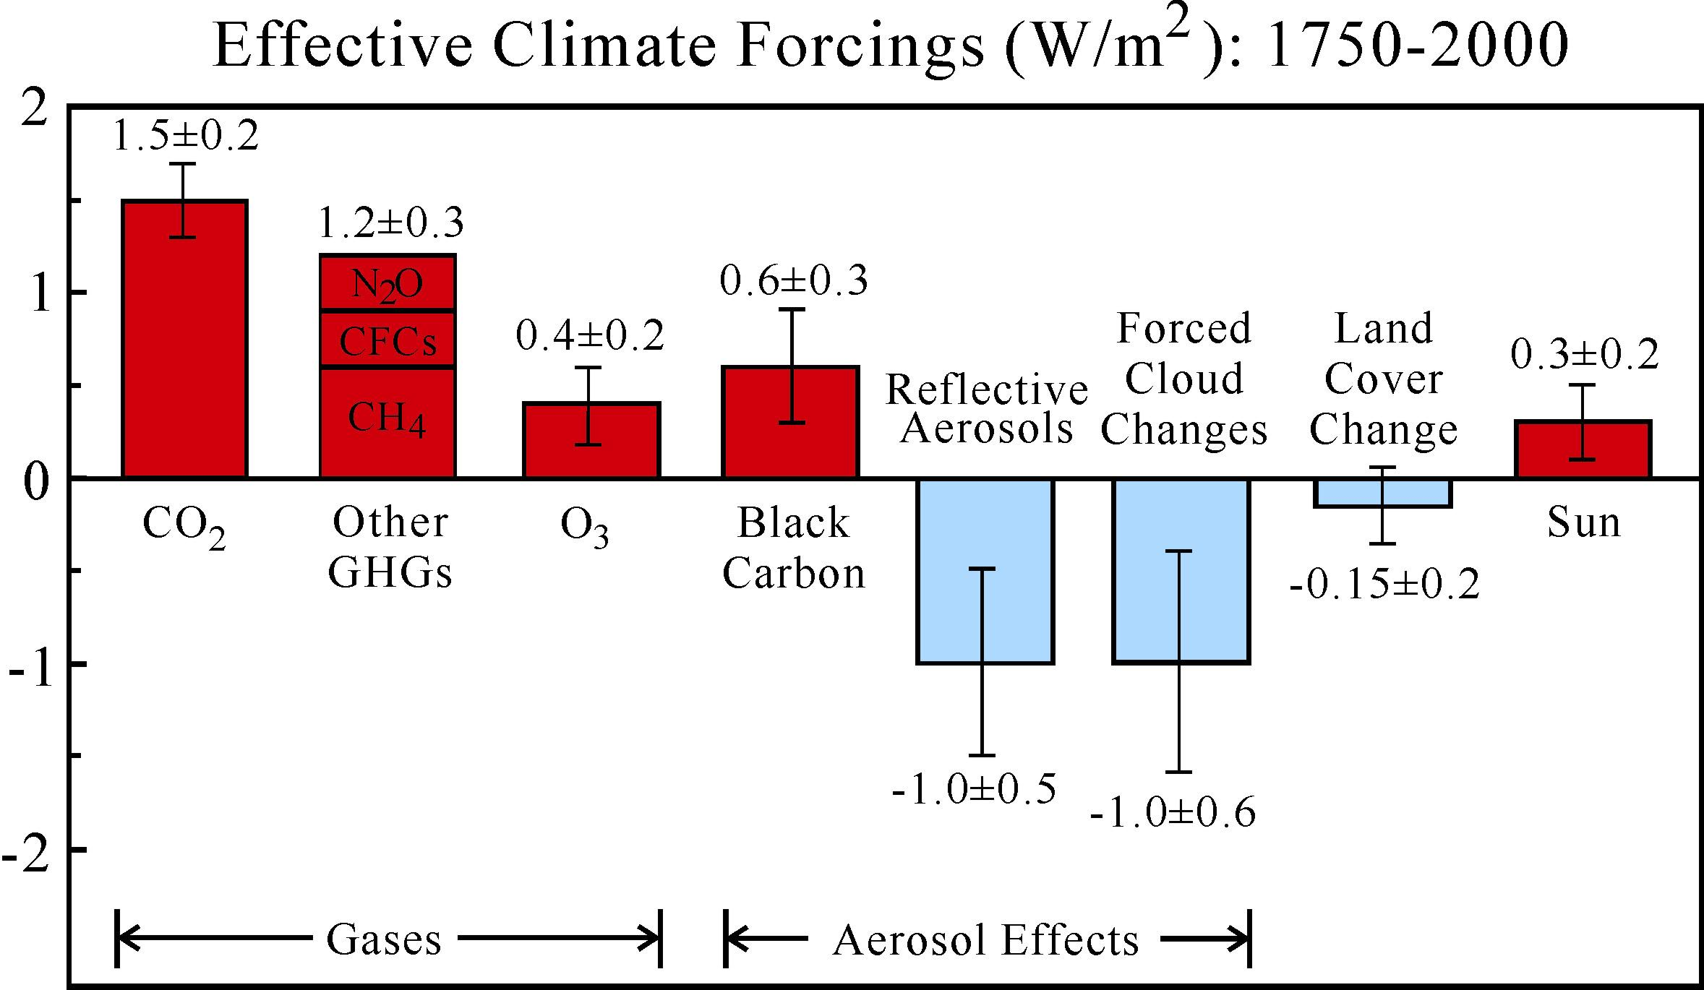
Climate forcing agents in the industrial era.
Source: Hansen et al., JGR, 110, D18104, 2005.
Forcing during the Industrial era has been about 1.8 W/m². For a sensitivity of 3/4º C per W/m², as just shown from Ice Age data, we expect a 1.4º C rise in temperature – which is what we have experienced.
Expected total forcing from doubled CO₂ concentration is 3.7 W/m². We can expect a total of at least 2.5º C rise in global temperature compared to pre-industrial times. Other feedbacks may start up (CH₄ clathrates?)
Notes:
There are two major forcings in the industrial era, both human-made.
The greenhouse gas forcing is large and positive, causing warming. It is known very accurately.
Aerosols cause a net negative forcing, via their direct effect on sunlight and their effect on cloud properties, but the error bars are huge.

Slide 54

Absorption and Emission of Radiation on Earth
CO₂ and water absorb in the infrared region of 5-50 micron wavelength, where the Earth is trying to radiate its heat away.
If you increase the concentration of CO2 or H2O, these ‘absorption’ bands get broader and trap more heat before it can escape.
This is the ‘Greenhouse effect’, which has been understood for more than 100 years.
Note how powerful water is as a greenhouse gas.

Slide 55

Satellite measurements
University of Alabama in Huntsville (UAH) and Michigan State U (MSU) have made extensive analyses of the temperature of the surface of the Earth from an ever changing array of satellite measurements of the radian
These satellite measurements confirm the surface station average (0.15 degree C per decade)

Slide 56

Forces acting on the climate
Solar variations are small
Volcanic dust has a big effect by increasing the reflectivity of the planet (the “albedo”) and cooling the atmosphere. But the dust falls out after a year or two.
Man-made “aerosols” are more systemic and long-lived and have to be taken into account
Only greenhouse gas forcing looks like the recent temperature rise.
Watts per square meter
hitting the ground
1000 1500 2000
(Year)
(Average Solar power incident on Earth = 341 Watts/m²)

Slide 57

CO₂ emissions by fossil fuels
(500 GtC ~ 250 ppm CO₂ ~ 2º C.)

Slide 58

Making the ‘BEST’ Measurement of the Earth’s Surface Temperature – By a ‘Skeptic’ !
Many insist that as cities and their ‘urban heat islands’ have grown in size, any local temperature sensors will record an artificial increase.
There are many temperature sensor locations that are obviously flawed (near air conditioning exhausts, parking lots, etc.), but most aren’t.
A self-described ‘skeptic’ Berkeley professor – Richard Muller – embarked on a complete reanalysis of the temperature record, independent of NASA:
‘BEST’ = ‘Berkeley Earth Surface Temperature project’

Slide 59

Carbon cycle in the Earth/Atmosphere
Note that the carbon resident in fossil fuels outweighs combined mass of carbon in atmosphere + soil + biomass + upper ocean
Our impact on the atmosphere is about 0.7% per year, and rising
Illustration courtesy NASA Earth Science Enterprise.

Slide 60

PIOMAS (Pan-Arctic Ice Ocean Modeling and Assimilation System – U. Washington) is a model that uses estimates for sea ice thickness and then calculates ice volume
To understand the drastic nature of what is happening in the Arctic regions, it’s Important to Concentrate on Volume, not Area
20,000 km³
0
1980
2015

Slide 61

Geothermal Forcing is Irrelevant
This heat source does not affect climate since it is
too weak (.1 W/m²) and is very, very constant

Slide 62

Variations in Solar Output are Small
Surface Averaged Solar Forcing
+/- 0.25 W/m2
Notes:
Let me make note of the assertion that the world could be headed into colder times because of changes on the sun, because that misconception has been spread widely.
Solar irradiance has been measured since the late 1970s, and the solar irradiance remains at or near a prolonged solar minimum, which is deeper than the prior measured minima. This is data of Frohlich and Lean through the end of September.
These solar irradiance variations do not have any known relation with the shorter period oscillations of Pacific Ocean temperature. In a few moments I show quantitatively that the effect of the sun is not negligible on longer time scales (the time scale of the 10-12 year solar cycle and longer time scales), but it is much smaller than the climate forcing due to human-made greenhouse gases.

Slide 63

Most of the added heat is absorbed in the ocean.
Will it be able to provide this buffer in the future?
What is it doing to deep sea ecology?

Slide 64

Pick a Temperature !
The temperature of the Earth changes as you go up or down in the atmosphere – by 100 degrees C!
The temperature depends critically on the composition of the gases in its atmosphere, their spectral properties and their distribution.
Let’s talk about the average temperature on the surface, where we live.

Slide 65

Mean Surface Temperatures Over 11,000 years

Slide 66


Results from the GRACE satellites
Total mass of
West sheet = 2.2 x 10⁶ Gtons)
(Total mass = 2.5 x 10⁶ Gtons)
Loss of mass in all three of the Earth’s major ice sheets is of the same order and is accelerating.

Slide 67
Absorption and Emission of Radiation on Earth
CO₂ and water absorb in the infrared region of 5-50 micron wavelength, where the Earth is trying to radiate its heat away.
If you increase the concentration of CO2 or H2O, these ‘absorption’ bands get broader and trap more heat before it can escape.
This is the ‘Greenhouse effect’, which has been understood for more than 100 years.
Note how powerful water is as a greenhouse gas.

Slide 68

El Nino (& La Nina) –
Southern Oscillation (ENSO)
El Nino: High atmospheric pressure in the western Pacific causes heat flow eastward. La Nina is the reverse.

Slide 69

El Nino (& La Nina) –
Southern Oscillation (ENSO)
These episodes are correlated to global temperatures at the 0.2º C level and can be corrected for in global averages.

Slide 70

Has Global Warming Stopped in the last 15 years?
?

Slide 71

No. Anthropogenic Global Warming is Continuing at a Steady Pace
Important observation: The El Nino fluctuation and slightly lower solar power in the last few years have given slower temperature rises. But make no mistake about it: the underlying trend will overpower any such noise sources

