Slide 1
Overview of 650MHz Test Stand
Jerry Leibfritz
December 17, 2020

Slide 2
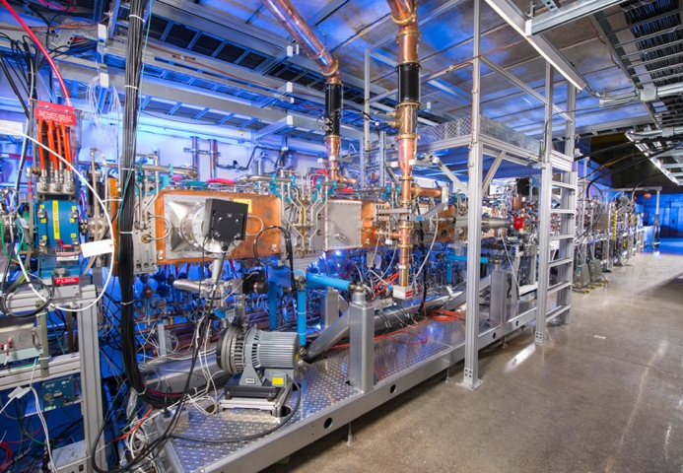
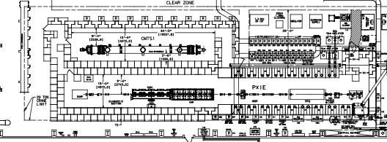
Overview – PIP2IT
PIP2IT (PIP-II Injector Test)
  Near full-scale test of the PIP-II front-end with beam (located at CMTF)
  The first two PIP-II cryomodules: Half Wave Resonator (HWR) and prototype SSR1 are being tested in PIP2IT as part of front-end test
HWR Cryomodule
Prototype SSR1 Cryomodule
PIP2IT Test Cave
PIP-II Injector Test

Slide 3
650 MHz Cryomodule Test Stand
After beam testing is complete (FY21), PIP2IT will be converted into two cryomodule test stands for testing 650 MHz & SSR cryomodules (without beam)
3-D model showing HB650 and SSR Cryomodule overlaid in PIP2IT

Slide 4
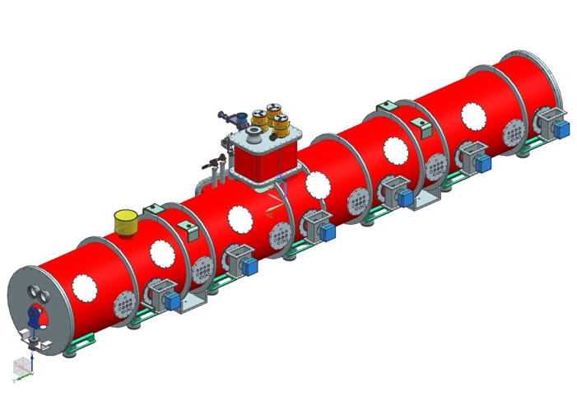
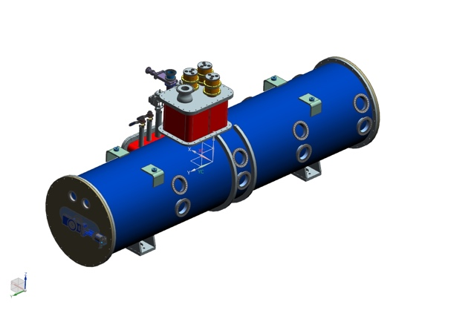
650 MHz Cryomodule Testing
HB650 Cryomodule (6-cavity)
  (4) HB650 CM’s will be tested
  1st one arrives for testing Nov 2021
  HB650 CM has recently completed their Final Design Review
LB650 Cryomodule (4-cavity)
  (9) LB650 CM’s will be tested
  1st one arrives for testing ~ July 2024
  LB650 CM design is being worked on
    Interfaces being negotiated, plan is for cryogenic interfaces to be essentially identical
    We will plan (budget) for a second set of u-tubes in case there are slight geometric differences

Slide 5
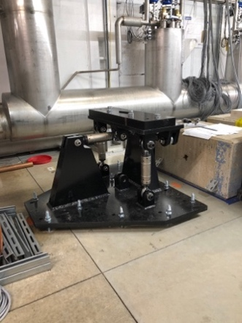
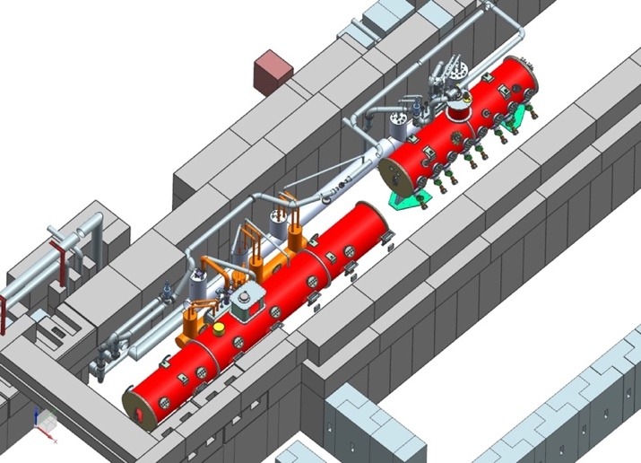
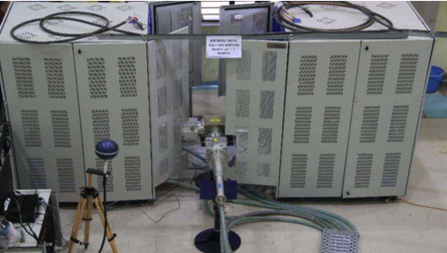
PIP2IT 650 Test Stand Modifications
Several infrastructure/system modifications to PIP2IT are required for the 650 Test Stand
  Removal of PIP2IT beamline and cryomodules – Linac Installation
  Installation of new stands – Linac Installation/Test Infrastructure
  New RF Amplifiers and RF distribution – HPRF
  Vacuum systems (beamline and insulating)– Vacuum
  Controls, LLRF, Instrumentation, etc. – Accelerator Systems
  Electrical and mechanical infrastructure & utilities – Test Infrastructure
  Integration and installation support of all sub-systems – Test Infrastructure
  Cryogenic Transfer Line & Controls – Test Infrastructure
Cryomodule Stands
RF Amplifiers

Slide 6
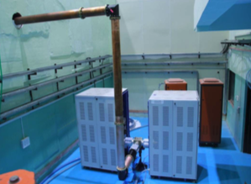
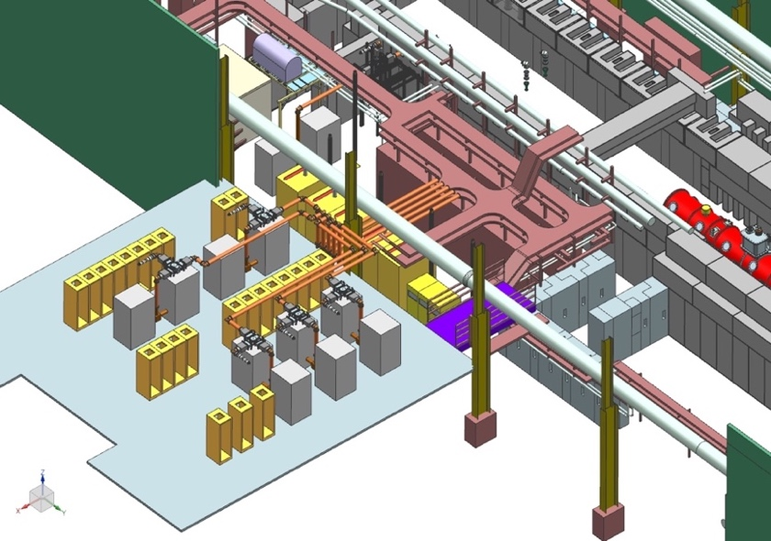
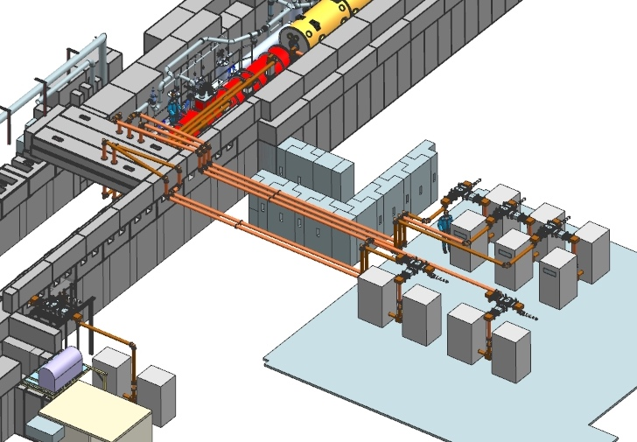
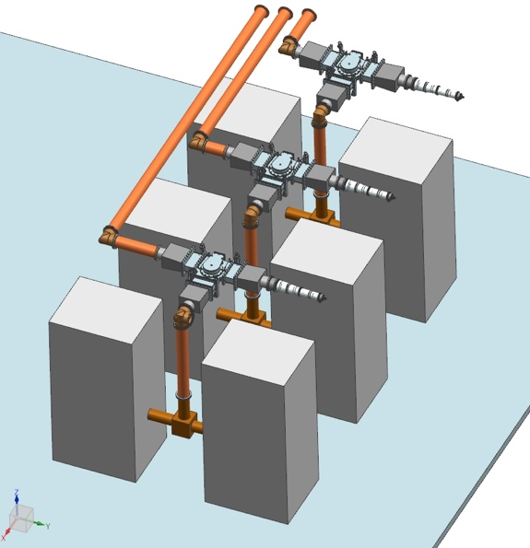
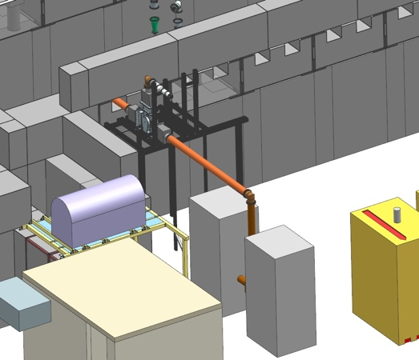
HPRF design effort for 650 Test Stand
RF amplifier and distribution modeling and layout
FDR took place in August 2020
RF amplifier from India
3-D Models of 650 MHz RF amplifiers and RF distribution at PIP2IT

Slide 7
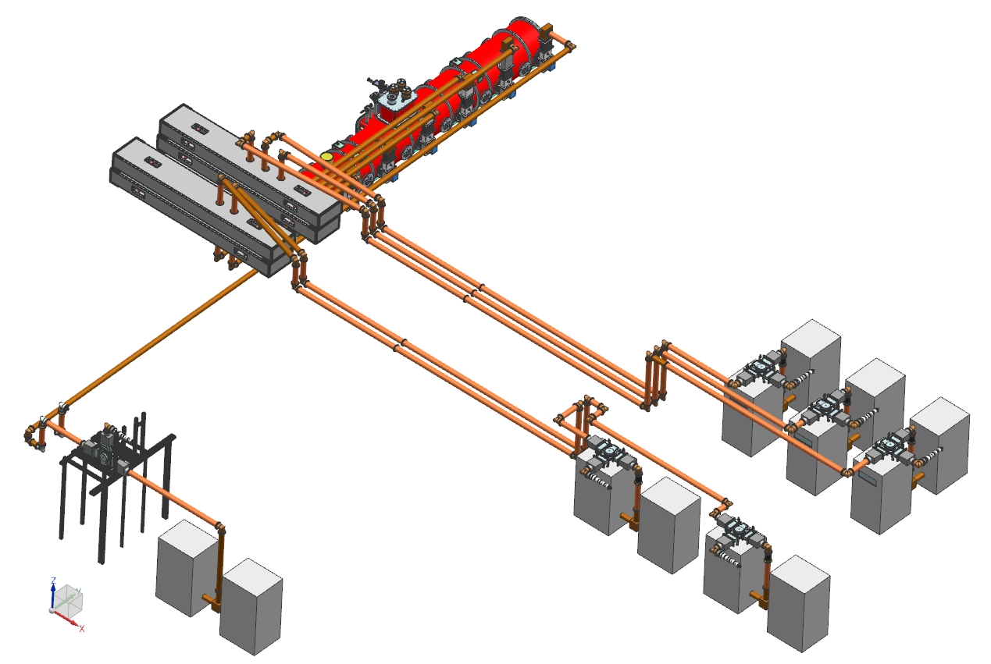
HPRF Distribution for HB650

Slide 8
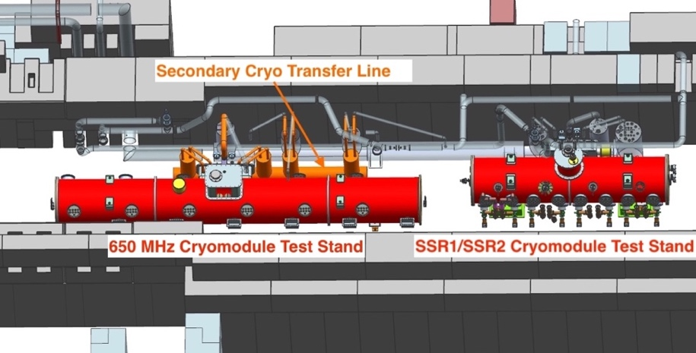
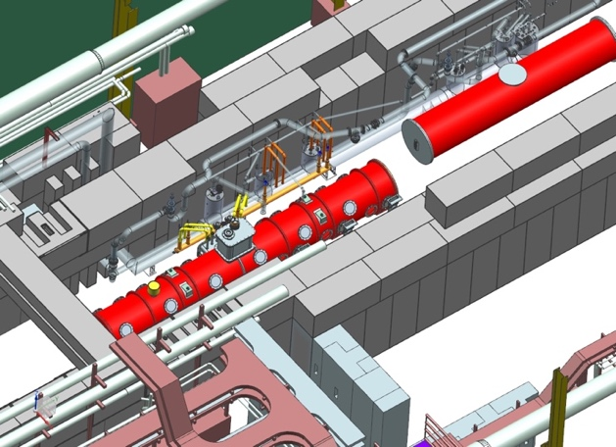
650 Intermediate Cryo Transfer Line (CTL)
The existing CTL was designed for the HWR cryomodule and does not mate up directly with the 650MHz cryomodules
A secondary or “intermediate” CTL was designed to tie the existing CTL to the 650 cryomodule
  FDR of the 650 CTL was completed and fabrication is underway
Existing Cryo Transfer Line (CTL) for HWR & SSR1 (Grey)
Conceptual model of 650 Test Stand showing intermediate CTL (orange)

Slide 9
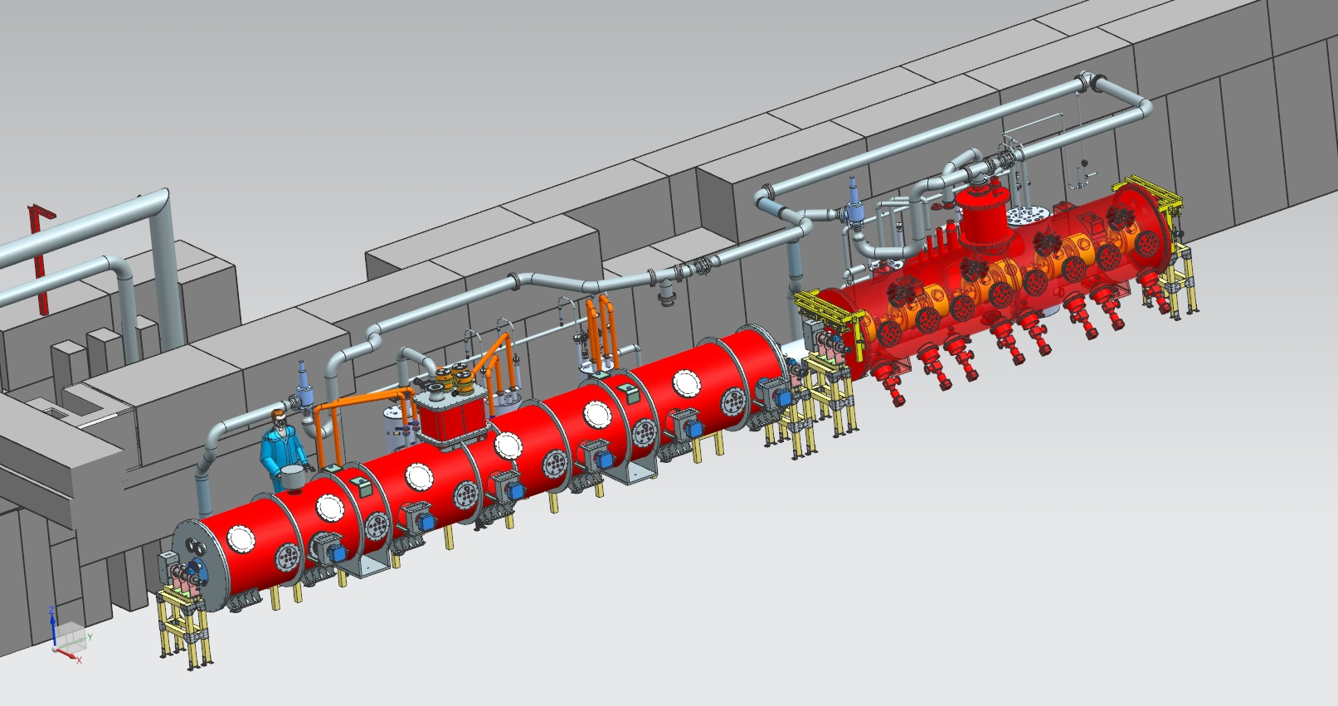
Test Stand – 3D model
SSR1 CM
HB650 CM

Slide 10
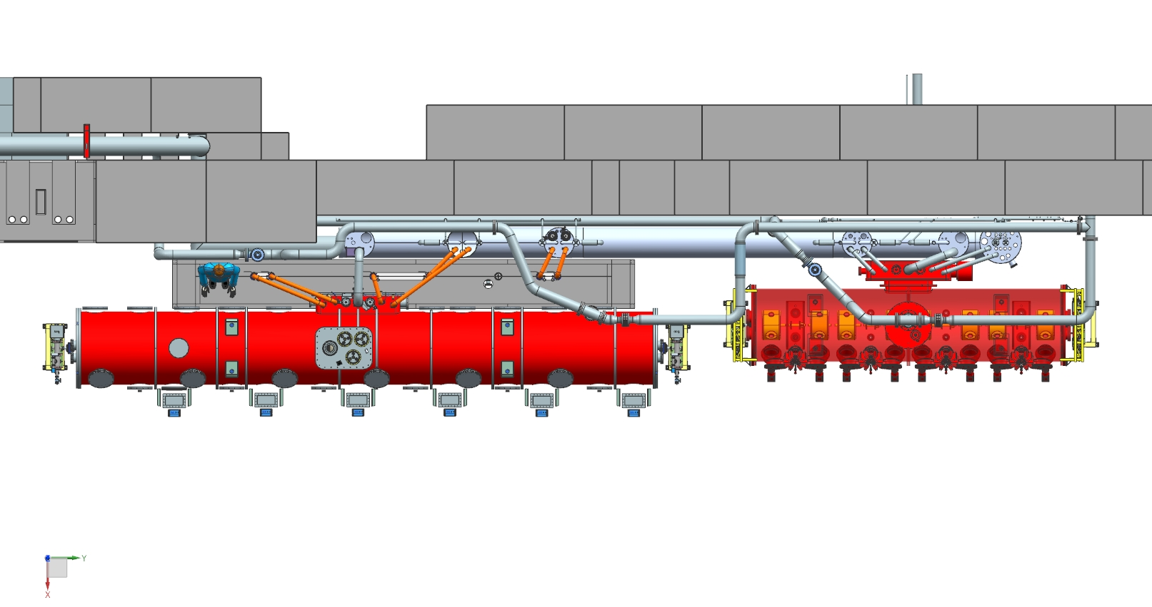
Test Stand - plan view
SSR1 CM
HB650 CM

Slide 11
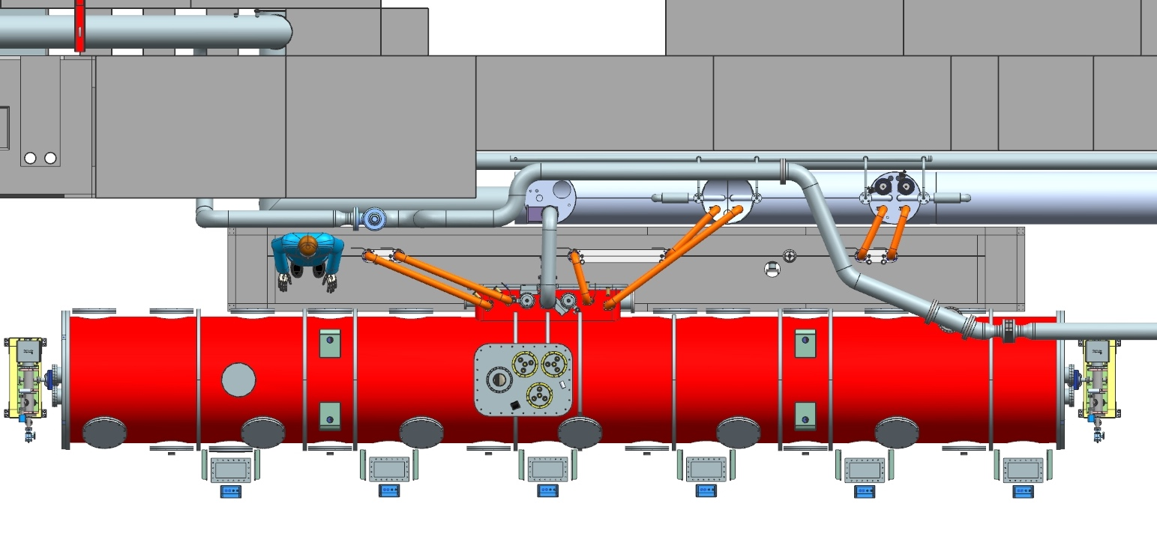
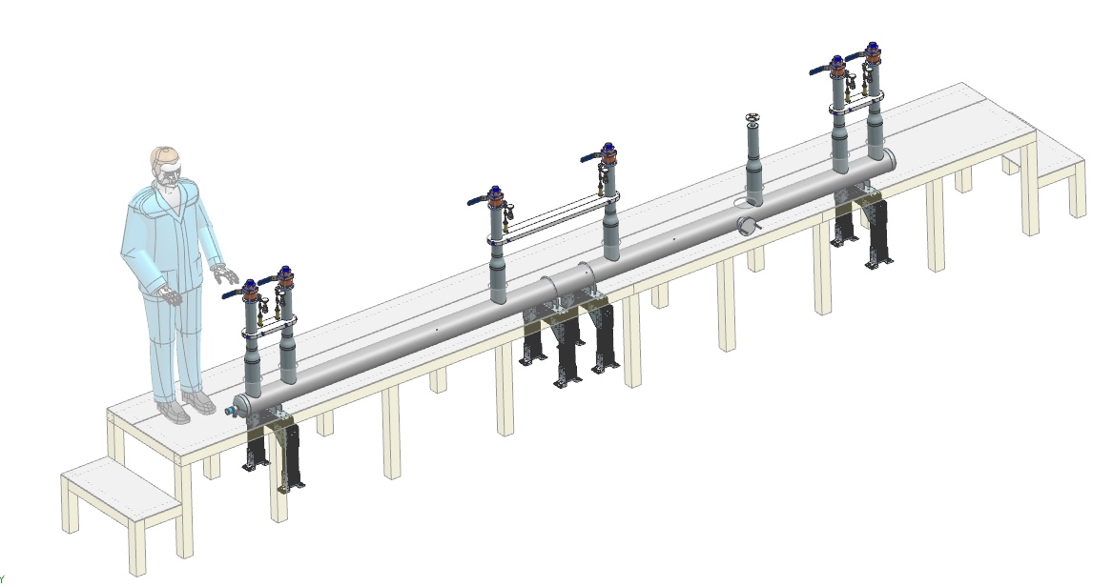
650 Test Stand

Slide 12
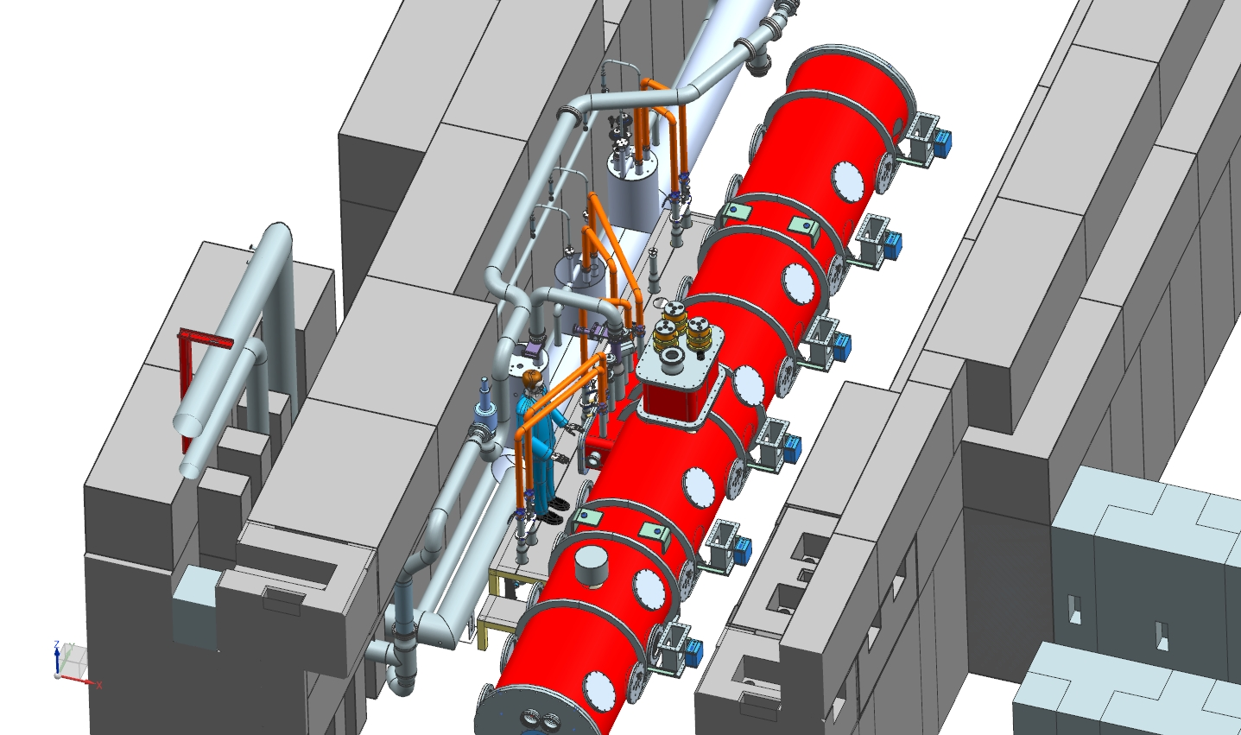
650 Test Stand

Slide 13
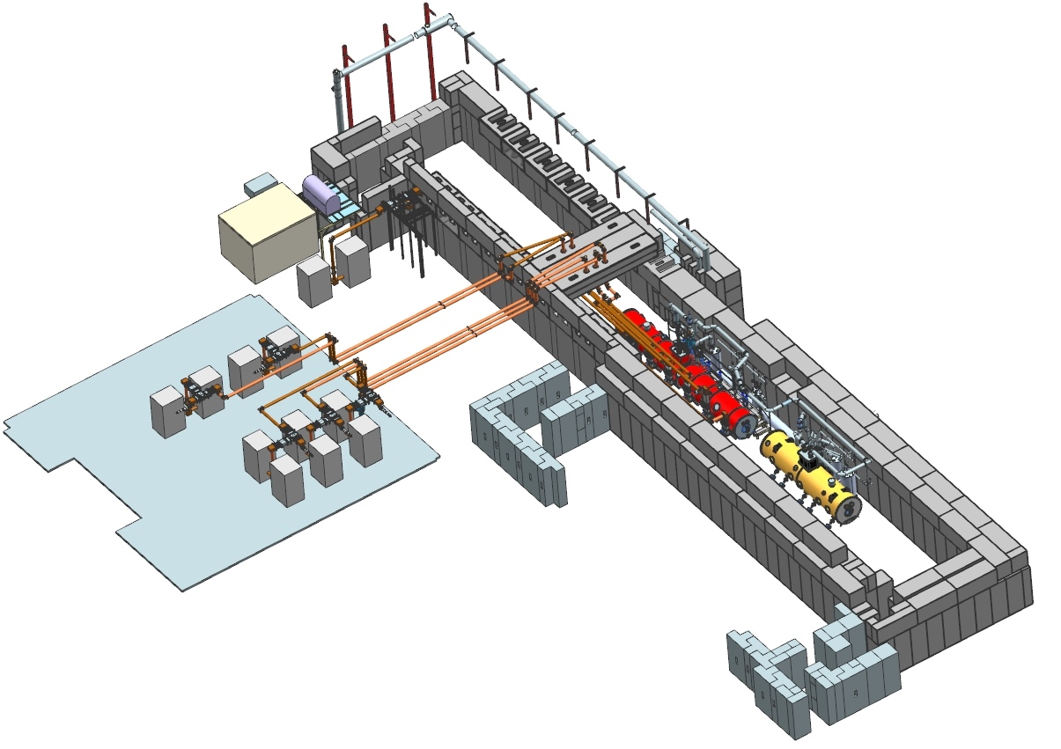
Overview 3D

Slide 14
High Level Schedule
650 Test Stand P6 Schedule
  Procurement/Fabrication – 7 months
  Installation – 5 months
  Ready for 1st CM installation in November 2021

