Slide 1






LB650 Cryomodule Testing - Overview
A Partnership of:
US/DOE
India/DAE
Italy/INFN
UK/UKRI-STFC
France/CEA, CNRS/IN2P3
Poland/WUST
Joe Ozelis
11/19/20

Slide 2
Outline
Requirements driven test program
Test plan synopsis
Instrumentation and measurements - commonality

Slide 3
Requirements flow down
Basic fundamental requirements captured in the Cryomodule FRS, project PRD, etc (Functional Requirements Specification, Physics Requirements Document).
Additional details and requirements also come from
  TRS (Technical Requirements Specifications)
  Sub-system FRSs (tuner, coupler, etc….)
These are then summarized into an ACL – Acceptance Criteria List.
  Specific measurable performance criteria, traceably derived from project requirements.
The ACL specifies WHAT we must measure, what performance must be confirmed.

Slide 4
Cryomodule Test Plan
The ACL specifies WHAT we must measure, the CM Test Plan specifies HOW we go about making those measurements.
The test plan documents :
  Scope of testing/specific systems/sub-systems
  Required support systems
  Step-by-step Test Plan
    Warm checkout
    Cooldown – 4K
      Cooldown restrictions/requirements
      Flux monitoring
    Cooldown – 2K
    Alignment measurements
    Static heat load measurements
    Individual cavity testing at 2K (incl. 2K dyn heat load/Q₀)
    Ensemble cavity testing at 2K (incl. 2K total heat load)
    Microphonics & LLRF control studies

Slide 5
CM Test Traveler
The ACL specifies what we must measure, the CM Test Plan specifies how we go about making those measurements, the CM Test Traveler is the vehicle used to RECORD the results of and CONTROL the measurements.
The traveler provides :
  Process control – procedures/guidance for performing measurements, with links to detailed procedures as needed (measurement context)
  A mechanism to record measurement results (including upload of files, in addition to data fields)
  Method to identify and document non-conformances
  Process tracking and oversight (review & approval)
  Wide access (web-based)
  Data-mining capabilities
The Traveler mirrors the Test Plan, is a complementary document
Travelers are controlled documents – subject to review, approval, version control.

Slide 6
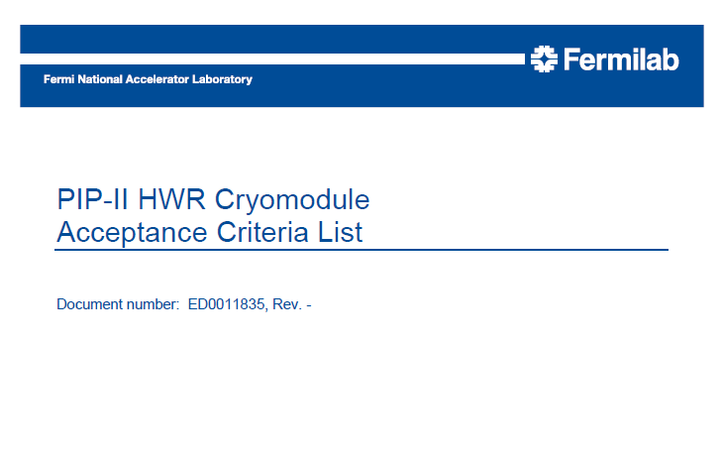
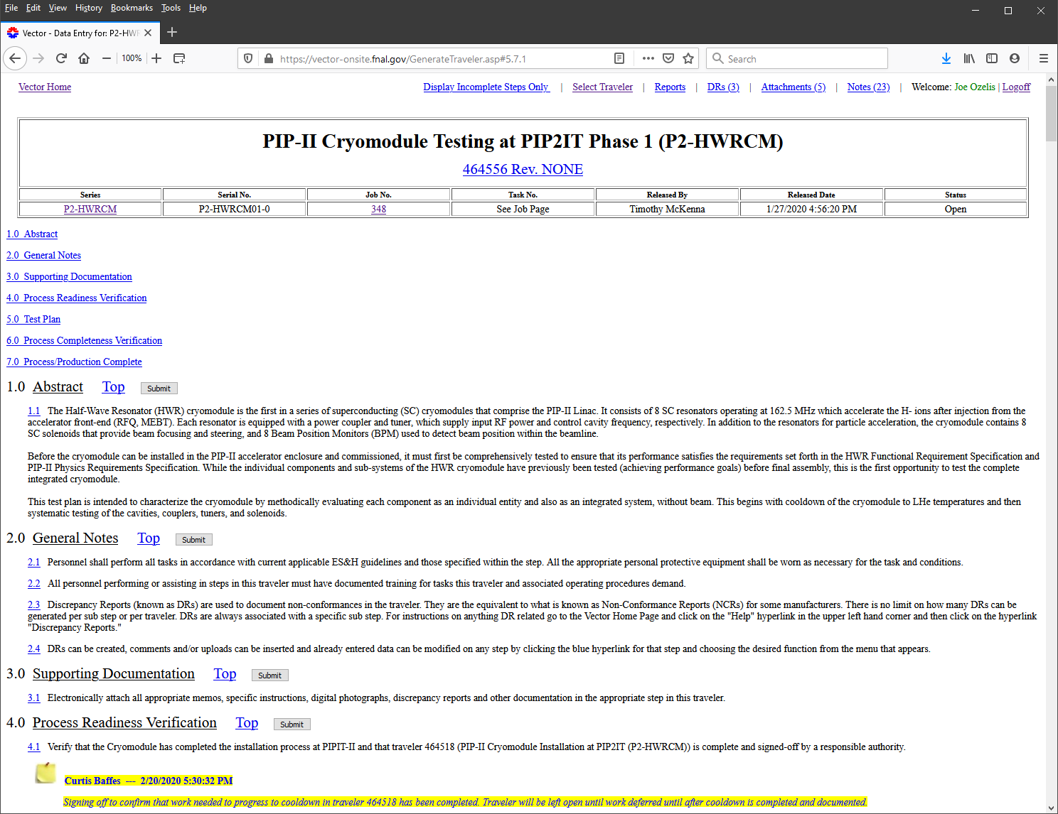
Examples
HWR ACL, Test Plan, Test Traveler (TC Doc # ED00011835)

Slide 7
LB650 Test Plan - Overview
LB650 ACL in process – draft table from dFDR (draft Final Design Report)

Slide 8
LB650 Test Plan – Highlights 1
Warm checkout after installation
  Thermometry, liquid level sensors, flux gates, pressure/vacuum transducers, alignment, RF cables (TDR, S₁₁/S₂₁), tuner motors & piezos, cryogenic valves, cavity f, coupler Q_{ext}, etc.
    This is a “double-check” of all instrumentation/controls previously verified during last stages of assembly
Cooldown to 4K
  Thermal shields (50K) first, taking note of cooldown rate restrictions
  4K circuits follow (fast cooldown for cavities)
    Monitor fluxgates to verify flux expulsion
  Cryogenic instrumentation data-logged throughout
    Cavity frequencies (df/dP) ?
Cooldown to 2K
  Cryogenic instrumentation data-logged throughout

Slide 9
LB650 Test Plan – Highlights 2
Once at 2K, prepare for testing
  Cryogenic (RTDs, LL, Pres, Vac) instrumentation data-logged throughout
  Measure cavity frequencies and coupler Q_{ext} (w/NA)
    Can pre-tune cavities to 650.000MHz
  Alignment measurements
  Exercise tuners (slow & fast)
  RF cable/system calibrations
  LLRF/HPRF/RFPI system checkouts (or earlier)
  Coupler HV Bias enabled/verified
  Radiation detectors mounted, checkout, data-logged

Slide 10
LB650 Test Plan – Highlights 3 – Testing @ 2K
Individual cavity testing (SEL (Self-Excited Loop) mode)
  Couper conditioning (off resonance) ?
  Cavity Gradient measurement
    FE onset (initial and post-proc), FE processing (if necc.), MP, determine field limit (quench, or admin), LFD coefficient
    Coupler performance (temps, vacuum, e⁻ pickup, etc.)
  Tuner performance (slow and fast)
    Range, resolution, hysteresis
  2K Heat load (Q₀) measurements (calorimetric)
  LLRF control (operation in GDR (Generator Driven Resonator)) mode, LFD compensation), if so equipped
    Microphonics spectrum measurement

Slide 11
LB650 Test Plan – Highlights 4 – Testing @ 2K
Static Heat load measurements
  50K circuits/thermal shield
  5K circuits/shield
  2K circuits
    Typically done after CM has been cold for ~2 weeks (“cold soak”)
Ensemble cavity tests
  Run all cavities at maximum nominal gradients
    Perform total 2K dynamic heat load measurements
    “Stability” test – operate for ~8 hrs or until coupler thermal equilibrium achieved/demonstrated
    Measure dark current (req all cavities in GDR mode and phased to accelerate) – optional?
Thermal cycle (?)
  Partial – above T_{c}, repeat “fast cooldown”
  Full (> 250K), alignment repeatability

Slide 12
LB650 Test Plan
Presented here is an overview/draft
  To be refined by generating the requisite documentation
    ACL, Test Plan, Test Traveler, flowdown from PRD, FRS, TRS, etc.
  Partner involvement expected
The HB650 pCM Test will of course require identical treatment/development (next 6-9 mos)
  Much of that effort can inform the LB650 CM Test
As the test program becomes refined, we then focus on procedures and instrumentation required to pursue that program
  Identical (or nearly so) procedures and infrastructure are desirable as they reduce systematic effects/uncertainties

Slide 13
LB650 Test Plan – Infrastructure/Instrumentation
Start off with a general list of CM instrumentation and control interfaces (again this will basically be identical to what is done for the HB650 CMs):
  RTDs (thermometry) : Cernox and PT
  Flux gates/sensors (residual fields, flux expulsion)
  Pressure transducers (2K bath)
  Vacuum gauges (insulating and beamline vacuum)
  Helium level sensors
  Heaters (cavity, 2K header)
  Alignment
  Coupler e- pickups (PMTs, IR sensors?)
  Tuner controls
  Limit switches
  Flowmeters (coupler airflow)
  Coupler HV Bias (control, readback of HV, readback of current)
  Cryogenic valve actuation & readback
This doesn’t include HPRF or LLRF systems – those are already under discussion/development
Instrumentation will be documented in ISD (Interface Specification Document) and/or Instrument List.

Slide 14
LB650 Test Plan – Strategy for Commonality
Most instrumentation can be read out vis a number of commercially available systems, with equal quality/reliability
  RTDs, vacuum, pressure
Likewise, where required, power supplies meeting voltage/current/power/control/readback requirements can be interchangeable
  Heaters
  Coupler HV bias
  PLC’s for cryo valve control
  Gate valve control
In those cases, it may come down to “use what you have” or “use what you are comfortable with” (spares, operational experience, programming)
However some systems will benefit from using identical instrumentation, due to the specificity of the sensors:
  Bartington Flux Gate readout
  AMI level probe readouts
  Turbopump controllers
In those cases we should strive for identical solutions, to minimize measurement or control errors.

Slide 15
LB650 Test Plan – Strategy for Commonality - 2
In some cases, in addition to instrumentation, we may also want to employ an identical process/procedure.
  E.g., calorimetric Q₀ measurements : mass flow, level change, dP/dT
  FNAL experience is that a mass flow sensor, in conjunction with a heater in the 2K manifold used to calibrate mass flow vs heat load, is the most effective/reliable approach.
    This is one measurement procedure we may wish to standardize
  Another example is radiation detectors
    Identical placement around the CM
    Energy acceptance, time constants
      Unfortunately FNAL practice in CM test stands is to use FNAL designed/built detectors (“FOXs”) rather than commercial ones, so availability is uncertain.
As we develop the test plan & measurement requirements, we can identify areas where commonality is required or strongly preferred.

Slide 16
LB650 Test Plan – Path forward
Requirements are at an early stage… but testing of HB650 pCM in ~ year means that requirements, test plans, test procedures for HB650, which will be virtually identical to LB650, will be developed in the near future.
  LB650 benefits from that
For LB650, we can prioritize those elements that have impact on infrastructure choices/decisions
  Ensure required commonality can be achieved in a timely manner.
  Define the scope of any additional infrastructure development/acquisition as early as possible

