Slide 1
Discussion about RF power/measurements needs

Slide 2
Power levels: any update?
 |  | Max Acc. Cavity Voltage in Lattice (MV) | Max Acc. Cavity Voltage Operations (MV) | Max Cavity Voltage Conditioning and Testing (MV) | R/Q | Q0 | QL | QL min | QL_max | Cavity coupling Nominal | Cavity coupling min | Cavity coupling max | Pf for min coupling (at cavity, kW) | Pf for max coupling (at cavity, kW) | Maximum Pf including coupling errors (at cavity, kW) | Transmission line efficiency | Maximum amplifier power with coupling errors and margin, 1dB compression (kW)
FNAL | LB650 | 11.79 | 12.969 | 13.61745 | 340 | 2.40E+10 |  |  |  |  | 1922 | 2768 | 10.93 | 15.74 | 15.74 | 0.9 | 17.49
CEA | LB650 | 11.9 | 13.09 | 13.7445 | 340 | 2.40E+10 | 1.04E+07 | 8.32E+06 | 1.25E+07 | 2307 | 1922 | 2884 | 11.14 | 16.70 | 16.70 | 0.89 | 18.74
Document reference number: ED0010221: July 8th, 2020
We consider the waveguides length for each RF path to be about 40 m
Maximum total losses in the RF network (based on manufacturer data) 0.5 dB
No need to consider detuning due to microphonic for the RF power requirement during the RF tests at CEA
➔ P1= 18.74 kW (To check if we need additional margin)

Slide 3
What need to be discussed: most important and most critical
Hardware choice
SSA class
For which hardware we need harmonization between CEA and Fermilab?
Any recommendation?

Slide 4
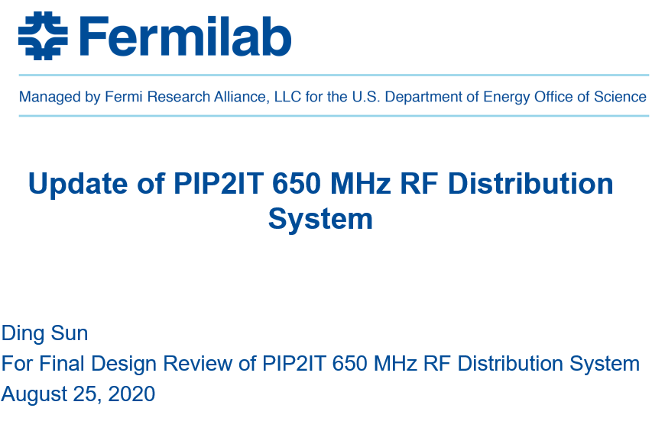
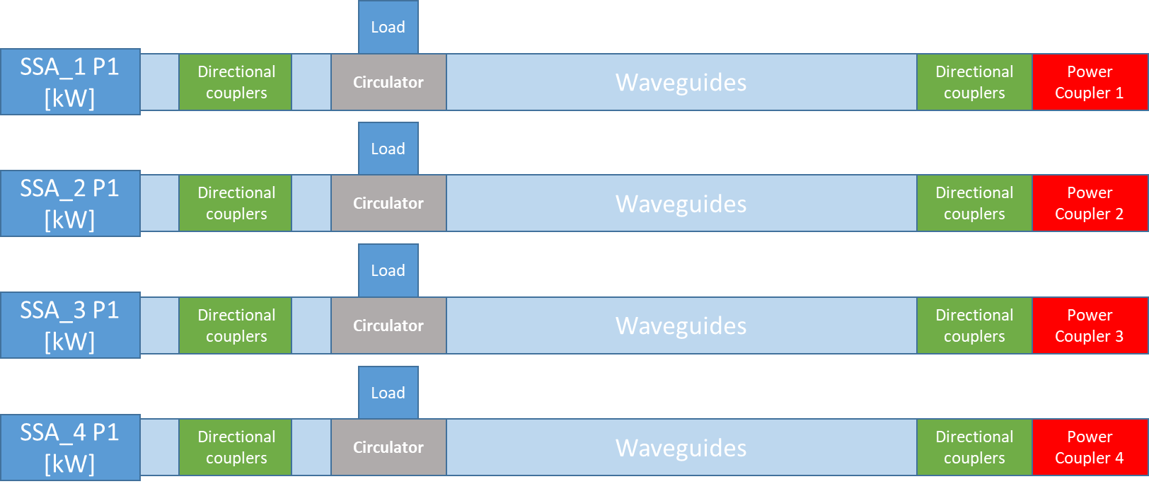
Distribution Line
CEA Schematic of the distribution line design.
Both configuration use 2 Dual directional couplers:
1 Dual directional coupler upstream the circulator
1 Dual directional coupler close to the Power coupler transition
Same choices at CEA but the entire network will be WR1150 waveguides.
FNAL Schematic of the distribution line design.

Slide 5
SPECIFICATIONS of WR1150 Dual Directional Coupler (PIP2IT)
Electrical:
WR1150 Dual Directional Coupler (reflectometer)
Power: 70 kW CW, with up to full reflection @ any phase
Center Frequency: 650 MHz
Bandwidth: 10 MHz (650 MHz +/- 5 MHz)
Coupling: -50 +/-0.5 dB (forward & reverse, w/ factory calibrations labeled)
Coupling Flatness: 0.1 db in the 650 MHz +/- 1 MHz frequency region and 0.3 db over bandwidth
Directivity: > 40 dB directivity across bandwidth
Mainline VSWR: < 1.02:1 over the bandwidth
Mainline Insertion loss: < 0.01 dB over the bandwidth
Coupling ports: dual broadwall (same side) loop couplers, external termination
Coupling port: VSWR 1.10:1 over the bandwidth
Coupling Port Connectors: Type N (non-teflon), 50 ohm impedance
Coupling windows: Rexolite
RF body leakage: < -60 dB
Do we need exactly the same specifications?
35dB for +/-1MHz and 30dB for +/-5MHz

Slide 6
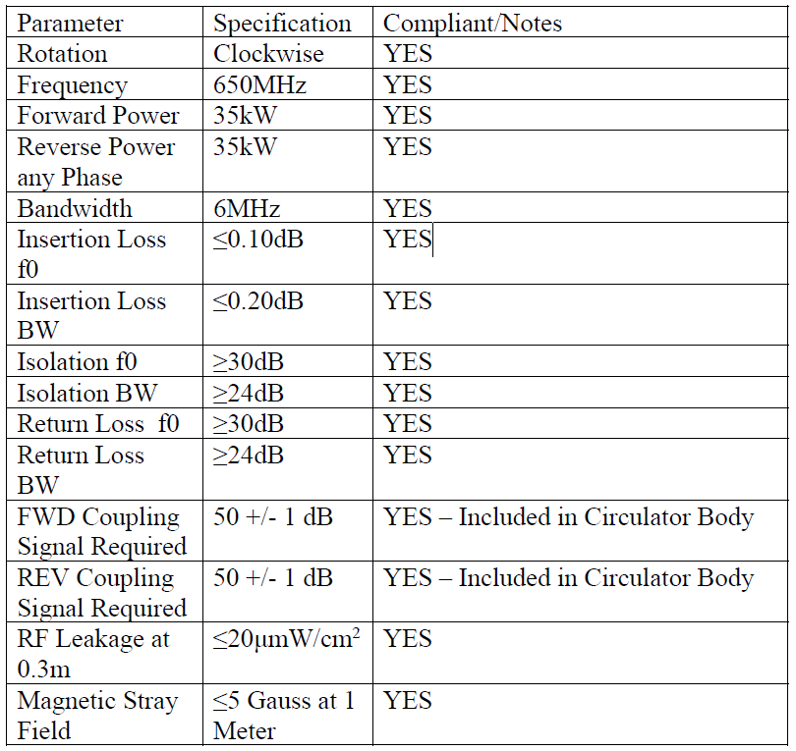
Specification of 650 MHz 70 kW CW Waveguide Ferrite Junction Circulator
Port configuration: 3 Ports, Port 1 (input port), Port 2 (output port), Port 3 (will be terminated with a water cooled termination by Fermilab)
Orientation of Rotation: clockwise
Flanges of all ports: WR1150 CPRF
Center Frequency: 650 MHz
Bandwidth (BW): 12 MHz
Insertion loss: ≤ 0.13 db at center frequency, ≤ 0.3 db in BW
VSWR at all ports: ≤ 1.1:1 at center frequency, ≤ 1.20:1 in BW
Isolation: ≥ 26 db at center frequency, ≥ 20 db in BW
Power handling capability: the circulator should function normally (meet all specification listed in this document, no sparking and no overheating should occur) under all operating conditions as follows:
1. Output power (CW) at Port 2: 0 - 70 kW, with full reflection back to Port 2 at ant phase while input power at Port 1 is at full level for 0 - 70 kW output power at Port 2 (the input power is ON).
2. At the end of each operation, immediately after the input power is shut off the stored energy in a superconducting cavity is released and generates return peak power of ~ up to 140 kW back to Port 2. This return power decays exponentially to 0 in ~ 3 millisecond.
RF leakage: RF leakage at any joint should be less than 0.4 mW/cm² measured at the closest distance from the joint.
….
Example of RF circulator specification (Ferrite):
20 KW or 35 KW same price

Slide 7
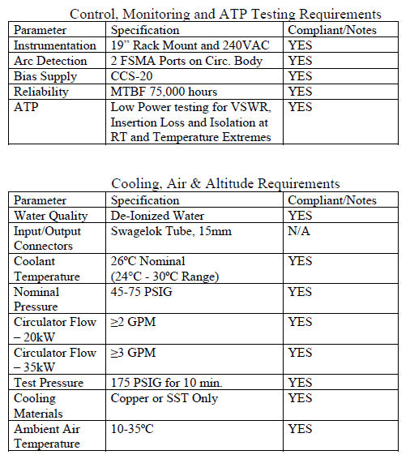
Specification of 650 MHz 70 kW CW Waveguide Ferrite Junction Circulator
Coolant: De-ionized water.
Inlet cooling water temperature (optimum setting): 86 F – 90 F
Coolant connector: 1/2” NPT male connector, stainless steel
The following green lines are for vendor to specify.
Allowable inlet cooling water temperature range:
Coolant flow rate (should be ≤ 10 GPM):
Coolant pressure drop: (pressure drop should be < 20% of inlet pressure)
Coolant input pressure: (should be ≤ 145 PSI)
Coolant leak test pressure and duration of the test (in minutes): (for example: 15 bar for 10 minutes)
Allowable ambient temperature range during operation: 15 C – 40 C
Temperature Compensating Unit: Data Sheet (function and technical specification) is required for bidding process.
The circulator is required to satisfy all specifications listed in this document from startup to any steady state operating power levels (between 0 to 70 kW output power) at any power ramp rate without need for operator adjustment to the Temperature Compensating Unit (TCU).
Magnetic Stray Field: < 5 Gausses at 1 meter distance
Arc detectors and access ports must be installed.
Mounting: tapped holes or brackets should be provided for mounting the circulator to a base metal plate.
Lifting: eyelets for crane lifting.
I have written a test plan: “High Power Test Plan of Fermilab PIP-II 650 MHz 70 kW Circulator”

