Slide 1
HB650 Test Stand – Cryogenic System
Joe Hurd, Ben Hansen, Renzhuo Wang
April 15, 2021

Slide 2
Outline
Functional Requirements
Special Modes of Operation
CTL Design
Relief Header Modifications
Fast Cooldown Preliminary Analysis

Slide 3
Special Modes of Operation
Thermal Bump to 45K
Fast Cooldown
Heat Load Measurements
HTTS
LTTS
2K Static/Dynamic

Slide 4
650 Test Stand FRS ED0013603 Key Requirements
Independent cryogenic operations from CMTS
Independent cryogenic operations for SSR cryomodules.
Repattern HWR bayonet locations to match 650 bayonet locations
HTTS controlled cooldown/warm up at 20K/hr
Installation of warm supply required
50K thermal bump on cavities
Maintain LTTS around 5K during thermal bump
Fast cooldown required estimated 80-100g/s
2K operations capable.
Static heat load measurements
High Temperature Thermal Shield
Low Temperature Thermal Shield
Cavity 2K bath
Red text = not capable for on current as built PIP2-IT cryo distribution system

Slide 5
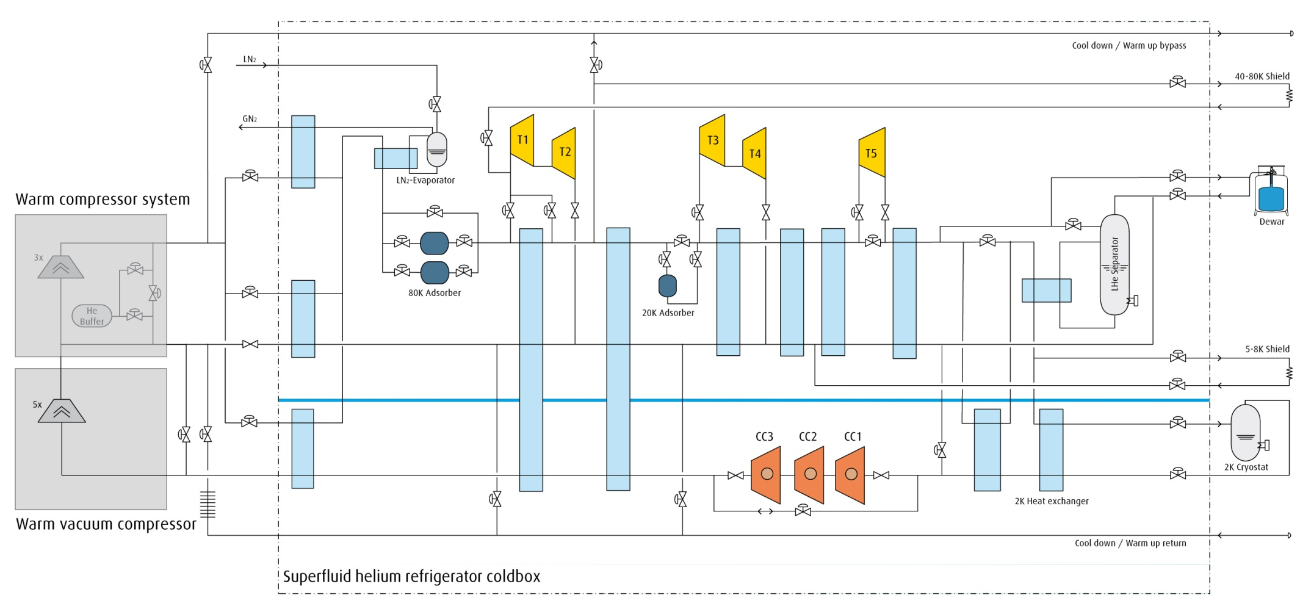
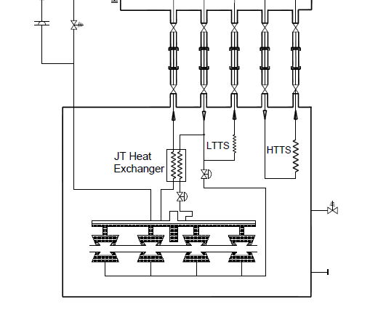
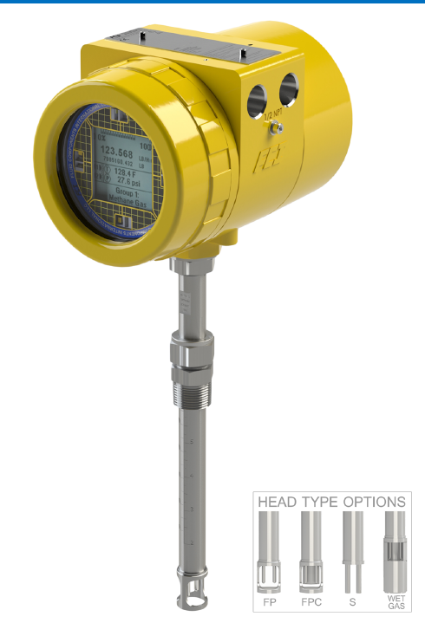
Simplified Process Flow Diagram of Integrated System
HT
Kinney WVC
FT1
FT2
PV-FCD
FCI Thermal flow meter used to measure CM CD return flows at room temperature
FT1 is a 0-5 g/s model for measure 2K heat loads
FT2 is a large range 0-80 g/s with dual sensing elements for consistent accuracy across full range
FT2 is used to measure Fast Cooldown flow rate and LTTS and HTTS heat loads measurement

Slide 6
Fast Cooldown Step 1 – Thermal Bump to 45K
~60 g/s
~60 g/s
HT
1200 W
HP Supply
Kinney WVC
FT1
FT2
HP supply gas is used to mix with 4.5K gas to regulate the cavity supply temp to 45K and soak for >30min.
LTTS reverse flowed with trickle of 4.5K gas to keep intercepts cold.
Cryoplant refrigeration of ~1200W regulated in external dewar and reserve liquid accumulated
Fast CD return is through a DN80 valve off the relief stack of the CM.
T

Slide 7
60 g/s
HT
1200 W
~60-80 g/s
HP Supply
Kinney WVC
FT1
~60-80 g/s max
FT2
Fast cooldown is initiated by fixing the external dewar heater at ~1200W
HP mixing valve is closed
LTTS reverse flow closed
External dewar supply is ramped closed while the CM CD valve ramped open
FT2 will measure the full fast cooldown flow rate until liquid begin accumulating at which point it will drop off

Slide 8
HTTS Heat Load Measurement Configuration
HT
HP Supply
Kinney WVC
FT1
FT2
Ti
To
HTTS Static heat load is measured by returning only the HTTS flow to CD line to measure flow rate.
The heat load is then calculated based on change in enthalpy times mass flow rate.

Slide 9
LTTS Heat Load Measurement Configuration
HT
HP Supply
Kinney WVC
FT1
FT2
To
LTTS Static heat load is measured by returning only the LTTS to the CD line to measure its flow rate.
The heat load is then calculated based on change in enthalpy times mass flow rate.
Ti

Slide 10
Cavity Heat Load Measurement Configuration
HT
HP Supply
Kinney WVC
FT
FT
2K flow rate is measured with FCI thermal flow meter FT1 at outlet of the Warm Vacuum Compressors
The heat load is then back calculated from this flow rate and the JT expansion properties.
Ti
Pi

Slide 11
Heat load Measurements - Instrumentation
Circuit | Measurement | Tag # | Sensor | Range | Description/Location
HTTS | Temperature Inlet | TX-035 (A/B) | Lakeshore PT-103 Platinum RTD | 14K-873K | On HB60 HTTS Inlet: Side port
 | Temperature outlet | TX-036 (A/B) | Lakeshore PT-103 Platinum RTD | 14K-873K | On HB650 HTTS Outlet: Side port
 | Pressure Inlet | PT-607-H | Sentra # 2061500PG2M11T18NN | 0-500 psig | On PIP2-IT Transfer line
 | Pressure Outlet | PT-608-H | Sentra # 2061500PG2M11T18NN | 0-500 psig | On PIP2-IT Transfer line
LTTS | Temperature Inlet | TX-030 | Cernox | 1.4K -325K | On HB60 HTTS Inlet: Side port
 | Temperature outlet | TX-034 | Cernox | 1.4K -325K | On HB650 HTTS Outlet: Side port
 | Pressure Inlet | PT-605-H | Sentra # 2061500PG2M11T18NN | 0-500 psig | On PIP2-IT Transfer line
 | Pressure Outlet | PT-606-H | Sentra # 2061500PG2M11T18NN | 0-500 psig | On PIP2-IT Transfer line
HTTS & LTTS¹ | Flow Meter | FT-601-H | FCI ST100A: Split Range Thermal Mass flow meter | Analog 1: 0-20 g/s Analog 2: 20-200g/s | Suction Header near SCP plant
2K | JT Heat exchanger Temperature inlet | TX-032 (A/B) | Cernox | 2K -325K | HB650 inlet: Sideport
 | Helium Vessel Pressure | PT-041-H | MKS 230EA–00100BB | 0-100 Torr | Helium vessel 2phase Pipe
 | Flow Meter | FT-K2K3SUM | FCI: ST80: Thermal Mass flow meter | 0-15 g/s | Kinney Vacuum 2/3 Discharge
Static Heat loads on HTTS and LTTS must be performed individually due to shared flow meter
(A/B) shows redundancy to a sensor build into the 650 CM prototype &production

Slide 12
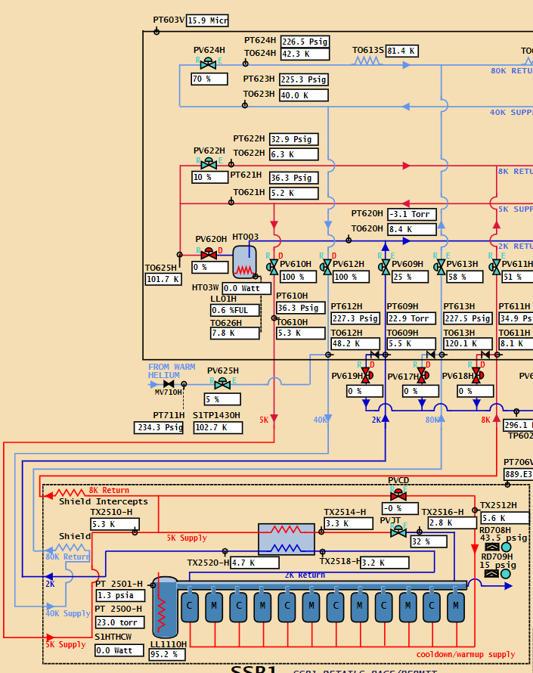
Current cooldown flow path

Slide 13
Max flow rate with existing system
Pressure at cavities < 2 bara
With existing cooldown valve, but adding 2” thick foam insulation to all the ¾” lines and 2” lines
With current cooldown valve (max Cv = 7.31)
Pressure near 6” recovery header is 6 psig (slightly below relief parallel plate set pressure)
Helium exiting cavities at 55 K (after picking up heat from the cavities)
Max flow rate is estimated to be ~40 g/s
Could replace the current bullet (max Cv = 7.31) with the max bullet available (max Cv = 12.76 based on WEKA catalog).
Max flow rate with larger bullet is estimated to be ~50 g/s based on the same assumptions from previous slide.

Slide 14
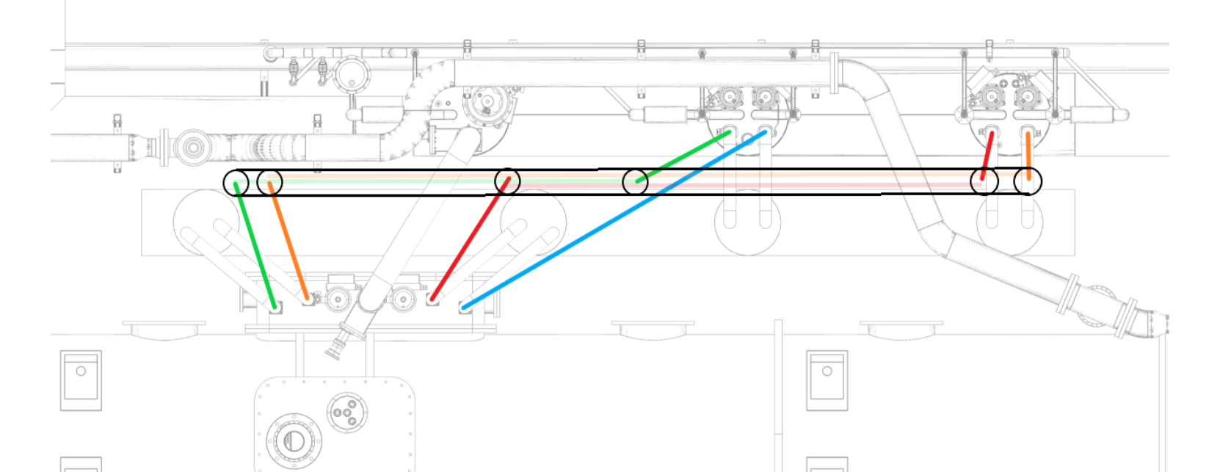
650 CTL Flow Schematic
HB650 Cryogenic Transferline (CTL) designed to repattern existing HWR bayonet locations to new HB650 bayonet locations
Design includes provision for HTTS warm mixing for controlled cooldown
Fabrication in progress (50% completed)
Existing PIP2IT transfer line
New CTL Transferline
HB650MHz Cryomodule
Red: HTTS Supply. MV-614-H
Orange: LTTS Return- MV-616-H
Blue: 5K Supply- MV610-H
Green: LTTS Return- MV-612-H
Purple: HTTS Warm Helium injection

Slide 15
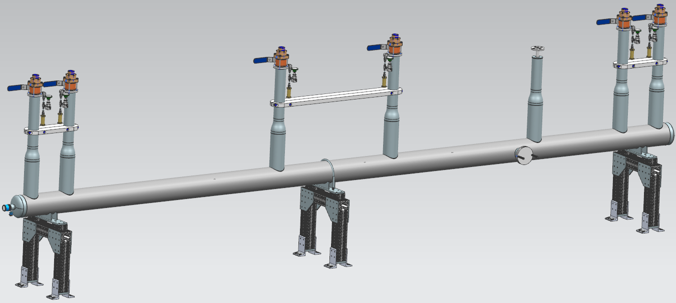
650 CTL model: Interface between 650 and PIP2-IT TL
HTTS Warm Helium Injection
HTTS Return to PIP2IT TL
LTTS Return
To PIP2IT TL
HTTS Return
From 650
HTTS Supply
To 650
HTTS Supply
From PIP2IT TL
LTTS Return
From 650

Slide 16
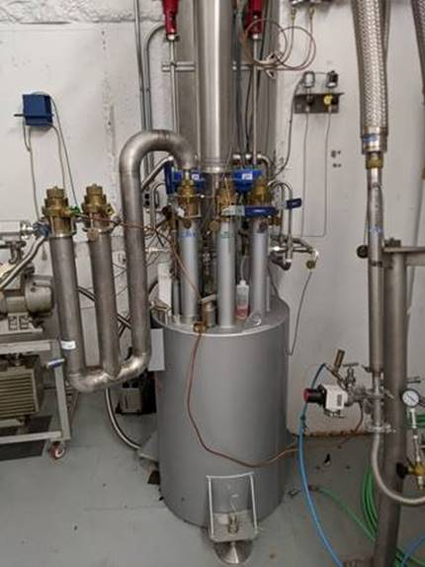
5K Supply W- tube for thermal bump
Bayonets to be installed on locations indicated by circles
Warm helium injection
W-tube currently installed at Meson Detector Building

Slide 17
Relief Header Modifications Preliminary Design
2 bara Warm MAWP relief
GE Balanced Bellow Relief Valve : 400 g/s capacity.
2 bara Required capacity: 117 g/s
4 Bar Cold MAWP relief
Rupture disc: 4 bara
Fast Cooldown Bypass:
Weka DN80- Fast cooldown discharge to compressor suction.

Slide 18
Existing HWR Relief header
Rupture Disk
Balanced Bellows Relief

Slide 19
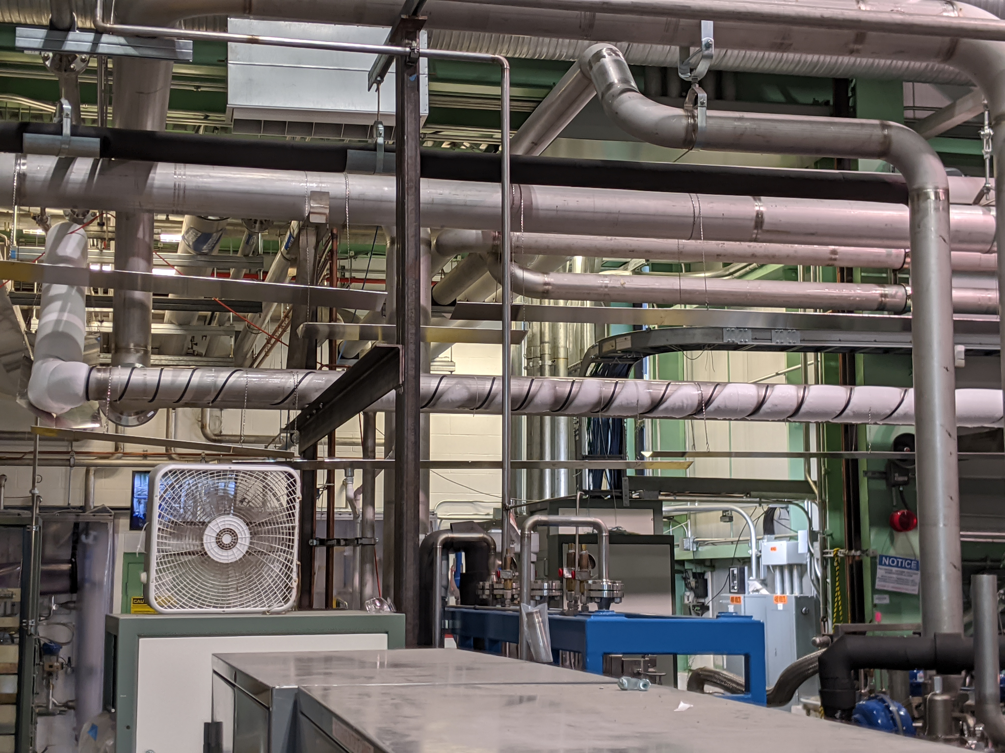
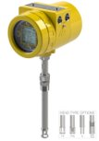
Flow Measurement
Install dual range thermal flow meter to the 6 inch suction header near coldbox​
0-5 g/s​
100 g/s​
To measure heat load on 5 K intercept and 40 K shield, flow can return to the cooldown line instead of returning to transfer line.

Slide 20
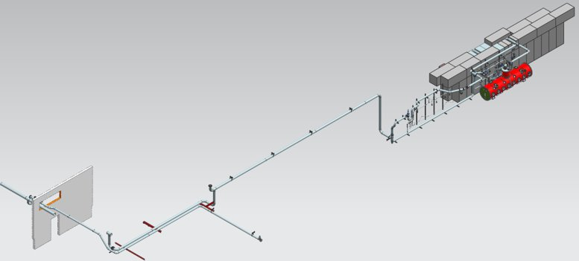
CD Return Flow Transducer Location
Approximate Location of new Flow Transducer

Slide 21
TRS ED0013632 (Draft) - Heat Load Measurement Requirements
 | LTTS flow rate | HTTS flow rate
unit | g/s | g/s
LB650 | 0.57 | 0.81
HB650 | 0.86 | 1.28
Reference
[1] ED0008200-revB
[2] ED0008555-rev1

