Slide 1
Intensity Frontier- Muon Technical Leadership
Karie Badgley
DOE OHEP IF Research Briefing
December 16, 2020

Slide 2

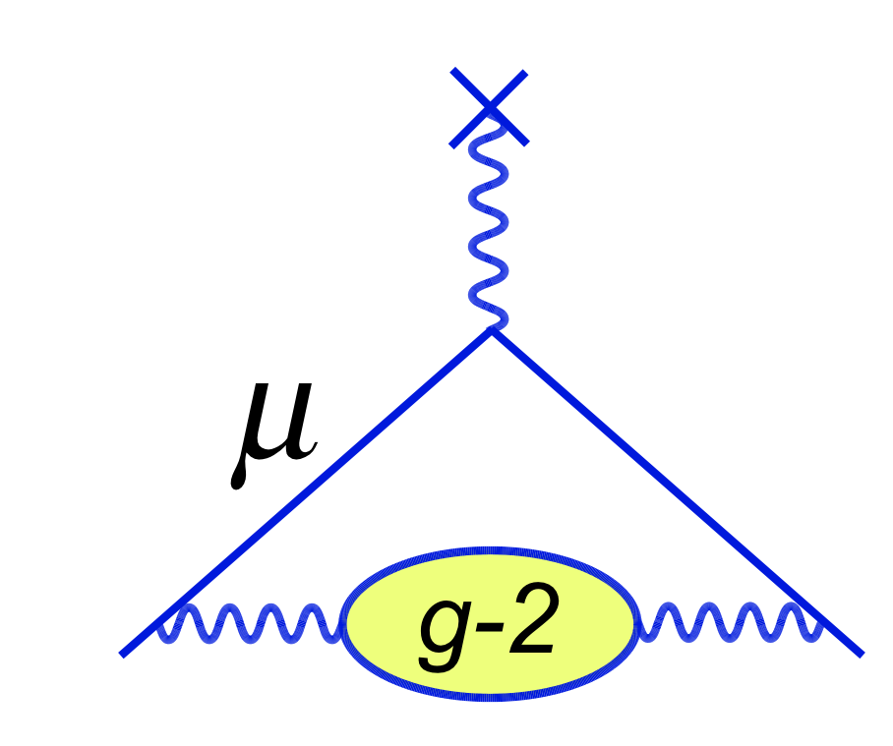
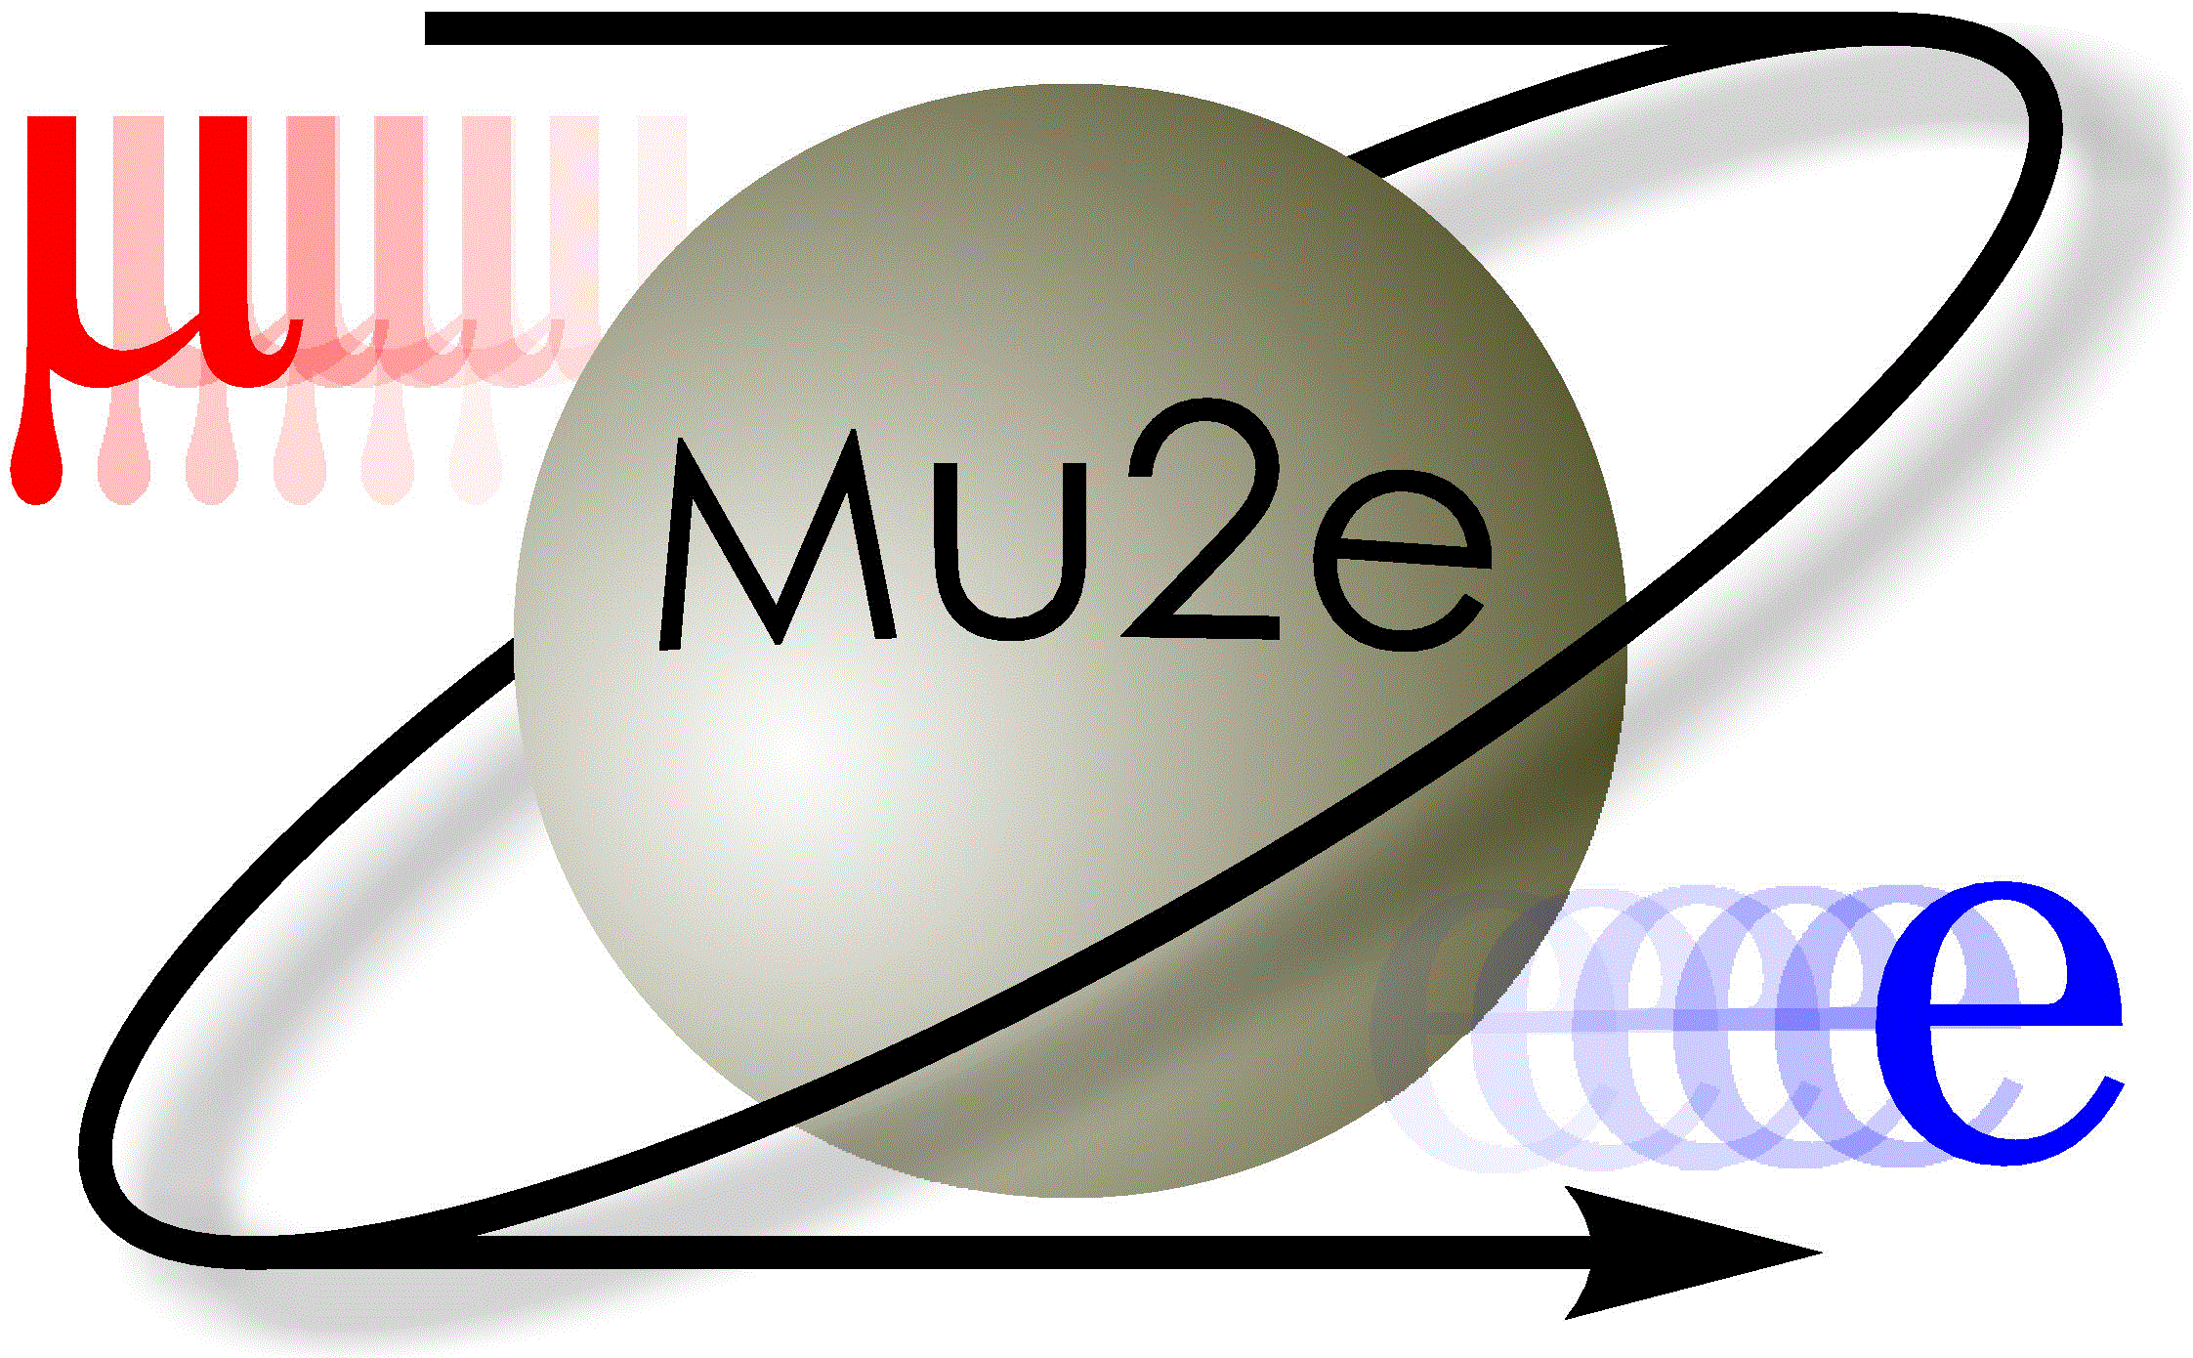
A bit about me…
Background in superconducting magnet
design/fabrication and beam dynamics
Post-doc on g-2 in PPD
  Target program selection committee (‘17-’18)
Associate Scientist in APS-TD
  g-2
  Mu2e, TS Solenoid Test Lead
  ORNL PPU Magnetic Measurement Lead
  Intensity Frontier Strategic Planning Lead(‘18-’20), Snowmass Co-convenor accelerator working group Mu2e-II
  Scientific Advisory Committee(‘18-’20), LDRD Selection Committee

Slide 3
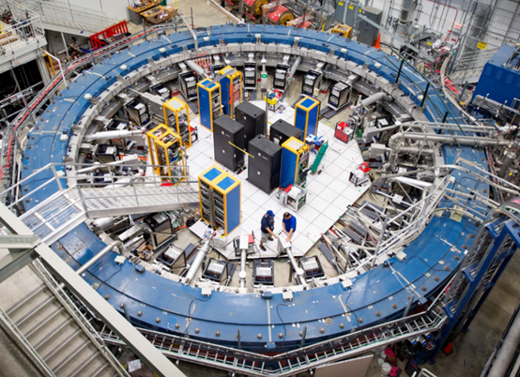

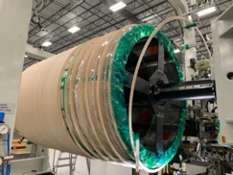
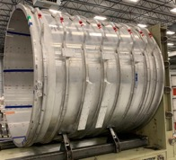
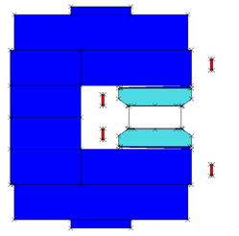
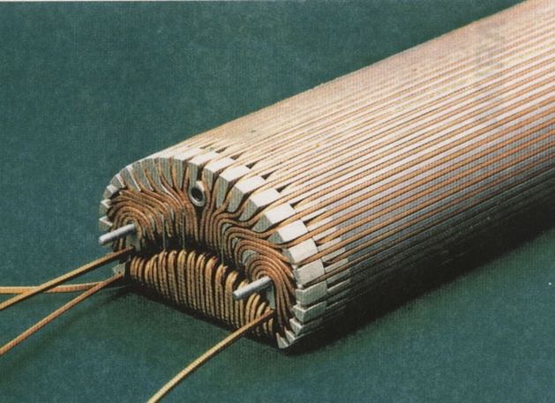
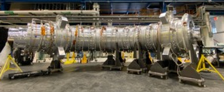
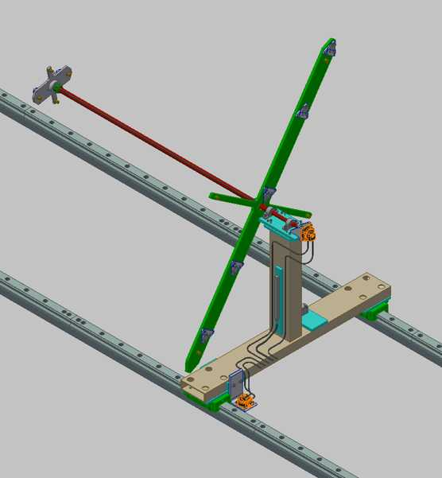
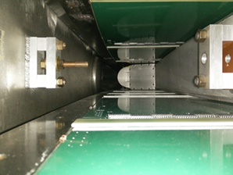
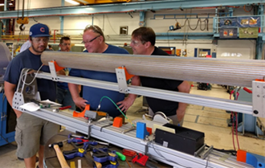
Muon g-2 and Mu2e Major Components- Superconducting Magnets
Production Solenoid
Detector Solenoid
Inflector
Storage Ring
Transport Solenoid
Field Mapping
Surface coils
New inflector
K. Badgley | DOE OHEP IF Research Briefing

Slide 4
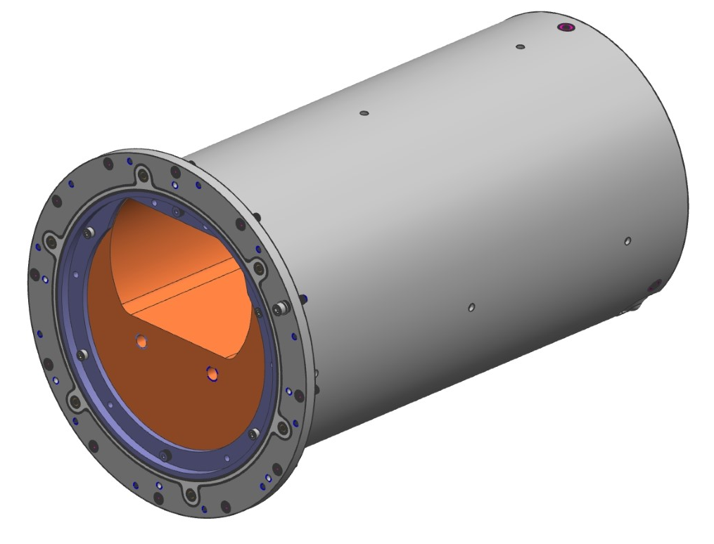
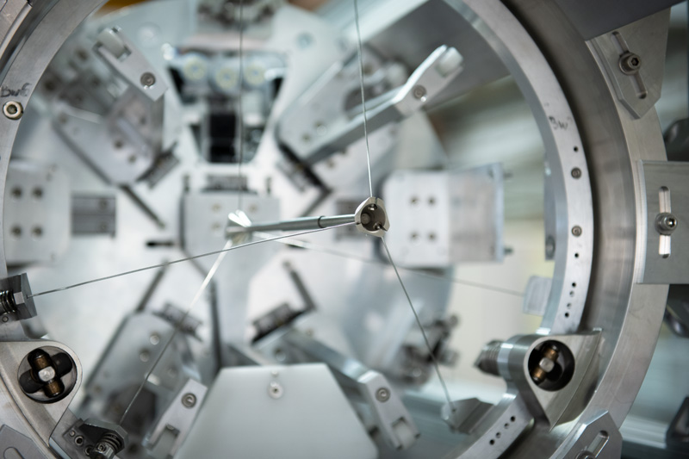
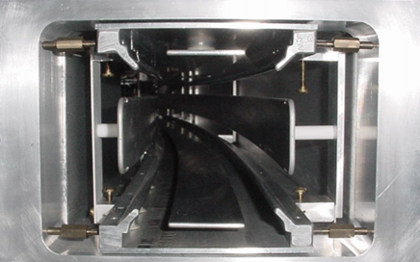
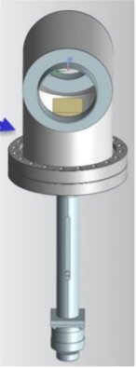
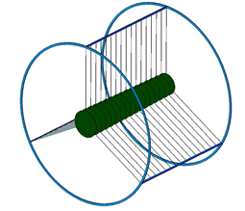
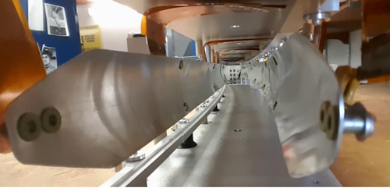
Muon g-2 and Mu2e Major Components-
Beam Production and Manipulation
Production Target
Collimators
Quads
Kickers
Wedge
Stopping Target

Slide 5
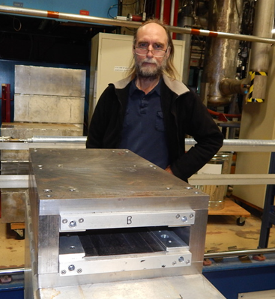
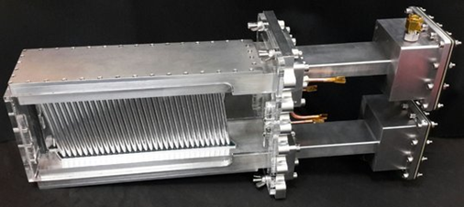
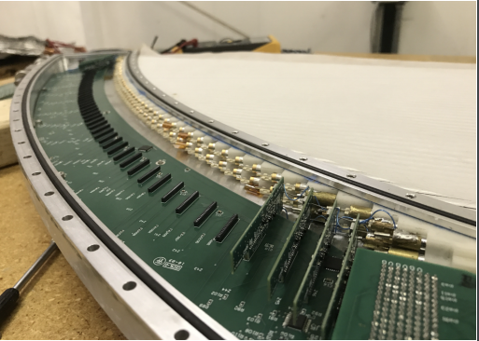
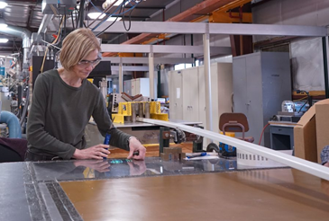
Muon g-2 and Mu2e Major Components-
Detection and Monitoring
Extinction monitor
Tracker
Straw trackers
Tracker electronics
Cosmic ray veto scintillator

Slide 6
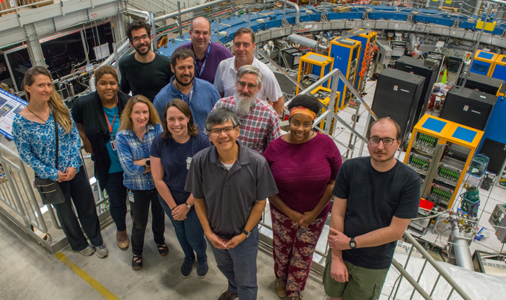
Fermilab Muon Scientists
Muon Scientist | Roles
G. Ambrosio | L3 Transport Solenoid, TS Magnet production oversight
K. Badgley | TS Testing Lead, Magnetic modeling, TS testing and production, g-2 electrostatic quadrupole control and inflector
R. Bernstein | 2010-14 Co-Spokesperson, Pion and antiproton simulation, analysis optimization software
R. Coleman | L3 Production Target Station
S. Feher | L3 Detector Solenoid, L3 Magnetic Field Mapping, PS/DS vendor oversight
A. Gaponenko | Background and Sensitivity Working Group, Simulation job submission and data handling, Extinction Monitor design and testing
H. Glass | L3 DS Internal Shielding, Magnetic Modeling , Stopping target and shielding design, Configuration Manager
D. Glenzinski | 2014-Present Co-Spokesperson, Deputy Project Manager 2011-2014
A. Hocker | L2 Solenoids Deputy, TS test facility and testing, superconductor procurement
P. Kasper | L3 Extinction Monitor, Extinction Monitor design
M. Lamm | L2 Manager for Solenoids, Superconductor procurement
Mukherjee | L2 Manager for Tracker, Tracker prototype construction and testing
A. Pla-Dalmau | L3 CRV Scintillator Extrusions, Scintillator design and production
R. Ray | Project Manager
V. Rusu | L3 Tracker readout electronics
P. Schlaback | TS magnet assembly
T. Strauss | Coil position monitoring system, magnetic field mapping

Slide 7
Fermilab Muon Scientists
Muon Scientist | Role
J. Whitmore | Deputy Project Manager
Y. Sun | Installation, testing, and commissioning of tracker electronics
M. Yucel | Constructing, installation, and commissioning of full tracker
Chris Polly | Project Manager, Analysis Coordinator, Co-Spokesperson
Brendan Casey | L2 Detector Manager, FY16 Run Coordinator, Production and Simulation Co-Coordinator, Tracker
Hogan Nguyen | L2 Ring Manager, Ring Operations Manager, quadrupole, kicker, inflector
Brendan Kiburg | Field shimming Team Leader, Installation Coordinator, FY17 Co-Run Coordinator, Field Operations Manager
James Stapleton | Release Manager, Kicker magnet control, muon precession frequency analysis
Chris Stoughton | Kicker magnet
Diktys Stratakis | Analysis Co-coordinator of Beam Dynamics group, ionization cooling, wedge
Saskia Charity | Kicker data acquisition and field analysis, Kicker GUI development, ‘20-’21 Run-coordinator
Jessica Esquivel | Kicker GUI development, ‘20-’21 Run-coordinator
Manolis Kargiantoulakis | Mu2e Construction and test of tracker electronics, radiation studies → g-2 Quadrupole operations and beam dynamics analysis
Robyn Madrak | Kicker feedthrough upgrade design, testing, installation, Kicker operation Lead

Slide 8
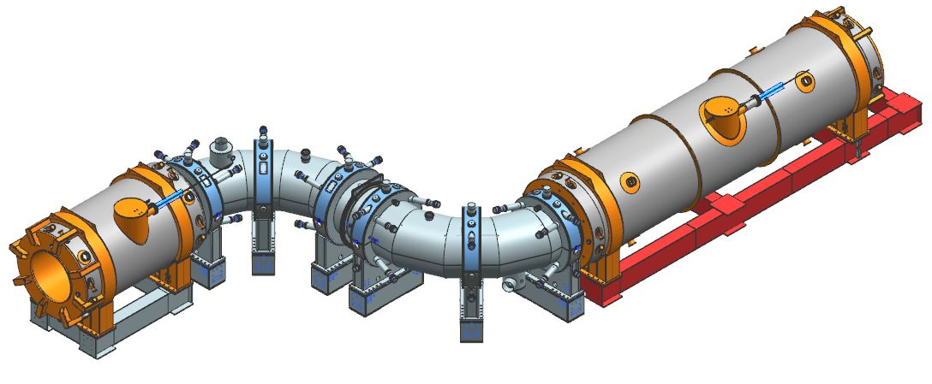
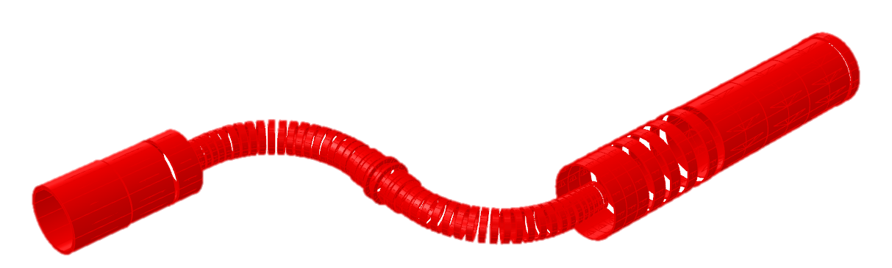
Mu2e Solenoids
Transport Solenoid upstream
Production Solenoid
Detector Solenoid
1.0 T
Transport Solenoid downstream
2.5 T
2.0 T
4.6 T

Slide 9


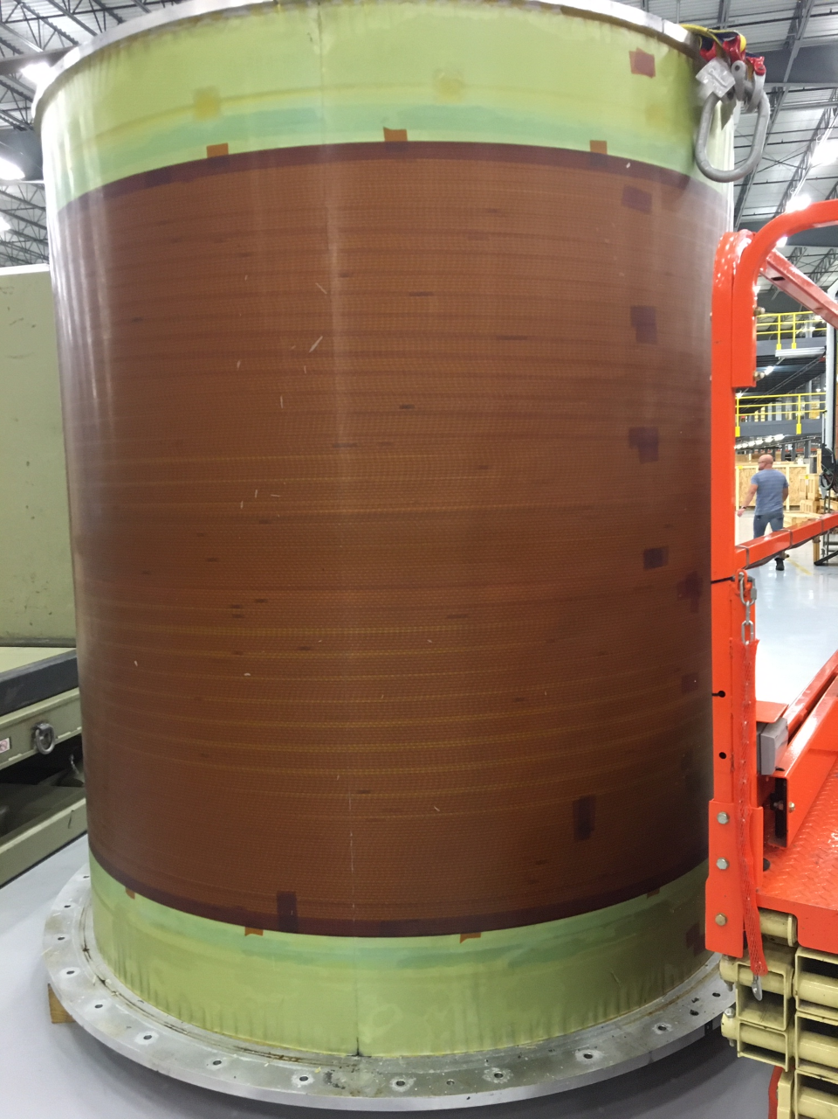
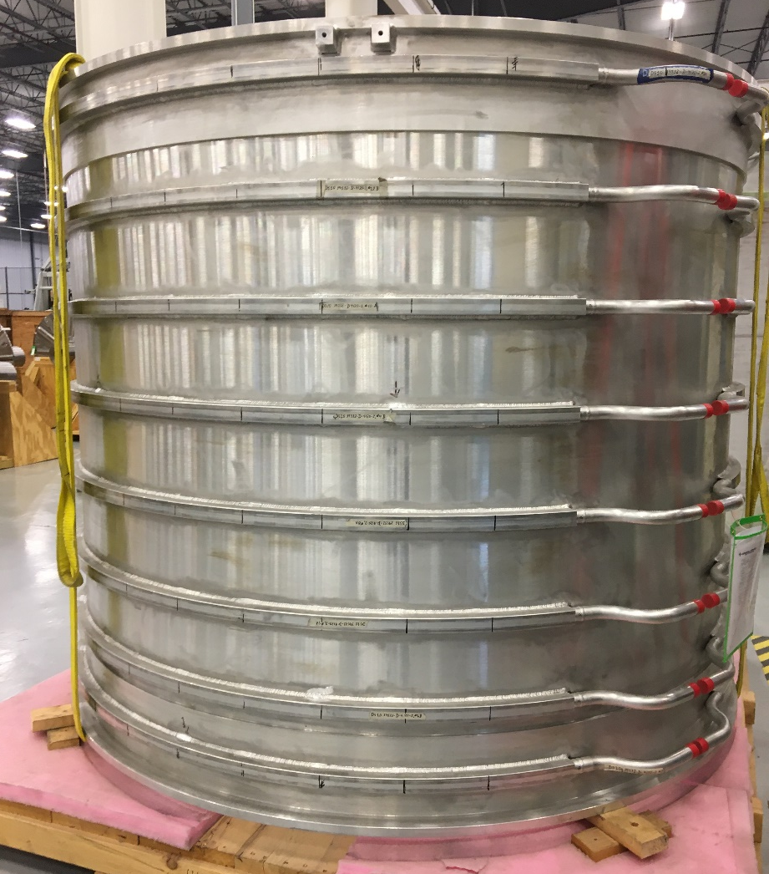
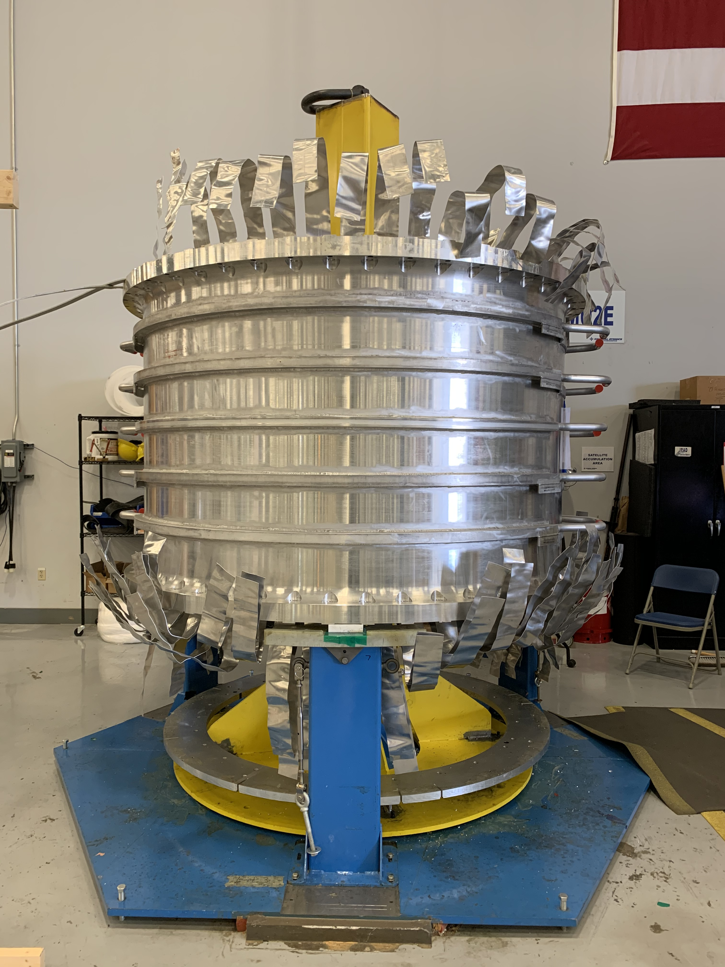
Production and Detector Solenoids
PS/DS fabricated by GA in Tupelo, MS
Will be delivered fully cryostated and ready to install
Hold regular meetings and provide continuous* oversight at the Tupelo facility
PS1 on the winding machine
DS10 Wound and epoxied
DS10 Shell
PS2 inserted in shell

Slide 10

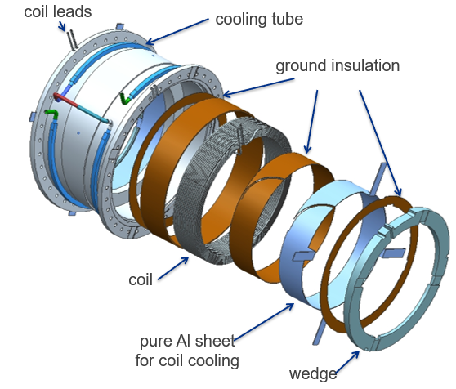
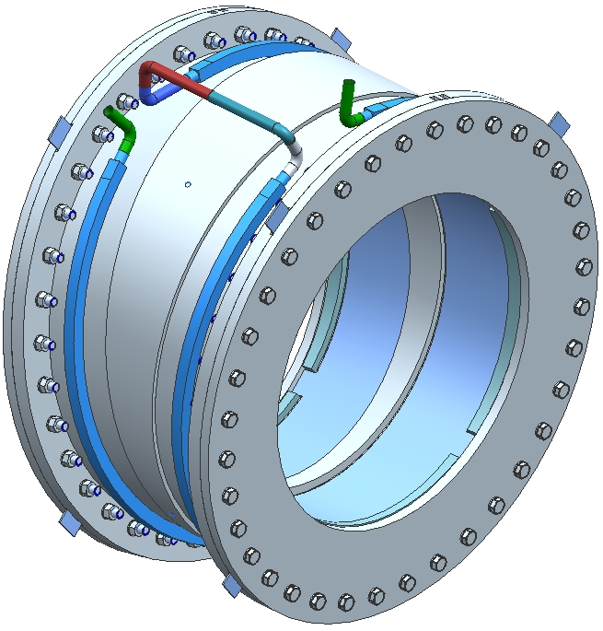
Transport Solenoid
TS fabricated in Italy at ASG
Delivered in units which need to be tested and assembled
Thermal shield and cryostat will be installed at FNAL
K. Badgley | DOE OHEP IF Research Briefing

Slide 11
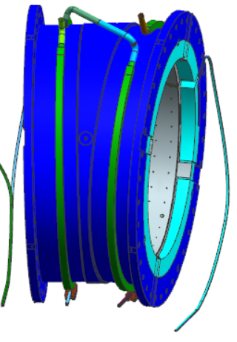
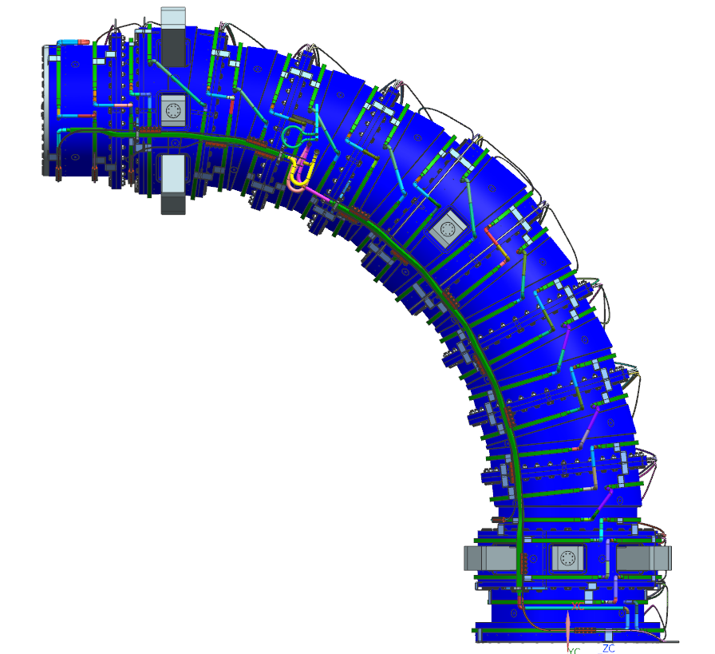
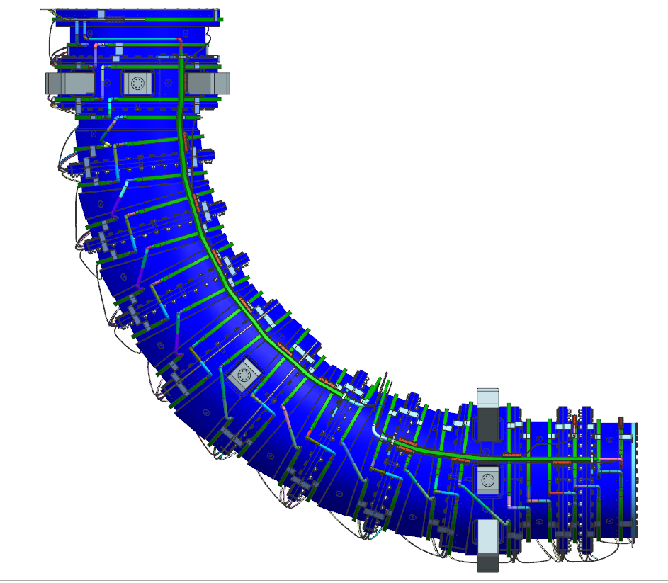
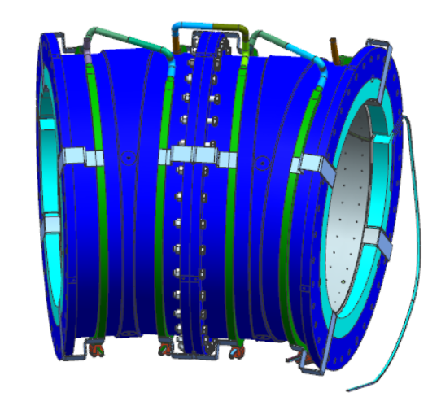
Transport Solenoid
52 Superconducting Coils
  TSu – 25 coils
  TSd – 27 coils
27 Modules
  TSu – 13 modules
  TSd – 14 modules
14 Test Units
  TSu – 7 test units
  TSd – 7 test units
~2 coils per module
14 units for the TS
TSU
1-3 modules per unit
TSD
K. Badgley | DOE OHEP IF Research Briefing

Slide 12
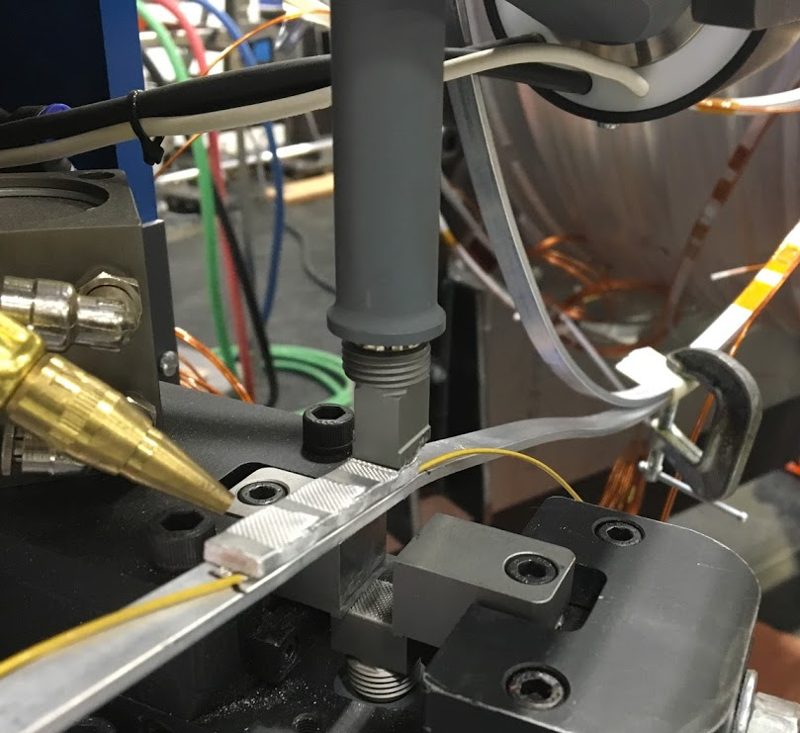
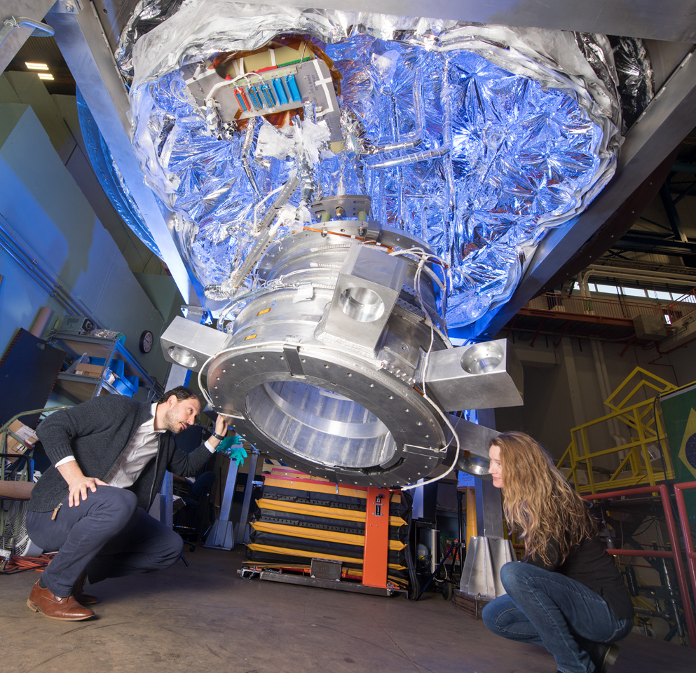
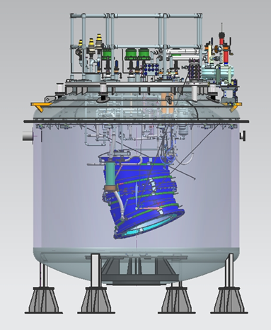
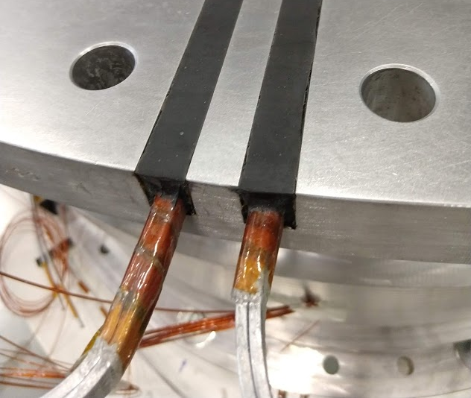
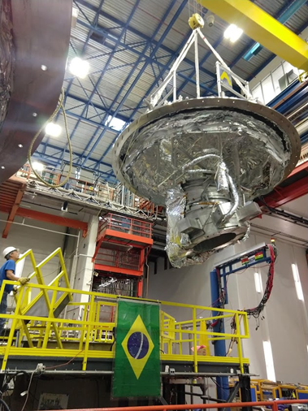
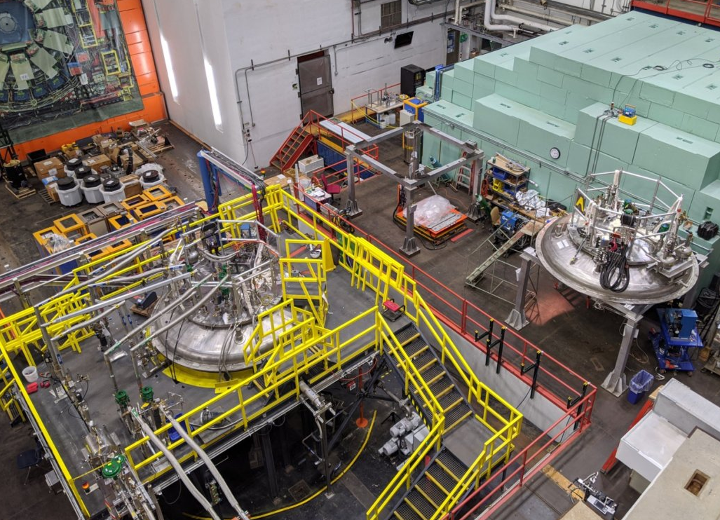
Cold Test
Ultrasonic weld of splices and voltage taps
Cryogenic, electrical, and RTD connections
Dished head and unit moved to the cryostat
Max temperature differential between the shell and coil of 23 K to avoid stress on coil from differential thermal contraction (~week)
Coils powered to 2100 A, 120% of 1730 A operating current
Requirement on splice to be less than 2 nΩ
Dished heads and test cryostat at HAB
K. Badgley | DOE OHEP IF Research Briefing

Slide 13
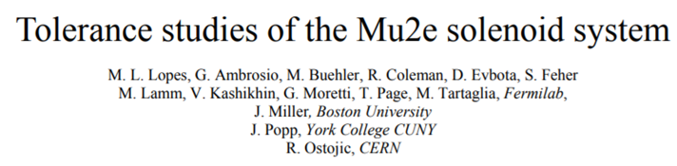
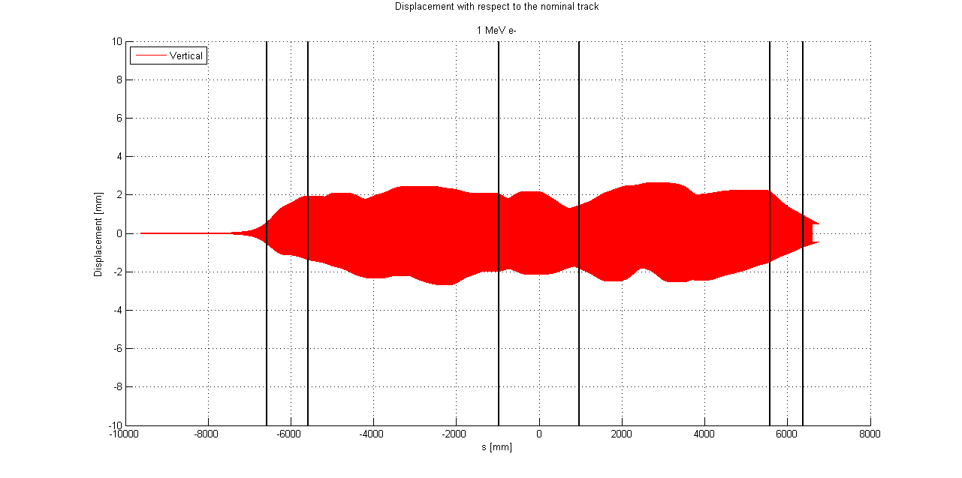
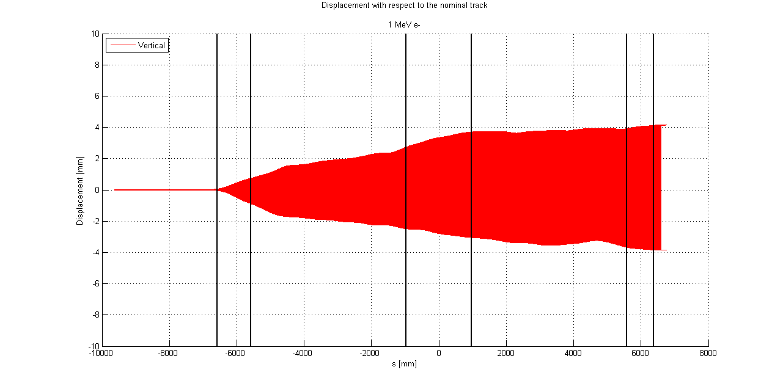
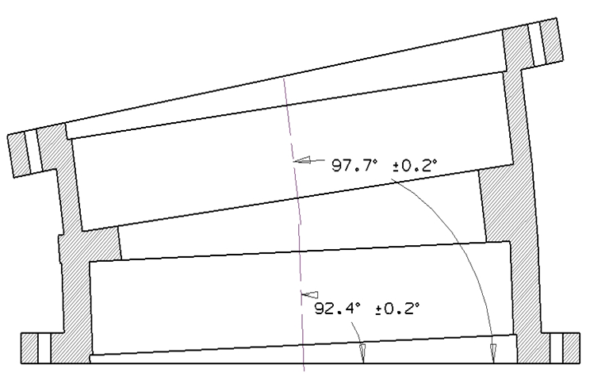
Requirements and Tolerance
Mu2e requires efficient muon transmission and no trapped particles
Particle tracking studies helped set the tolerances for fabrication and assembly
Transmission was found to be sensitive to the angle between coils
ΔV = 10 mm
ΔP = 5 mrad

Slide 14
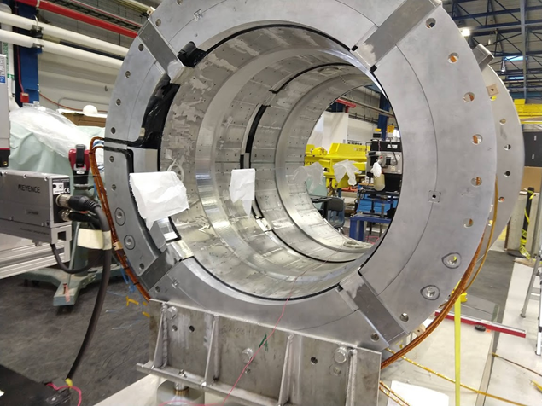
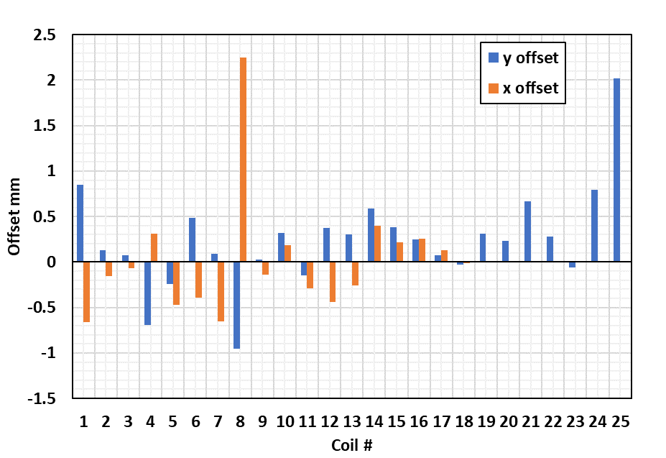
Magnetic Axis
Vibrating stretched wire measurement made for each coil
Position measured with respect to fiducials on the shell and wire system, translated to the Mu2e coordinate system
Coil angle to angle < 0.2 degrees, axis location within 1 mm of nominal
Coil interface | Angle [deg] | Requirement | Difference
coil 1/2 | 0.17393 | 0 | 0.17393
coil 2/3 | 0.06739 | 0 | 0.06739
Coil 3/4 | 0.00176 | 0 | 0.00176
coil 4/5 | 5.73794 | 5.7 | 0.03794
coil 5/6 | 4.79044 | 4.8 | -0.00956
coil 6/7 | 5.28002 | 5.3 | -0.01998
Coil 7/8 | 5.6238 | 5.5 | 0.1238
coil 8/9 | 5.35184 | 5.5 | -0.14816
coil 9/10 | 5.5817 | 5.5 | 0.0817
coil 10/11 | 5.5577 | 5.5 | 0.0577
Coil 11/12 | 5.36518 | 5.5 | -0.13482
coil 12/13 | 5.46542 | 5.4 | 0.06542
coil 13/15 | 5.46223 | 5.4 | 0.06223
coil 15/14 | 5.50251 | 5.5 | 0.00251
coil 14/16 | 5.51549 | 5.5 | 0.01549
coil 16/17 | 5.5175 | 5.5 | 0.0175
coil 17/18 | 5.4378 | 5.5 | -0.0622
coil 18/19 | 5.34079 | 5.3 | 0.04079
coil 19/20 | 4.799 | 4.8 | -0.001
coil 20/21 | 3.696 | 3.7 | -0.004
coil 21/22 | 0.04809 | 0 | 0.04809
coil 22/23 | 0.000877 | 0 | 0.000877
coil 23/24 | 0.02175 | 0 | 0.02175
coil 24/25 | 0.01493 | 0 | 0.01493
K. Badgley | DOE OHEP IF Research Briefing

Slide 15
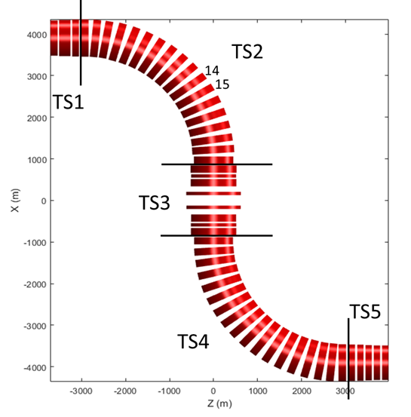
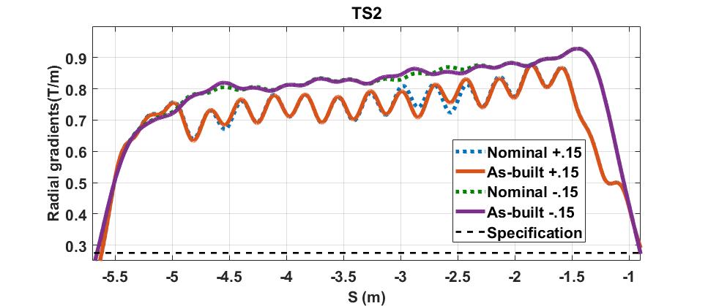
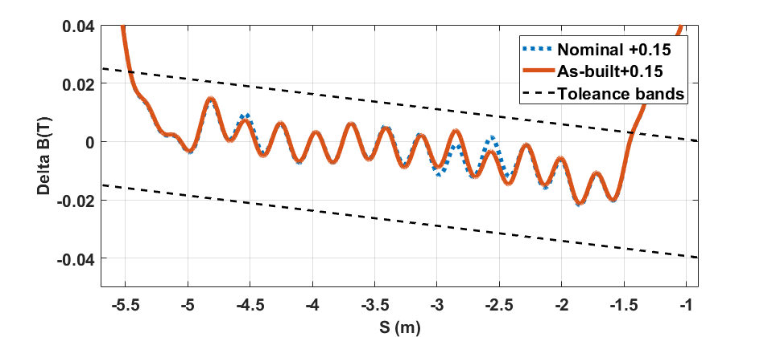
As-Built Magnetic Field
Transport Solenoid Magnetic Requirements
Stretched wire results used to update magnetic model and ensure magnetic requirements are met
Radial Gradient dBs/dr > 0.275 T/m
Ripple ± 0.02 T out to 0.15 m
K. Badgley | DOE OHEP IF Research Briefing

Slide 16
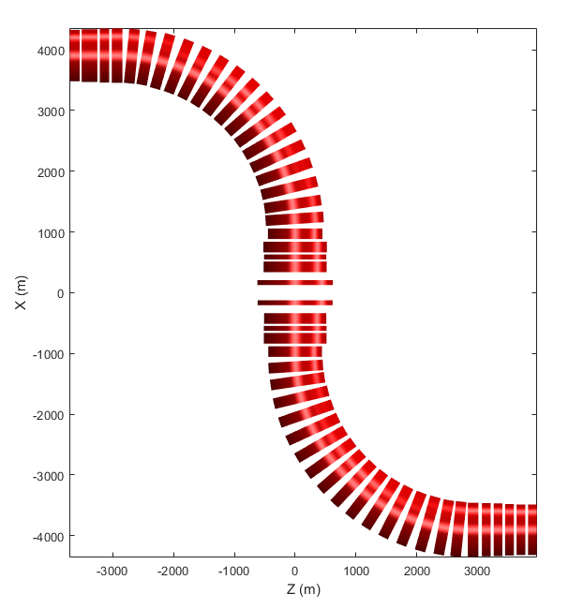
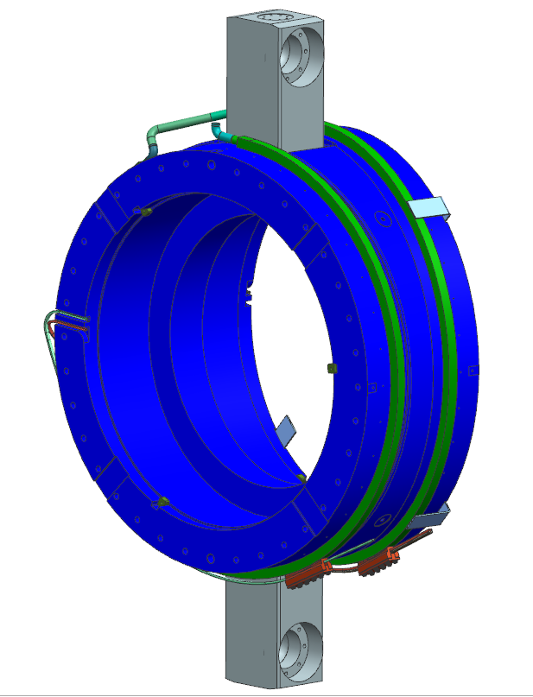


Swapped Coils 14 & 15
14 & 15
Vendor swapped the machining of the coil cylinders in one unit. Options:
  Reject the shell, take a schedule hit
  Add material to one coil, machine a larger cylinder for the other
  Allow the coils to be inserted in the swapped locations
The coil lengths and ID are the same, coil 15 has one additional layer of conductor
K. Badgley | DOE OHEP IF Research Briefing

Slide 17


TSU Coldmass Complete!
Still need to add thermal shield and cryostat
K. Badgley | DOE OHEP IF Research Briefing

Slide 18

All TS Units On-site!
K. Badgley | DOE OHEP IF Research Briefing

Slide 19
Concluding Remarks
Muon g-2 is taking data, still requires technical scientific oversight
Mu2e is in the construction phase, technical leadership is crucial
Fermilab scientists
  Hold technical leadership positions throughout muon g-2 and Mu2e
  Make significant contributions to several major systems, aligned with our expertise
  Integral part of Mu2e solenoid design, testing, and production
  Will be primary contributors in the installation and commissioning of Mu2e
K. Badgley | DOE OHEP IF Research Briefing

