Slide 1


6m Furnace
Working Group Meeting
Fred Nobrega – Fermilab
6m Furnace Working Group Meeting – December 21, 2020

Slide 2
Overview
Furnace
BNL reaction plots
FNLA reaction plots (QXFA128)
Issues (reaction process capabilities out of tolerance)
  Thermocouples (calibration, type J vs K, spread)
  Heating zone activation
  210C dwell times unpredictable

Slide 3
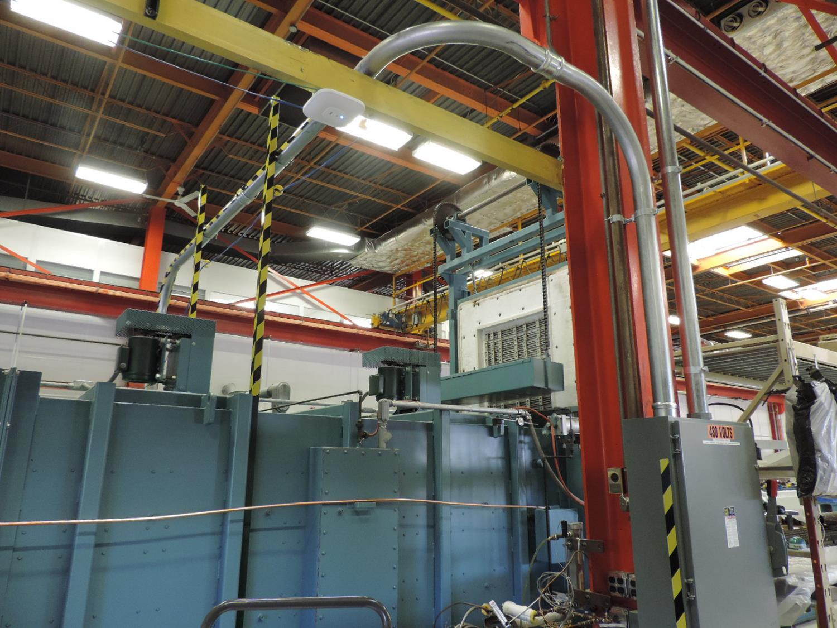

Slide 4
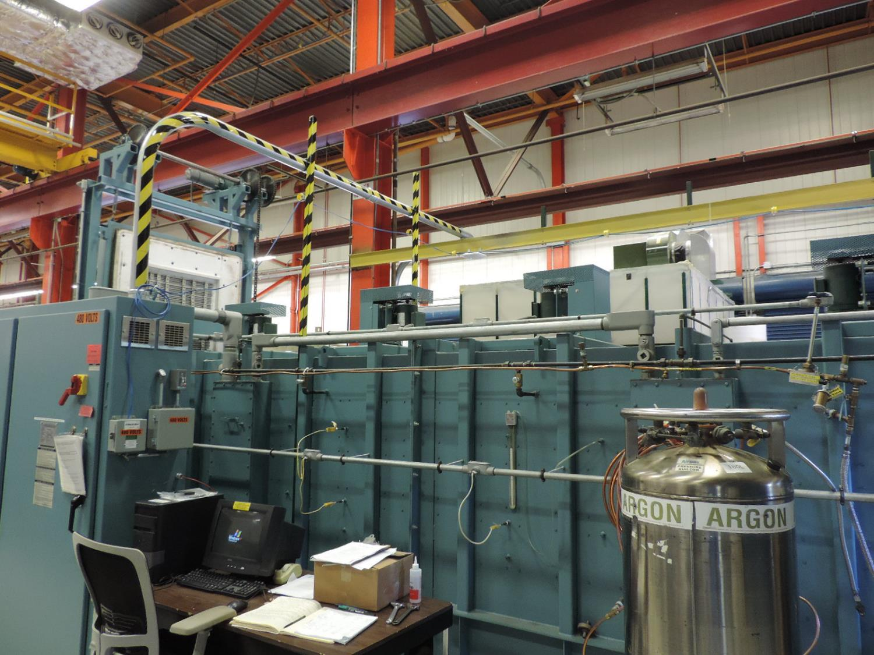

Slide 5
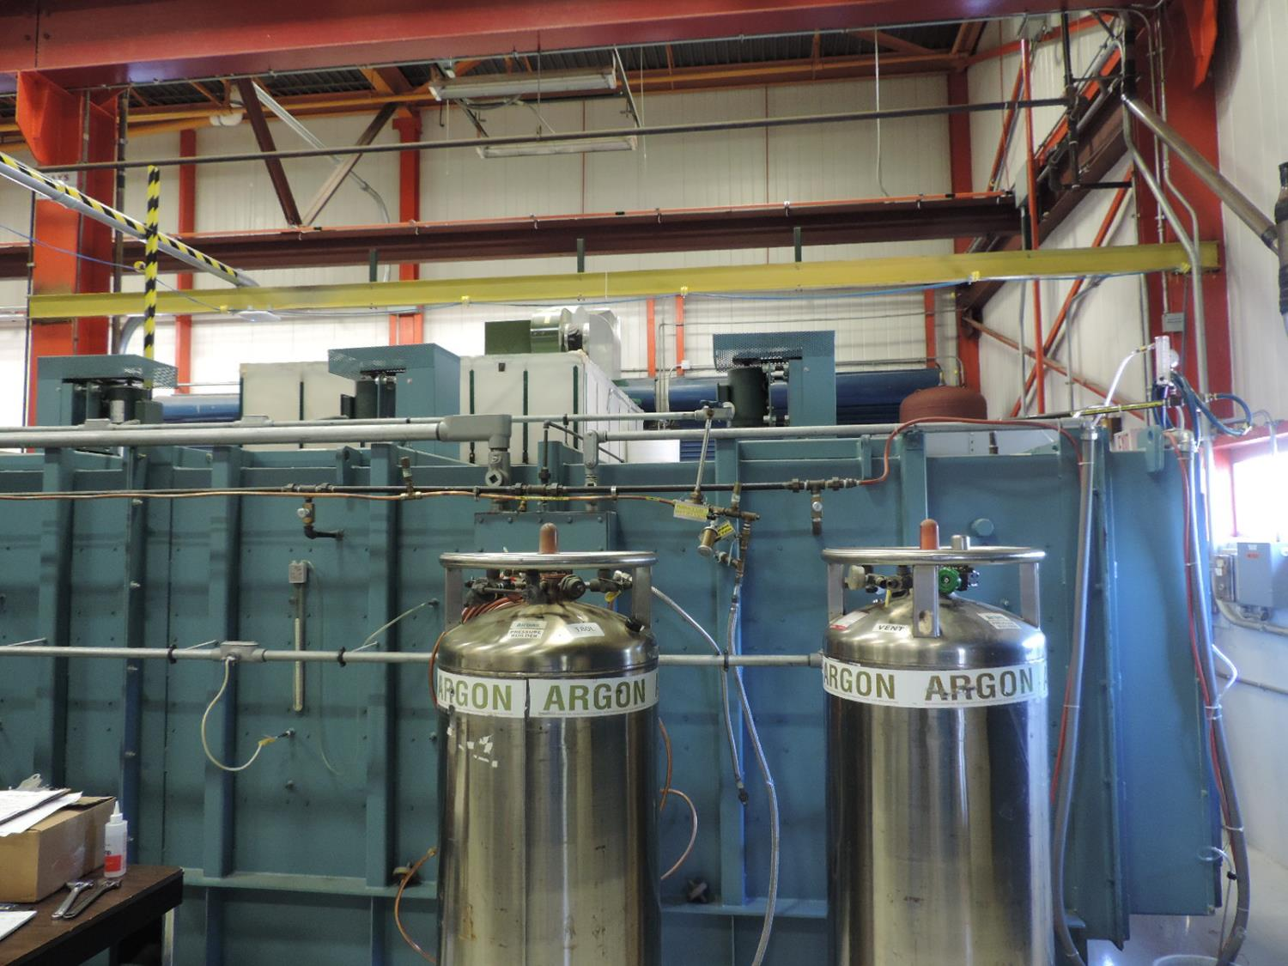

Slide 6
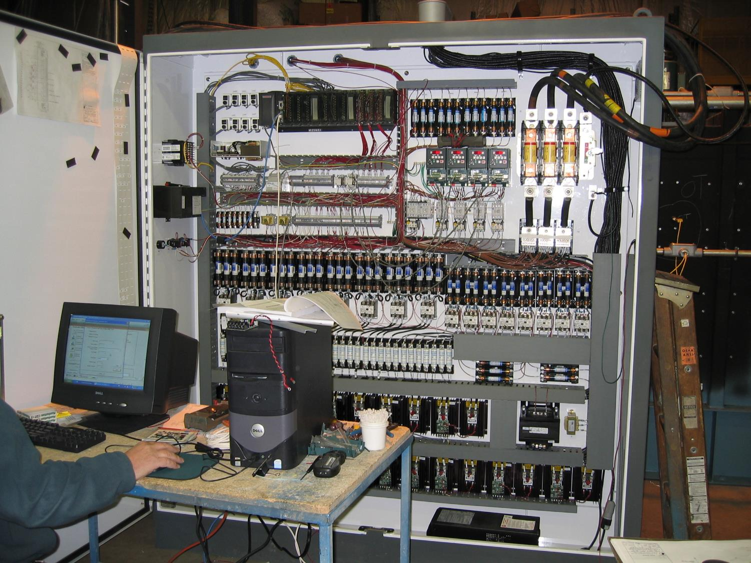

Slide 7
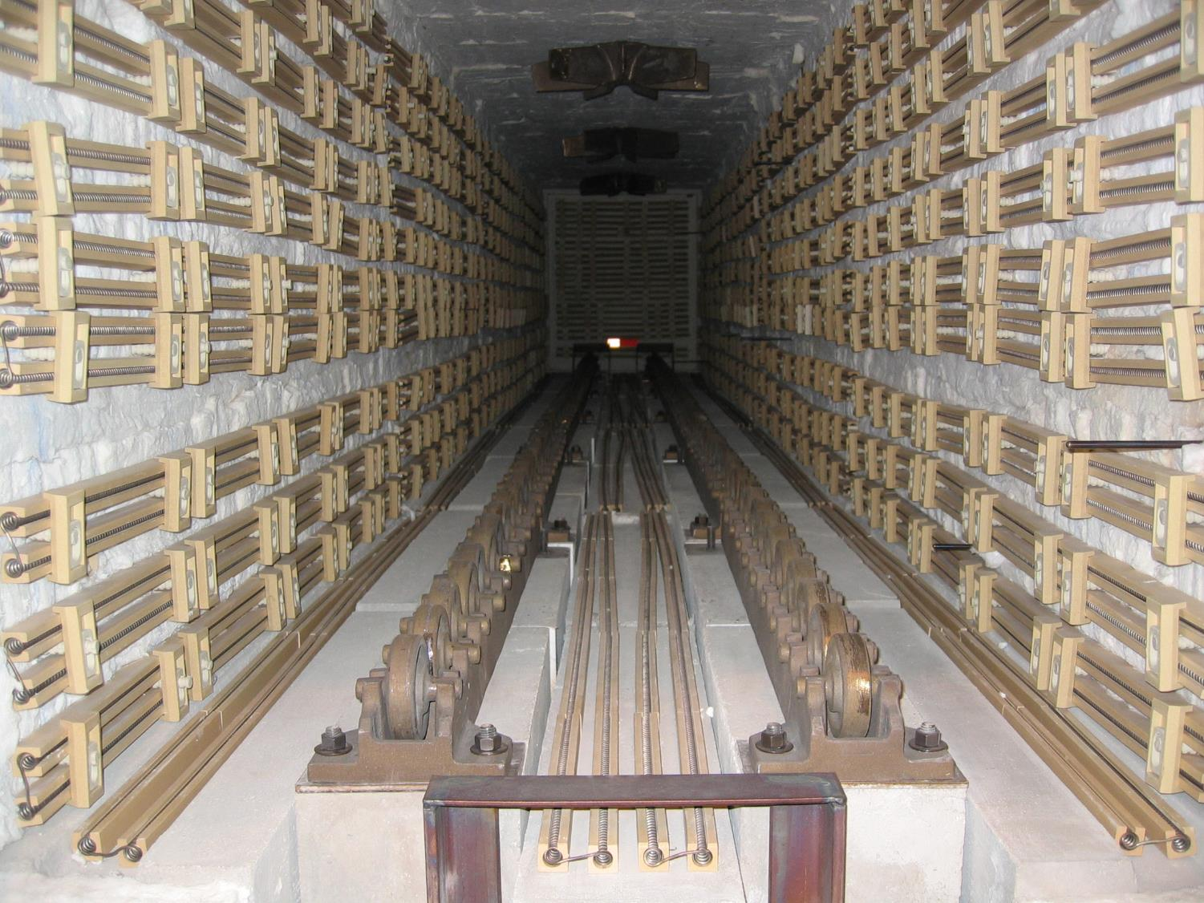

Slide 8
Scale= 1”: 30”
= K Thermocouple (Controlling)
= Distance
= Over-temperature Thermocouple
Purple numbers= Thermocouple label
TC= Abbreviation for thermocouple
Michael McGinnis, Jr.
TARGET intern
Supervisor: Luciano Elementi
Miscellaneous details:
Furnace model: FN2220, manufactured by L&L SPECIAL FURNACE CO, INC.
This diagram is based upon the fact that one is looking at it from a point where the door is on the left side of this diagram.
There are no thermocouples on the opposite side of the furnace.
TC 1, 2, 7, and the over-temp. TC go about 4” into the furnace.
TC 8 and 6 go about 5” into the furnace.
TC 4, 3, and 5 go about 6” into the furnace.
ZONES (continues on next page):
Green zones include zone 2(left) and zone 1(right) and use 18,913.3 Watts.
Red zones include zone 4(left) and zone 3(right) and use 28,640 Watts.
Blue zones include zone 6(left) and zone 5(right) and use 9,546.7 Watts.
Tan zones include zone 7 and zone 8 and use 5,220 Watts.
275.625”
20.625”
20.625”
20.625”
18.125”
22.5”
21.875”
76.875”
40”
1
7
2
28.125”
19.375”
26.875”
19.375”
76.25”
47.5”
76.875”
8
4
3
30”
6
5
36.25”
36.25”
36.25”
30”
28.75”

Slide 9
Zone and Thermocouple explanation
Each thermocouple controls the zone that they are labeled. For example, TC 1 controls zone 1, TC 2 controls zone 2, etc.
The one over-temperature thermocouple is not assigned a number nor a zone because it monitors the entire furnace for overheating.
TC 7 controls zone 7, which is located at the top back and top door of the furnace
TC 8 controls zone 8, which is located at the bottom back and bottom door of the furnace.
Since the top back and top door sections of the furnace are very similar, such that they do very little to heat up the furnace, zone 7 covers two areas of the furnace while only being controlled by TC 7. The same applies for the bottom back and bottom door, being controlled by TC 8.
= K Thermocouple (Controlling)
= Over-temperature Thermocouple
Purple numbers= Thermocouple label
Green text= Zone label
TC= Abbreviation for thermocouple
Zones 1 & 2 use 18,913.3 Watts
Zones 3 & 4 use 28,640 Watts
Zones 5 & 6 use 9,546.7 Watts
Zones 7 & 8 use 5,220 Watts
Zone 2
Zone 1
1
Zone 7
7
2
Zone 7
Zone 4
Zone 3
Zone 8
8
4
3
Zone 8
6
Zone 6
Zone 5
5

Slide 10
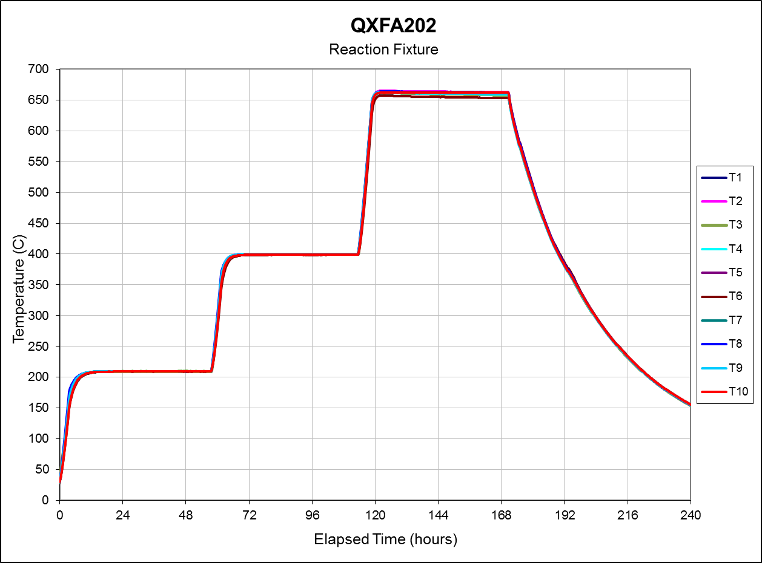
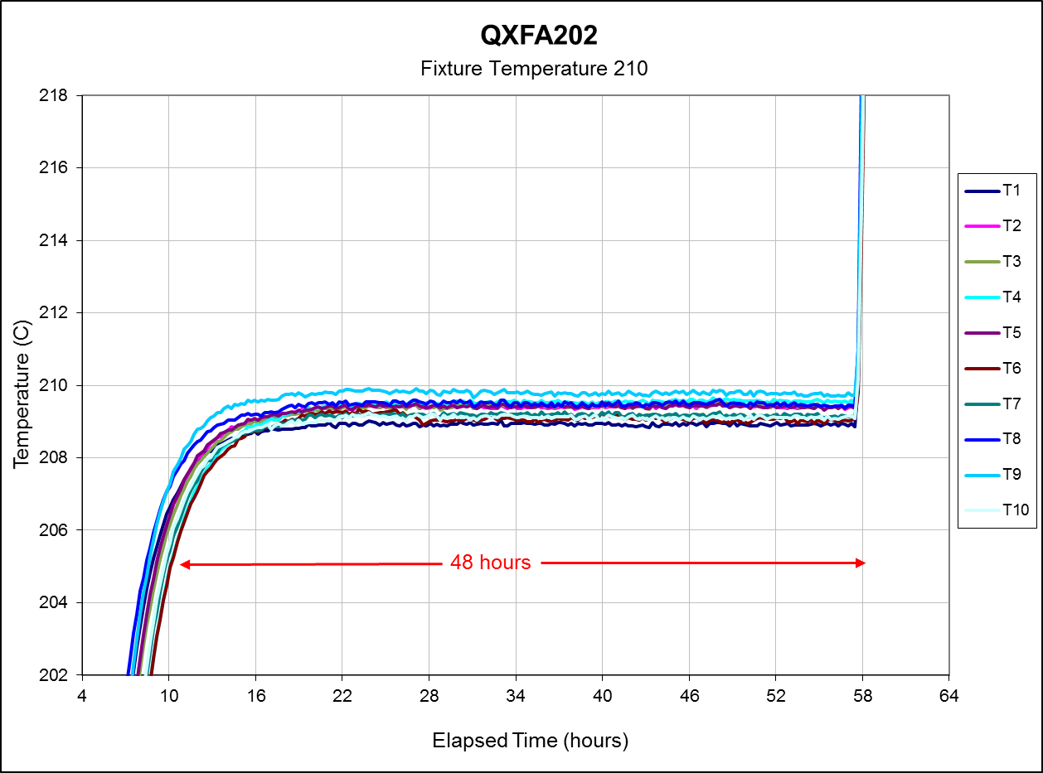
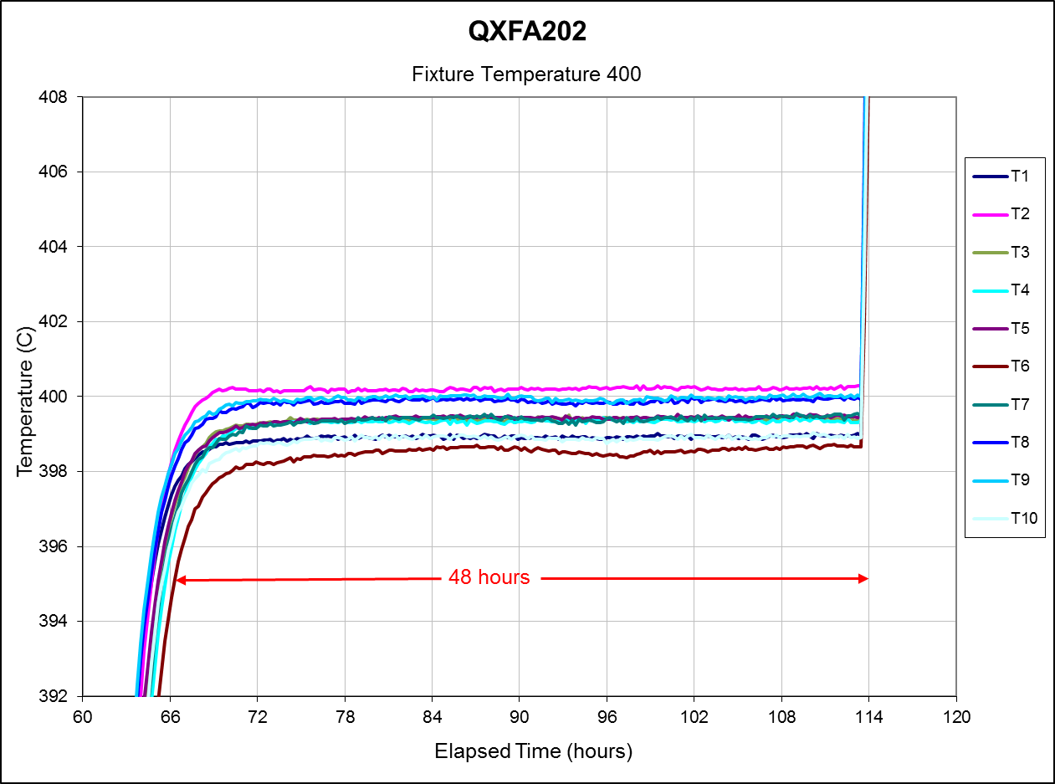
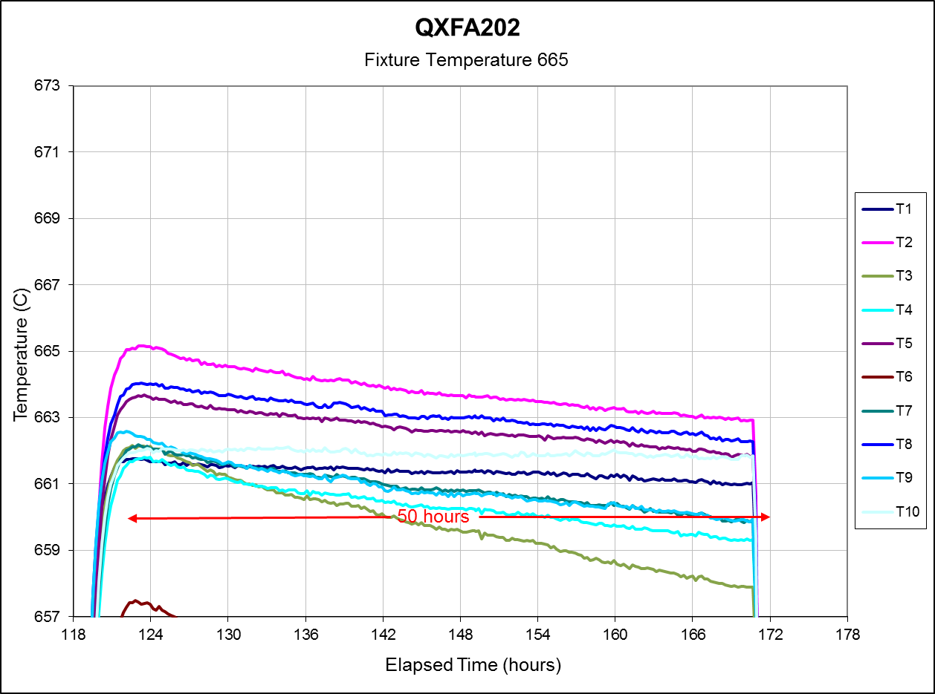
QXFA202
Reaction Cycle:
48 Hours at 210 C
48 hours at 400 C
50 hours at 665 C
Witness samples inside reaction fixture.

Slide 11
QXFA128 Furnace Parameters
Specification
Furnace Input (recipe)

Slide 12
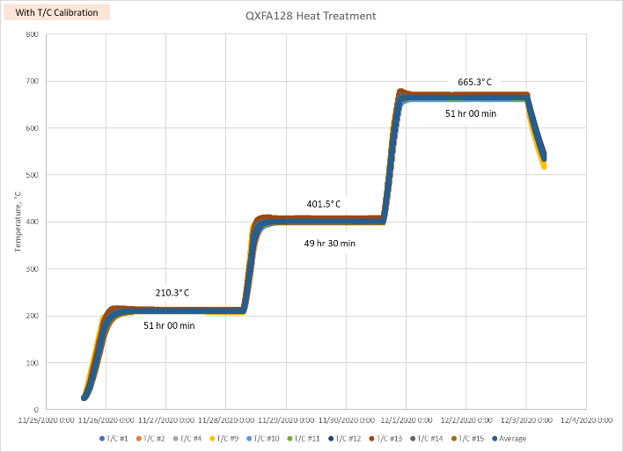
QXFA128
T/C#9
T/C#13
T/C#14
T/C#11
T/C#12
T/C#10
T/C#2
T/C#1
T/C#15
T/C#4

Slide 13
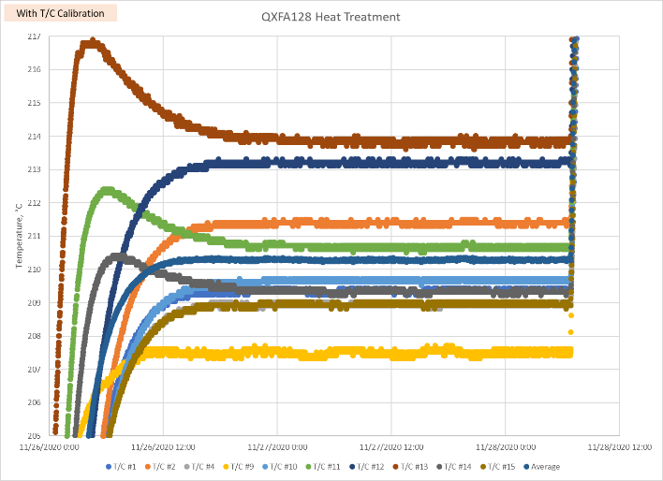
210° C Plateau
T/C#9
T/C#13
T/C#14
T/C#11
T/C#12
T/C#10
T/C#2
T/C#1
T/C#15
T/C#4

Slide 14
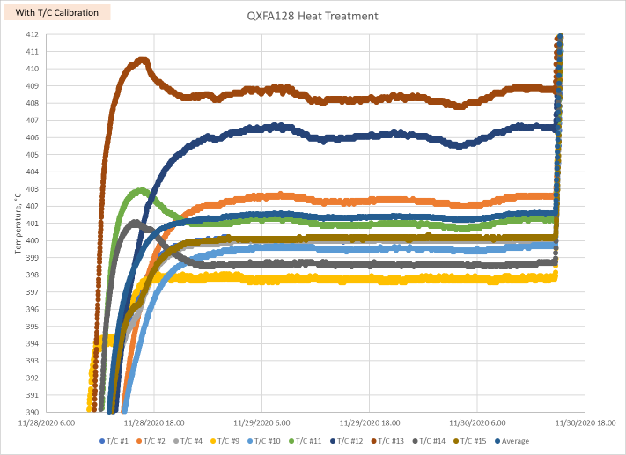
395° C Plateau
T/C#9
T/C#13
T/C#14
T/C#11
T/C#12
T/C#10
T/C#2
T/C#1
T/C#15
T/C#4

Slide 15
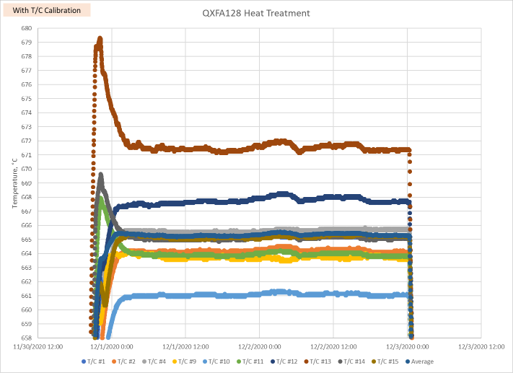
665° C Plateau
T/C#9
T/C#13
T/C#14
T/C#11
T/C#12
T/C#10
T/C#2
T/C#1
T/C#15
T/C#4

Slide 16
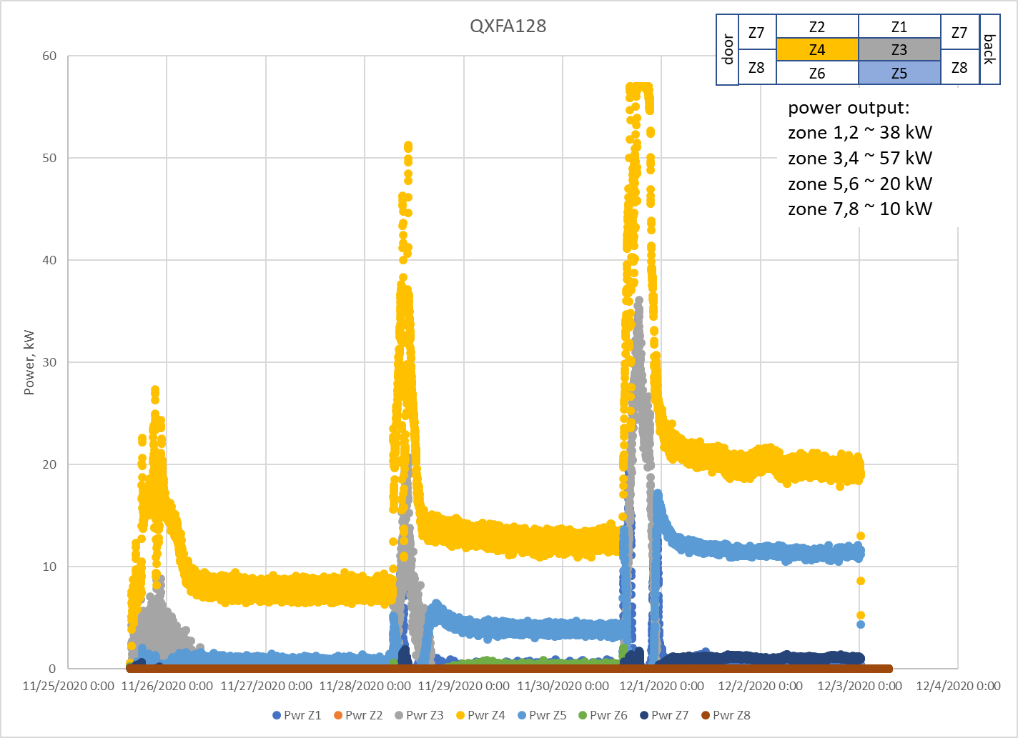
QXFA128 Power Output

Slide 17
Furnace Parameters with type K
Specification
Furnace Input

Slide 18
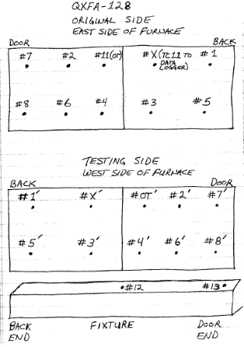
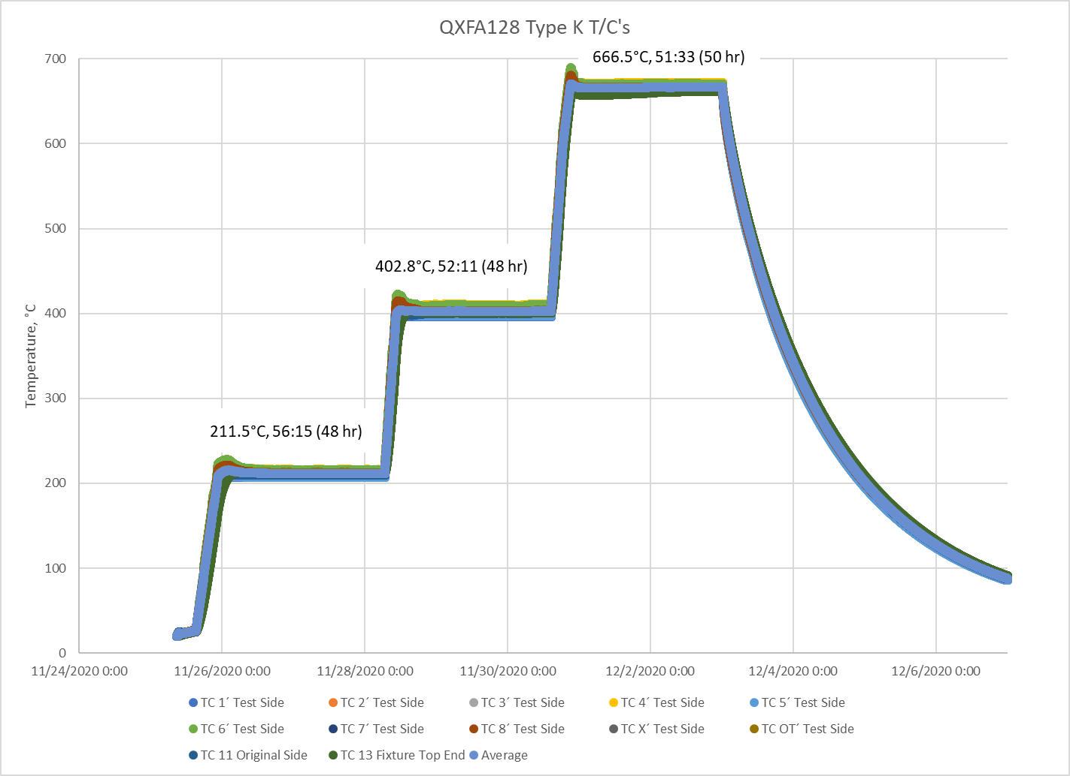
QXFA128, type K, no bias

Slide 19
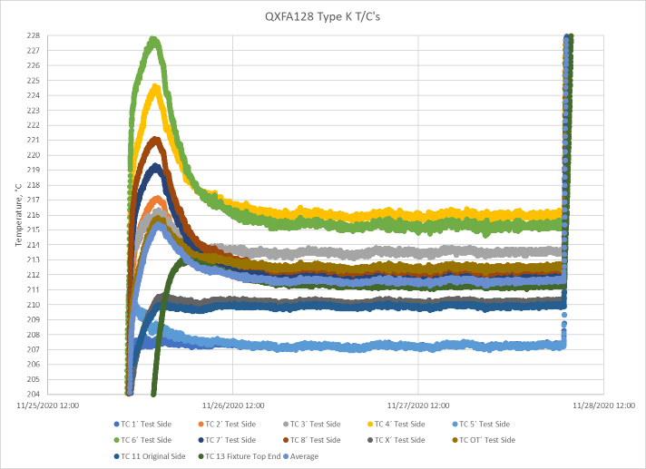
210° C, Type K, no bias

Slide 20
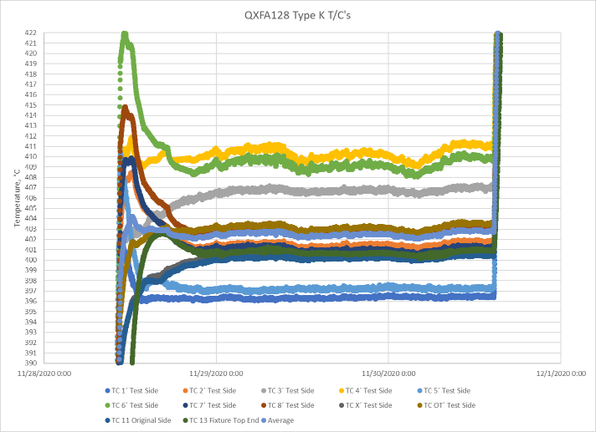
395° C, Type K, no bias

Slide 21
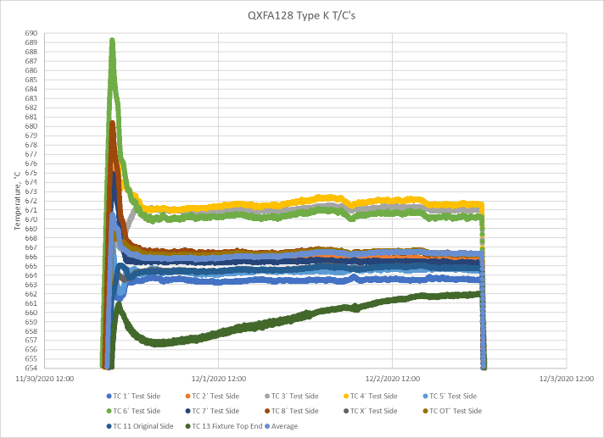
665° C, Type K, no bias

Slide 22
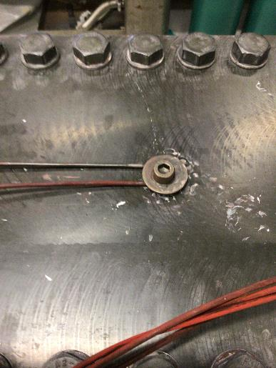
QXFA128 LE - middle
Type J
T/C#9
T/C#13
T/C#14
T/C#11
T/C#12
T/C#10
T/C#2
T/C#1
T/C#15
T/C#4
Type J, T/C #14
Type K
Type K
T/C#13

Slide 23
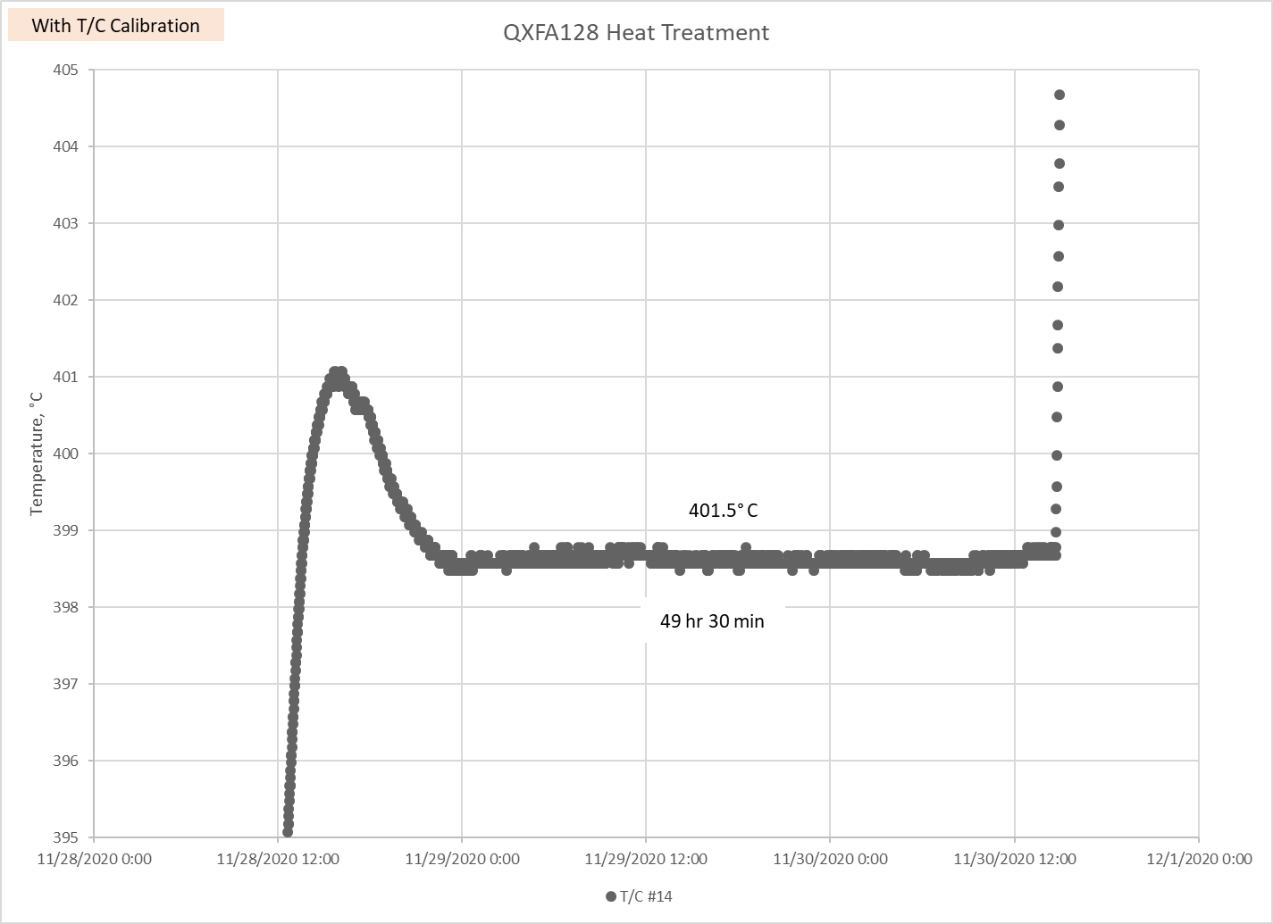
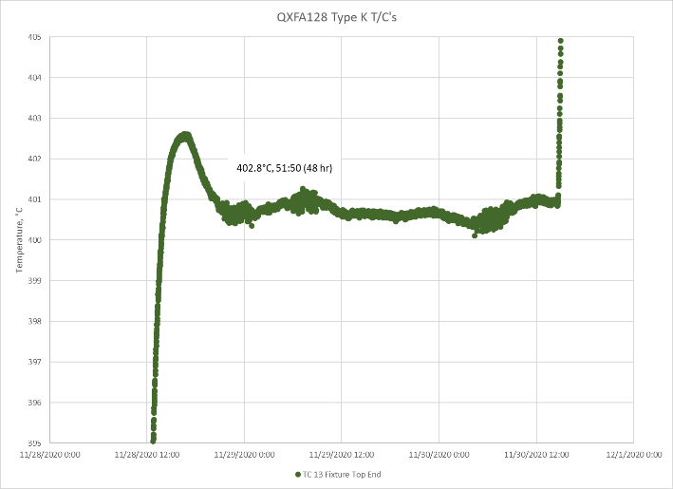

Slide 24
QXFA128 Type J (LE-mid)
T/C#9
T/C#13
T/C#14
T/C#11
T/C#12
T/C#10
T/C#2
T/C#1
T/C#15
T/C#4

Slide 25
QXFA128 Type K (LE-mid)

Slide 26
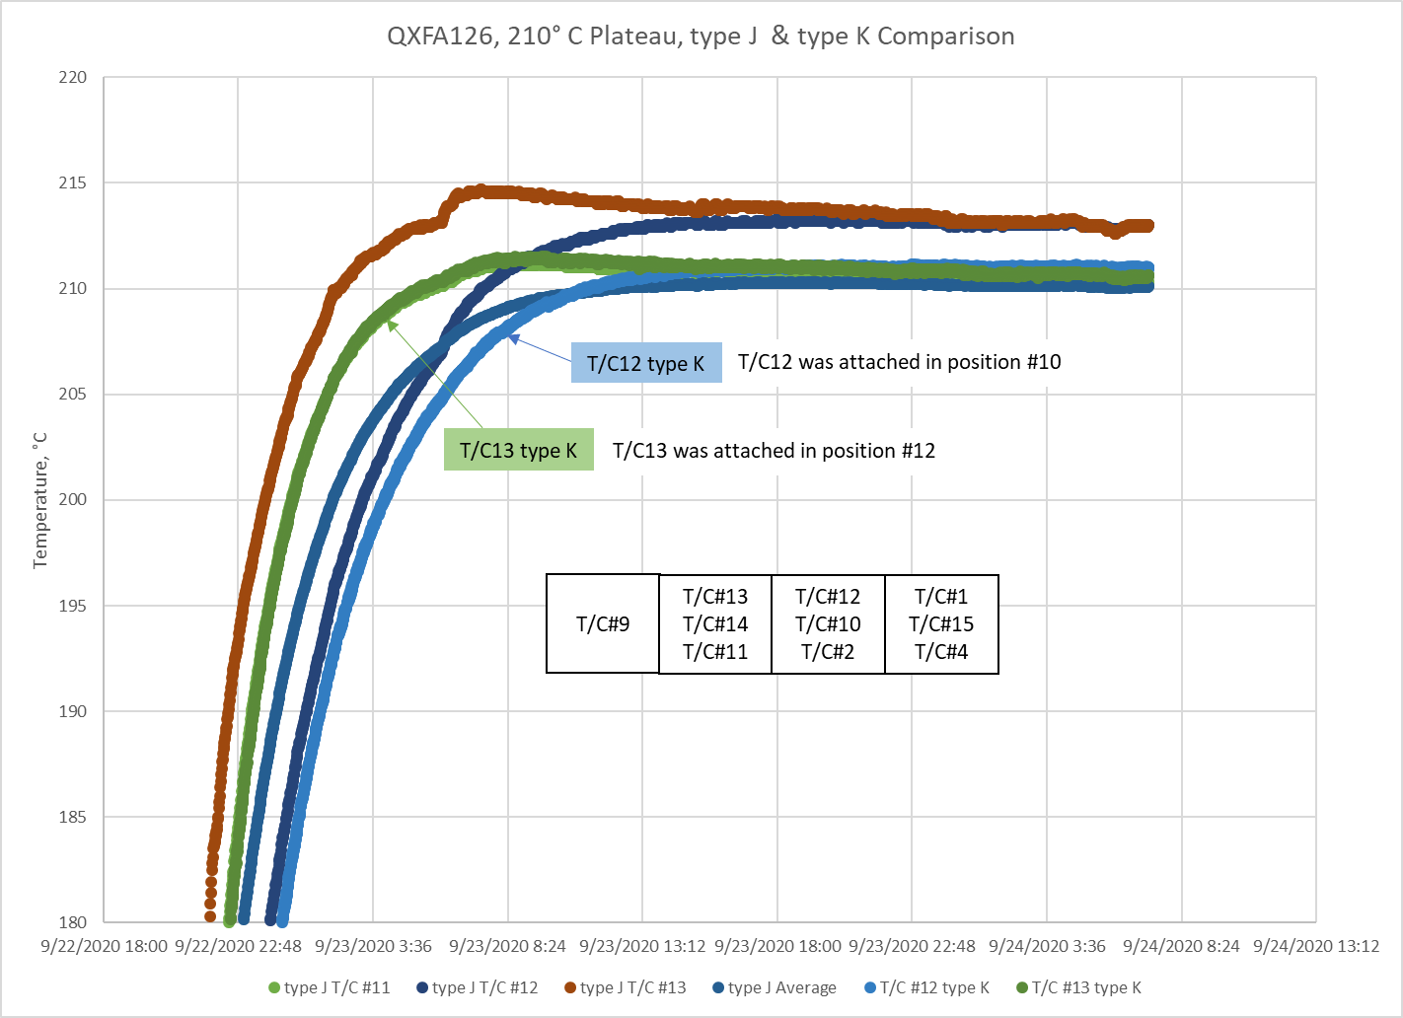
QXFA126, 210° C Plateau, type J & type K Comparison

Slide 27
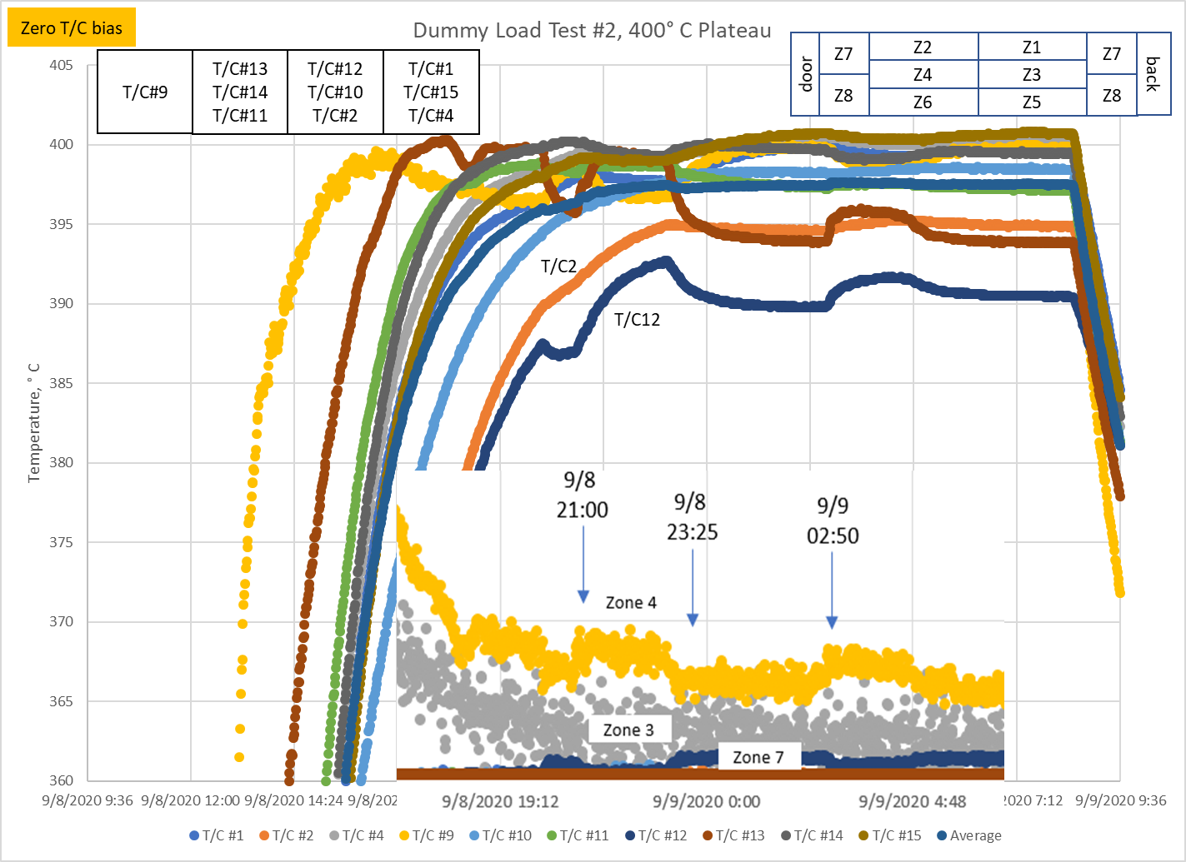
Test #2, Type J, 400° C

Slide 28
Reaction Issue – Fail AUP Statistical Analysis
From earlier meeting 9/4/20
Large time vs temperature arc from ramp up to plateau → thermal inertia
  Thermocouples measure temperature at tip of probe
  Probe tip under a washer pressed against tooling measures the tooling mass temperature
  Probe tip held by washer with tip extending beyond washer measure something between the tooling mass and surrounding environment.
  See page 2 for pictures and page 3 for plots.
  Plan is to run furnace Dummy Load Test #2 with thermocouples extended beyond clamping washer and compare results to Dummy Load Test #1. Results expected by 9/18/20.
Thermocouple temperature spread on reaction fixture
  Thermocouple calibration probe used in larger cavity & gave inaccurate calibration values. Probe reworked.
  Plan is to calibrate all thermocouples with the probe in correct position and verify hypothesis. Results expected by 9/25/20.

Slide 29
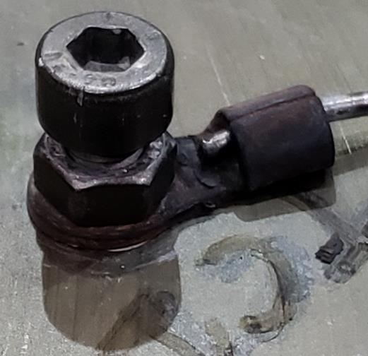
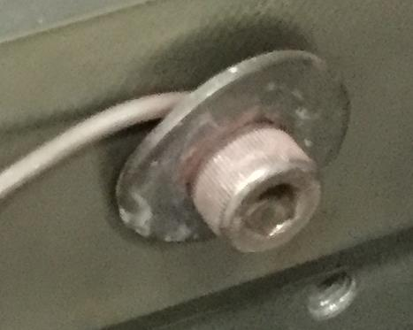
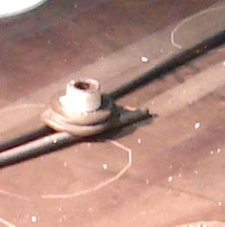
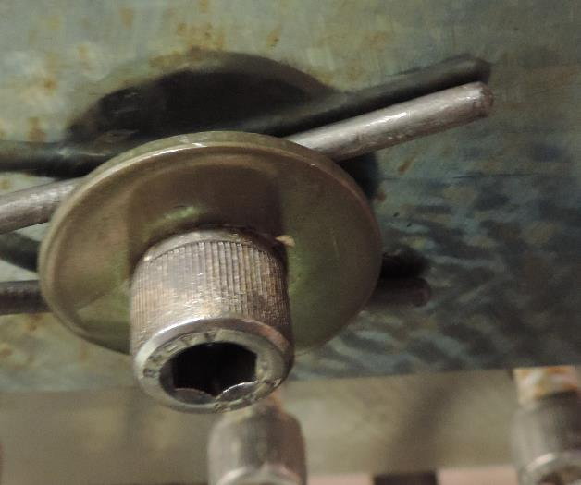
BNL AUP
FNAL AUP
FNAL LQ
FNAL QXFP

Slide 30
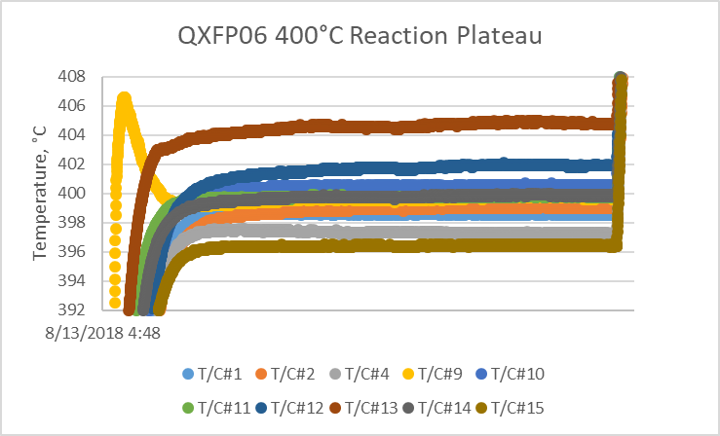
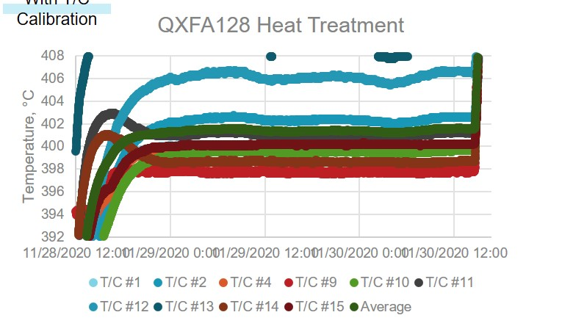
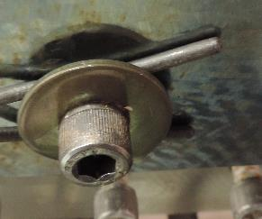
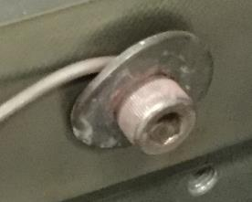
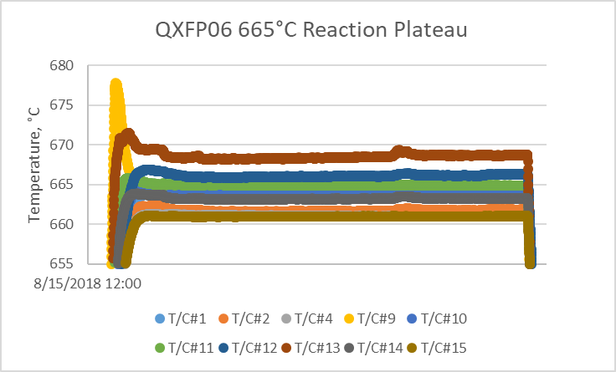
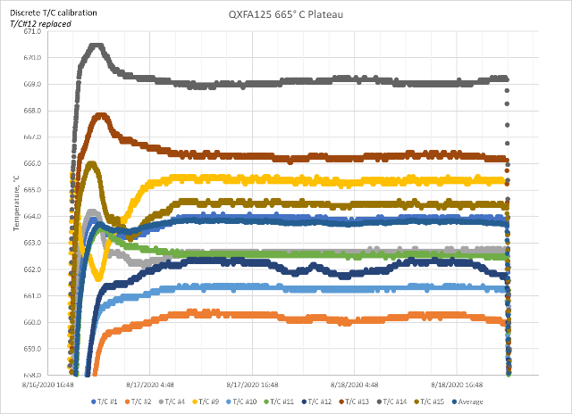
Reaction Plots QXFP vs QXFA

Slide 31
Results
Difference between clamping the TC tip or having it extend slightly beyond had minimal effect.
Thermocouple calibration had small effect on reaction process capabilities.
  Thermocouple calibration process specification
  Discreet thermocouple calibration applied to each plateau.
No difference between type J & type K thermocouples.
Discovered PID oscillation and added transition step at 600 C to slow the ramp.

