Slide 1
Towards design of inhibitors of SARS-CoV 2 protein folding
Amir Bitran
Eugene Shakhnovich Lab
Harvard University PhD Program in Biophysics

Slide 2
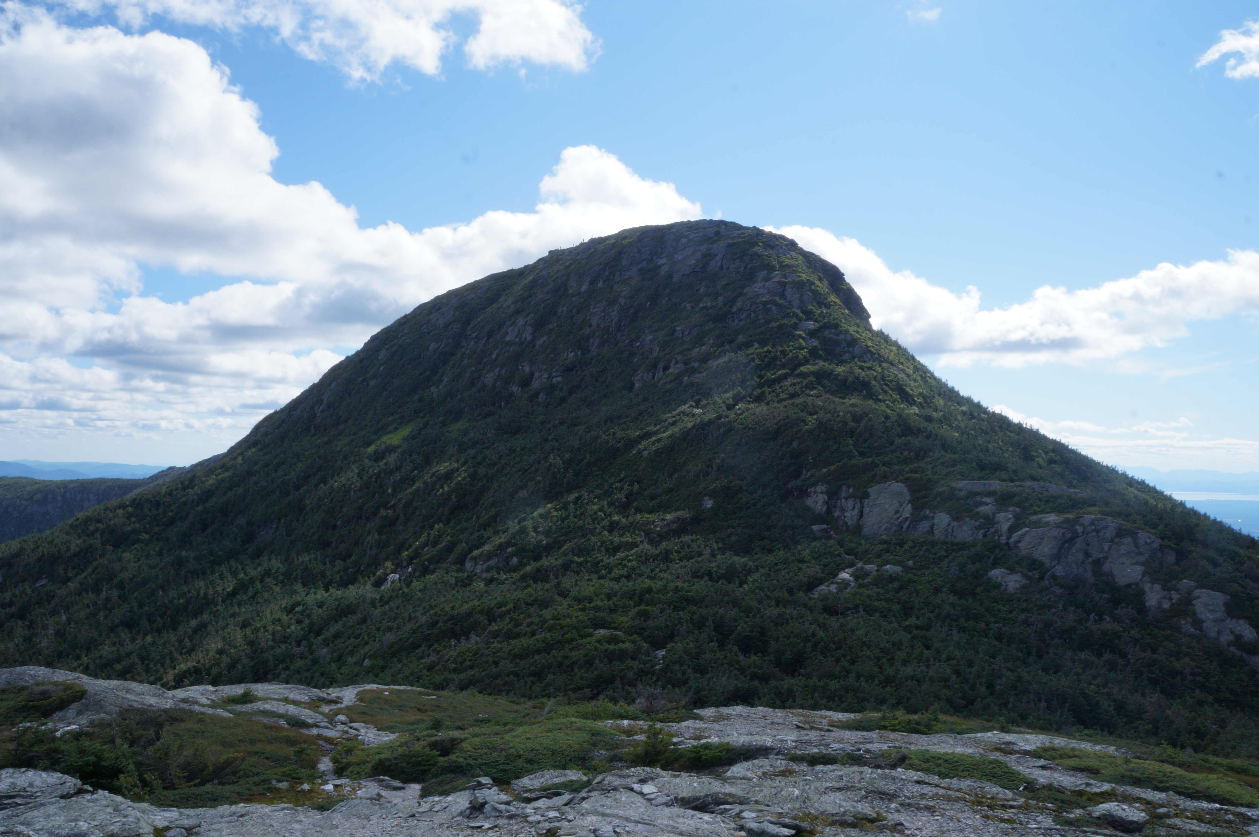
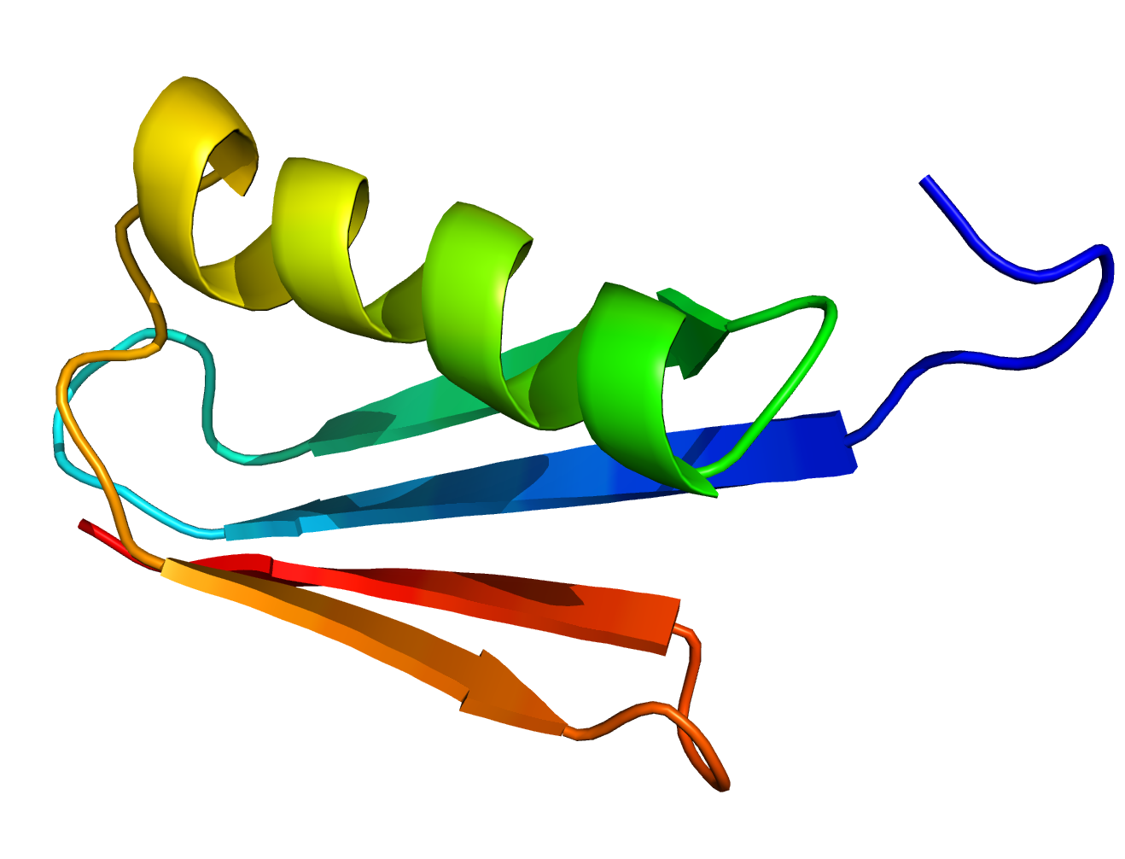
A little about me
Harvard, B.A. in physics 2016
Current Ph.D. student in biophysics
in Eugene Shakhnovich’s lab

Slide 3
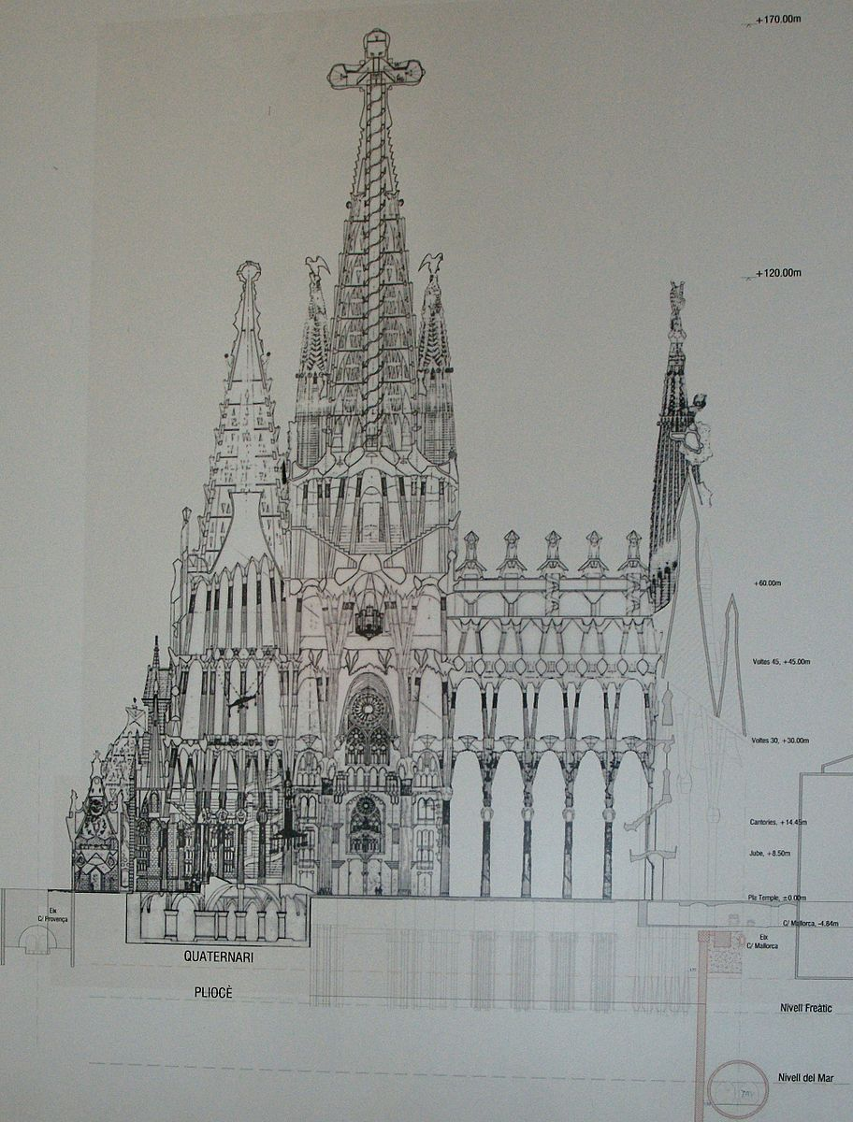
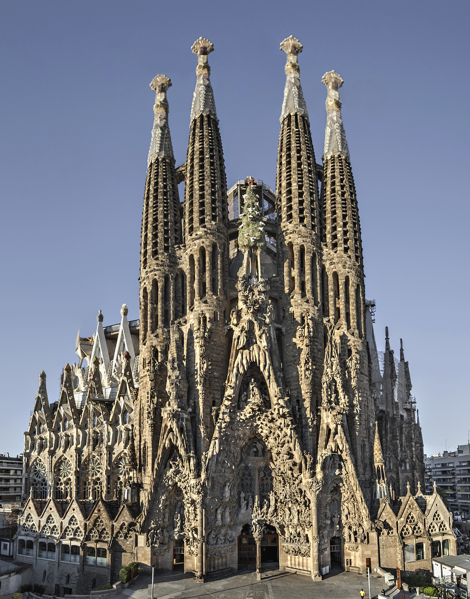
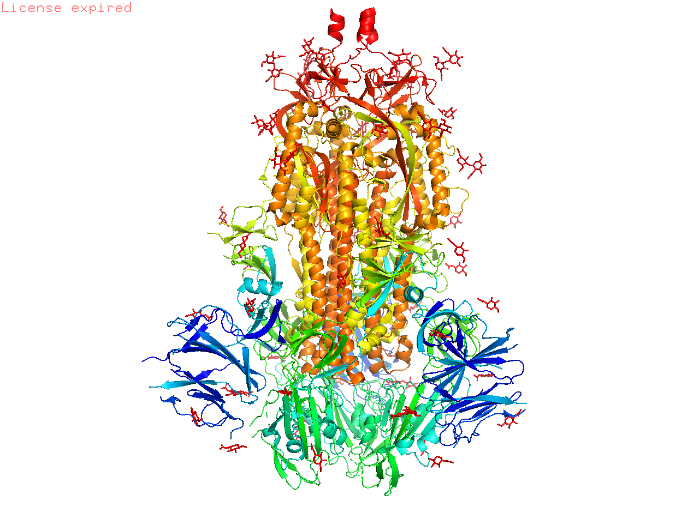

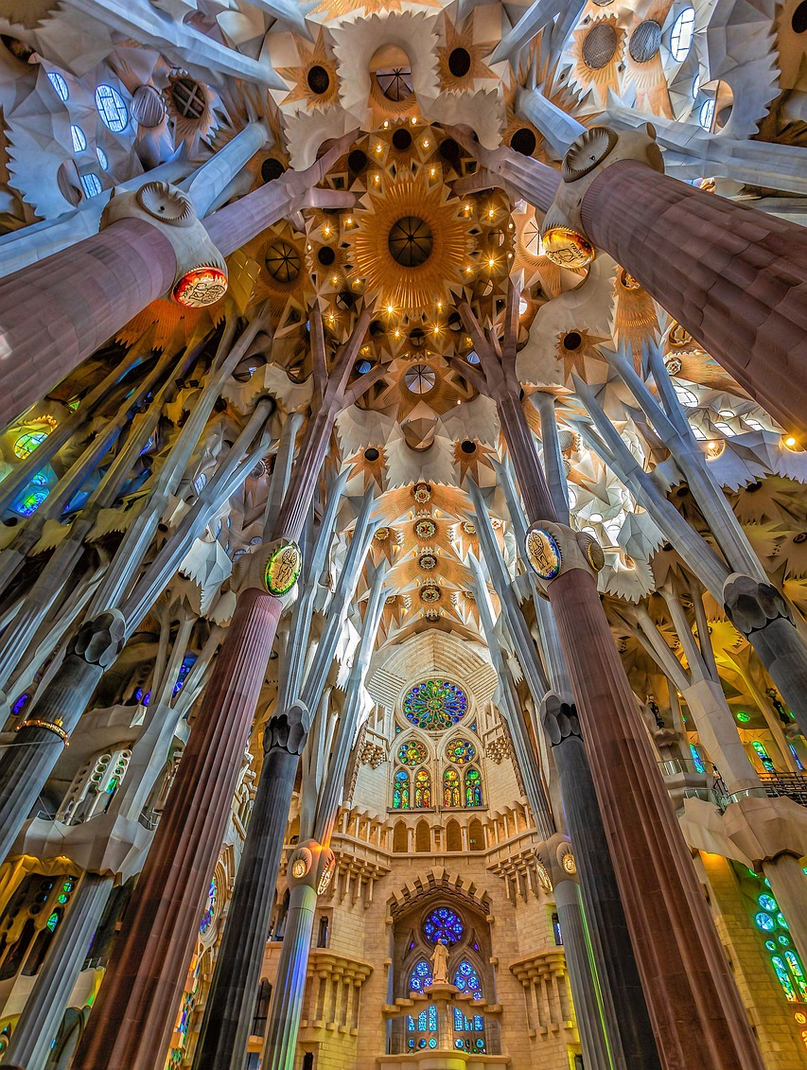
How is the blueprint of life realized?
SARS-CoV-2
spike protein
By what mechanisms does an amino acid sequence dictate a protein’s final structure?

Slide 4
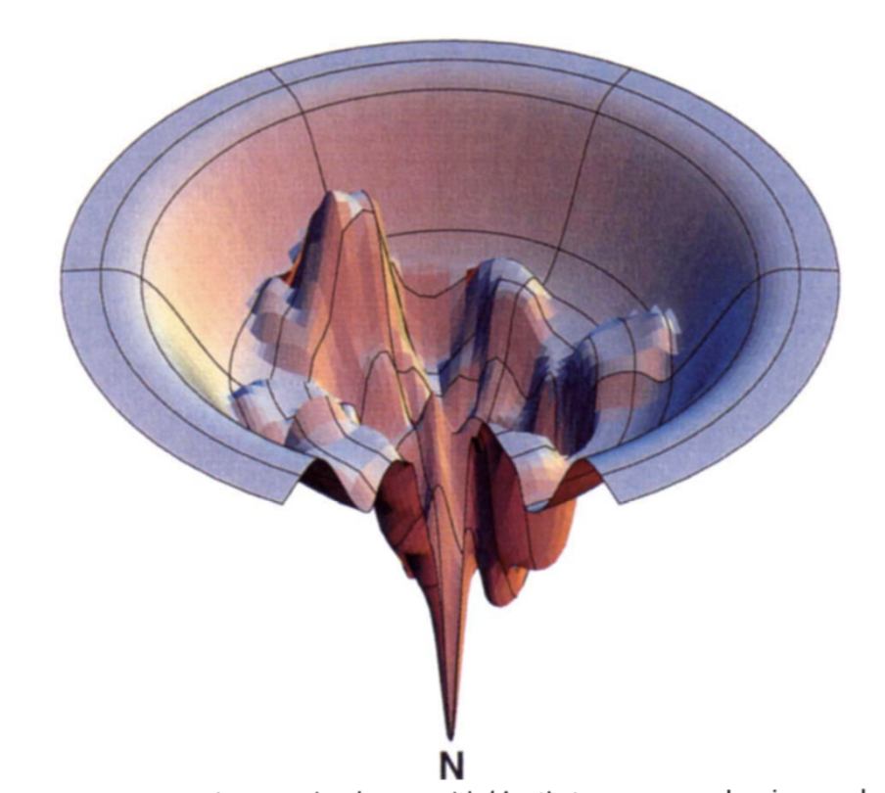
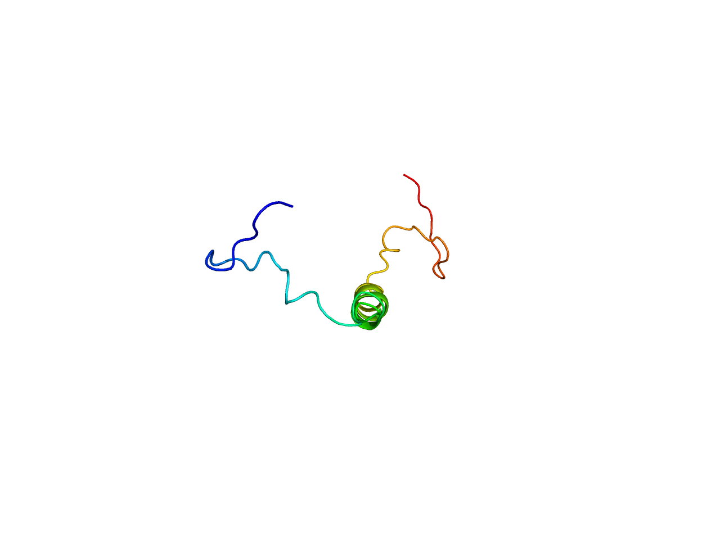
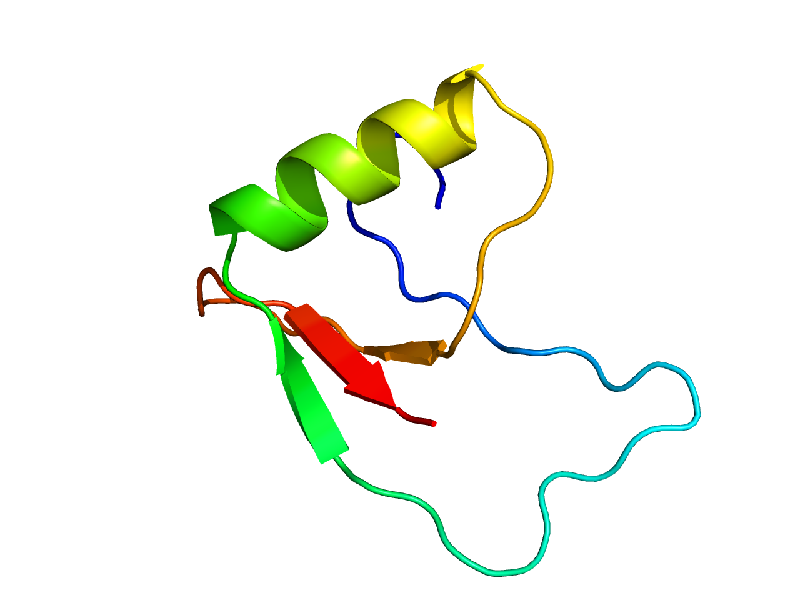
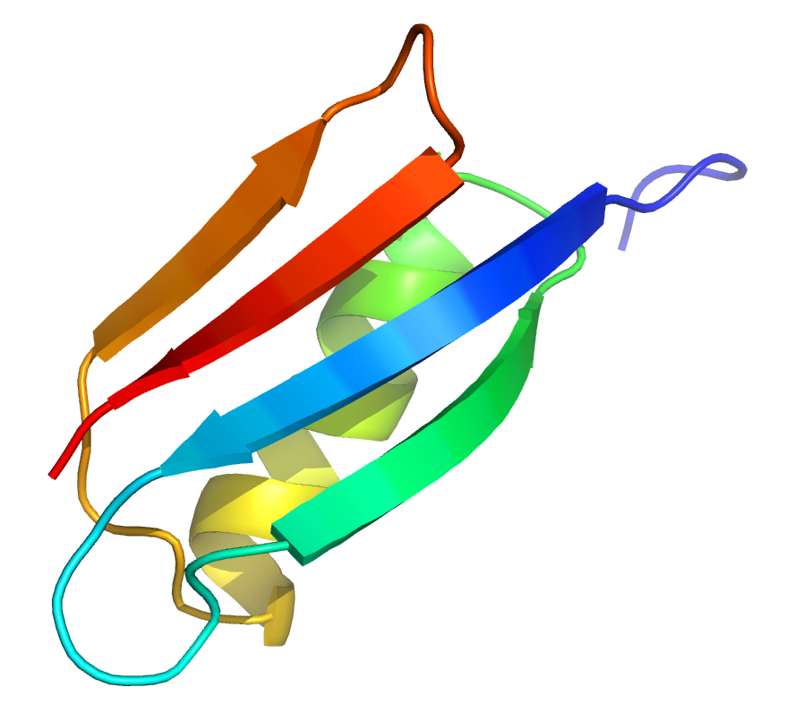
The folding funnel analogy
Small, simple proteins
Larger, more complex proteins
Intermediate
Native state
Larger proteins often get trapped in incorrect folded states, and need assistance from cell to fold quickly (e.g. Bitran et al PNAS 2020)
Possible Achilles tendon for complex viral proteins?

Slide 5
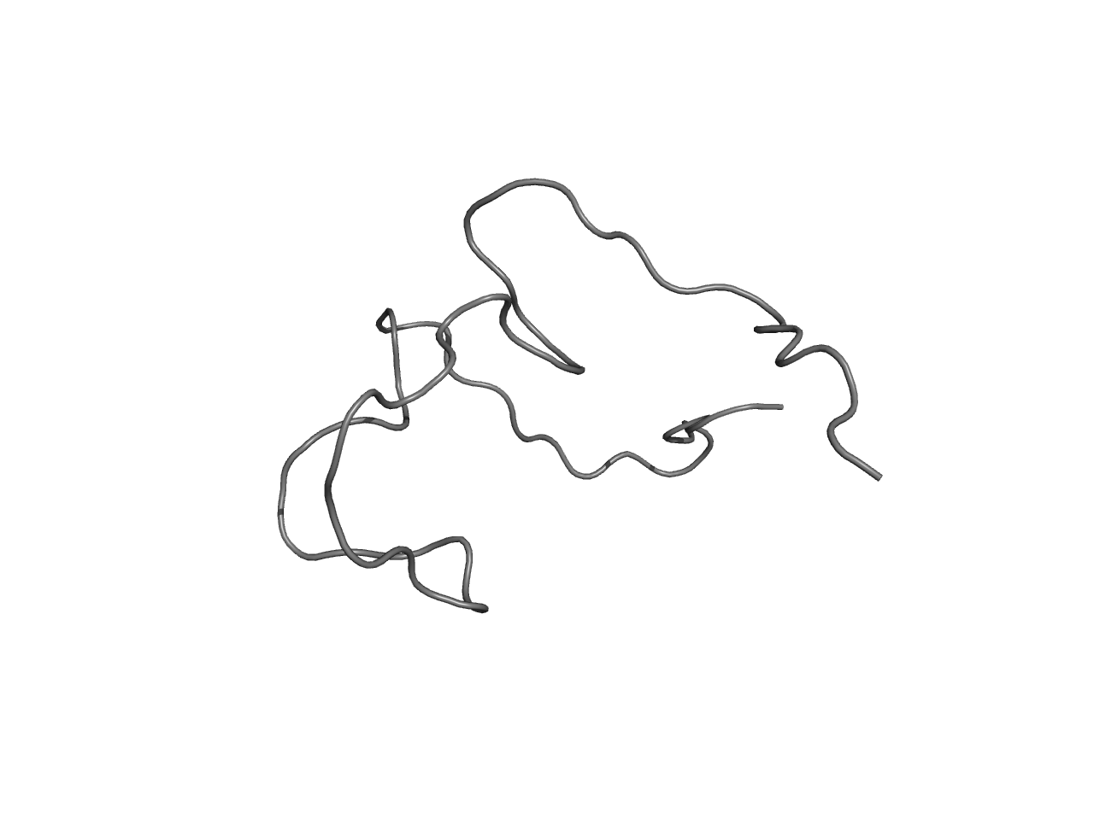
Rational drug design against proteins
Traditional approach:
Competitive or allosteric
inhibitors target native state
Our approach:
Folding inhibitors
Evolutionary escape not difficult via mutations
that reduce binding but not stability
(e.g. E484K in South African variant)
Evolutionary escape more difficult as mutations
to core residues compromise stability

Slide 6
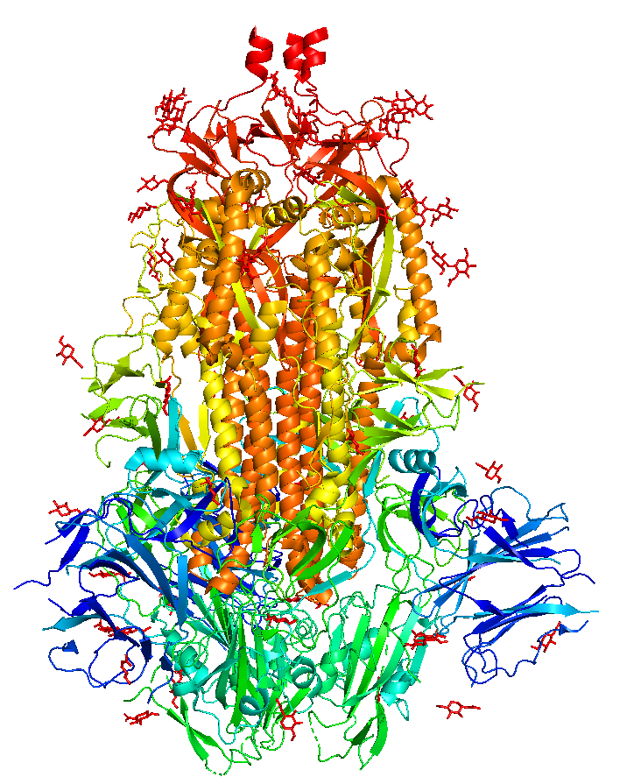
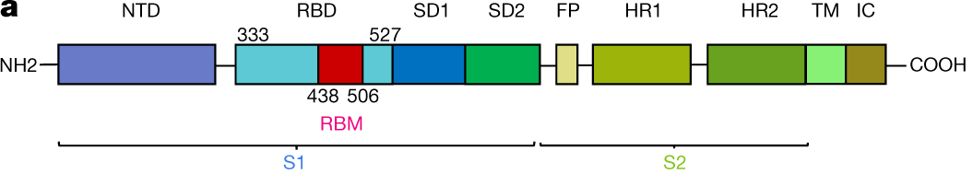
Large viral proteins are expected to fold one domain at a time
E.g. spike protein of
SARS-CoV 2
Lan et. al. Nature 581 (2020)
PDB ID: 6vxx
Goal: Specifically identify intermediates in the folding of individual domains

Slide 7
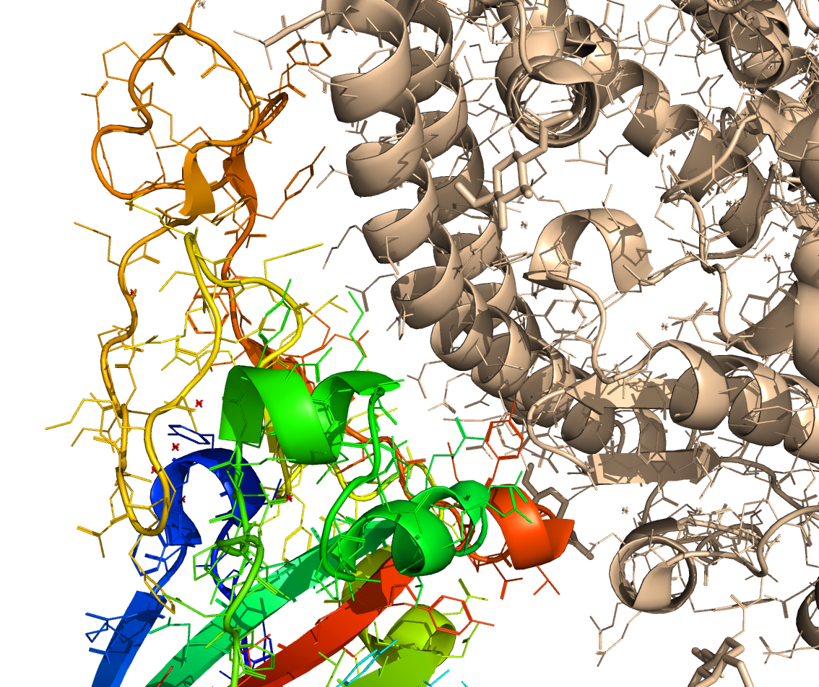
The SARS-CoV 2 spike protein
RBD
ACE2 receptor
Goal: Inhibit (co-translational) folding of receptor binding domain (RBD)

Slide 8
The pipeline
1
2
3
4
5
Compute folding
pathways/rates
Cluster intermediate
structures & Identify
recurrent pockets
Screen existing
drugs to bind
pockets
Verify binding
affinities using
Molecular Dynamics
Filter out hits
that bind
native state
Unfolded
Long-lived
Intermediate
Design compounds
de novo
to bind pockets
Native
Bitran et. al.
PLOS Comp Bio
2020

Slide 9
The predicted RBD folding pathway
Correct,
functional
structure
Incorrect
”off-pathway”
structures

Slide 10
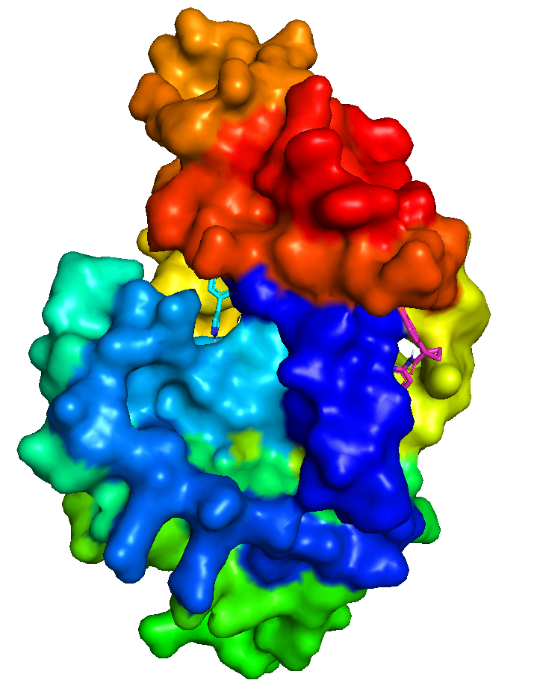
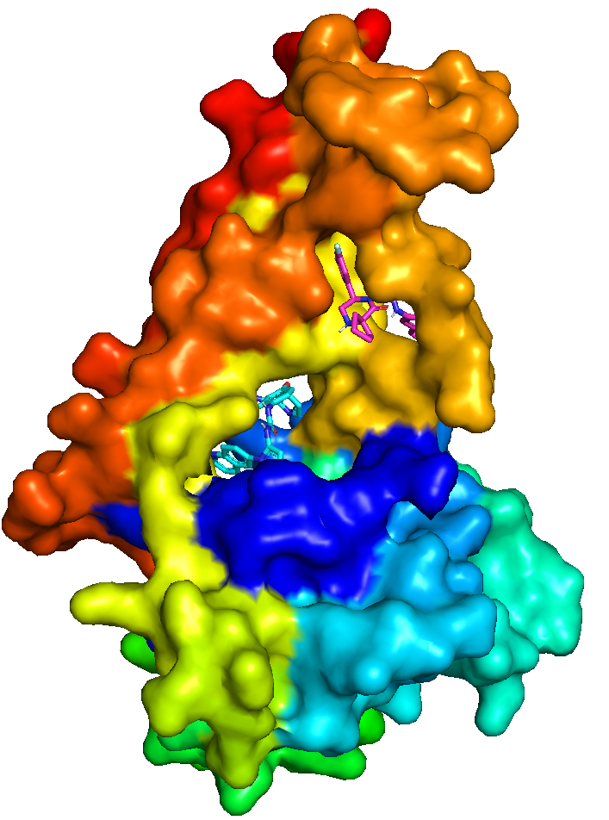
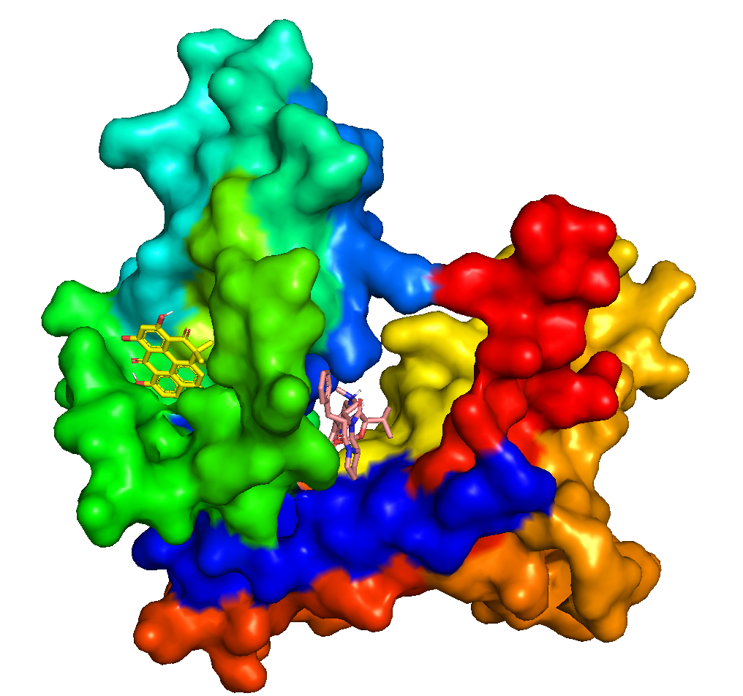
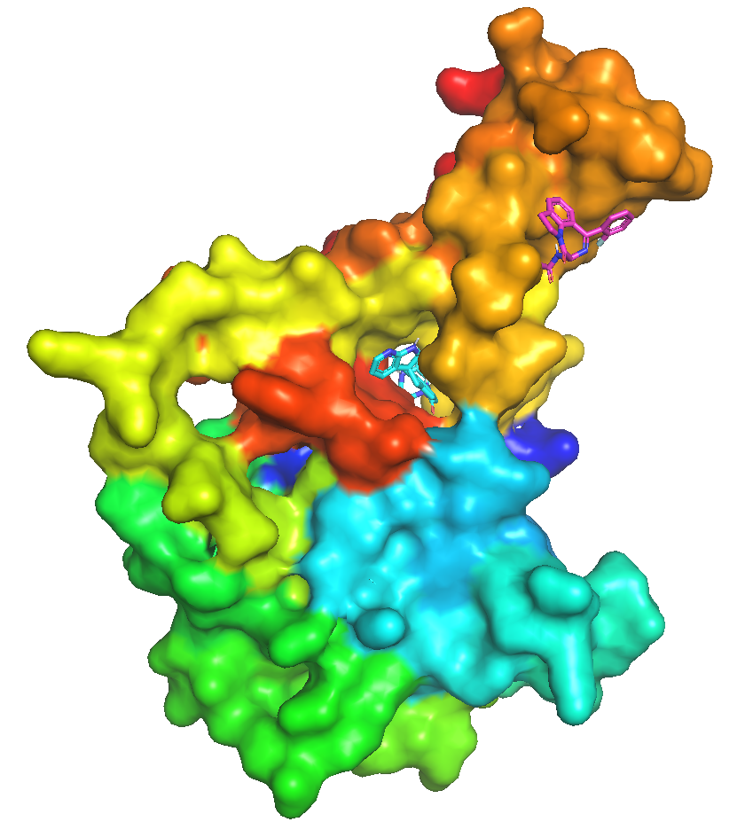
Off-pathway structures cluster into well-defined conformers with druggable pockets
Brian Zhao
P2
P1
P2
P2
P1
P1
P1
P2
Conformer 1
Conformer 2
Conformer 3
Conformer 4
Notes:
Finds regions of high curvature on protein surface (putative cavities), then refines using docking

Slide 11
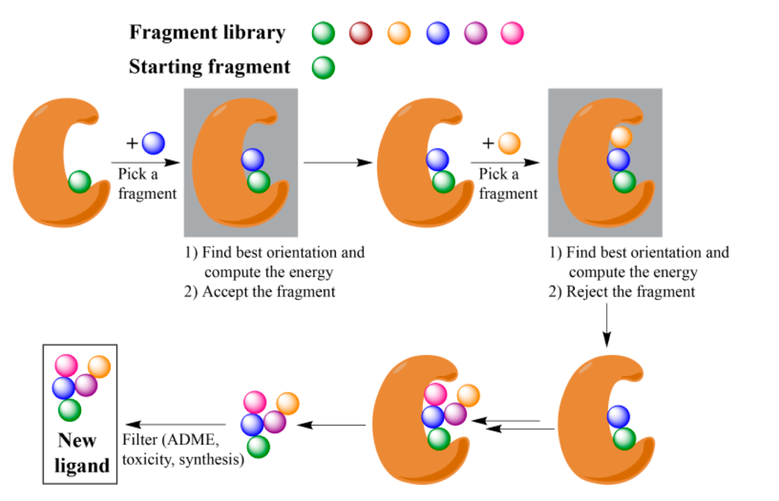
The OpenGrowth algorithm: Designing custom small molecules that bind a specific pocket
(fragment = chemical group)
Chéron, Jasty & Shakhnovich, J. Med. Chem.
59, 4171-4188 (2016)

Slide 12
OSG resources instrumental to the success of this approach
Goal is to obtain multiple tight binders (sub-50 nM affinity)—represent less than 1 in 100,000 designed compounds
Single opengrowth job produces ~100 compounds after 7 days
OSG enabled significant parallelization—4000 jobs per pocket (24K jobs total) and thus ~2.4 million compounds produced
  4 million CPU hours run within a few weeks
Such throughput impossible on other clusters within a reasonable time due to significant queues for limited CPUs (e.g. Harvard Canon cluster: 75K CPUs total, 5K users)

Slide 13
Results of computational docking
Brian Zhao
Initial screen with autodock vinna
Verification with molecular dynamics
57 tight* binders to misfolded state
  8 designed with Opengrowth
  49 approved, existing compounds
33 show tight binding (58% of initial hits)
15 show specificity for misfolded state over native state
*Binding energy stronger than -10 kcal/mol (sub 50 nM affinity)
**At least 3 kcal/mol energy gap between misfolded and native state binding (>150-fold affinity difference)

Slide 14
Summary of binding energies
Brian Zhao
 | Overall | Native | SA score
c2p2_Ci-988 | -24.99 | -17.82
c2p2_r1-102 | -24.65 | -12.63 | 4
c2p1_Silmitasertib | -20.95 | -13.33
c2p1_Pranlukast | -19.26 | -15.53
c3p1_Gedatolisib | -18.67 | -11.25
c2p2_Piketoprofen | -17.02 | -8.15
c2p2_Mk3207 | -16.40 | -10.56
c2p1_Glisamuride | -16.08 | -14.86
c2p1_Radotinib_deprotonated | -15.95 | -12.45
c2p1_Ocaperidone | -15.94 | -8.36
c2p2_Dirlotapide | -15.94 | -22.27
c1p2_Heliomycin | -15.61 | -11.64
c1p2_Ar-12 | -15.42 | -12.07
c2p2_r1-14 | -14.76 | -20.19 | 4
c2p2_Talniflumate | -14.44 | -5.88
c2p1_Golvatinib | -14.39 | -14.53
c2p2_Vs-5584 | -14.18 | -13.19
c1p1_r1-1701 | -14.04 | -17.28 | 2.5
c2p2_Spiclomazine | -13.82 | -8.28
c2p1_Tioclomarol | -12.33 | -9.29
c2p2_Balaglitazone | -12.27 | -8.84
c3p1_Azd-4547 | -12.15 | -8.06
c2p2_Ethyl-biscoumacetate | -12.13 | -9.78
c3p1_Ubrogepant | -12.01 | -13.72
c2p1_Tulopafant | -11.89 | -11.96
c3p1_Merestinib | -11.62 | -18.25
c2p1_Nilotinib_deprotonated | -11.30 | -13.55
c2p1_Radotinib_protonated | -10.77 | -8.82
c4p1_Setipafant | -10.69 | -19.34
c2p1_Pf-00477736 | -10.61 | -9.90
c3p1_Fluazuron | -10.57 | -10.75
c2p3_r1-540 | -10.55 | -5.21 | 2.2
C{n}p{m} refers to a compound that binds conformer n and pocket m within that conformer
Notes:
(Note: one-indexing is used for conformers, in contrast to previous presentations)

Slide 15
Experimental test of computational predictions

Slide 16
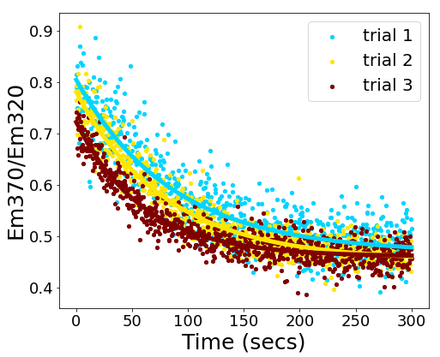
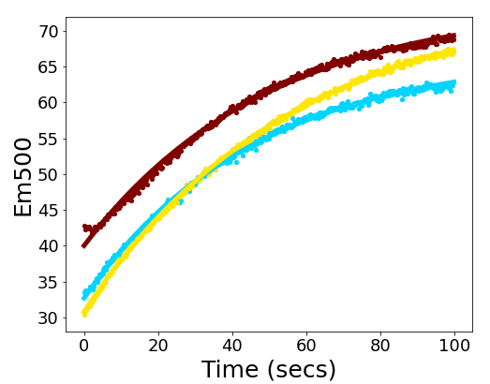
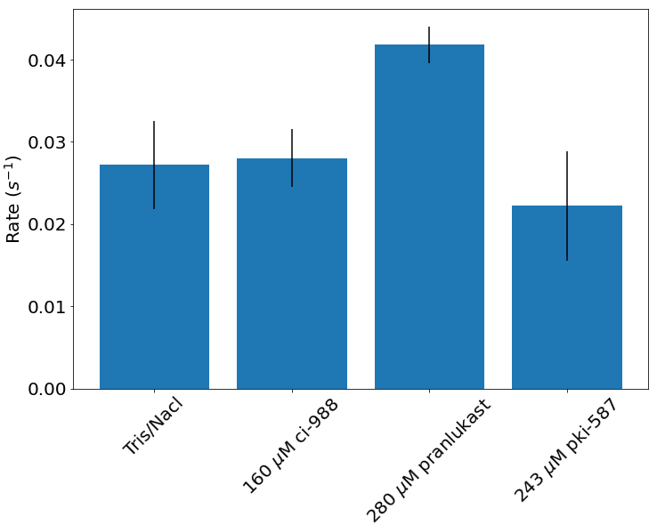


Testing effect of compounds on RBD refolding
Intrinsic fluorescence
bis-ANS fluorescence
$$Υ=0.014±0.002 s^{−1}$$
$$Υ=0.02±0.002 s^{−1}$$
No slowdown due to compounds so far
Repeat while accounting for native disulfides & increase experimental screening throughput

Slide 17
Conclusions
amirbitran@g.harvard.edu
Simulations predict druggable off-pathway intermediate
Using OSG resources, designed millions of compounds against intermediate, including some predicted tight binders
Experimental tests in progress

Slide 18
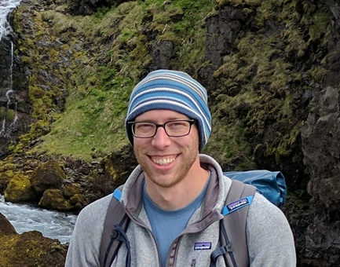
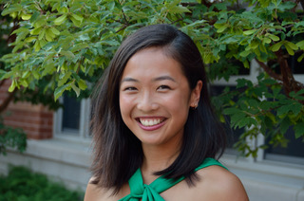


Acknowledgements
João
Rodriguez
Sourav
Chowdury
Eugene
Shakhnovich
Sanchari
Bhattacharyya
William Jacobs
Xiadi Zhai
Brian Zhao
Funding from NSF GRFP,
Harvard Quantitative Biology Fellowship Program,
and Harvard Biophysics training grant
And thank you to the OSG for your invaluable support!

Slide 19
Memory usage
6 gb RAM per job
  144 terabytes RAM used in total (24000 jobs jobs)
~4 kb per output file
  ~10 gb total

Slide 20
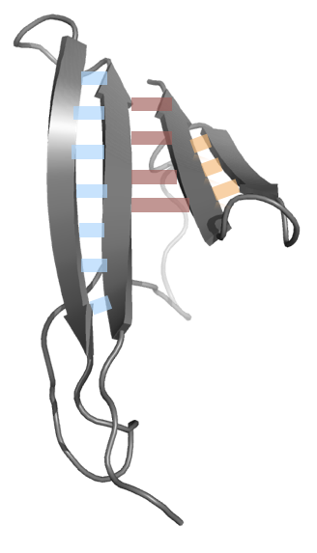
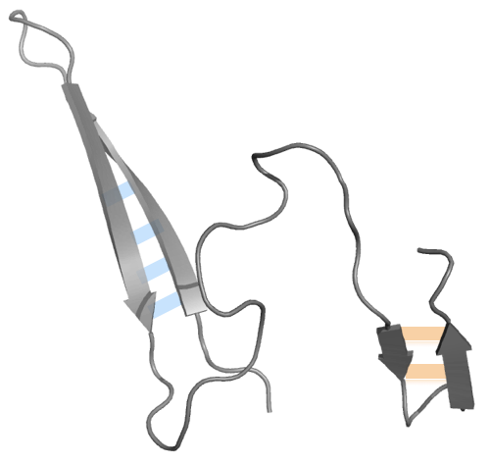
DBFOLD: A novel computational method to compute folding pathways/rates for large proteins
Free energy
High temperatures
Physiological temperatures
3
Extrapolate unfolding rates to low temperatures
4
Folding rate from detailed balance
2
Unfolding simulations:
Give barrier heights at
high temperatures
1
Replica exchange simulations:
Give free energies of intermediates
Bitran et. al.
PLOS Comp Bio
2020
5
Repeat at multiple chain lengths and plug into kinetic model

Slide 21
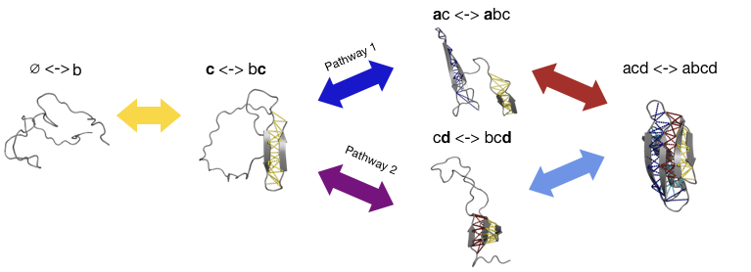
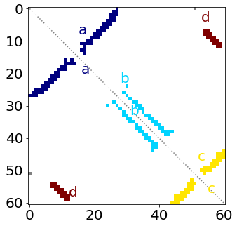
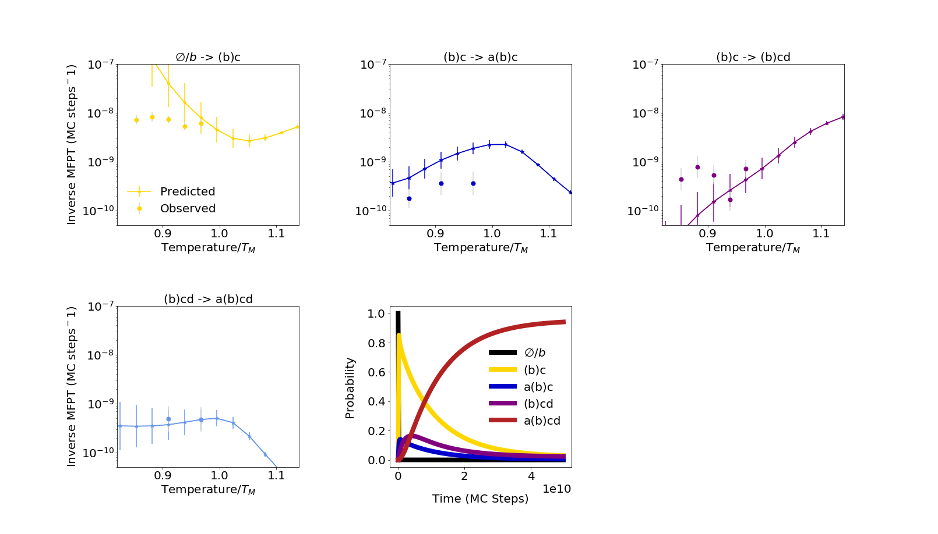
Validation of DBFOLD against a small, fast-folding protein
streptococcal protein G
Bitran et. al.
PLOS Comp Bio
2020

