Slide 1
OSG as an Agent for Research Computing Democratization
Miron Livny
John P. Morgridge Professor of Computer Science
OSG Technical Director
UW-Madison/CHTC

Slide 2
A Partnership was launched!
On October 1, 2020 we started the 5 years, $4.5M annual budget NSF “Partnership for Advanced Throughput Computing (PATh)” project
“The Partnership to Advance Throughput Computing (PATh) project will expand Distributed High Throughput Computing (dHTC) technologies and methodologies through innovation, translational effort, and large-scale adoption to advance the Science & Engineering goals of the broader community.”

Slide 3
A strong partnership
Partnership between the UW-Madison Center for High Throughput Computing (CHTC) and the Open Science Grid (OSG) Consortium
Two main elements of the project are the HTCondor Software Suite (HTCSS) and the Fabric of Capacity Services (FoCaS) offered by the OSG
Involves ~40 individuals at seven institutions
Brian Bockelman (Co-PI), Miron Livny (PI), Lauren Michael (Co-PI), Todd Tannenbaum (Co-PI),Frank Wuerthwein (Co-PI)

Slide 6
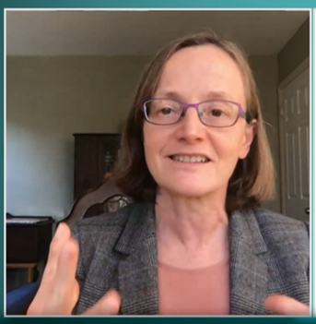

Slide 7
PATh Executive Summary
“Broader Impact – We firmly believe in dHTC as an accessible computing paradigm which supports the democratization of research computing to include researchers and organizations otherwise underrepresented in the national CI ecosystem. Our work is founded on universal principles like sharing, autonomy, unity of purpose, and mutual trust.”
(April 2020)

Slide 8
The Open Science Pool (OSPool) is our answer to the democratization of access challenge!

Slide 9
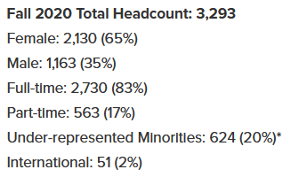
38 sites from the OSPool contributed capacity over 12 month to the HTC application of ONE researcher from the University of Arizona

Slide 10
The NSF Campus Cyberinfrastructure (CC*) program brings the capacity of new campuses to the OSPool
Over the last 24 months we provided close to 50 letters of commitment to CC* proposals

Slide 11
We are working on enabling researchers to augment the capacity provided by the OSPool via the OSG-Connect Access Points with “Bring Your Own (BYO)” capacity
BYO capacity of clusters on your campus
BYO capacity of XD facilities that were allocated to you by XRAC
BYO capacity of commercial clouds that was allocated to you in the form of a an account via CloudBank
Single HTC Access Point to all sources of raw capacity

Slide 12
On Saturday 2/27/2021
We recorded the completion of close to 78K jobs that were served with the capacity of the OSPool
29 users who belong to 23 projects submitted these jobs
The average wall-clock core hours of these jobs was 6.4
11.6K of these jobs belong to one user.
11K were less than one minute.
.6K jobs had an average of 3.5 core hours.
The 75 percentile was 5 hours, and the maximum was 34 hours
All the jobs of this user requested one core.

Slide 13
We must do better!
How do we get more researchers to signup for accounts?
Spread the word that any researcher who is associated with a US institution can get an account and compete for capacity that is assigned on a “fair share” basis
Spread the word that access to the services provided by the Access Points of the OSPool increases throughput and reduces effort

Slide 14
We must be user oriented
How do we get researchers to benefit more from the services our Access Points provide?
Improve usability of the services provided by our Access Points
Leverage note-book technologies
Provide “how to” recipes for basic as well as advanced HTC workloads
More and better training activities and materials that target researchers

Slide 15
We need to Scale Out
Deploy OSPool Access Points and Data Origins at campuses to localize management of users and data
Improve portability and maintainability of Access Points
Improve portability of Data Origin interfaces
Support fair-share provisioning across campuses

