Slide 1
Data Mining in Genomics By
High-Throughput Computing
2021 OSG All-Hands Meeting
Zhonggang (John) Li
March 1, 2021
University of Wisconsin-Madison, Madison, WI

Slide 2
The Goal of Genetics:
From Genotype to Phenotype
Phenotype
Genotype
Notes:
Genetic is used to identify changes in DNA that alter disease-related phenotypes. This approach has successfully identified a whole host of genetic variants, and in some cases the underlying genes, that increase an individual’s risk of developing diseases such as obesity, atherosclerosis, diabetes and osteoporosis.
However, this approach fails to provide insight on the cellular mechanisms altered by these variants or the larger gene networks within which they function.

Slide 3
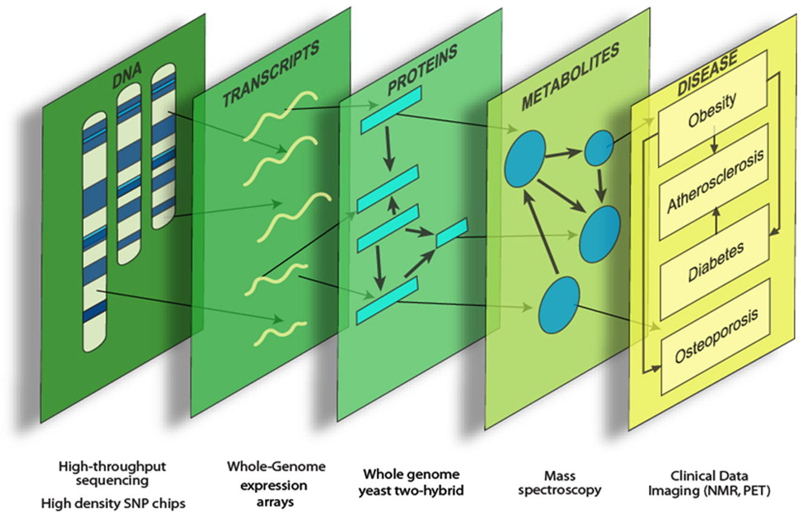
Systems Genetics: A New Approach for Gene Discovery Based on Network Analysis
Lusis, et al. Genetics.
Notes:
Disease-associated genetic variation elicits its influence by perturbing biological components and their interactions. Systems genetics can be used to identify these perturbations, and the genes and networks involved, and the mechanisms through which they lead to disease.
“Systems Genetics” and it seeks to understand complexity by combining the principles of systems biology and genetics to uncover connections between genotype and complex disease. Importantly, systems genetics attempts to explain the role of genetic variation in cellular function and disease from the perspective of the entire system, not simply from the level of individual genes.
systems genetics leverages high-throughput omics technologies, such as RNA sequencing (RNAseq) or mass spectrometry–based metabolomics, to quantitate additional molecular traits (eg, expression levels or metabolite abundances) alongside more complex clinical phenotypes.
systems-level approaches based on omics technologies

Slide 4
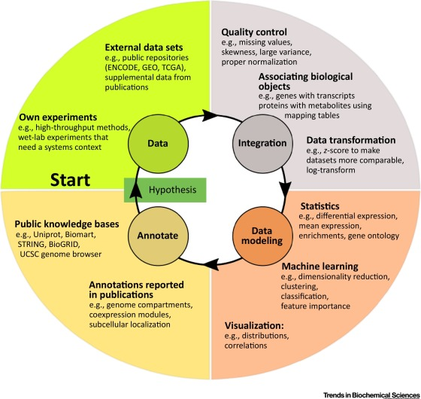
Key Components in Systems Genetics
Dataset acquisition and pre-processing.
Dataset integration and analysis.
Piotr Grabowski, Trends in Bio Science
Notes:
for complex disease traits
For data acquisition, there are public available datasets we can use. Sometimes we generate our own genetic population dataset specific for our research goal.
In today’s talk, I will focus on the second part. Which is also the key of conducting system genetics study.
Integration of Biological Layers Using Systems Genetics Techniques

Slide 5
Overview
Construction of Hepatic Gene Expression Networks to Identify Novel Cholesterol Genes.
Construction of Genome-Wide Epistasis Atlas for Exploring Metabolic Complex Traits.

Slide 6
Project 1
Construction of Hepatic Gene Expression Networks to Identify Novel Cholesterol Genes.

Slide 7

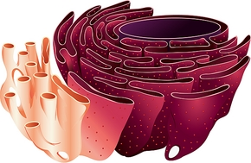

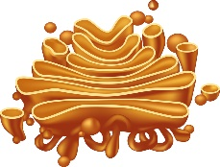
Cholesterol Genes And Hypercholesterolemia Treatment
Cholesterol
Biosynthesis
Statin
HMGCR
Cholesterol
Depletion
PCSK9
Inhibitor
Pro-SREBP2
HMGCR
PCSK9
SREBP2
LDLR
ER
LDLR
Nucleus
Cholesterol
Uptake
SREBP2
Cleavage
Golgi
Any Other Unknown Genes in Cholesterol Pathway?

Slide 8
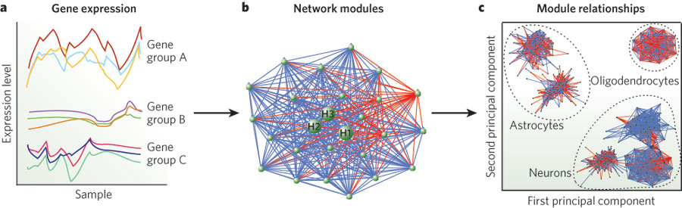
Gene Co-Expression Network:
Weighted Gene Co-expression Network Analysis (WGCNA)
Construct Gene Co-Expression Network

Slide 9
Computational Challenges of WGCNA in Using Multiple
Gene Co-Expression Datasets
But ……….
What if we have 15x5=75 hyperparameters ?
What if we have 35 datasets to analyze?
One cholesterol module identified from HMDP
female mouse dataset based on WGCNA
~ 7 hours running time on local computer

Slide 10
Estimate Running Time for 35 Datasets With Parameters Search
7 x 75 x 35 hours ≈ 2.1 years
Study | Sex | Assay Type | Diet /Conditions
HMDP_CD_male | Male | Microarray | Chow
HMDP_HF_male | Male | Microarray | High-Fat
HMDP_HF_female | Female | Microarray | High-Fat
HMDP_Response | Male | Microarray | Response to High-Fat
DO_CD_male | Male | RNA sequencing | Chow
DO_CD_female | Female | RNA sequencing | Chow
DO_HF_male | Male | RNA sequencing | High-Fat
DO_HF_female | Female | RNA sequencing | High-Fat
DO_CD_protein_male | Male | Proteomics | Chow
DO_CD_protein_female | Female | Proteomics | Chow
DO_HF_protein_male | Male | Proteomics | High-Fat
DO_HF_protein_female | Female | Proteomics | High-Fat
Iron | Male | RNA sequencing | Chow
ApoE_female | Female | Microarray | Chow
ApoE_male | Male | Microarray | Chow
Athero_female | Female | Microarray | Chow
Athero_male | Male | Microarray | Chow
BileAcid |  | Proteomics | Chow
BCAST_male | Male | RNA sequencing | Chow
BCAST_female | Female | RNA sequencing | Chow
HDMP_protein | Male | Proteomics | Chow
CCL4-Control |  | Microarray | Control
CCL4-treated |  | Microarray | Treated
BXD |  | Microarray | Chow
MLRATIO_female | Female | Microarray | Chow
MLRATIO_male | Male | Microarray | Chow
BXH_female | Female | Microarray | Chow
BXH_male | Male | Microarray | Chow
Hepatocytes |  | Microarray | Chow
BXD_HFD |  | Microarray | High-Fat
BXD_CD |  | Microarray | Chow
BXD_protein_CD |  | Microarray | Chow
BXD_protein_HFD |  | Microarray | High-Fat
Lowess_male | Male | Microarray | Chow
Lowess_female | Female | Microarray | Chow
35 datasets
75 Power values/ Module size

Slide 11
Estimate Running Time Using CHTC and OSG
All computation runs are parallel, not depended on each other.
Combine to one model after all parameters/datasets runs are finished.
~ 7 x 75 x 35 hours
2625 Jobs
~ 7 hours

Slide 12
Efficiency of WGCNA Computation in CHTC
Submitted jobs: 2625 jobs
Request: 32 Gb Memory / 16Gb Disk
Running jobs: ~ 200-500 jobs
Running time: ~7 hours per job
~1 week to finish all WGCNA tasks with all parameters of 35 datasets using CHTC Service

Slide 13
Gene Network Analysis in Cholesterol Gene Discovery
Identification of a conserved liver cholesterol module across mouse populations datasets.
Further using mouse liver network and human lipid GWAS for gene discovery.
Validation of Sestrin1 as a gene that regulates cholesterol biosynthesis.
Li, et al. Cell Metabolism,2020.

Slide 14
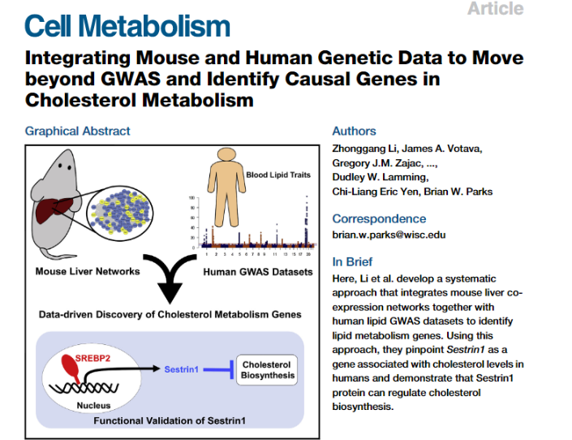
Networks Identified Sesn1 As Novel Cholesterol Gene
Li, et al. Cell Metabolism,2020.

Slide 15
Project 2
Construction of Genome-Wide Epistasis Atlas for Exploring Metabolic Traits

Slide 16
Epistasis: Non-Additive Gene-Gene Interaction

Slide 17
Factored Spectrally Transformed Linear Mixed Models
(FaST-LMM)
FaST-LMM is a general purpose GWAS algorithm to perform univariate GWAS; tests for epistasis; corrections for cellular heterogeneity via the inclusion of principal components; set association tests; and heritability estimation.
To select two pairwise SNPs (SNP 1 and SNP2), and test SNP-SNP interactions on complex traits.
Exhaustive Computation
Lippert, et al. Nature Methods,2011.

Slide 18
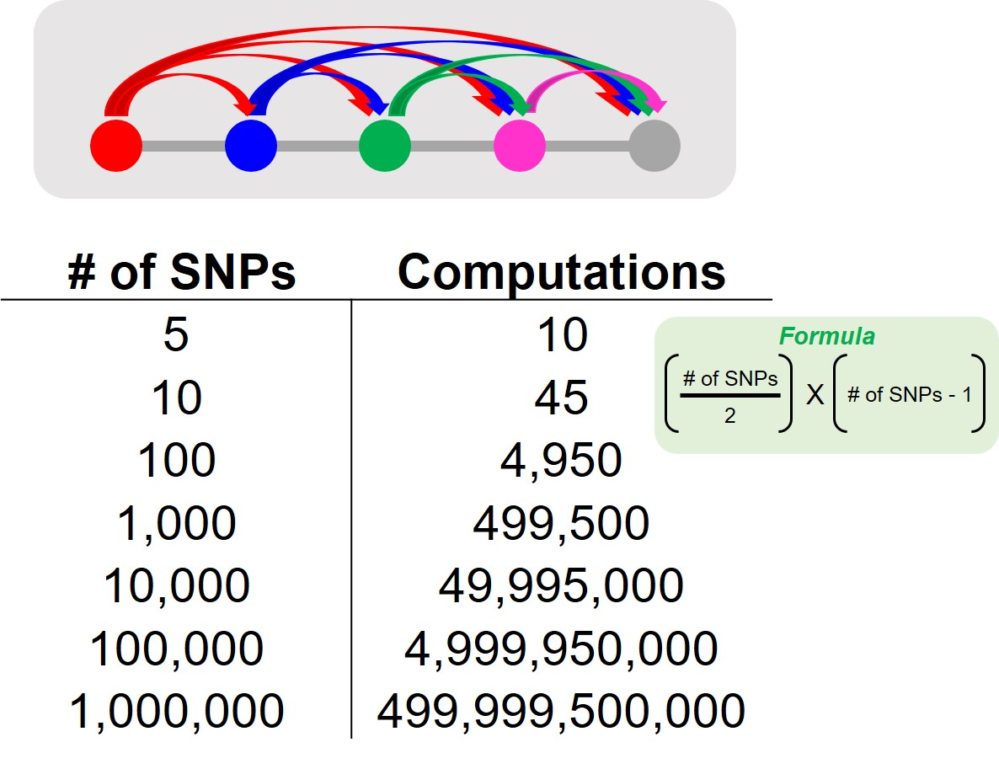
Computation Burden to Conduct Exhaustive Genome-Wide Epistatic Analysis
Needs 20 billion computations for all pairwise SNPs analysis for all mouse SNPs. The estimate computation time is ~ three years in computer.
Li, et al. Manuscript In preparation.

Slide 19
Directed Acyclic Graph (DAG) in Epistatic Computation
Job 1
Job 2
split
filter
Filter Significant Interactions
Rank
Return
Sorted Results
20 Billion Computations
Job 3
….
Job 60,000

Slide 20
Epistatic Computation Pipeline
CONDOR Access
Li, et al. Manuscript In preparation.

Slide 21
Epistatic Computation Efficiency
Submitted jobs: 60,000 jobs
Request: 1 Gb Memory / 16 Gb Disk
Running jobs: ~ 1000-2000 jobs
Running time: 15 min per job
Using resource from high-throughput computing (CHTC) and open-science grid (OSG) Cloud Computation Service, we could finish all computational jobs for one complex trait within two weeks.
We have 20 traits , Project is still on-going

Slide 22
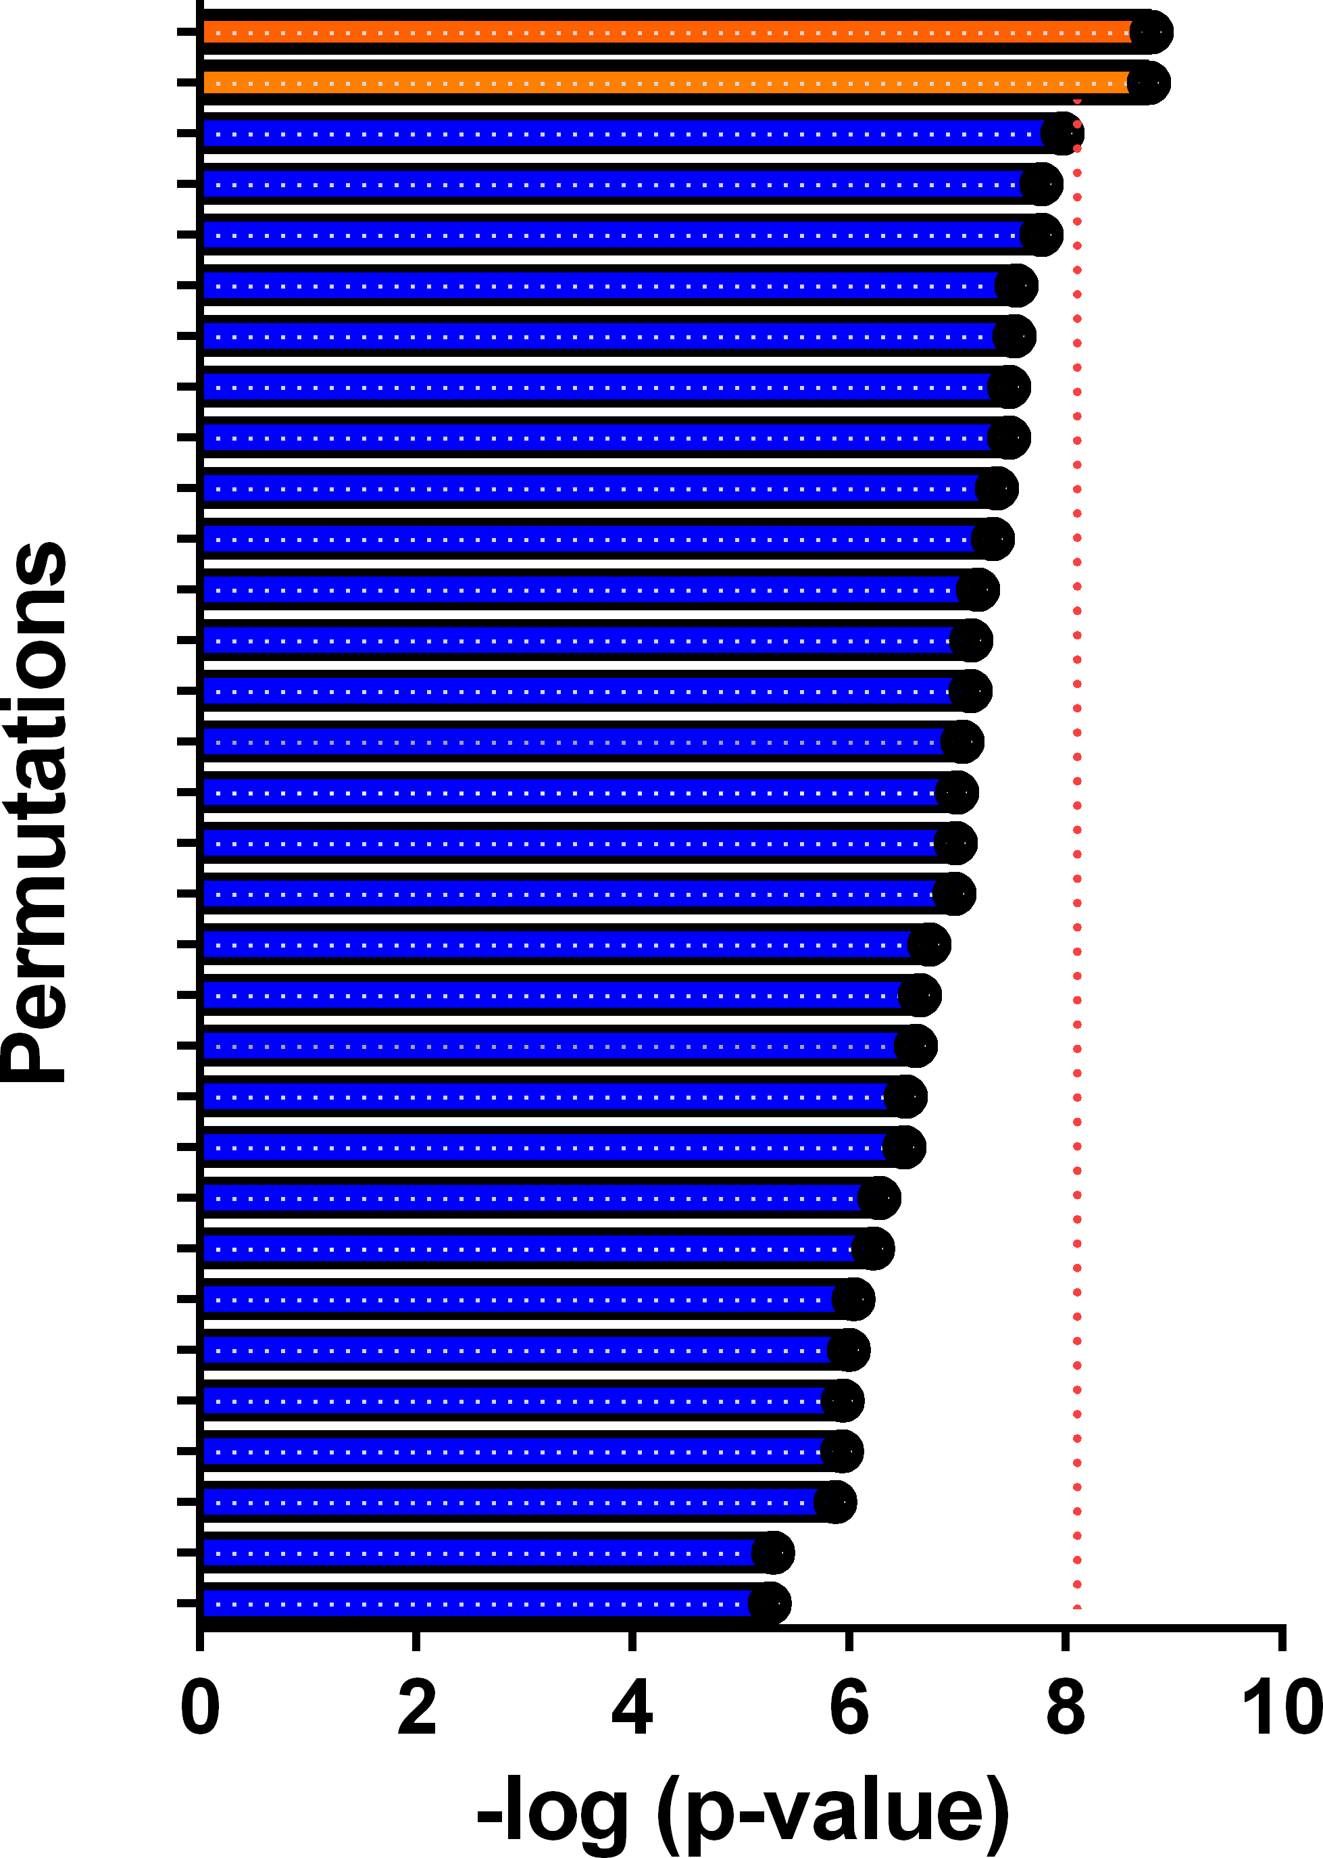
Using Permutation to Identify Epistatic Interaction Threshold
Permute all labels for 100 times to get randomized
threshold value.
Run epistatic interaction computation 100 times in OSG
to calculate the 5% p value threshold, choose the top 2 values
as the threshold for the significant epistatic values.

Slide 23
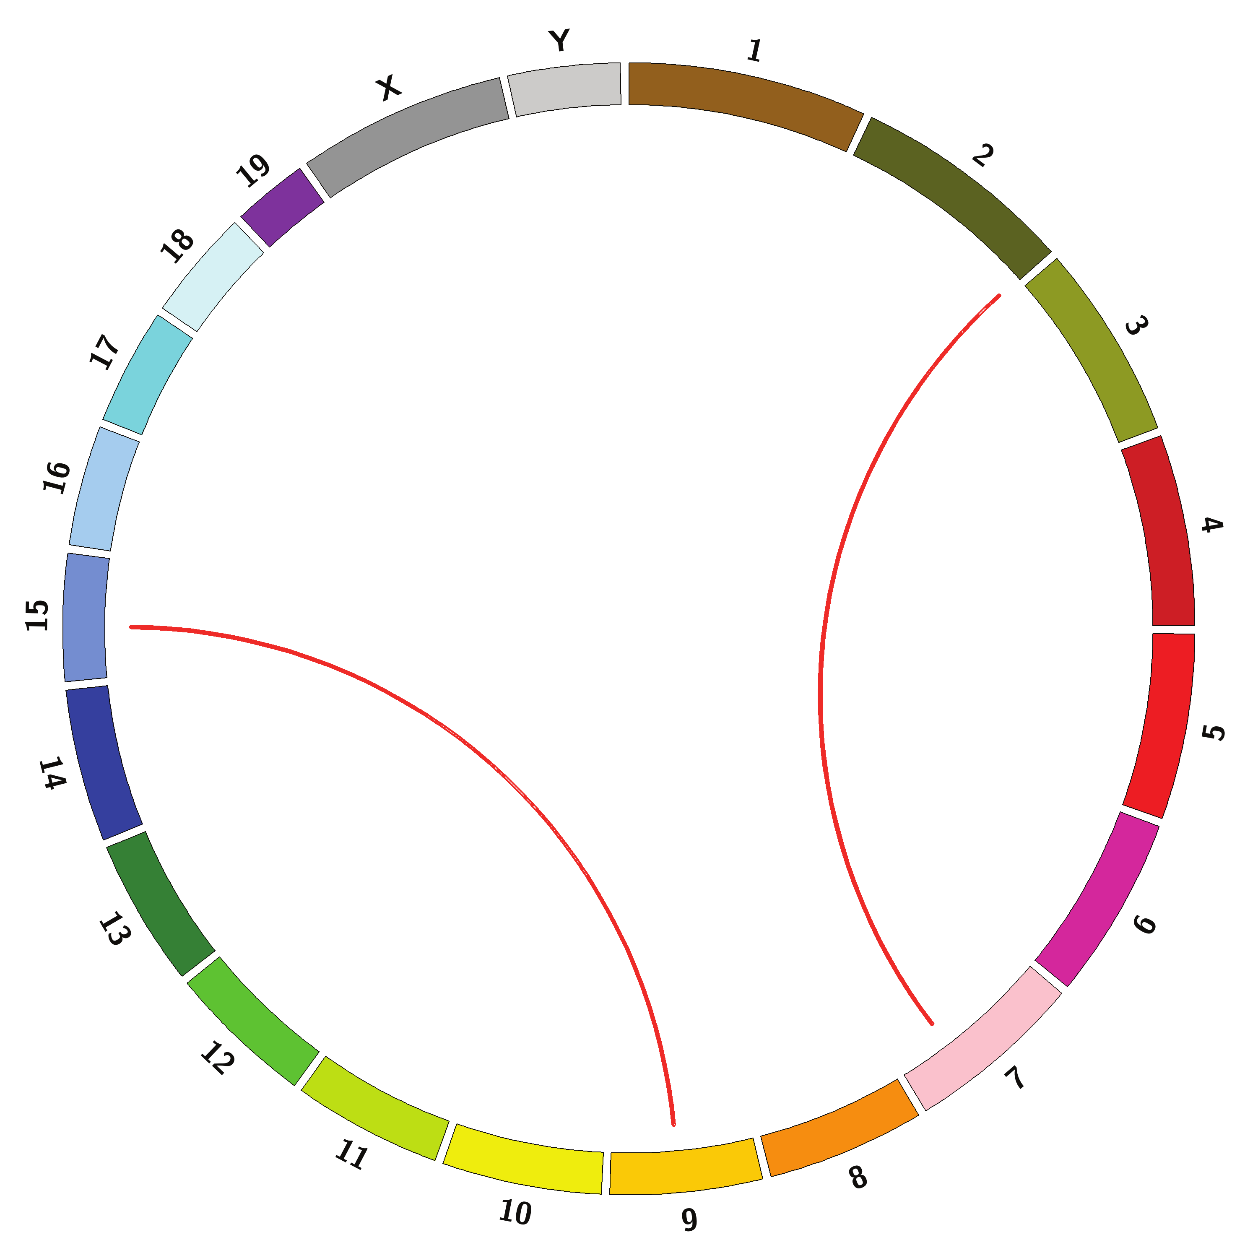
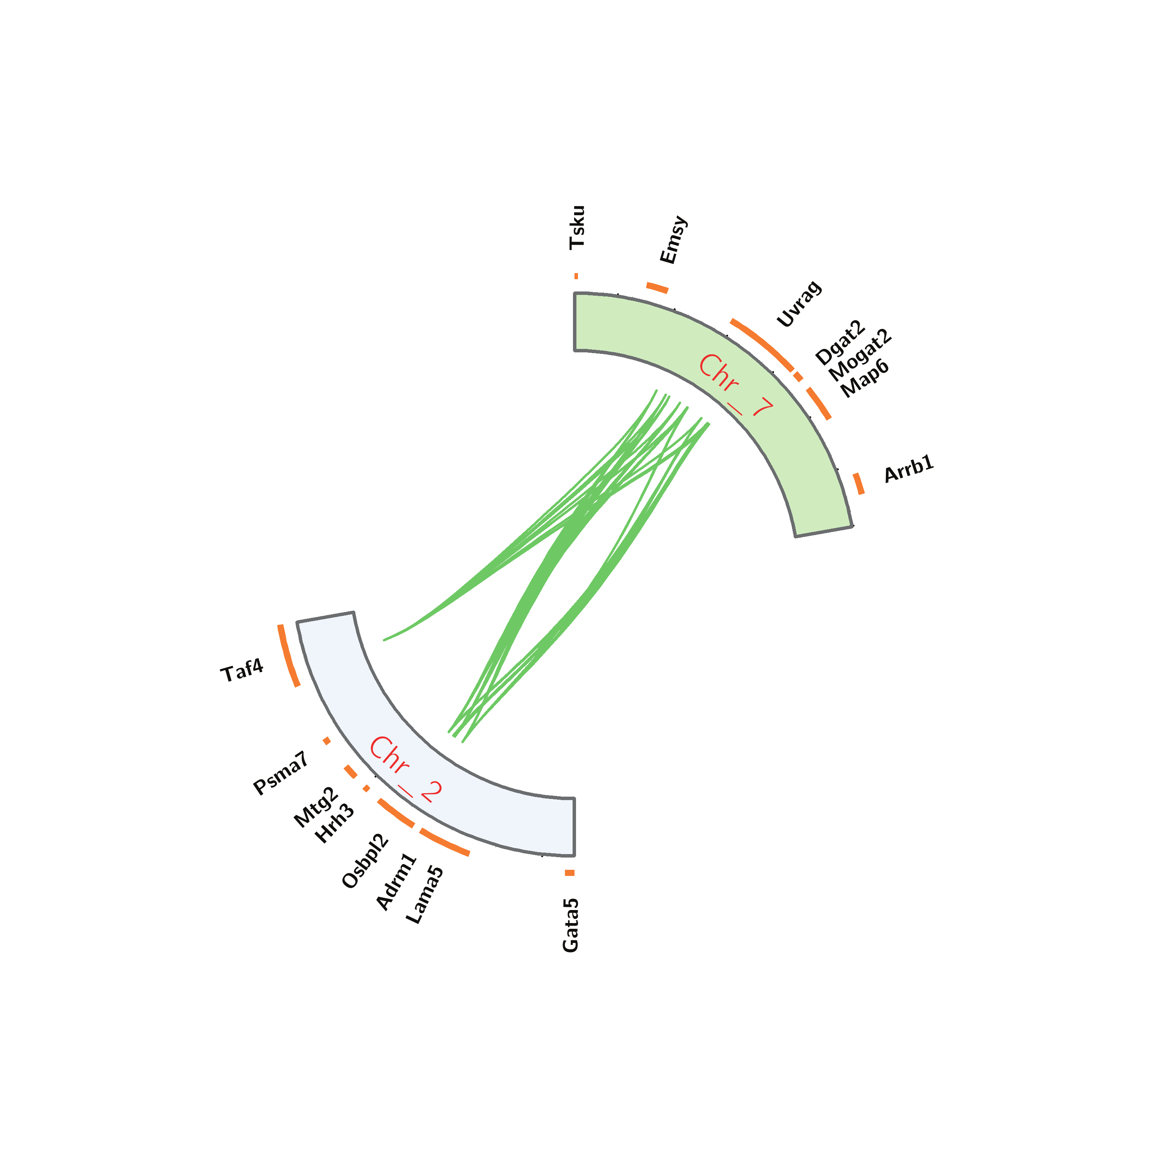
Our Pipeline Identified Epistatic Interactions between Two SNPs in Chromosome 2 and 7
p < 1e-8
Li, et al. Manuscript In preparation.

Slide 24
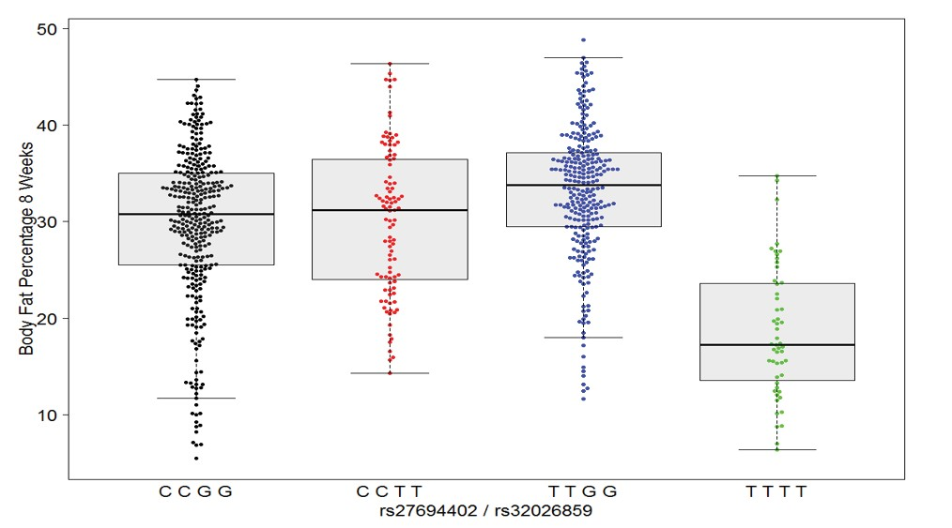
Epistatic Interactions between Two SNPs in Chromosome 2 and 7
Li, et al. Manuscript In preparation.

Slide 25
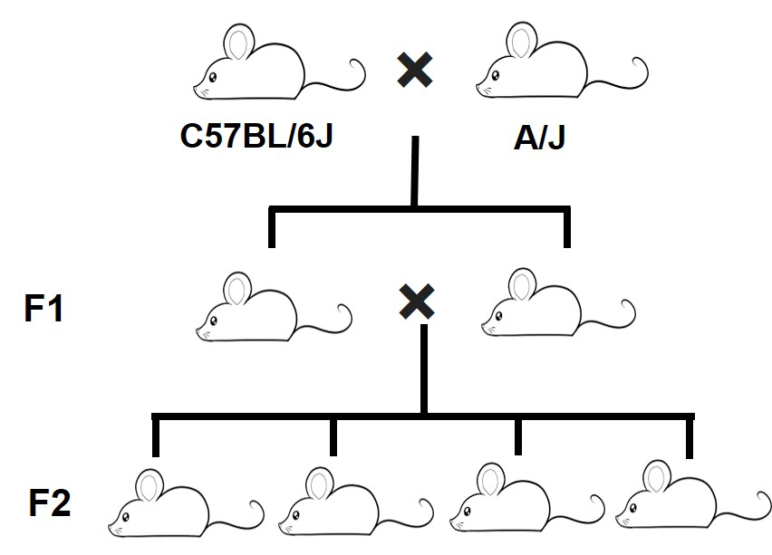
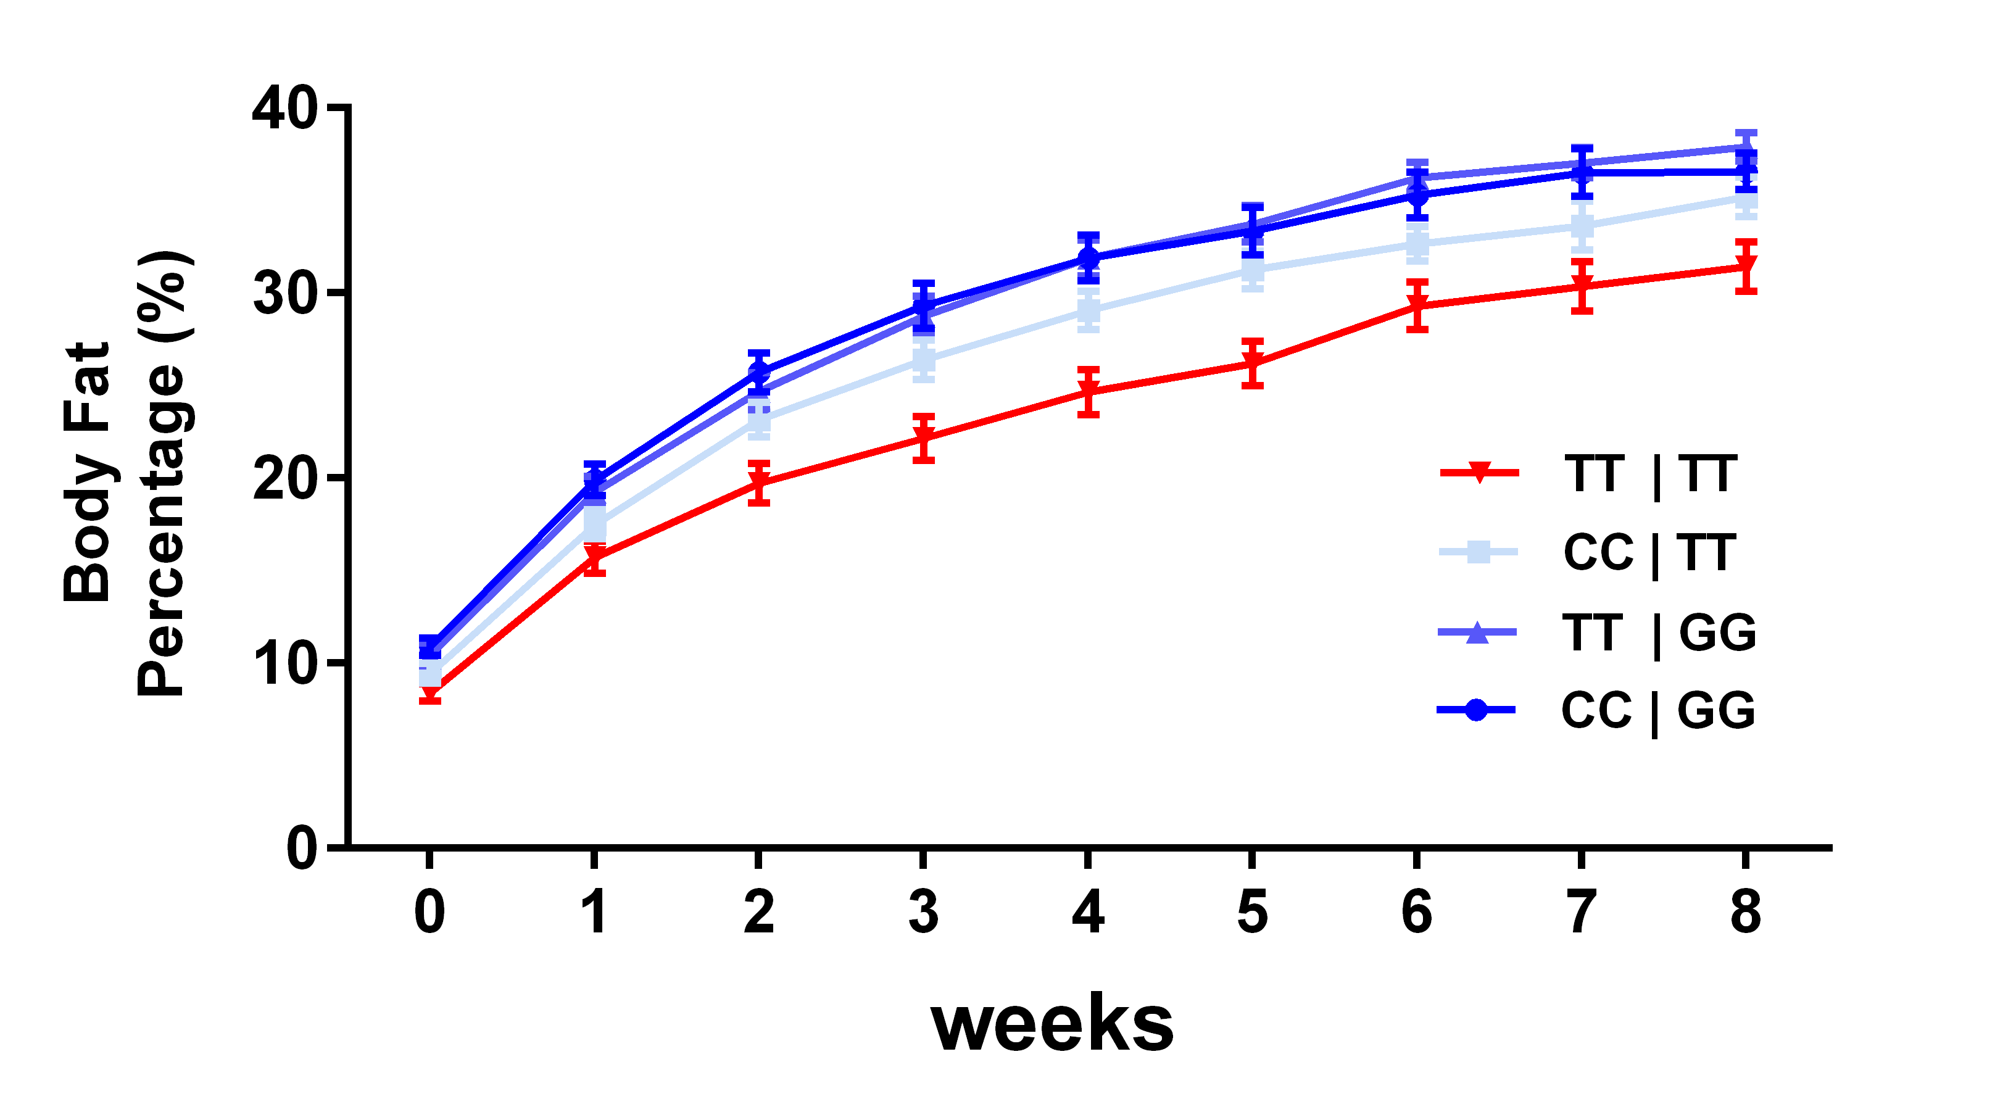
Validation of Epistatic Interactions By Mouse Crossing Model
Identified SNPs
Li, et al. Manuscript In preparation.

Slide 26
Advantages of Using OSG for Genomic Data Mining
High-Throughput Computing can be used for both repetitive (project 1) and computation heavy (project 2) computation tasks.
High-Throughput Computing saves large amount of computation time (2-3 years to 1-2 weeks).

Slide 27


Parks Lab
CHTC Team
Lauren Michael
Christina Koch
Brian Parks
Samantha St. Clair Jennifer Nguyen
Chris Gottsacker Zirui Tao
Fernanda Leyva Jaimes
Funding
NIH R01 HL147097-02
Molecular and Applied Nutrition Training Program

Slide 28
Thank You !

