Slide 1
Discussion on Physics Performance goals for ProtoDUNE II
Simon Peeters DS meeting, 2021.08.31

Slide 2
Content
What are the DAQ Physics Performance goals for ProtoDUNE-II?
These are some very first thoughts. I asked the question and there was no answer: this is to start the discussion. Please add, correct, etc.!

Slide 3
Content
What are the DAQ Physics Performance goals for ProtoDUNE-II?
These are some very first thoughts. I asked the question and there was no answer: this is to start the discussion. Please add, correct, etc.!
NOTE Not all of it is perhaps PP – but it is also not necessarily ‘someone else’s problem’ either and let’s start with casting the net widely. Again … for discussion.

Slide 4
Content
What are the DAQ Physics Performance goals for ProtoDUNE-II?
These are some very first thoughts. I asked the question and there was no answer: this is to start the discussion. Please add, correct, etc.!
NOTE Not all of it is perhaps PP – but it is also not necessarily ‘someone else’s problem’ either and let’s start with casting the net widely. Again … for discussion. I’ll making notes in this presentation (slide notes in PP) and will upload that final version to DocDB.

Slide 5
ProtoDUNE-I
Collection wire hit finding (FPGA, software, incl. ‘naïve’ induction wire hit finding)
Online trigger
Online monitoring of TP rate (very interesting for electron lifetime monitoring)
Noise model
Raw data files (for offline testing)
Notes:
Horizontal muon trigger

Slide 6
New in ProtoDUNE-II
ProtoDUNE-II
4 instead of 6 APAs
Flipped APAs (electronics on bottom)
Final components as much as possible
Vertical Drift with ethernet R/O
ProtoDUNE-II DAQ
New firmware (Induction wire hit finding)
Software framework
CCM/DQM
Possible new Upstream DAQ HW (later? Ethernet for VD) Further aims:
PDS hit finding
Combining collection/induction and collection/induction + PDS
ROI

Slide 7
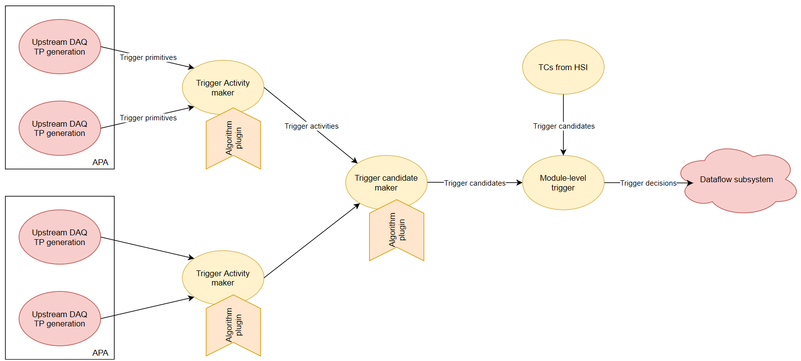
ProtoDUNE-II goals
DAQ (miniDAQ) performance (HD/VD)
Verify performance TP, TA, TC algorithms(metric/method?)
³⁹Ar?
Michel electrons (dE/dx range?)?
(figure from Phil R.)
Notes:
Rain of cosmics? TP verification – straight forward (multiple thresholds, see plots Phil R, Carl W – look at rate) - protoDUNE-I – didn’t make sense, need to see in pDUNE-II
TA harder:
39Ar: loads of contamination from spallation?
Michel: use trigger, nicely inclusive, prediction on rate.
Horizontal muons – sort f known.
Compare data to MC.

Slide 8
ProtoDUNE-II goals
DAQ (miniDAQ) performance (HD/VD)
Verify hit finding / clustering / trigger (metric/method?)
³⁹Ar?
Michel electrons?
ROI (metric/method?)
Notes:
RoI: either in
module level trigger. Should be OK. (APA / adjustable timing)
OR
high-level filter (not sure there will be one in ProtoDUNE-II).
Can do high-level filter offline and look at CPU requirements. Mind the interactions with dataflow.
Booking keeping.
MC DAQ model needed.

Slide 9
ProtoDUNE-II goals
DAQ (miniDAQ) performance (HD/VD)
Verify hit finding / clustering / trigger (metric/method?)
³⁹Ar?
Michel electrons?
ROI (metric/method?)
Get appropriate data files – which is??
Currently MC→miniDAQ, develop MC DAQ model and test?

Slide 10
ProtoDUNE-II goals
Verify / improve noise model HD
Develop one for VD
(figure from Pierre L./Babak A.)
Notes:
Model applied to the data to build the model.
If links look different, it is a problem – model is tuned.
Is there data included?
VD: two different noise models? Get VD people involved.

Slide 11
ProtoDUNE-II goals
CCM/DQM develop DAQ-based ‘physics’ monitoring Example: TP rate TC rate(s)?
Notes:
Pip – get a DQM talk in PP meeting.
TC rate – need to prescale.

Slide 12
ProtoDUNE-II goals
What would go into DAQ section of a ProtoDUNE-II paper?
Notes:
Highest trigger rate, how does this improve with included ROI.
Time it takes to run algorithms.
SN trigger: 10 EM showers from muons or something??
(Define TAs that could act as a burst trigger.)
Other avenue: pulsed neutron source – this gives a predictable (?) delta. Look at TA.
Man Rodriguez and someone else (Patricia Mendez)?
Compare to other trigger sources (CRT?)?
Tracks through APA-CPA-APA (signal on wall facing planes)

