Slide 1


302.4.01 Magnets Vertical Test at BNL
Weekly Report
Joseph F Muratore – BNL
04-Jan-2021

Slide 2
Return to Work Planning– Building 902 High Bay
Magnet Division Electrical Group
Date | Days | Probable Staff | Job | # of SMD staff | Staff %
Ph 1 | D+0 | William McKeon,Frank Teich, John Cintorino | Tower water, compressors for pump and purge. | 6 | 15
 |  | Ray Ceruti, Glen Jochen, Toby Levin | Coil fabrication preparation.
 |  |  | DI water, QA cable, start cryo plant.
Ph 2 | D+15 | Above+ Piyush Joshi, Honghai Song | Validate and debug field measurement | 21 | 50
 |  | Sebastian Dimaiuta, Daniel Sullivan | LabView program.
 |  | Joseph Muratore, Patrick Doutney, Richard Felter | AUP magnet preparation.
 |  | William Themann, Dominick Milidantri | QA cable, start cryo plant, start coil fabrication.
 |  | Matthew Milidantri,Drew Carleton, Michael Hartsough | Alpha G.
 |  | Thomas Van Winckel, Jesse Schmalzle, Andy Marone
Ph 3 | D+30 | Above + Peter Galioto, Suresh Deonarine, Jorge Galarraga | Start AUP magnet testing. | 30 | 75
 |  | Shresht Joshi, Anis Ben Yahia, Henry Hocker, Paul Kovach | Prepare 10kA and 8kA PS for
 |  | Michael Anerella, Chris Runyan | sweet spot magnet testing.
Ph 4 | D+45 | Above + John Cozzolino, Steve Plate, Ramesh Gupta | Engineering and scientific work. | 40 | 100
 |  | Brett Parker, Kyle Capobianco, Kathleen Amm
 |  | Peter Wanderer, William Sampson, Marteenio Sams,
 |  | New Admin
Started 1-June
Started 18-June
Started 6-July
P. Joshi and K Amm.
NOTE: Long Island is close to the being a Red Zone.

Slide 3
CRYOGENICS UPDATES
  Work on CTI4000 in progress:
    New Phase 1 heat exchanger (LN2) is in place. Welding to pipes is finished.
    One expansion engine rebuilt.
    Other expansion engine had regular maintenance done.
    Need:
      Pressure test.
      New valves to protect heat exchanger: one is in place, the other is waiting bracket for mounting and wiring. IN PROGRESS.
      Programming for control of new valves. IN PROGRESS.
      In-line purifier heater has a short that requires repair. IN PROGRESS.
  Cryogenic tech out on medical indefinitely. Close to returning.
  CTI4000 cooldown: latest estimate – still looking for 14-January 2021.

Slide 4
QUENCH ANTENNA UPDATE
  Quench antenna to be shipped to Fermilab for amplifier replacement on noisy channels.
  Packed in warm bore tube crate and ready to ship.
    No need to use coil crate.
    Fits without bending cables on lead end.
  Shipped Fri 12-Dec afternoon.
    Dedicated, air ride truck, as for coils.
    Should arrive today Mon 14-Dec.
  Arrived Fermilab on Mon 14-Dec
  Work by Joe D in progress at Fermilab.
  Cooldown of MQXFA05 now to start 14-Jan-2021.

Slide 5
MQXFA05 UPDATE
  Magnet bore video done.
  New centering fixture installed and checked for concentricity within 0.1 mm.
  Spacers to be added to WBT. Manufacturing request has been sent to BNL Central Shop.
  There might some delay since some shop personnel are out on medical/contact quarantine.
  Main and MM Test Plans are finished.
  Magnet is now in vertical test stand (Dewar 2).
  WBT with return end centering fixture installed.
  WBT bumpers not yet ready.
  Room temperature z-scan at ±15 A.
  Preliminary analysis: Centering offsets about half that of MQXFA04.
  Cooldown of refrigerator and magnet 300-100K cooldown to start 14-Jan-2021.

Slide 6
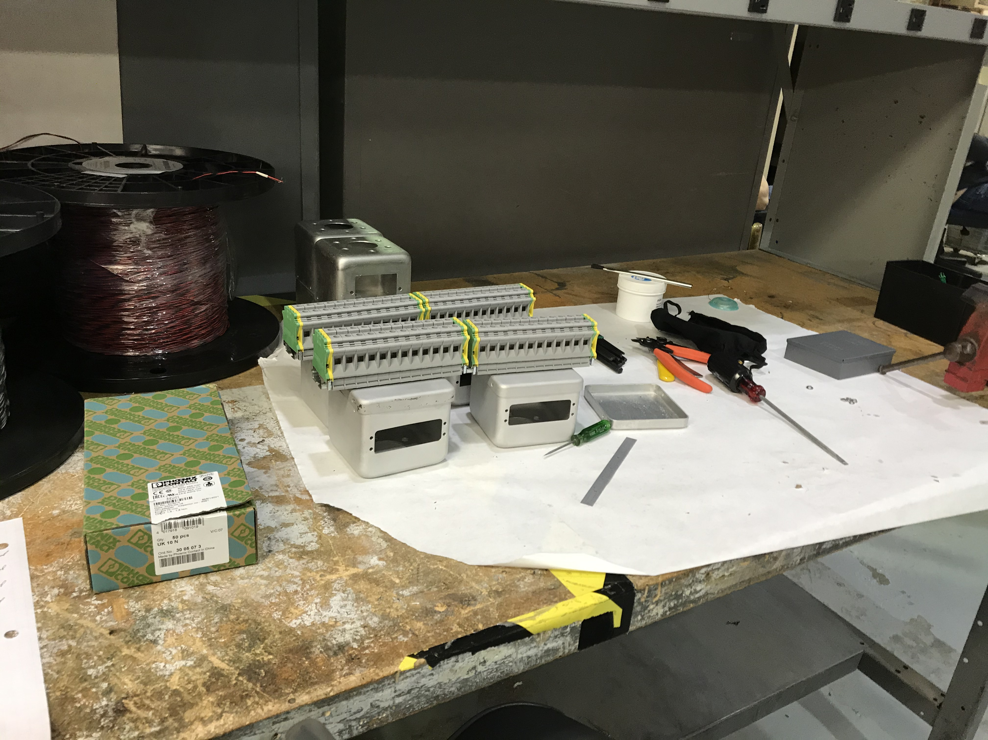
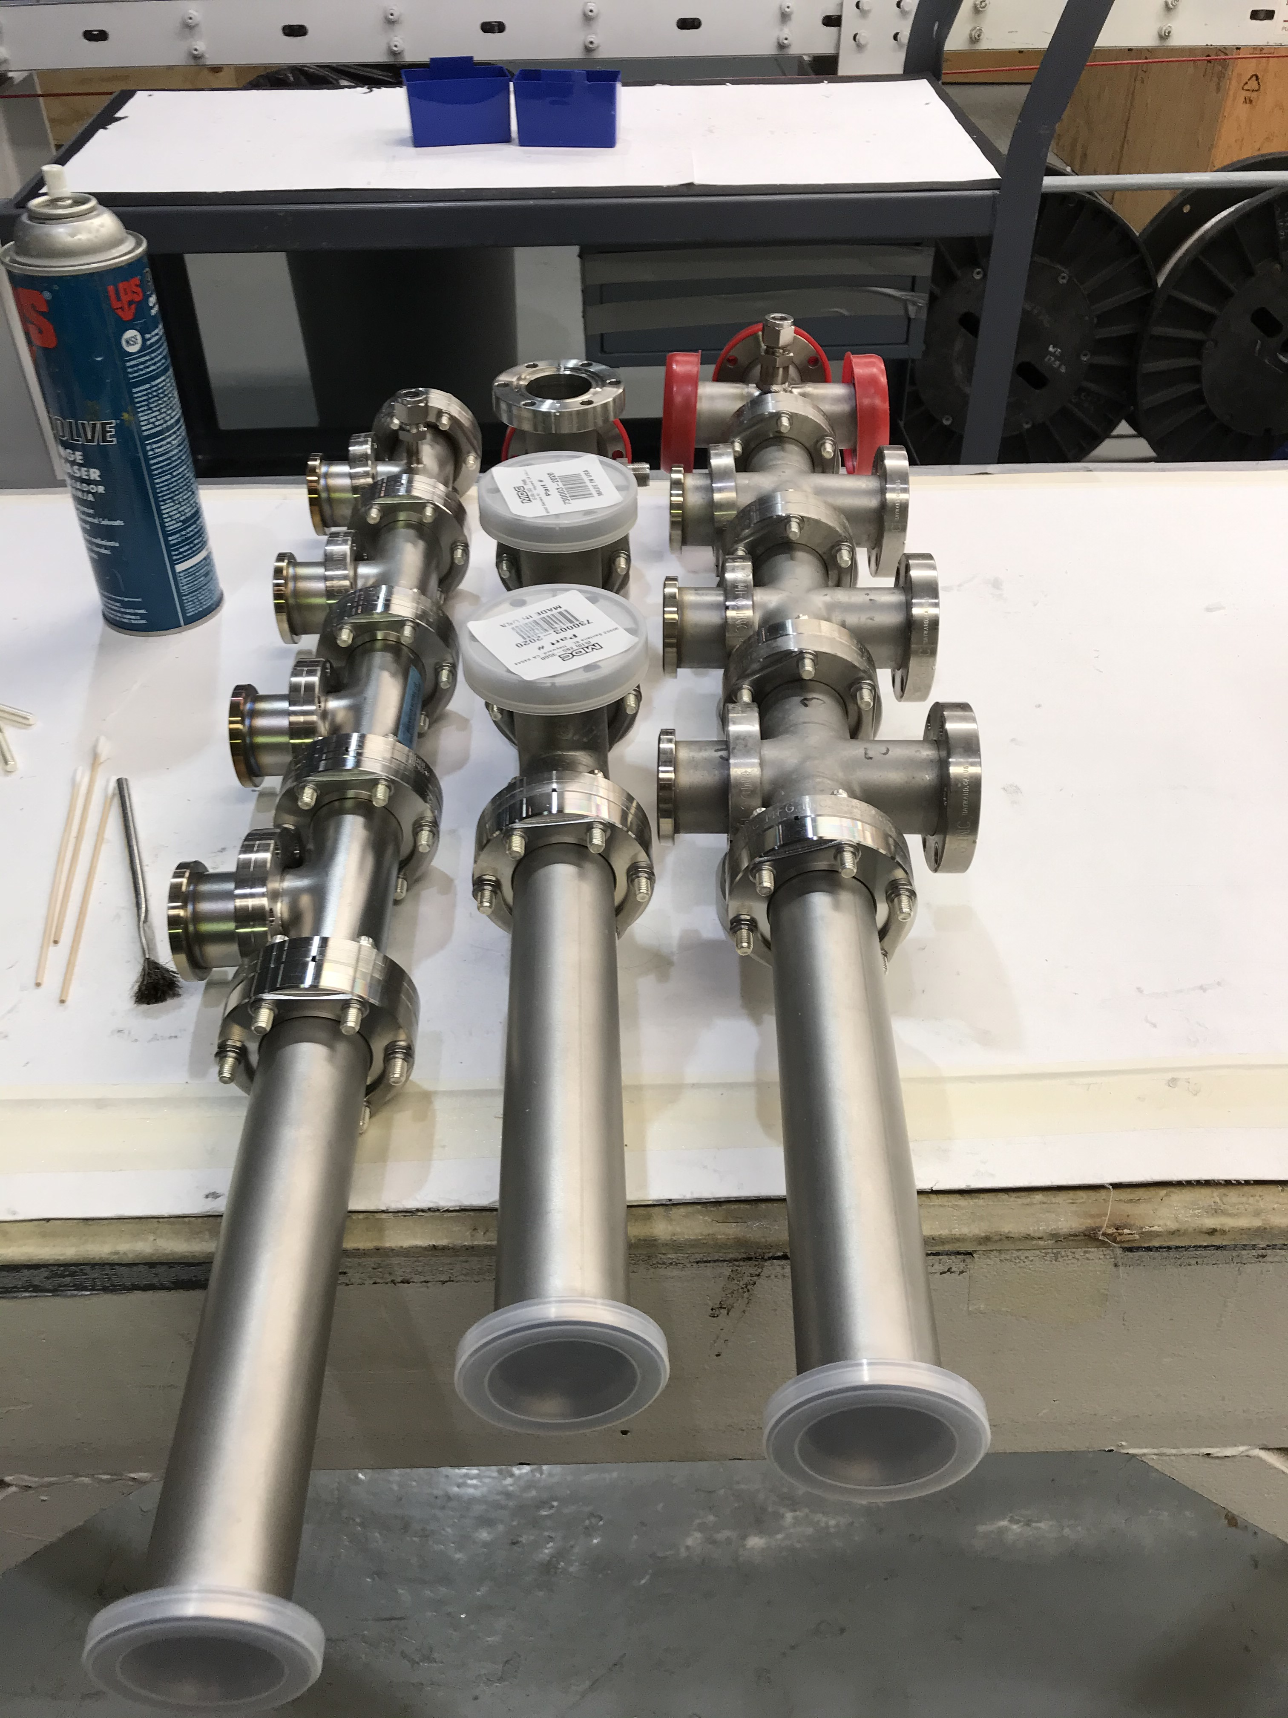
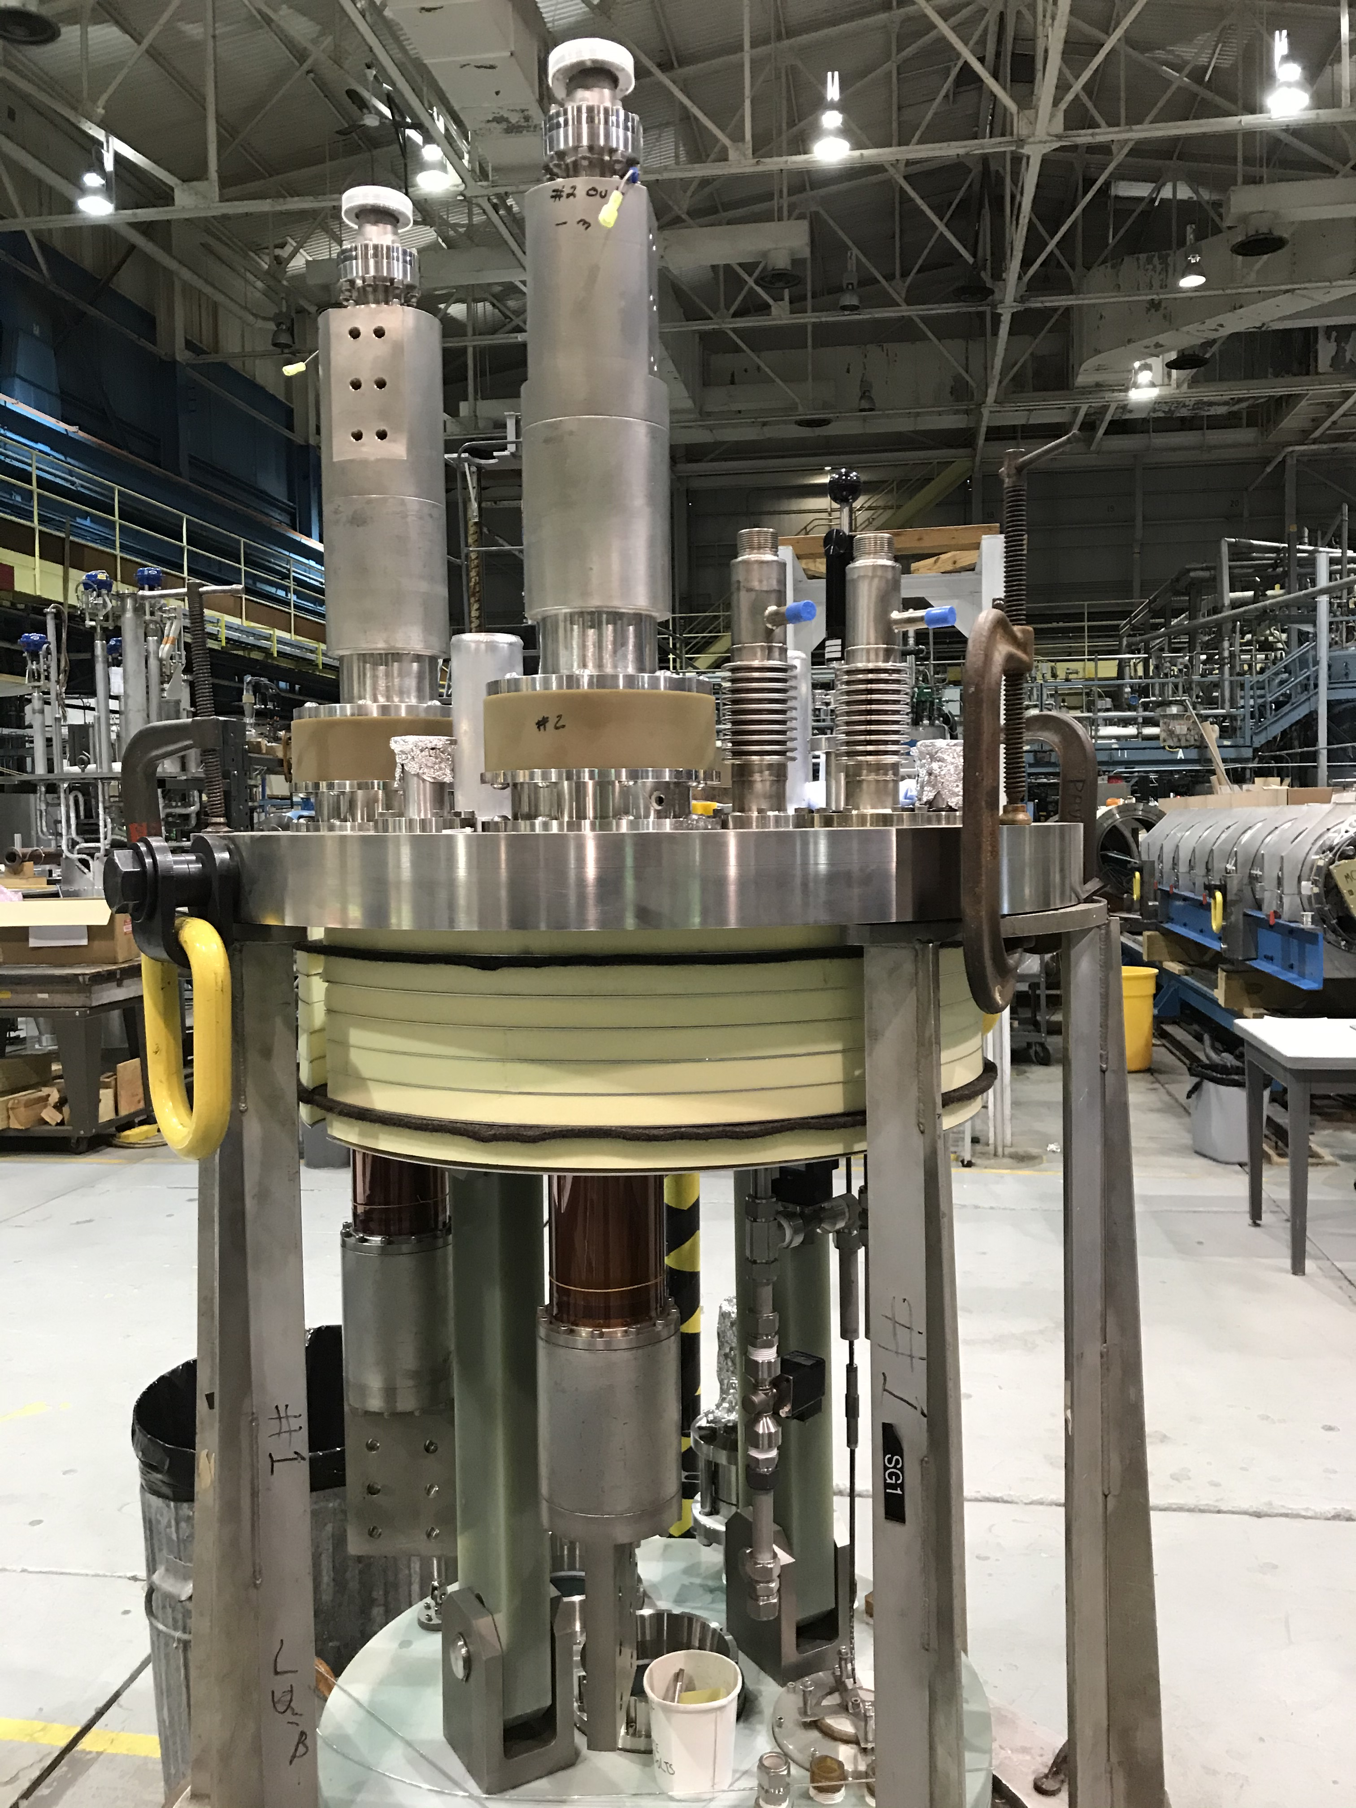
2nd TEST FIXTURE UPDATE
  Work on second top plate/test fixture in progress.
    Mains and CLIQ leads are installed.
    Lambda plate and hanging hardware are installed.
    Still to be done:
      Connector trees and wiring.
        Wiring for connector trees was in progress with tech dedicated to this work. Tech now back after quarantine due to COVID contact.
        New electrical and mechanical techs are being hired and will be helping with remaining work.

Slide 7
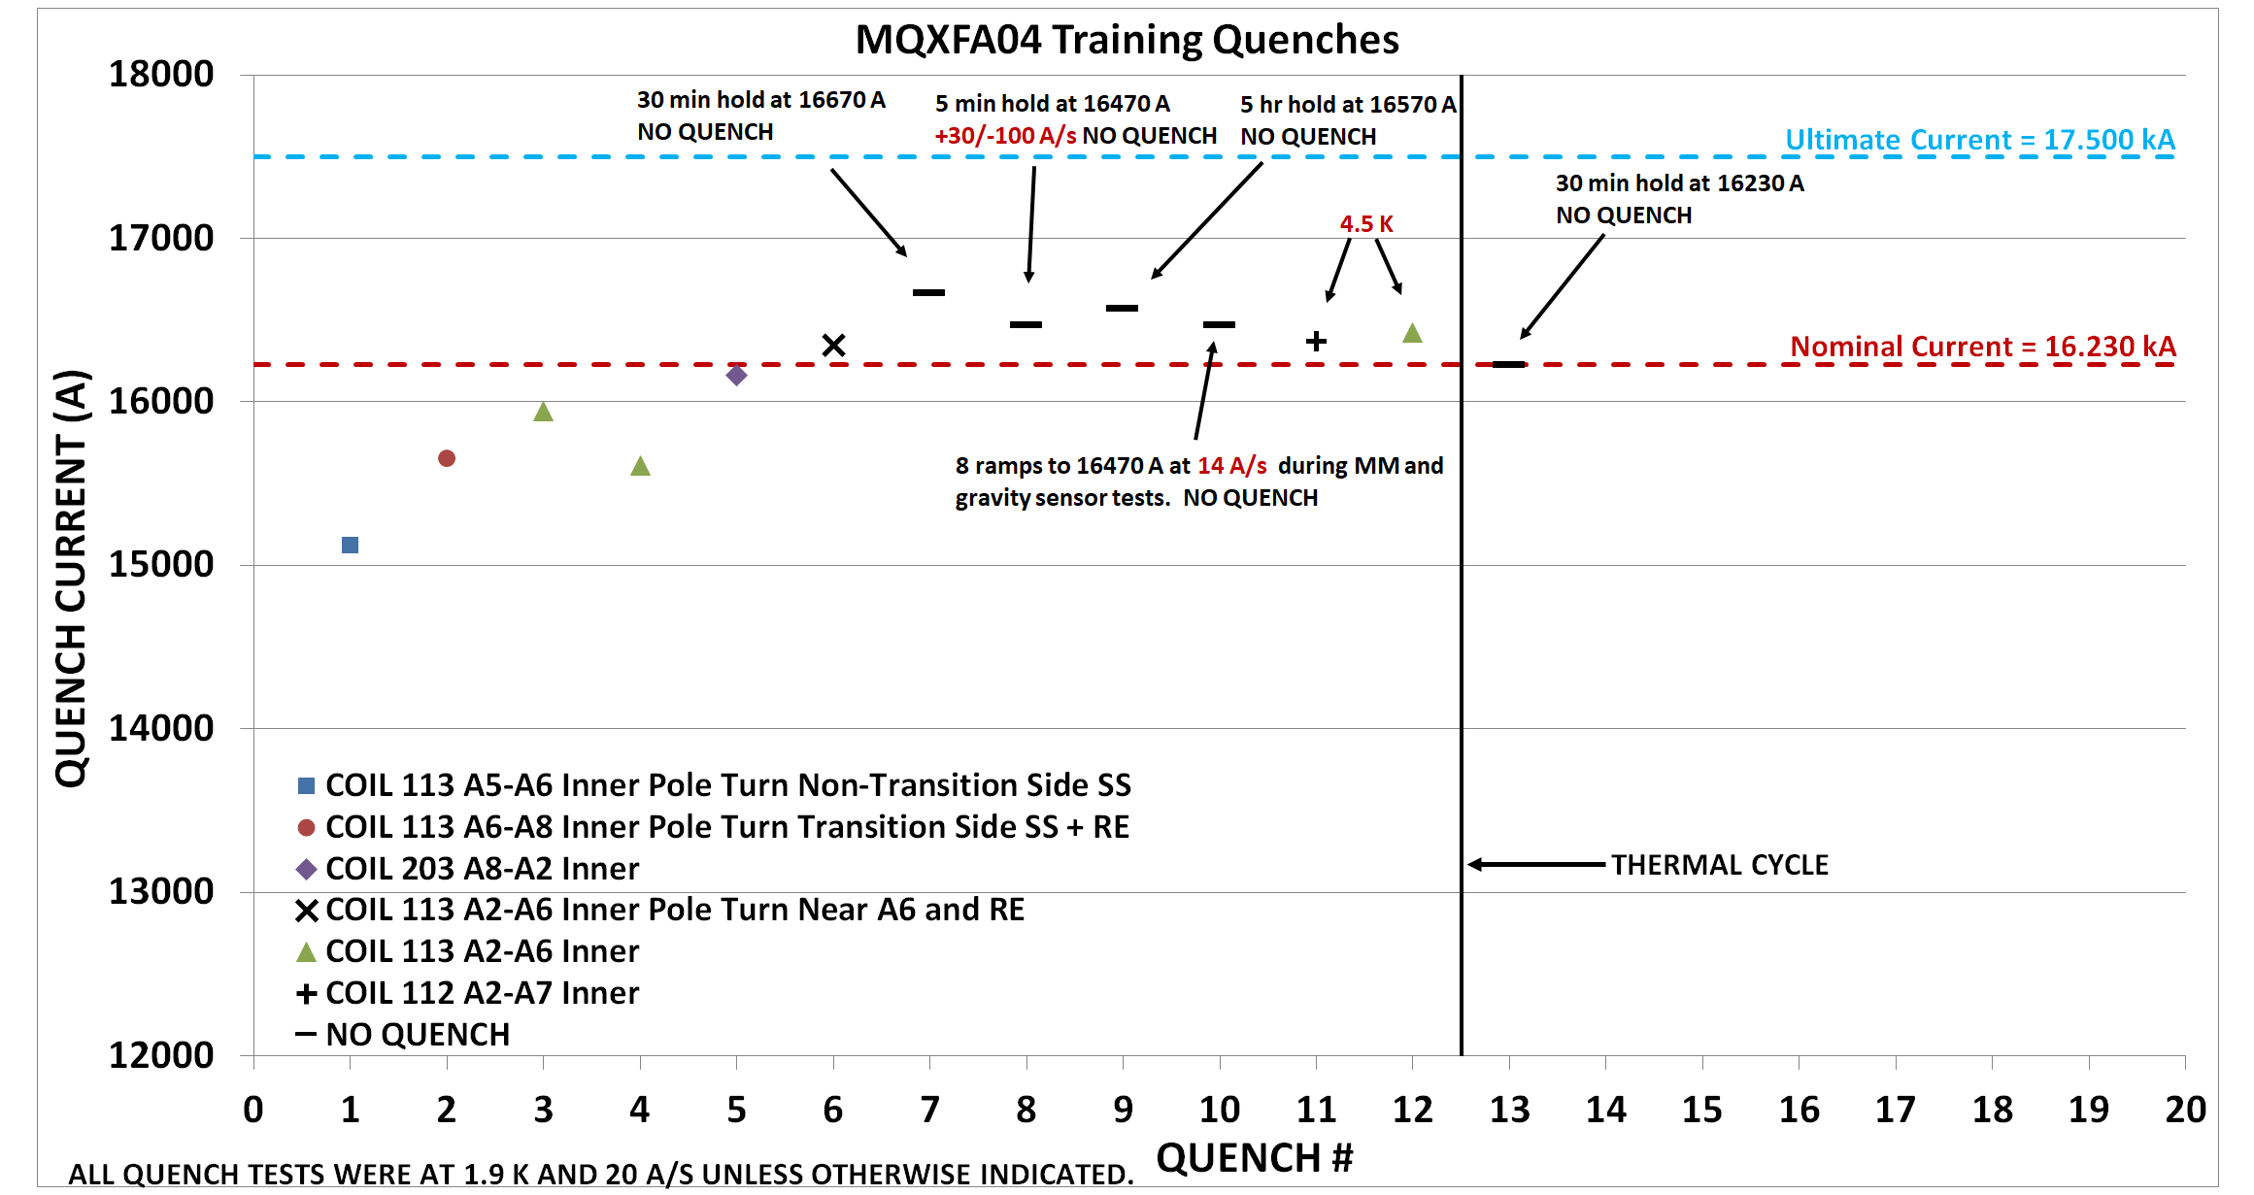

Slide 8
MQXFA04 UPDATE
  Final electrical measurements are done – all tests OK. Electrical check sheets (Excel) are finalized.
  Test summary for CERN done.
  Magnet at Fermilab.

Slide 9
MQXFA03 UPDATE
  Magnet at Fermilab.
  Missing jam nuts from return end found.
  Were removed to install micarta centering fixture for warm bore tube.
  Nuts placed in hardware cabinet and not re-installed before shipping.
  “Rust” on threads probably micarta dust.

Slide 10
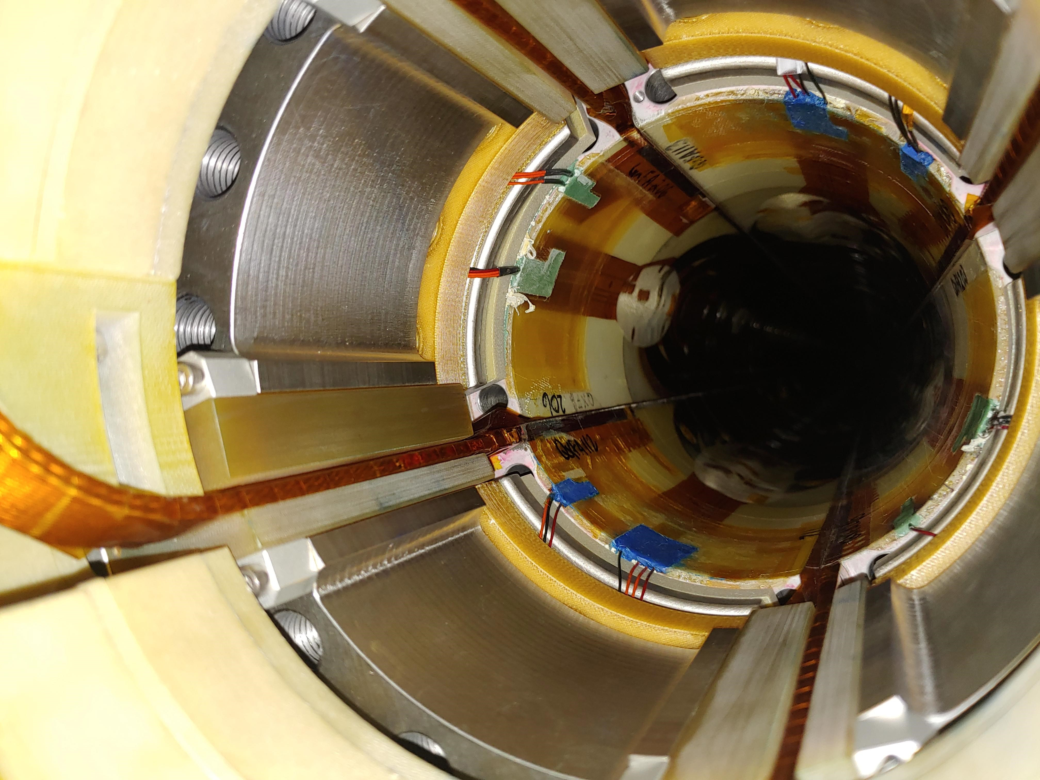

Slide 11
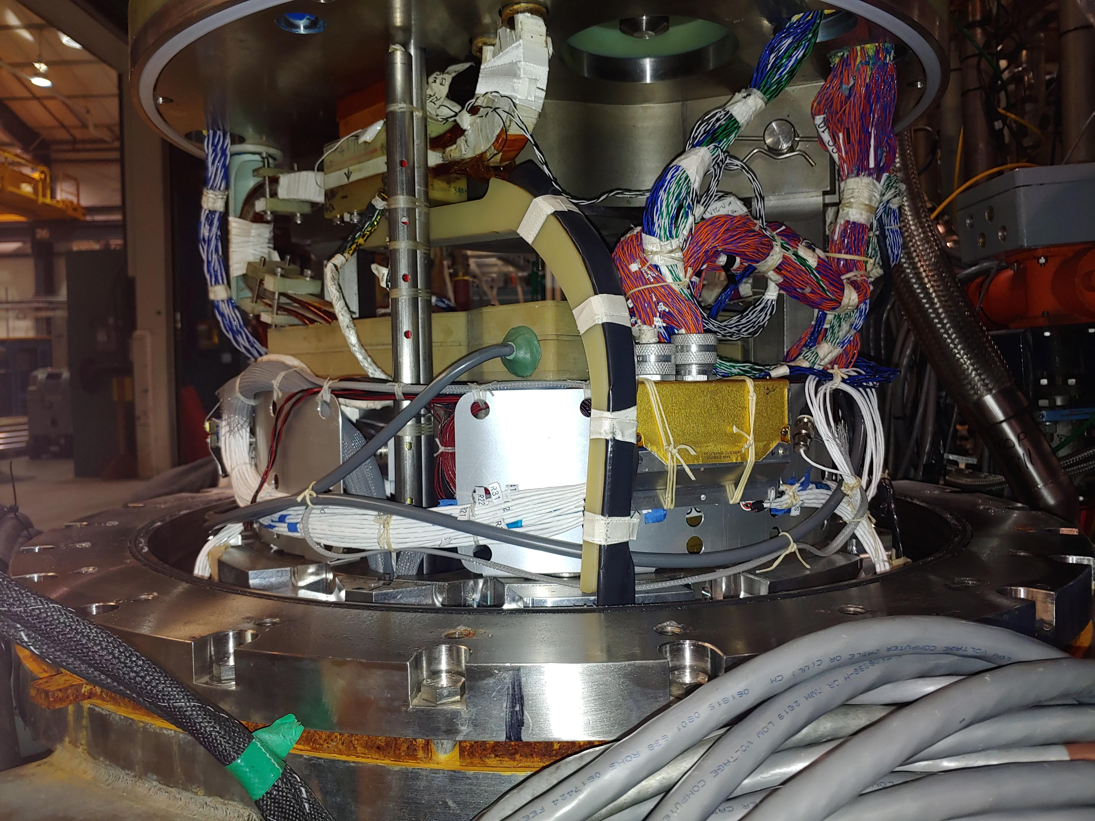

Slide 12
