Slide 1
Cryostat Assembly Status Update
R. Rabehl
January 4, 2021

Slide 2
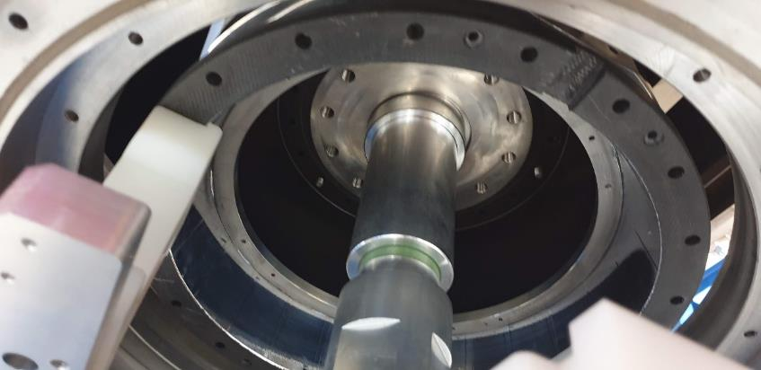
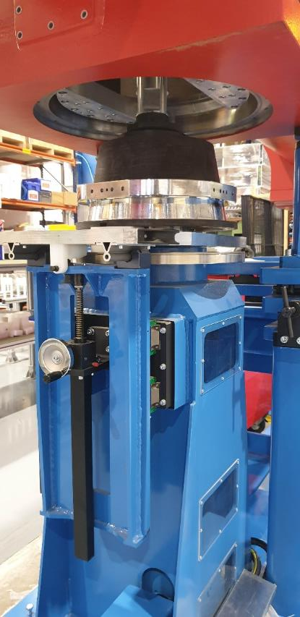
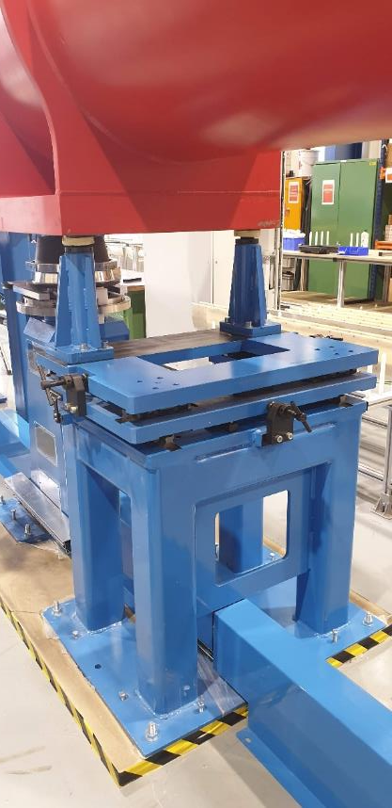
Vendor travel/visas
Visa interviews for Applus+ personnel were completed on December 10.
Two people from the original 4-person team will not travel to Fermilab due to personal reasons.
Two people (1 engineer, 1 technician) will travel to Fermilab.
Visas have been updated with the requested travel dates, so Applus+ personnel are planning to travel on January 18th.
Fermilab tooling installation planned to begin on Tuesday January 19th. Final travel plans still to be confirmed.
Fermilab will provide additional technicians.
Based on personnel used during CERN tooling installation, we have secured 2 IB2 mech techs and 3 IB1 mech techs.
Vendor will subcontract alignment services.
CMMS
Applus+ plans to place a P.O. with them this week.
Planning for alignment work on Friday, January 22

Slide 3
Fermilab COVID rules
Latest Fermilab rules have provisions for when a 14 day quarantine is not possible
Division Head approval
Follow all safety protocols (PPE, distancing)
COVID-19 test administered by Fermilab Medical Office 5 days after arrival

Slide 4
Preparations for vendor visit
Fermilab Task Manager (Kelly Sedgwick) is addressing the on-site work requirements
Hazard Analysis in progress – second draft circulated late last week
Badge applications for both Applus+ visitors completed cooperatively via Zoom
Additional requirements for arriving/beginning on-site work are known
Both visitors will be on the Essential Personnel list, their passports will get them on-site, and we will arrange an escort to bring them to the ICBA work location.
Contractor Orientation class
Get badges at Wilson Hall Badging Office
Inspection by the ES&H Electrical Safety Officer of any power tools they bring with them.
Read and sign the HA
CMMS has been contacted to begin the badging process for their technician.

Slide 5
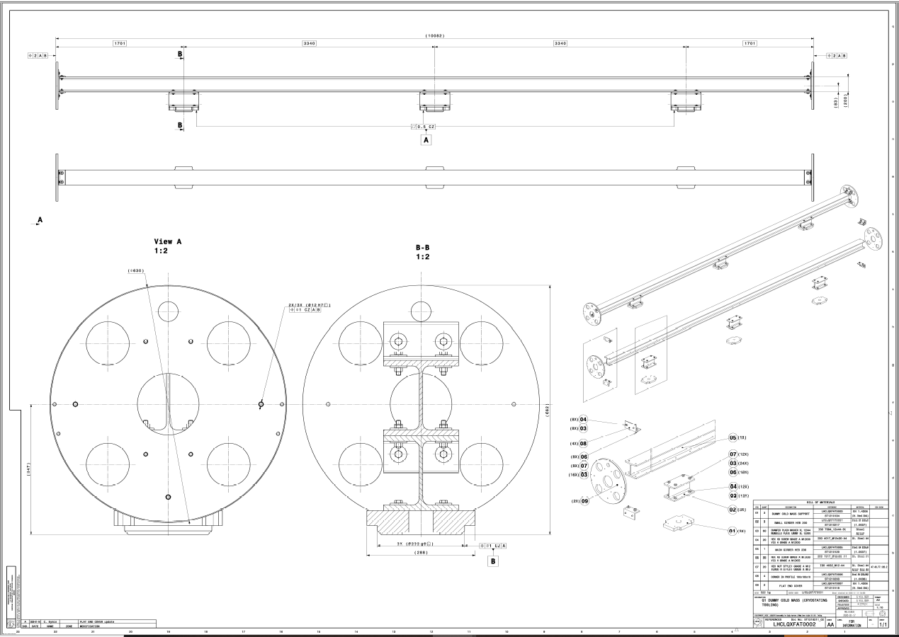
Dummy Cold Mass
CERN strongly prefers using a dummy cold mass rather than an actual cold mass to commission the cryostat tooling.
Because we cannot fully commission the cryostat tooling until a vacuum vessel is available, we will plan to have a dummy cold mass available to coincide with arrival of the first cryostat kit.
An engineer is working with the Fermilab Machine Shop to begin fabrication of parts.

Slide 6
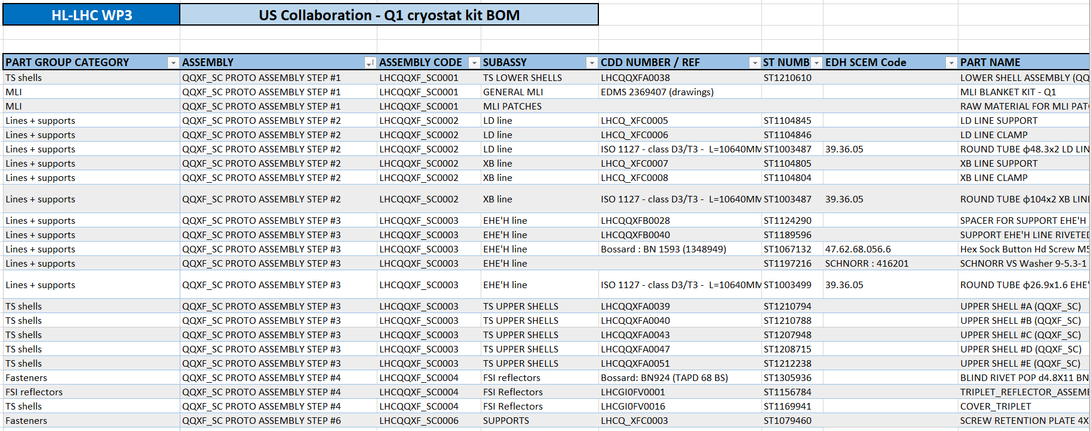
Cryostat
First cryostat kit to ship at the end of January.
Progress in making vacuum vessels leak-tight using silicone-oil lubricated o-rings, which are already in use throughout the LHC.
Cryostat kit would be received in late February-early March.
Have received the bill of materials for the first Q1/Q3 cryostat kit. A few items, such as the CLIQ/k-mod/IFS cover flange assemblies, may need to be shipped separately in January 2021.

