Slide 1
Neutrino Beamline Prototype Horn A Final Design Review
Requirements, Interfaces, Parameters
Cory Crowley / Keith Gollwitzer
26 January 2021

Slide 2
Outline
CERN EDMS Requirement Listing
Requirements Applicable to Horn A
Interfaces
Interface Matrix
Major Interfaces
Parameters & Specifications Document
Summary

Slide 3
CERN EDMS Requirement Listing

Slide 4
CERN EDMS Requirement Listing
id | Artifact Type | Name | Primary Text
1299 | Requirement | Horns - event rate | The horns shall be designed to maximize the neutrino event rate in the far detectors in the desired energy range that covers the first and second neutrino oscillation maxima
1300 | Requirement | Horns - conductor heating | The horns shall have conductors that are able to endure the combined heat load from beam heating and resistive heating
1301 | Requirement | Horns - conductor thickness | The horns shall have inner conductors whose thicknesses are minimized to avoid absorbing the mesons
1302 | Requirement | Horns - conductor stresses | The horns shall survive repetitive thermal and magnetic stresses over a minimum of 100,000,000 pulses
1303 | Requirement | Horns - remote operation | The horns shall have connections that are able to be made or unmade remotely
1304 | Requirement | Horns - target fitting | Horn A shall accommodate the target support tube fitting through the inner conductor with a nominal 5mm radial clearance.
1305 | Requirement | Horns - inert gas | The horns shall be filled and actively flushed with inert gas
1306 | Requirement | Horns - exhaust hydrogen | The horns shall have the provision to exhaust accumulated hydrogen gas
1307 | Requirement | Horns - conductor shape | The horns shall be constructed of aluminum for maximum event rate and ease of manufacturing.
1308 | Requirement | Horns - water drain port | The horns shall minimize the required size and locational impact of the water drain ports, to minimize magnetic field distortion.

Slide 5
CERN EDMS Requirement Listing
1309 | Requirement | Horns - Target De-coupling | Horn A shall allow independent replacement of the integrated target while remaining attached and instrumented through its support module.
1310 | Requirement | Horn Modules - carry weight | The horn modules shall carry the weight of the horns and be mounted to target hall support structures
1311 | Requirement | Horn Modules - alignment mechanisms | The horn modules shall have mechanisms that allow the horns and target to be aligned to the required tolerances of beam optics
1312 | Requirement | Horn Modules - integrated shielding | The horn modules shall be integrated with internal shielding tee blocks and external target shield pile blocks to minimize radiation exposure above the target pile
1313 | Requirement | Horn Modules - remote operation | The horn modules shall have remotely disconnectable features for all sensor and cooling water utilities to minimize exposure to workers during maintenance and replacement operations
1314 | Requirement | Horn Modules - support striplines | The horn modules shall support stripline blocks to provide current to the horns
1315 | Requirement | Horn Modules - service life | The horn modules shall have a service life equal to that of the LBNF 20 complex.
1316 | Specification | Horns - life | The horns shall be designed to last for at least 2 years or 100 million pulses
1317 | Design choice | Horns - conductor straightness | The horns shall have an inner conductor straightness tolerance of 0.5 mm
1318 | Specification | Horns - conductor variation | The horns shall have an inner conductor thickness azimuthal variation < 2%
1319 | Specification | Horns - chase width | The horns shall fit within a minimum target chase width of 78.5 inches and this space shall be uniform around all horns.
1320 | Specification | Horn A - I.C. Thickness | Horn A shall maintain an inner conductor thickness of 2.5mm where possible

Slide 6
CERN EDMS Requirement Listing
1321 | Specification | Horn B - I.C. Thickness | Horn B shall maintain an inner conductor thickness of 3mm where possible
1322 | Specification | Horn C - I.C. Thickness | Horn C shall maintain an inner conductor thickness of 4mm where possible
1323 | Design choice | Current Equalization Sections | All horns shall integrate current equalization sections into the inner and outer conductors where possible.
1324 | Specification | Horn Modules - max weight | The horn modules shall not exceed 60 tons in weight each, including their associated horns, utilities, baffle, etc (the crane limit)
1325 | Design choice | Horn Modules - water cooled | The horn modules shall be sufficiently cooled up to a maximum beam power of 2.4MW to prohibit excessive thermal displacement or material strength degredation.
1326 | Design choice | Horn Modules - Materials | The horn modules shall be constructed from steel and encased with corrosion resistant stainless steel where required. Steel surfaces shall be primed with Aeroglaze or equivalent epoxy coating.
LBNF/DUNE Requirement Listing broadly covers what Horn Systems are expected to deliver.
Some items are direct, such as conductor straightness (1317) & thickness (1320).
Others such as target fitting (1304) & decoupling (1309) can only be achieved through iterative design with all interfacing systems.
Some have been major design effort drivers:
Conductor Heating, Remote Operation, Target Decoupling, Lifetime Requirements.

Slide 7
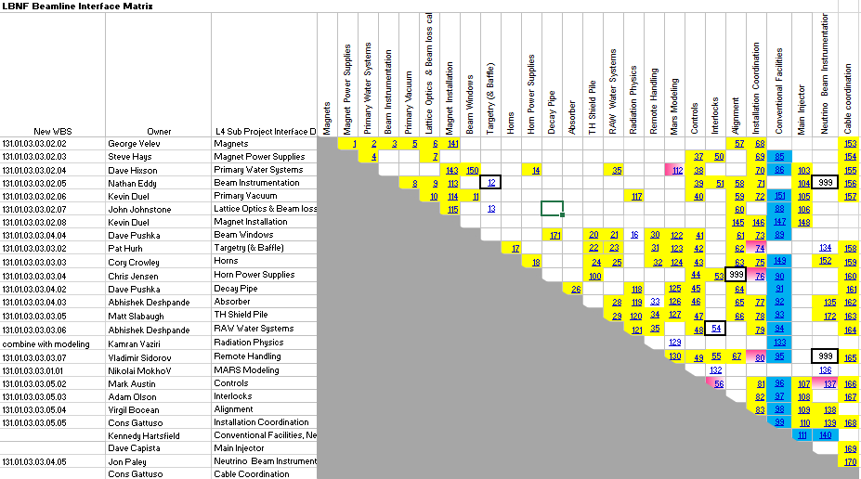
Interface Matrix
Interfacing elements with Horn A have been identified, defined, and are under change control with Beamline management.

Slide 8
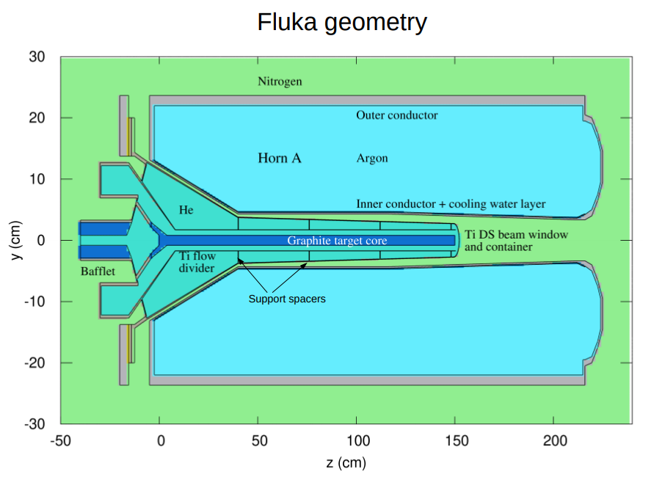
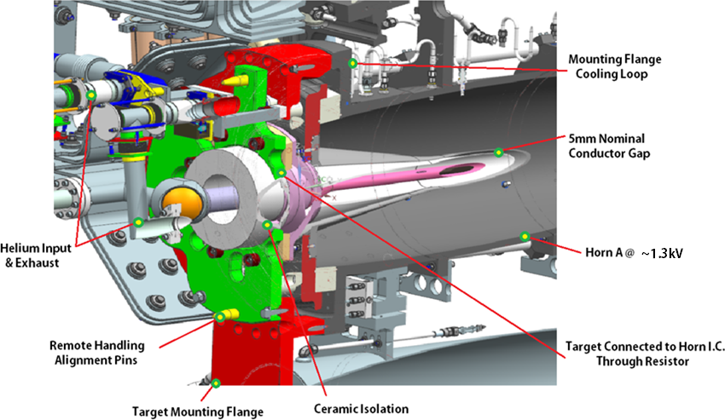
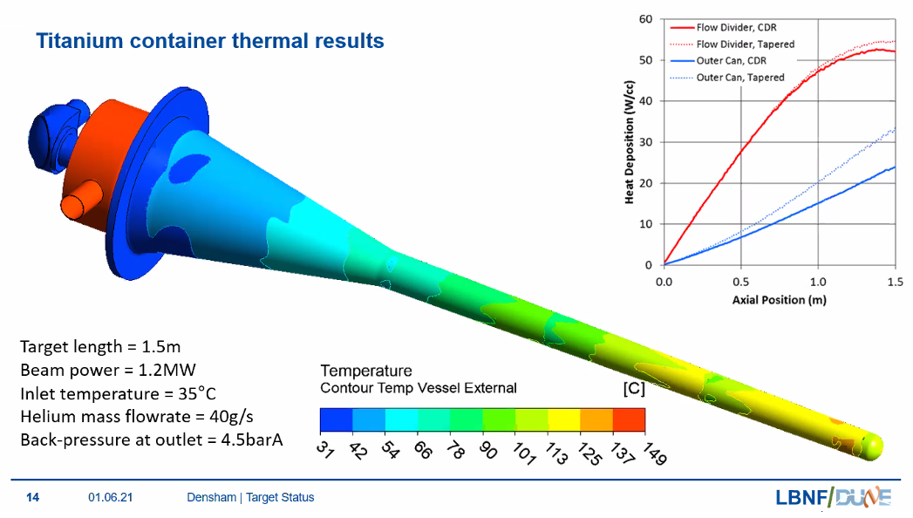
Major Interfaces - Target
Credit: RAL
Credit: Z. Tang

Slide 9
Major Interfaces - Target
Credit: Patrick Hurh
Beam-Based Alignment (BBA - HADES)
 |  | NuMI Values | LBNF Values | NuMI Comments | LBNF Comments | Current estimate | Squared
 |  | (+/- mm) | (+/- mm) |  |  | (+/- mm)
 | Bafflette alignment to Target Core (or target fiducials for as-found) | N/A | 0.1 | NuMI target does not need Bafflette | As-found survey needed more than alignment to target +/- 0.1 mm might be achieveable. Symmetry is desired to ease BBA - HADES process. Manufacturing/Assembly process needs to be optimized to achieve acceptable alignment. Current guess is +/- 0.25 mm may be achievable. | 0.1 | 0.01
 | Uncertainties in BBA-HADES measurement (US end; via bafflette features) | 0.2 | 0.2 | Includes uncertainties from BPM measurement and beam size fluctuations (K. Yonehara) | Assumes LBNF can achieve same level of uncertainty as NuMI (J. Paley)
 | Uncertainties in BBA-HADES measurement (DS end; via center of mass) | 0.2 | 0.2 | Includes uncertainties from BPM measurement and beam size fluctuations (K. Yonehara) | Assumes LBNF can achieve same level of uncertainty as NuMI (J. Paley). | 0.2 | 0.04
 | Target Core to Target Fiducials | ? | TBD | NuMI-NOvA targets can directly survey graphite core fins to tooling balls prior to target closure (probable value of +/- 0.05 mm?) (V. Bocean to check) | Includes uncertainties from thermal expansion gaps, mechanical tolerances, and survey accuracy. Current rough estimated value is +/- 0.15 mm (if measured after target closure) | 0.3 | 0.09
 | Target Fiducials to Horn A Fiducials | N/A | 0.05 | Target is not mounted to Horn | Fiducial to fiducial is limited only by survey accuracy (V. Bocean to check) | 0.05 | 0.0025
 | Horn A Fiducials to Horn A/1 Geometric Center Line | 0.15 | 0.0254 | Inner conductor CL determined from depth micrometer measurements through nozzle ports. Need to understand from nozzle ports to Horn 1 fiducials. | Potential to improve measurements for LBNF with more controlled nozzle port machining tolerances? Or Removable fiducial tool to measure IC CL from the ends (C. Crowley confirms depth micrometer check to I.C. position from outer conductor fiducial surface has resolution of .001" / .0254mm | 0.0254 | 0.00064516
 | Horn A/1 Geometric Center Line to Magnetic Center Line | 0.5 | 0.3 | NuMI checks that centroid in one location (at IC neck) is within (+/-) 0.5 mm. Then Geometric Center Line is used for the Horn 1 alignment | Potential to reduce uncertainties for LBNF with more controlled nozzle port machining tolerances and location,, better field probe control and other modifications? Maybe to +/- 0.25 mm? (C. Crowley added opposing field mapping ports 11/2020 to improve accuracy) | 0.3 | 0.09
 |  |  |  |  |  | 0.98 | 0.48
 |  |  |  |  |  | Linear sum | Quad sum

Slide 10
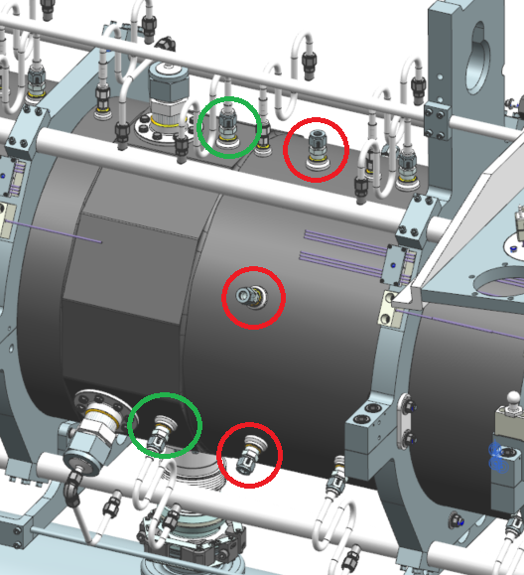
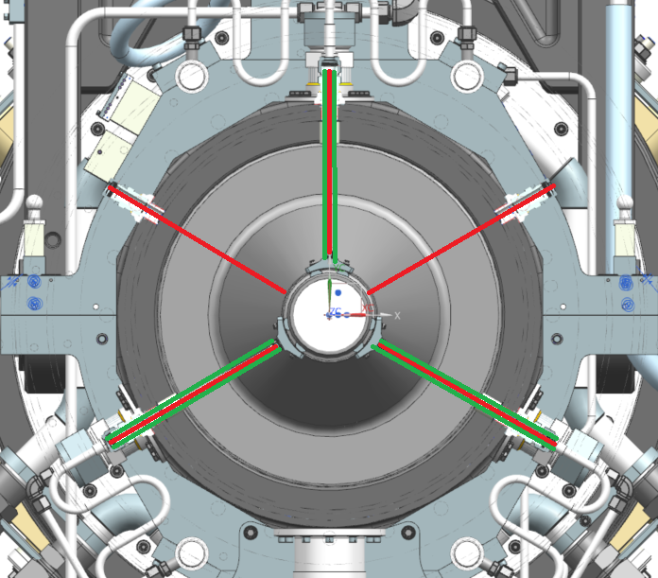
Alignment Interface
Well defined fiducial surfaces exist for depth mic measurements.
Dedicated ports added for radial field mapping with opposing ports where possible to simplify data analysis & resolution of magnetic centerline.

Slide 11
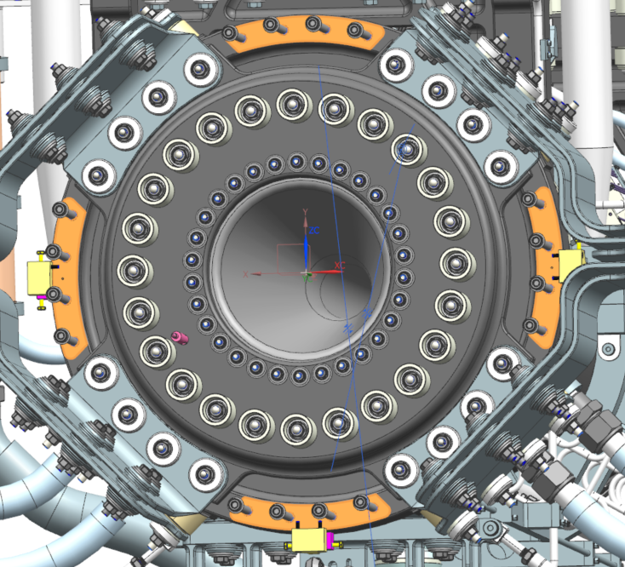
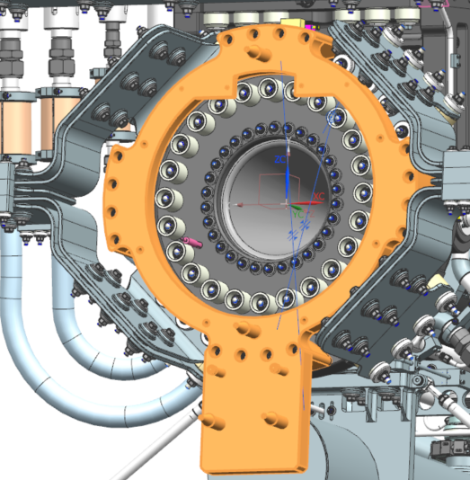
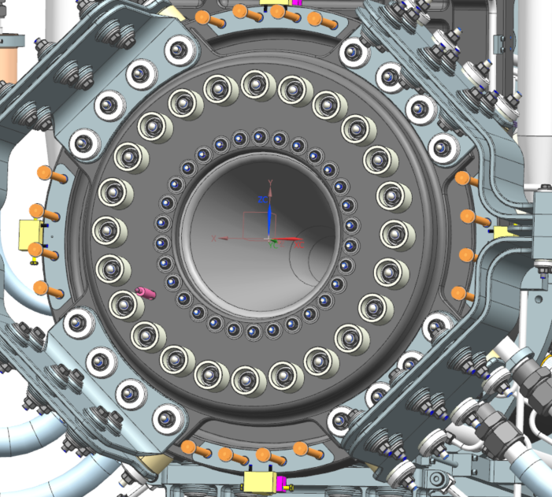
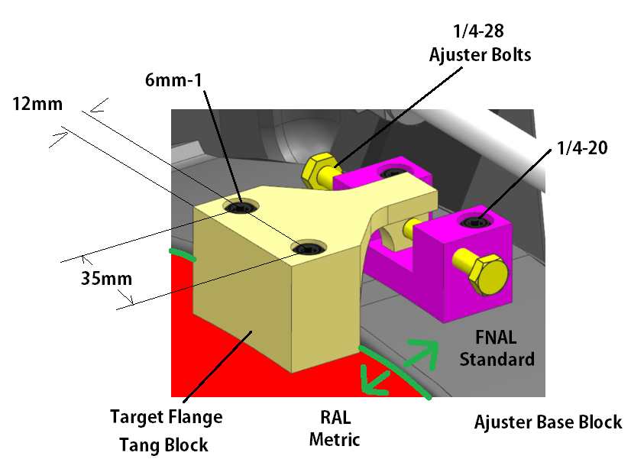
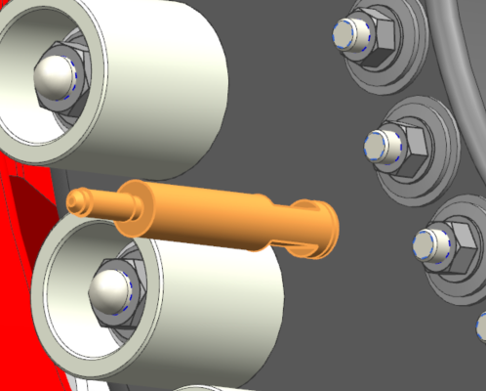
Major Interfaces - Target

Slide 12
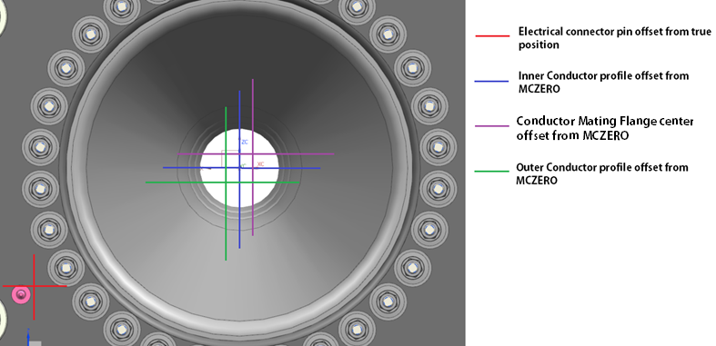
Major Interfaces - Target
Must pay attention to tolerance stack-up.
Horn A is accumulation of different centerlines (physically & magnetically)
Targets and horns must be interchangeable and stay near .5mm quadrature offset guidance.
Final survey during bracket assembly will essentially serve as GO / NO GO gauge.
Testing target fitment is required but will never capture all O.O.T. conditions. Too many interfacing parts to rely on one fitment test…

Slide 13
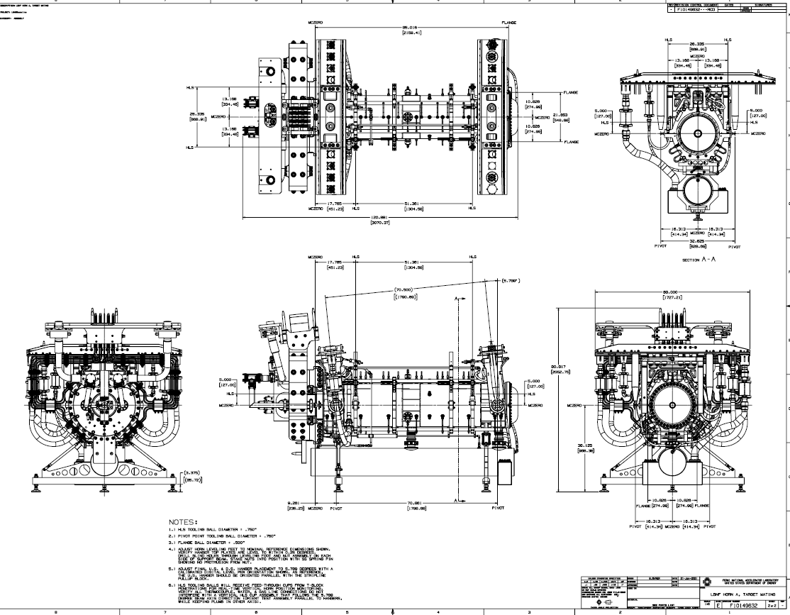
Major Interfaces - Target

Slide 14
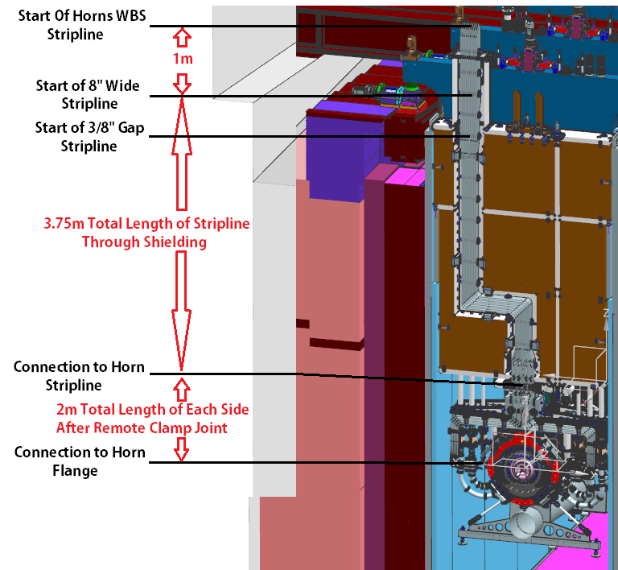
Major Interfaces – Power Supply
Interface to Power Supply occurs at top of stripline shield block.
Horn parameters (part of this scope) drive majority of design & analysis requirements.
Dedicated Electrical layout drawing exists for Horn A and has been peer reviewed by PS L4.
PS analysis efforts are derived from those features & dimensions.

Slide 15
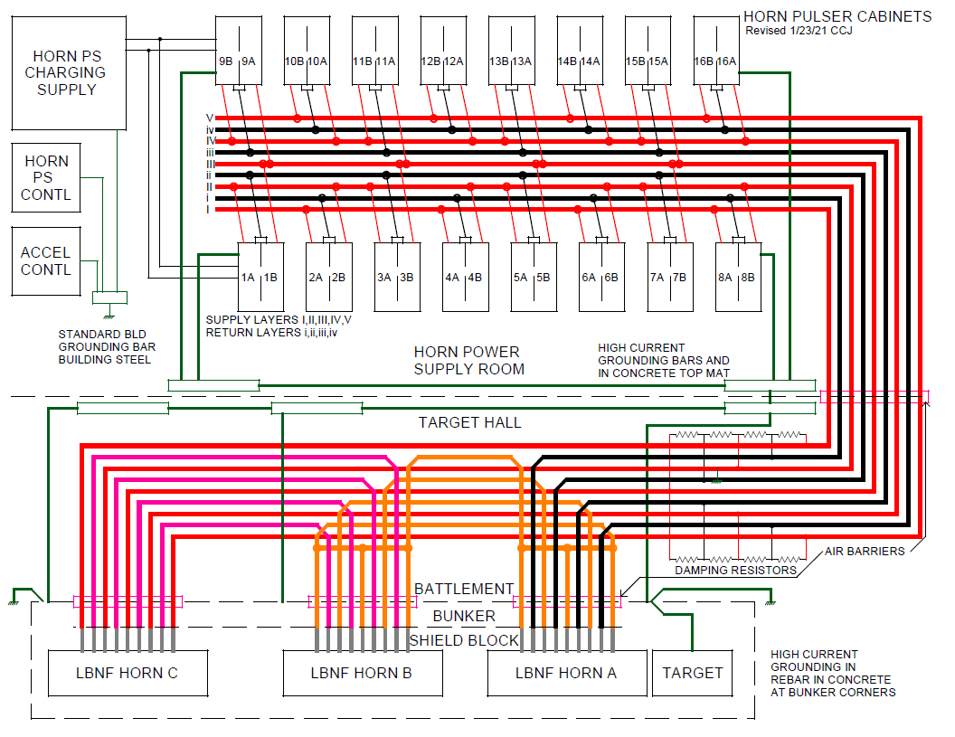
Major Interfaces – Power Supply
Credit: EE Support

Slide 16
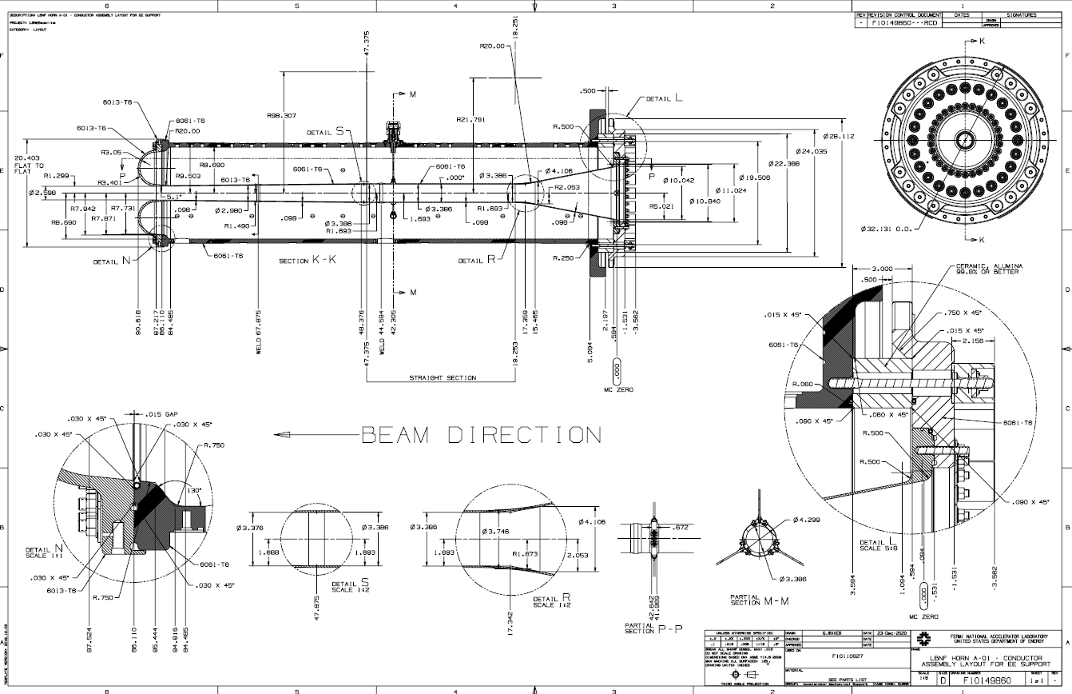
Major Interfaces – Power Supply

Slide 17
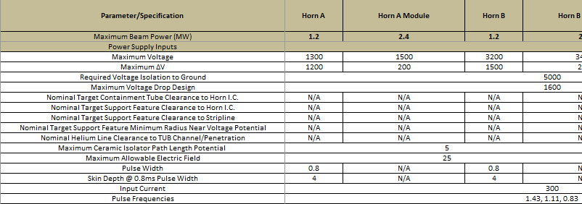
Major Interfaces – Power Supply
Horn A maximum voltage and voltage drop is confirmed.
Analysis work used these nominal voltages to meet acceptable safety factors for corona inception in an ionizing environment based on BNB operational history.
Pulsed power parameters have remained unchanged since inception of LBNF optimized design: (300kA, 0.8ms half sine pulse, 1.43Hz rep rate).

Slide 18
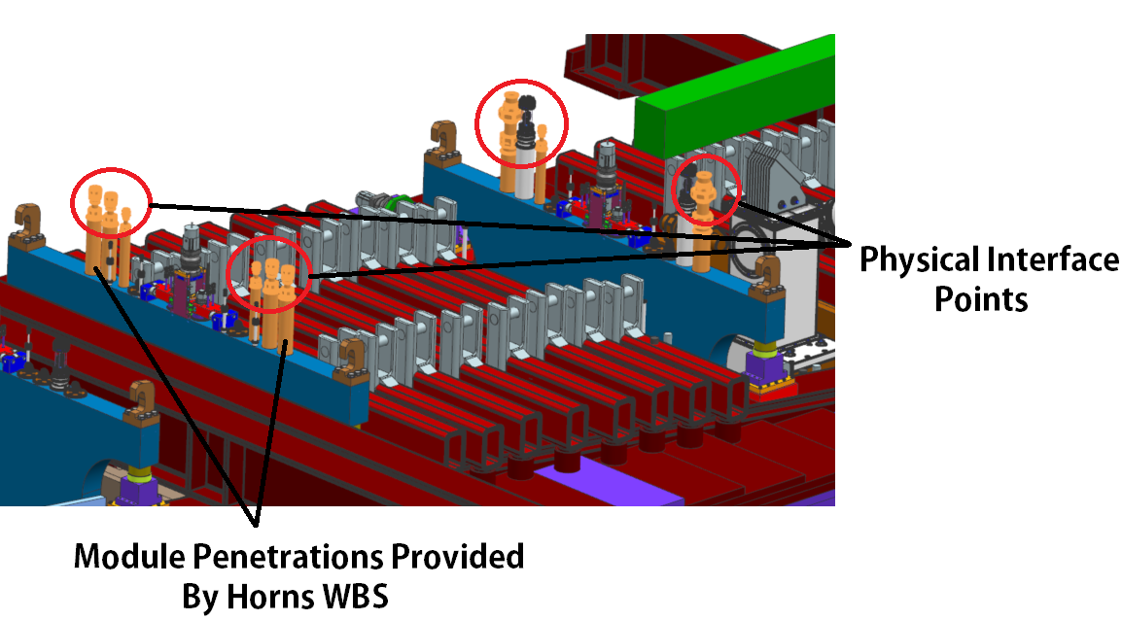
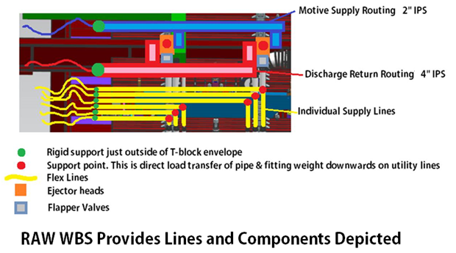
Major Interfaces – Radioactive Water Systems
Interface has understood line loads, supports, and overall routing.
Line loads flow through module utilities and connect to Horn A hangers.
Loads on Horn A hangers affect conductor position.
And by default, integrated target position.
Heat load from MARS is verified with FEA & transferred to RAW for exchanger sizing given pressure, flow, and temperature requirements.

Slide 19
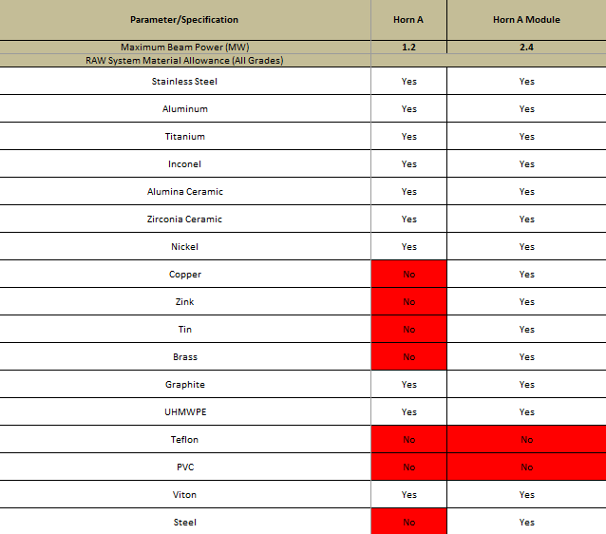
Major Interfaces – Radioactive Water Systems
Critical Interfaces:
Maximum filter element pass through sizing (20 micron).
Maximum purge system
flow (~9L min).
All manifold pressures
(40 PSIG nominal).
Material Allowances.
RAW supply temp range
(70F Nominal, +5F / -10F).
- Line weights through module.

Slide 20
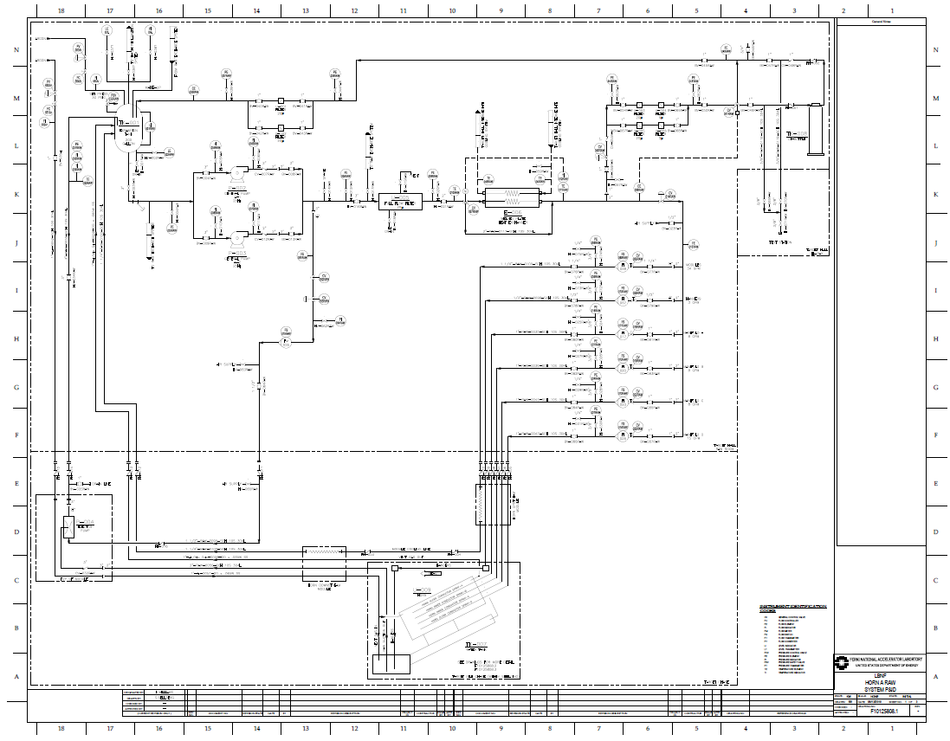
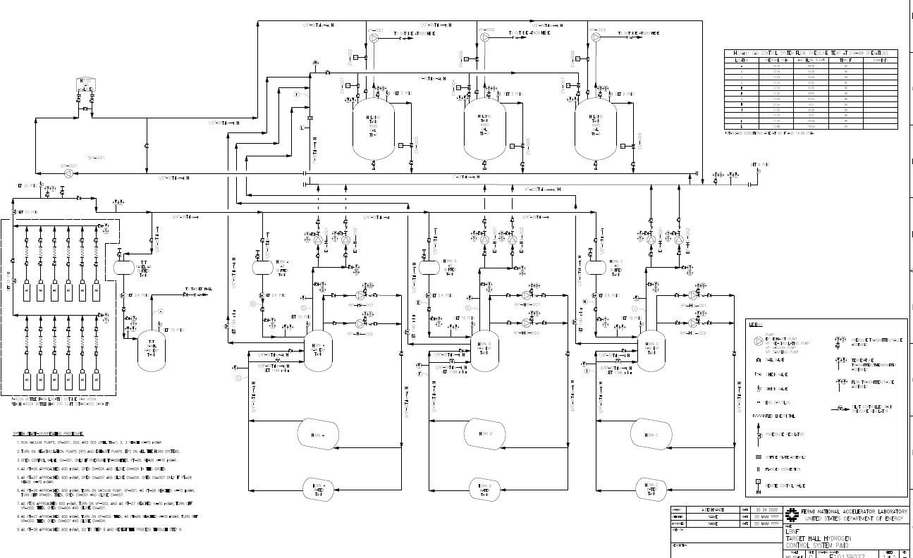
Major Interfaces – Radioactive Water Systems
All horn water system details are accounted for in RAW pressure / flow / heat removal software (FATHOM).
Dedicated P&ID’s exist between each horn and the supporting RAW skid.
A comprehensive Ar / H / O purge system is documented.
Horn & water tank analysis accounts for these pressures.
Credit: Des Deshpande

Slide 21
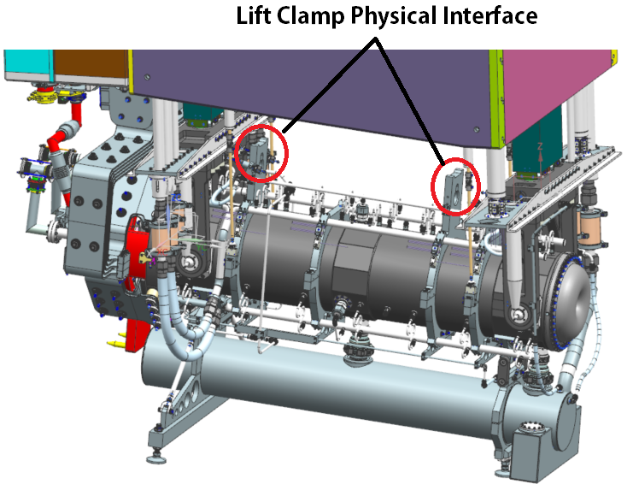
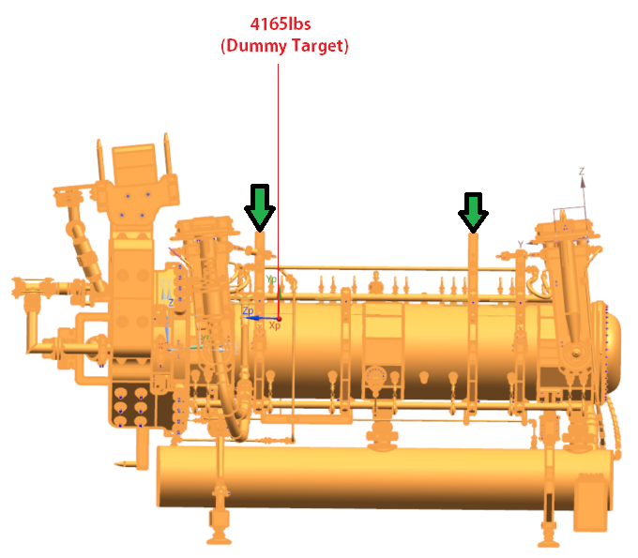
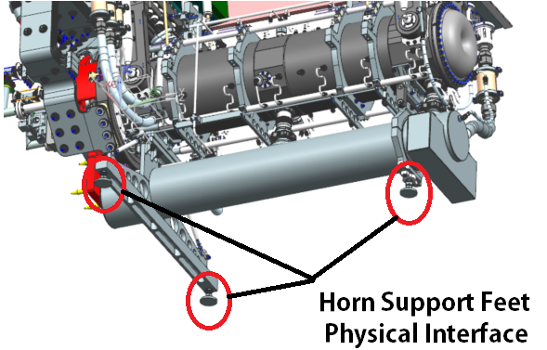
Major Interfaces – Remote Handling
Remote handling points mimic NuMI design & allow for C.G. of entire integrated Horn A & Target assembly to be located within lift clamps.
Current C.G. & weight totals are conservative, since they assume a “dummy” target (dummy default is 100% steel). C.G. will shift D.S.
Assembly support feet locations are locked & agreed on.
All remote handling parameters for weight, lift clamp spacing, and support feet position are agreed on & approved in specification sheet.

Slide 22
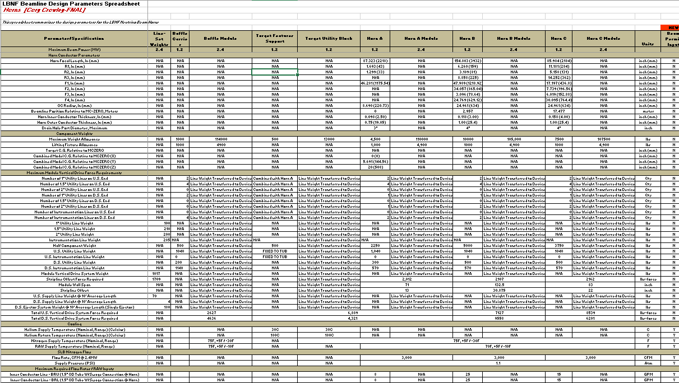
Parameters & Specifications Document
Parameters & Specifications Document captures all engineering details that are being created to meet requirements & interfaces.
Let’s take a look!

Slide 23
Summary
Requirements are known, clearly stated, and drive the design of Horn Systems, starting with Prototype Horn A.
Interfaces for Prototype Horn A are entered, & peer reviewed.
Horn A Parameters & Specifications are well defined, and fully apply to the design & fabrication of Prototype Horn A.
Each of these major project control documents are under change control and reflect design decisions evident on Horn A & the supporting analysis work.
Questions?

