Slide 1
Neutrino Beamline Prototype Horn A Final Design Review
Design Overview
Cory Crowley / Nnamdi Agbo
26 January 2021

Slide 2
Outline
Design Approach to Prototype Horn A
Engineered Horn Parameters
Locating / Positioning in Chase
Kinematic Movements
Feature Design
Conductor Profiles & Support
Cooling
Electrical Considerations
Argon Purge
Interfacing Connections
Summary

Slide 3
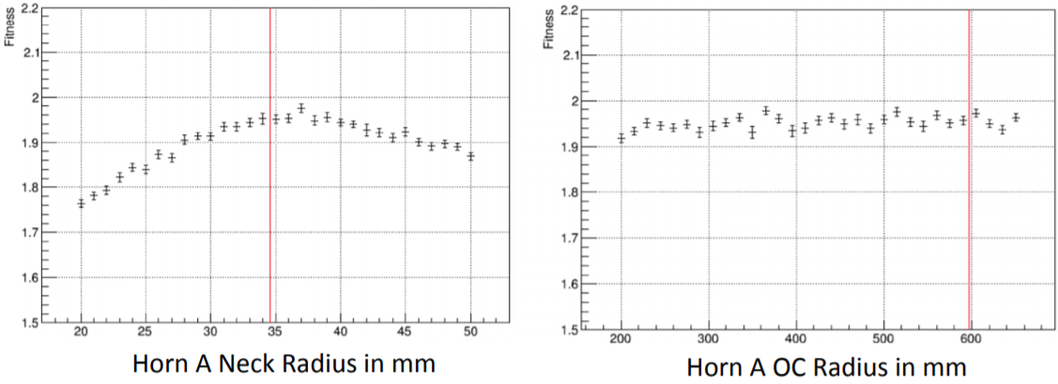
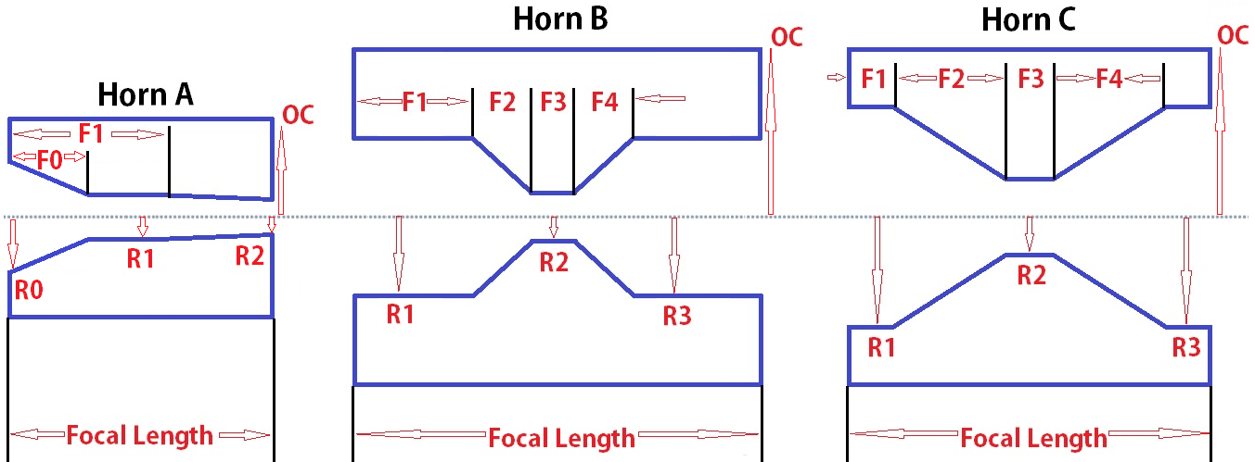
Engineered Horn Parameters
Horns have been packaged into chase and kept most all critical dimensions in Beam Optimization Task Force report, DUNE-doc-2901.
Variations exist from VE, sensitivity, engineering, & manufacturing limitations.
Horn Conductor Parameters | 1.2MW Values
Horn Focal Length, In (mm) | 87.323 (2218)
R0, In (mm) | 5.512 (140)
F0, In (mm) | 15.748 (400)
R1, In (mm) | 1.693 (43)
R2, In (mm) | 1.299 (33)
F1, In (mm) | 46.281 (1175.5)
OC Radius, In (mm) | 8.690 (220.7)
Beamline Position Relative to MC-ZERO, Meters | 0
Horn Inner Conductor Thickness, In (mm) | 0.098 (2.5)
Horn Outer Conductor Thickness, In (mm) | 0.75 (19.1)
Drain Hole Port Diameter, Maximum | 3“ (76.2)

Slide 4
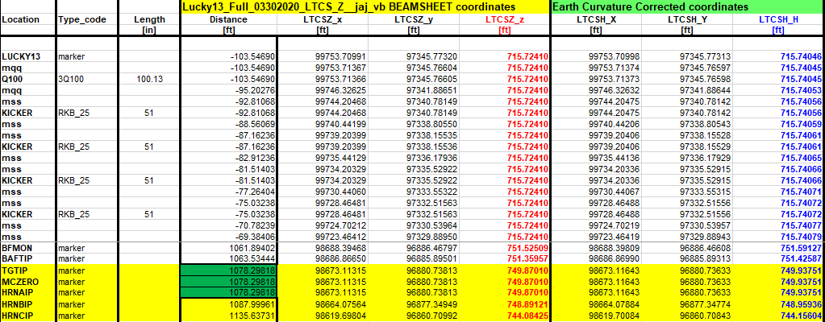
Beam-Sheet Positions
Final Horn A location relative to target & insertion point is reflected on beam-sheet, DUNE-doc-418.
MCZERO is start of Monte-Carlo simulations & origin of target hall chase.
TGTIP / MCZERO / HRNAIP all coincide at same point for 1.2MW design.

Slide 5
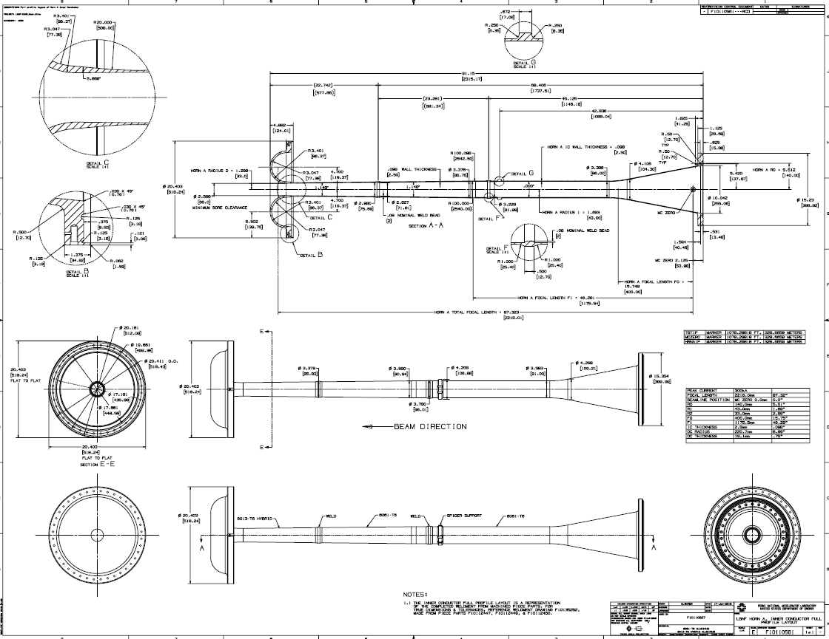
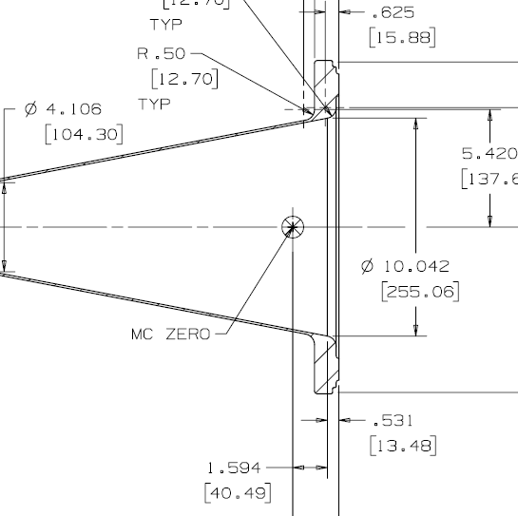
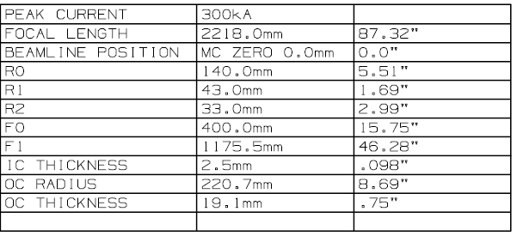
Beam-Sheet Positions & Traceability

Slide 6
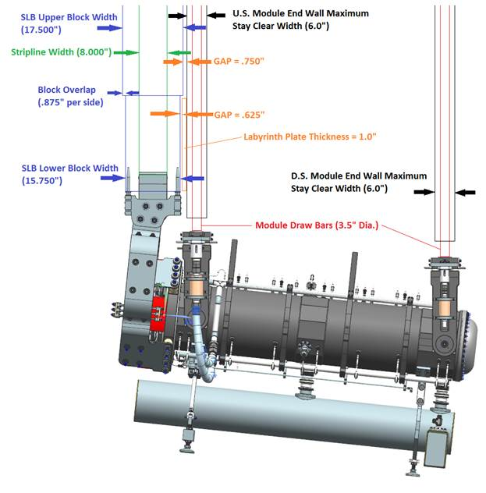
Module Spacing / Limits / Design Drivers for Horn A
THC crane limit @ 60T.
Horn A + Target budget of 2.5T.
Stripline shield block @ 22.5T
Target Utility Block (TUB) weight budget of 5T.
Lifting fixture budget of 2.5T
Module budget is balance of weight @ 27.5T.
With a 78” wide chase & 120” of shielding, module end & side walls are thin.

Slide 7
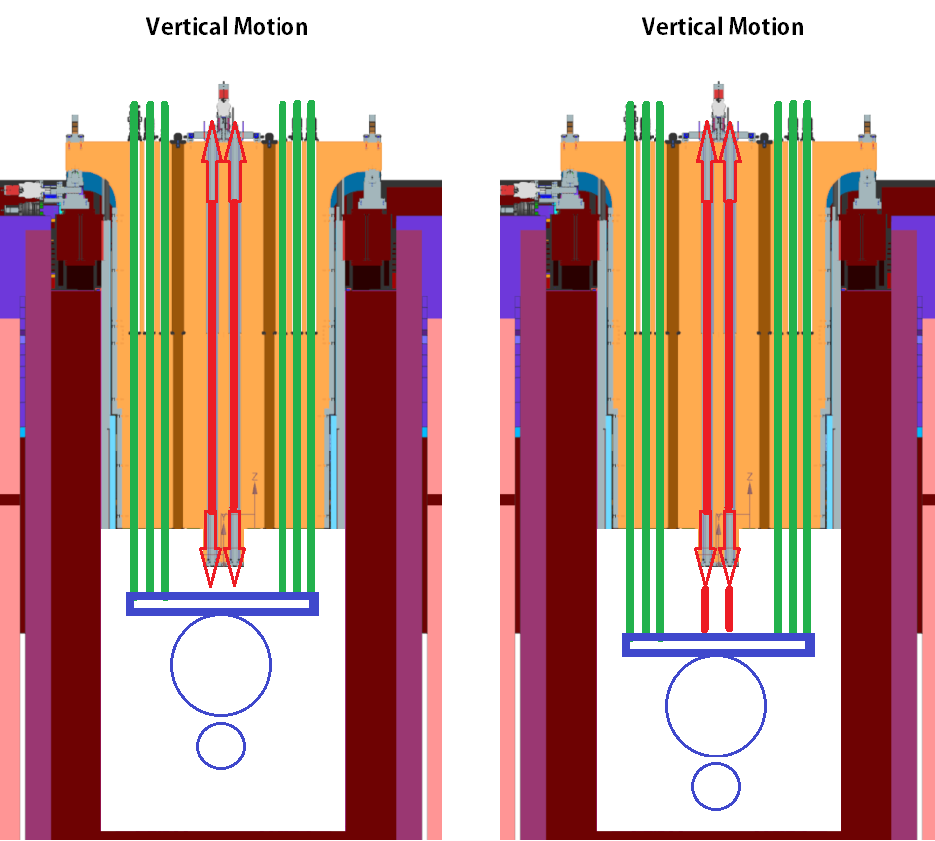
Design Approach: Vertical Kinematics

Slide 8
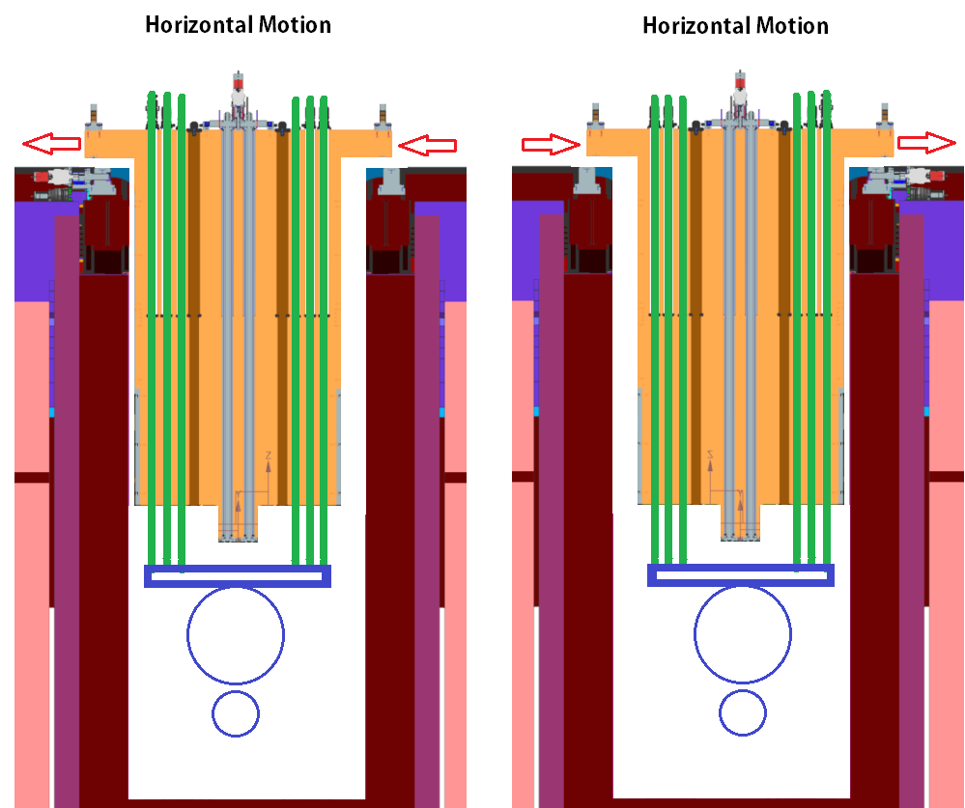
Design Approach: Horizontal Kinematics

Slide 9
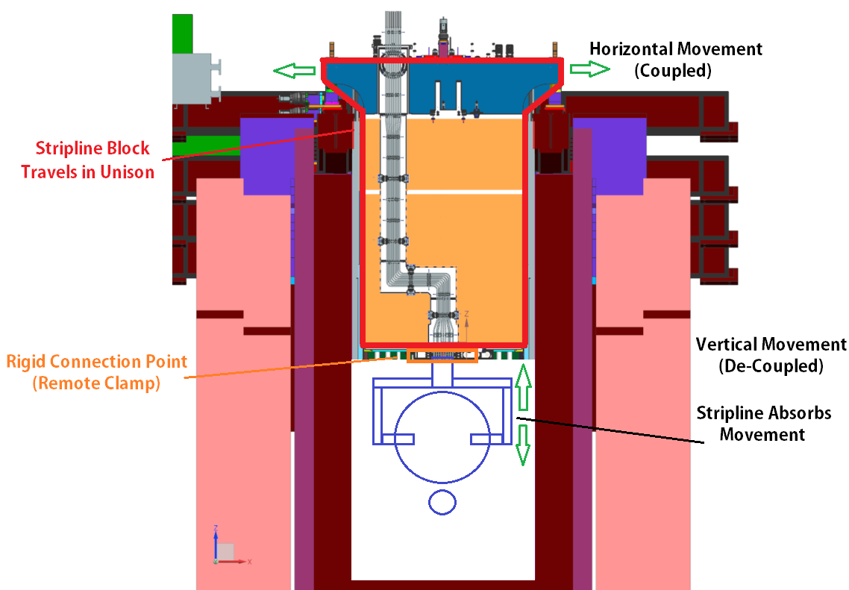
Design Approach: Stripline Kinematics

Slide 10
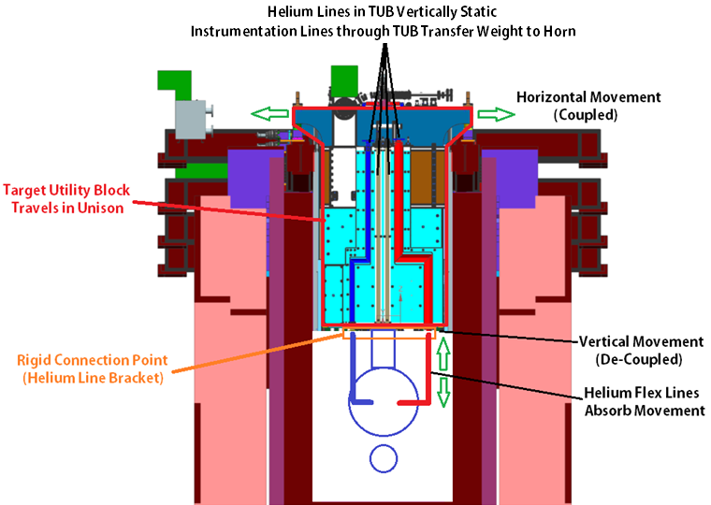
Design Approach: Target Utility Block Kinematics

Slide 11
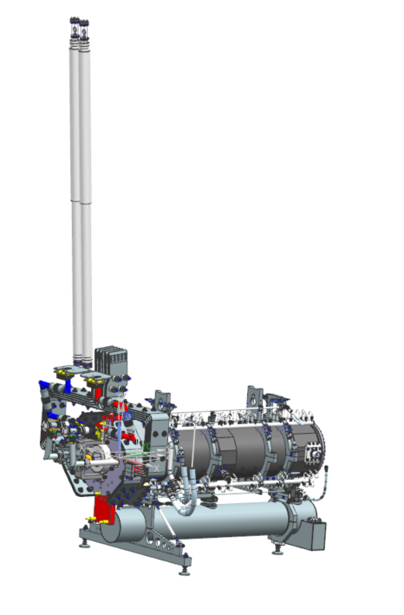
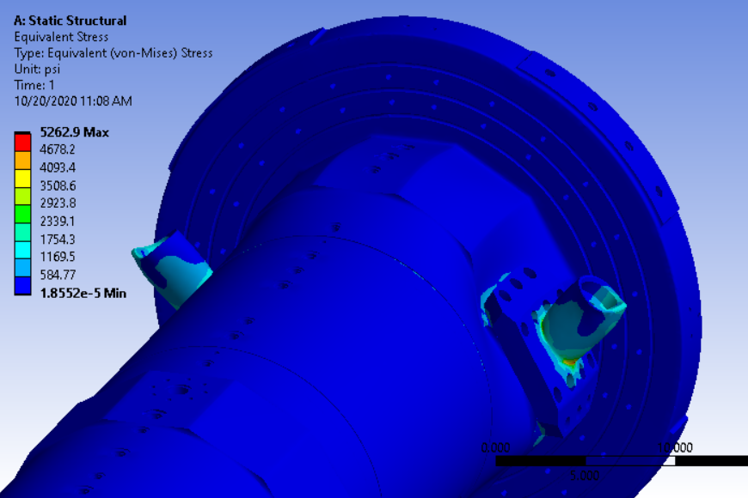
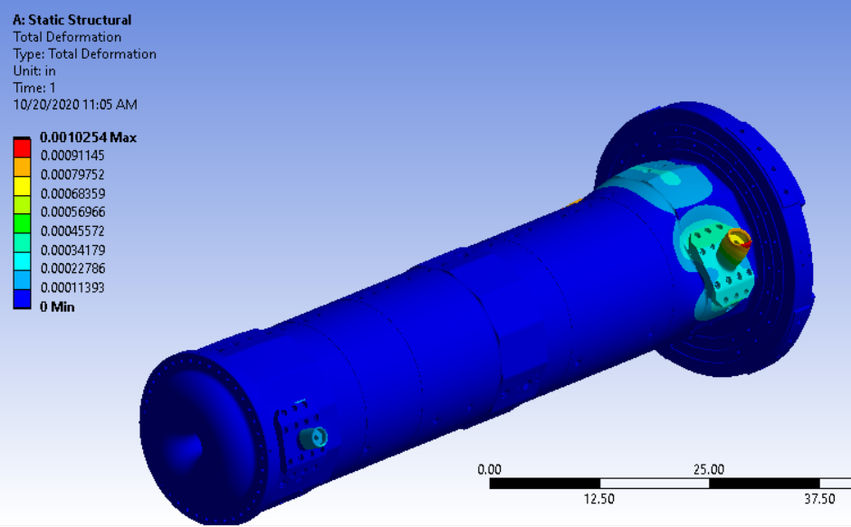
Target Instrumentation Loads to Horn A
Final design accounts for utility lines that directly connect to target frame and transfer all loading into hangers.
Loads analyzed are worst case scenario. RAL has requested line weight reduction for target bracket concerns.
All conductor connections & bracket stress / deformation are within allowable range for conductor concentricity and will not need to be reanalyzed as target design matures, including changes in target length.

Slide 12
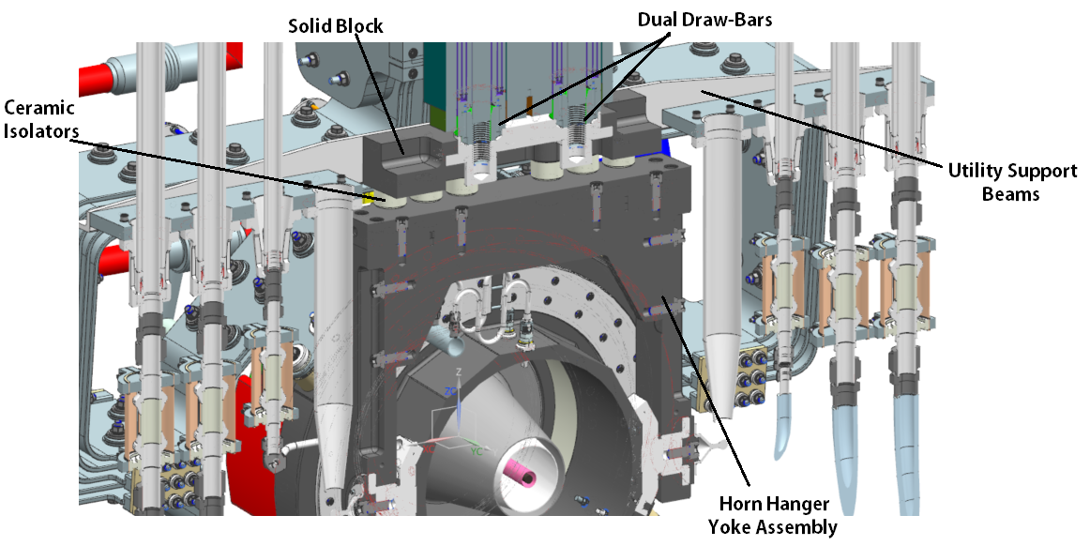
Horn to Module Connection – U.S. Hanger
U.S. hanger serves as rigid linkage for horn positioning & alignment.
Utility support beams are identical U.S. / D.S. & across all horns.
Volume reduction & stiffening complete on large aluminum structures.

Slide 13
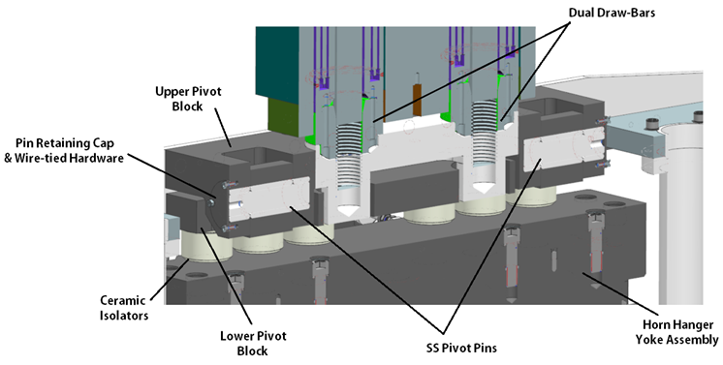
Horn to Module Connection – D.S. Hanger
D.S. hanger serves as swinging linkage for horn expansion.
Pivot block concept like NuMI.
Employs 410SS pins inside of 6061-T6 (anodized) bores.

Slide 14
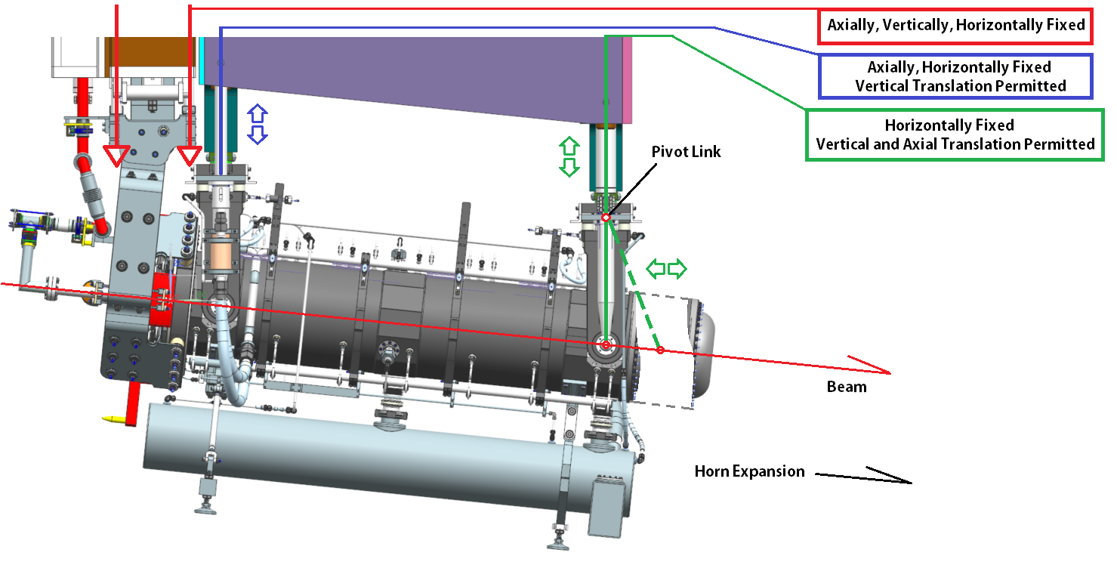
Horn + Hanger Motion
Horn A thermal expansion (axial) on order of ~1mm.
D.S. vertical translation due to linkage movement effectively 0mm.
Linkage must exist to not stress hangers / draw bar interface / vertical drive binding.

Slide 15
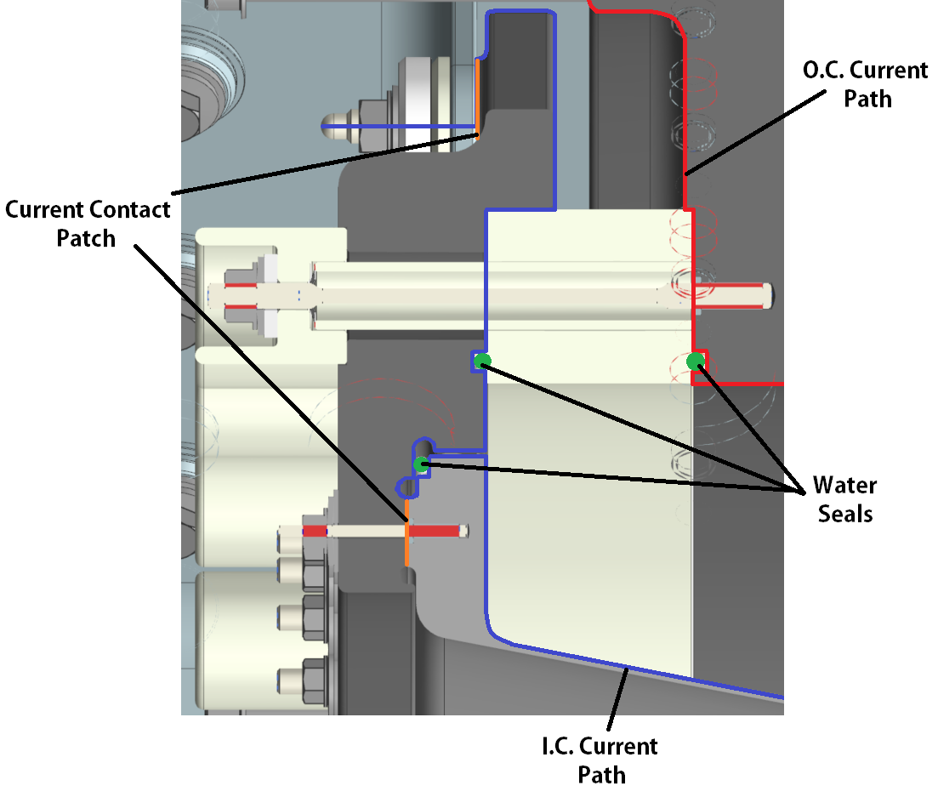
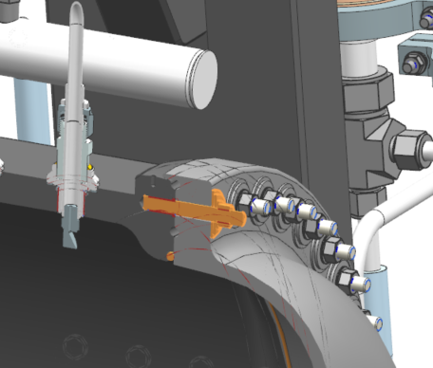
Feature Design - U.S. & D.S.
U.S. end has standard seal arrangement, 2 @ ceramic ring + 1 @ connecting flange to inner conductor interface.
Inner conductor current flows through connecting flange.
D.S. turn-around has single water seal & profiled to facilitate draining.

Slide 16
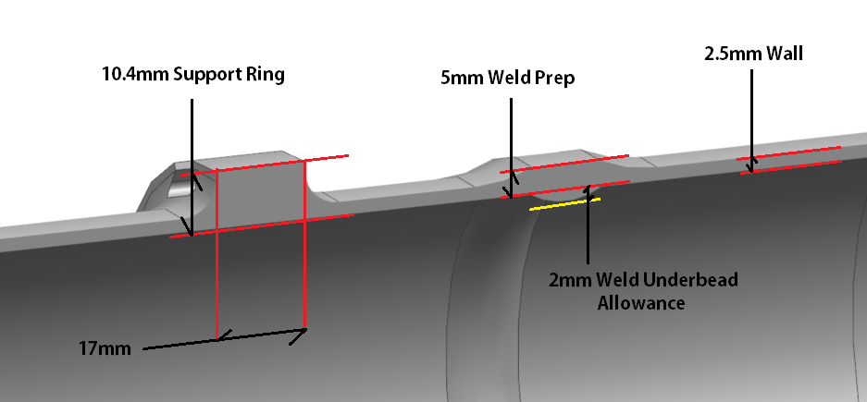
Feature Design - Horn Profile
Nominal I.C. conductor thickness is 2.5mm, O.C. 19.05mm (3/4”).
Both welds (2) are 5mm thick (2 x wall for 50% weld efficiency), so precisely matches NuMI weld preparation reference measurements of 0.197” for CNC TIG welding program generation.
Conductor supports “spider supports” have dedicated ring on I.C. for mounting nuts and mimic NuMI style & shape.

Slide 17
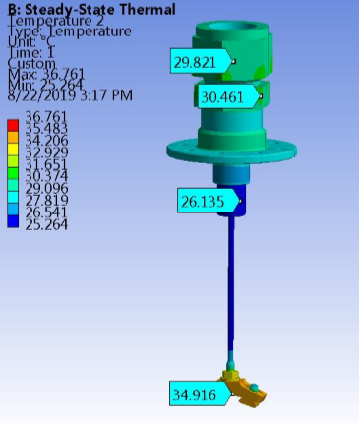
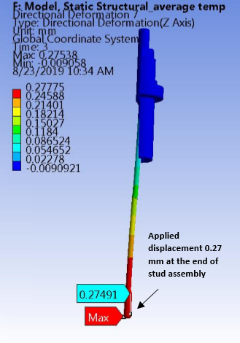
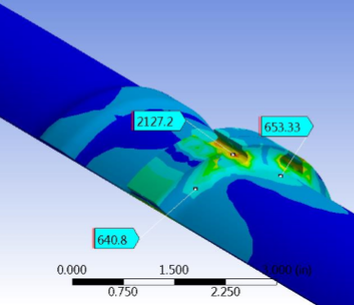
Feature Design – Conductor Supports (Spider Supports)
Structural considerations are major concern; run through test stand cycles + bore-scope / inspection.
Investigated operating temp, stress, deformation. Matched deflection to I.C. displacement.
Analyzed conductor connection & incorporated into final I.C. run.
FEA Credit: Ang Lee & Zhijing Tang

Slide 18
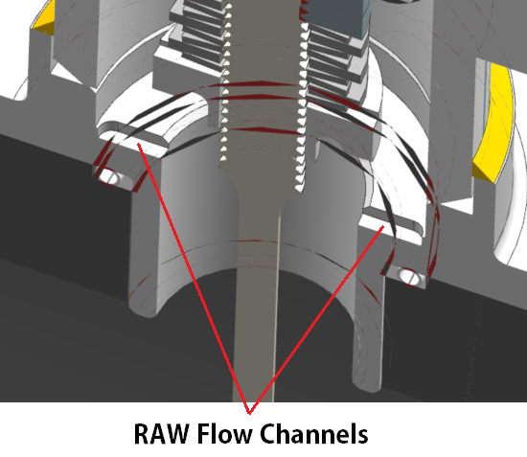
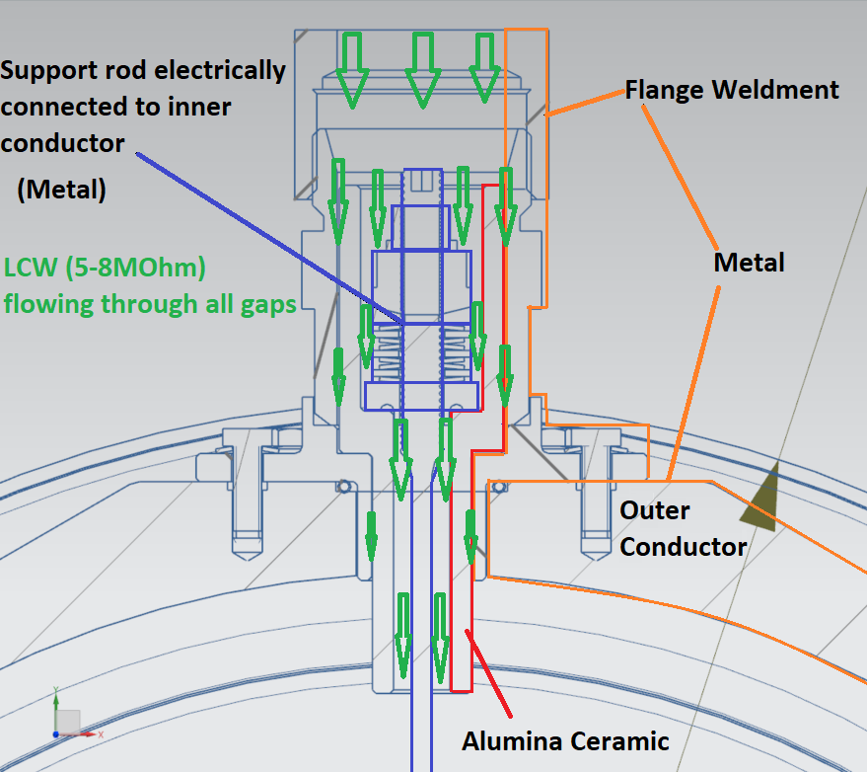
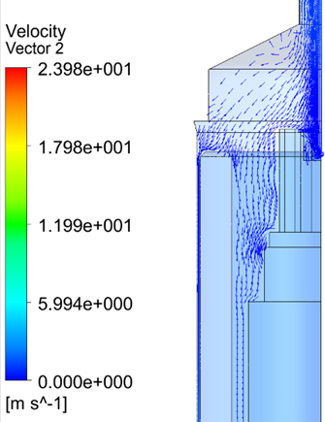
Electrical Considerations
Maintain electrical isolation.
Stagnant water would be known issue with this arrangement.
Solution is to actively flow RAW through all internal passageways to flush out assembly.
Both internal & external hardware stack-up are flushed.
Dedicated flow channels milled in flange base and main washer.
FEA Credit:
Jacob Kintner

Slide 19
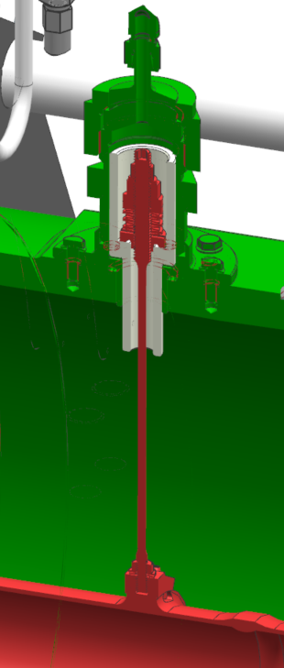
Electrical Considerations
Scalable design must account for maximum anticipated ΔV.
~800 ΔV @ Horn B mid-conductor. Horn B drives spacing but design is used across horns.
Alumina ceramic chosen.
Cheaper manufacture.
Lower dielectric constant.
Low stress @ 285lbs max anticipated preload.
Consideration of losses via induced current & dissipation of magnetic energy.
123mW @ 1sec rep rate for current induction.
87mW @ 1sec rep rate for magnetic dissipation.
No concern on heat loss from EE Support.
Additional analysis / electrical testing planned.

Slide 20
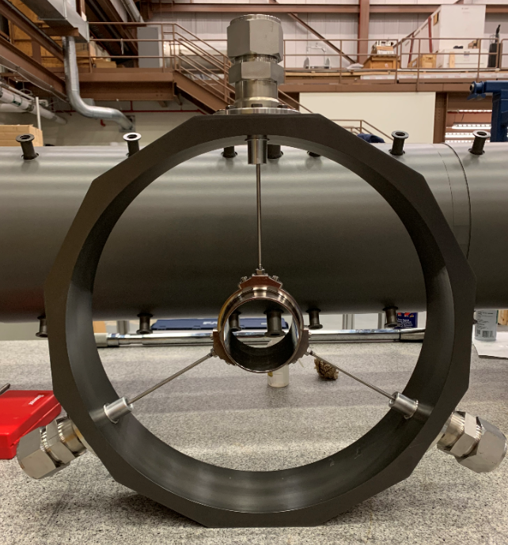
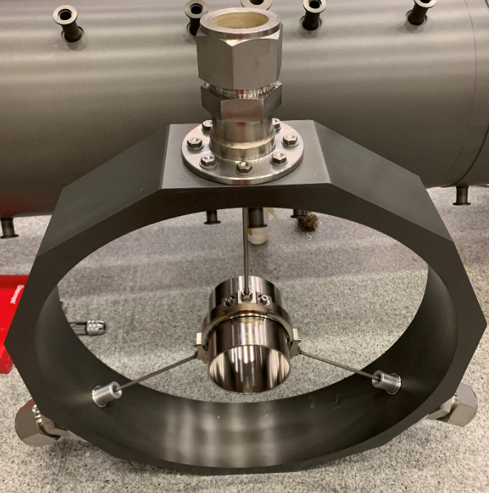
Full Scale Critical Element Testing

Slide 21
Feature Design – Cooling Flow Requirements
Conductor Position | I.C. Manifold # 1 BRU | I.C. Manifold # 2 BRL | I.C. Manifold # 3 BLL | O.C. Manifold # 4 BLU
I.C. Nozzle 1 | 1/8TEK-SS5 | 1/8TEK-SS5 | 1/8TEK-SS5 | N/A
I.C. Nozzles 2-8 | H1/8VV-316SS9508 | H1/8VV-316SS9508 | H1/8VV-316SS9508 | N/A
I.C. Nozzle 9 | 1/8TEK-SS5 | 1/8TEK-SS5 | 1/8TEK-SS5 | N/A
O.C. Nozzles 1-10 | N/A | N/A | N/A | F10119111
Cooling Medium | Required Temperatures
Nitrogen Supply Temperature (Nominal, Range) | 75F, +5F / -30F
RAW Supply Temperature (Nominal, Range) | 70F, +5F / -10F
Manifold | Required Flows | Required Pressures
Inner Conductor Line - BRU (1.5" OD Tube W/Swage Connection @ Horn) | 8GPM | 40PSIG
Inner Conductor Line - BRL (1.5" OD Tube W/Swage Connection @ Horn) | 8GPM | 40PSIG
Inner Conductor Line - BLL (1.5" OD Tube W/Swage Connection @ Horn) | 8GPM | 40PSIG
Outer Conductor Line - BLU (1.5" OD Tube W/Swage Connection @ Horn) | 15GPM | 40PSIG
Ejector Line - (2.0" OD Tube W/Swage Connection @ Horn) | 54GPM | -7.8PSIG
Hanger Cooling Line (1.0" OD Tube W/Swage Connection @ Horn) | 5GPM | 40PSIG
Gas Purge Inlet / Outlet (Argon) (1.0" OD Tube W/Swage Connection @ Horn) | 9085cc/min | 1.3PSIG

Slide 22
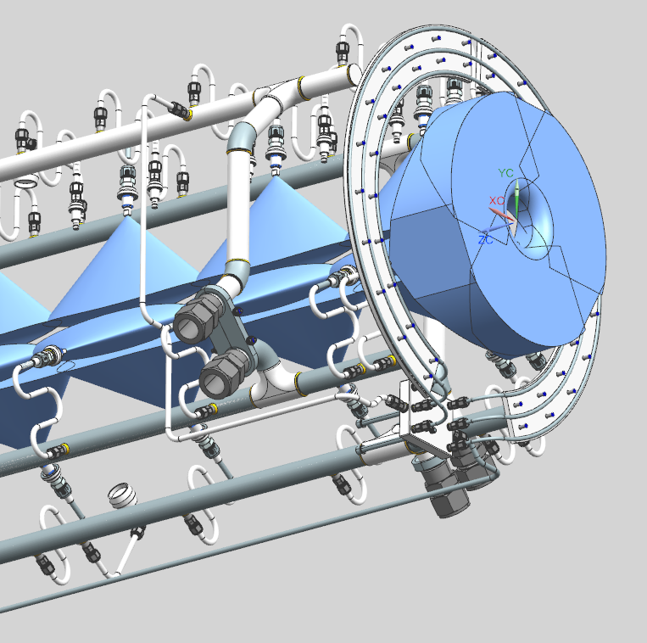
Feature Design - Horn A Cooling System Layout
Four primary manifolds supply all conductor cooling.
3 for I.C.
1 for O.C.
All water manifold components are 316LSS Seamless Tube.
Manifolds are 1.5” O.D. X .120” wall
Nozzle tributaries are .375” O.D. X .035” wall
All designed per FESHM 5031.1 / ASME B31.3 & peer reviewed by RAW Technical Manager.

Slide 23
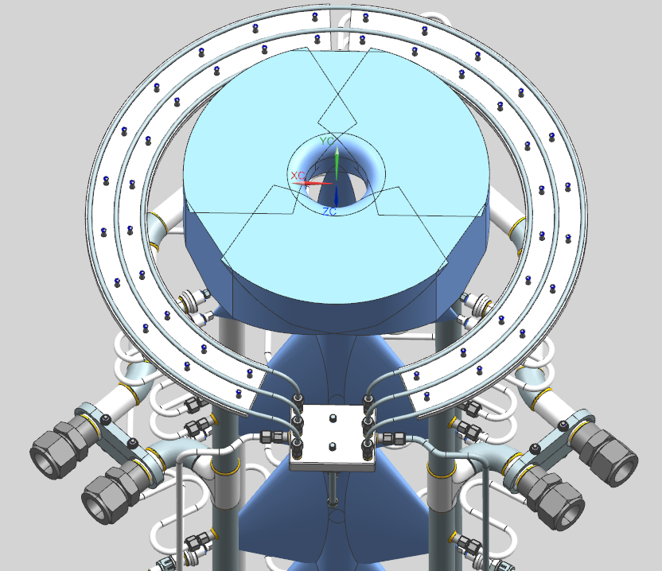
Feature Design - Horn A Cooling System Layout

Slide 24
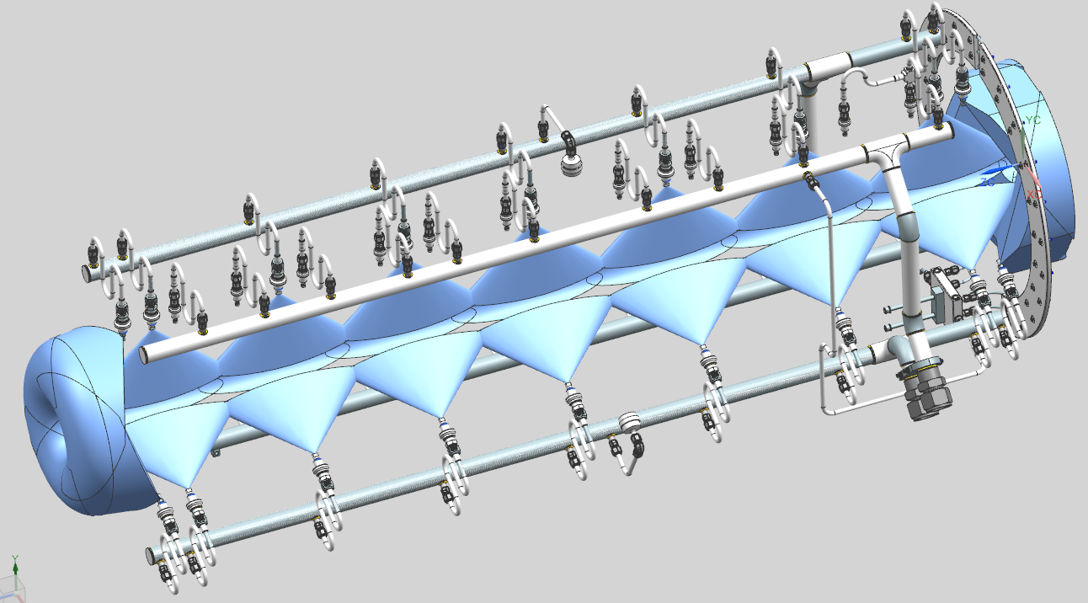
Feature Design - Horn A Cooling System Layout
Manifold | Tube Specs | Material
Inner Conductor Nozzle Feed | .375” O.D. X .035” Wall | 316L SS Seamless Tube
Outer Conductor Nozzle Feed | .375” O.D. X .035” Wall | 316L SS Seamless Tube
Argon Purge | .500” OD X .049” Wall | 316L SS Seamless Tube
U.S. Outer Conductor Flange Loops | .250” OD X .035” Wall | 5052 Al Seamless Tube

Slide 25
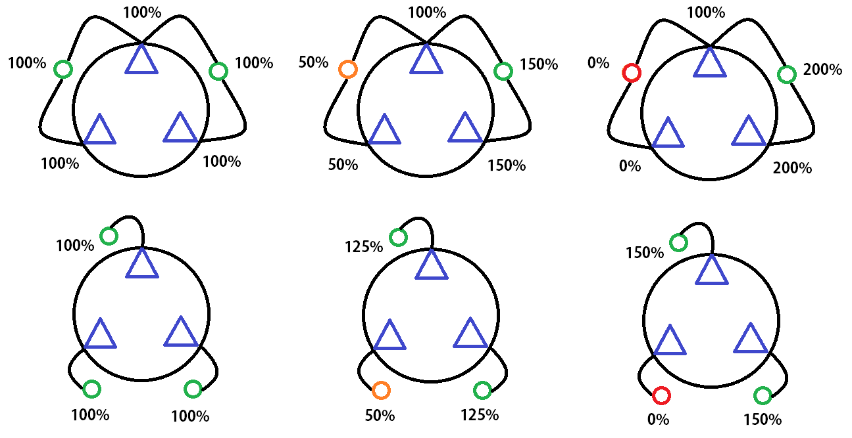
Feature Design - Horn A Cooling System Layout
Use of redundant manifolds investigated.
Design direction is that 3 separate supply manifolds (1 for each nozzle string) will still have better flow control & balancing capabilities than 2 lines with crossovers if there is a leak.
Not clear additional complexity of 3 lines with crossovers is worth it…

Slide 26
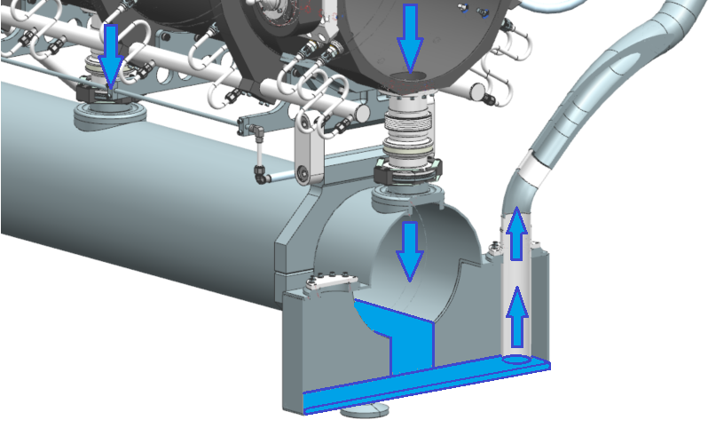
Feature Design - Horn A Water Tank
Water tank is sized to handle ~100% of RAW piping input volume so system shutdown does not fill horn volume with water.
Provides protection against errant current pulse and potential hydraulic shock to conductors.
2X Ejection Ports.
Sump pit
Direct line from hangers
6061-T6 construction
100% seam welds utilizing ER4043
Follows critical aluminum weld preparation specification.
Released in ED0000862

Slide 27
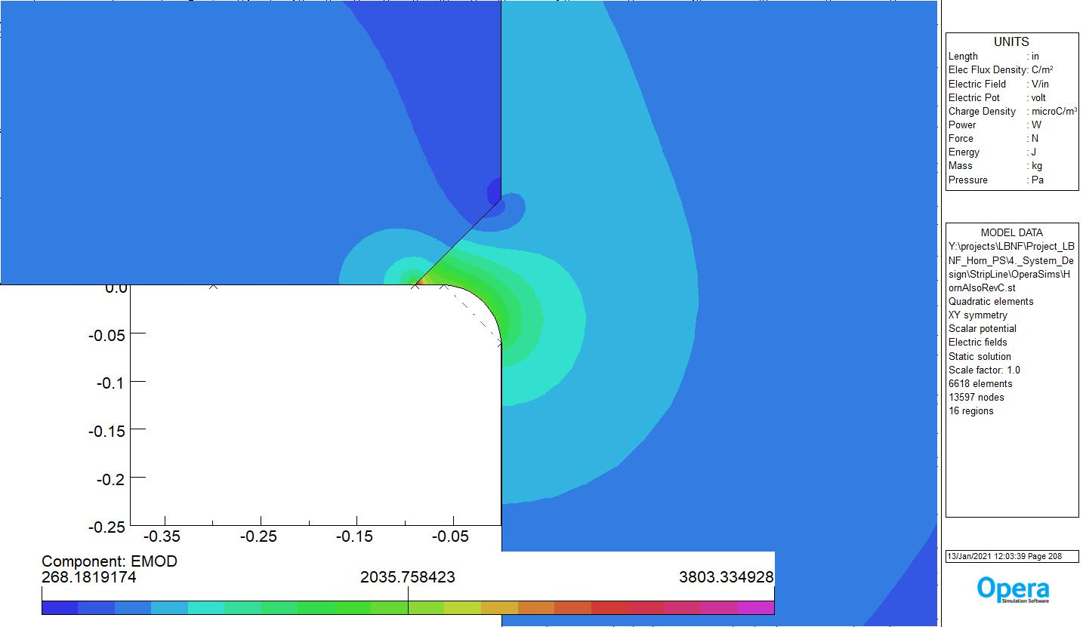
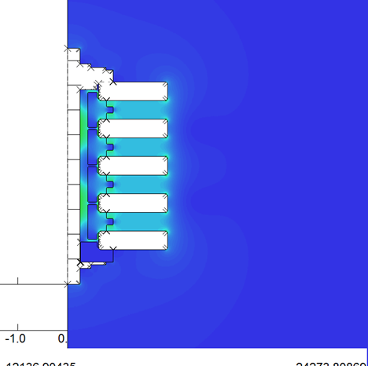
Horn Design – Electrical Considerations
EE Credit: Chris Jensen / Ken Quinn
Max V @PS | Max Allow. E Field | Max Isolator Path Length Potential | Horn A ΔV | Horn B ΔV | Horn C ΔV
~5000V | 25V/.001” | 5V/.001” | ~1200V | ~1600V | ~600V

Slide 28
Horn Design – Electrical Considerations Cont.
EE Credit: George Krafczyk / Ken Quinn / Chris Jensen
Current depth (skin depth) @ 625Hz is fully developed through inner conductor thickness until end flange transition wall surpasses 4.0mm.
Horn stripline is 9.5mm thick X 203.2mm wide (3/8” X 8”).
Impedance matched from P.S. stripline to horn face. Nominal stripline width is 304.8mm (12”), with a 12.7mm (½”) gap between layers.
Transitions to a 8” wide stripline with 3/8” gap at shield block to account for weight limitations on module assembly and bent blank pattern fitment on 12” wide stock from mill.

Slide 29
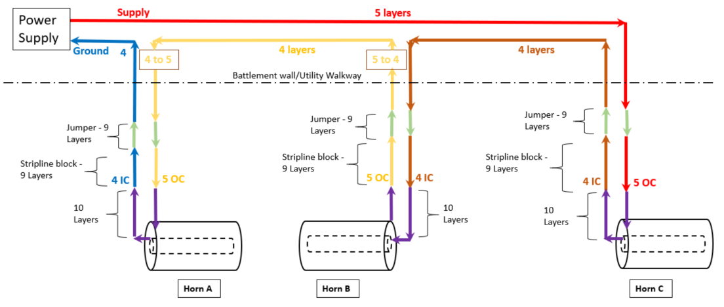
Design Layout
Horn A is last horn in 3-horn series arrangement.
300kA @ ~5kV sent to Horn C (testing features to 15kV).
Horn A is at lowest potential to ground (~1.3kV) to minimize arcing concerns to target (connected through resistor) from inner conductor.

Slide 30
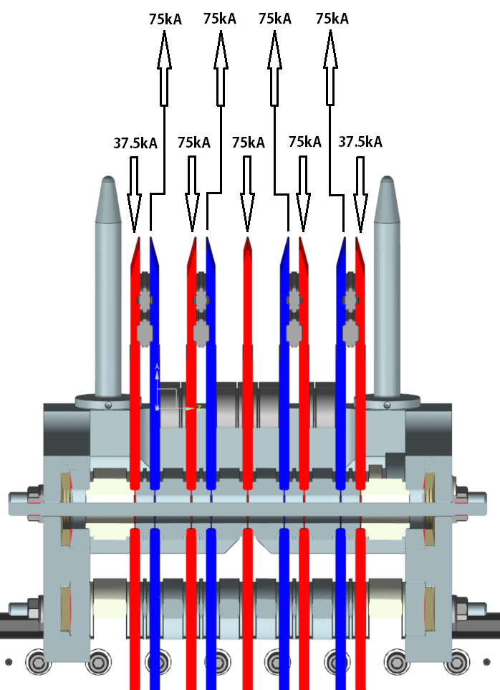
Design Layout Cont.
Full 75kA current on inner 7 layers.
Half current @ 37.5kA on external 2 layers.
Confirmed with EE Support Opera analysis for AC time-dependent current distribution.
Forces on outer layers are roughly half that of NuMI stripline.
3D Maxwell ANSYS analysis confirms Opera findings.
Advantage for:
Bus fatigue life.
Vibration / ringdown.
PS system requirements.
Credit: Ken Quinn

Slide 31
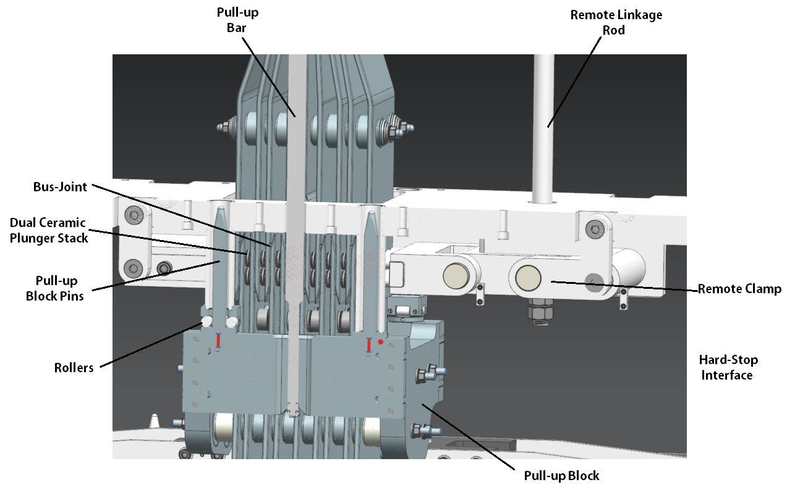
Horn Connection to Stripline Shield Block
Stripline block connection uses NuMI & T2K style remote clamp mechanism.
Two pull-up bars slide through pull-up block in work cell and turn 90 degrees.

Slide 32
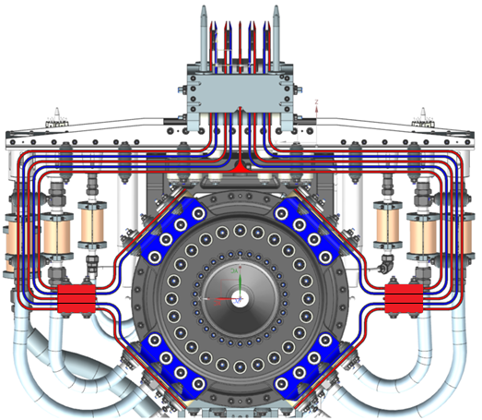
Design Layout Cont.
Balanced 9-layer arrangement.
Starts at PS capacitor bank.
Continues to jumper plate just prior to quadrant split.
Quadrants are essentially unbalanced dipoles.
Highly stressed area from I^2 effect (75,000A).
5 high-potential legs (red).
4 return legs (blue).
Current flow to O.C. and returning through I.C.

Slide 33
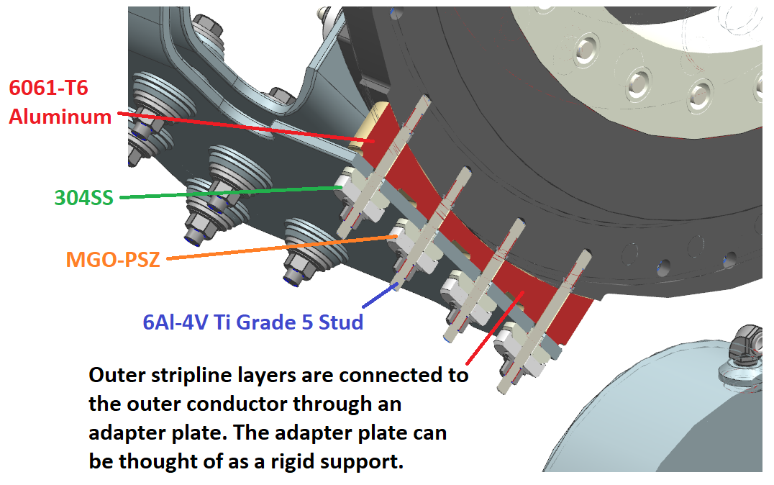
Materials Cont.

Slide 34
Materials Cont.

Slide 35
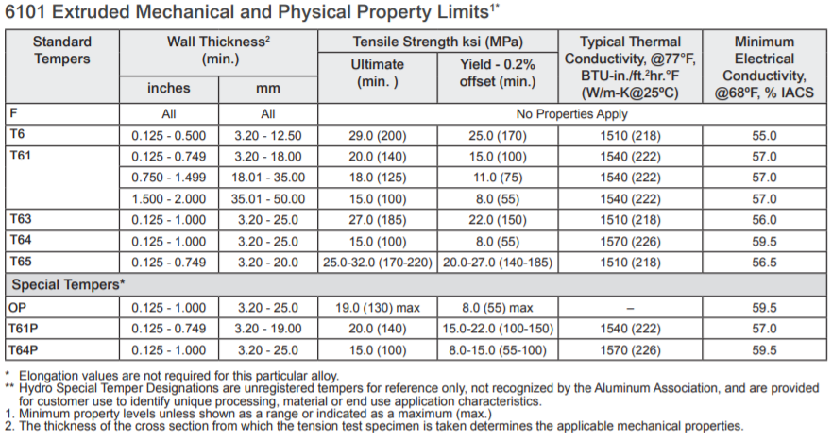
Loading Conditions – Mechanical
Bus Material | SL Loading S.F. @ 1.6KV Bolt Group (1.25” ID) | SL Loading S.F. @ 5.0KV Bolt Group (1.5” ID)
6101-T61 | 1.82 | 1.96
6101-T6 | 3.03 | 3.27

Slide 36
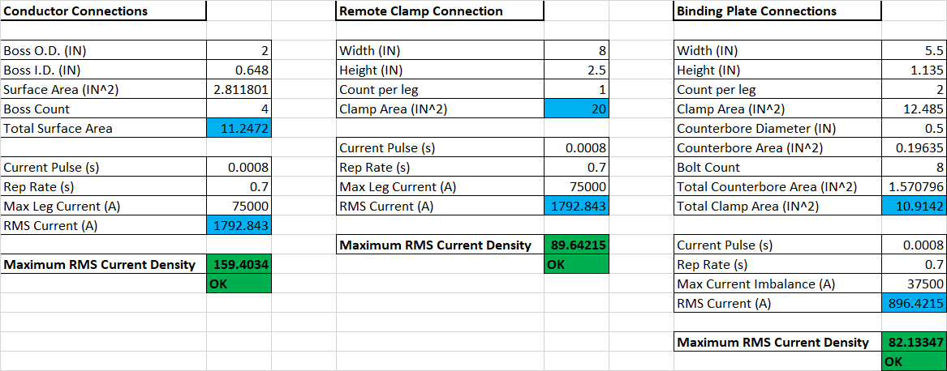
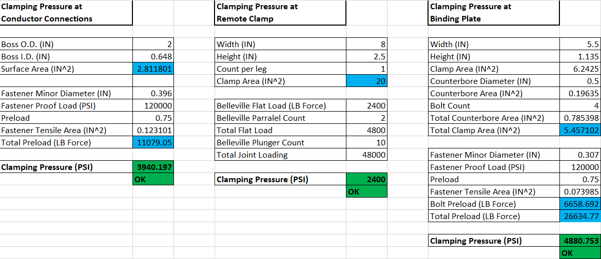
Loading Conditions – Electrical
Current density guidelines:
Field prepped joint: 100A-RMS/in^2 maximum.
Well prepped joint: 200A-RMS/in^2 maximum.
Design Goal: 150A-RMS/in^2.
Bus connections guidelines: 1400PSI minimum.
Clamping pressures are above minimum and well bellow material yield.
Belleville washers used on every connection for maintaining preload.

Slide 37
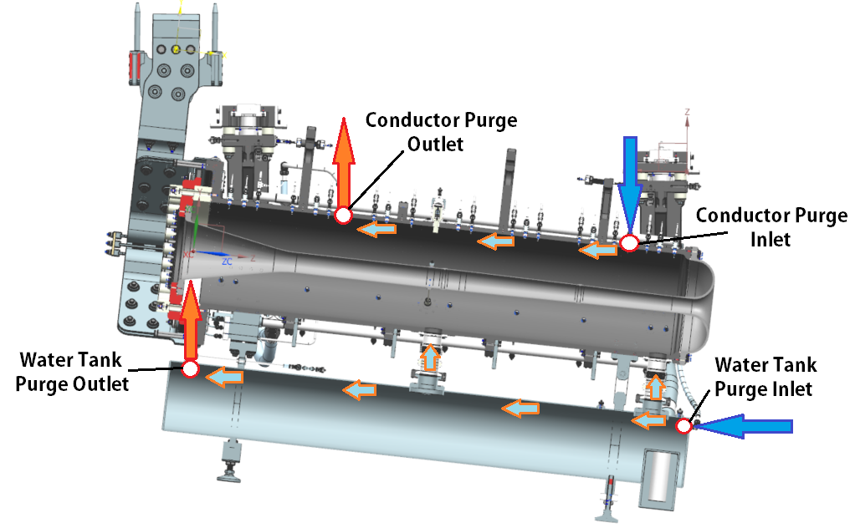
Horn A Conductor Volume Purge
Dissociation of RAW to Hydrogen & Oxygen requires forced gas purge to keep concentrations in volume under explosive limit.
RAW group using Argon to flush out system back to expansion tank headspace.
Twin inlet / outlet with purge inlet D.S. & purge outlet U.S.
Combine at top outlet tee.
2.4MW Requirements:
See DUNE-doc-18321
9085cc/min
~1.28PSIG

Slide 38
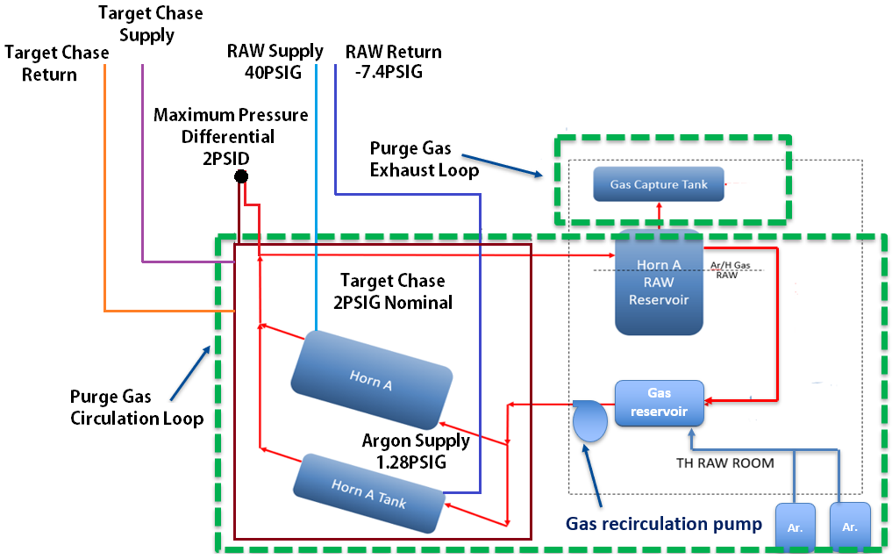
Horn A Conductor Volume Purge
Complex horn pressure ranges.
Chase nitrogen at 2PSIG; design max 5PSIG.
Recombination system at 1.28PSIG. Design max must stay below lower explosive limit.
Raw supply @ 40PSIG / Ejector suction head effects @ -7.4PSIG.
Horn conductor &
water tank structural
analysis completed
with 2PSIG internal
pressure.
Insignificant contribution
Sources:
Karl Williams &
Des Deshpande

Slide 39
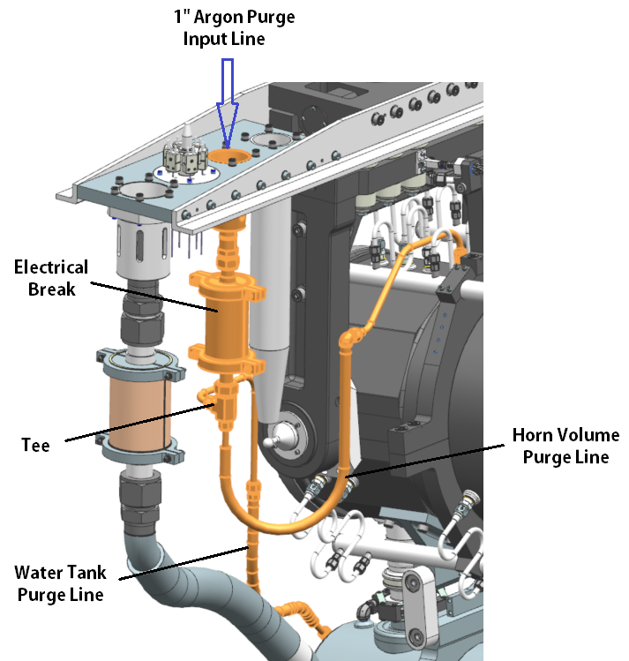
Horn A Purge System Layout
1” Supply (swage fitting / utility cup).
Tee after isolation.
Gas lines are sufficiently sized for 9L/min combined flow.
Generally chosen to work well with remote connections, standard electrical breaks, & retention brackets.

Slide 40
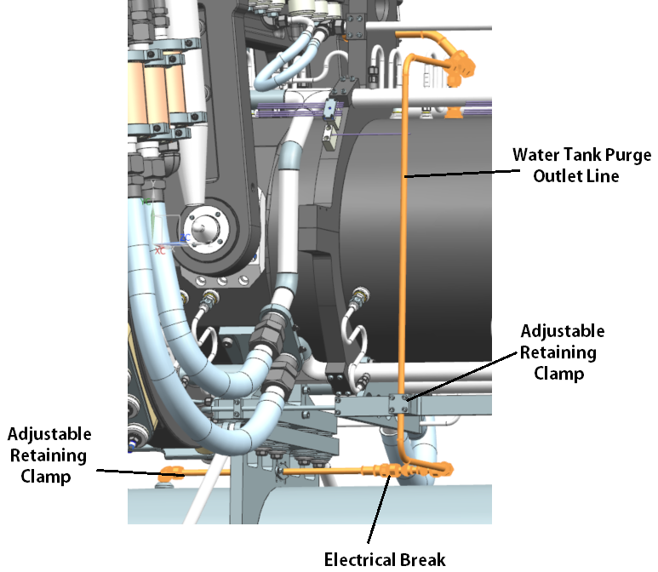
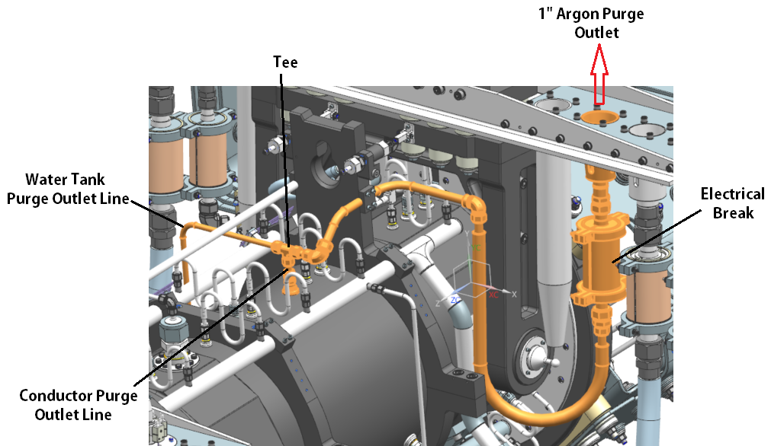
Horn A Cooling System Layout
1” Outlet + flex lines & brackets shown.
Tee back together before isolation.

Slide 41
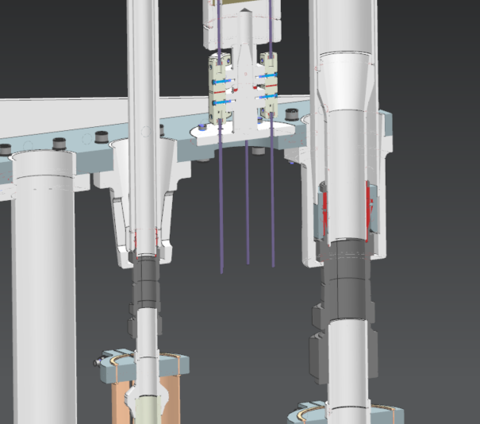
Horn Utility / Instrumentation Line Connections
Horn connections remain conceptually identical to NuMI layout.
Swage fittings up to 2” for water & gas connections.
Omega Type K thermocouple connectors on hexagon mount.
Each horn has 2 instrumentation lines, 12 readouts total.
Temperature only; no field probes.

Slide 42
Summary
Horn A design has largely stayed the same since the PDR.
Made minor changes to the following:
Lift clamp location & ancillary brackets / field mapping ports
Stripline jumpers / support hangers
Made major advancements in:
Supporting analysis work
Drawing packages
System integration
Documentation
Design efforts follow what has proven successful wherever applicable.
Important new features receive early testing (see Prototyping talk).
Questions?

