Slide 1
Neutrino Beamline Horn A Preliminary Design Review
Analysis of Horn A Stripline
Zhijing Tang
27 January 2021

Slide 2
Outline
Thermal analysis
Heat loads
Boundary conditions and cooling film coefficients
Temperature
Mechanical analysis
Mechanical loads
Displacement
Stress
Fatigue safety factor calculation
- Minimum safety factor
Other Beam Scenarios

Slide 3
Finite Element Model

Slide 4
Thermal Loads
Beam Heating - The beam heating data are calculated with MARS simulation by Diane Raitzner.
Joule Heating – Calculated by FEA model with applied current and specified resistivity.
Radiation from surrounding – assume surrounding temperature of 80 C.
For our half model, we have
beam heating | joule heating | radiation | total heating
72 | 410 | 300 | 782 W

Slide 5
Cooling and Boundary Conditions
Top end insulated
Bottom end temperature match horn conductor temperature
Surface convection film coefficients provided by Cory Crowley
Nitrogen gas temperature is 30 C
Cooling film coefficient (W/m^2-C)
section | external | internal
1 | 10 | 3
2~6 | 15 | 5
7 | 15 | 3
8~10 | 10 | 3
11~12 | 5 | 5

Slide 6
Temperature Distribution

Slide 7
Structural Model Loads
Weight – standard gravitation
Thermal – temperature as calculated
Bolt preload (50262 N per bolt)
Magnetic force (with peak current) calculated using Maxwell 3D

Slide 8
Magnetic Force on stripline A

Slide 9
Displacement

Slide 10
Stress

Slide 11
Alternate Stress

Slide 12
Mean Stress

Slide 13
Materials and welds

Slide 14
Material strength data
material | Tensile Yield Strength (MPa) | Tensile Ultimate strength (MPa) | Fatigue Strength (MPa) (10^8 cycles, Range)
6101-T6 | 172 | 200 | 60
6061-T6 | 276 | 310 | 96.5
6013-T6 | 286 | 311 | 124
Area near Weld (assume within the distance of 3 times the thickness),
the strength has a 50% deduction.

Slide 15
Safety Factor Calculation
segment | Material strength | Minimum safety factor
Seg 1 | Strength of 6101-T6 | 2.6
Seg 2 | Strength of 6101-T6 | 2.6
Seg 3 | Strength of 6013-T6 | 3.9
Seg 4 | Strength of 6061-T6 | 24
Weld 1 | 50% of Strength of 6101-T6 | 8.1
Weld 2a | 50% of Strength of 6101-T6 | 1.9
Weld 2b | 50% of Strength of 6013-T6 | 3.4
Weld 3a | 50% of Strength of 6101-T6 | 2.1
Weld 3b | 50% of Strength of 6061-T6 | 12

Slide 16
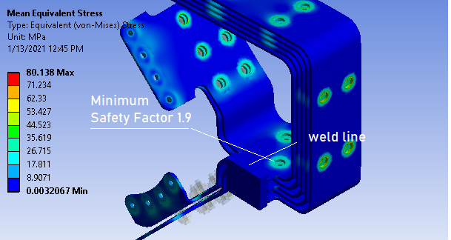
Minimum Safety Factor
Dominate load is bolt preload (compression)
Deduction of 50% is quite arbitrary
Although this safety factor is less than 2, we consider it safe

Slide 17
Other Beam Scenarios
Above analysis is for 120 GeV beam at 1.2 s repetition rate
We may also have 80 GeV at 0.9 s repetition and 60 GeV at 0.7 s repetition.
Since joule heating dominates, we run a 60 GeV case assume the same beam heating. The results shows higher temperature, but displacement and stress are close to that of 120 GeV case.
80 GeV case is between 60 and 120 GeV.
All three cases are safe

Slide 18
Temperature for 60 GeV beam operation Scenario

Slide 19
Displacement of strip lines (60 GeV)

Slide 20
Solution combinations for 60 GeV case

Slide 21
Summary
Thermal and mechanical behavior of stripline are analyzed using finite element model for 120 GeV beam.
Maximum temperature is 53 C.
Maximum displacement is 0.56 mm.
Maximum stress is 80.5 MPa.
Safety factor is calculated using modified Goodman equation
Minimum safety factor is 1.9
80 GeV and 60 GeV cases are also considered, they are not too much different from 120 GeV case.
All three cases are safe.

