Slide 1
Neutrino Beamline
Prototype Horn A
Final Design Review
Ancillary Structure Analysis
Cory Crowley / Nnamdi Agbo
27 January 2021

Slide 2
Outline
Analysis Approach & Documentation Tracking
Significant FEA Projects
  Lift Clamps
  Water Tank
  Pivot Blocks
Excel Sheet Calculations
  Plateau Loads & Helicoflex Seal Compression
  Stripline Features
Summary

Slide 3
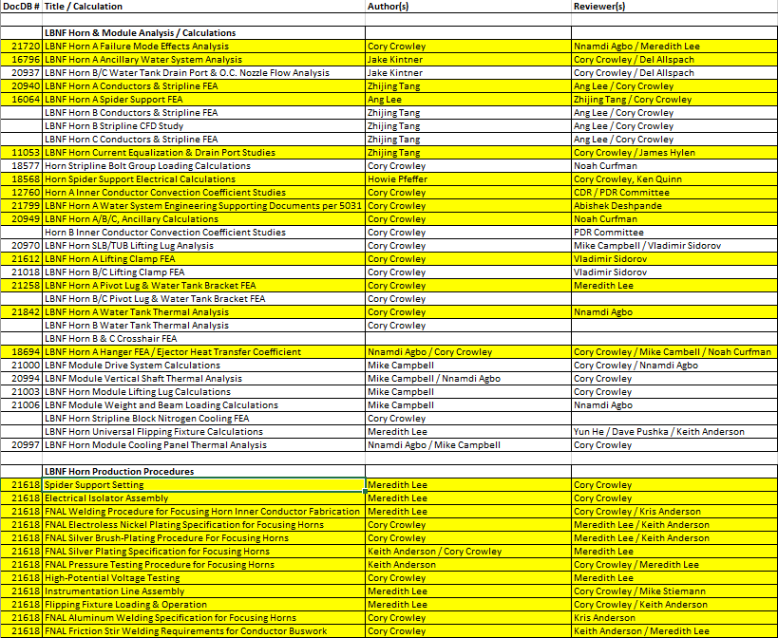
Analysis Approach & Documentation Tracking
Master excel sheet listing identifies all Horn Systems analysis efforts.
Highlighted items applicable to prototype Horn A.
Lists author & reviewer(s).
Location of analysis work per DUNE/LBNF.
Most have ED number in Teamcenter.
Nothing should be local to engineer.

Slide 4
Analysis Approach & Documentation Tracking
EM allows graded approach. Individual engineer needs to match complexity of work to amount of documentation.
Most FEA work is substantial and receives dedicated ED number and can be found in Teamcenter as required per the EM.
Non-critical brackets / mounts / weldments are at discretion of engineer / designer.
Peer review correspondence is tracked through email at minimum.
All documents found in DUNE-doc-db will still have ED number associated with it for traceability. Teamcenter ED will continue for versioning after project is complete.
Release process is group effort / takes time. Any ED not yet released in TC while waiting for checker / approver team has email peer review correspondence to substantiate review completion.

Slide 5
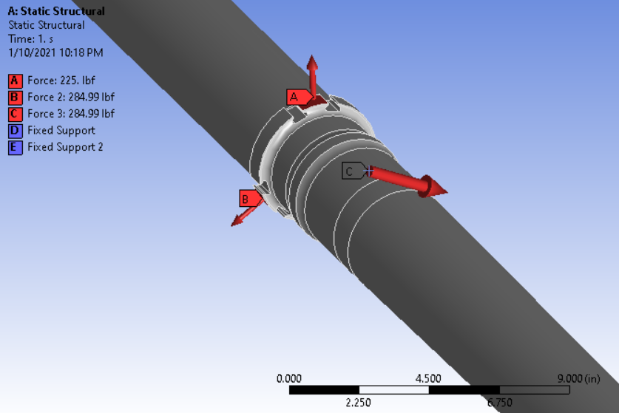
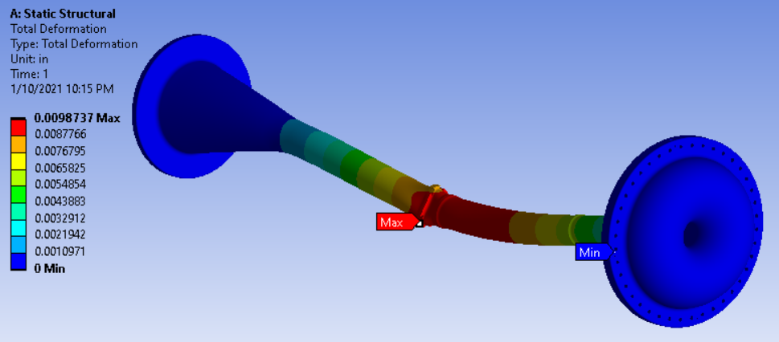
Horn A Conductor Stiffness / Spider Loading Check
PDR recommendation: confirm spider supports have the ability to pull Horn A into straightness tolerance.
Horn A profile should not leave welding machine more than .010” out of ideal centerline.
Force offsets to pull horn .010” from centerline in ANSYS should be near identical to pull horn .010” back in centerline…
2 spiders need 60lb force advantage @ 120 degree azimuth to achieve goal.
285lb available preload is sufficient.

Slide 6
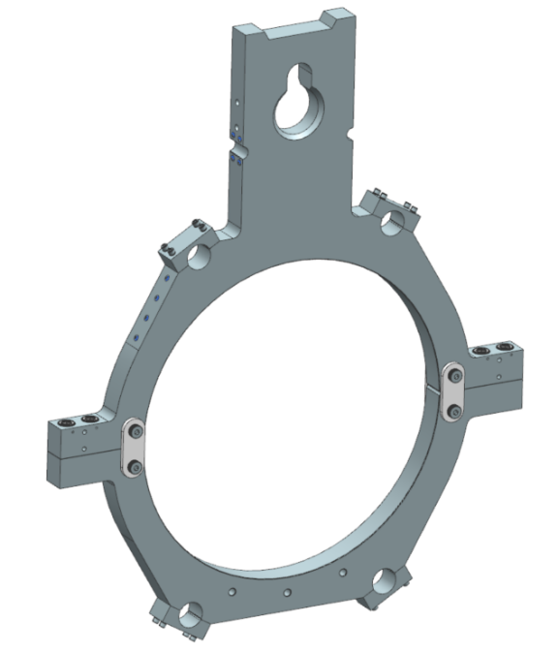
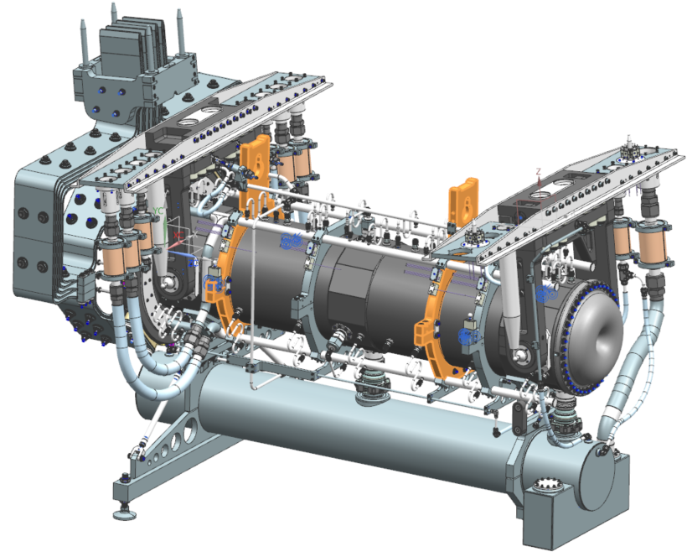
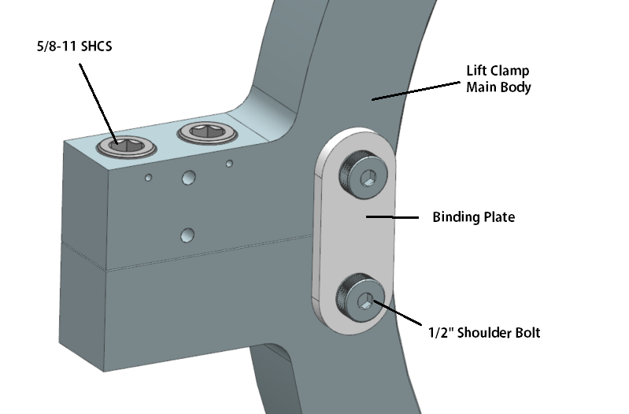
Lift Clamp FEA – ED0013019
Special clamps provide coupling surfaces & keyway for remote handling fixture insertion.
Identical concept to NuMI.
Strengthened concept to handle Horn A weight.

Slide 7
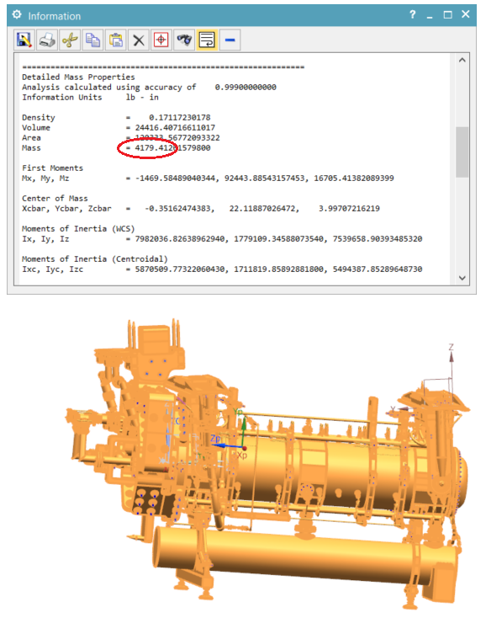
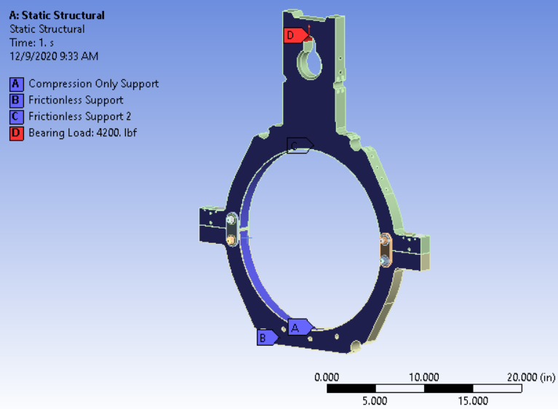
Lift Clamp FEA – ED0013019
Mass is overestimate due to steel “dummy” target. Don’t know target weight, but steel is worst case, so, use worst case.
C.G. is known to be close to U.S. clamp, but not past it.
Decided to load single clamp with full horn weight for conservative analysis.

Slide 8
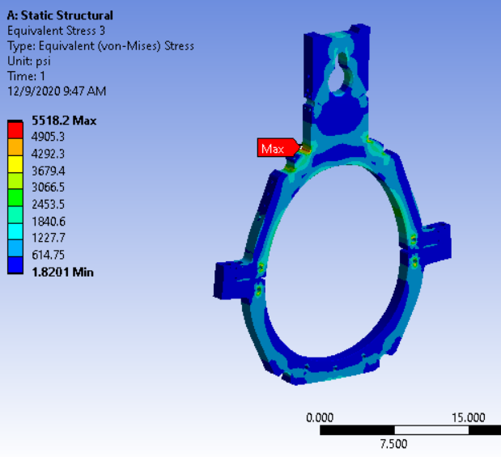
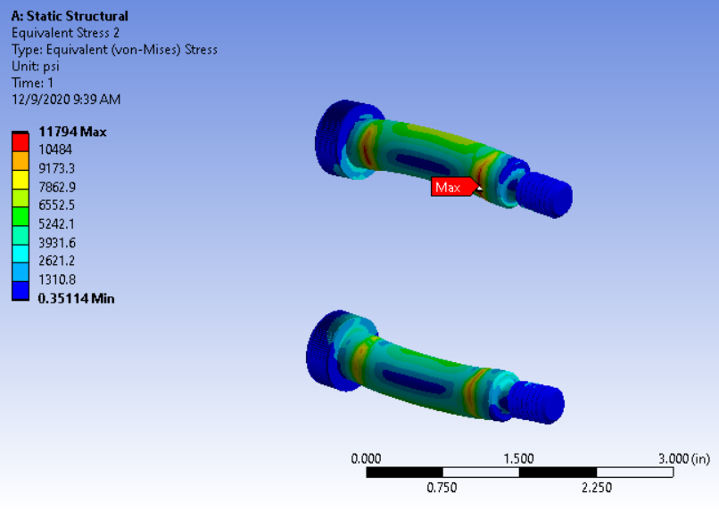
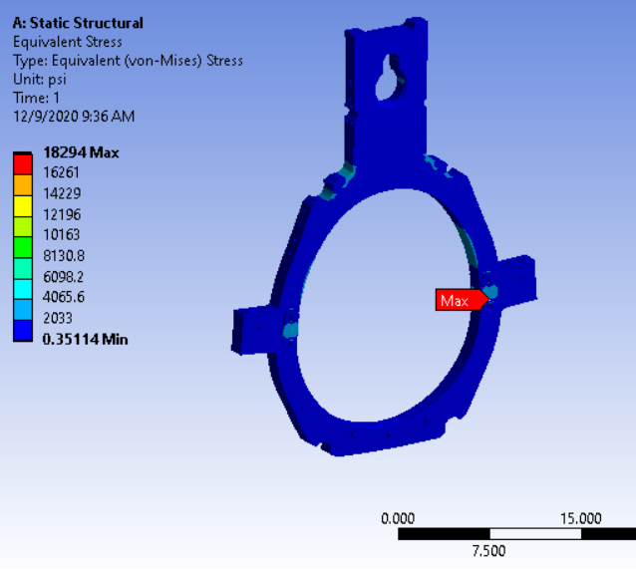
Lift Clamp FEA – ED0013019
All stresses are acceptable & well below allowable for yield.
Ignored any stiffening contributions from water line clamps.
No threads for binding plate shoulder bolts are in shear.

Slide 9
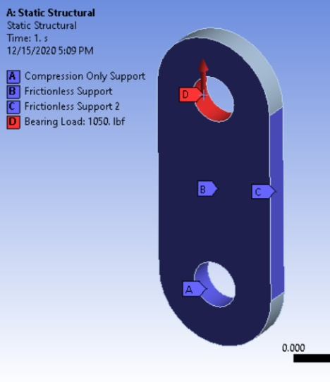
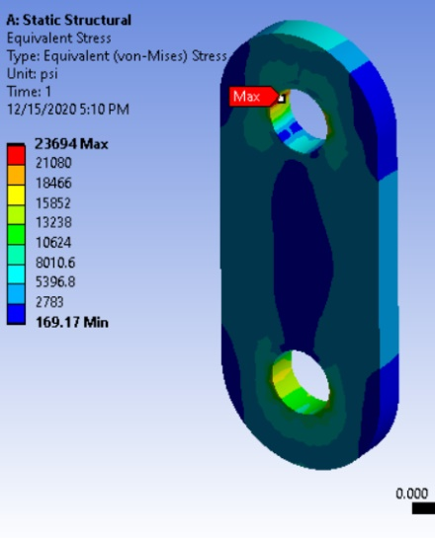
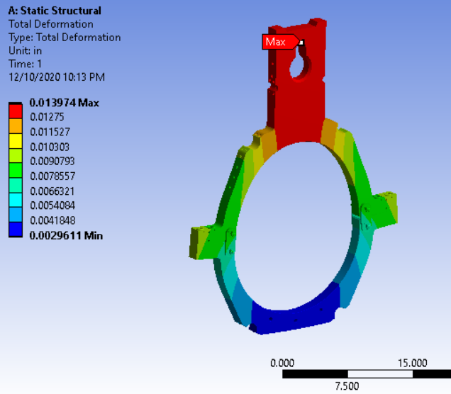
Lift Clamp FEA – ED0013019
Investigation of equivalent stress at binding plate shows concentration where expected. Did not ignore concentration & upgraded material from 304SS to Nitronic 60 to get S.F. above 2 & meet AISC / ASD criteria.
Binding plate can be suppressed, and clamp studs will hold load, though deflection increases.
Lift clamp deflection as analyzed is acceptable.

Slide 10
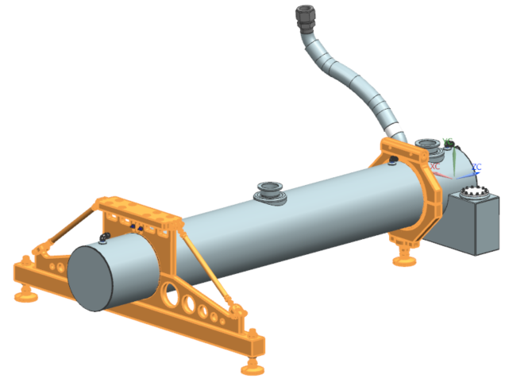
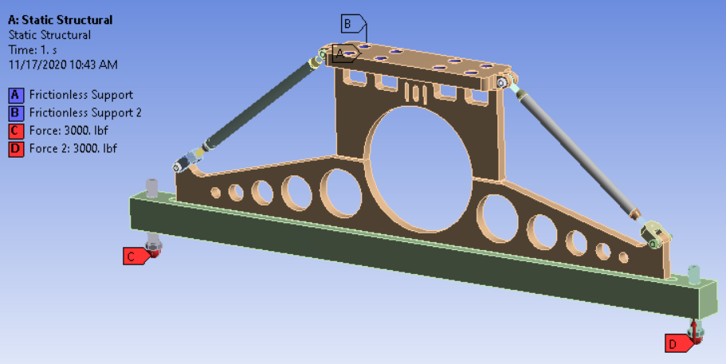
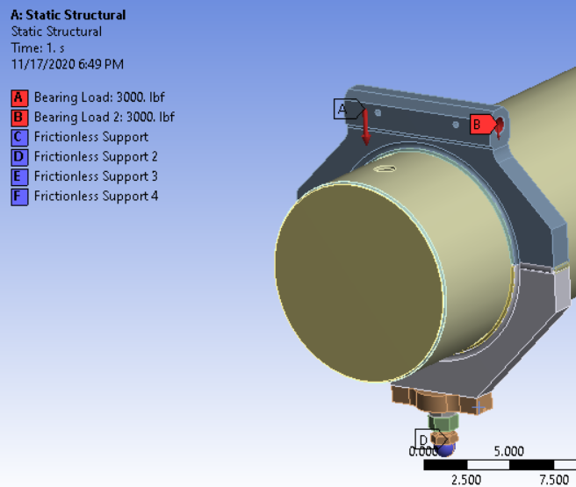
Water Tank FEA – Structural: ED0012923
Water tank support system is designed for all horns.
Heaviest horn is Horn B (~8500lbs), but worst-case scenario is maximum hydraulic table loading in work cell.
6000lb-force per support table, 1 support table for each end.
Need to ensure water tank and Horn do not catastrophically fail during remote handling link-up to support module.

Slide 11
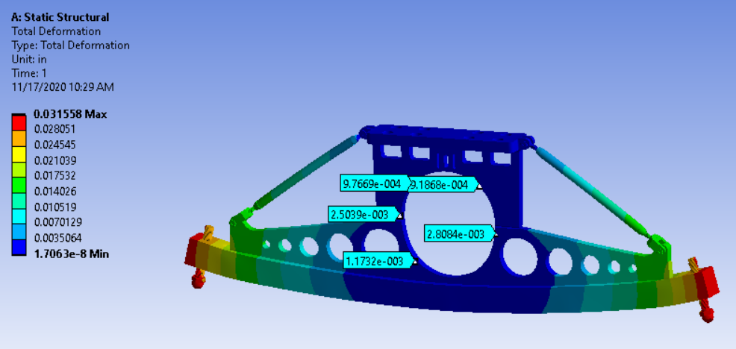
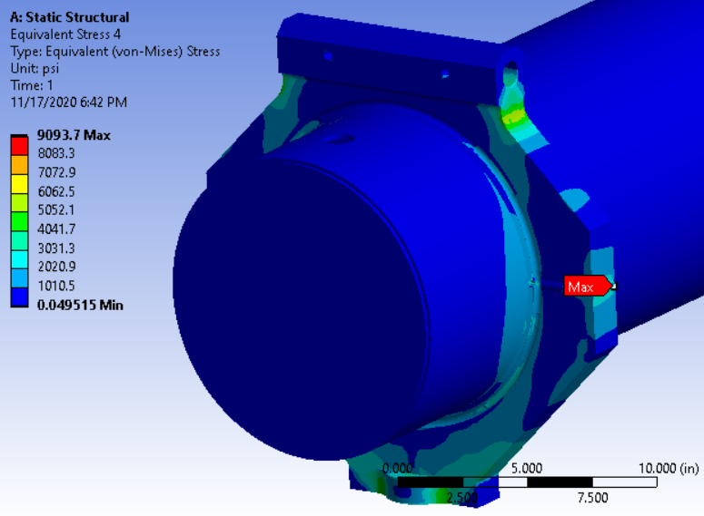
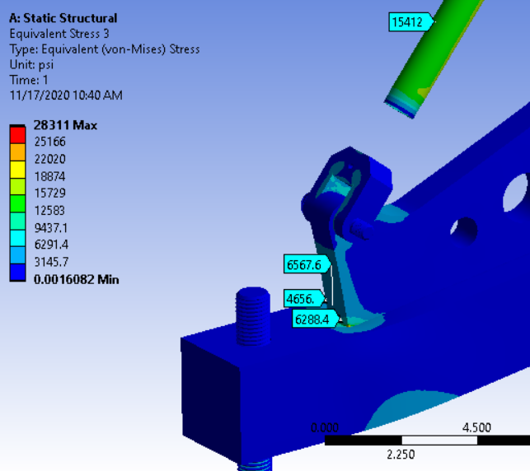
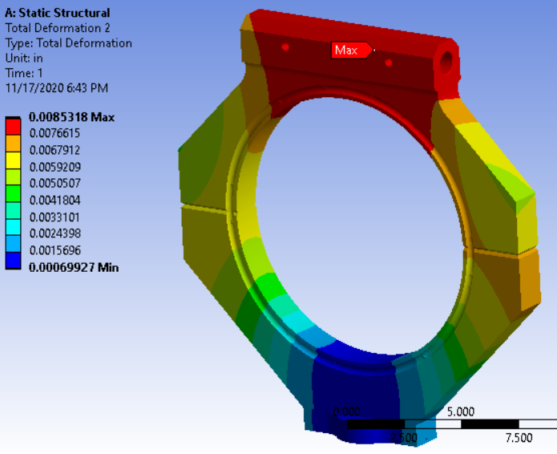
Water Tank FEA - Structural: ED0012923

Slide 12
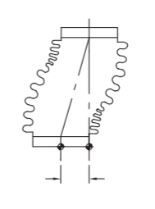
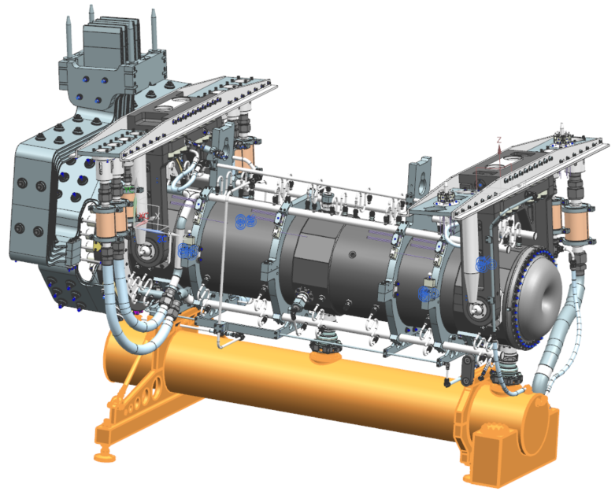
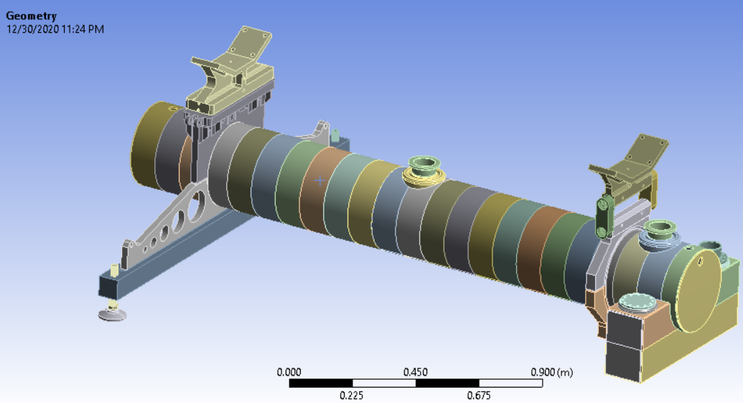
Water Tank FEA – Thermal / Structural: ED0013085
PDR comment: Confirm water tank thermal expansion does not cause bellows failure for (furthest) drain line.
Internal secondary check: confirm pivot link swing from expansion does not cause excessive moment at U.S. rigid connection.

Slide 13
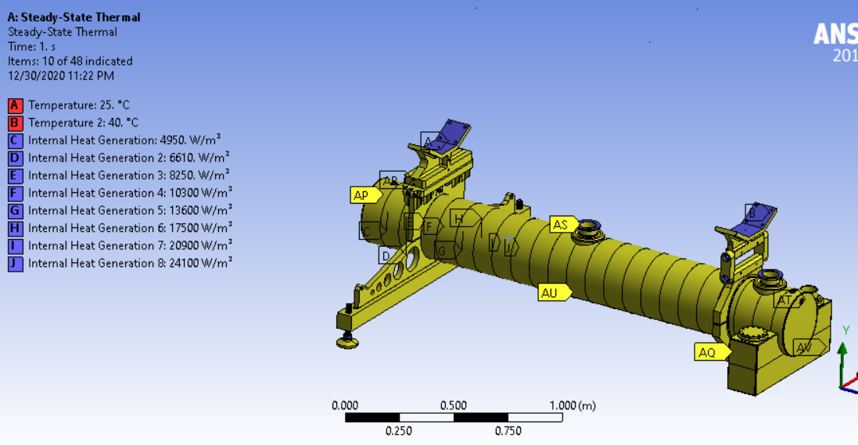
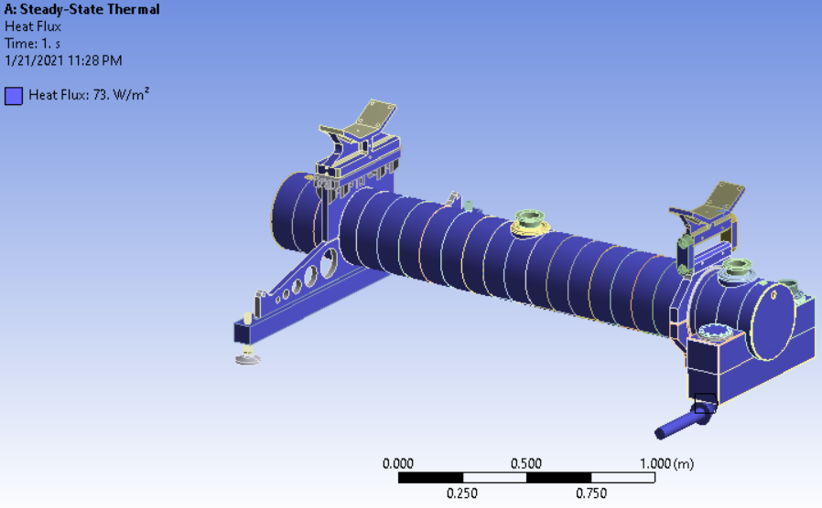
Water Tank FEA – Thermal / Structural: ED0013085
Applied internal pressure from argon system (2PSIG).
Applied 115% EDEP from 1.8M target @ 1.2MW.
Applied thermal radiation load from average chase floor & wall temperature assuming form factor of 1 & corroded aluminum (conservative).
Exterior tank convective cooling matches standard chase values.
Interior cooling provided by water flow from horn.

Slide 14
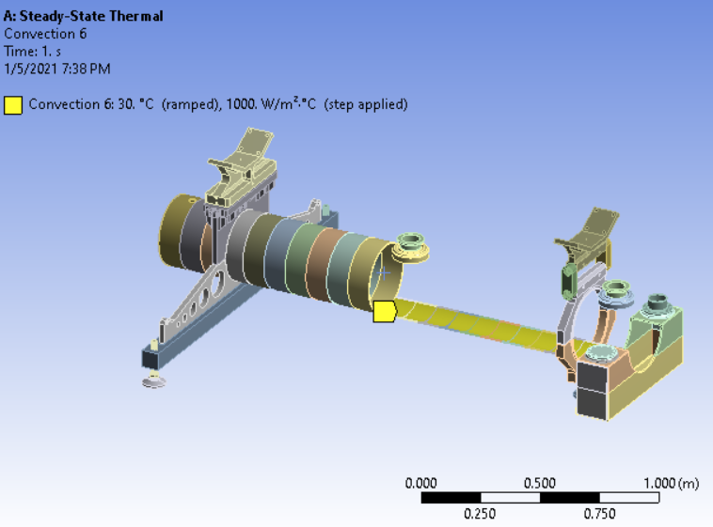
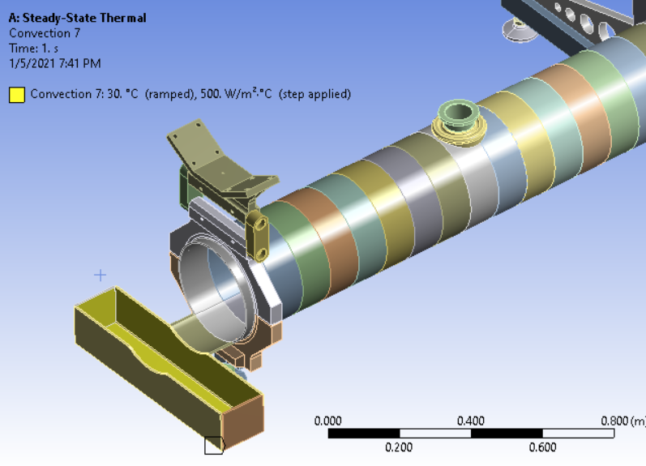
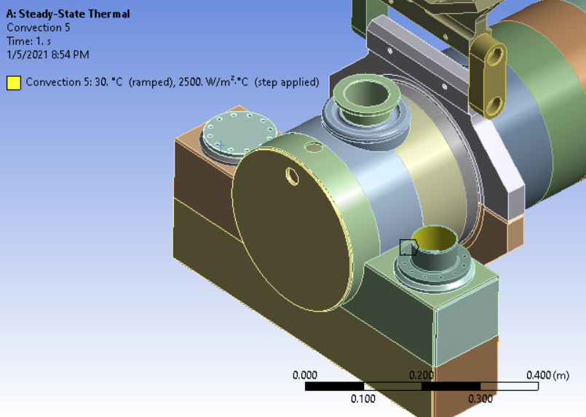
Water Tank FEA – Thermal / Structural: ED0013085

Slide 15
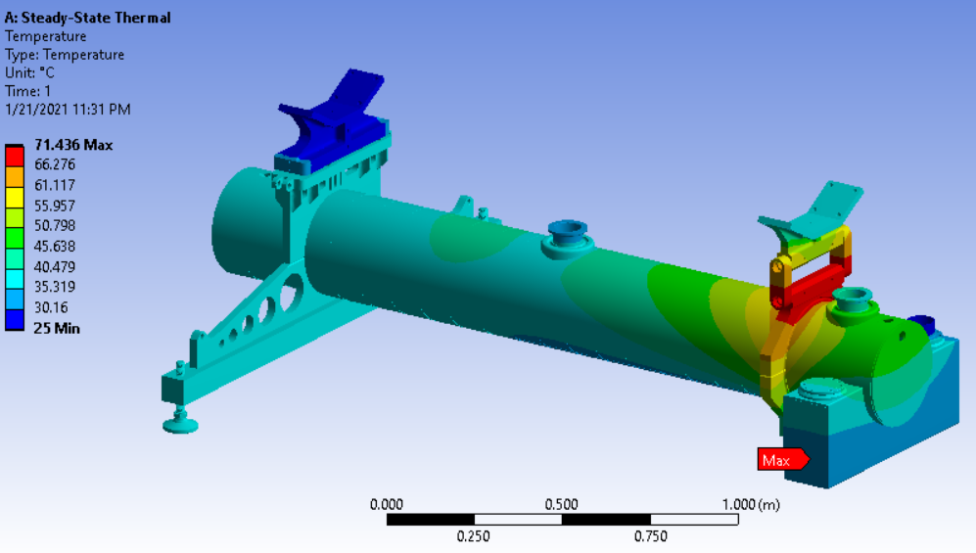
Water Tank FEA – Thermal / Structural: ED0013085
Temperatures not too high…
Hot spots are not surprising
  Main swinging link bracket with no direct contact to water cooled surface.
  Stainless swivel foot is hottest @ 71C.

Slide 16
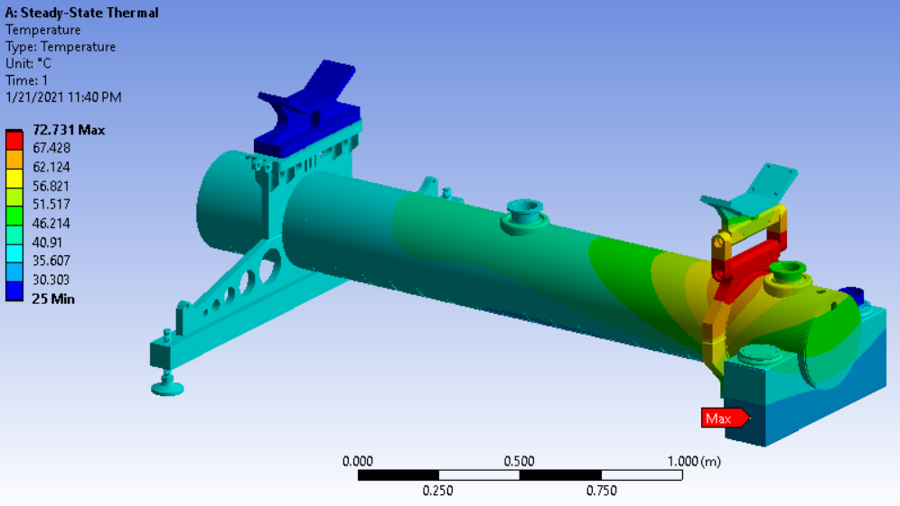
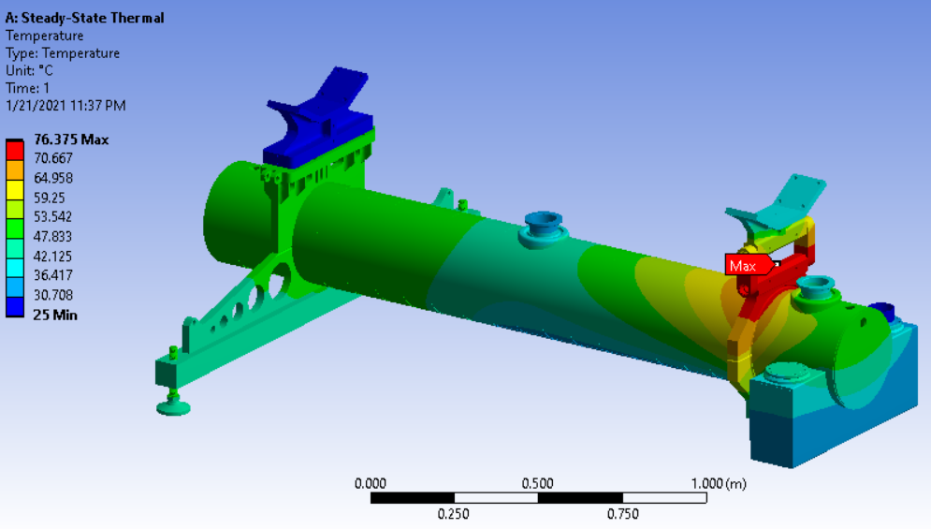
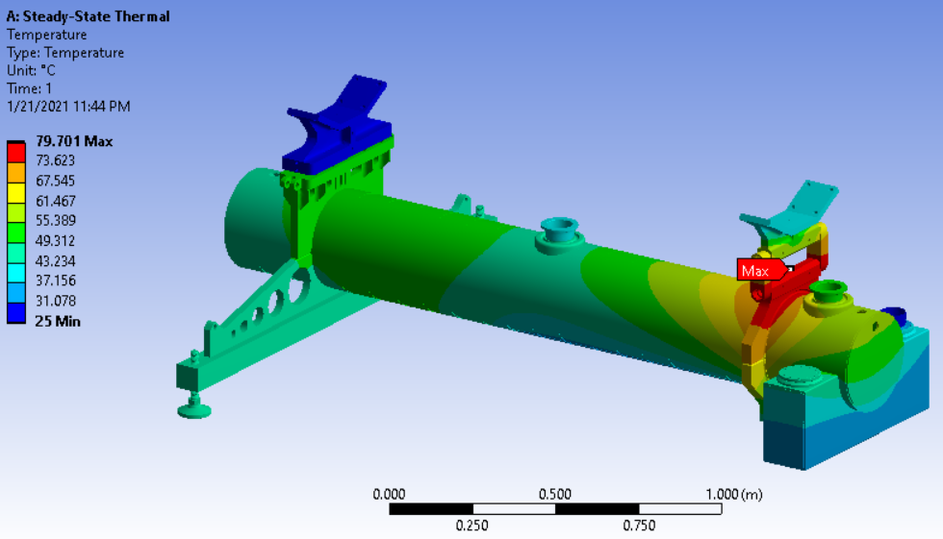
Water Tank FEA – Thermal / Structural: ED0013085
Performed sensitivity studies.
  Trial 1: Cut exterior convection 50% (Nitrogen cooling)
  Trial 2: Cut Interior convection 50% (water cooling)
  Trial 3: Cut all cooling 50% except ejector
All reductions had minor effects.
Cutting chase cooling had larger effect than interior cooling.
Points to thin shell thermal conductivity limitations.
2
1
3

Slide 17
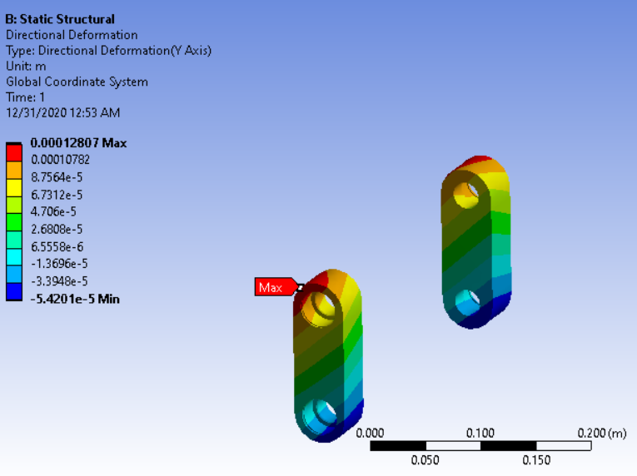
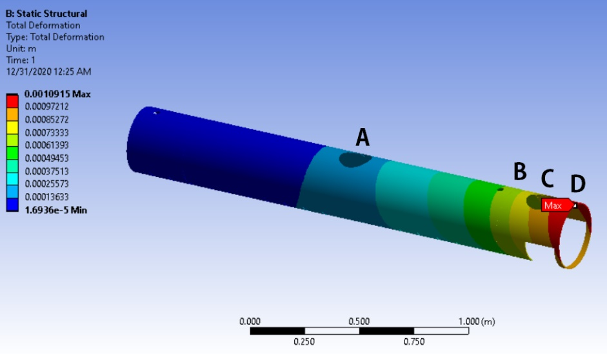
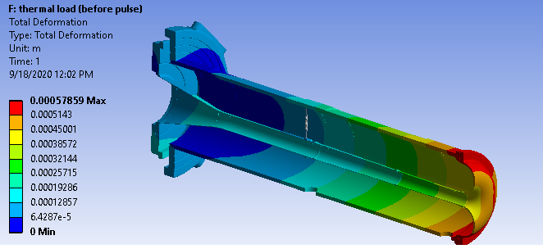
Water Tank FEA – Thermal / Structural: ED0013085
Conclusion: Pivot link growth and differential tank swing is very low.
Links grow .005” from thermal load.
Links swing out .024” from tank growth when measuring from rigid base to point B (bracket location).
Vendor guidance is 10% offset of 1” live length is acceptable.
Even factoring in rare thermal event where conductors are immediately cooled and tank remains hot, D.S. bellows @ point C have 3X allowable flexibility before surpassing guidelines.

Slide 18
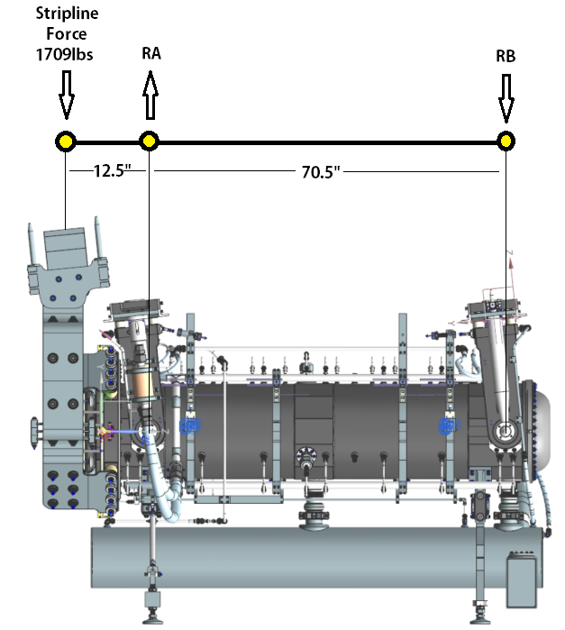
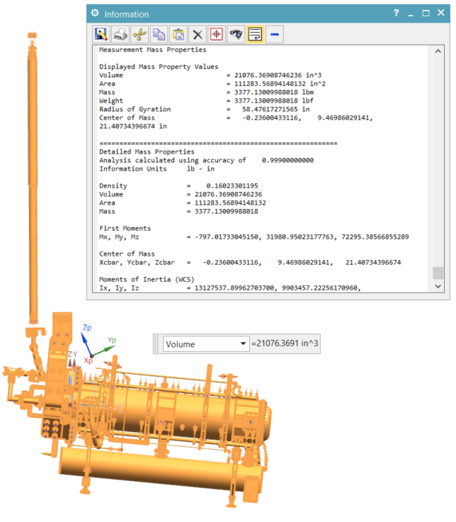
Pivot Block FEA - ED0012923
Pivot blocks are primary structural attachments that link the conductor package to the support hangers & module.
They must take full horn weight, target weight, target utility lines, and stripline offset reaction force for vertical displacement.
They can ignore all horn utility line weights, as those are carried by the utility beams and link back to module mounts.

Slide 19
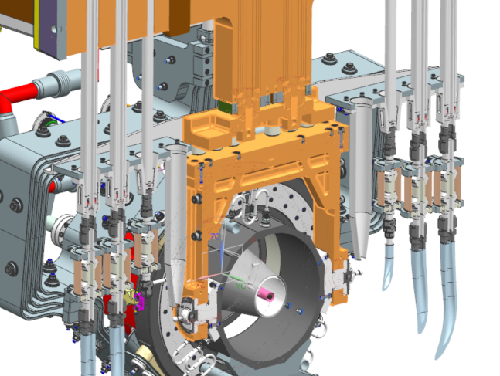
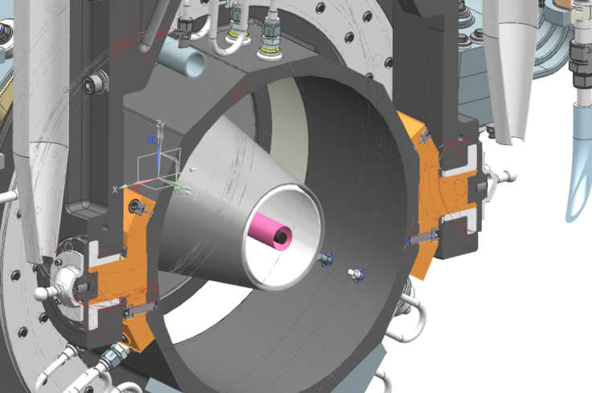
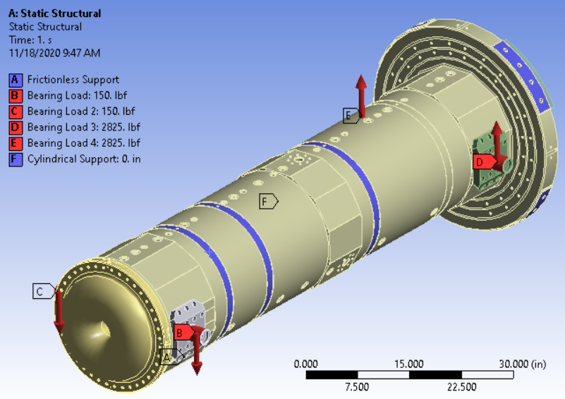
Pivot Block FEA - ED0012923
Loads on hanger are trivial; extremely rigid. SF 50+ for most areas.
Deformations on conductor harder to understand with complexity of geometry.
Must not cause outer conductor concentricity to be appreciably affected.

Slide 20
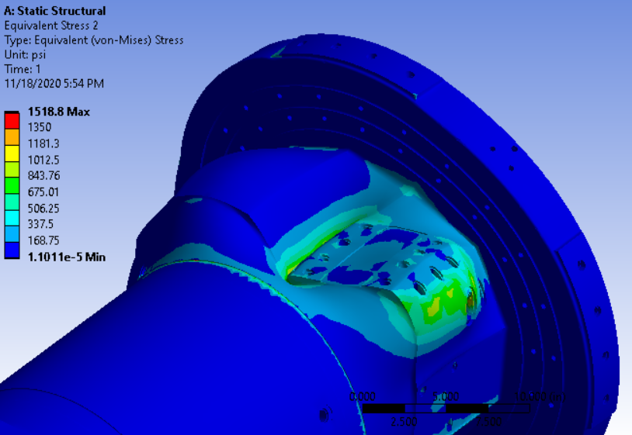
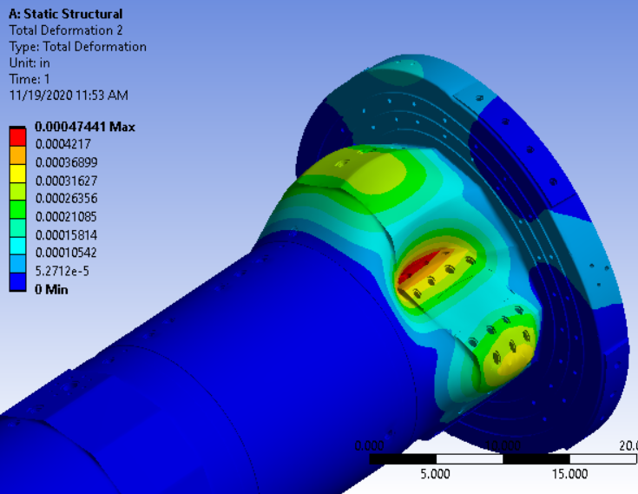
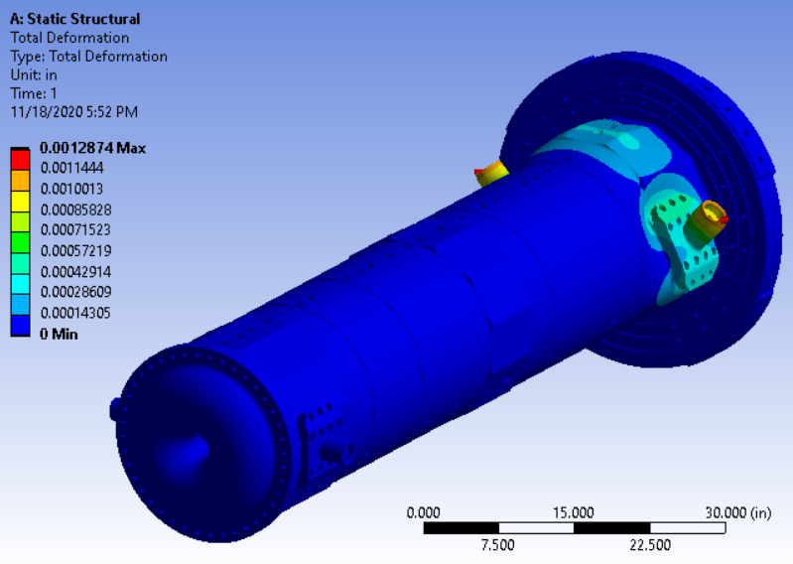
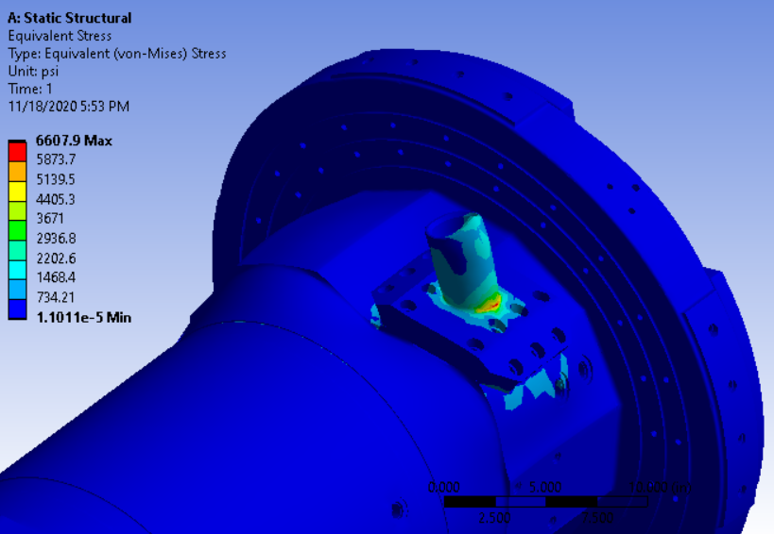
Pivot Block FEA - ED0012923

Slide 21
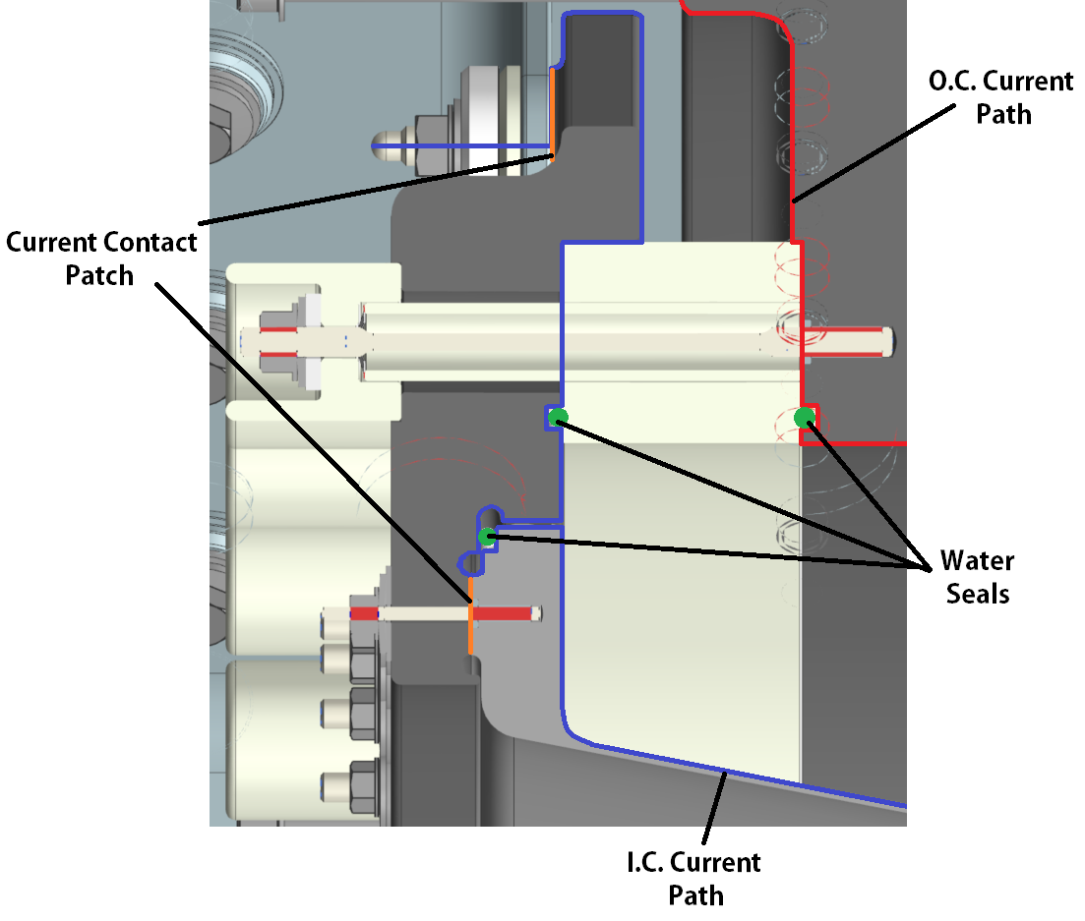
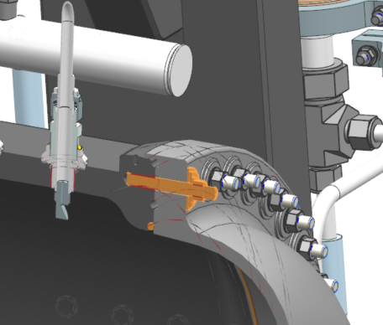
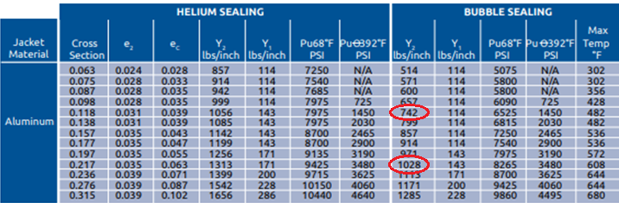
Plateau Loads & Helicoflex Seal Compression
LBNF Horns use Helicoflex seals for conductor joints, ceramic ring / connecting flange, water drain ports, & spider supports.
Chosen for company reliability, available size ranges, and cost.
2 sizes used throughout entire Horns WBS.
Y2 is required load per linear inch to compress.
Known difficulty is achieving high compression load.

Slide 22
Plateau Loads & Helicoflex Seal Compression
Conductor joints must also meet 1400PSI current plateau load minimum.
Some bolt groups have 2 jobs to do:
  Compress Helicoflex seal first.
  Increase joint load to 1400PSI with remaining preload.
These joints are arguably the most critical in horn design; how to test preload??
Measure resistance across the joint after conductor fastening.

Slide 23
Stripline Force & Vibrations
Force check
Vibration check
Both determine bolt group spacing

Slide 24
Stripline Features
Unbalanced portion of LBNF stripline after jumpers is one of most highly stressed areas.
Theoretical calculations agree well with Z. Tang analysis work.
Need to have great Q.A. / no surface imperfections, or most likely failure point for Horn A.

Slide 25
Summary
All major subcomponents have been structurally and thermally analyzed when difficult to capture with engineering basics.
Final design iterations meet all required safety factors or design criteria per DUNE / LBNF requirements, FESHM / EM, & Aluminum Conductor Bus Handbook.
All work is documented on DUNE-doc-db.
All work has been peer reviewed and has supporting peer review correspondence.
Questions?

