Slide 1
Neutrino Beamline Horn A Design Review
Horn A Hanger Analysis
Nnamdi Agbo
26 – 29 January 2021

Slide 2
Outline
Introduction
Executive summary
Horn A final design model
Problem Statement
Thermal Analysis Setup
Loading / Boundary Conditions
Material Properties
Thermal Analysis Results
Structural analysis Setup
Loading / Boundary Conditions
Structural Analysis Result
Conclusion
Appendix

Slide 3
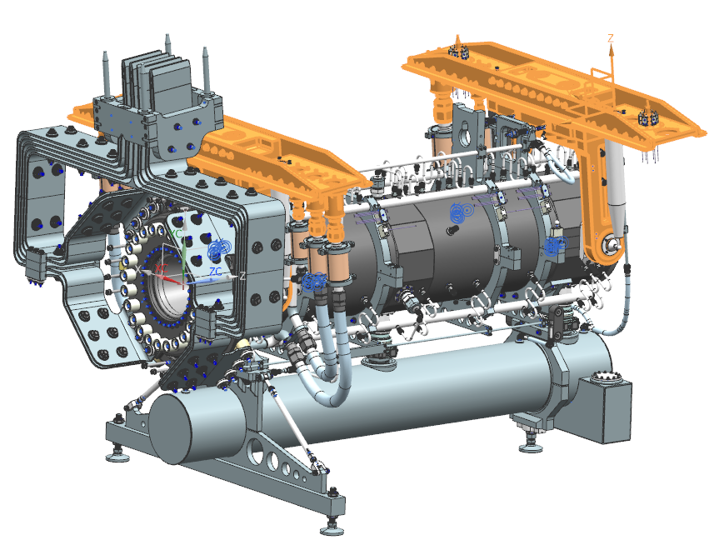
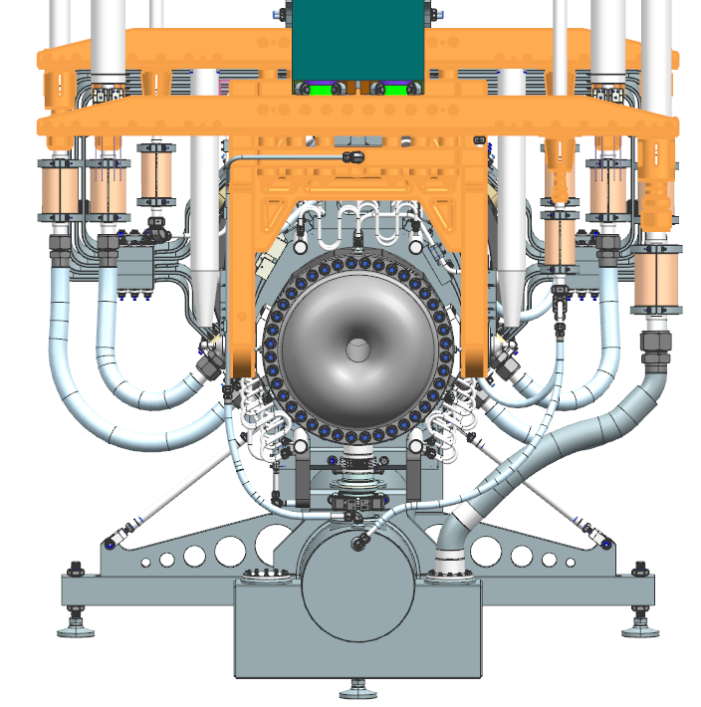
Introduction
Executive Summary:
This presentation is focused on the thermal and structural analysis performed to determine the maximum temperature and deformation seen in Horn A Hanger Utility Support Beam as well as investigate the magnitude of Horn A center offset due to the thermal and structural loads inputs on the Horn.
Final Design Model:

Slide 4
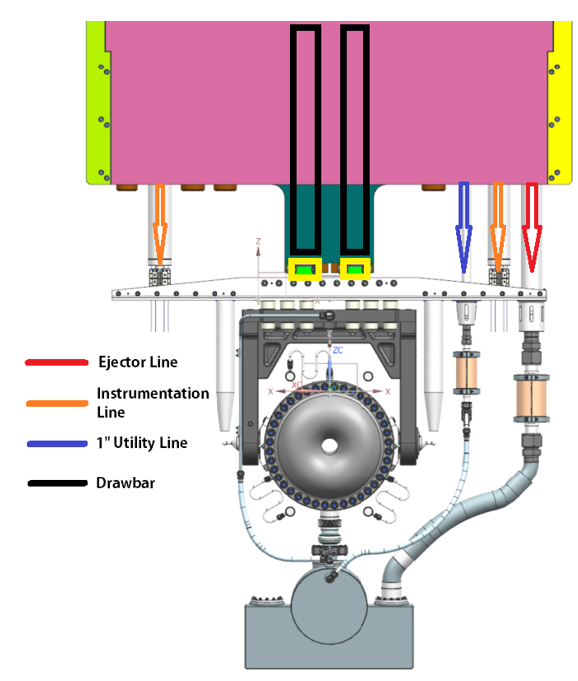
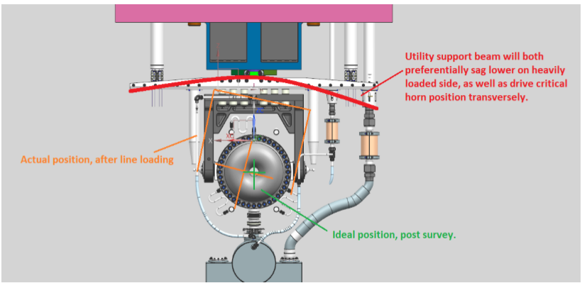
Problem Statement
The utility support beams for LBNF are significantly longer and more heavily loaded than it was in prior horn designs. The load which is asymmetric was suspected to create a large moment around the horn-drawbar connection point. This in turn could move the horn away from the beamline or impact the ability to thread on utility lines remotely. The initial analysis presented during the preliminary design review resulted to the utilization of a double drawbar system. It also showed that the resulting horn displacement was negligible. However, the accurate energy deposition was not available at the time. This analysis was therefore completed for the purpose of addressing some of the issues raised during this preliminary design review and equally ensure that the design objectives has been met.
The following analysis will be discussed during this presentation;
LBNF Horn Utility Support Beam Thermal Analysis
LBNF Horn A Structural Offset Analysis

Slide 5
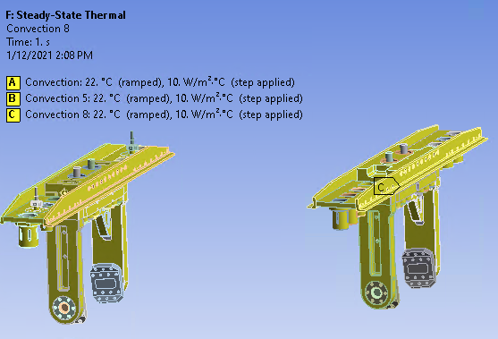
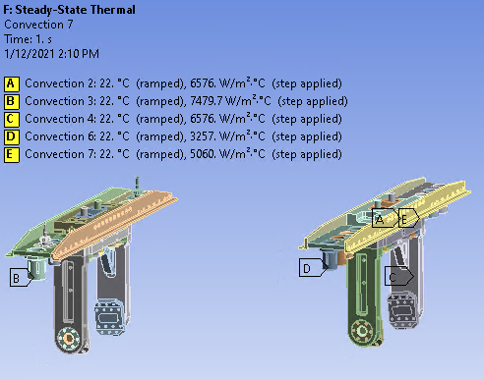
Thermal Analysis Setup
Boundary condition:
Convection Coefficient of 10W/m^2 in the surfaces
Heat flux from the drawbars – Input from Michael Campbell’s Calculation ( File Attached on the Appendix)
Temperature constraint of 40Deg C on the horn’s surface attached to the hanger pivot clamps

Slide 6
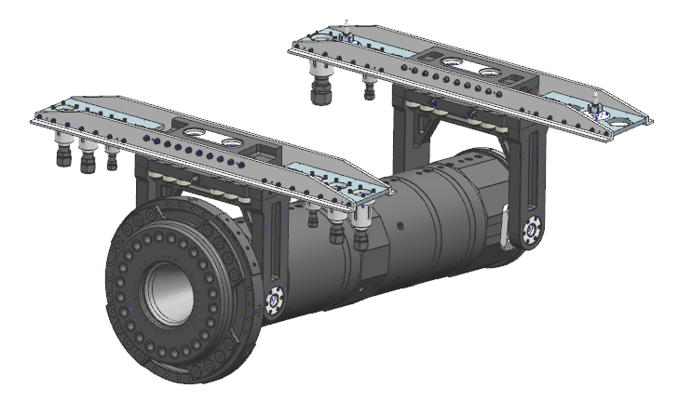
Thermal Analysis Setup
Material Selection:
Material | Density(g/cc) | UTS (MPa) | YTS (MPa) | Young’s Modulus (GPa) | Thermal Conductivity (W/mK)
6061-T6 | 2.7 | 310 | 276 | 68.9 | 167
SS304 | 8.0 | 505 | 215 | 200 | 16.2
Ti 6Al 4V | 4.43 | 900 | 830 | 114 | 6.7
Material | Density(g/cc) | Flexural Strength (MPa) | Compressive Strength (MPa) | Poison Ratio | Young’s Modulus (GPa) | Thermal Conductivity (W/mK)
PSZ-MGO | 5.72 | 900 | 1970 | 0.3 | 200 | 2.8
SS304
Al 6061 –T6
PZ-MGO
SS304

Slide 7
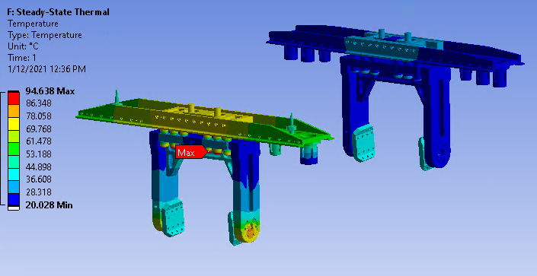
Analysis Results: Max Temperature
Due to the high EDEP on the downstream side, the maximum temperature is on the zirconia ceramic on the downstream end. This is as a result of its lower thermal conductivity compared to steel and aluminum.

Slide 8
Analysis Results: Max Temperature
The images above shows the max temperatures recorded on the upstream end (on the left) and downstream end (on the right) of Horn A hangers

Slide 9
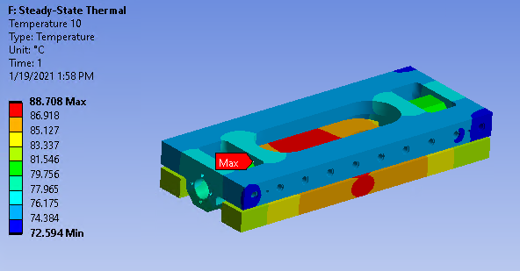
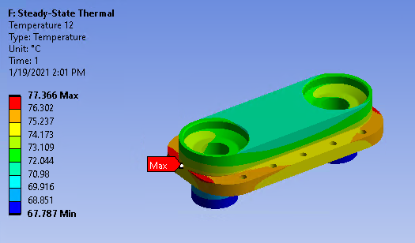
Analysis Results: Max Temperature (Downstream End)
(6061-T6) at 78.9 Deg C
(6061-T6) at 88.7 Deg C
(SS304) at 77.4 Deg C

Slide 10
Analysis Results: Max Temperature
The maximum temperature seen on the utility support beam was also less than the design threshold for aluminum 6061-T6 which experiences some materials degradation at temperatures above 100 Deg C. As such, Aluminum was shown to be adequate for the design.

Slide 11
Steady State Structural - Loading / Boundary Condition
This shows the loads exerted on the hanger utility support beam by the various utility lines. Horn A specifications sheet has been attached on the appendix for more information on the loading condition.
#Note: The thermal load was also applied to understand its effect on the horn.

Slide 12
Analysis Result – Total Deformation
The maximum deformation of the utility support beam was also below the required design specification which is expected to be below 2mm. The initial iteration was significant higher which resulted to an increase of the horn’s utility line to 5/8” thickness and increase the height by ½”.

Slide 13
Analysis Result – Total Deformation
The maximum principal stress of 38.4MPa was recorded around the utility beam bolt hole.
This is very low when compared to the yield strength of Aluminum 6061-T6 which is about 276MPa. Thus resulting to a safety factor of about 7.

Slide 14
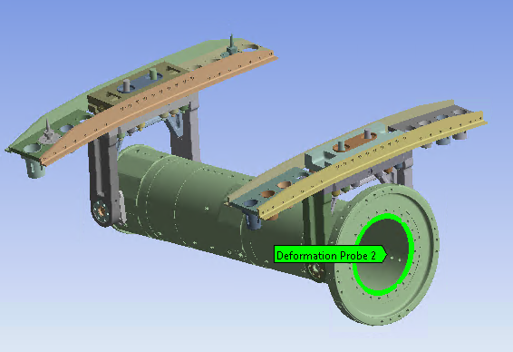
Horn Center Displacement – No Thermal Load
The horn center displacement for the downstream end of the horn due to the utility line weight was approximately 0.00078” on the y-axis.

Slide 15
Horn Center Displacement with thermal load
With the addition of thermal load, the horn was displaced by a magnitude of 0.019” on the y-axis which verifies that the thermal load plays a significant impact to the horn displacement.

Slide 16
Conclusion
The thermal analysis result shows that the maximum temperature during steady state operation at 1.2MW /120GeV beam power was below the maximum permissible temperature (100 Deg C) for all Al 6061-T6 parts.
The maximum deformation of the utility support beams were also less than 0.080” (2.03mm) specified.
From the steady state structural analysis, the Horn center is expected to experience a 0.019” (0.48mm) offset from the line of beam during full operation. This is mainly due to the thermal load input. It should be noted that the analysis was performed using 1.2MW beam power with 15% margin added was .
The maximum principle stress on the utility support beam was also well below the material’s yield strength which verifies that Al 6061-T6 is sufficient for the design.

Slide 17
Appendix
Energy Deposition Data Sheet – Diane Reitzner
Determination of Heat Transfer Coefficient of Horn A Ejector Line Utility Cup – Cory Crowley
Thermal Calculation for LBNF Drawbar - Michael Campbell
Horn Line weight from Horn A Spec Sheet – Cory Crowley
PSZ-MGO Material Specifications

