Slide 1
MQXF125 Midplane Cable Damage From Filing Epoxy Flash
Fred Nobrega – FNAL
Coil Working Group Meeting – Wednesday Nov 11, 2020

Slide 2
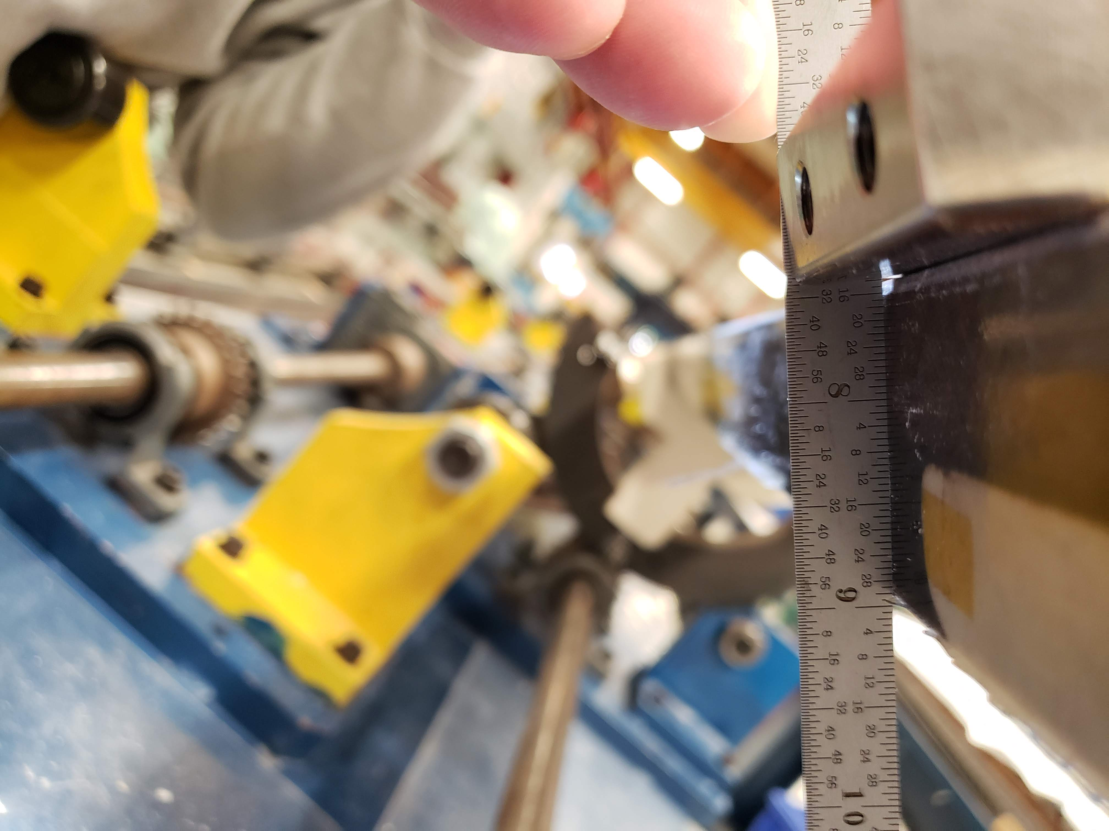
Discrepancy 12166
Description
After coil QXF125 impregnation and during epoxy flash removal, too much epoxy and fiberglass was filed exposing the corner of the cable.
Cause
Improper use of file angle and pressure
Corrective Action
Refresher training and demonstration for technicians performing epoxy flash removal.

Slide 3
QXFA125 Damaged Area
Lead End
Lead End

Slide 4
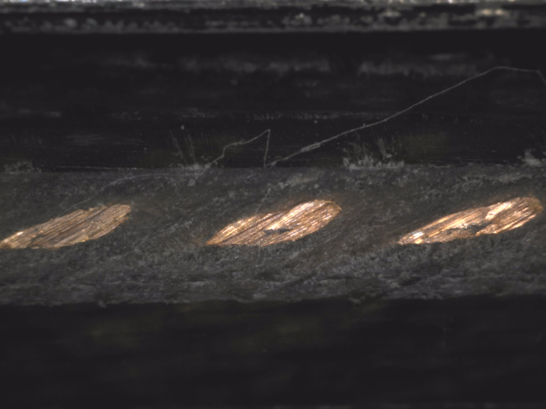
4/64 = 0.0625” (1.588 mm)
Lead End
Lead End
1/64 = 0.016” (0.397 mm)
\\tdserver1\project\HFM\LARP\QXF Coils\QXFA Coils\QXFA 125\DR Post Impregnation Filed Lead\QXFA125\Picture \A022 - 20201028_112237
\\tdserver1\project\HFM\LARP\QXF Coils\QXFA Coils\QXFA 125\DR Post Impregnation Filed Lead\QXFA125\Picture \A007 - 20201013_095629

Slide 5
Lead End

Slide 6
QXFA125 CMM Scan
Coil OD
Midplane

Slide 7
QXFA125 CMM Scan
Coil OD
COIL OD
0.145 mm cable insulation
0.100 mm trace
0.310 mm Hexel S2 glass
0.555 mm nominal thickness
Midplane
0.145 mm cable insulation
0.125 mm G11
0.270 mm nominal thickness
Midplane

Slide 8
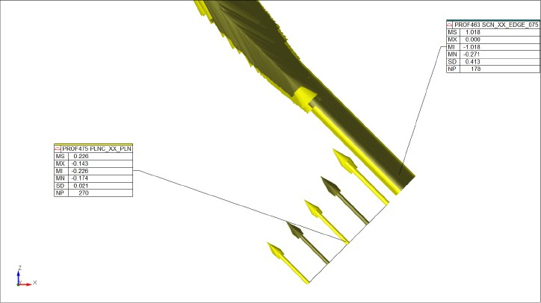
QXFA125 CMM Scan
The difference between the mean of the base plane & the worst point on the edge scan,
Should give us the maximum amount of missing material. 1.02-0.17 ≈ 0.85mm
Another technique used measured missing material at 0.65 mm.

