Slide 1
Validation of the CLIC alignment strategy on short range
OUTLINE
Introduction: CLIC project & active pre-alignment
Alignment strategy on short range
Module test setup and associated results
Description
Fiducialisation & alignment on a common support
Adjustment
Validation of the global strategy
Conclusion

Slide 2
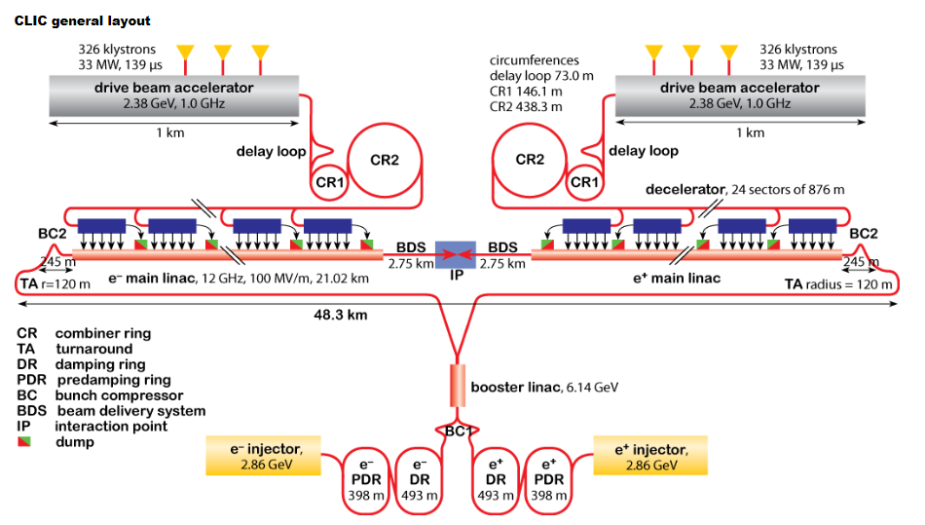
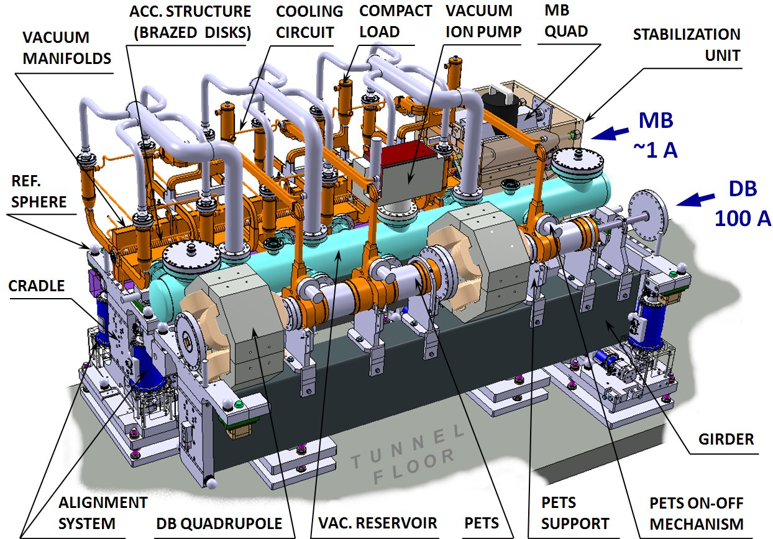
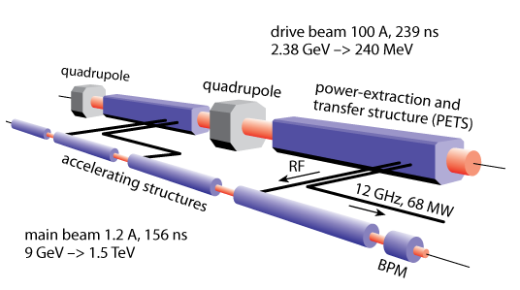
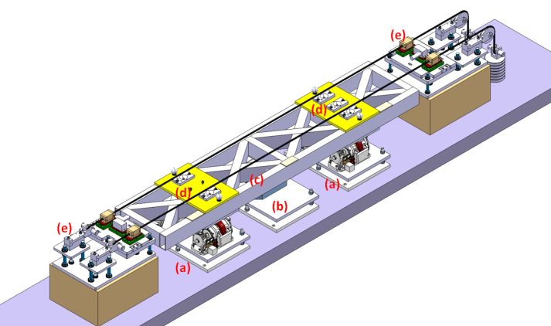
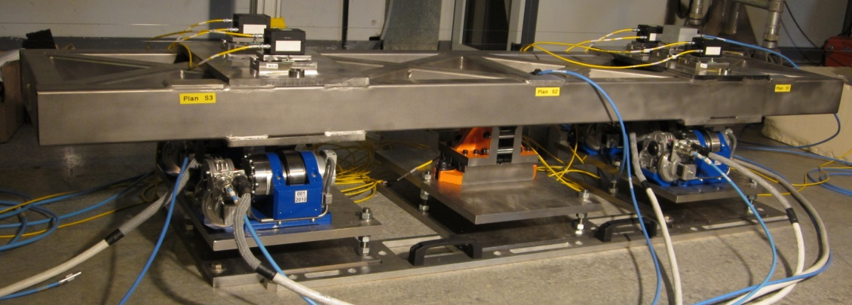
CLIC = Compact LInear Collider
Study for an e- e+ collider, with a center of mass energy of 3 TeV
Length > 40 km for 3TeV
The main linacs consist of more than 20 000 modules (2 m length)
Based on the two beam acceleration concept

Slide 3
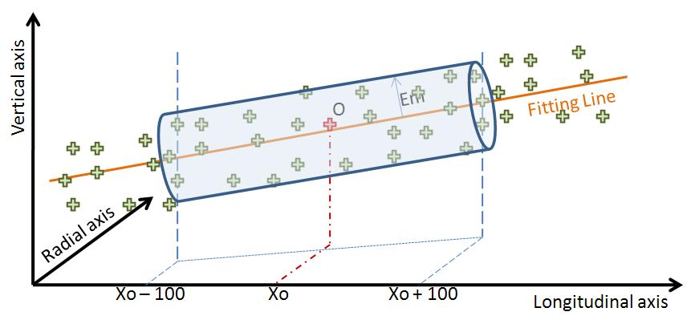
Problem and solution proposed
PRE-ALIGNMENT (beam off)
Mechanical pre-alignment
Active pre-alignment
Beam based alignment
Beam based feedbacks
Within +/- 0.1 mm (1σ)
Within a few microns
Determination of the position of the components in a general coordinate system by alignment systems
Active pre-alignment
=
+
Re-adjustment by actuators
The zero of each component will be included in a cylinder with a radius of a few microns:
14 µm (RF structures & MB quad BPM)
17 µm (MB quad)
Adjustment required: step size below 1 µm

Slide 4
Problem and solution proposed
Solution proposed
Several components will be pre-aligned on supports or girders:
Configuration of girders and supports:
Reference of alignment: overlapping reference lines

Slide 5
Problem and solution proposed
Solution proposed for CDR
Sensors & actuators are associated to each support / articulation point of girder:
As a summary:
For CDR: - straight reference = stretched wires
- sensors = Wire Positioning Sensors (WPS)

Slide 6
OUTLINE
Introduction: CLIC project & active pre-alignment
Alignment strategy on short range
Module test setup and associated results
Description
Fiducialisation & alignment on a common support
Adjustment
Validation of the global strategy
Conclusion

Slide 7
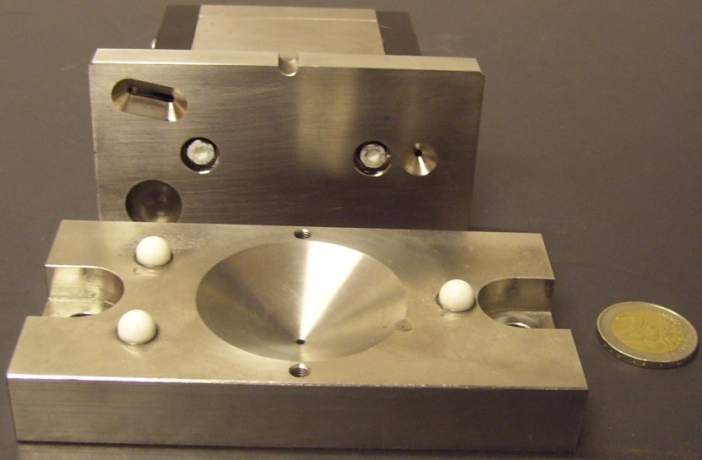
Short range strategy (1)
Different types of fiducials that are glued on the components or supports
Reference system of alignment sensors: 3 balls mechanical interface

Slide 8
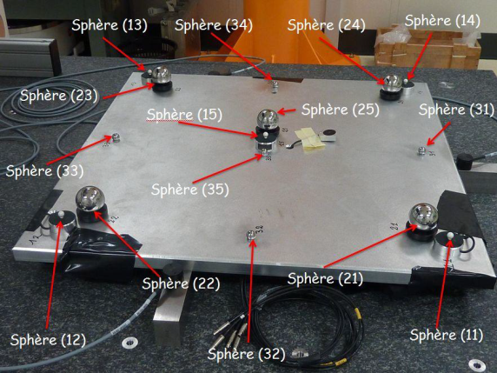
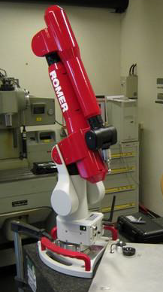
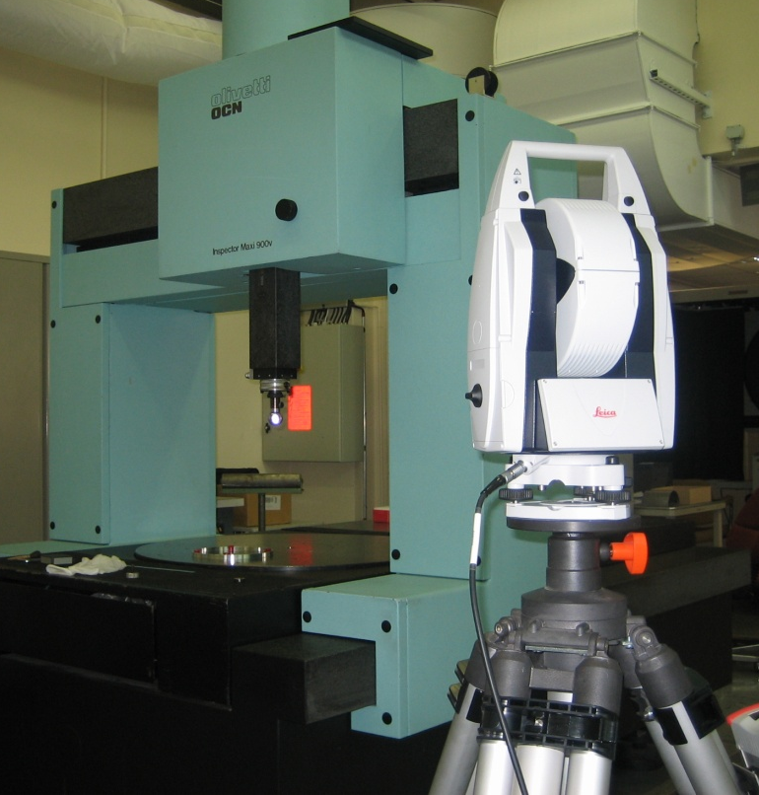
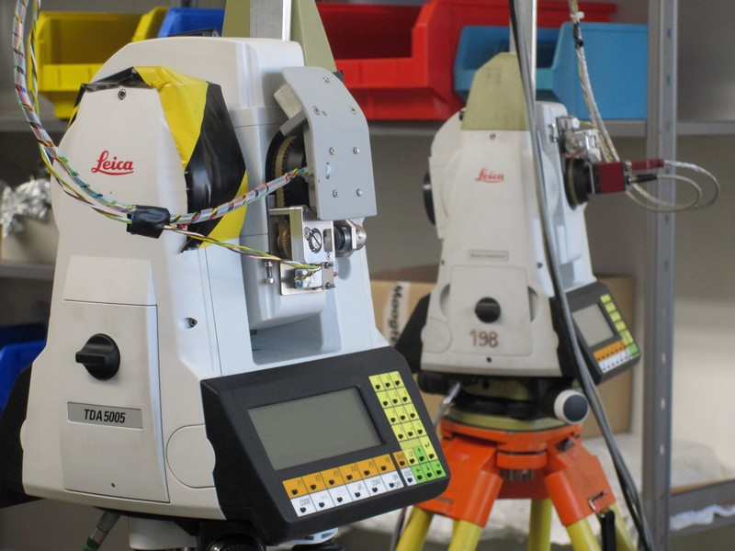
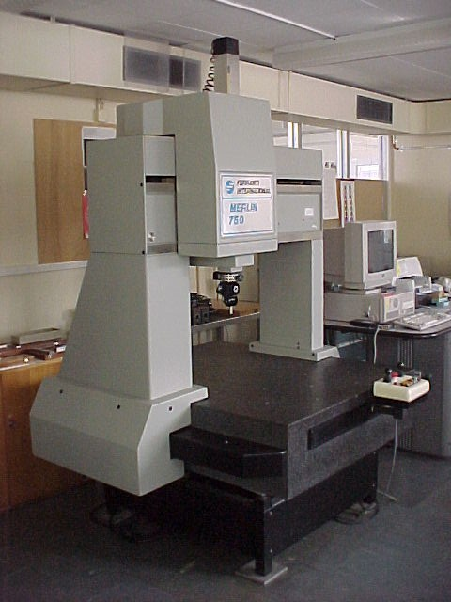
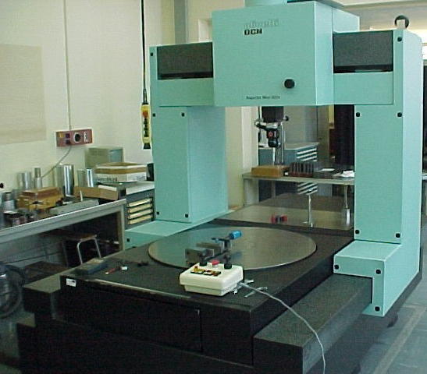
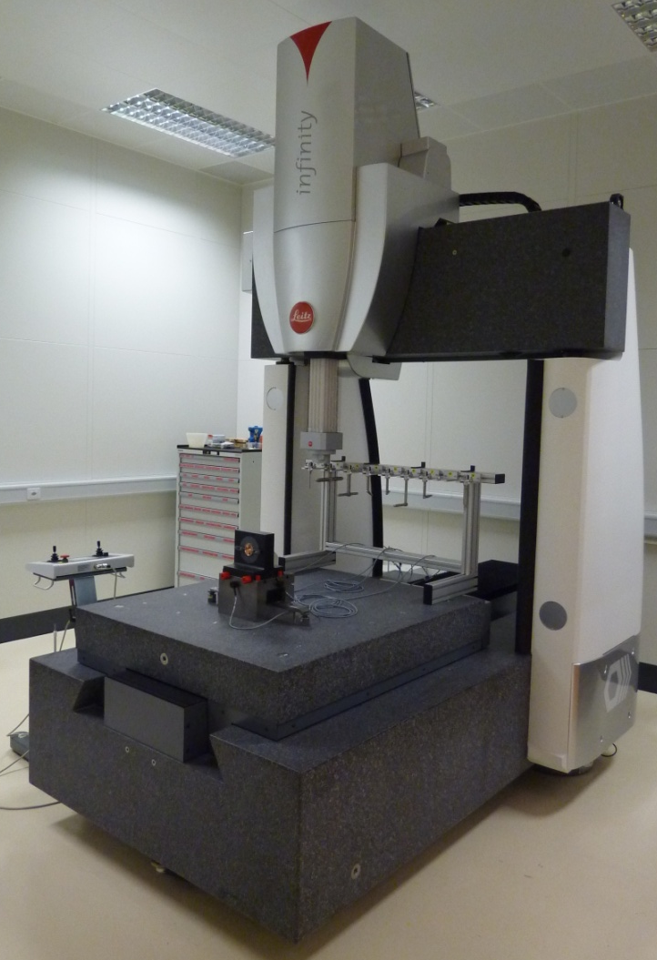
Short range strategy (2)
Means
Instrument | σ (μm)
AT401 | < 5
Micro triangulation | < 5
Romer arm | < 10
AT401
Micro triangulation
Romer arm
σ = Standard deviation between instruments and CMM measurements
LEITZ
1200x1000x700 mm
MPE: 0.3 μm + 1 ppm
FERRANTI
750x500x500 mm
Uncertainty of measurement : 6 μm (3σ)
OLIVETTI
1600x900x600 mm
Uncertainty of measurement: 6 μm (3σ)

Slide 9
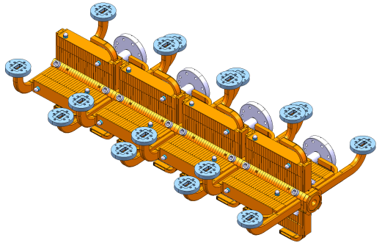
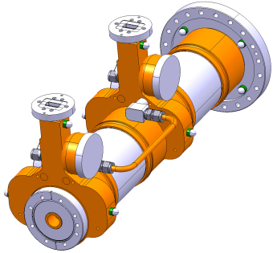
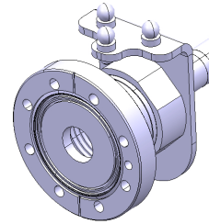
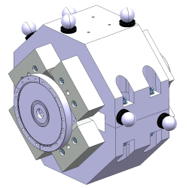
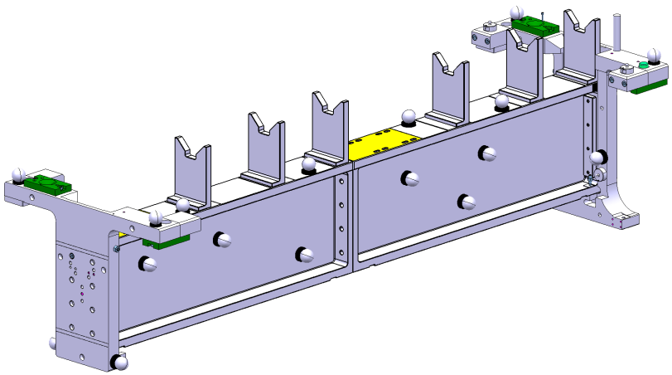
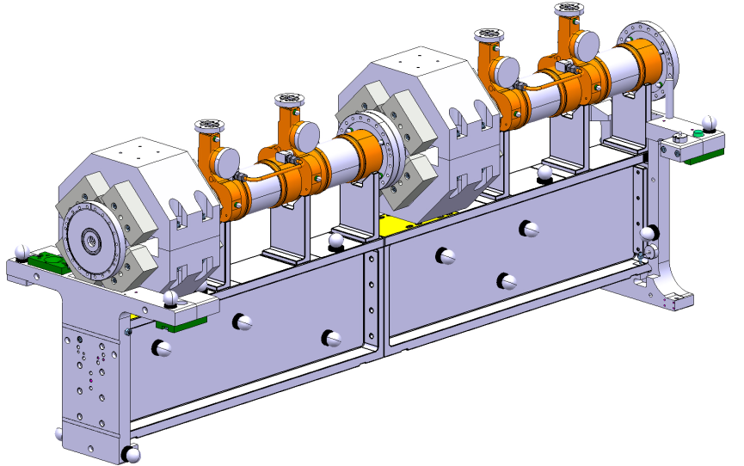
Short range strategy (3) ➔ determination of the position
Fiducialisation of components
Fiducialisation of their common support
Alignment on a common support
Whole assembly ready to be aligned

Slide 10
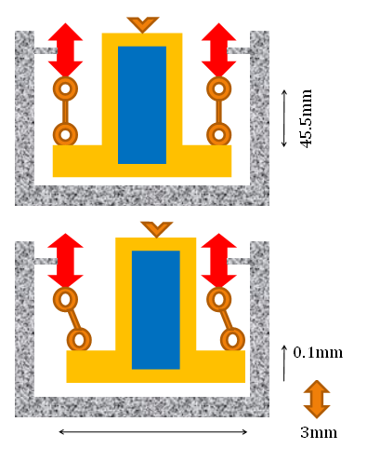
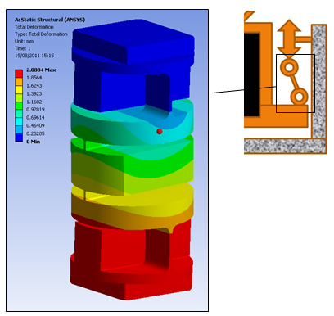
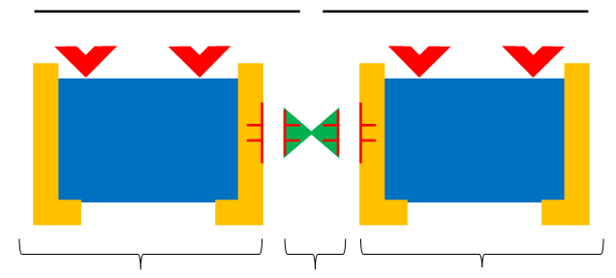
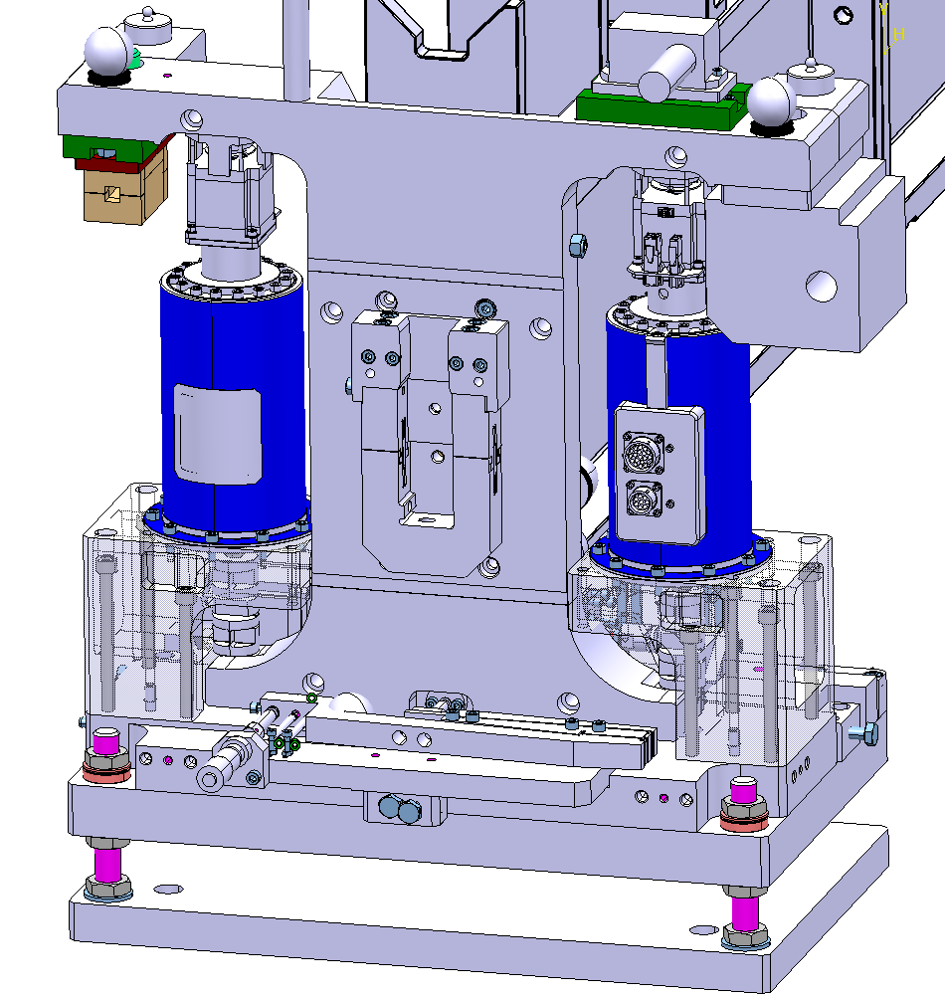
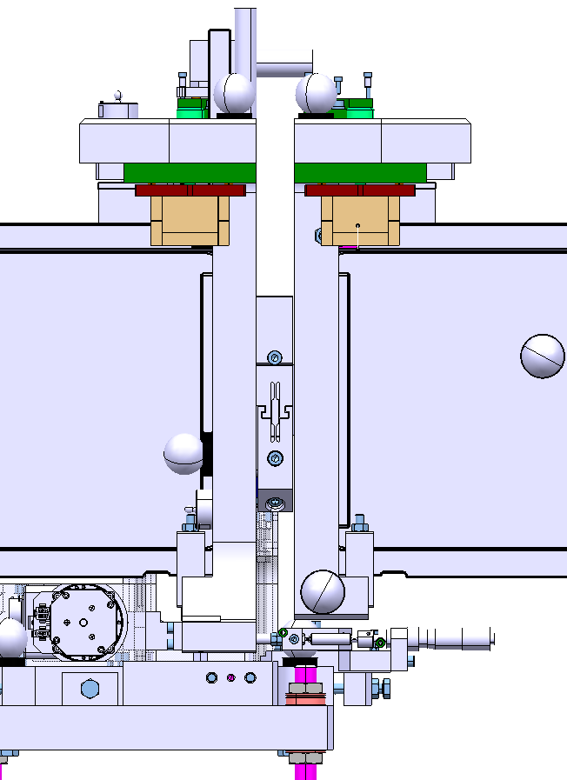
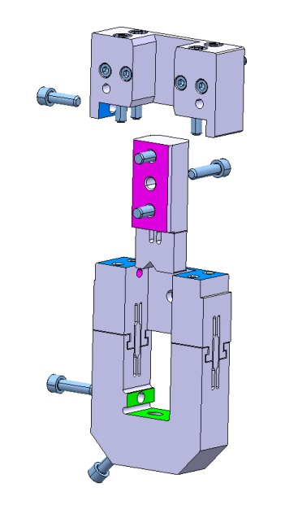
Short range strategy (4) ➔ adjustment

Slide 11
OUTLINE
Introduction: CLIC project & active pre-alignment
Alignment strategy on short range
Module test setup and associated results
Description
Fiducialisation & alignment on a common support
Adjustment
Validation of the global strategy
Conclusion

Slide 12
Description of module test setup
Objective: demonstration of the two beam module design:
Assembly and integration of all the components and technical systems (vacuum, stabilization, alignment, beam instrumentation, supporting, RF components and their associated water cooling and waveguides)
Validation of sub-systems such as vacuum, supporting and alignment
Concerning alignment:
Validation of the fiducialisation strategy according to different configurations of girders and actuators
Validation of the pre-alignment strategy on short range
Current configuration:
2 modules
Installed in a laboratory environment (no beam)

Slide 13
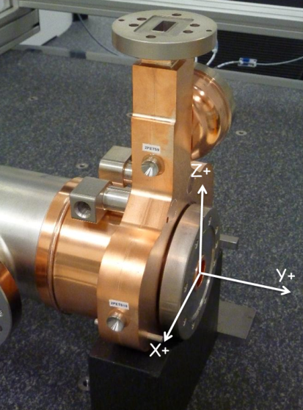
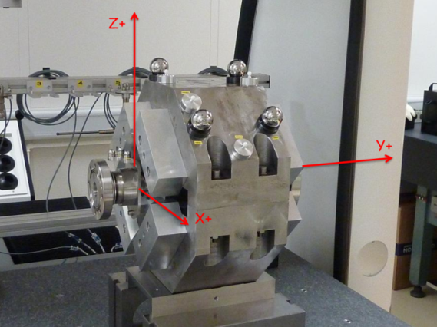
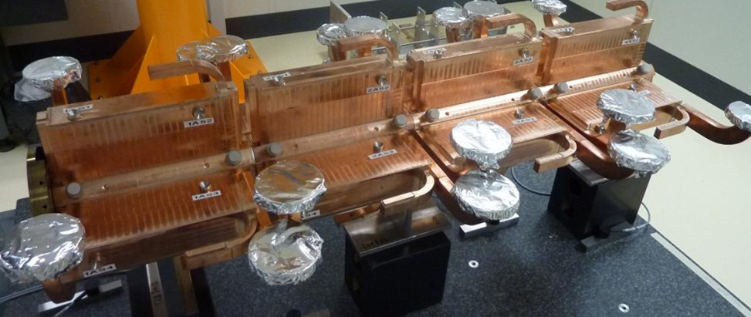
Description of module test setup
Configuration:
Components:

Slide 14
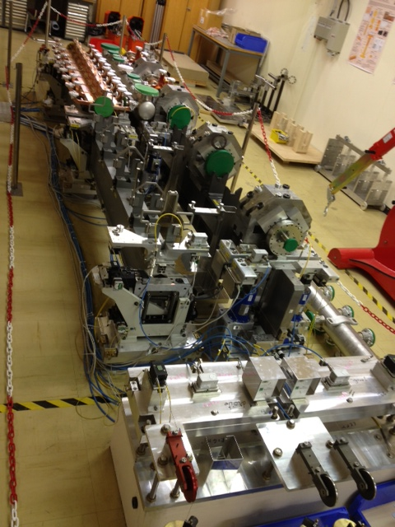
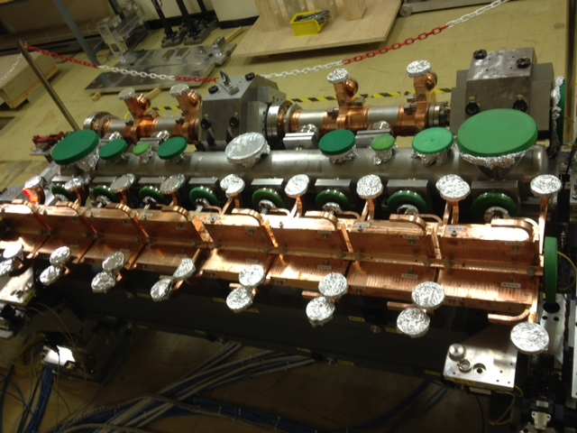
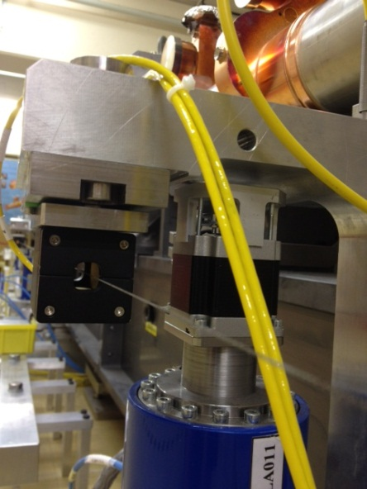
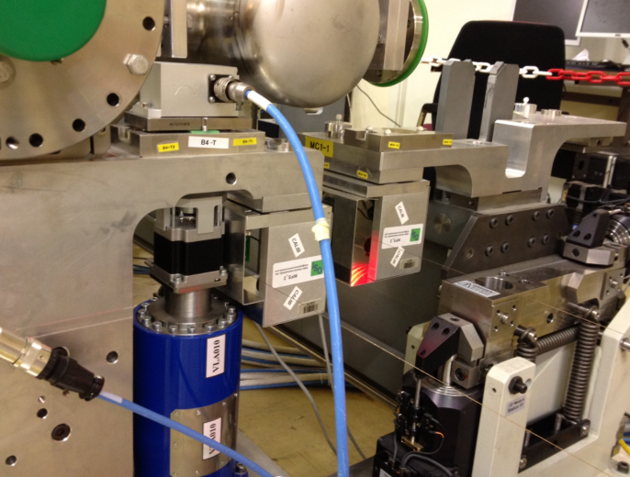
Description of module test setup
Current configuration:

Slide 15
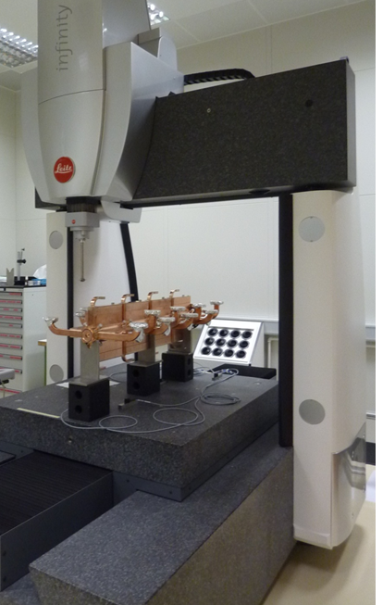
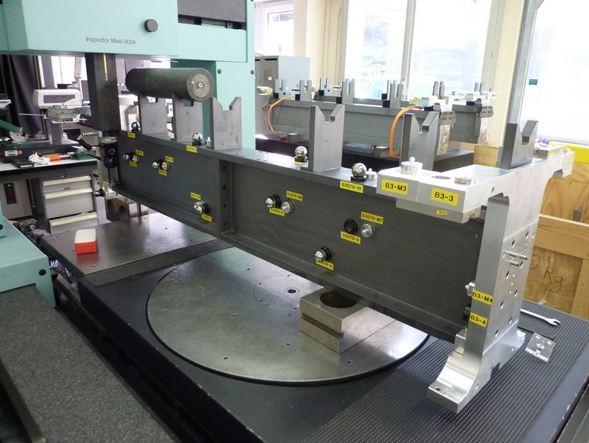
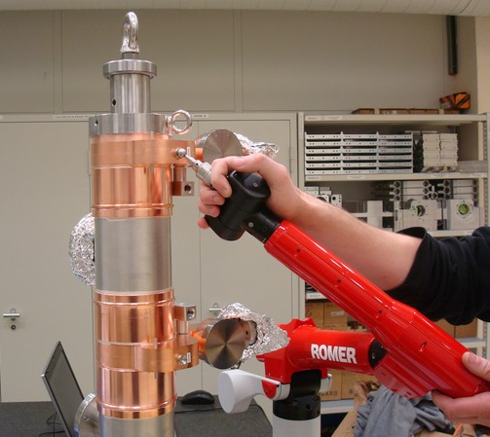
Fiducialisation
Means of measurements chosen according to the length & accuracy required

Slide 16
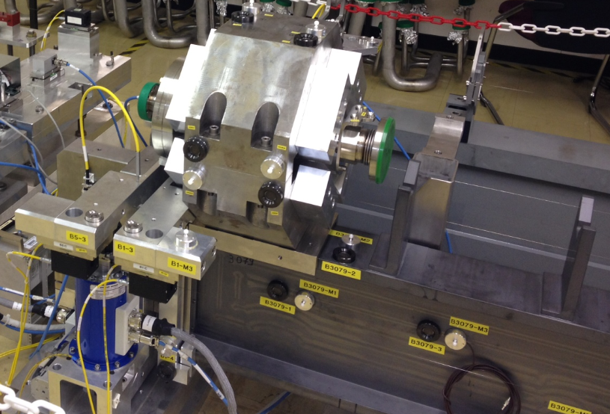
Alignment on a common support
In situ, by combination of mobile means
Case of the DB quad
(alignment of the other components under progress)
Determination of the position of the DB quad on its interface plane w.r.t. the mean axis of the V-shaped supports
performed by AT401 and Micro-triangulation measurements, with a precision and accuracy better than 10 μm
Adjustment system based on shims did not provide the required resolution of adjustment (not better than 20 μm)

Slide 17
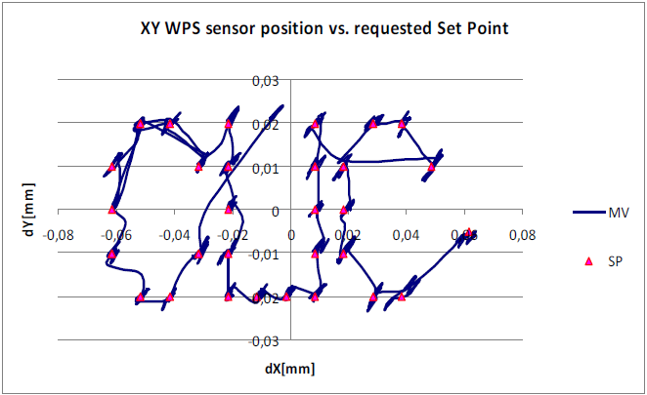
Adjustment
Active adjustment of the master cradle and its associated girder, based on sensor readings and fiducialisation measurements, has been validated successfully for relative measurements:
➔ closed loop algorithm is convergent in maximum 2 regulation cycles at the micron level for shifts lower than ± 0.5 mm on vertical and radial axes.
The trajectory following test based on a list of coordinates of points as targets of displacements was successfull, even though sensor noise was affecting the final regulation quality

Slide 18
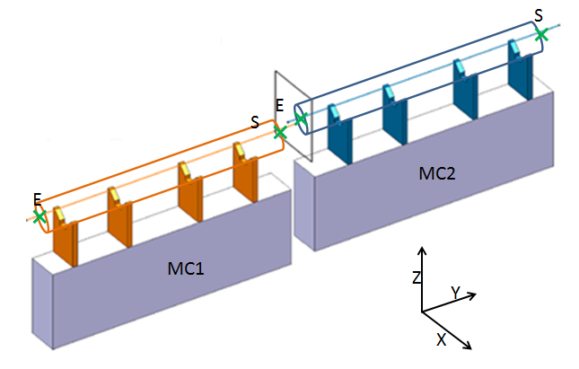
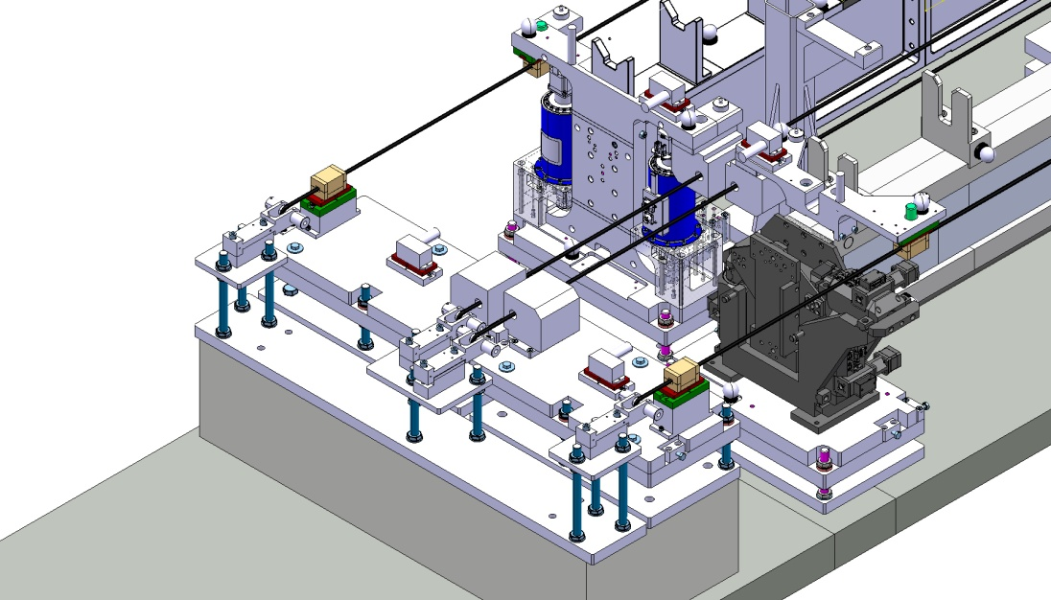
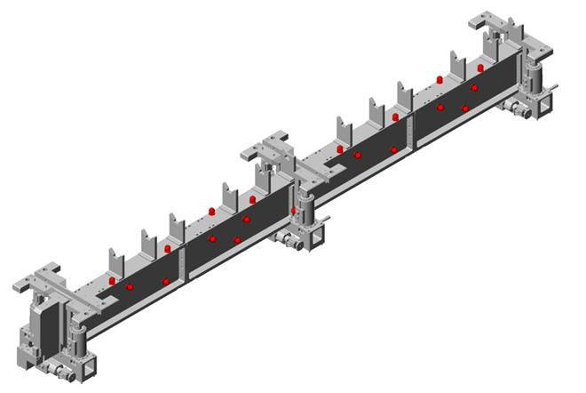
Validation of the global strategy
Determination of the mean axis of the V-shaped supports by two different methods:
AT401 measurements on the fiducials measured by CMM [mean axis w.r.t. fiducials]
WPS measurements readings on the 3 balls sensor interfaces measured by CMM [mean axis w.r.t balls]
 | X (µm) | Z (µm)
MC1-E | -5 | 12
MC1-S | 10 | -5
MC2-E | -1 | -4
MC2-S | -11 | -7
Difference between coordinates of mean axis extremities calculated by 2 different methods

Slide 19
Summary
The alignment strategy on short range consists of a very accurate determination of the coordinate systems of:
The components
Their supports assembly
The sensors
combined with a micrometric adjustment
First lessons learnt:
CMM measurements are the most precise and accurate, provided that the component or its support is shorter than the volume of measurement
CMM measurements of fiducials as a first step combined with AT401 + Romer arm measurements as a second step provide the best solution for micrometric alignments on site. The determination of the position of components was better than 10 µm in a stable environment.
Standard means of adjustment (shimming,…) cannot be applied without added value to micrometric alignment.
The first obtained results show that the followed strategy can be successful. The problem is that only the mechanical axis of the components was considered and not their electrical zero or magnetic axis.
➔ one solution: perform at the same time the determination of the magnetic axis and electrical zero and the CMM measurements.

