Slide 1
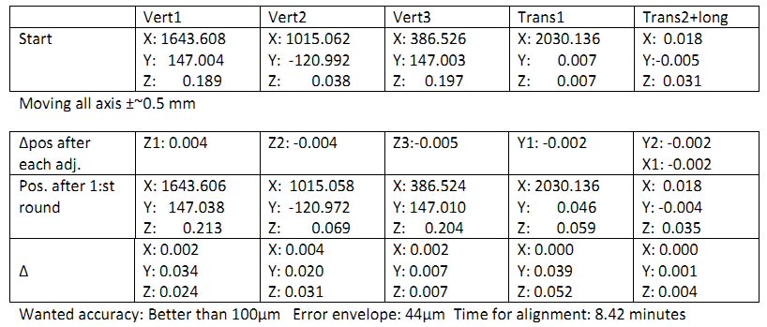
Fiducialization and alignment strategy for the integrated magnets in the MAX IV rings.
Bengt Sommarin MAXIV Laboratory, Pawel Garsztka MAXIV Laboratory
The 1.5 GeV-ring
Task:
3GeV-ring: 140 integrated magnet blocks in 20 acromats.
Block size: 256x350x2300-3350mm.
Circumference: 528 m.
Alignment tolerance: 100 (goal 50)μ, 1 sigma
Roll: 0.2mrad, 1 sigma.
1,5GeV-ring: 12 integrated magnet
blocks.
Block size: 300x400x5000mm.
Circumference: 97 m.
Alignment tolerance: 100 (goal50)μ, 1 sigma
Roll: 0.2mrad, 1 sigma.
One of the 20 achromates in the 3 GeV-ring
Solution:
The aim when constructing the alignment mechanisms was to fulfill the usual design features like alignment precision, orthogonal motion, vibrational stiffness, stability and simplicity.
We decided for a solution with a complete separation of the adjusting mechanisms.
Three sturdy standoffs of threaded rod type combined with spherical bearings and sliding surfaces.
Two transversal adjustments of push-repush (spring washer) type combined with spherical bearings and sliding surfaces.
One longitudinal adjustment like the transversal type.
Stability gain.
When calculating the Eigen frequency of the bigger and heavier magnet blocks for the 1.5 GeV-ring the constructors was worried by the low Eigen frequency of 46Hz (goal> 55Hz). Realizing that with our alignment solution there is no “locked” position of the mechanisms as long as the sliding surfaces are parallel and the movement follows the axis, we let all the positions free to be optimized with respect to bending and vibrating. The constructors were then able to raise the Eigen frequency to 55 Hz. Problem solved!
Fiducialization.
In order to reduce the time needed for alignment we have arranged the fiducialization of the magnet blocks so that the time required for aligning each block is mini-mized. We have minimized the ”alignment backlash” in order to get as few iterations as possible. This is achieved by placing the target holders right over each rotation axis.
Analyzing the system, one finds that the minimum number of target holders on the rotation axis follows the formula x = n-1 In this case it is 2 for vertical, one for transversal and none for longitudinal motions. The “free” target holders can be placed so that one will get a free line of sight from the preferred instrument position or positions.
Error budget over one acromat, 1 sigma.
Our Leica AT401 over 10.5 m 39 μm
Tolerance at manufacturing 20 μm
Control measuring 3 μm
(Network estimated 30 μm)
Sum 44 (53) μm
Result:
Time for alignment: 8.42 min.
Biggest discrepancy: 52μm
One more round on vertical and transversal could be needed.
Magnet block in the 3 GeV ring
Vertical (in the back) adjustment
Longidudinal (in front) adjustment
Alignment mechanisms
Integrated target holders

