Slide 1
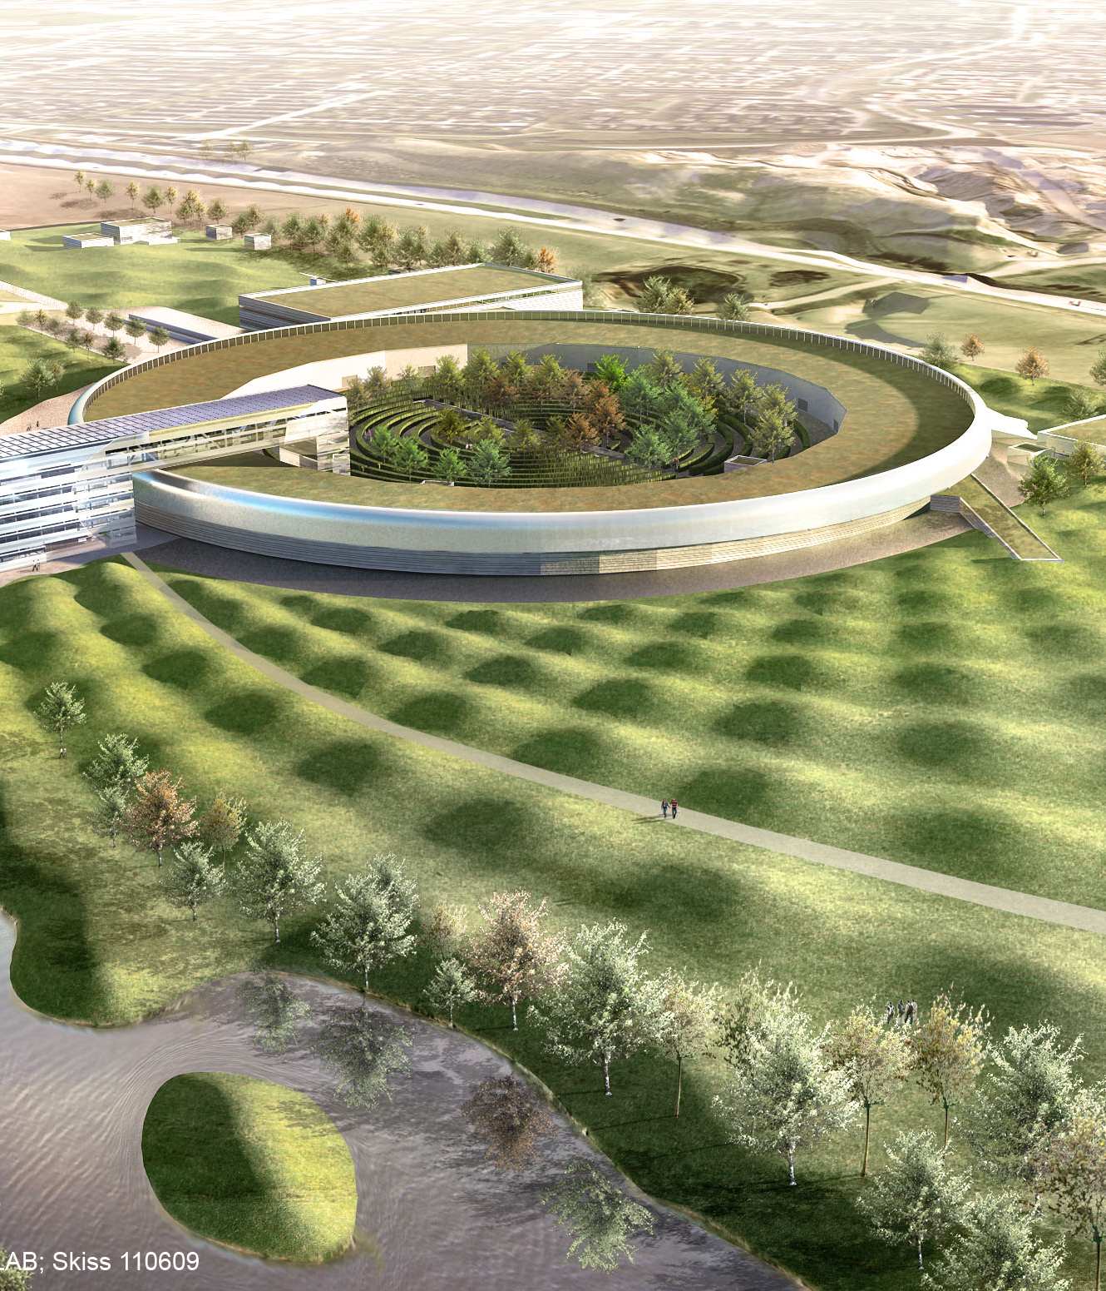
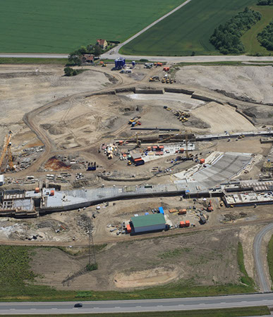
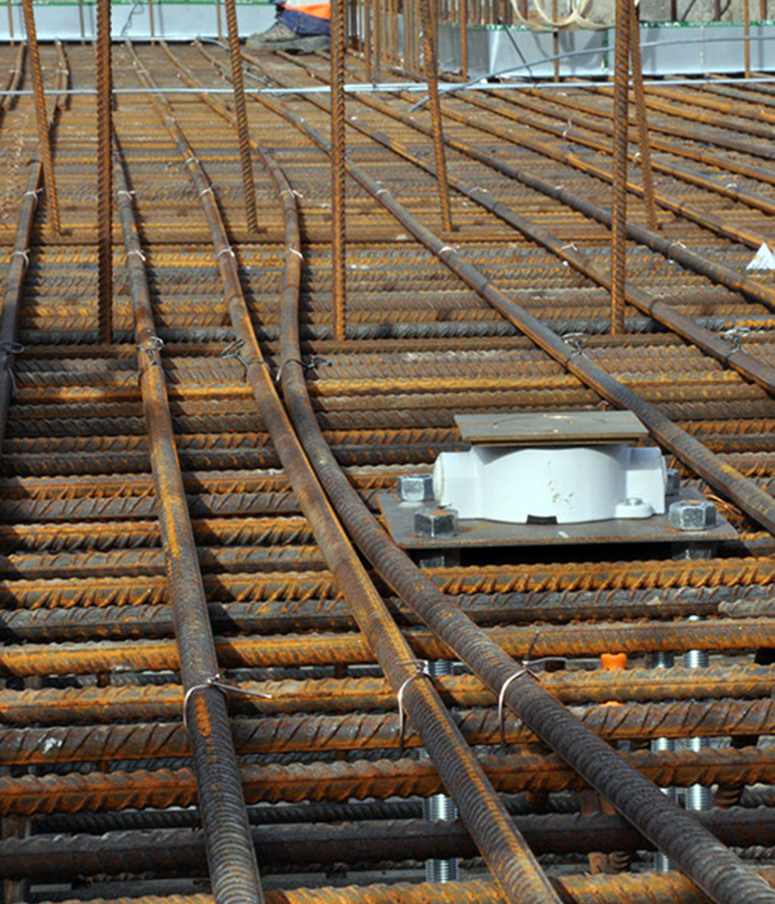
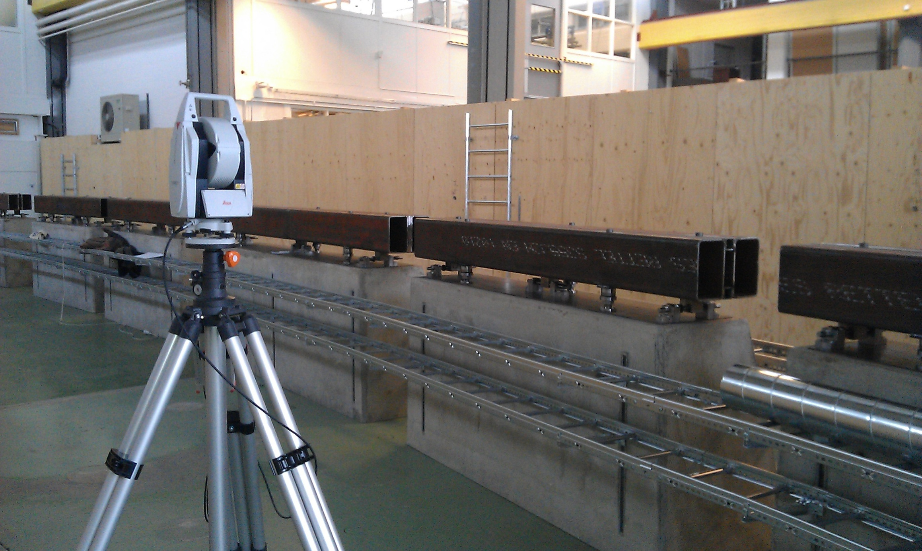
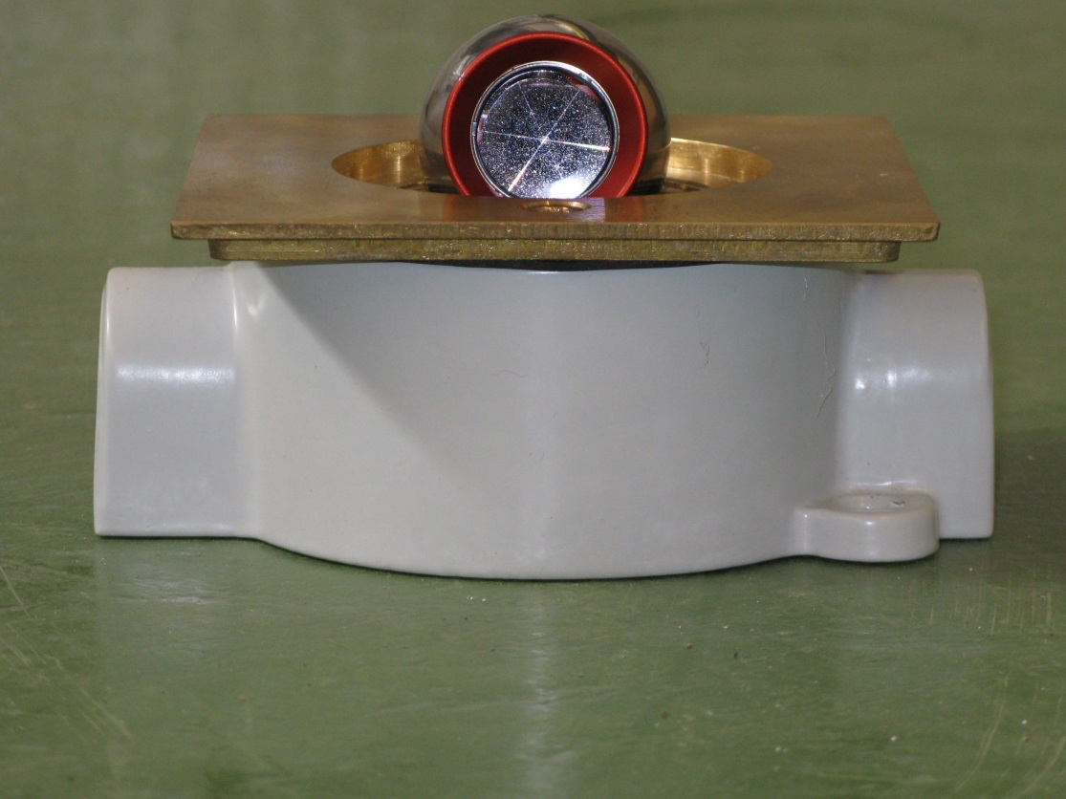
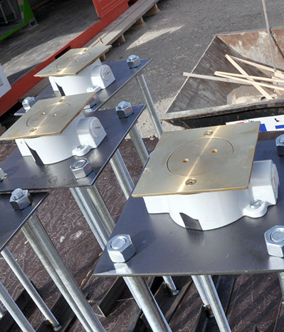
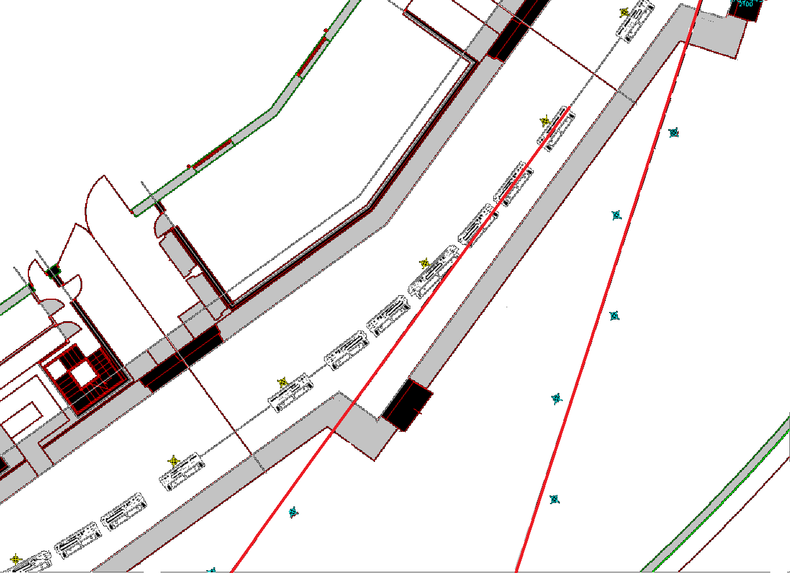
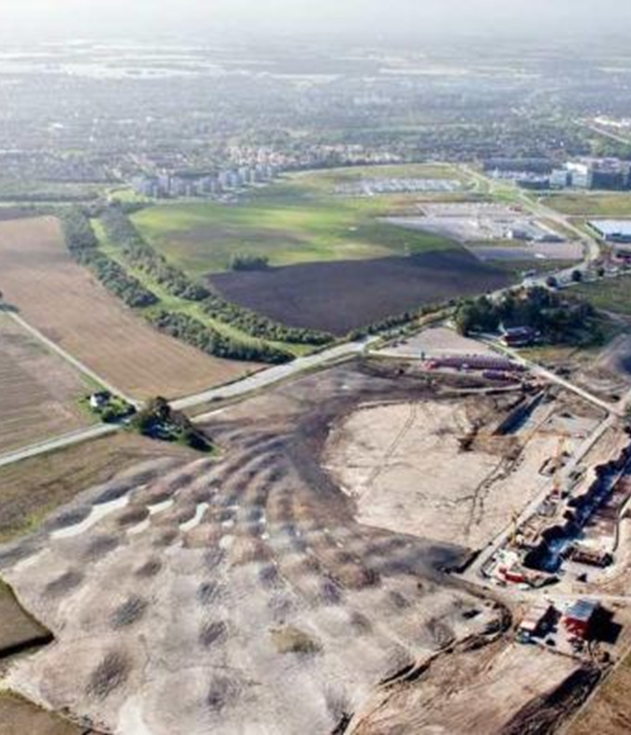
MAX IV
Reference network for the new facility at MAX IV Laboratory
Pawel Garsztka, MAX IV Laboratory, Lund, SWEDEN
Bengt Sommarin, MAX IV Laboratory, Lund, SWEDEN
The new facility at MAX IV Laboratory consists of the following parts:
250 meter long LINAC with the maximum 3.4 GeV energy
two storage rings: the smaller ring will have electron energy of 1.5 GeV and a circumference of 96 meters. The bigger ring will have electron energy of 3GeV and a circumference of 528 meters.
SPF (Short-Pulse Facility)
In the first phase 7 beamlines will be build. In total 30 beamlines at the two rings will be possible.
In addition the MAX IV design also includes an option for the FEL (Free Electron Laser) as a second development stage of the facility.
The alignment group is a part of the stability group at MAX IV Laboratory and consisting of two people. Our general task for the near future is to establish the reference network which will be used for the alignment of all accelerator and beamilne components for the new facility.
AT 401 in the mock up
  NETWORK
The reference network will be divided in 4 groups joined with each other:
network 1 - in the ca 300m long LINAC tunnel with transfer lines and SPF (short-pulse facility),
network 2 and 3 - in the storage ring tunnels: 3 GeV and 1.5 GeV
network 4 - in the experimental hall (beamline area)
The networks 1,2 and 4 will be joined via transfer lines between the LINAC and the ring tunnels. Connection between the network 3 and 4 will be possible by opening the concrete doors between the tunnels and the experimental halls in all front ends.
In addition we will check the diameter of the 3 GeV ring tunnel. Standing in the middle of the facility and measuring through the inward doors of the tunnel its diameter can be observed(8 cross checks).
The established network will be local and without any connection to the existing outside geodetic networks.
  The goal is built a grid of equally spaced points covering the area around the objects to be aligned. We chose the layout where 3 target nests are mounted on the wall (1200) every 9 meters. Those “rings” are complemented with 1 floor cup (360) and 1 target nest for each area between the rings. These will give us a better differential distribution of vertical angles observations.
  All observations (in three dimensions) will be carried out with only one instrument: Leica AT401 laser tracker. The raw data will be pre-analyzed in the Spatial Analyzer software. The final solution, based on the least square adjustment will be processed in the PANDA software package.
  TESTS
  For the tests we used the mockup - a full scale model of 1/20th of the 3GeV storage ring tunnel: 23 m length and 5.5 width.
  Even if the mockup gives an real scale feeling of the future facility it still has some disadvantages:
  the nests for the reflector are placed on the wooden walls or an unstable floor
  the temperature inside the building is not stable
  only a small part of the future building could be used for the observations and instruments stands (18 reference points and 4 instrument stands)
  Nevertheless even if working in that environment it has been possible to test the instrument in practice as also check the geometrical/spatial efficiency for our reference network concept. After the adjustment the error values for the mockup network were in between 30-40 micrometer RMS range.
Här skriver jag en liten bildtext

