Slide 1
Neutrino Time of Flight measurements (with MINOS)
Phil Adamson
12th September 2012

Slide 2
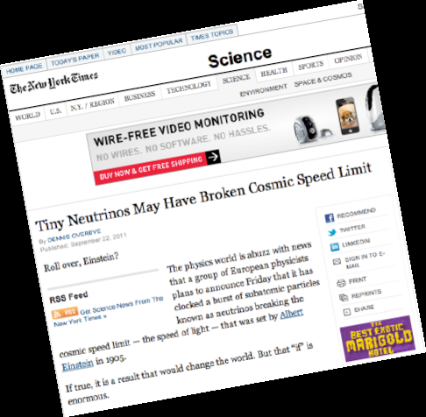
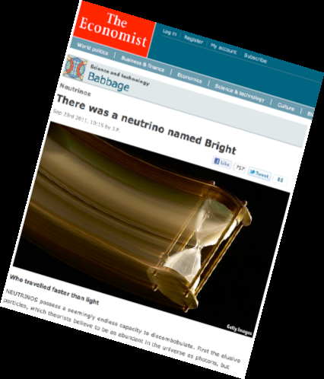
Back Story
In September 2011, OPERA measured neutrinos travelling from CERN to Gran Sasso (730 km) and arriving faster than light by$60 ±10 \text{ns}$
The world’s press noticed…
In February 2012, OPERA announced they had found a loose optic fibre which could cause this discrepancy
Subsequent measurements by all CNGS experiments are consistent with the speed of light
ICARUS (arXiv:1208.2629) ~2ns systematic error

Slide 3
A neutrino beam
Primary proton beam on target
Produce π,K
Magnetic focusing horns
sign-select pions
Decay volume
π⁺ -> µ⁺ ν_{µ}
Beam Absorber
Absorb hadrons
Muons range out in rock
Neutrinos left
Target
Focusing Horns
π⁻
2 m
ν_{μ}
ν_{μ}
120 GeV protons from MI
π⁺
15 m
30 m
675 m

Slide 4
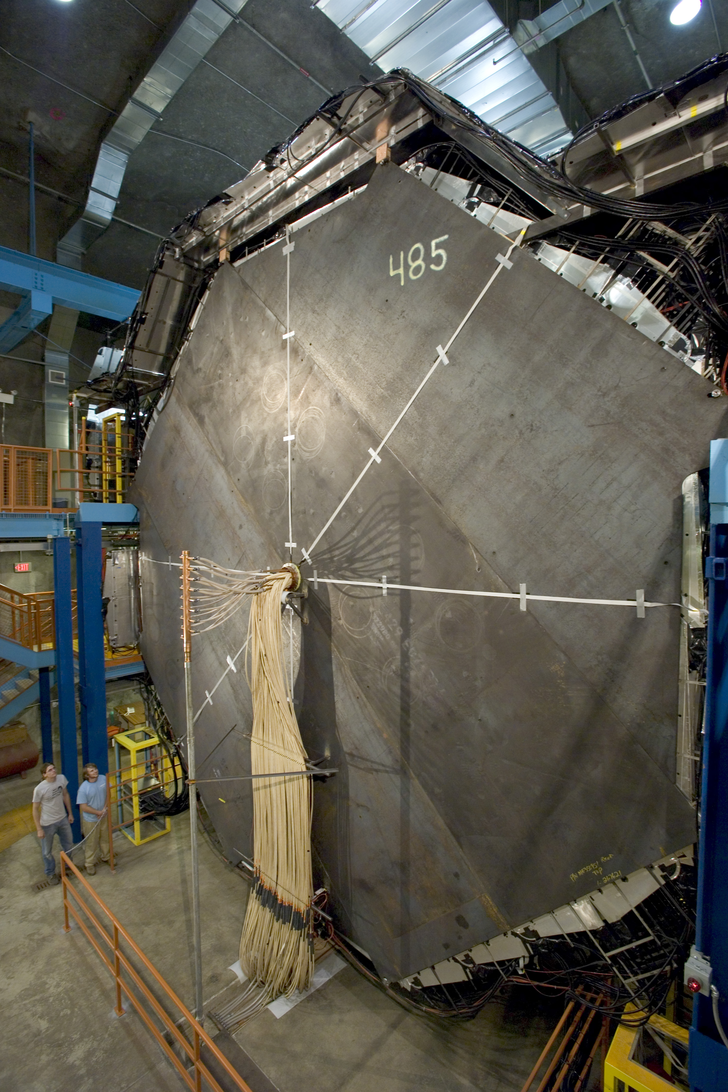
MINOS detectors
Magnetized steel/scintillator tracking calorimeters
1” steel plates
1cm scintillator (4.1cm wide strips)
Functionally eqivalent
Same materials
Same segmentation
Same mean B field (1.3 T)
Many systematics cancel
5.4 kT Far Detector
735 km from source
1 kT Near Detector
1 km from source

Slide 5
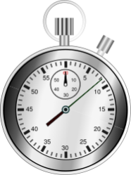
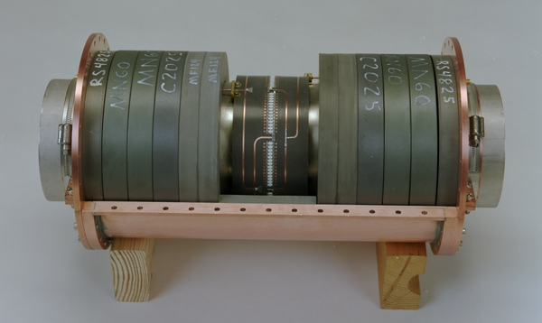
Measuring neutrino velocity
Neutrino to neutrino measurement
ND
FD
target
distance
Grade school: $\text{speed} = {distance}/{time}$
Three detectors
Near and Far (neutrinos)
RWCM in beamline (protons)
But you can’t ever detect the same neutrino in each place
Cross section very small
Neutrino consumed in detection
Ceramic break

Slide 6
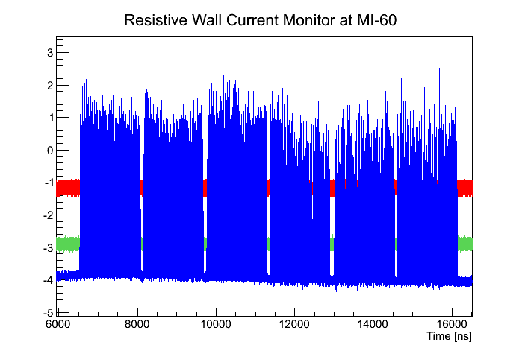
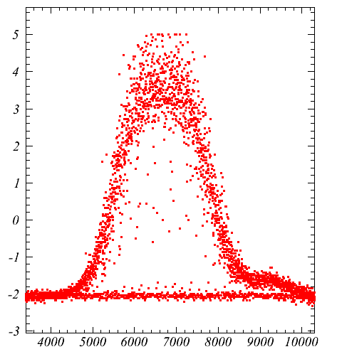
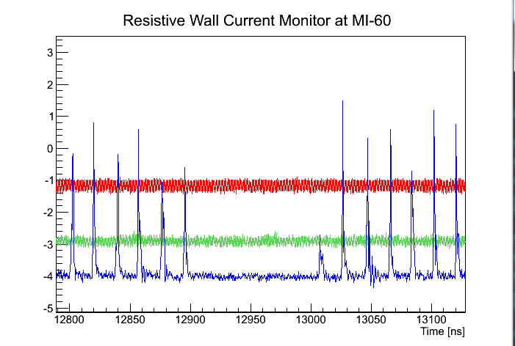
MINOS Beam structure
6 1.6 µs batches separated by ~100ns
Each batch has 81 bunches
Bunch spacing 18.83 ns
Bunch sigma ~1 ns
MINOS detectors can resolve this
18.83ns
~100ns
3.5 ns

Slide 7
Measuring time
Neutrino to neutrino measurement
ND
FD
target
distance
Absolute time was never a very interesting number
Use time of expected beam at Far Detector to suppress background events from cosmic rays
Beam spill is 10 µs long, so timing only has to be good to 1 µs
Relative timing between scintillator strips important for distinguishing upward & downward-going muons from atmospheric neutrinos

Slide 8
Telling the time
Divide time measurement into 2 parts
Time with respect to local clock
Beam structure
Electronics
Accuracy
Quantization
Detector Latency
Quality of local clock
Transferring time between two detector sites
“Routine” for time labs
Steve Jefferts, Stephen Mitchell talks
TWTT over fibre (MI60 to ND, surface to ground)
TWSTT
GPS (PPP or Common View)

Slide 9
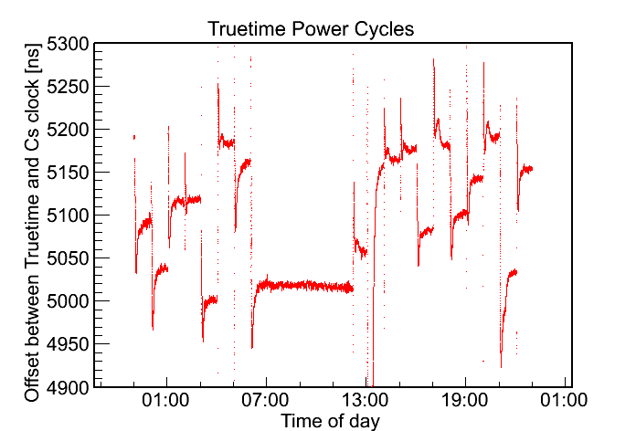
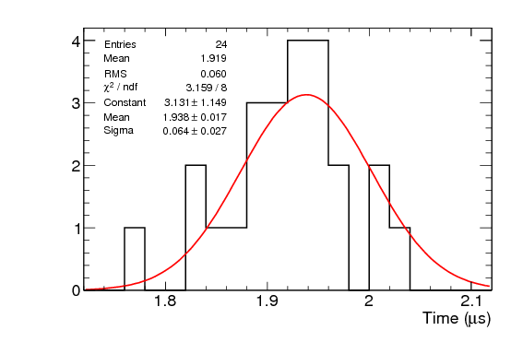
Old GPS System
Good enough for background rejection
But not for time of flight
GPS has a random-but-stable offset with respect to UTC
Changes with each power cycle
RMS 60 ns
See next talks for something better than this!
Intentional Power Cycles
of GPS receiver
9

Slide 10
Detector latency
Remember those “functionally identical” detectors?
The electronics is completely different
Also larger Far Detector has
Longer wavelength-shifting fibres
Longer clear readout fibres
Can measure latency of each piece and sum, but then combine many uncertainties
We measure latency of whole detector at once

Slide 11
Auxiliary Detector
Build two identical simple, portable muon detectors
2 1m x 1m MINOS-style scintillator planes and photomultipliers
Coincidence of PMT dynode signals makes muon paddle
Timestamp hits against local Cs clock with BI220 Time Interval Analyser
Measure large detector timing signal against local Cs clock
Place behind MINOS ND, track muons into AD, measure offset between time in large detector and auxiliary detector
Take one apart, drive whole thing to Soudan and repeat with FD.
You now have a relative latency measurement between the two detectors, which is what you need for time-of-flight

Slide 12
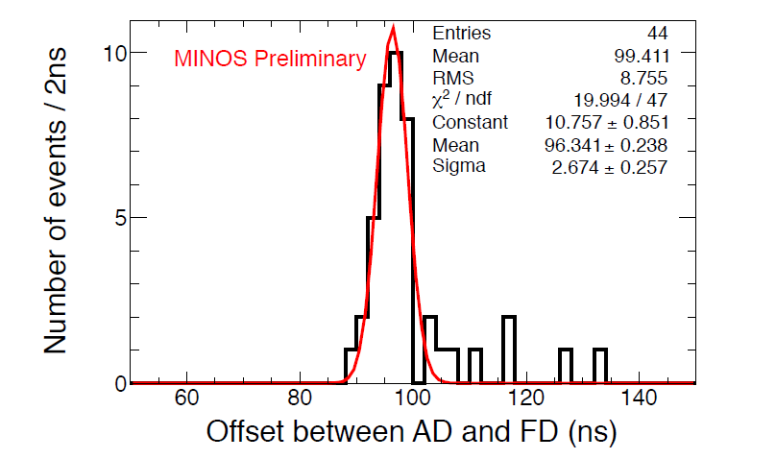
Latency measurement at FD

Slide 13
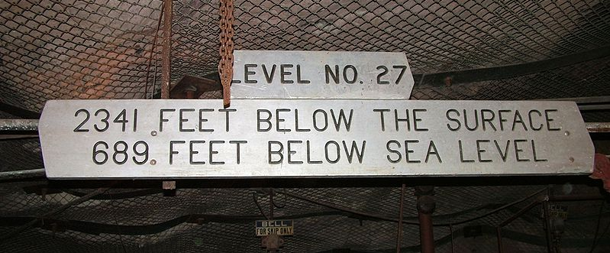
Measuring distance
Neutrino to neutrino measurement
ND
FD
target
distance
Talk later this morning from Virgil
3 components
Surface measurement between sites
Tie between surface and underground network at ND
Same at FD
…and don’t forget that the Earth rotates
Far detector is the big challenge
2341 feet down single mineshaft
Bent, not vertical
Usually has fog half way up
Currently ~70cm uncertainty on inertial measurement
Time-of-flight requires significantly more accurate distance than oscillation measurements

Slide 14
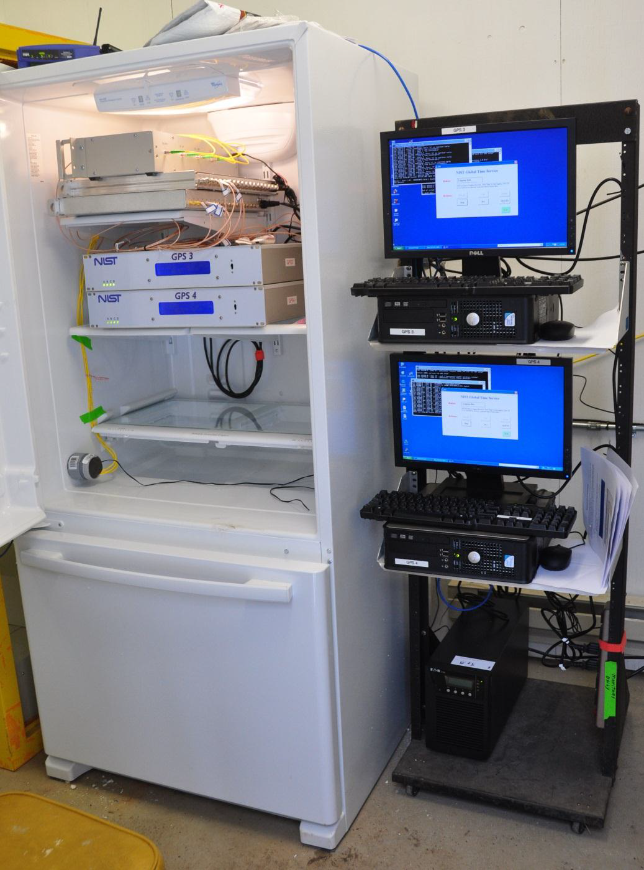
Summary
Neutrino velocity measurement is conceptually simple, but technically challenging
Grade school: $\text{speed} = {distance}/{time}$
Challenge is to approach 1ns uncertainty
Time transfer
Distance measurement
Environmental chamber on surface at Soudan maintains temperature within 1 °F

