Slide 1


IWAA 2012 - Fermilab
September 2012
HIE ISOLDE
Alignment and Monitoring System
Technical Design and Project Status
Jean-Christophe Gayde BE/ABP-SU
Guillaume Kautzmann BE/ABP-SU
Sebastian Waniorek BE/ABP-SU

Slide 2
Contents
Introduction
Alignment Specifications
BCAMs
Viewports
Targets
Mechanical supporting and adjustment system
Schedule
Conclusions

Slide 3
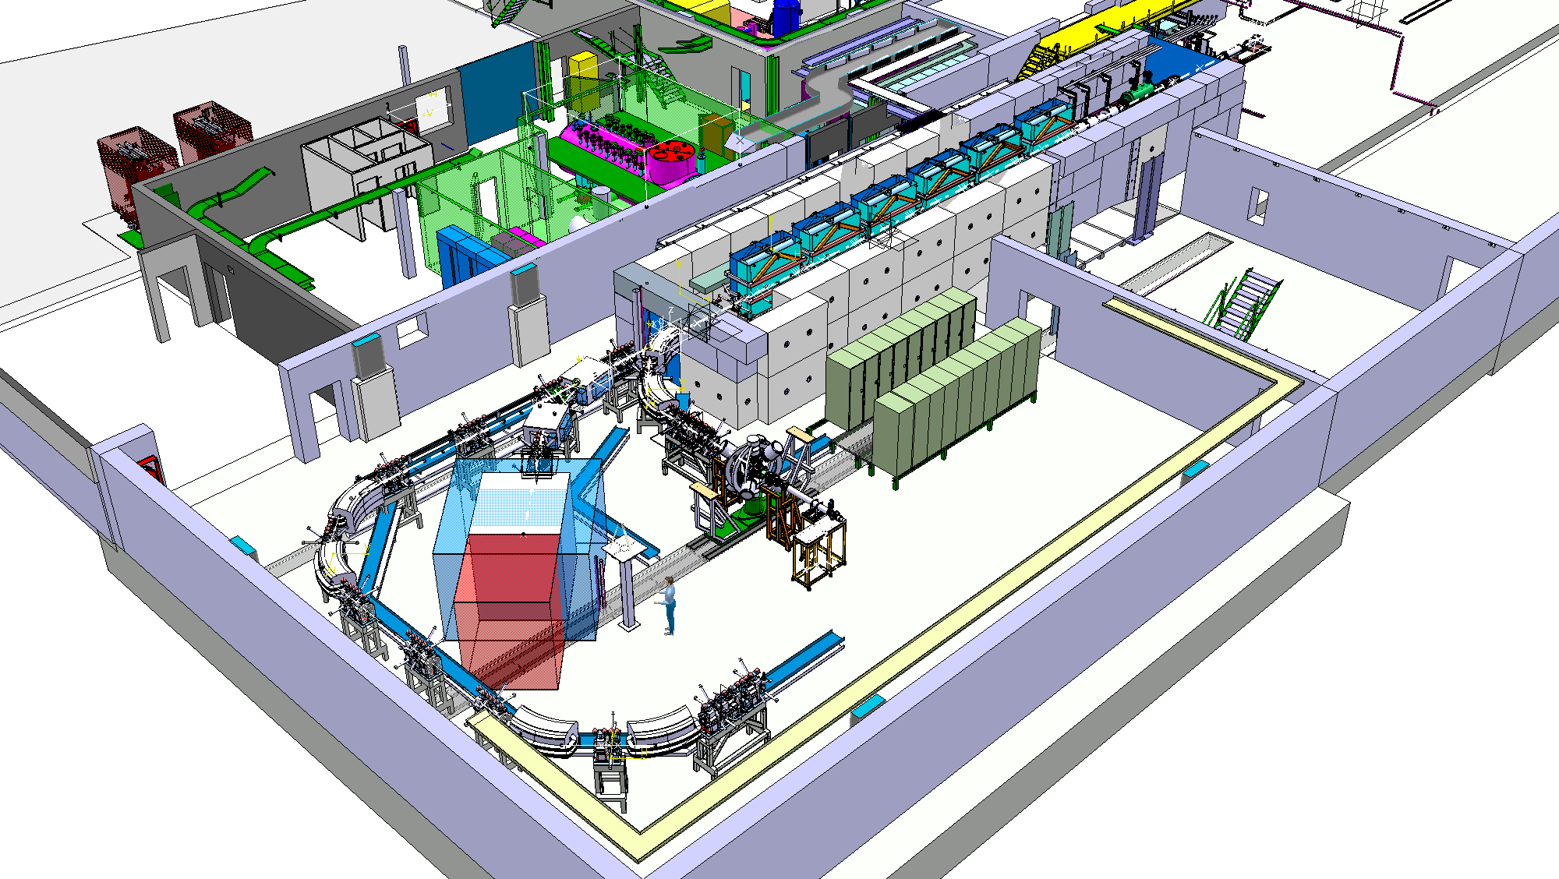
INTRODUCTION
HIE-ISOLDE
HIE-ISOLDE SUPERCONDUCTING LINAC
~16m
Transfer line
High Intensity and Energy (HIE)-ISOLDE ➔ Important upgrades of REX-ISOLDE
Goal: Increase the energy and the quality of post-accelerated Ion Beams

Slide 4
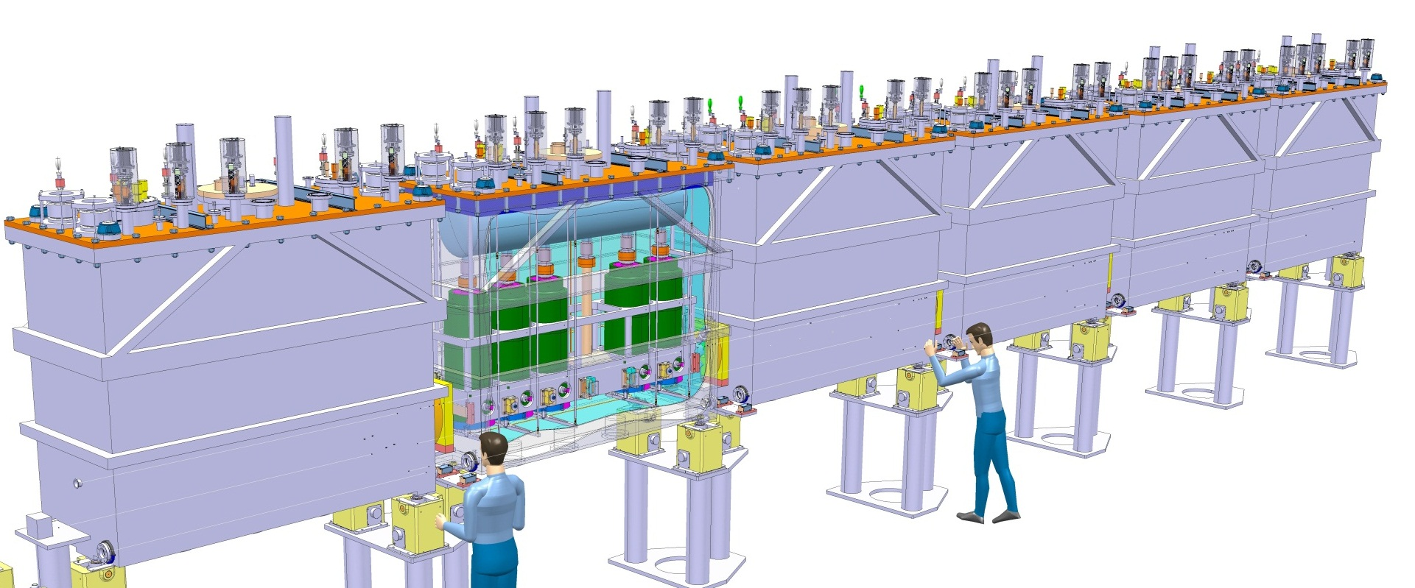
Linac and Alignment Specifications
Alignment and monitoring of the Cavities and Solenoids in the Cryomodules
Alignment w.r.to a common nominal beam line along the Linac
Permanent system
Precision demanded along radial and height axis at 1 sigma level :
  300 microns for the RF Cavities
  150 microns for the Solenoids
Temp. 4 K
High Vacuum
Solenoid
NBL
RF Cavities
+/-150 micr
+/-300 micr

Slide 5
Alignment System
CONCEPT
Creation of a closed geometrical network continuously measured
Observation and position reconstruction of Cavities and Solenoid in this Network
SYSTEM
RF cavities and solenoid equipped with targets
Interface Atmosphere / High Vacuum → Precise viewports
BCAM cameras fixed to inter-module metrological tables
External Lines => Position and orientation of metrological tables and BCAMs
Internal Lines => Position of the targets inside the tank
RF Cavity
Solenoid
BCAM
External Line
Pillars
Pillars
Cryo-module
Metrologic Table
Internal Line
BCAM observations

Slide 6
Alignment System
Top view
Overlapping zone of BCAM obs. on external lines
Double sided targets observations on internal lines
=> Redundancy
Side view
Ext. line
Overlapping
Pillar
Pillar
BCAM
BCAM to BCAM observations
Metrological Table
BCAM to Pillar observations

Slide 7
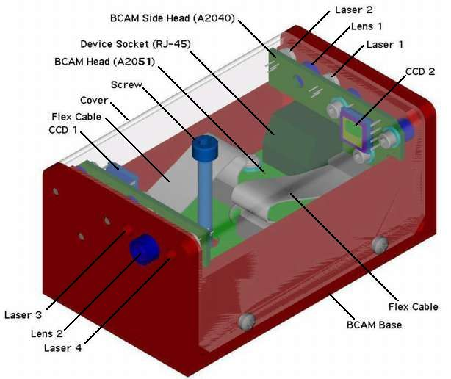
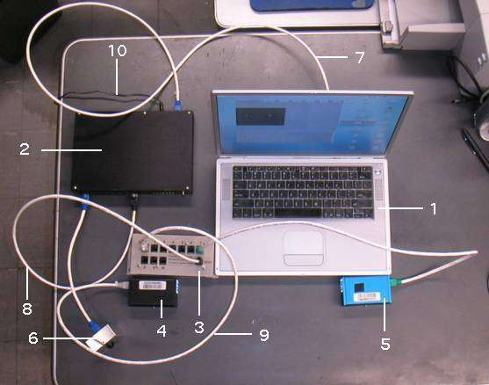
BCAMs
Developed on 1999 by Brandeis University for ATLAS Muon alignment
OSI (Open Source Instruments)
http://alignment.hep.brandeis.edu/
http://www.opensourceinstruments.com/
Original BCAM → HBCAM
Camera focal length: 72 mm → 50 mm
Sensor: 336 x 243 pixels 10 microns → 659p × 494p, 7.4 microns
Field of view: 40 mrad x 30 mrad → ~ 100 x 70 mrad
Sources: Laser Diodes 650 nm
+ Additional synchronized illumination system
Mounting: "Plug-in" isostatic system under the BCAM body
Double sided model → Chain of BCAMs
Resolution: 5 micro radians constructor (OSI)
Accuracy of 50 micro radians to absolute
Cable length BCAM/Driver > 60 m
Delivered calibrated (focal length, position diodes, geometric relationship with plate support)
Original BCAM:
Camera focal length: 72 mm
Sensor: 336 x 243 pixels 10 microns
Field of view: 40 mrad x 30 mrad
Sources: Laser Diodes 650 nm
Mounting: "Plug-in" isostatic system under the BCAM body
Double sided model → Chain of BCAMs
Resolution: 5 micro radians constructor (OSI)
Accuracy of 50 micro radians to absolute
Cable length BCAM/Driver > 60 m
Delivered calibrated (focal length, position diodes, geometric relationship with plate support)

Slide 8
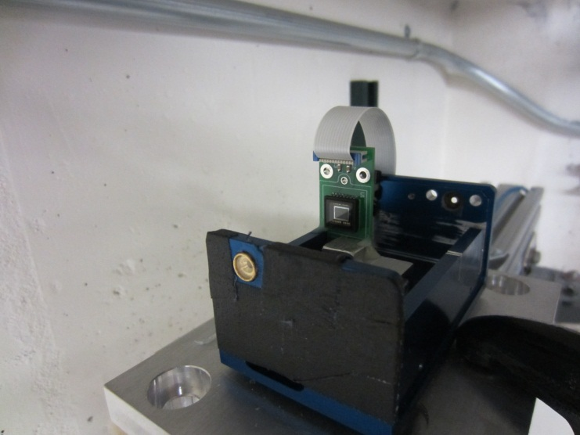
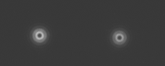
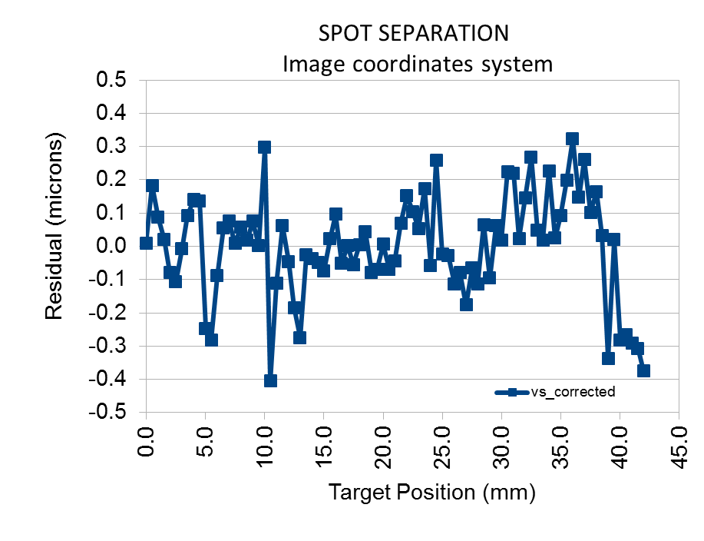
HBCAM – Some news
HBCAM proto
HBCAM - LAST NEWS FROM OSI - BRANDEIS
First tests results:
No cyclic error
Resolution spot position of 0.1 um on CCD
Spot separation over a CCD scan: rms 0.15 um
Test conditions
No cover on HBCAM Box
Ambient light on
Many thanks to Kevan Hashemi and
Jim Bensinger
1 micron on CCD

Slide 9
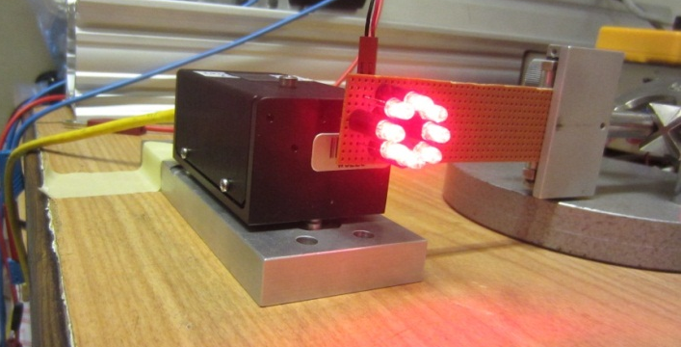
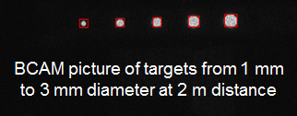
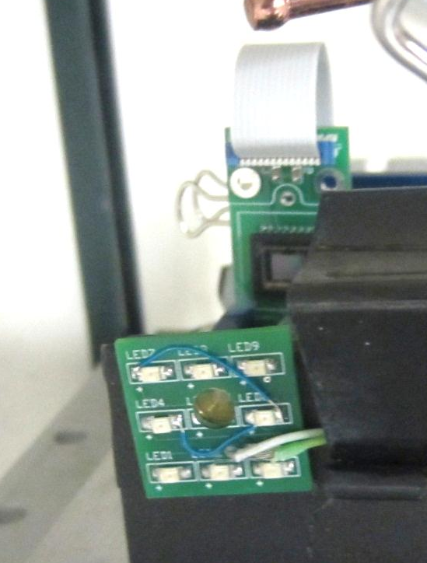
HBCAM – Some news
Illumination of Retro Reflective Targets
HBCAM integrated illumination system for retro-reflective targets observations
1st illumination prototype
1st Prototype
  Validation of the components / intensity …
2nd Prototype - Brandeis
  Remotely controlled by HBCAM Driver
  No extra power supply needed
  Synchronized with the HBCAM

Slide 10
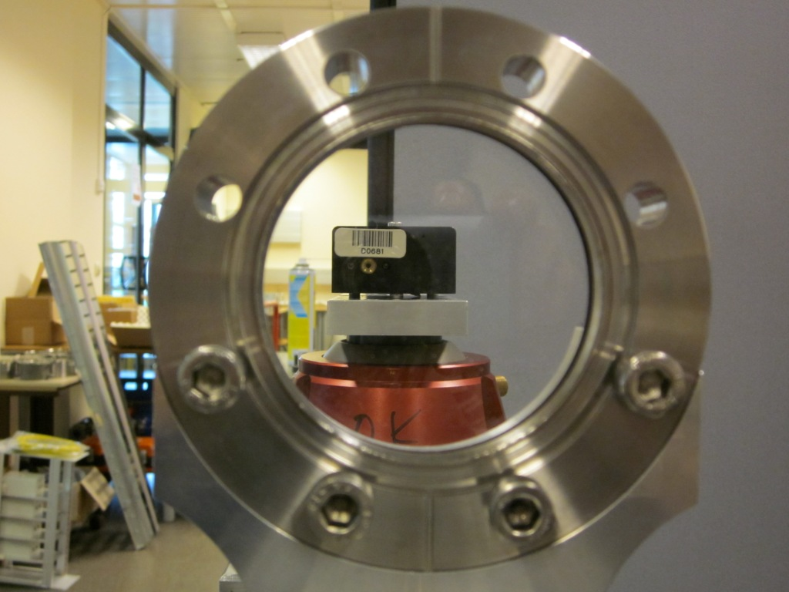
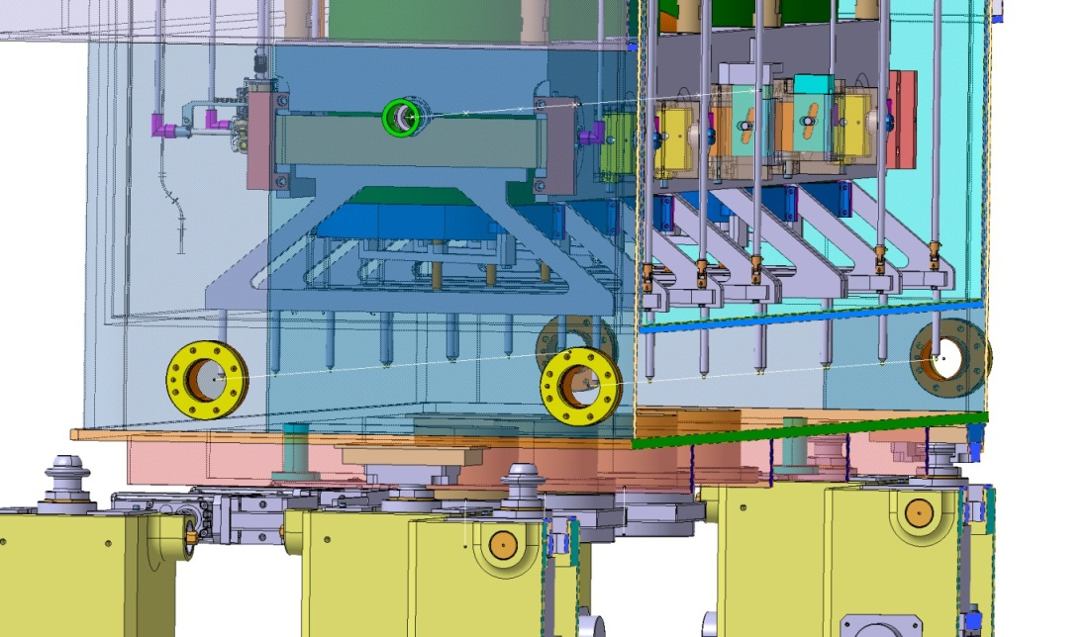
Viewports
Atmosphere / Vacuum interface
Parallel plates window
Viewports at CM ends (off the shelf)
Study of viewport effects on BCAM observations
Viewport 6.55 mm thick
3 opt. quality classes tested

Slide 11
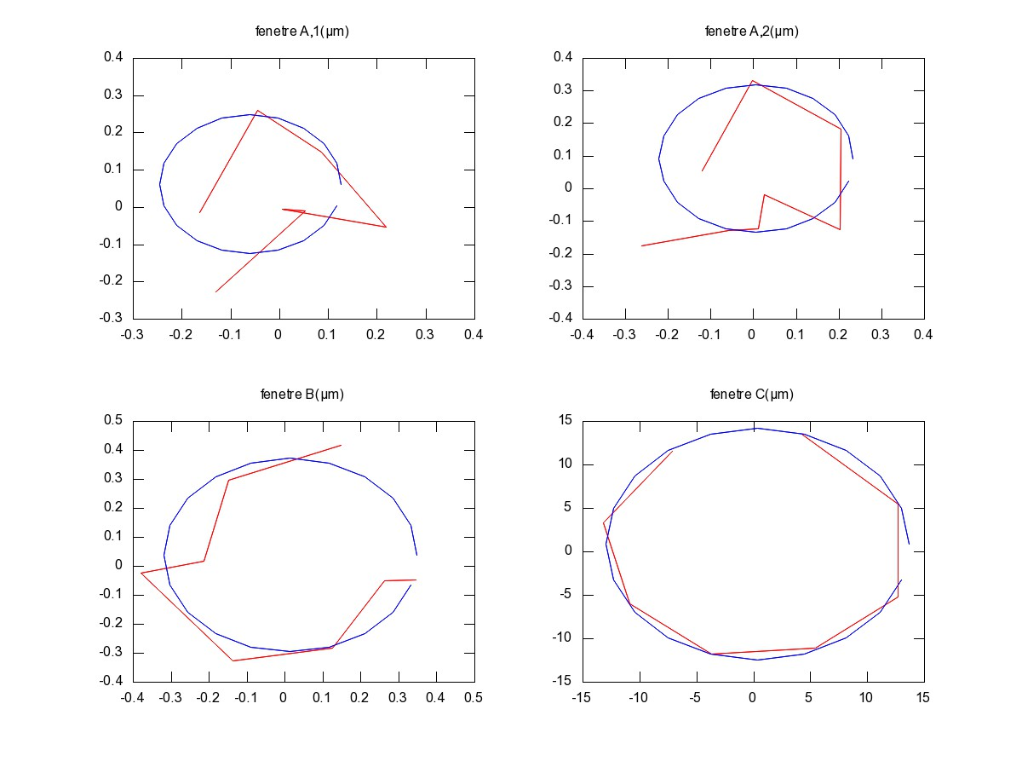
Viewport Study
Wedge Angle
Wedge angle and wedge angle effect evaluation
Principle: Measure a fix point through the window → Rotation of the window around the main axis → Observation of the point image coordinate change → Calculation of the wedge angle
Window A,1 (micr)
Window A,2 (micr)
Window B (micr)
Window C (micr)
Window | Given wedge angle (microrad) from window’s technical data | Wedge angle observed (microrad) | Influence on target at 1m (micr) | Influence on target at 2m (micr)
A | 25 | 5 | 2.5 | 5
B | 50 | 10 | 5 | 10
C | 500 | 300 | 150 | 300
Tests: Nicolas Gauthé
In red: measurements on the CCD
In blue: best fit circle
10 microrad wedge angle acceptable
Viewports better than manufacturer data

Slide 12
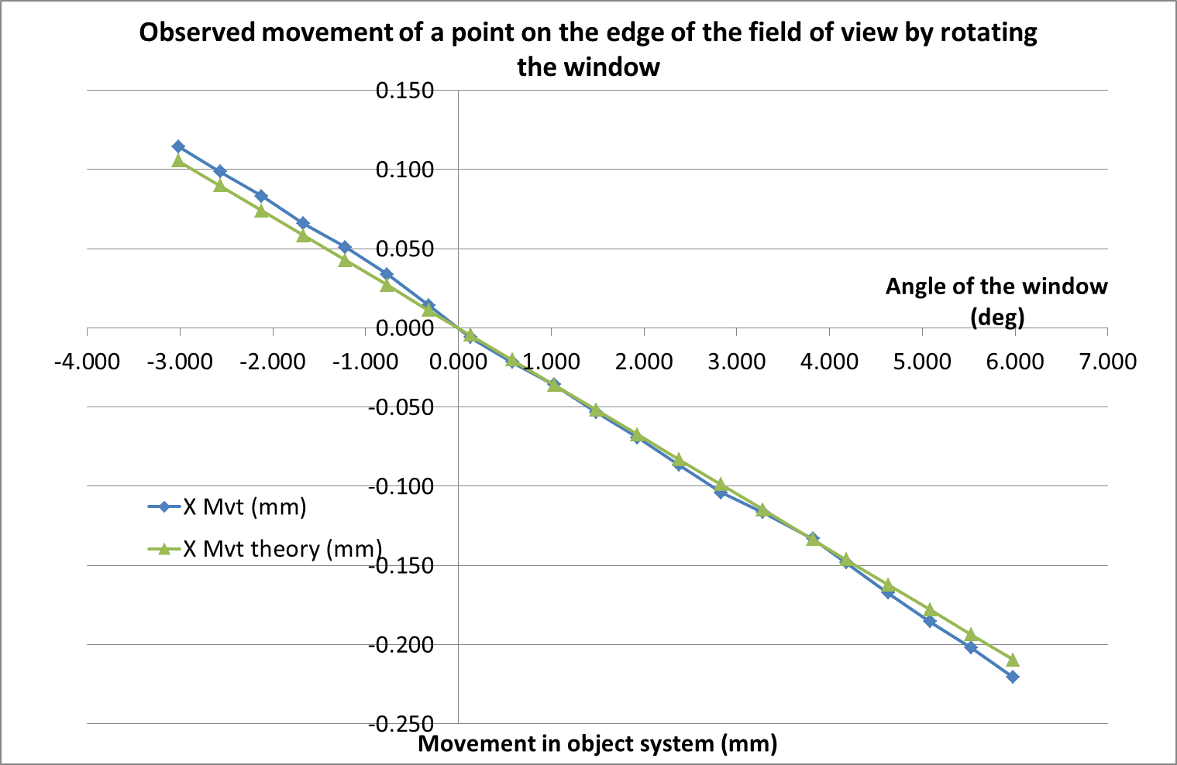
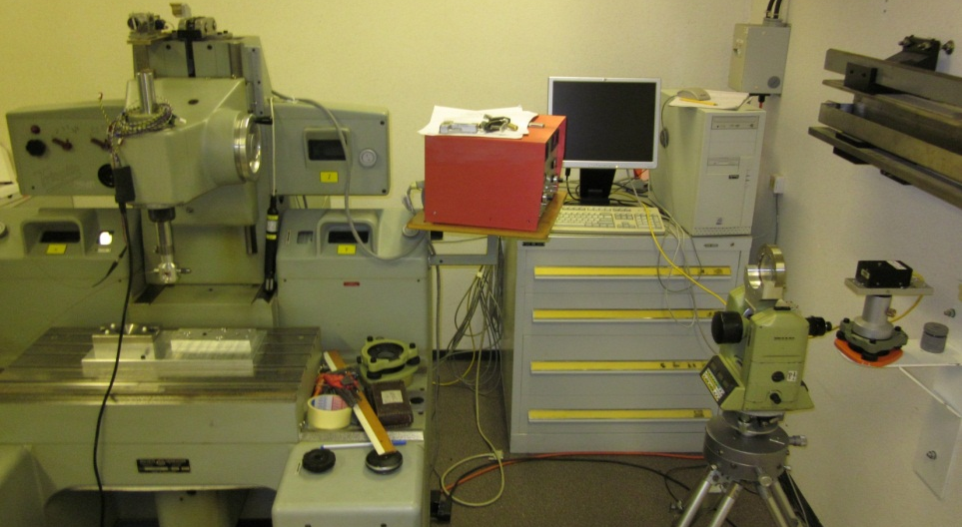
Viewport Study
Parallel Plate Effect
Parallel plate effect on image at different incident angles
50 microns
Optical fiber attached to a Coordinate-measuring machine controlled with an interferometer
Window mounted on a theodolite (rotation) and a translating holder
BCAM W0226
Difference Theory/observed:
Average: 0 micr
Standard deviation: 6 micr
BCAM to Target distance: 1.3 m
Incident angle change of 1gon (0.9deg) → 37 microns radial object “displacement”
Match the theory by a few microns → Easy observation correction by software
Adjustment of the Window within less than 1 degree → Ease the correction

Slide 13
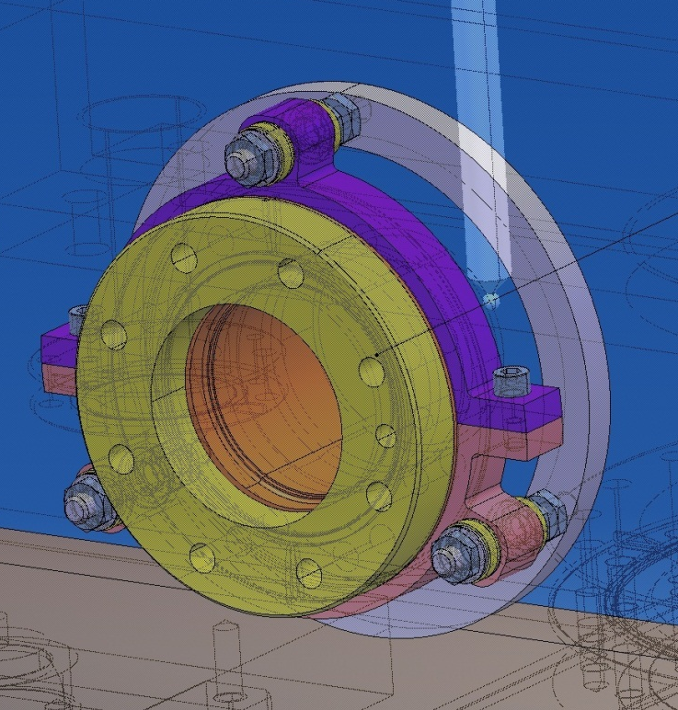
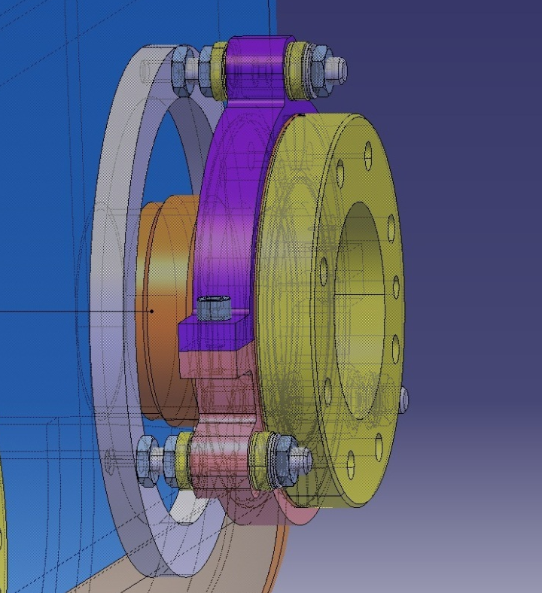
Viewport Study
Viewport Adjustment System
Drawings by A. Bouzoud
Preliminary design for a viewport alignment system
Adjustment of the viewports within less than one degree
  Viewport adjustment system
  Collimator (under development) or Standard Survey methods

Slide 14
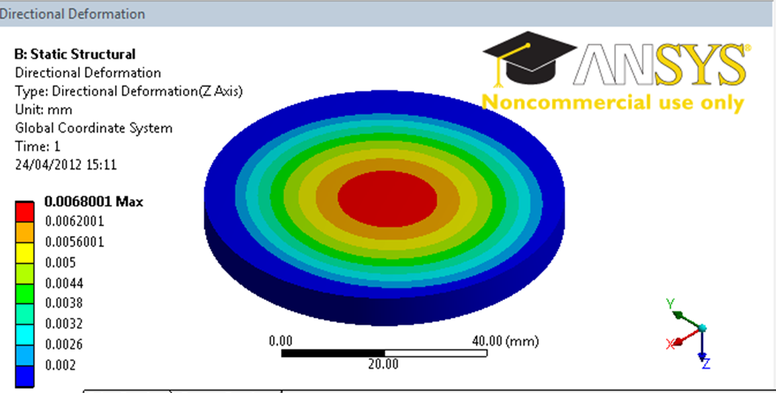
Viewport Study
Vacuum Deformation
Viewport: 6.55mm thick
Less than 7 microns deformation at the center
Less than 0.015 degree of angular deviation
7 microns
Y.Leclercq – CERN
Deformation measurements at Liberec University (CZ):
Results match the calculated deformations by a few microns
Same deformation on both side → Parallelism kept

Slide 15
The Targets
Overview
Constraints → HIGH VACUUM - CRYO CONDITIONS - SIZE
Studied Target Types
  Silica Silica optical fiber end
      - feed-through needed, one-sided target
      + easy light level control, OK with cold and vacuum (tested)
  Silica Silica optical fiber ended by a ceramic ball
      - feed-through needed, connection fiber/ball
      + visible from all positions, good diffuser
  Retro-reflective targets
      - illumination needed, all targets in one shot
      + double-sided, passive target, no feed-through
      More tests in cold and vacuum ongoing
IWAA12 - Sept 2012
HIE ISOLDE Alignment System
15

Slide 16
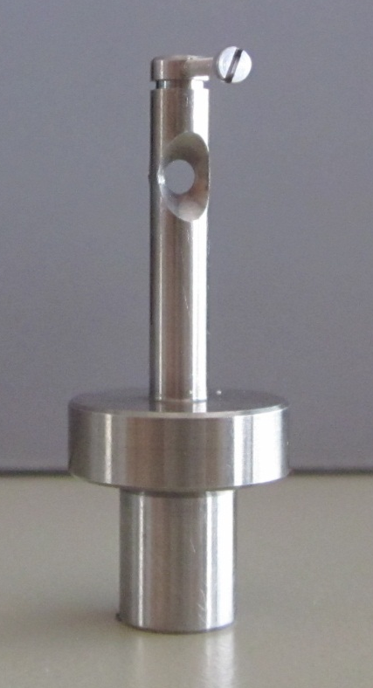
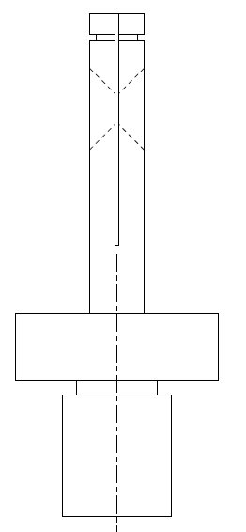
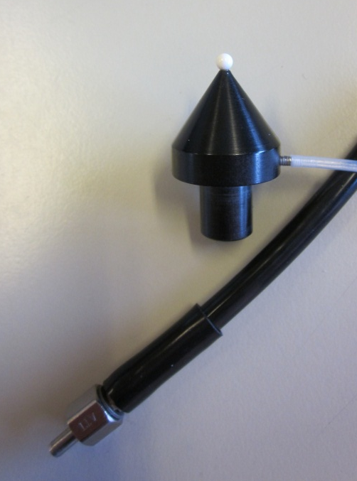
Double Sided Targets
Two types of “double sided” targets considered
Retro-reflective bi-directional target
Laser illuminated ceramic balls
4mm
3 mm diffusion ball
Fiber inside the support
Slot for double sided retro foil
2mm
Fiber
Light injection
Double sided retro-reflective target Prototype tests on-going
Test prototype for an illuminated ceramic ball synchronized to the acquisition system

Slide 17
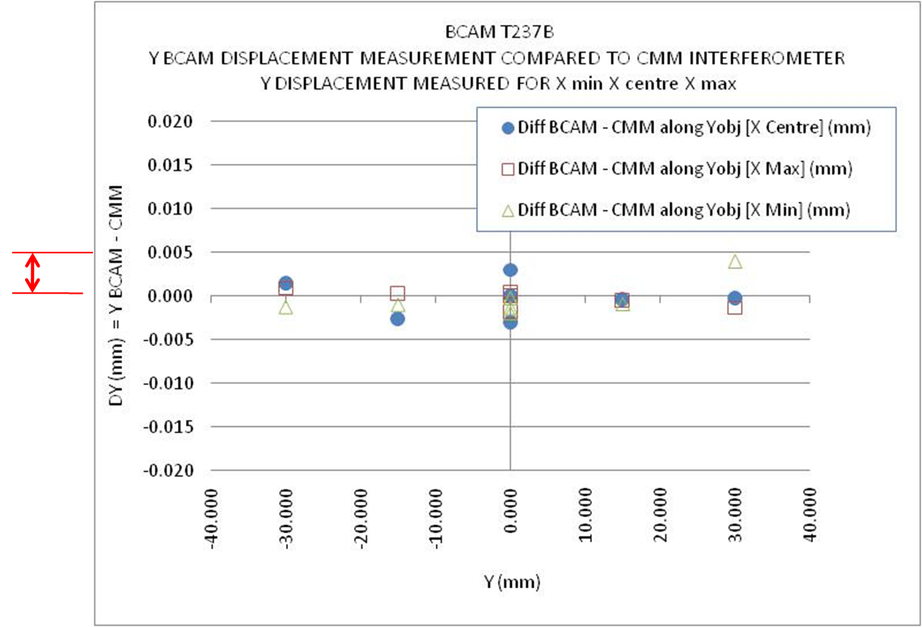
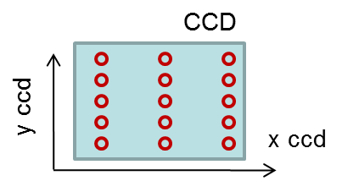
Target Movement Reconstruction
BCAM measurements on Optical Fiber End – Ref CMM measurements
5 microns in object space
Large part of the CCD surface covered
Target at 1.415 m from the BCAM lens
[BCAM to Optical Fiber End] compared to CMM → Better than 5 microns
Comparison of different types of targets → Differences at 7 microns level

Slide 18
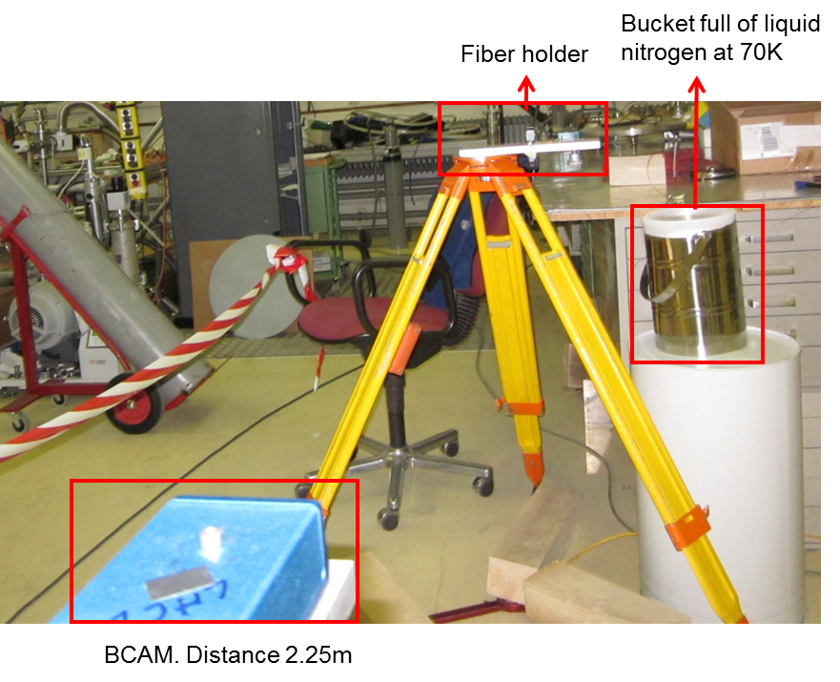
Target Study
Cryogenic Conditions
Targets and fiber tests in cold conditions – Liquid nitrogen at 70K
Test carried out in the Cryolab with Mario Herrmann (TE/VSC)
Tested: fibers, retro-reflective ball, retro-reflective targets and ceramic diffusion balls
All of them resist to 70K cold conditions
No visible crack on the fibers (Microscope)
Light transmission in the fiber still OK

Slide 19
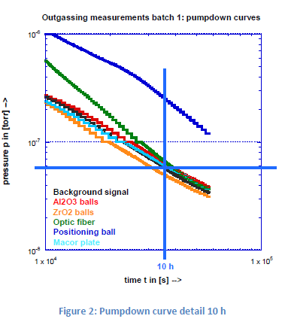
Target Study
Vacuum
Inside the Cryomodules: Common beam and insulation vacuum
Outgassing tests of:
Ceramic balls (Al2O3 and ZrO2)
Silica/Silica optical fibers
Photogr. retro-reflective ball on anodized support
Macor plate
Test performed by Mario Herrmann (TE/VSC)
ALL TESTED TARGET CAN BE USED
Retro-reflective tape: under test

Slide 20
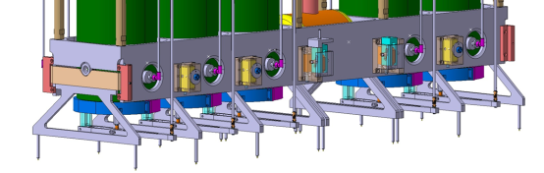
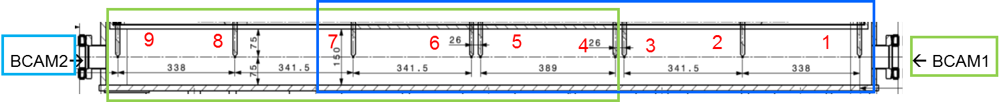
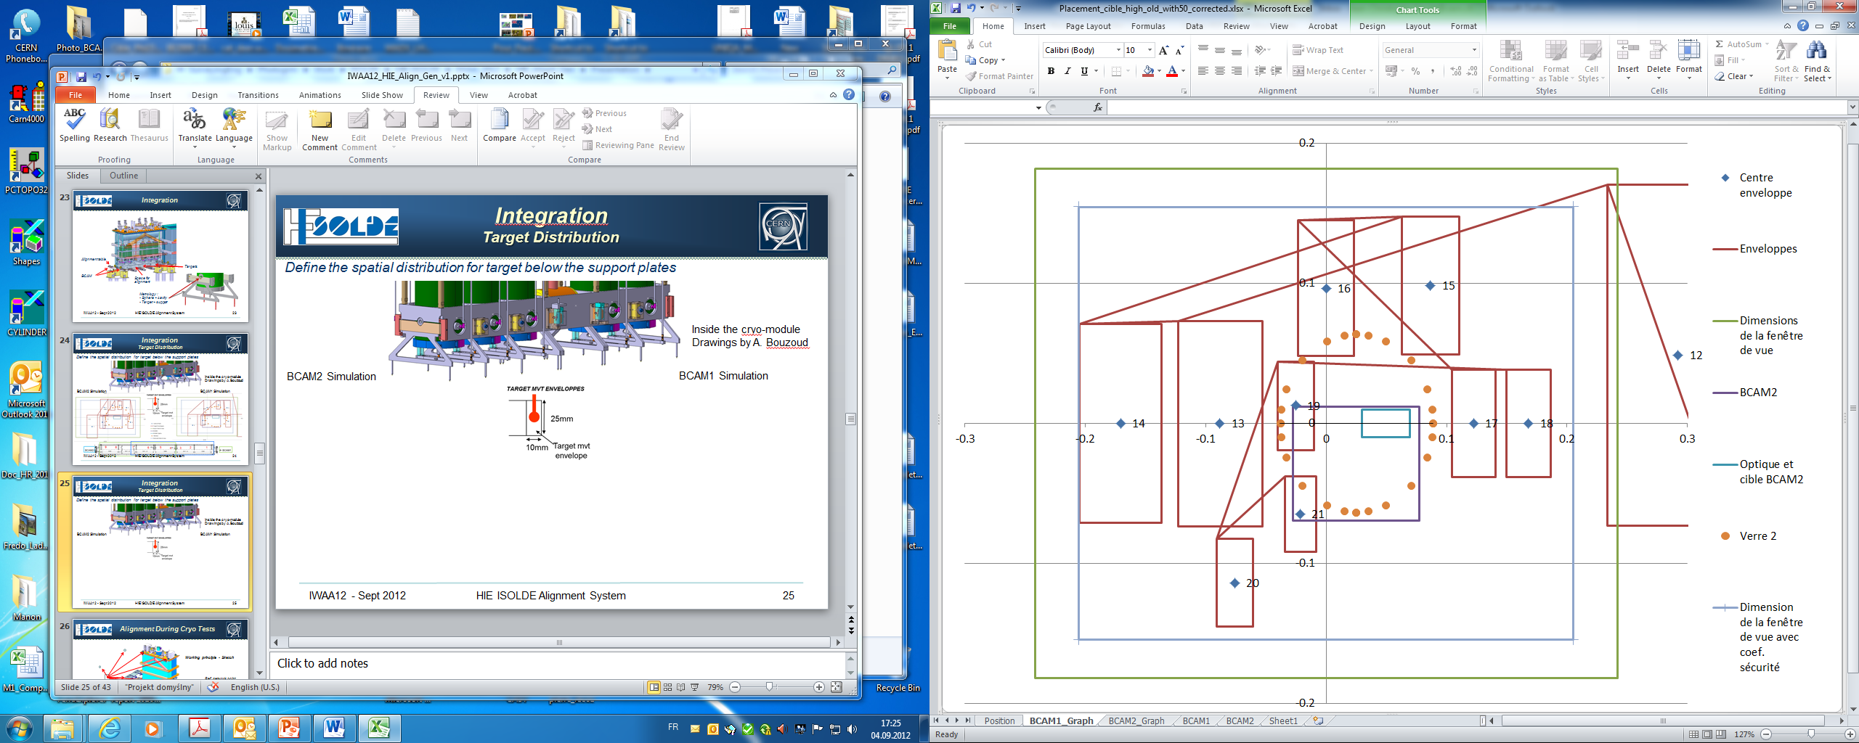
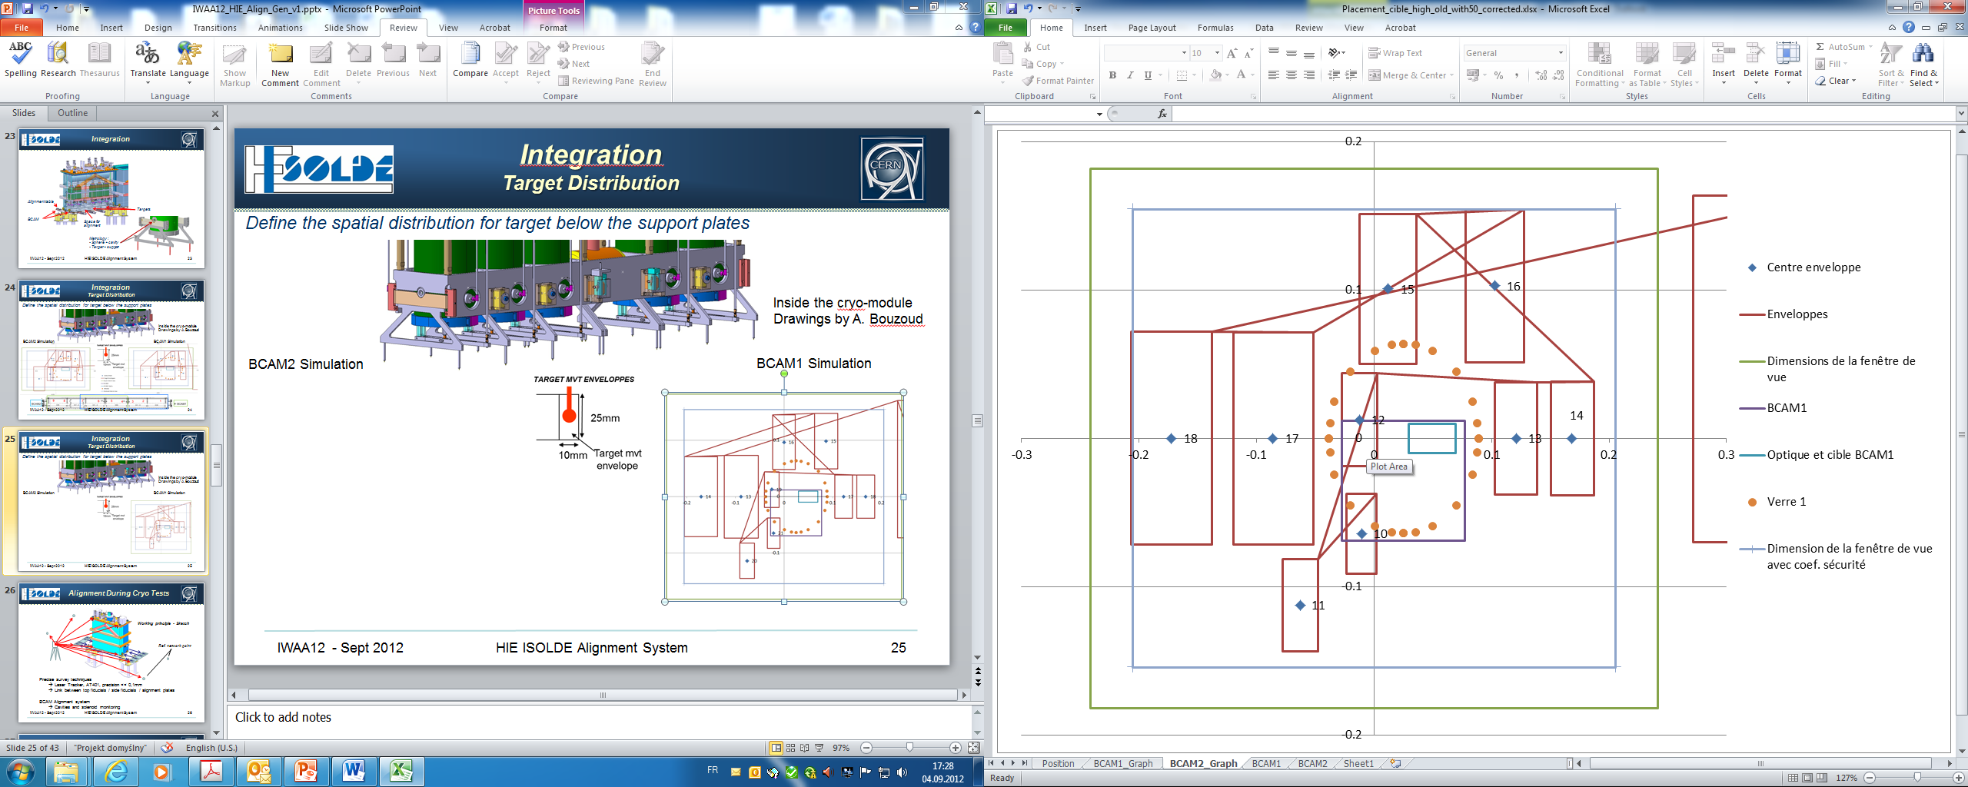
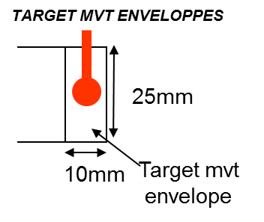
Integration
Target Distribution
Cryomodule
Internal Line BCAM
Target
Drawing A. Bouzoud
From BCAM2
From BCAM1
CCD
Target env.
Opp. Viewport
Opp. BCAM
BCAM2 Simulation
BCAM1 Simulation

Slide 21
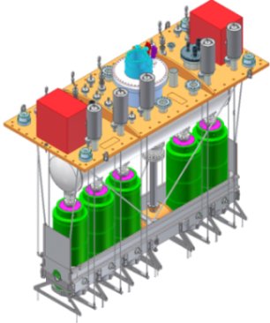
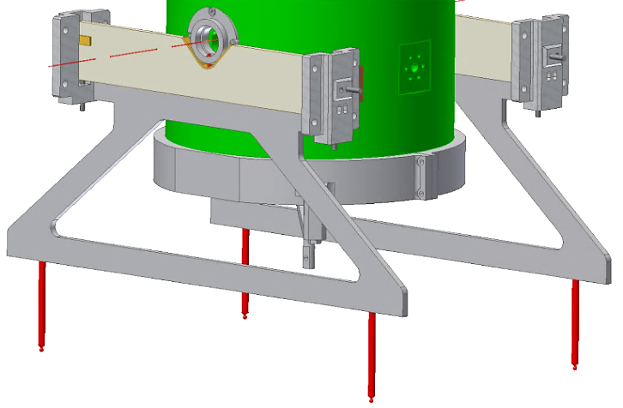
Supporting and Adjustment
Cryomodule assembly in ISO Class 5 clean room
Survey sockets → Assembly / CM pre-alignment
Tie-rods → Frame suspension and adjustment
Cavity and solenoid isostatic support: Sphere – V-shape
Precise adjustment
Solenoid adjustment allowed in operational conditions
Used as Target support

Slide 22
Project Staging
LINAC 2014
LINAC 2016
LINAC 2017
Modular Alignment System → Adapted to staging of the project

Slide 23
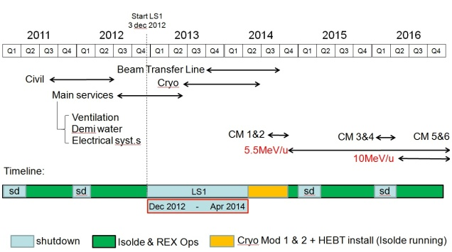
Project Planning
Minimum disturbances to the Experiments presently running

Slide 24
Conclusions
ALIGNMENT SYSTEM MAINLY BASED ON WELL KNOWN ELEMENTS
BCAMs
  Proved and used devices
  HBCAM development → Very promising results
VIEWPORTS
  Fit well to the theory → Easy BCAM observation corrections
  Be careful in the choice of the viewport → High optical quality needed
TARGETS
  All alternatives seem to work well (Fibers – Ceramic balls – Retro targets)
  Retro targets looks promising → Passive targets
  Target support ~ Std Survey → Easy control when CM open (Clean room…)
SOFTWARE:
  Development well advanced
  Simulation of metrol. table position reconstruction → ~20 microns at 1 sigma level
  Validation tests on going → Promising results
GOAL: BE READY FOR THE VACUUM AND CRYOGENIC TESTS OF 1st CRYOMODULE

Slide 25
Thank you

Slide 26
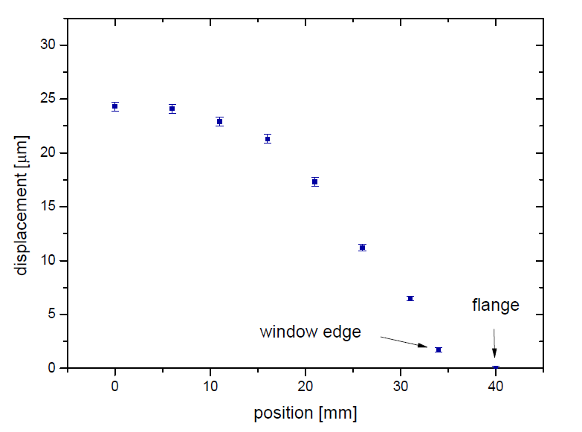
Viewport Study
Vacuum Deformation
Viewport: 3.55mm thick
Experimental results by Liberec University Many thanks to Miroslav SULC
Simulation
25 microns
25 microns
Viewport of 3.55mm thick
  → 25 micr (±0.4) in the center
  → 0.08 deg angular deviation
Results match the theory by a few microns
Same deformation on both side
  → Parallelism kept
0.08 deg

Slide 27
Viewport Study
Window Uniformity
Effect of a lateral translation of the B viewport in front of the BCAM
Measurement of a fix point through a window translated in front of the BCAM
Window translation (mm)
Window translation
X
10 microns
in Object space
BCAM1
: Windows
Influence on observed X object (mm)
: Optical axis
11.5 mm
Window
Window Center
0
65 mm
Set-up less stable
Set-up less stable
No visible influence / In the instrumental precision (about ±7micr at this distance)

Slide 28
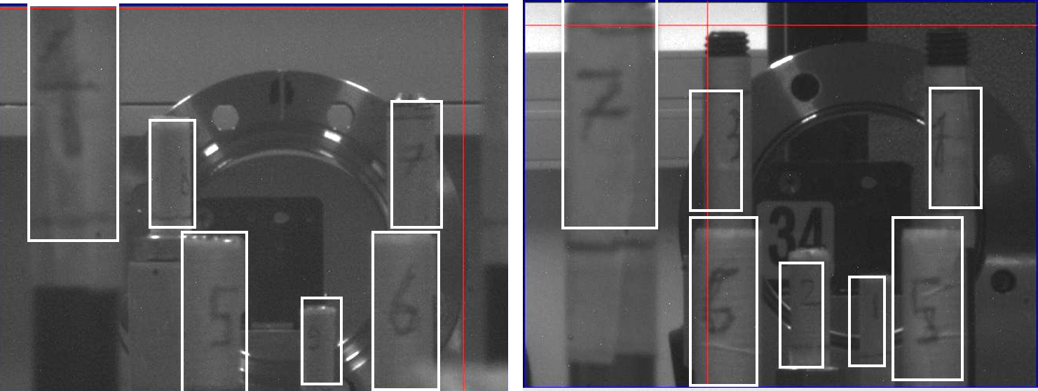
Integration
Target Distribution
Validation of calculated target distribution - Apr 2012 - Setup for a 8 targets design
BCAM1
BCAM2
In White: the expected position according to simulations.
Done with prototype W0226
Field of view 70x50 mrad
No standard length and position for target support
Decrease of BCAM focal length to 50 mm → approx. 30% more field of view
To be refreshed with the new supporting design (more plates)

Slide 29
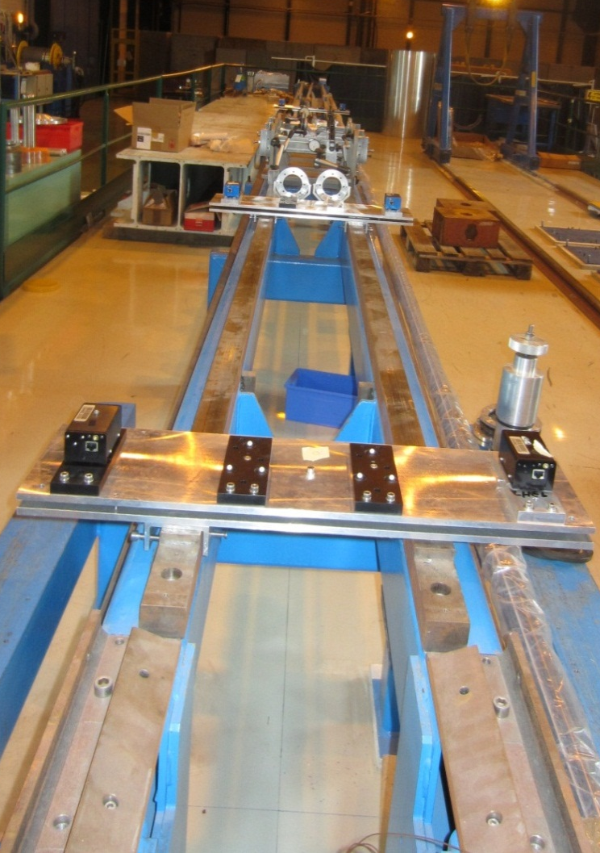
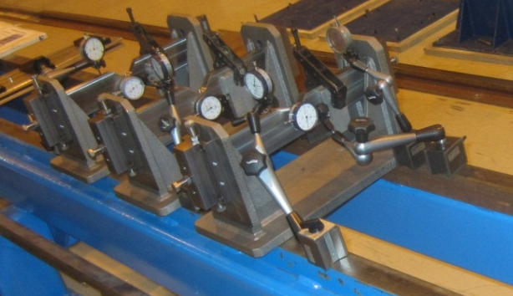
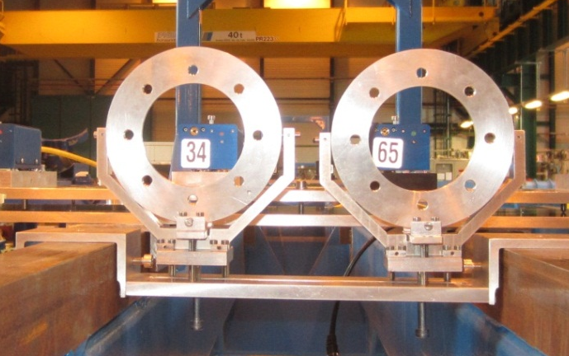
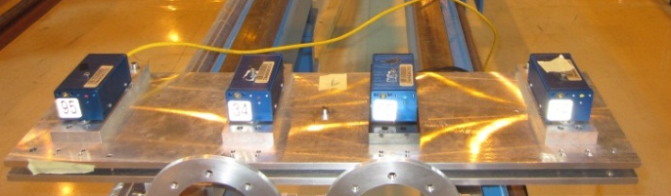
Large Scale Test Bench
Tests with standard BCAMs lent by OSI
Under construction
2,5m
Cavity support mockup
2,5m
Adjustable viewport table
2m
Complete set-up in SMI2
Almost 1:1
: BCAM
: Viewport
: Targets
Adjustable BCAM table

