Slide 1
IWAA 2012 - Fermilab
September 2012
HIE-ISOLDE
ALIGNMENT AND MONITORING SYSTEM SOFTWARE AND TEST MOCK-UP
Jean-Christophe Gayde BE/ABP-SU
Guillaume Kautzmann BE/ABP-SU
Sebastian Waniorek BE/ABP-SU

Slide 2
Table of Contents
Alignment Specifications
Alignment Concept
Mathematical Concept
Software
Model Validation
Simulation
Conclusions

Slide 3
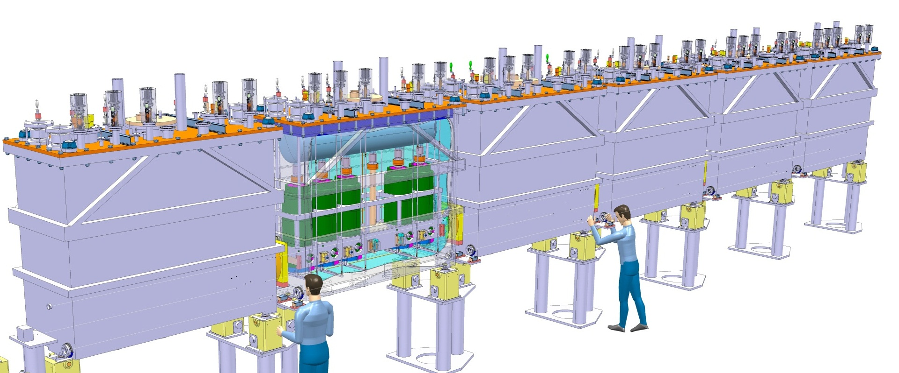
General
Alignment Specifications
HIE-ISOLDE : Upgrade of the existing REX-ISOLDE
Alignment and monitoring of the Cavities and Solenoids in the Cryomodules w.r.to a common nominal beam line (NBL) along the Linac
Permanent system
Precision demanded along radial and height axis at 1 sigma level :
  300 microns for the Cavities
  150 microns for the Solenoids
~16 m
NBL
+/-150 micr
+/-300 micr

Slide 4
General
Alignment Concept
Proposed concept:
Overlapping zone of BCAM obs. on external lines
Double sided targets observations on internal lines
Hardware:
BCAM based observations
Metrological tables
Targets
Viewports
Conditions:
Cryogenic conditions (4.5K)
High Vacuum
Software is needed to reconstruct the target and table positions

Slide 5
Mathematical concept
Coordinate Systems
Hierarchical scheme of coordinates systems :
  Topmost: HIE system → Link to the NBL
  For each table: Table system → Link between the BCAMs
  For each BCAM: Mount system → Calibration parameters
  CDD System → Observations

Slide 6
Mathematical concept
Adjusted Parameters
Translations and rotations for each table need to be estimated: 6 parameters per table in the setup
Relations between mount systems on the same table are fixed → Tables considered as a rigid body

Slide 7
Mathematical concept
BCAM Observations
Two observations per spot: the x and y coordinates of the image coordinate on the CCD, transformed in the mount system by calibration parameters
The spot approximated theoretical position is projected on the observing CCD and in the same mount system.
Transformation parameters of the observing and observed plate are included.
Pivot
Light
Point
source

Slide 8
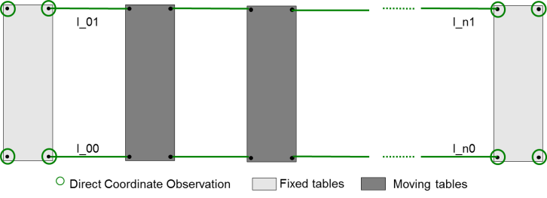
Mathematical concept
External Observations
BCAMs (angle monitors) cannot measure distances directly
For the first implementation, distance measurements between the plates are introduced manually
Coordinates of end plate corners as direct observations with their accuracy to set the weight

Slide 9
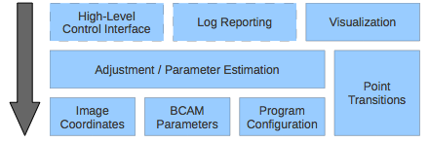
Software
Principles
Designed as a portable, modular C library with some C++ implementation parts, uses only C99 and ANSI C++98
Can be included into any software that provides a user interface to the algorithms
Flexible description of the setup using configuration files

Slide 10
Software
Configuration
The description of the setup and measurement data is defined in an INI-style, hierarchical configuration file

Slide 11
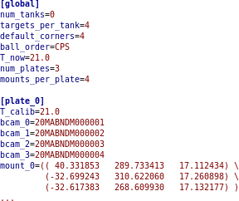
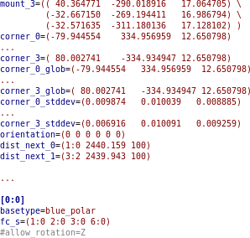
Software
Configuration
The description of the setup and measurement data is defined in an INI-style, hierarchical configuration file
Global parameters
Plate parameters
Mount parameters

Slide 12
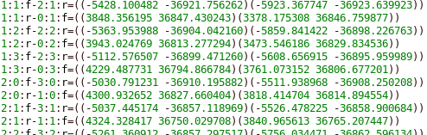
Software
Observation and Calibration Input
Observations
Observations parameters
Observation of one spot transformed in the Mount System
# of lines in file
Calibration parameters of the BCAM – Provided by OSI
timestamp
type
serial number
6/8*value
6/8*stddev
Example:
5124
20020819140700 black_polar_rs 20MABNDL000099 -4.74231264628081E+000 … 1.45386202984383E-002
…
20090429102929 blue_azimuthal_c 20MABNDB000354 -1.26310133593828E+001 … 6.23945700435415E-003

Slide 13
Software
Adjustment
Calibration parameters
External Observations
BCAM Observations
Configuration
Least square adjustment
Adjusted parameters between the systems
→ reconstructed coordinates

Slide 14
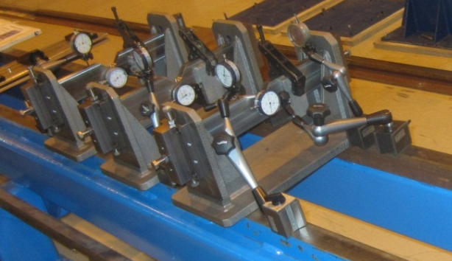
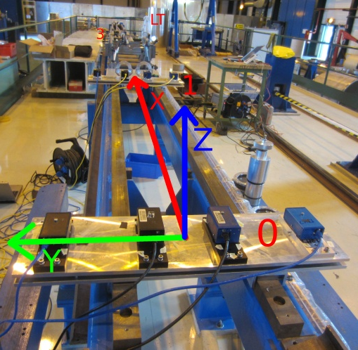
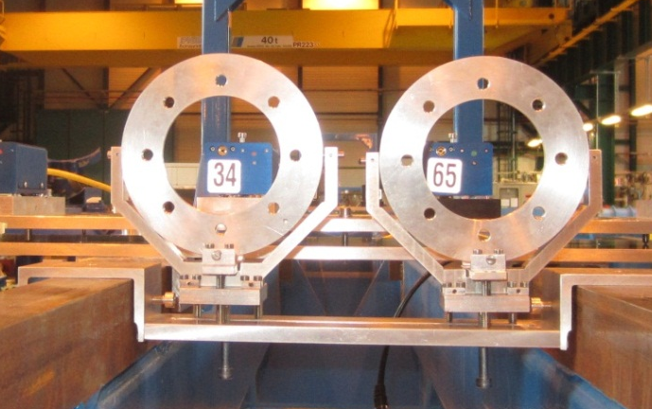
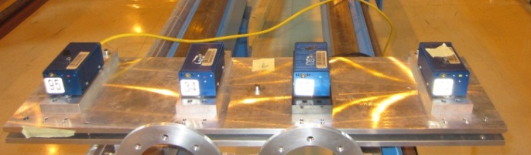
Model Validation
Mock-Up
3
2,5m
2
Cavity support mockup
2,5m
1
Adjustable viewport table
2m
0
Complete set-up in SMI2
Almost 1:1
: BCAM
: Viewport
: Targets
Adjustable BCAM table

Slide 15
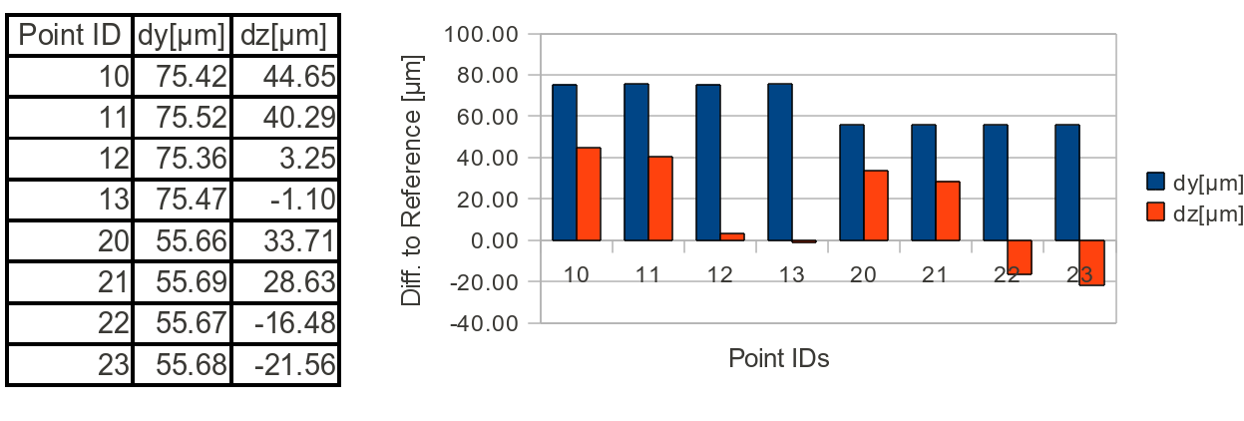
Model Validation
Results
Very first validation test:
Stochastic results of reconstruction
 | σty [μm] | σtz [μm] | σrx [μrad] | σry [μrad] | σrz [μrad]
0 | 2.9 | 3.2 | 9.2 | 29.5 | 7.5
1 | 70.1 | 55.9 | 177.8 | 26.0 | 111.2
2 | 78.5 | 66.5 | 198.8 | 23.9 | 111.2
3 | 5.4 | 6.4 | 19.0 | 36.0 | 7.7

Slide 16
Model Validation
Outlook
BCAM rotations
  Comparison of simulations and reference measurements suggests to investigate an in-situ determination of the mount rotations in an extra preprocessing step
  Determine mount rotations by collinearity equation approach

Slide 17
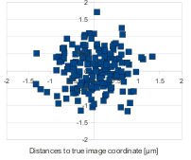
Simulation
Setup
Basically the same layout as in the reference measurements but with 7 plates like in the final extension of HIE-ISOLDE
To improve redundancy and add additional robustness, the outer BCAMS were elevated to see more than one BCAM
Overlap adds 128 observations, a rise from 228 to 356 for the same number of 42 unknowns
Image Coordinates were calculated from the positions and randomized by 1.5 micron
0
1
2
3
4
5
6
Table 0 and 6 fixed

Slide 18
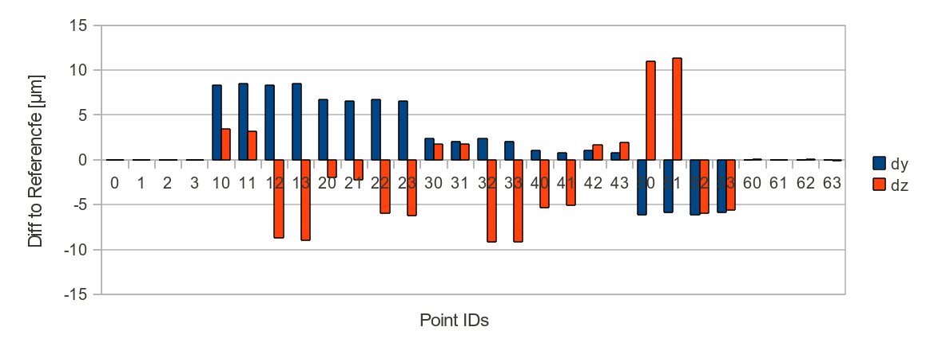
Simulation
Results
20 microns
Σ₀²=0.0117 | σty [μm] | σtz [μm] | σrx [μrad] | σry [μrad] | σrz [μrad]
0 | 0.49 | 0.53 | 1.54 | 3.51 | 1.2
1 | 9.19 | 10.72 | 34.5 | 4.16 | 3.78
2 | 12.72 | 15.38 | 38.2 | 3.59 | 3.39
3 | 13.67 | 16.87 | 38.02 | 2.82 | 2.69
4 | 12.73 | 15.6 | 38.27 | 3.56 | 3.39
5 | 9.21 | 11.01 | 34.54 | 4.18 | 3.78
6 | 0.9 | 1.07 | 3.18 | 3.93 | 1.23
Overlapping improves the results by a factor 2
Still some error budget for the reconstruction of the targets

Slide 19
Conclusion
Conclusions:
Validation of the theoretical model and software implementation
Promising simulations
Development well advanced
But still work to do:
Analysis of the second set of measurement on the test bench
New features on the software (Target reconstruction, Viewport and double-viewport correction, Image analysis, thermal expansion…)
Extended test bench
…

Slide 20

Acknowledgement:
This research project has been supported by a Marie Curie Early Training Network Fellowship of the European Community’s Seventh Framework Programme under contract number (PITN-GA-2010-264330-CATHI).
Thanks for your attention

