Slide 1
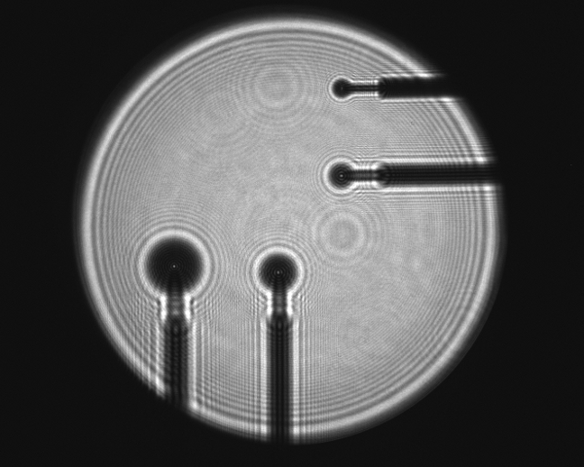
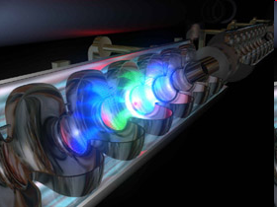
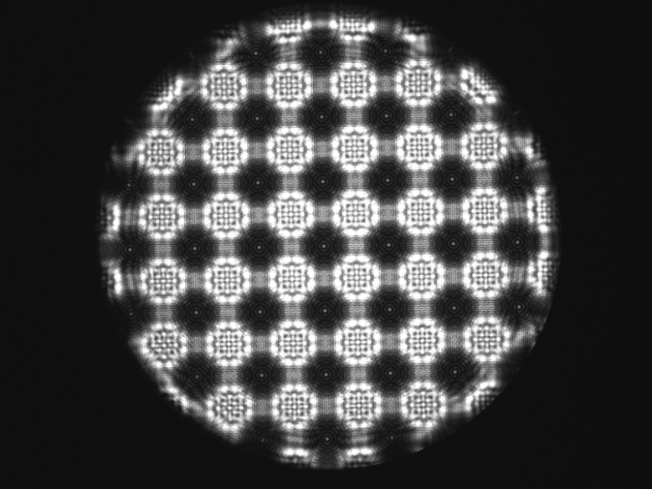
STRAIGHT LINE REFERENCE SYSTEM.
Status Report on Poisson System Calibration
Christian Schwalm
IWAA 2012 Fermilab
September 13, 2012

Slide 2
STRAIGHT LINE REFERENCE SYSTEM.
Agenda
Agenda
Agenda
Introduction
Poisson Alignment System
System Calibration
3.1 Calibration in Theory
3.2 Calibration in Practice
System Verification
Outlook and Conclusions

Slide 3
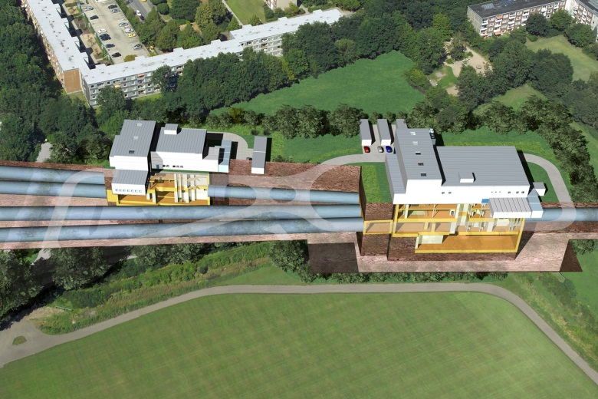
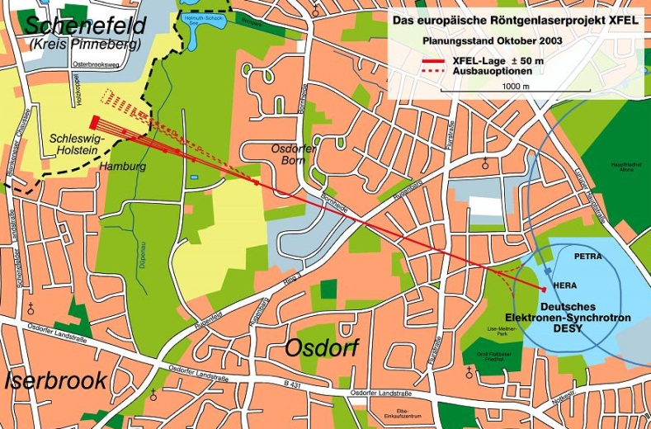
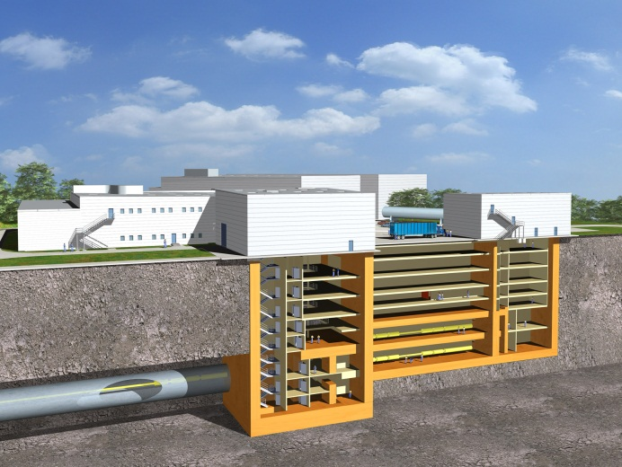
STRAIGHT LINE REFERENCE SYSTEM.
Agenda
Agenda
1. Introduction
Introduction
European XFEL under construction (completed in 2015)
3.4 km from DESY premises to the town of Schenefeld
Refraction is central problem in stretched geodetic networks
Straight Line Reference Systems needed to eliminate refraction

Slide 4
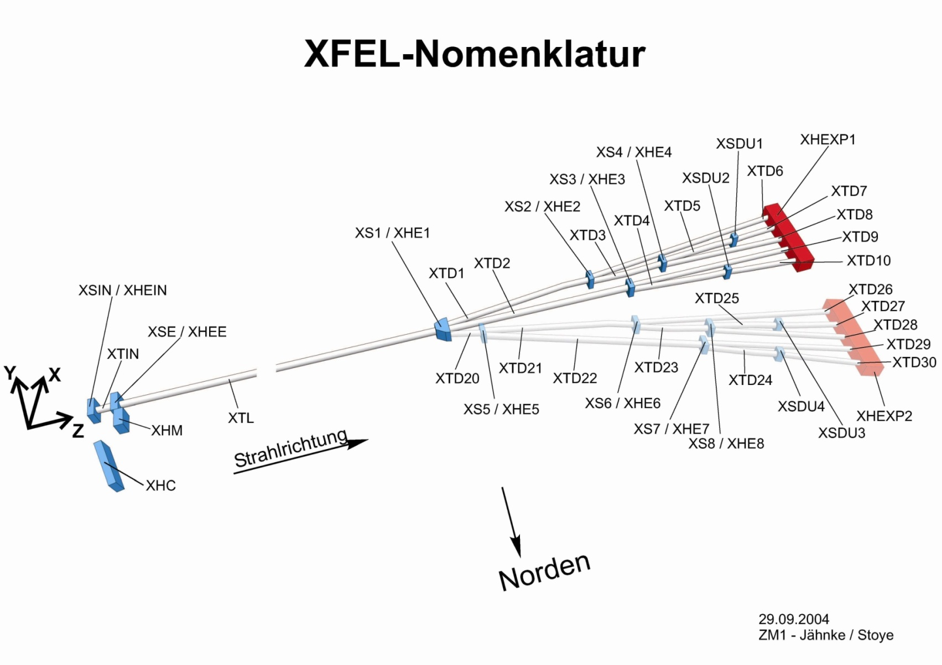
STRAIGHT LINE REFERENCE SYSTEM.
1. Introduction
3 SLR-Systems
SASE2: 555m
SASE3: 443m
SASE1: 535m

Slide 5
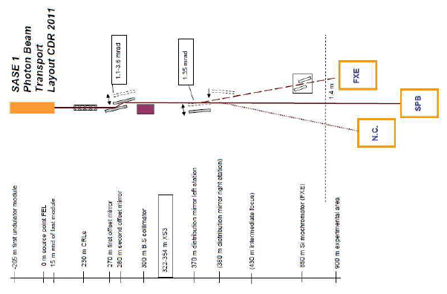
STRAIGHT LINE REFERENCE SYSTEM.
1. Introduction
SLRS from undulator to the “Bremsstrahlungscollimator”
Accuracy requirement: 1-2mm / 550m

Slide 6
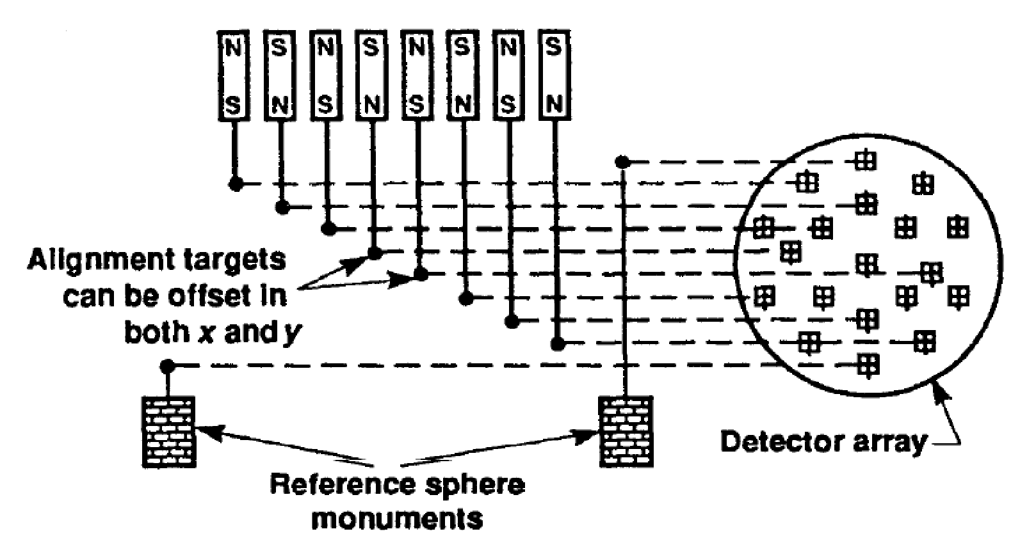
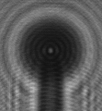
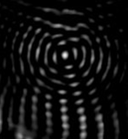
STRAIGHT LINE REFERENCE SYSTEM.
1. Introduction
2. Poisson Alignment System
2. Poisson Alignment
Conceptual view (Griffith 1989) Poisson‘s spot Correlation result
Processing: pattern matching via correlation algorithms
Characteristic patterns are created artificially
Sub-pixel estimation by paraboloid fit on correlation maximum
large
diameter
laser
beam

Slide 7
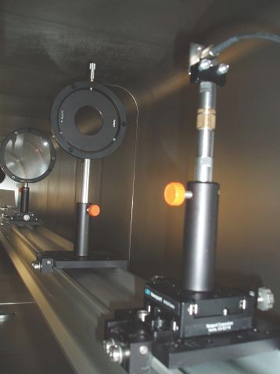
STRAIGHT LINE REFERENCE SYSTEM.
2. Poisson Alignment System
Optics setup
Camera: Firewire, 1.600x1.200 pixels, chip size: ½“
Blue laser (405 nm) for fine interference patterns and smaller spheres
Achromatic lens for minimal spherical aberrations
CCD Camera
Plan-convex lens
Targets
Achromatic lens
Aperture
Laser Point Source

Slide 8
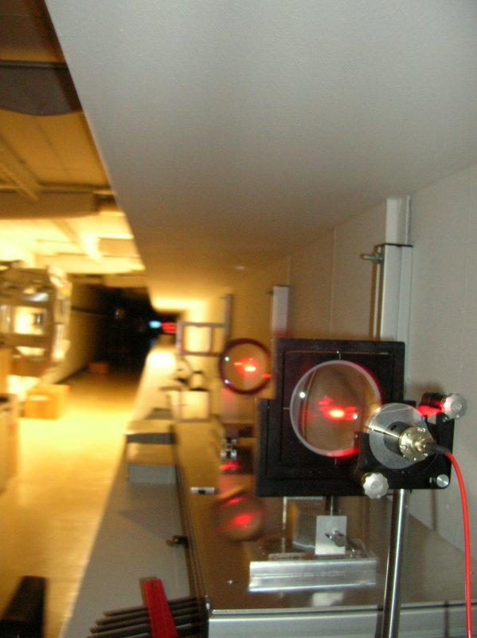
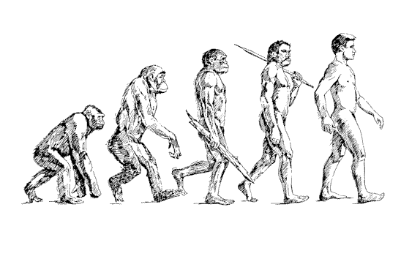
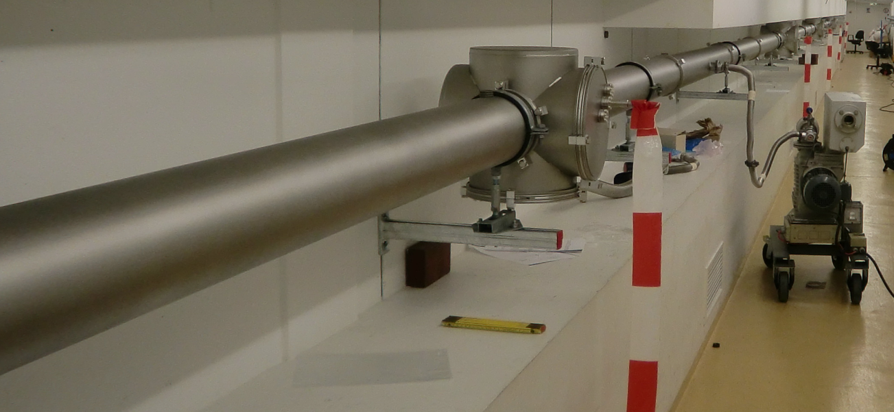
STRAIGHT LINE REFERENCE SYSTEM.
2. Poisson Alignment System
SLRS Prototype Evolution

Slide 9
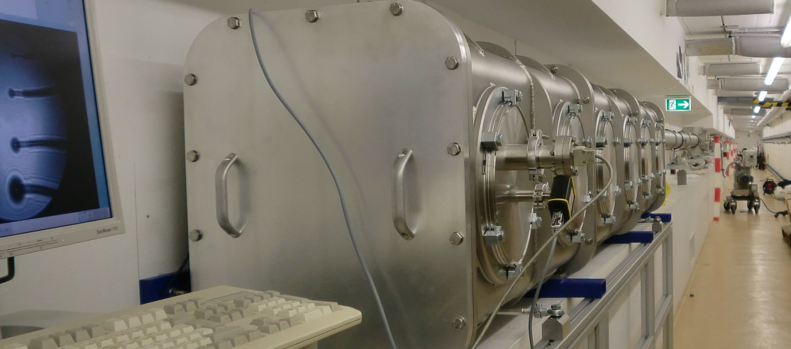
STRAIGHT LINE REFERENCE SYSTEM.
2. Poisson Alignment System
SLRS Prototype
Since 01/2010: New SLRS Prototype
Length: 48 m, Pipe diameter: 160 mm
Vacuum System designed for HV, operating pressure: 0.1 mbar
4 Measurement places

Slide 10
STRAIGHT LINE REFERENCE SYSTEM.
2. Poisson Alignment System
3. SLRS Prototype
System Integration
SLRS will provide correction parameters for the geodetic network (Δx, Δz)
No direct connection to components
Calibrated transfer pieces used to connect SLRS with tunnel network
Δx, Δz
Δx, Δz
Δx, Δz

Slide 11
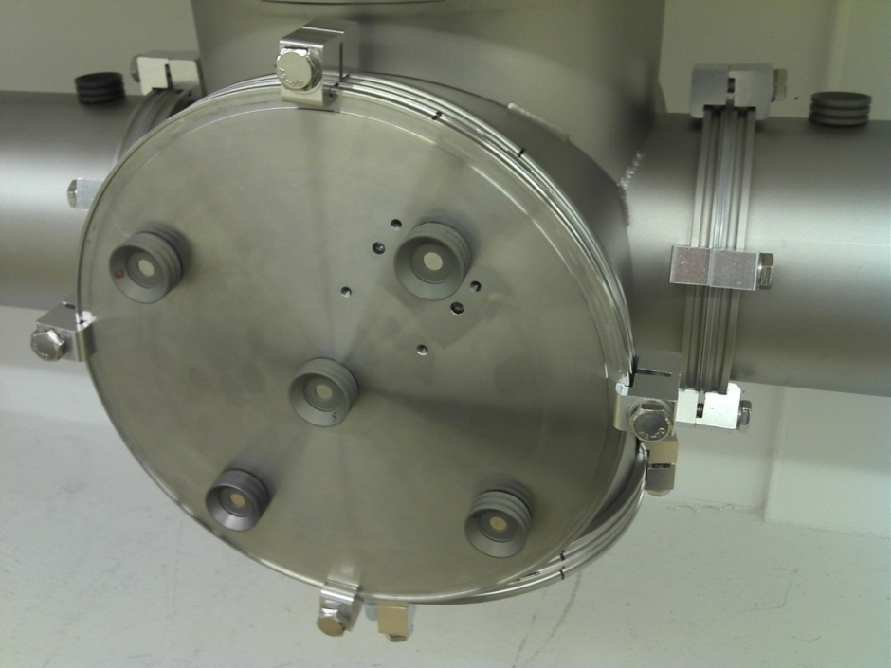
STRAIGHT LINE REFERENCE SYSTEM.
2. Poisson Alignment System
System Integration
Physical system connection by calibrated transfer pieces
Measurement from outside (fiducials) determines SLRS sphere centre in tunnel system
1.5“ CCR Fiducials
SLRS Sphere
ISO-K-Flange (DN200)
Air
Vacuum

Slide 12
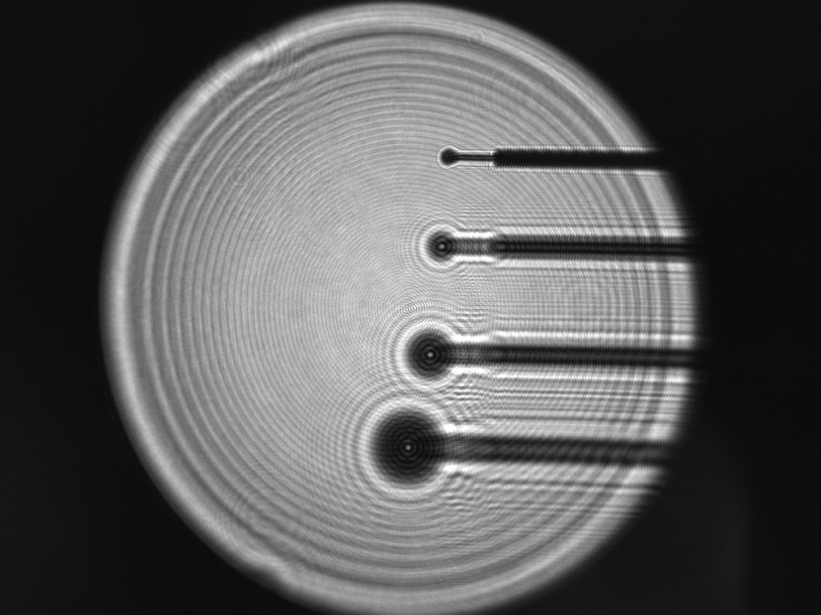
STRAIGHT LINE REFERENCE SYSTEM.
2. Poisson Alignment System
Performed tests
Resolution (0.05 pixel)
Scale (1 pixel = 0.14 mm)
Temperature sensitivity (necessity of the vacuum system)
„warm-up time“, system stability
Detection of defined translations along two axes
~ 25 microns along X ~ 50 microns along Y
4 targets, one at each
measurement place
x
y
R2 (38m)
Z2 (28m)
Z1 (19m)
R1 (10m)

Slide 13
STRAIGHT LINE REFERENCE SYSTEM.
2. Poisson Alignment System
3. System Calibration
3. System calibration
Objectives:
Calibration of the System (pixel coordinates → real alignment information)
Verification of the Calibration model and the measurement principles
Problem: What can be used as reference for the alignment info?
Different Alignment System (WPS, HLS) (currently n/a)
A good laser tracker network (not ideal)
Two Calibration models:
Simple Calibration model (5 params)
Extended Calibration model (12 params)

Slide 14
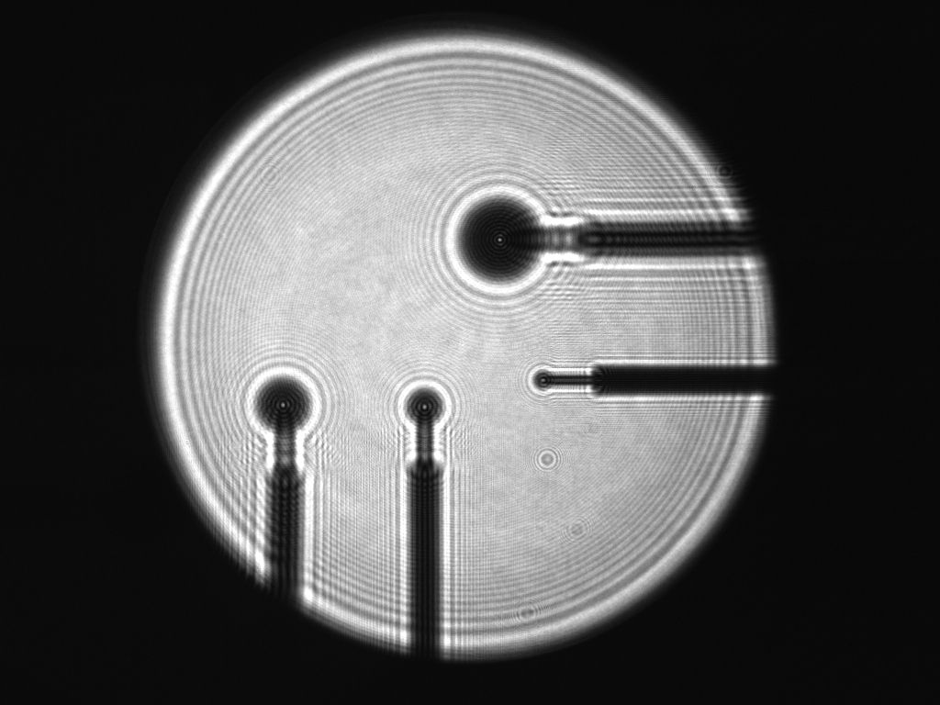
STRAIGHT LINE REFERENCE SYSTEM.
3. System Calibration
3.1 Calibration in theory
Reference spheres define a straight line in both systems (red)
Alignment info → Offsets of the other points to that line (blue)
In SLRS
Coordinate System
R1
ΔX₁
ΔX₂
Desired positions
if on-line
ΔY₁
ΔY₂
R2
Z1
Z2
How to connect the SLRS info
With the tunnel network?

Slide 15
STRAIGHT LINE REFERENCE SYSTEM.
3. System Calibration
Calibration in theory – The tunnel network
Prototype tunnel network is assumed to be refraction-free
Prototype tunnel network is levelled
Tunnel network is aligned with the SLRS-Axis
1st Axis aligned with SLRS tube
2nd Axis in horizontal plane

Slide 16
STRAIGHT LINE REFERENCE SYSTEM.
3. System Calibration
Calibration in theory – The basic model
Needed parameters to connect both systems:
2 scale factors s_{x}, s_{y}
1 rotation angle α
2 translations t_{x}, t_{y} (not needed for further processing)
Problem: Optical distortions are not accounted for
Misalignment of lenses
Lens characteristics
Relevant for long distances
Is the basic model sufficient?

Slide 17
STRAIGHT LINE REFERENCE SYSTEM.
3. System Calibration
Calibration in theory – The extended model
Use extended calibration model that includes optical distortion
Brown’s distortion model (Brown, D. C. 1966: Decentering distortion of lenses)
x* =x + x * (k1 * r² + k2 * r⁴ + k3 * r⁶) + p1 * (r² + 2x²) + 2 * p2 * x * y
y* =y + y * (k1 * r² + k2 * r⁴ + k3 * r⁶) + p2 * (r² + 2y²) + 2 * p1 * x * y
k1, k2, k3: radial distortion, p1, p2: decentering distortion
→ 7 additional params (5x distortion, 2x distortion center)

Slide 18
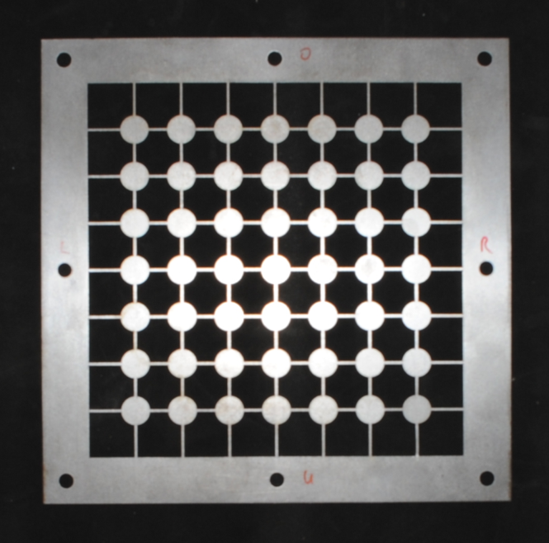
STRAIGHT LINE REFERENCE SYSTEM.
3. System Calibration
3.2 Calibration in practice
Calibration setup
Idea: introduce point array with known coordinates into the beam
→ Calibration Plates for each measurement place (3 for 4 measurement places)
Precision of wire electrical discharge machining (WEDM): ca. 10 micron
Installation of the Calibration Plate inside the Beam

Slide 19
STRAIGHT LINE REFERENCE SYSTEM.
3. System Calibration
Calibration in practice – Calibration setup
Problems
How accurate is the plate really manufactured?
Plate jaw, pitch, roll when inserted in the beam
Needed: reliable reference coordinates for each grid point
Ideal: Coordinates available in tunnel system and in SLRS
→ Calibration flanges

Slide 20
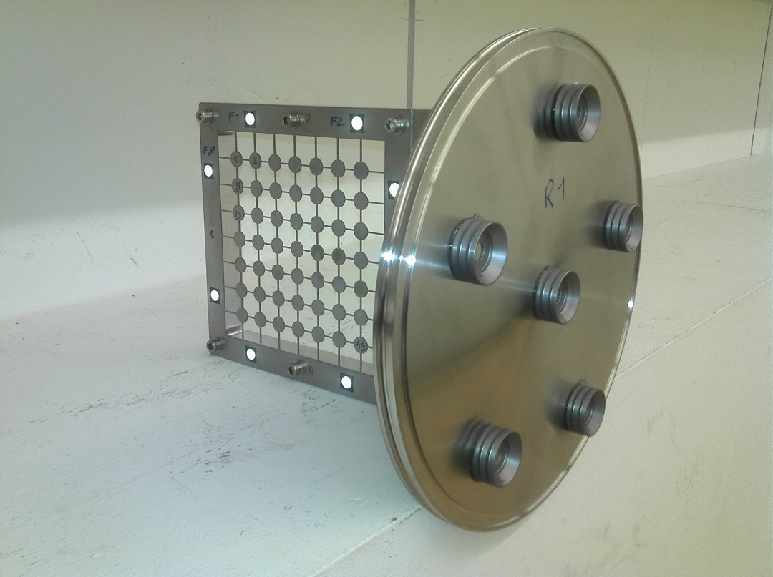
STRAIGHT LINE REFERENCE SYSTEM.
3. System Calibration
Calibration in practice – Calibration setup
Calibration flanges with calibration grid and 1,5“ CCR fiducials
By measuring the fiducials we can determine all grid point coordinates
Transfer measurement necessary (photogrammetry)

Slide 21
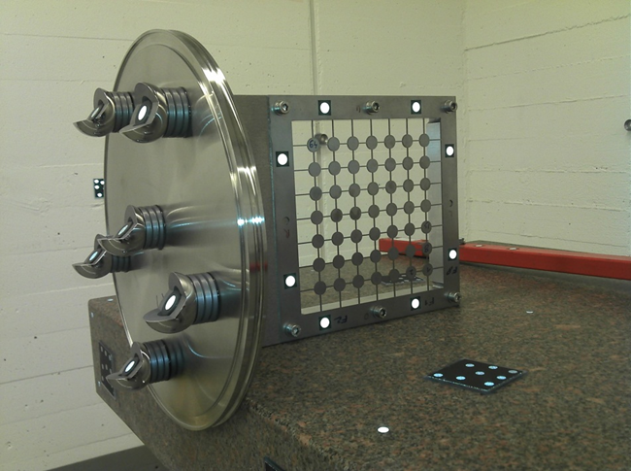
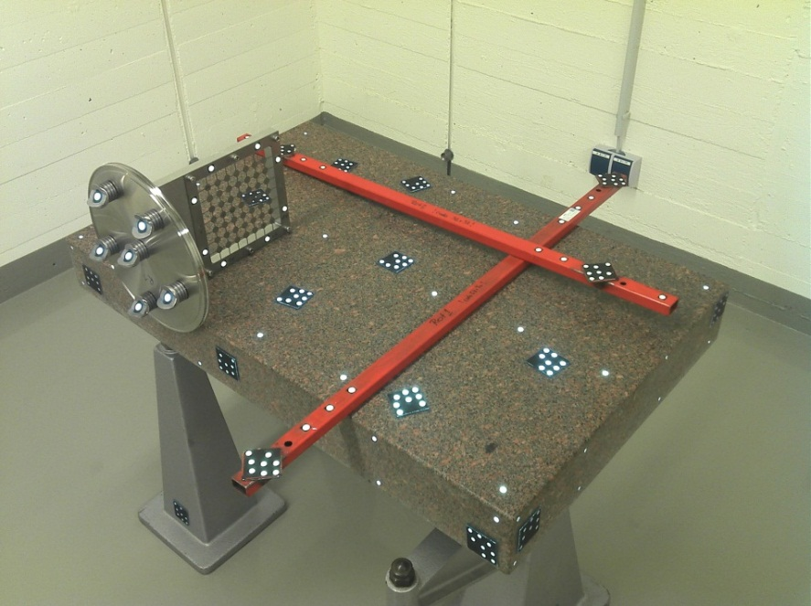
STRAIGHT LINE REFERENCE SYSTEM.
3. System Calibration
Calibration in practice – Transfer measurement
Step 1:
Calibration plate and CCR fiducials Bundle results: are equipped with photogrammetry marks (VSTARS)
Bundle of 160-180 images per calibration flange
RMS | X (mm) | Y (mm) | Z (mm)
R1 | 0.007 | 0.007 | 0.006
Z1 | 0.006 | 0.007 | 0.007
Z2 / R2 | 0.005 | 0.007 | 0.006

Slide 22
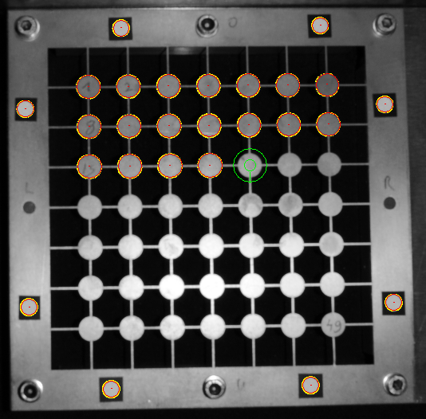
STRAIGHT LINE REFERENCE SYSTEM.
3. System Calibration
Calibration in practice – Transfer measurement
Step 2:
Grid point measurement not possible with VSTARS
Grid points and photogrammetry marks are measured with ellipse operator (LabView)
Coordinates are corrected for image distortion manually
Transformation of grid points into VSTARS system
Homography (projective transform)

Slide 23
STRAIGHT LINE REFERENCE SYSTEM.
3. System Calibration
Calibration in practice – Transfer measurement
Step 2:
Transformation result: Standard Deviations of the residuals
Grid coordinates and CCR fiducial coordinates in one system
→ Transfer measurement completed
Std. Dev. | X (mm) | Y (mm)
R1 | 0.012 | 0.011
Z1 | 0.017 | 0.015
Z2 / R2 | 0.013 | 0.013

Slide 24
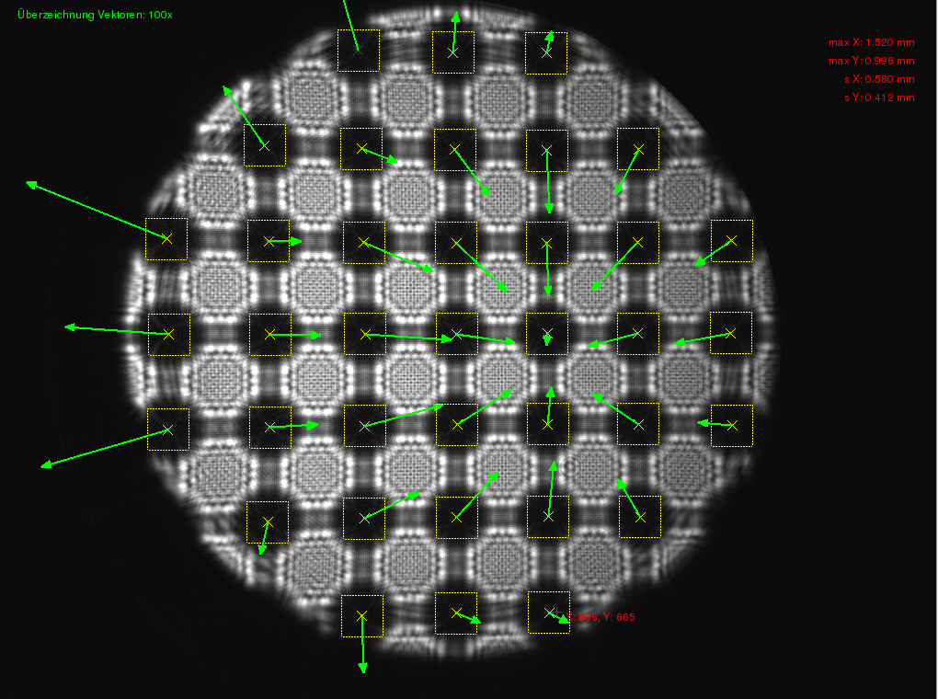
STRAIGHT LINE REFERENCE SYSTEM.
3. System Calibration
Calibration in practice – extended model test
Is the extended model correct?
Test: one lens out of focus for strong optical distortion effects
Transformation of grid coords in design grid
Residuals with simple model

Slide 25
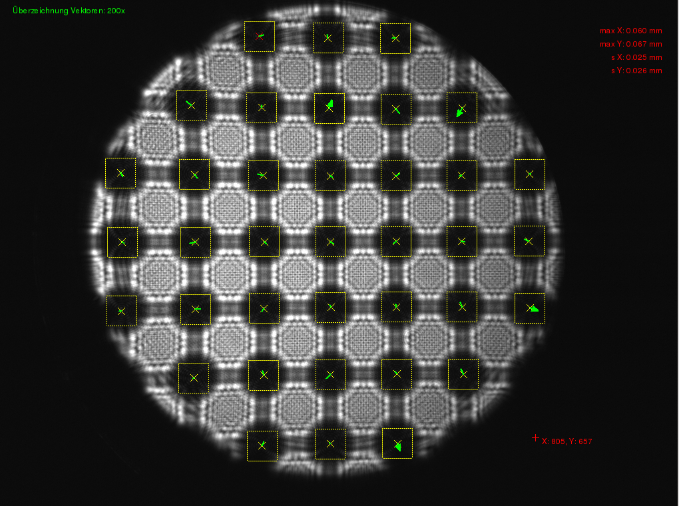
STRAIGHT LINE REFERENCE SYSTEM.
3. System Calibration
Calibration in practice – extended model test
Residuals with extended model
Optical distortion effects are accounted for correctly
→ Ready for calibration

Slide 26
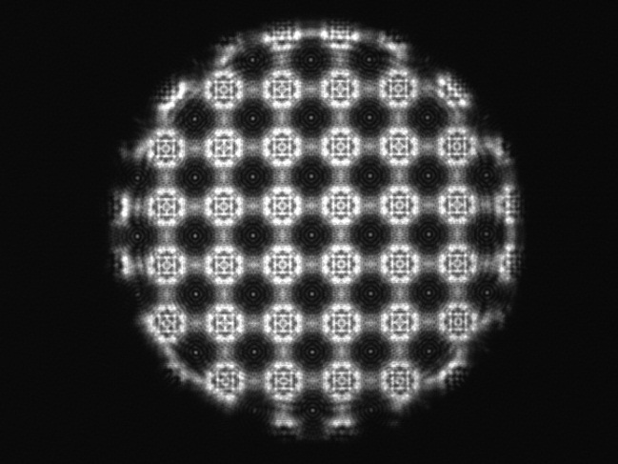
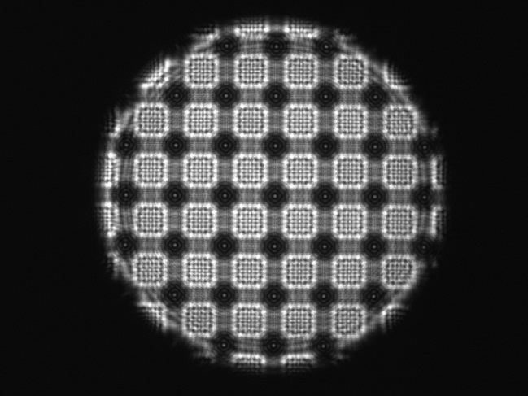
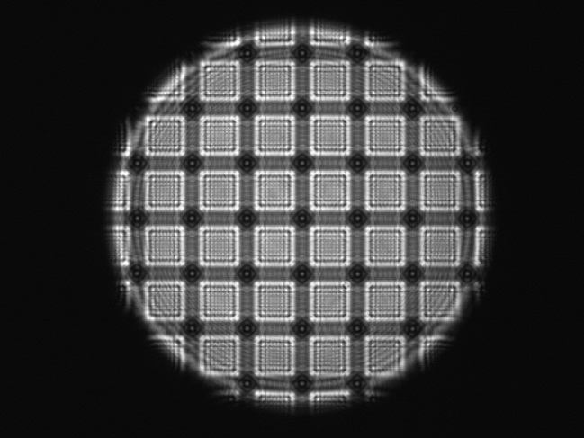
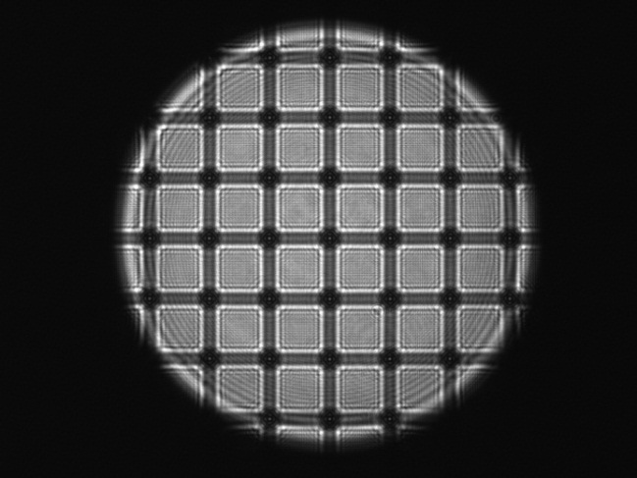
STRAIGHT LINE REFERENCE SYSTEM.
3. System Calibration
Calibration in practice – Calibration procedure
Calibration measurement performed in each measurement place
Coordinates of visible grid points measured by correlation and subpixel estimation in the SLRS system (SLRS Software)
Grid point coordinates determined in tunnel network by Laser Tracker (CCR fiducials)
Next step: Transformation of SLRS coordinates in tunnel system (using the simple / extended model)

Slide 27
STRAIGHT LINE REFERENCE SYSTEM.
3. System Calibration
Calibration in practice – Calibration results
Standard Deviations of residuals after transform:
Better results for extended model (esp. in Y)
Calibration parameters can be determined with good reproducibility
Std. Dev. | 5 Params |  | 12 Params
 | X (mm) | Y (mm) | X (mm) | Y (mm)
R1 | 0.065 | 0.082 | 0.047 | 0.043
Z1 | 0.055 | 0.085 | 0.042 | 0.041
Z2 | 0.051 | 0.082 | 0.029 | 0.038
R2 | 0.027 | 0.031 | 0.027 | 0.031

Slide 28
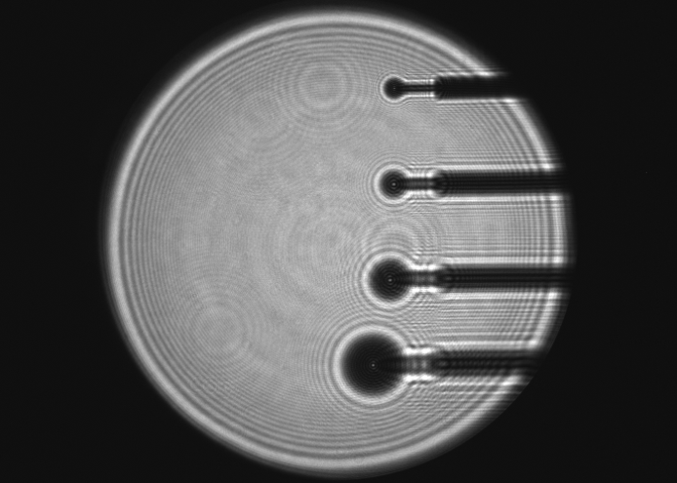
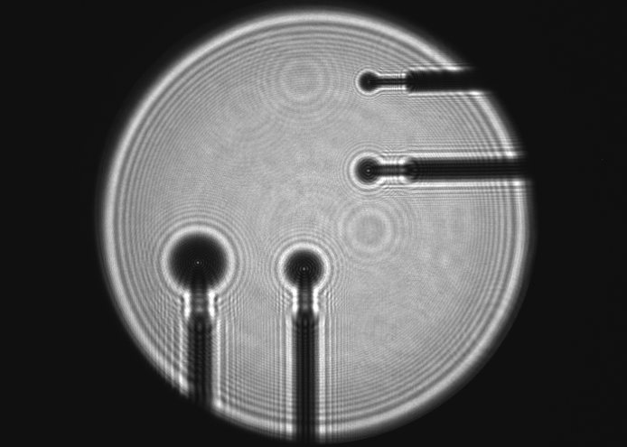
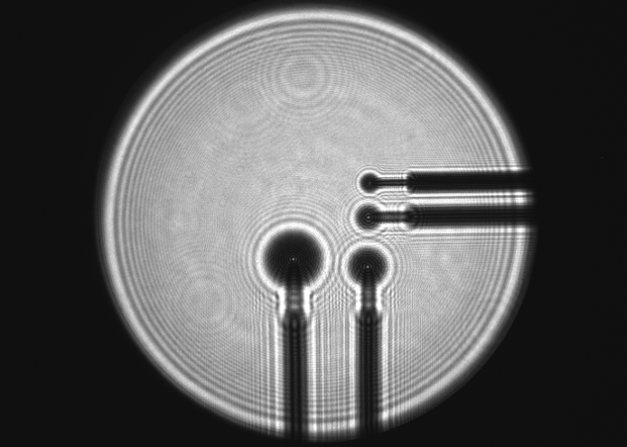
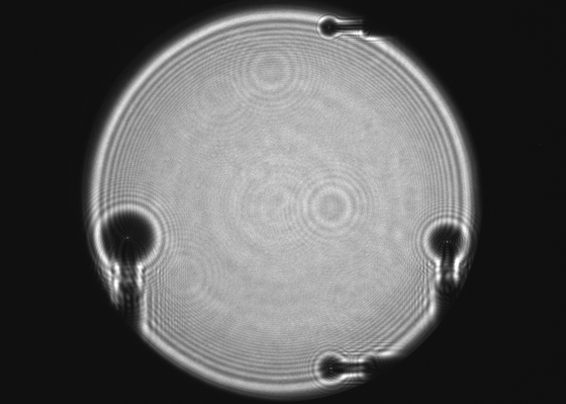
STRAIGHT LINE REFERENCE SYSTEM.
3. System Calibration
4. System Verification
4. System Verification
System is calibrated → Alignment info from SLRS and from tunnel network in the same system available
4 test setups for verification (V.1-V.4)
Alignment info from SLRS (Z1, Z2)is compared with those calculated from network coordinates
V.1
V.2
R2
X: -18.62
Y: +8.87
Z2
X: -1.89
Y: +0.12
Z1
X: -2.76
Y: +3.04
X: -14.81
Y: +22.38
R1
V.3
V.4
X: -7.91
Y: +2.88
X: -88.74
Y: +28.61
Offsets from tunnel system
X: -15.17
Y: +11.26
X: -24.39
Y: +96.37

Slide 29
STRAIGHT LINE REFERENCE SYSTEM.
4. System Verification
Verification results
Differences SLRS – tunnel network
Standard Deviations of differences: 5 params: 0.07 mm 12 params: 0.19 mm red: max. difference grey: tentative, recent data
Unexpected: Better results for simple model
Differences | 5 Params |  | 12 Params
 | X (mm) | Y (mm) | X (mm) | Y (mm)
V.1 Z1 | 0.09 | 0.02 | 0.28 | 0.00
V.1 Z2 | 0.10 | 0.17 | 0.36 | 0.13
V.2 Z1 | 0.04 | -0.05 | 0.28 | -0.06
V.2 Z2 | 0.11 | 0.14 | 0.39 | 0.09
V.3 Z1 | 0.09 | 0.03 | 0.25 | -0.11
V.3 Z2 | 0.08 | 0.18 | 0.32 | 0.06
V.4 Z1 | 0.09 | 0.01 | 0.42 | -0.06
V.4 Z2 | -0.04 | 0.07 | 0.38 | -0.10

Slide 30
STRAIGHT LINE REFERENCE SYSTEM.
4. System Verification
Discussion
Error sources
Geodetic network measurement (Laser Tracker)
Refraction
Transfer measurement of transition pieces (Laser Tracker)
Transfer measurement of calibration flanges (VSTARS / LabView)
SLRS measurement
Calibration measurements
A lot of interdependent single steps necessary
Measurement principle verified and within accuracy expectations (5 params model)

Slide 31
STRAIGHT LINE REFERENCE SYSTEM.
4. System Verification
Discussion
Extended model expected to be better
Distortion model is correct
More tests necessary
Review calibration data / algorithms
Optical distortions grow with distance → Important for 550m system
More work / investigations necessary w.r.t. extended model

Slide 32
STRAIGHT LINE REFERENCE SYSTEM.
4. System Verification
5. Outlook and Conclusions
5. Outlook and Conclusions
Adaption of the procedures for 550m system
Shown procedures are basically suitable for the final system
Refraction: Network translation + network torsion
Network-backed SLRS calibration
Scales: derived from calibration plate
Translations: affected by refraction, but no problem: Parameters not used for computation of alignment information
Rotation: affected by refraction → network torsion
Account for network torsion
Lateral levelling
As result of calibration

Slide 33
STRAIGHT LINE REFERENCE SYSTEM.
5. Outlook and Conclusions
5. Outlook and Conclusions
Adaption of the procedures for 550m system
Alternative calibration approach free from tunnel network
Calibration plate inserted in beam parallel to camera axes, no tilt
Scales from calibration plate
No translations needed
Rotation angle + Network torsion to be determined afterwards (2 point solution, inclinometer)

Slide 34
STRAIGHT LINE REFERENCE SYSTEM.
5. Outlook and Conclusions
Conclusions
Measurement principles and algorithms are verified
Test results within expected range (max diff. 0.18mm)
More investigation required w.r.t. the extended model
More investigation in alternative calibration method
Estimated achievable accuracies: 0,1 – 0,2 mm

Slide 35
STRAIGHT LINE REFERENCE SYSTEM.
That’s it.
5. Outlook and Conclusions
THANK YOU FOR YOUR ATTENTION

