Slide 1
Hydrostatic Level Systems at Fermilab and SURF
J Volk, V Shiltsev
Fermilab
A Chupyra, M Kondaurov, S Singatulin
Budker Institute of Nuclear Physics
D Fratta, A Meulemans, C Potier, H Wang
University of Wisconsin Madison

Slide 2
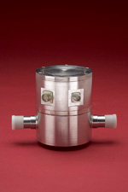
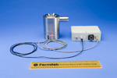
Systems
 | Location | Sensor type | Number of sensors | Separation
MINOS-2 | MINOS hall Fermilab | SAS-E | 10 | 10 m
LaFarge | North Aurora Ill | SAS | 5 | 30 m
Array C | SURF Lead South Dakota | SAS-E | 6 | 30 m
NML | NML Fermilab | SAS | 4 | Varies
MP7 | MP7 Fermilab | ULSE | 3 | 20 m
Stability test | MP8 Fermilab | SAS | 12
MT ULSE | MP8 Fermilab | ULSE | 12 | 1 m

Slide 3
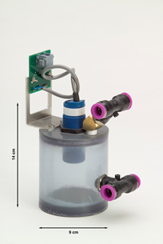
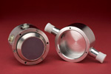
Inactive Systems
 | Location | Sensor Type | Number of sensors | separation
Array D | 4850 ft level SURF | ULSE | 12 | 7 m
B0 low beta quads | B0 Tevatron | SAS | 9 | Varies
D0 low beta quads | D0 Tevatron | SAS | 9 | Varies
Tev quads | Tevatron quads | Balluff | 204 | 30 m

Slide 4
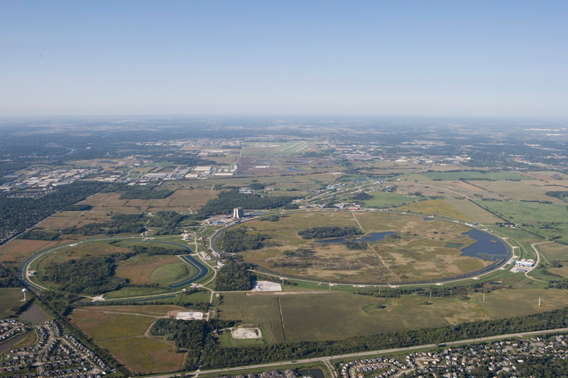
MINOS Near Detector
MINOS is the Fermilab
Neutrino oscillation
Experiment
The near detector is
Located on site
100 meters below grade

Slide 5
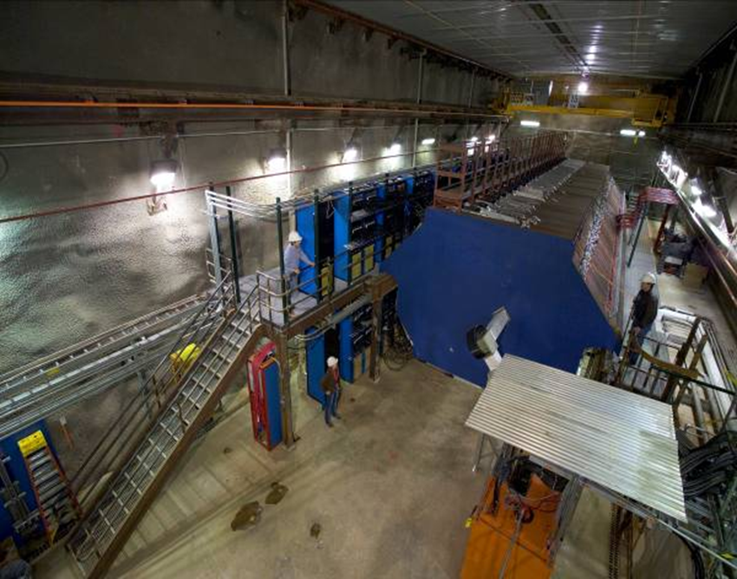
MINOS Near Detector

Slide 6
MINOS layout
Nova Cavern
under construction
North
2006
MINOS Detector
2008
2012

Slide 7
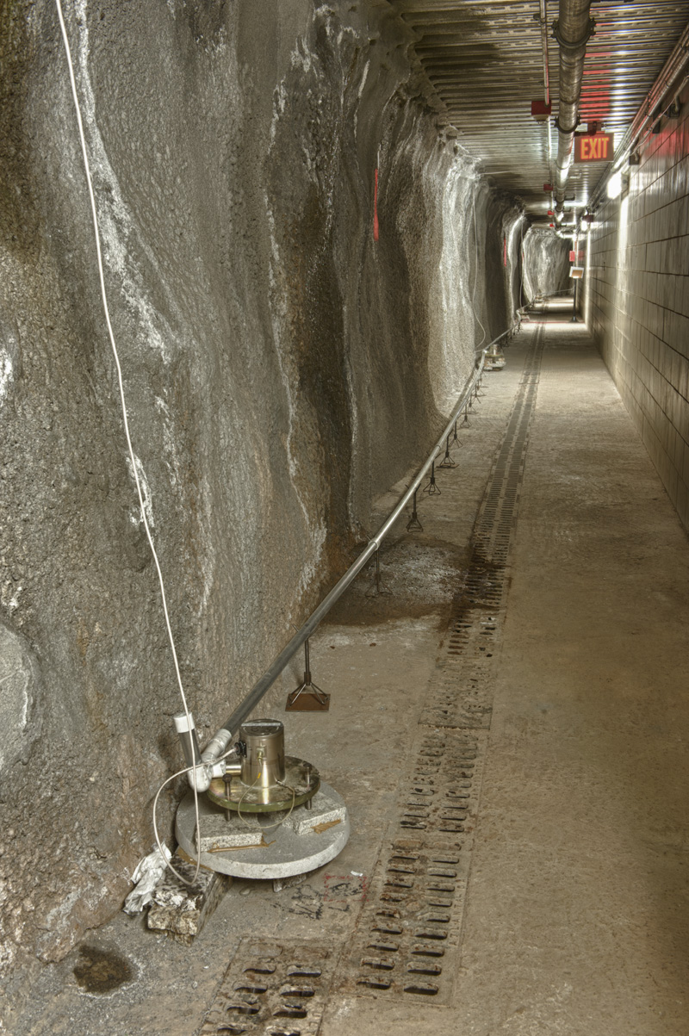
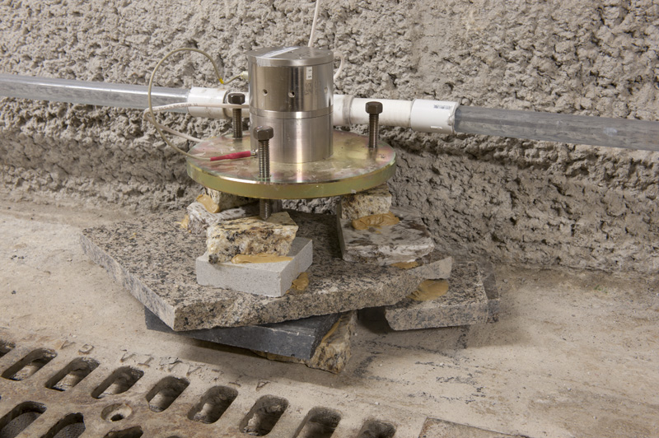
MINOS-2
Single pipe half filled system
10 m

Slide 8
Typical MINOS data August 2012
5 days of data
FFT of data
Time plot difference
Of two sensors

Slide 9
MINOS-2 Data Feb 2012 to August 2012

Slide 10
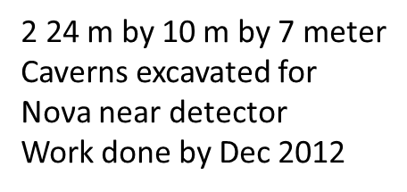
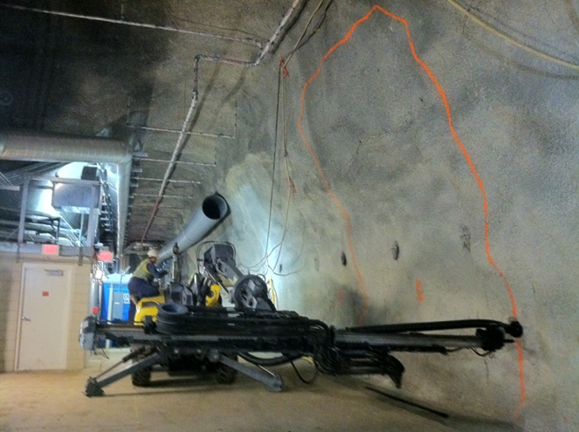
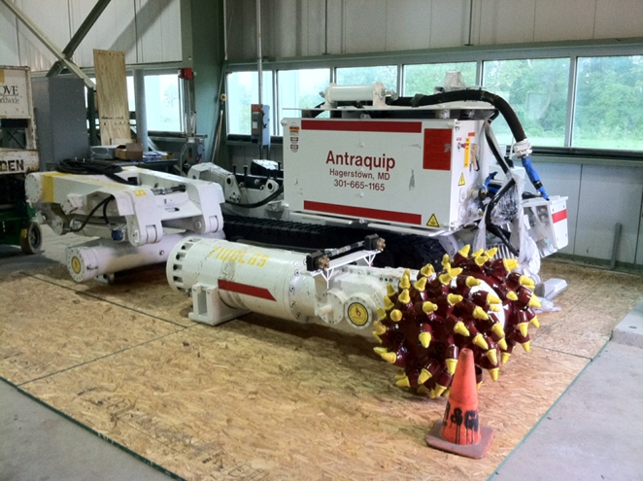
Road Header used to excavate the Noνa near detector hall extension

Slide 11
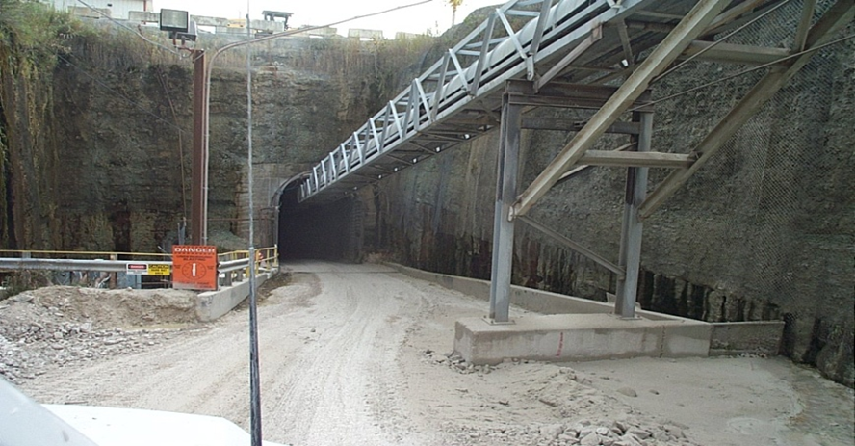
LaFarge Mine

Slide 12
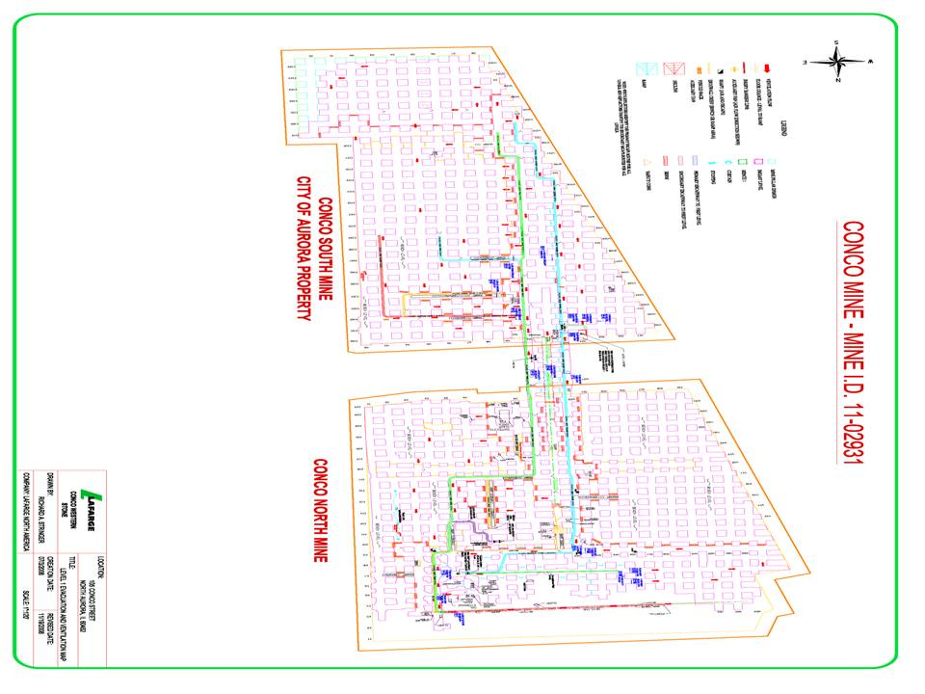
Level 1 of LaFarge Mine
34 hectares mined out Level 1
Drifts 20 meters wide by 20 meters high

Slide 13
Difference in two sensors 120 meters apart
weekend

Slide 14
Difference in two sensors 120 meters apart June 2008 to Jan 2009
Conveyor breakdown

Slide 15
Difference in two sensors 120 meters apart June 2008 to Jan 2009

Slide 16
Difference in two sensors 120 meters apart June 2008 to Jan 2009
Nov 2008

Slide 17
LaFarge East West Array
Jan 2011 to Aug 2012

Slide 18
Tohoku Earth quake March 2011
Mine blasts
Earth Quake

Slide 19
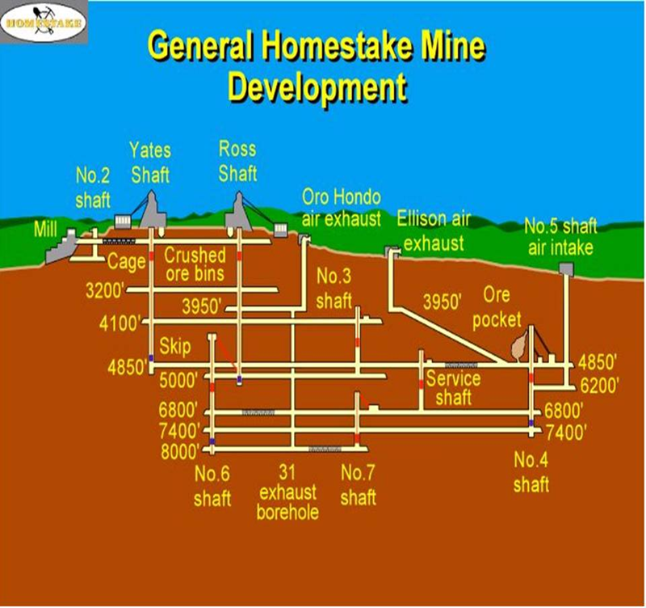
Sanford Underground Research Facility
Max water level
Current level
Holding 600 ft

Slide 20
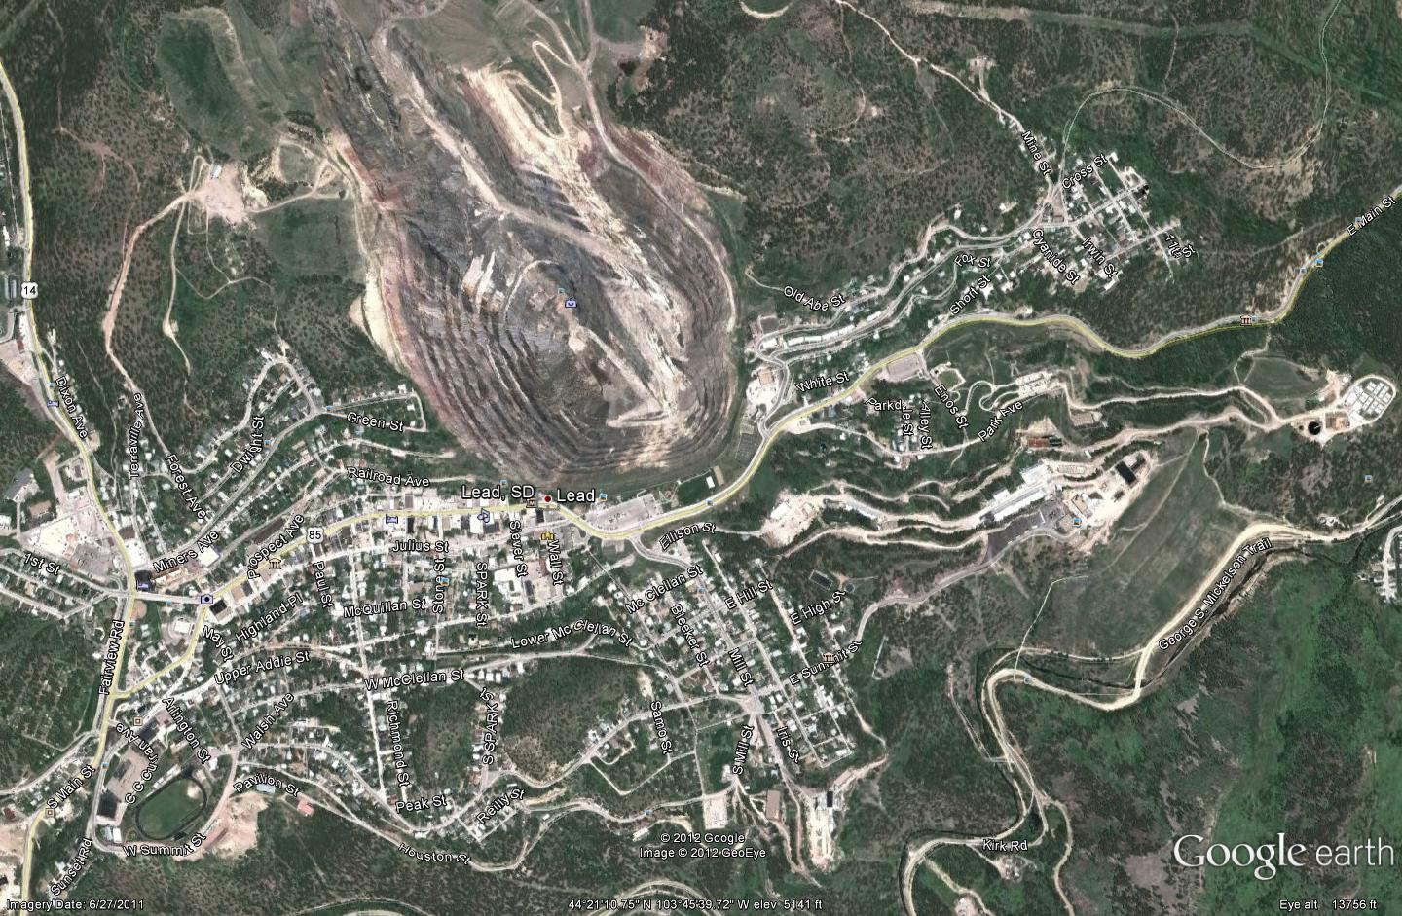
Surface view of SURF
North
Yates shaft
Ross shaft

Slide 21
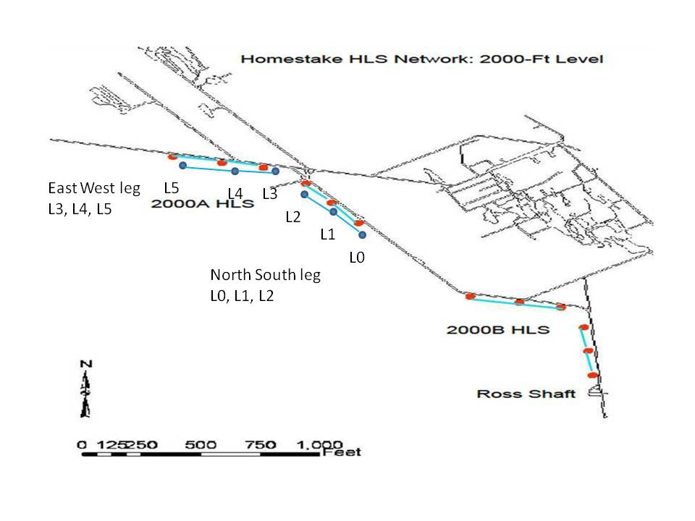
Array C layout

Slide 22
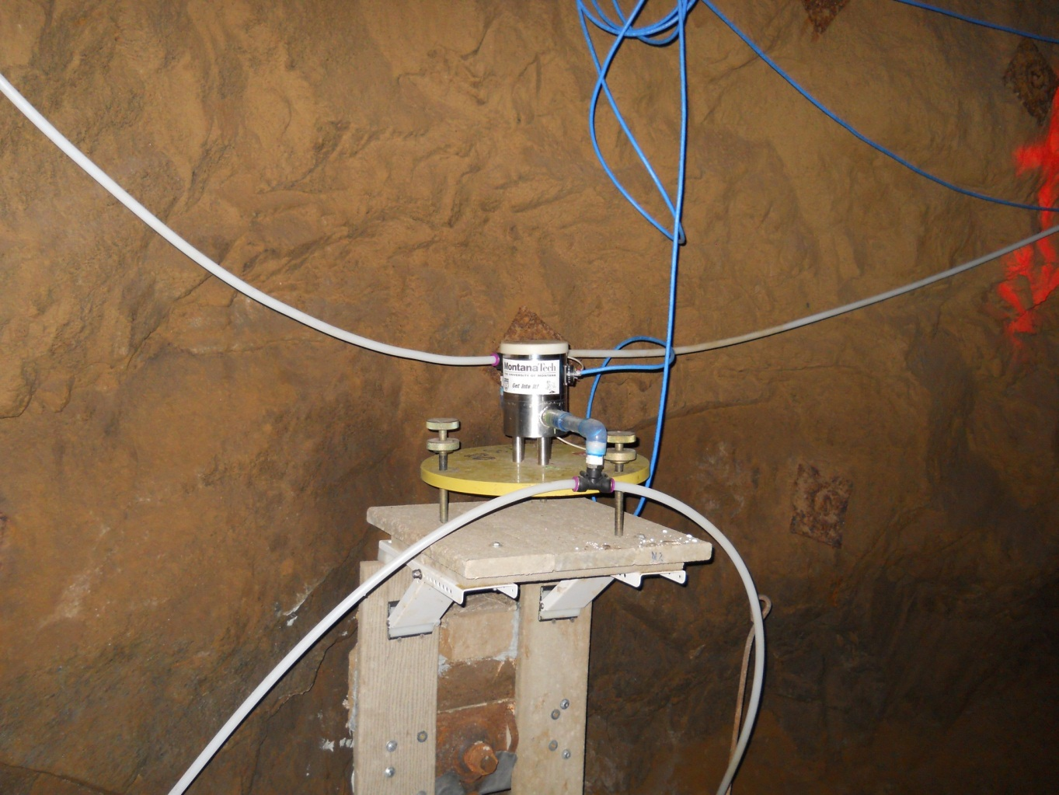
HLS at 2000 ft level on rock bolt shelf
Air line
Sensor
Water line
Rock bolt

Slide 23
Difference in two sensors
2000 ft level SURF

Slide 24
Tohoku Earth quake March 2011
Earth quake

Slide 25
Difference in two sensors 60 meters apart SURF 2000 foot level

Slide 26
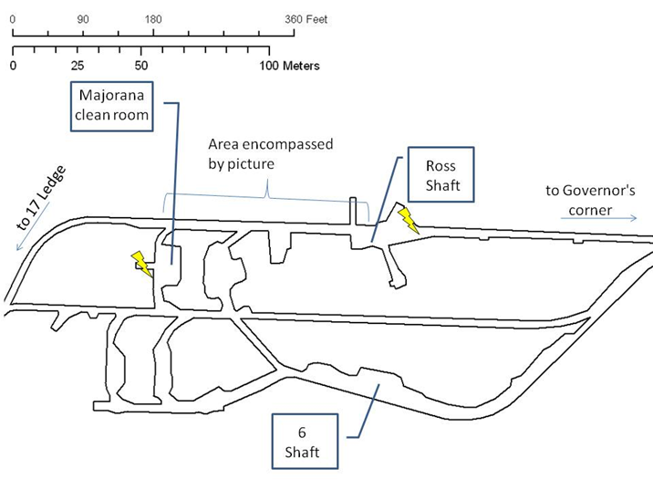
4850 ft level SURF installation

Slide 27
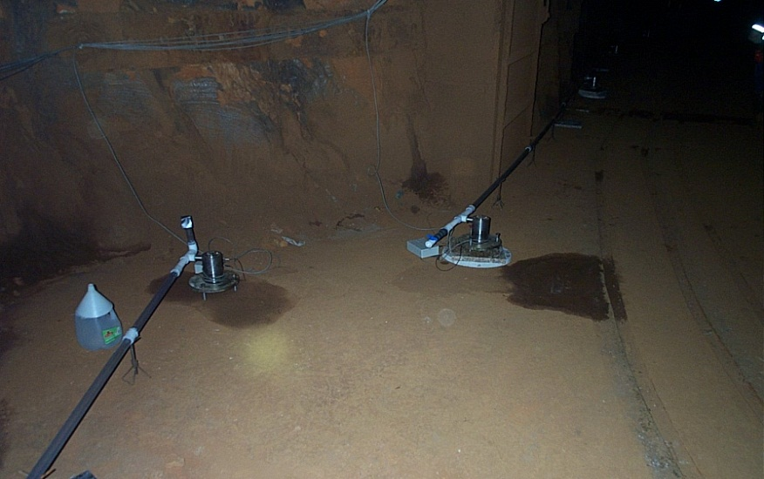
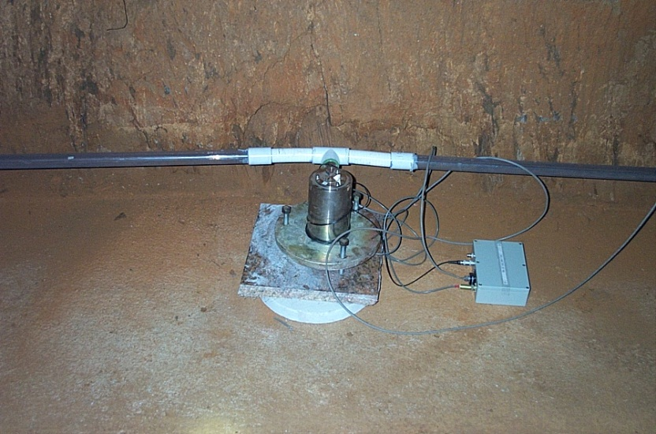
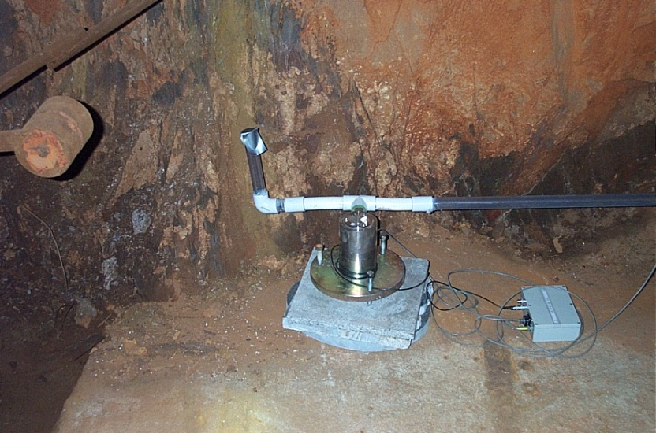
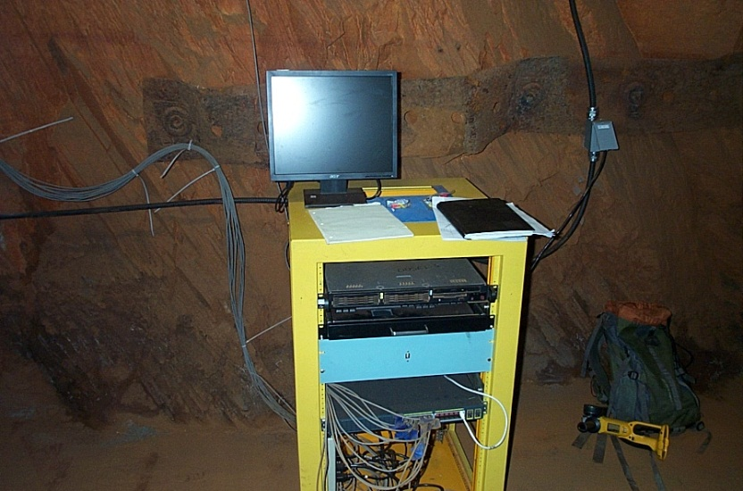
4850 ft installation SURF
Sensors 5 and 6
Sensor 9
Computer and
switch
Sensor 11

Slide 28
Difference in two sensors 4850 ft level

Slide 29
Difference in two sensors
4850 ft level SURF

Slide 30
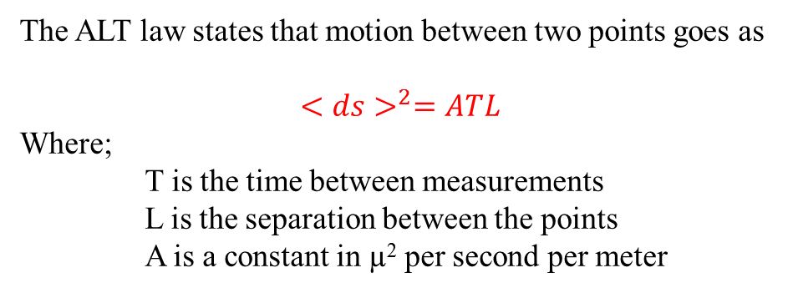
ATL law
The ALT law states that motion between two points goes as
$${<ds>}^{2}=ATL$$
Where;
T is the time between measurements
L is the separation between the points
A is a constant in µ² per second per meter
By comparing the double differences for sensors
(D1-D2)- (D2-D3)
at various time slices the A constant can be computed.
Corrections are made for constant drift of sensor such as in array C.

Slide 31
A values as a function of depth
System | Sensors | Double differences | Separation m | Depth m | Average A µ²/s/m
LaFarge mine | 4 | 3 | 30 | 110 | 1.61 10 ⁻⁵
MINOS-1 | 4 | 3 | 30 | 100 | 3.01 10 ⁻⁵
MINOS-2 | 7 | 6 | 10 | 100 | 3.91 10 ⁻⁵
Array C | 6 | 2 | 20 | 680 | 8.85 10 ⁻⁷
Array D | 12 | 8 | 7 | 1650 | 6.02 10 ⁻⁷

Slide 32
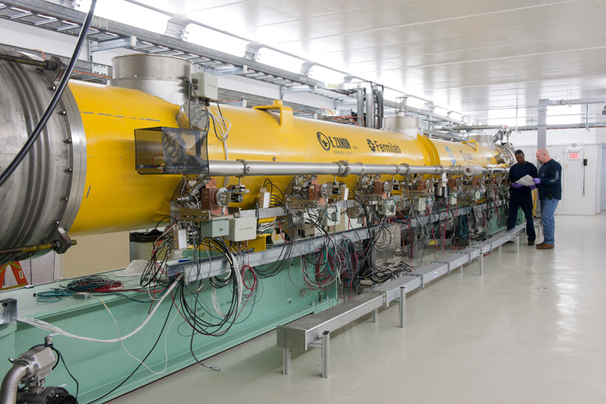
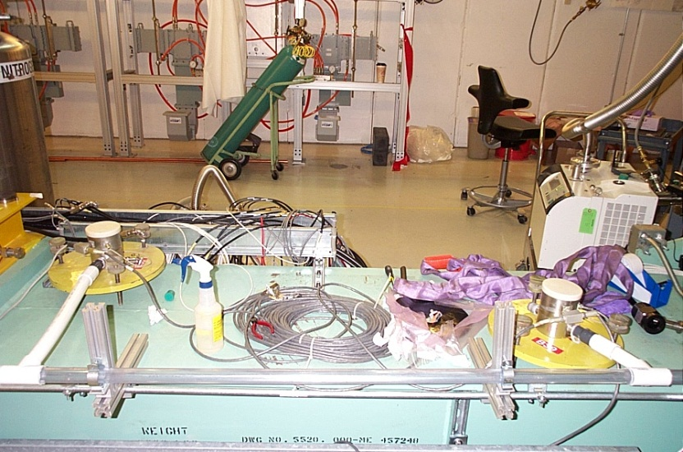
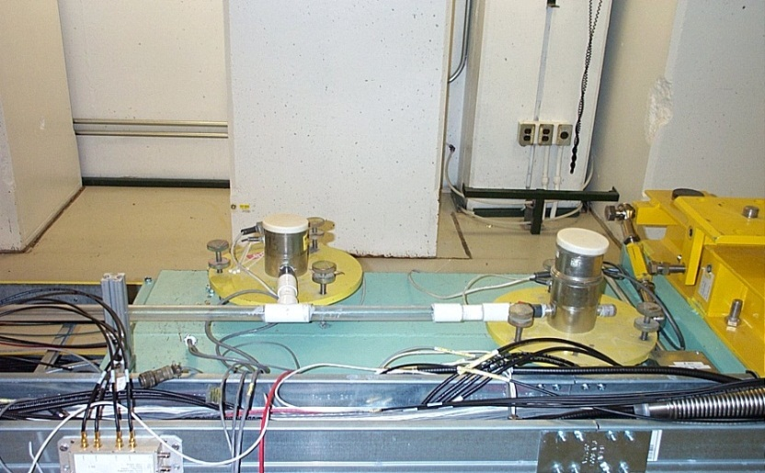
NML system for Project X

Slide 33
NML Data
L0-L1

Slide 34
Long Base Line Neutrino
LBNE
To save construction costs a the beam will be
extracted upward from the Main Injector.
There will be a hill 24 meters high to cover
the beam line.
Pillars to bed rock will be used to support the tunnel.
It is expected that the hill will settle over time.
Re use the Tevatron HLS system to monitor the
settlement soon after construction.

Slide 35
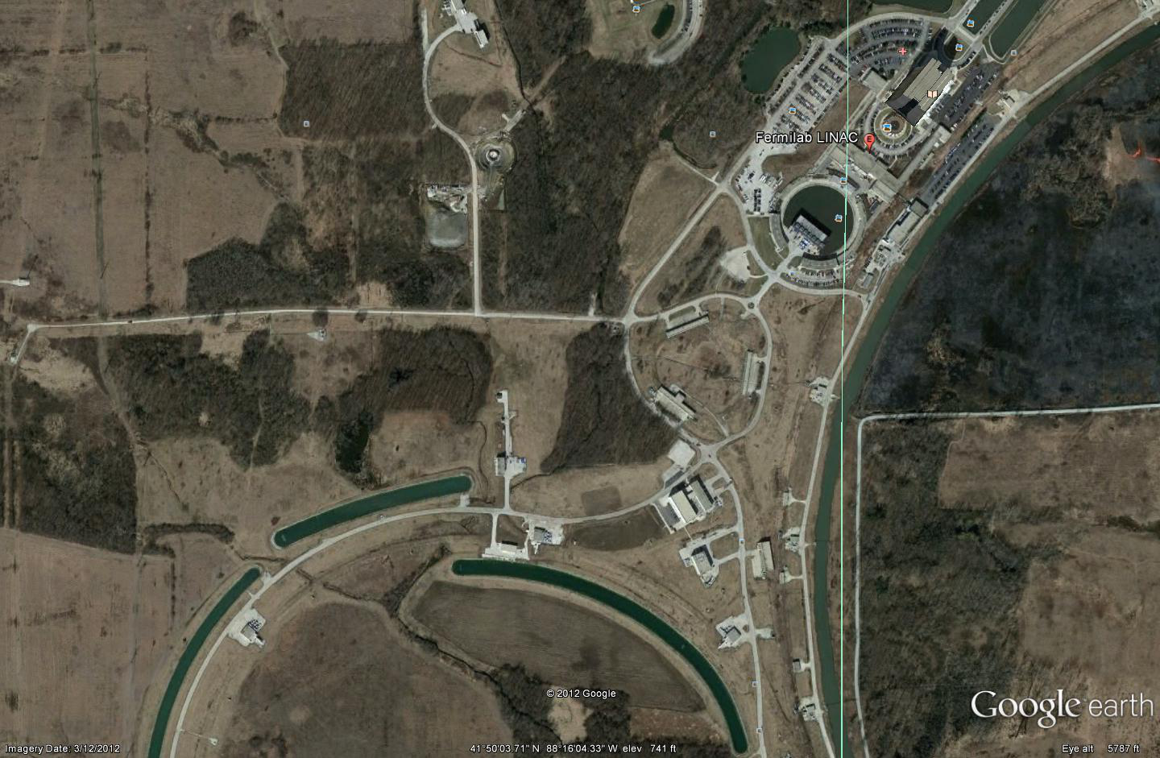
LBNE Target Hall

Slide 36
Cross section of LBNE tunnel
Ground level

Slide 37
LBNE Beam Line

Slide 38
Information
Hydrostatic Level Sensors as High Precision Ground Motion Instrumentation for Tevatron and Other Energy Frontier Accelerators
Published in JINST Fall of 2011 available at
http://dx.doi.org/10.1088/1748-0221/7/01/P01004
And on ArvicX
http://arxiv.org/abs/1205.1777
HLS data are available at
https://dbweb3.fnal.gov:8443/ilc/ILCGroundApp.py/index

Slide 39
Conclusions
There are 7 active HLS setups
at Fermilab and DUSEL
All are highly reliable and
have taken data for years
Most used to monitor slow ground
motion
Able to detect tides, earth quakes,
and the shifting of earth

Slide 40
Thanks any
Questions?

