Slide 1
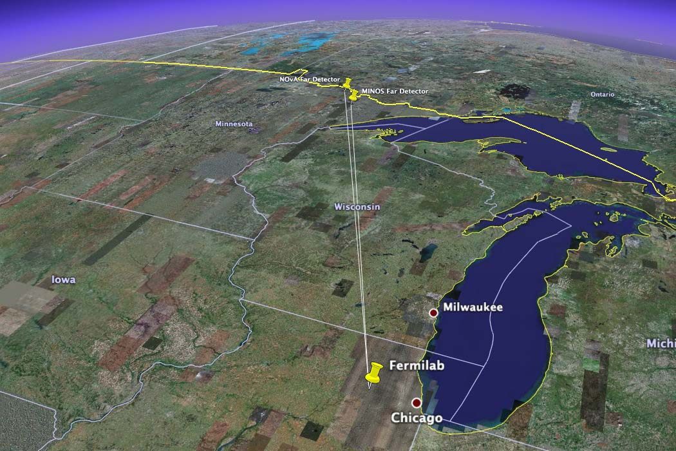
The NOνA
Experiment
Survey of the NOvA Far Detector
Babatunde O’Sheg Oshinowo
Horst Friedsam
Fermi National Accelerator Laboratory
Batavia, Illinois
Gary Feldman
Harvard University

Slide 2
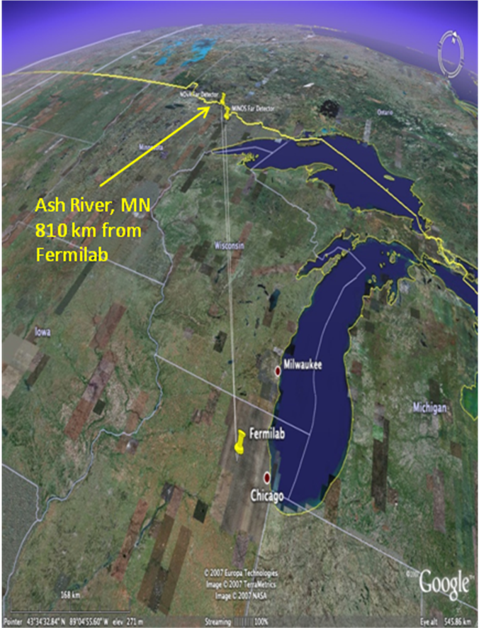
The NOvA Experiment
NOνA: NuMI Off-Axis ν_{e} Appearance Experiment
ν_{e} = electron neutrino
North America's most advanced neutrino experiment
NOvA is a second-generation experiment on the NuMI beamline
The NOvA project also includes accelerator upgrades to bring the NuMI beam intensity from 400 kW to 700 kW
Uses two detectors to look for changes in the neutrino beam as it travels:
Far Detector in Ash River, Minnesota
Near Detector at Fermilab
Run for 6 years : 2015 – 2021

Slide 3
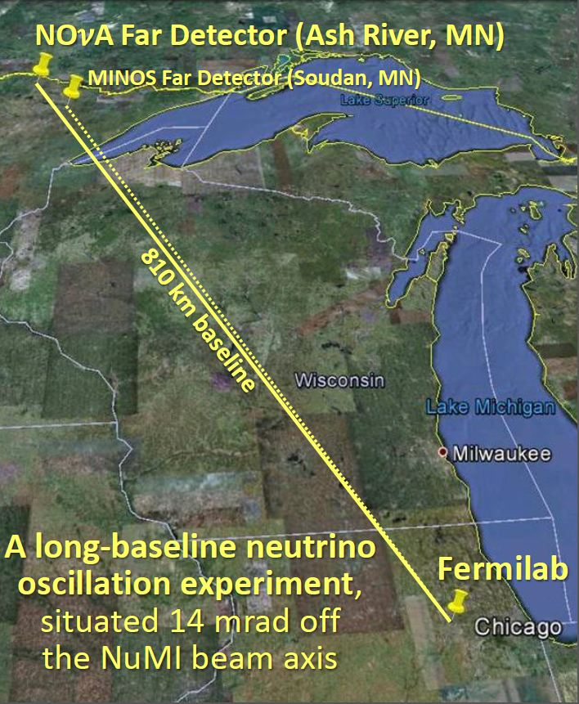
Far Detector Site
This site is at 810 km from Fermilab, about 11 km off-axis
The Ash River site is the farthest available site from Fermilab in the U.S. along the NuMI beamline

Slide 4
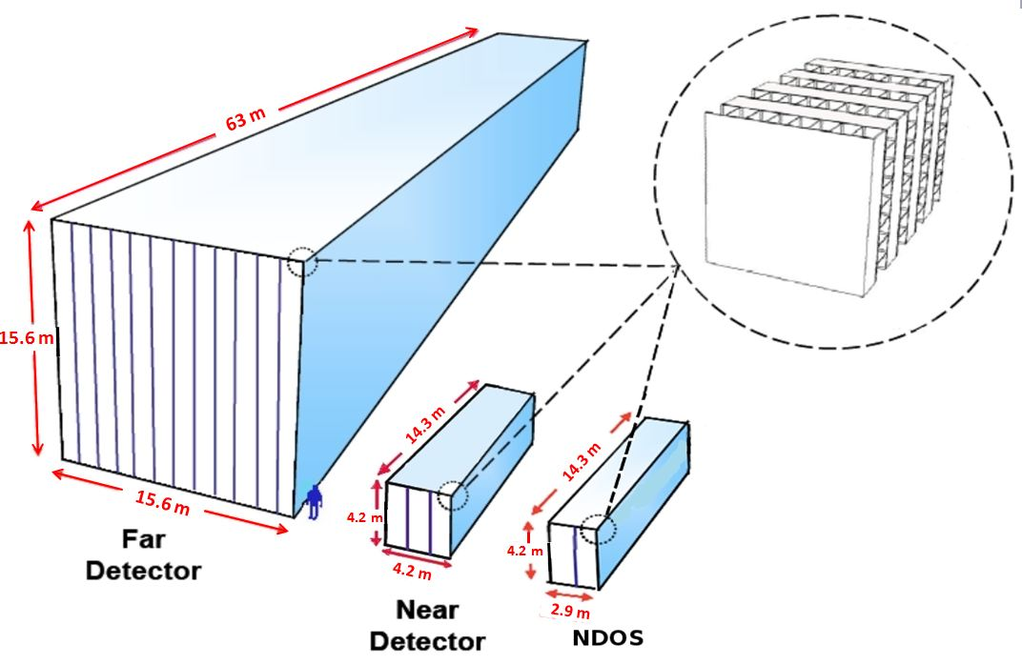
NOvA Detectors
NOvA Detectors:
• A 14 kTon Far Detector sited 14 mrad
off the NuMI beam axis at a distance
of 810 km at a distance of 11 km
(Assembly underway at Ash River)
• A 0.3 kTon Near Detector identical
to the far detector sited 14 mrad
off the NuMI beam axis at a distance
of 1 km from the NuMI Target
(Begin installation Spring 2013)
• An 84 Ton NDOS (Near Detector On
the Surface) identical to the Near
Detector sited on the surface 107 mrad
off the NuMI beam axis in the NOvA
Near Detector Surface Building at
Fermilab (IWAA2010; Completed and
running since November 2010)

Slide 5
NOvA Detector
PVC Extrusion
The NOvA detectors are constructed from planes of PVC modules
Extrusions have a cellular structure, with 16 isolated cells per extrusion
A module of 32 cells is constructed from two 16-cell PVC extrusions glued together
L = 15.6 m for Far Detector
L = 4.2 m for Near Detector
Modules are capped by a Manifold and an End Plate/Cap to contain the liquid scintillator
Twelve (12) extrusion modules get placed side by side on a flat assembly table to form one plane of the Far Detector
PVC Module
= Module Plane

Slide 6
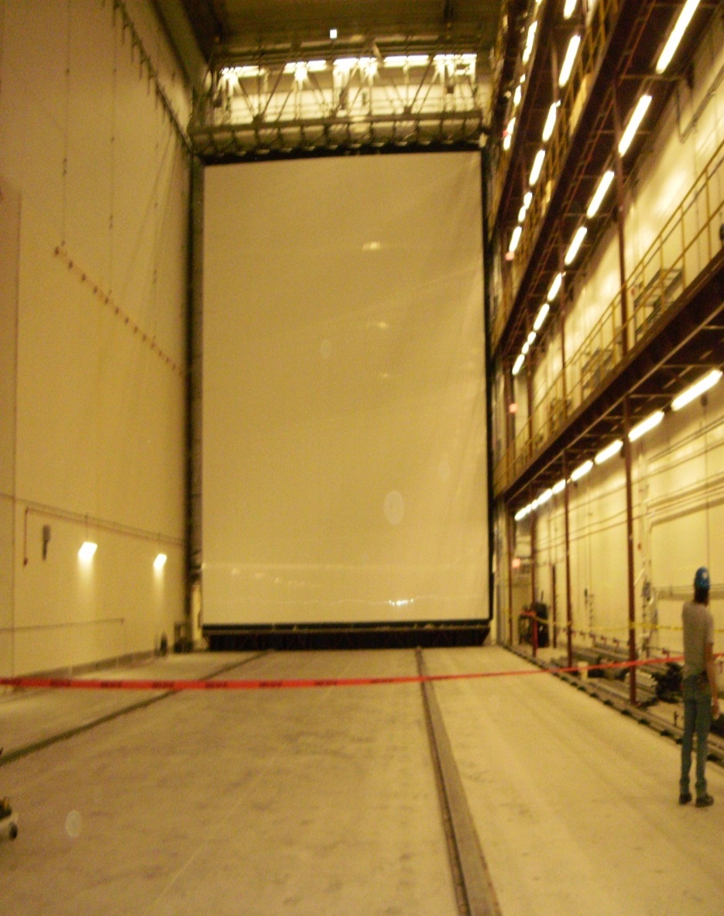
NOvA Block
32 planes make 1 NOvA block
5 blocks make 1 super block
NOvA block (B) configuration is as follows:
B = v₀h₁v₂h₃v₄h₅v₆h₇v₈h₉v₁₀ ….
v₂₀h₂₁v₂₂h₂₃v₂₄h₂₅v₂₆h₂₇v₂₈h₂₉v₃₀h₃₁
where v are planes of vertical modules and
h are planes of horizontal modules
number of planes is counted from 0 (Upstream) to 31 (Downstream)
Block assembly starts from plane (or layer) 31 (h₃₁) on the assembly table and ends with plane 0 (v₀)

Slide 7
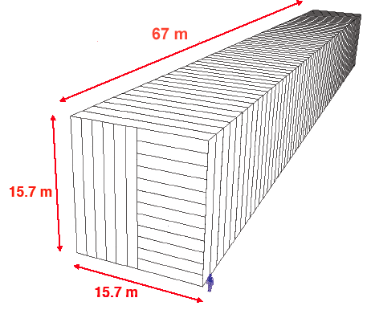
Far Detector
The Far Detector (FD) consists of 29 blocks:
FD → B₀B₁B₂B₃B₄ B₅……..B₂₅B₂₆B₂₇B₂₈B₂₈
where the number of blocks is counted 0 (Upstream) to 28 (Downstream)
The NOvA Far Detector consists of
928 (15.6 m square) planes
Twelve (12) modules make up a plane,
and the planes alternate in having their
long dimension vertical and horizontal
63 m
15.6 m
O’Sheg
15.6 m

Slide 8
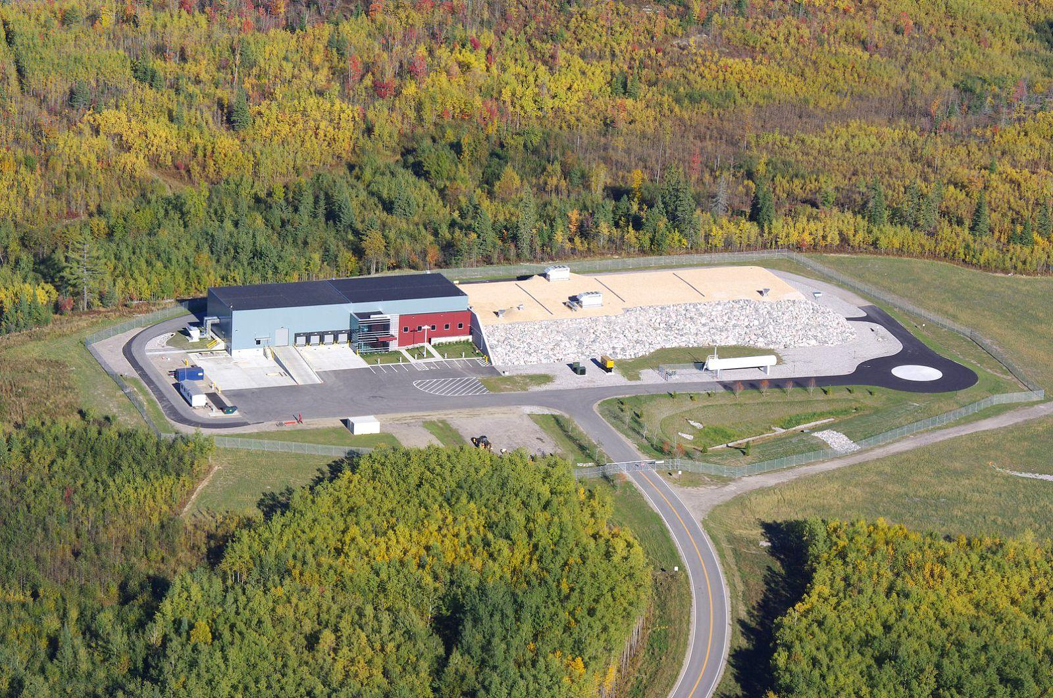
NOvA Far Detector Building
The NOvA Far Detector building contains
The Detector Hall at the south end
Block Assembly area at the north end

Slide 9
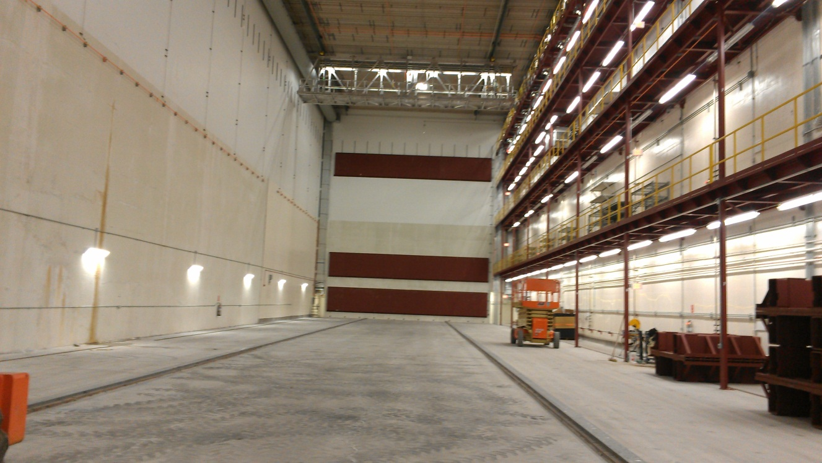
The NOvA Detector Hall
The Detector Hall will house all the 29 NOvA blocks.
The first block will rest on the Book End on the South Wall
The Pivoter Rails are used by the Pivoter to transport each block to the far south end
Book End
Pivoter Rails

Slide 10
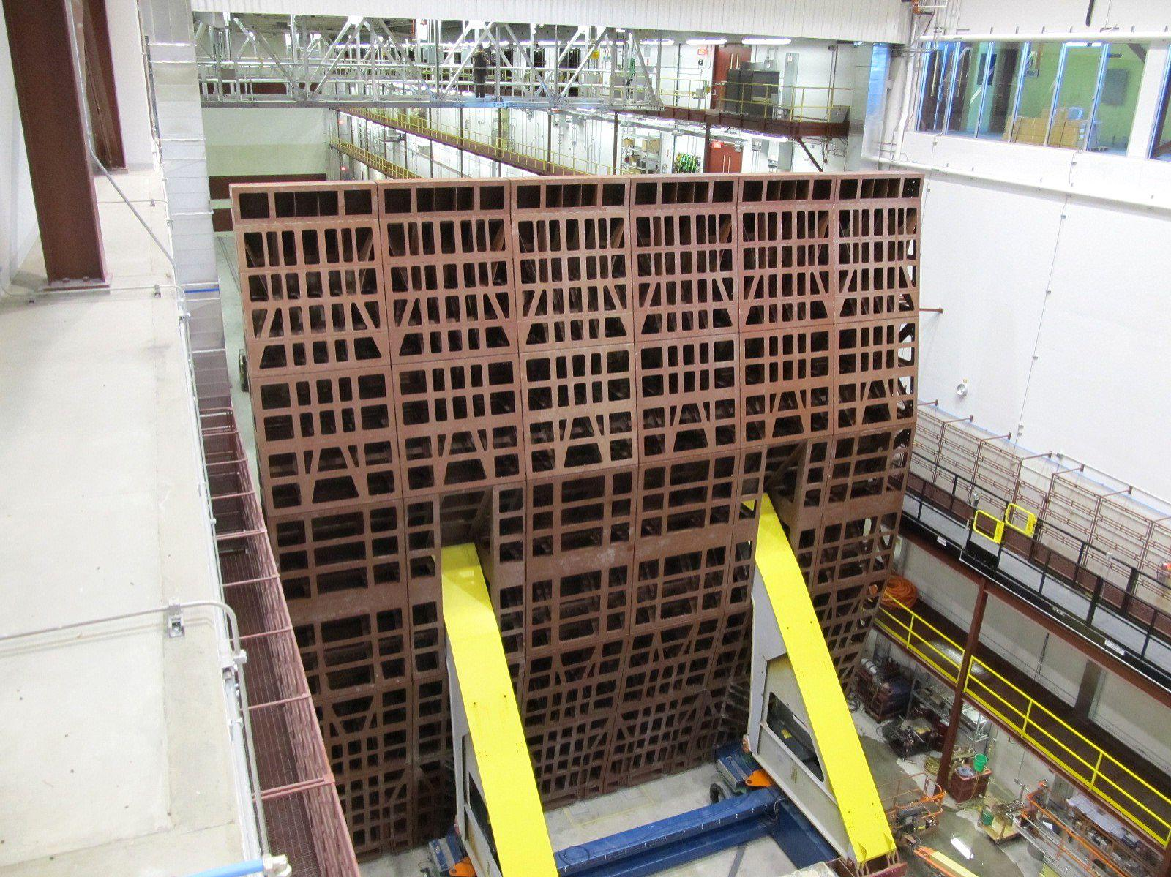
Block Assembly Area
The Block Assembly area houses the NOvA Block Pivoter machine and the Pivoter Assembly Table that is used to build all the blocks
All block are assembled on the assembly table while it is in its horizontal position
Assembly
Table
(Vertical
Position)
Pivoter

Slide 11
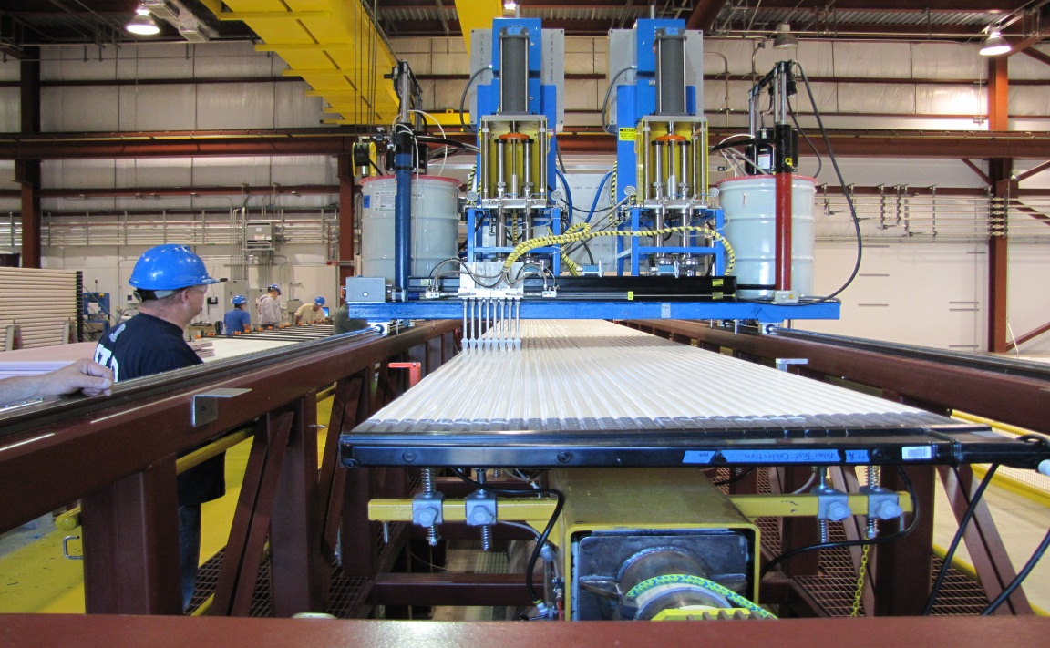
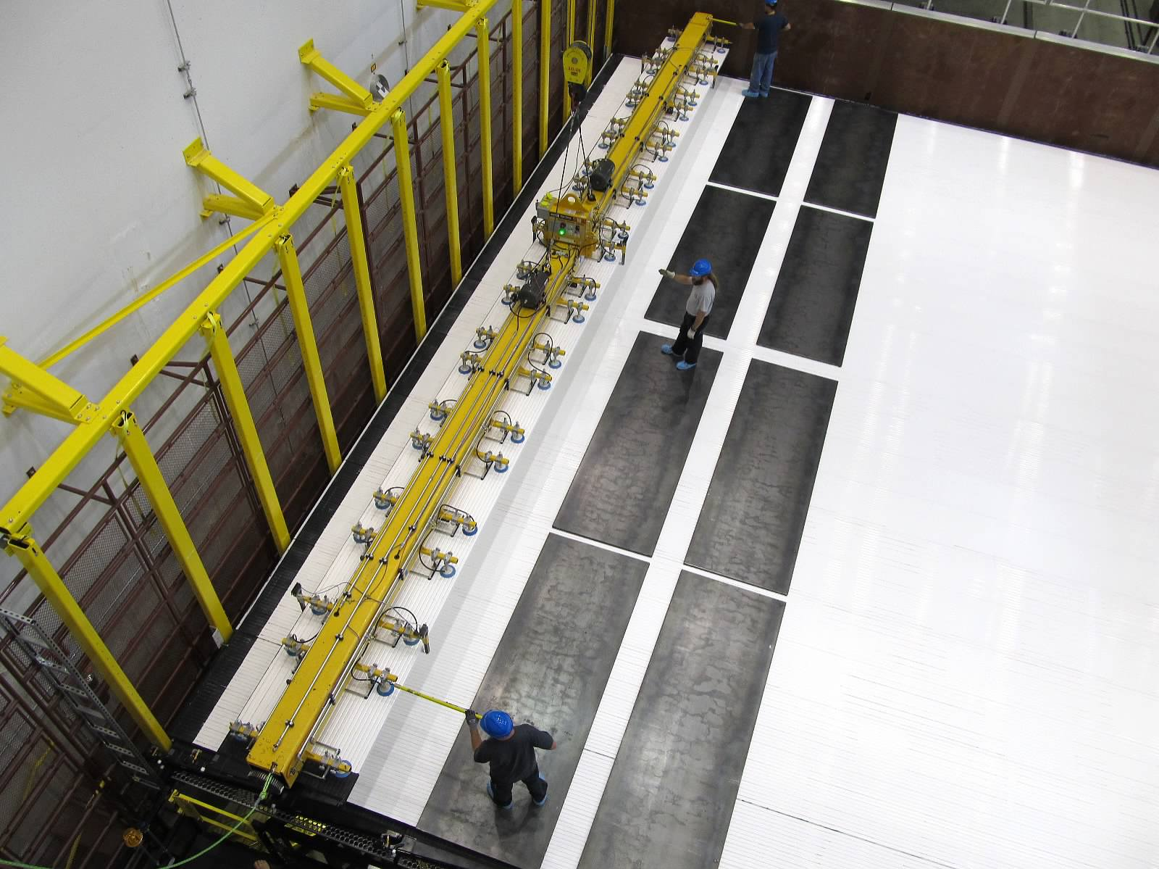
Block Assembly
Installation of the NOvA Far Detector
is underway
The Block assembly starts at the glue machine where glue is applied to the extrusion modules
The modules are then transported to the assembly table by the lifting fixture to be glued to the next modules to form planes (layers)
Alignment Posts attached to the assembly table are used as guides for the module installation
The block is assembled in its horizontal position starting first with the downstream end
Each plane is scanned with the Laser Scanner once the plane is completed
Alignment
Posts

Slide 12
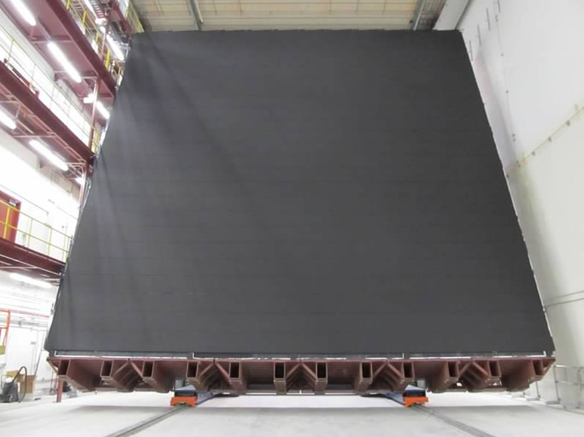
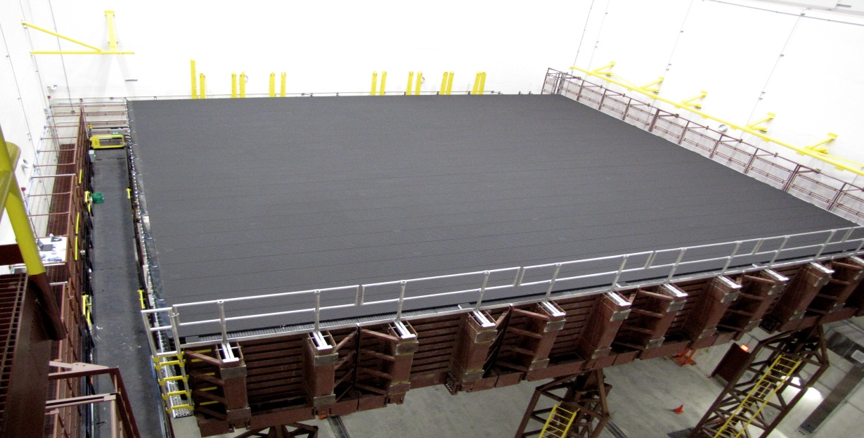
Block Assembly
Once a block has been finished, the last module is painted black, the block Pivoter is used to move the block into place within the detector building to the south wall
It then pivots 90° to set the block upright to the ideal location
The block will then be filled with
Liquid Scintillator

Slide 13
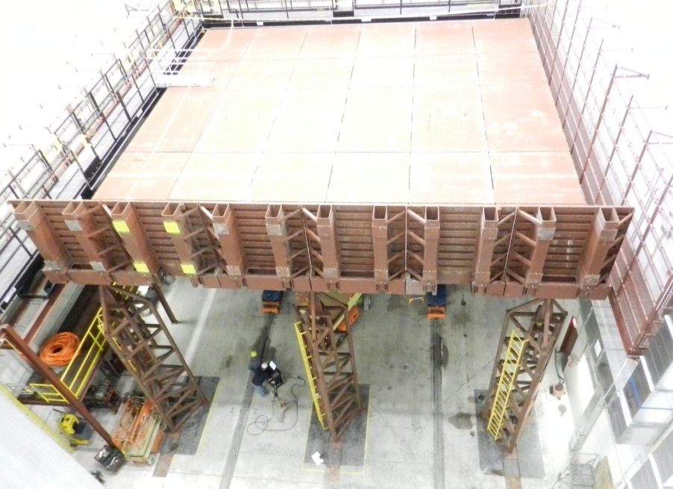
Survey of NOvA Far Detector
Purpose:
Establish a surface geodetic control network
Establish a precision horizontal and
vertical control network in the Far Detector
building
Floor Flatness measurements
Book End as-built measurements
Pivoter Rail measurements
Pivoter Table Flatness measurements
Block measurements
Book End
Pivoter
Table
Pivoter Rails

Slide 14
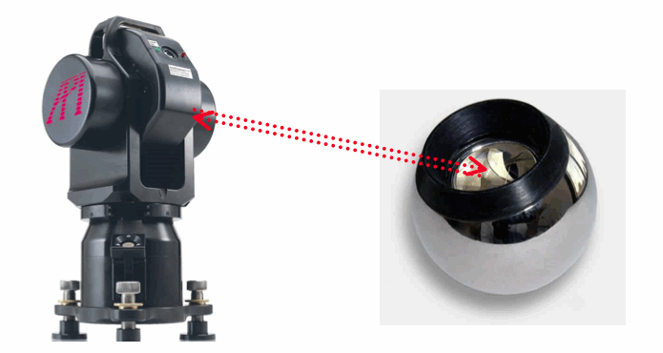
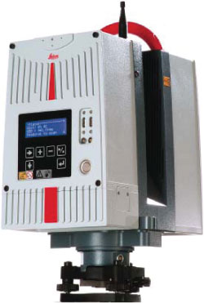
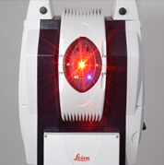
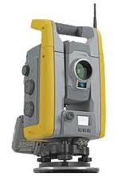
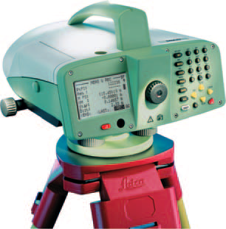
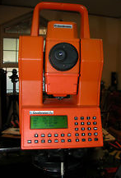
Survey Methodology
All Survey for the Far Detector was done with:
An API Tracker3 Laser Tracker and Spatial
AnalyzerTM
Leica Absolute Tracker AT401
Trimble S6 Total Station
Geodimeter Total Station
Leica DNA03 Digital level
Trimble GPS Receivers
Leica HDS6100 Laser Scanner system
and its associated software

Slide 15
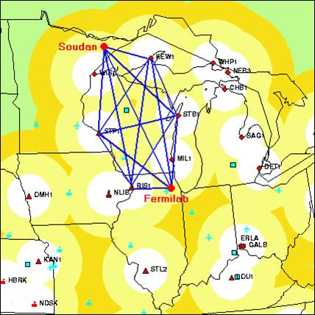
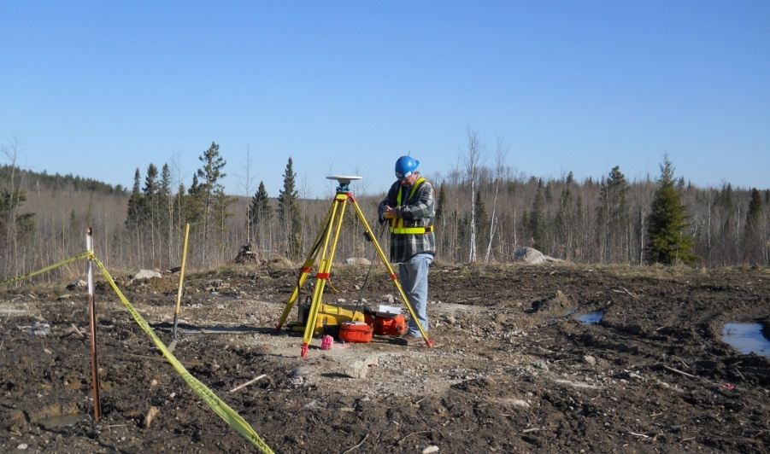
Far Detector Surface Geodetic Network
Established a GPS surface geodetic control network that connects points at Fermilab to Ash River
Tie surface control network to the National Geodetic Survey’s Continuously Operating Reference Stations (CORS) precision geodetic network
All long baselines are known to better than 1 cm horizontally and vertically
The network based on the NAD83 (North American Datum 1983) for horizontal datum and the NAVD88 (North American Vertical Datum 1983) for vertical datum
Ash River

Slide 16
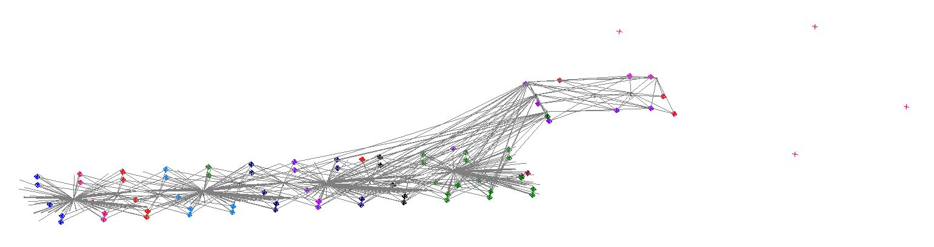
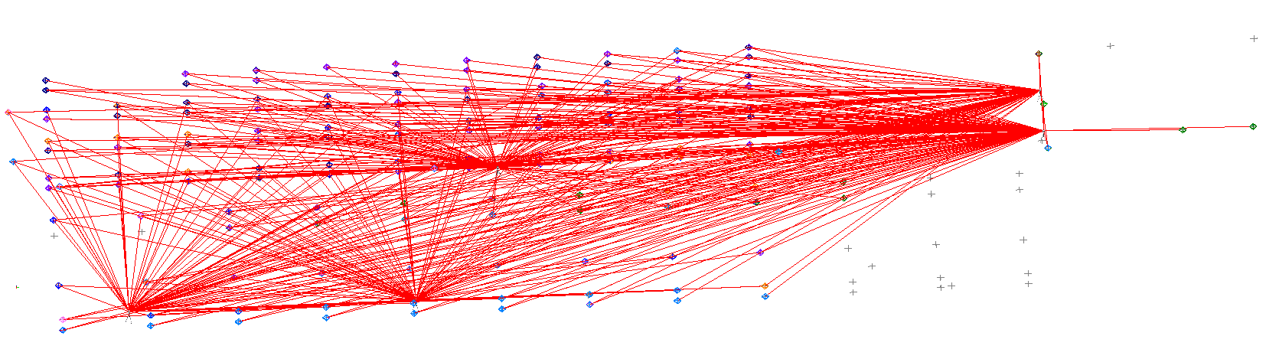
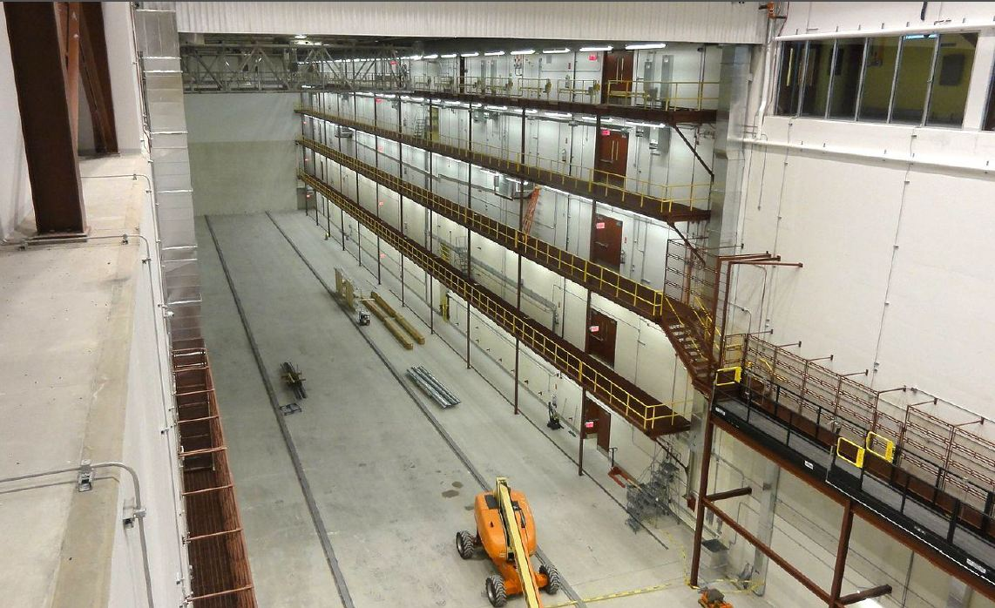
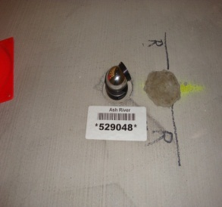
Far Detector Building Control Network
Surface Network
Lower Level
Upper Level
Established a primary precision control network
in the Far Detector building for positioning
the Far Detector using the API Laser Tracker
A secondary control network on the four levels
of the west wall of the Detector hall using the
Leica AT401
Primary network consists of 49 floor monuments
and 36 wall monuments in the Far Detector Hall and
the Detector assembly area. Secondary network
consists of 44 wall monuments
Tied the new building control network to the
surface network using the Geodimeter Total
Station
Floor
Monument

Slide 17
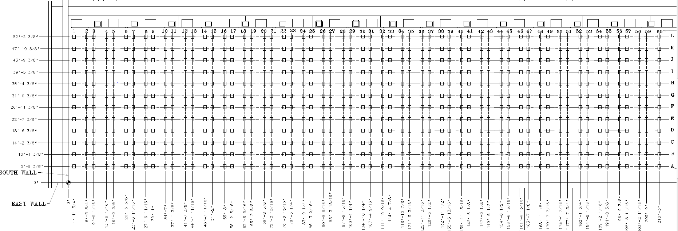
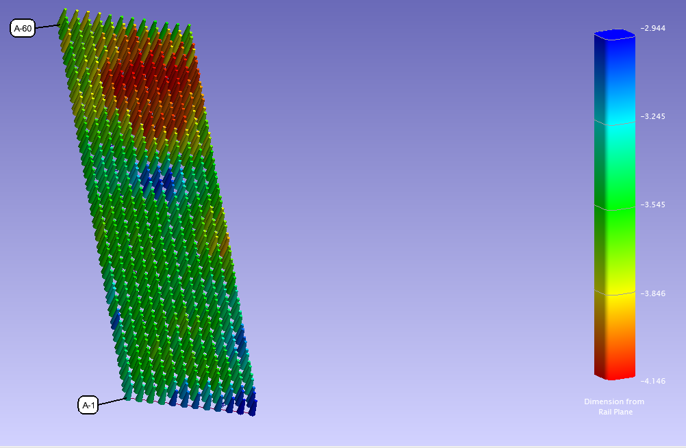
Floor Flatness Measurements
Floor Flatness measurements using 720 grid points in the Detector Hall
made with the Laser Tracker
These measurement results will be used for shimming the Pivoter Table pallets that the blocks sit on

Slide 18
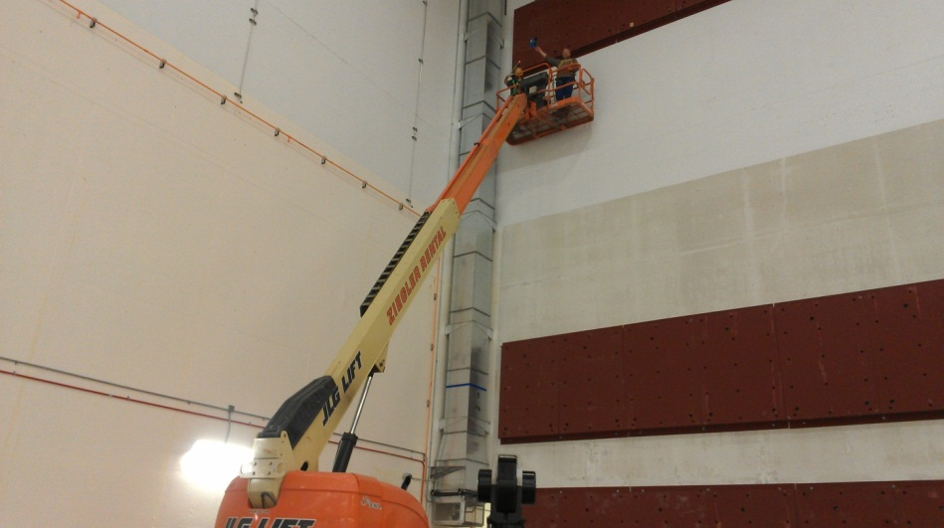
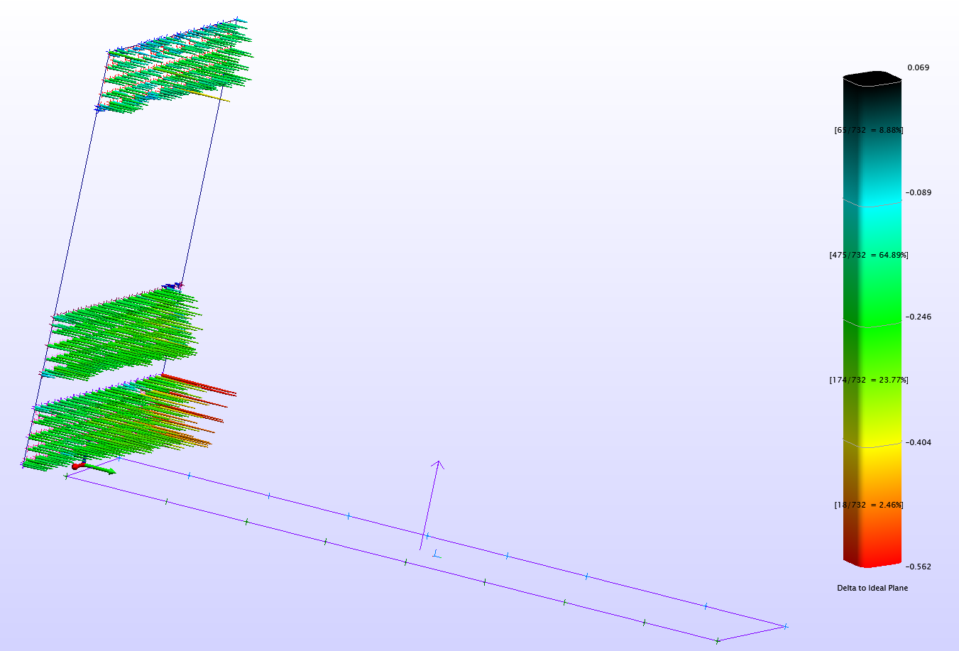
Book End As-Built Measurements
The surface of the three sections of the Book End on the South Wall were measured with the Laser Tracker
Deltas from the ideal plane defined by the Top Book End was reported to use for possible adjustments
Pivoter Rail Plane

Slide 19
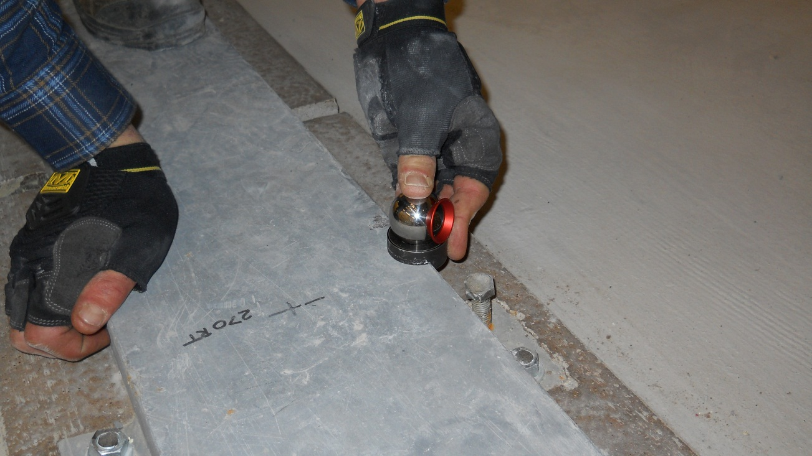
Pivoter Rail Measurements
The surfaces of the two Pivoter Rails were mapped with the API Laser Tracker
A plane fitted to the Pivoter Rails measurements was used to define the NOvA Far Detector Building Local Coordinate System

Slide 20
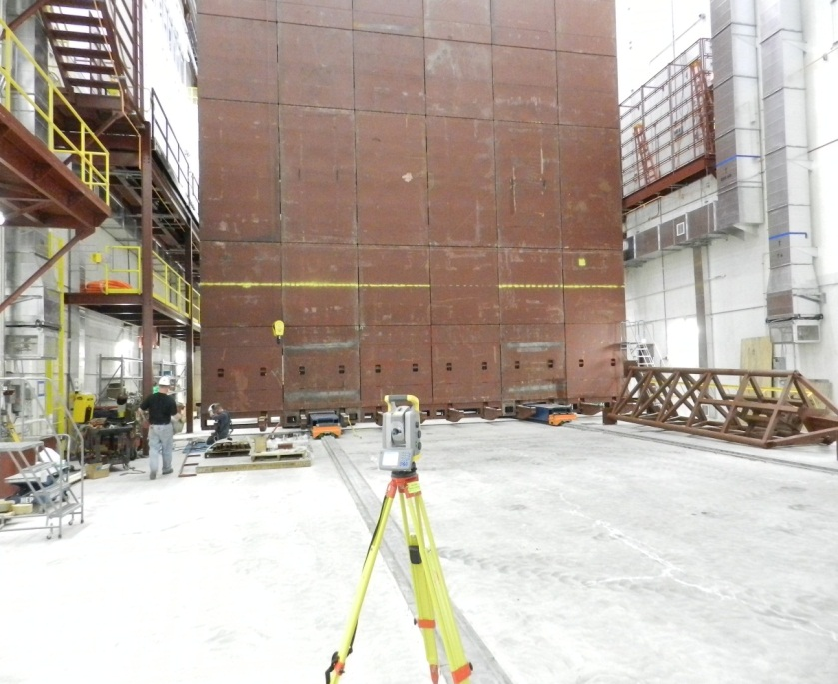
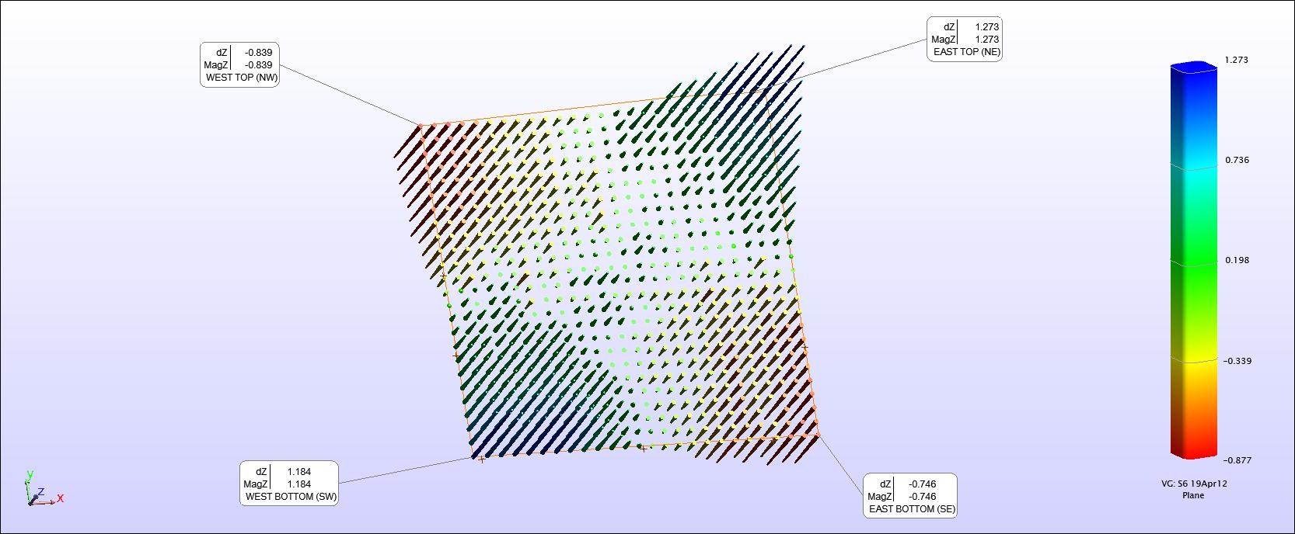
Pivoter Table Survey
The surface of the Pivoter Table was first measured with the Trimble S6 Total Station using 24” x 24” (61 cm x 61 cm) grids
Measurement of the Table Top was made with the Table in the vertical position

Slide 21
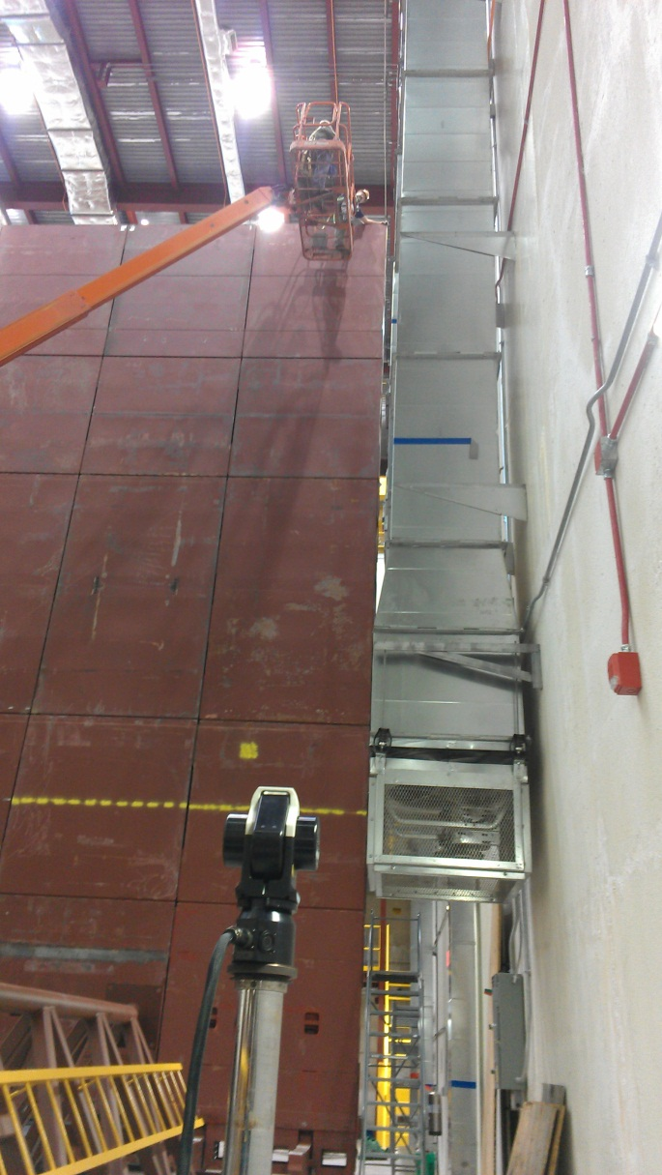
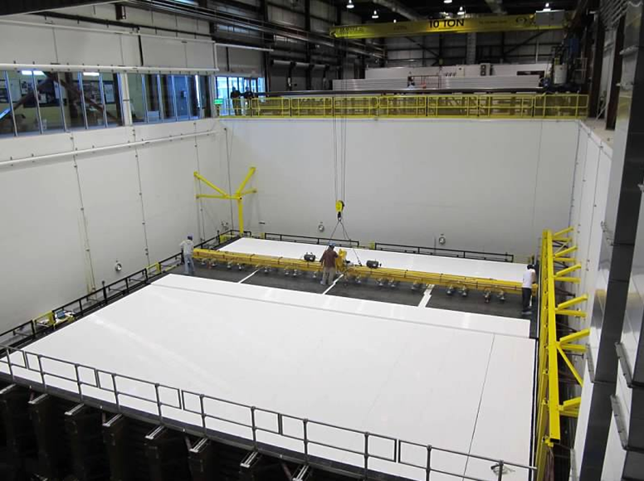
Pivoter Table Survey
Flatness measurement of the east side of the Pivoter Table was made using the Laser Tracker with the Table in the vertical position
Measurements were made at spots where the alignment posts were installed
Alignment Posts

Slide 22
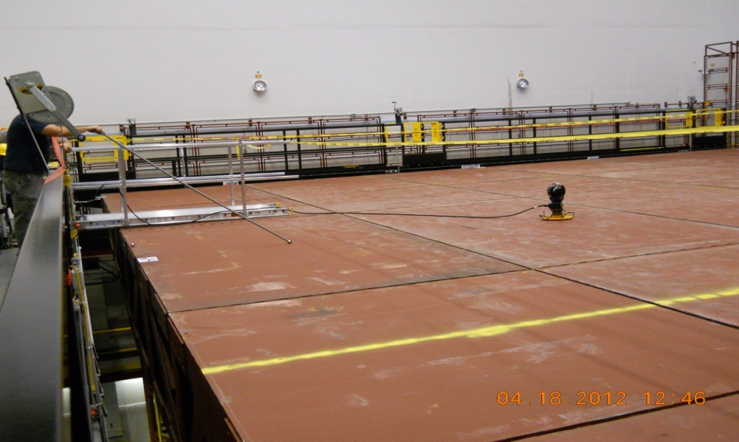
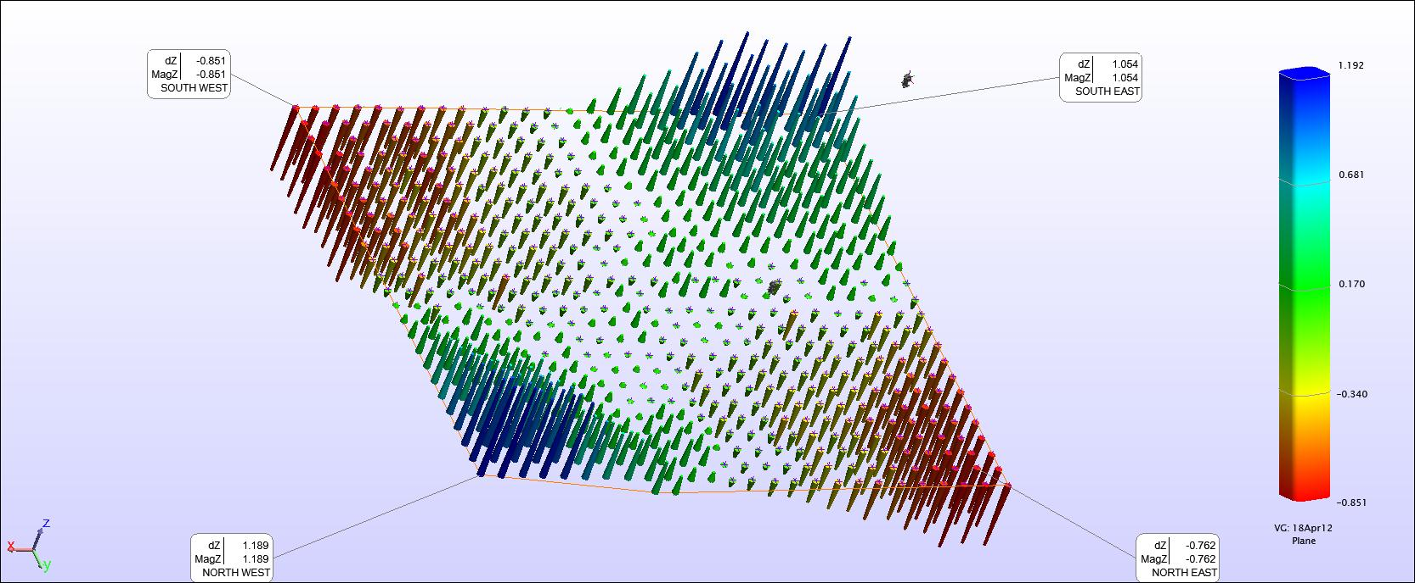
Pivoter Table Survey
The surface of the Pivoter Table was measured with the Laser Tracker using 24” x 24” (61 cm x 61 cm) grids
Measurement of the Table Top was made with the Table in the horizontal position
Based on these measurements, the Table surface was shimmed accordingly and covered with plywood

Slide 23
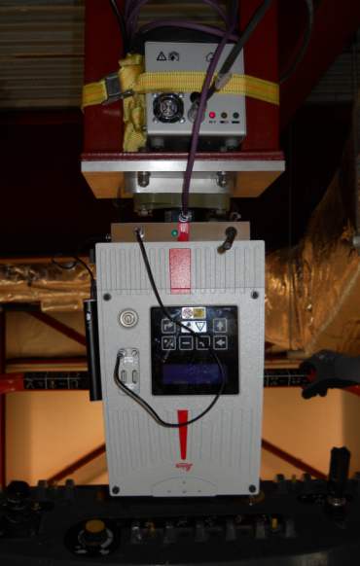
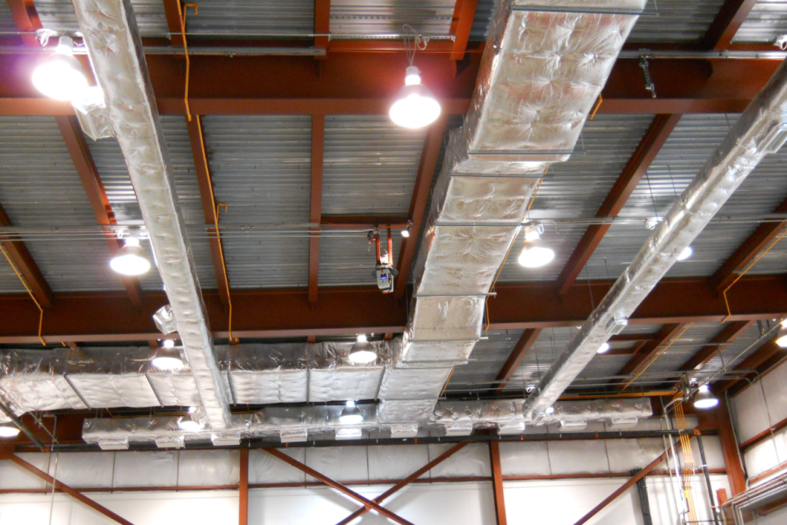
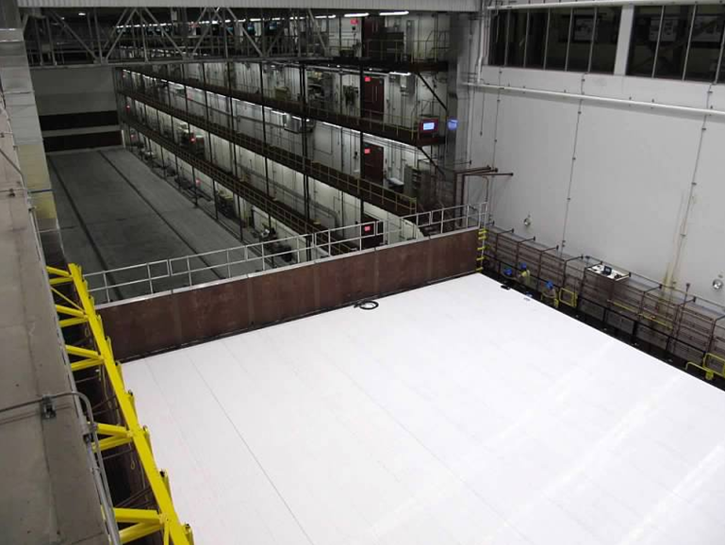
NOvA Block Plane Measurements
Laser Scanner
The surface of each of the 32 planes of
the NOvA Block is scanned with the Laser
Scanner located on the ceiling inverted
directly above the Pivoter Assembly Table
(See next presentation by Horst Friedsam)
Overall Block Survey Tolerance:
Relative 2 mm (Horizontal) edge to edge;
Relative 0.75 mm or better (Vertical)
between adjacent pieces
Angular tolerance of ± 2 mm/15.6 m
= ± 0.13 mrad
Block on
Pivoter
Table

Slide 24

What’s Next?
The first block, Block 0, was completed on
September 5, 2012
Block 0 was tilted to its vertical position on
September 10, 2012 and moved to the
Detector Hall south wall Book End
Installation of Block 1 is underway
After Block 1 is completed and moved to
the Detector Hall, the first two blocks will
be filled with Liquid Scintillator
The blocks will be surveyed before and
after filling with Liquid Scintillator using the
Laser Tracker at the lower level and Trimble
S6 at the higher level
28 more blocks to go!

Slide 25

Status NOvA Far Detector
The first super block is scheduled to be
completed by the end of the year
The Far Detector is scheduled to begin
taking data in 2013
Data taking will continue as the detector
is completed in spring of 2014
The NOvA experiment will run for six year : 2015 – 2021

Slide 26
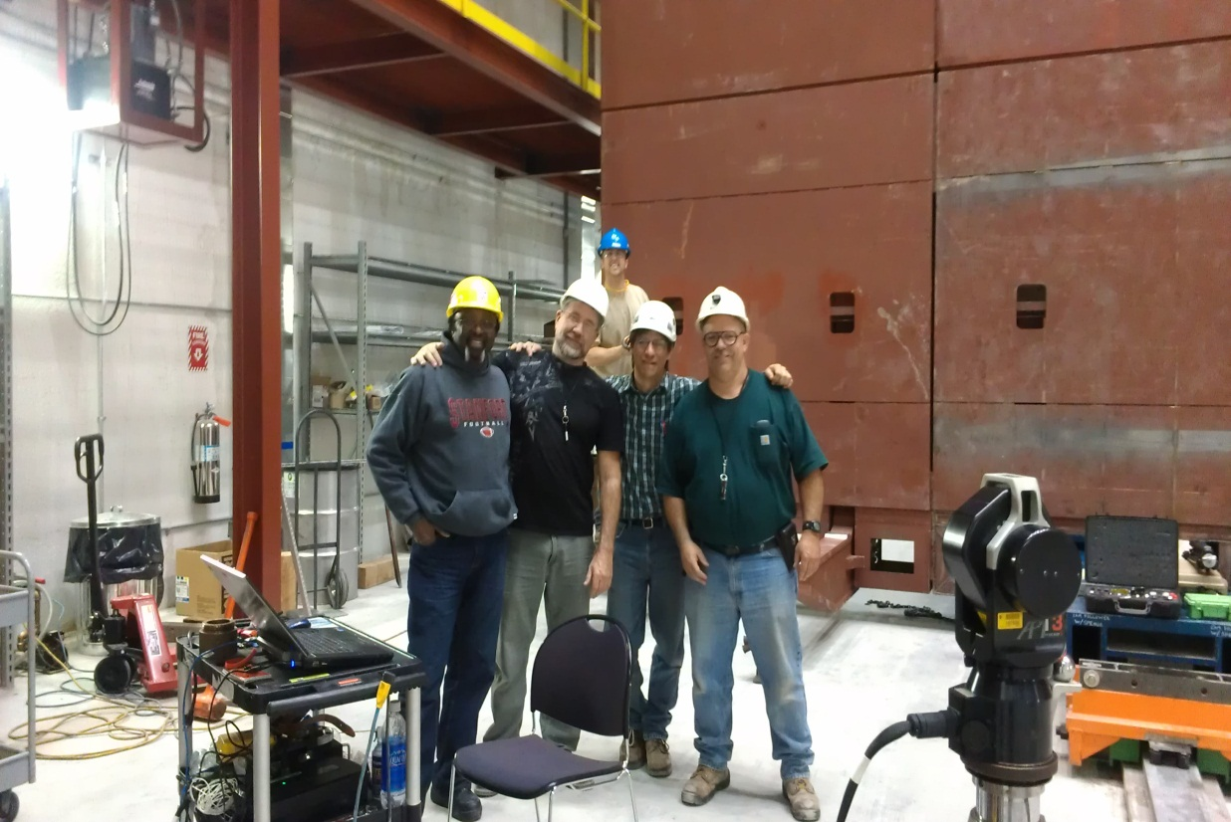
Acknowledgment
I would like to thank
Alignment and Metrology Department members
who participated in the NOvA Far Detector
survey
Dr. Pat Lukens, Dr. Ting Miao and David Pushka
- NOvA Collaboration
Questions?

