Slide 1
The ESRF Upgrade Programme Prototype Slab
D. Martin

Slide 2
The ESRF Upgrade Programme Prototype Slab
The ESRF Upgrade program
Tolerances for the experimental hall slab
Slab design
Implementation
The EX2 Prototype slab measurements

Slide 3
The ESRF Upgrade Program
The 286M€ Upgrade will focus
on five highlight areas:
Nano-science and nanotechnology
Pump-and-probe experiments and time-resolved science
Science at extreme conditions
Structural and functional biology and soft matter
X-ray imaging
X-rays are an ideal tool to study nano-objects, as X-ray wavelengths are perfectly matched to this length scale.

Slide 4
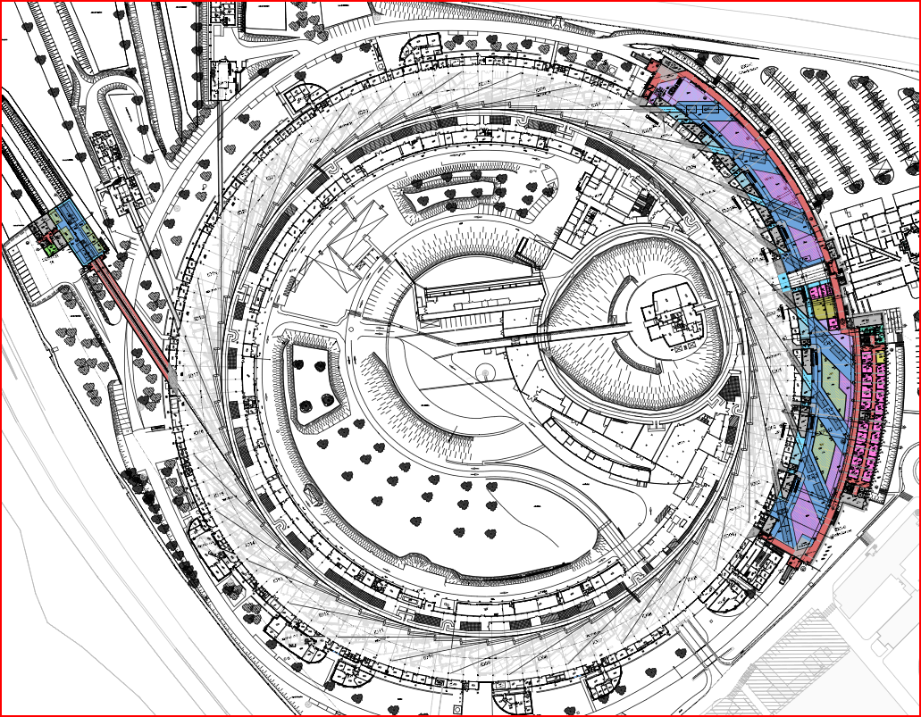
The ESRF Upgrade Program
ID16
EX2

Slide 5
Long Synchrotron Radiation Beamlines
Long beamlines can be compared to a microscope. The principal measure of merit is spatial resolution.

Slide 6
Long Beamlines
At the ESRF p=150 m and q=0.05 m so q/p=3000⁻¹ → theoretical probe size ~10 nm
The size of the focused x-ray probe spot depends on:
the source size,
the distance between the source and the focusing optics p, and
the working distance between optics and the experimental sample q.

Slide 7
Translation Tolerance
Tolerance is 10% of 50 nm probe size e = 5 nm over a period of 30 minutes
150 m
U(trans) =
× 5nm
= 15 µm
0.05 m

Slide 8
Rotation Tolerance
Tolerance is 10% of 50 nm probe size e = 5 nm
over a period of 30 minutes
5 nm
U(rot) =
= 100 nrad
0.05 m

Slide 9
Summary of the Static Slab Tolerances
Slab tolerances are divided into static and dynamic load cases. The Survey and Alignment group can measure the statics load cases.
Load Case | Deflection
Two pedestrians at 3 m | < 0.5 µm
Forklift at 10 m and in corridor | < 2.0 µm and < 200 nrad
Temperature over 12 hrs | < 2.0 µm and < 200 nrad
Temperature 20 °C outdoor change | < 1.0 µm and < 100 nrad

Slide 10
Slab Tolerances to Building Tolerances
Tolerances must be converted into building tolerances
A key characteristic of concrete is its drying shrinkage
The design team stipulates that if shrinkage is below 300 µm per m then there is a good chance the ESRF tolerances can be respected

Slide 11
Recent Light Source Slab Designs ESRF Design
a
a
a
a
a
b
c
c
c
b
d
c
b
b
b
e
d
Diamond UK
600 mm Steel reinforced concrete slab
600 mm diameter pile driven to the chalk layer
50 mm space
Soleil France
800 mm Steel reinforced concrete slab
600 mm diameter pile driven to the Fontainbleu sands
50 mm space
ALBA Spain
1000 mm Steel reinforced concrete slab
1700 mm compacted stone
Petra III Germany
500 mm fiber reinforced concrete slab
500 mm steel reinforced concrete slab
Bitumen layer
2000 mm compacted old concrete
Esrf France
350 mm steel reinforced concrete slab
2 mm Bitumen layer
100 mm finished concrete layer
550 mm rollcrete layer
Compacted earth

Slide 12
Recent Light Source Slab Designs ESRF Design
a
a
a
a
c
b
a
c
Technical Solutions:
Piles to cross the poor soil to reach a good one (Soleil and Diamond)
Compacted layers with new materials (Petra and Alba)
Rollcrete layer plus natural soil (Esrf)
d
b
c
c
b
b
b
e
d
Diamond UK
600 mm Steel reinforced concrete slab
600 mm diameter pile driven to the chalk layer
50 mm space
ALBA Spain
1000 mm Steel reinforced concrete slab
1700 mm compacted stone
Soleil France
800 mm Steel reinforced concrete slab
600 mm diameter pile driven to the Fontainbleu sands
50 mm space
Esrf France
300 mm steel reinforced concrete slab
2 mm Bitumen layer
100 mm finished concrete layer
550 mm rollcrete layer
Compacted earth
Petra III Germany
500 mm fiber reinforced concrete slab
500 mm steel reinforced concrete slab
Bitumen layer
2000 mm compacted old concrete

Slide 13
Recent Light Source Slab Designs ESRF Design
According the features of the support the design of the high quality part includes:
Steel reinforced concrete, with different thicknesses and steel ratio
An additional layer with fiber reinforced concrete for Petra
Bitumen layer for Petra and the Esrf to allow slippage without constraints during the drying period of the upper concrete layer(s)
a
a
b
c
b
d
c
d
e
Petra III Germany
500 mm fiber reinforced concrete slab
500 mm steel reinforced concrete slab
Bitumen layer
2000 mm compacted old concrete
Esrf France
350 mm steel reinforced concrete slab
2 mm Bitumen layer
100 mm finished concrete layer
550 mm rollcrete layer
Compacted earth

Slide 14
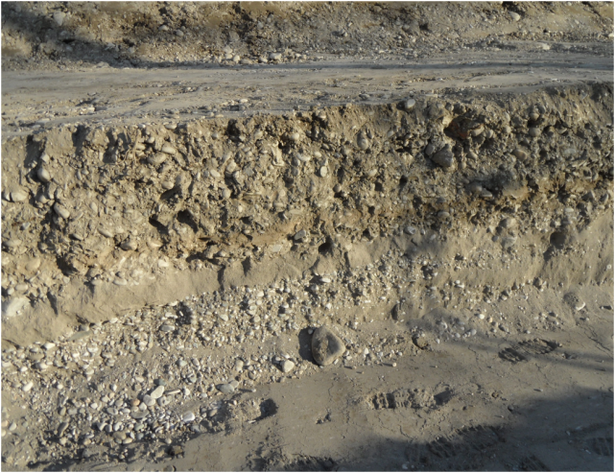
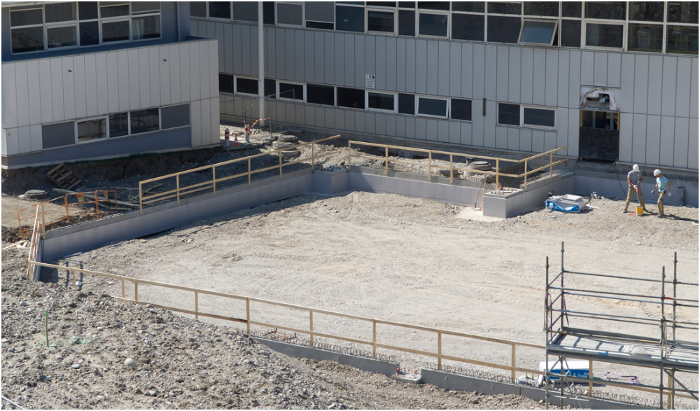
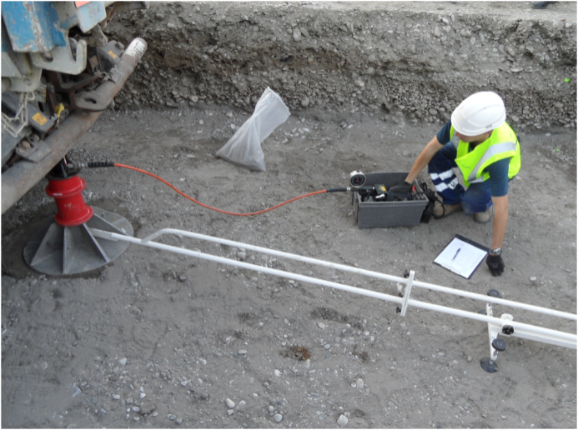
EX2 Slab Soil Preparation
Cross section of the soil
the base soil is reached
The soil has been prepared and well compacted
Final survey to check the soil features (vertical deformation under pressure)

Slide 15
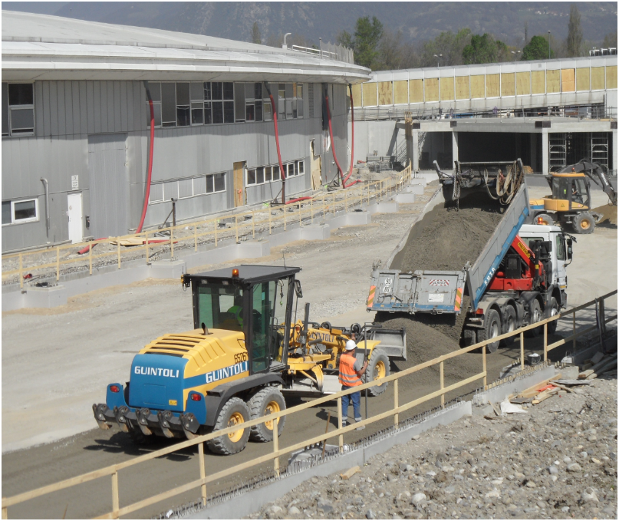
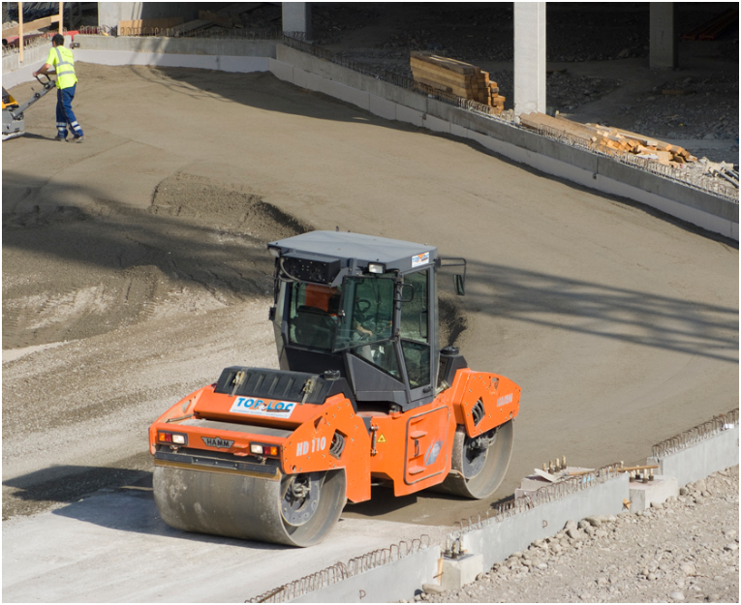
Rollcrete Layer
Compacting phases (8 times/layer)
Deliveries (250 trucks) and preparation

Slide 16
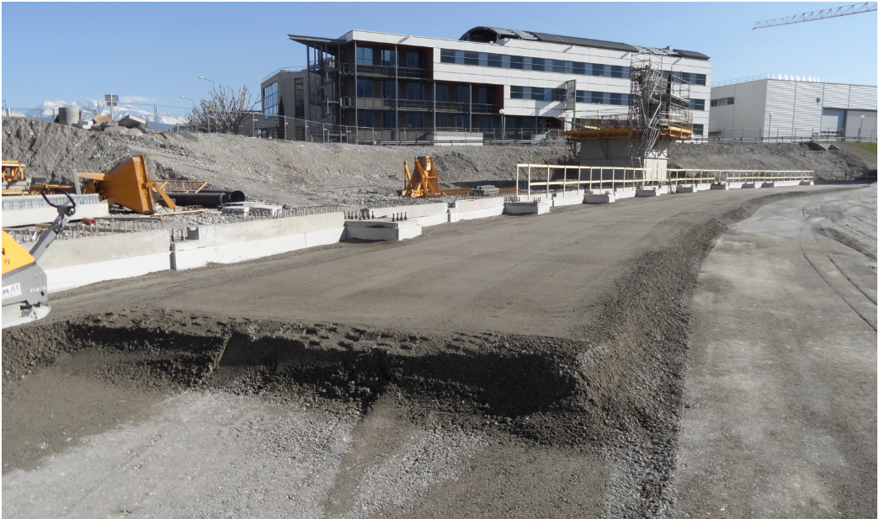
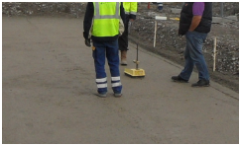
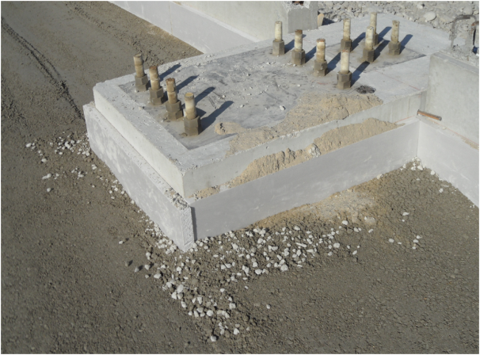
Rollcrete Layer
Final control with a gamma source
First layer and detail of edges

Slide 17
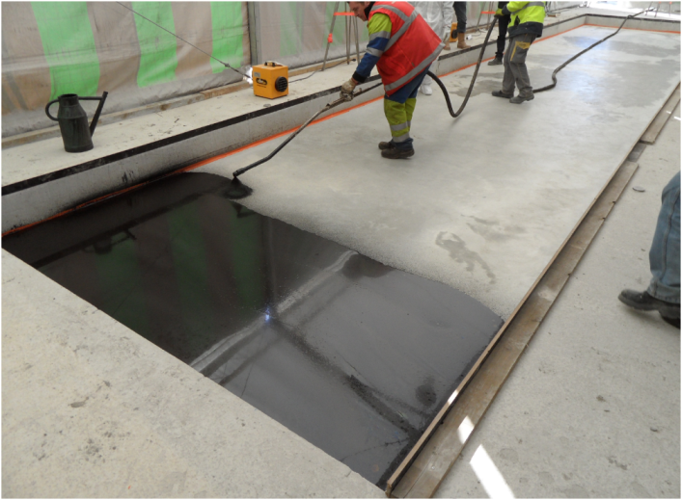
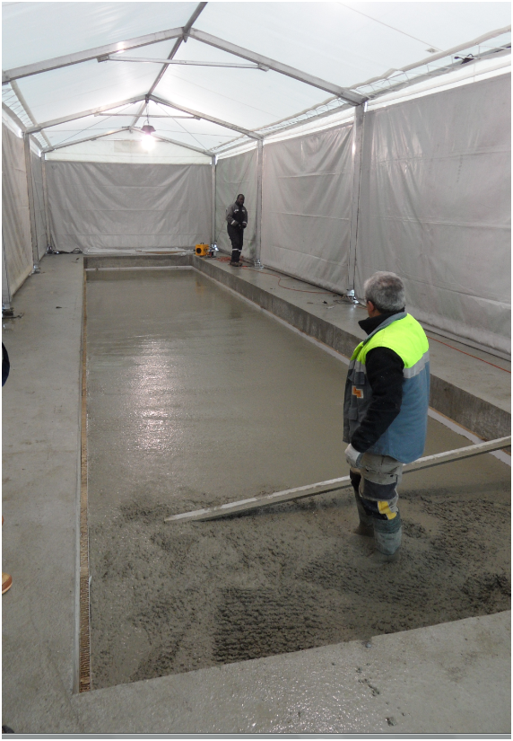
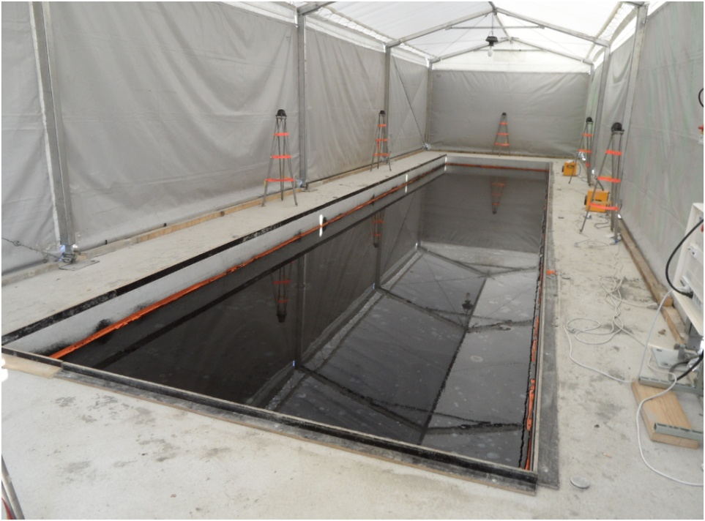
EX2 Prototype Slab
Bitumen layer
Finishing concrete layer over the rollcrete layer

Slide 18
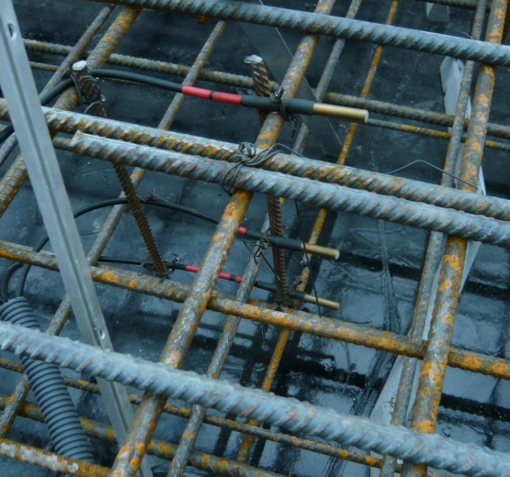
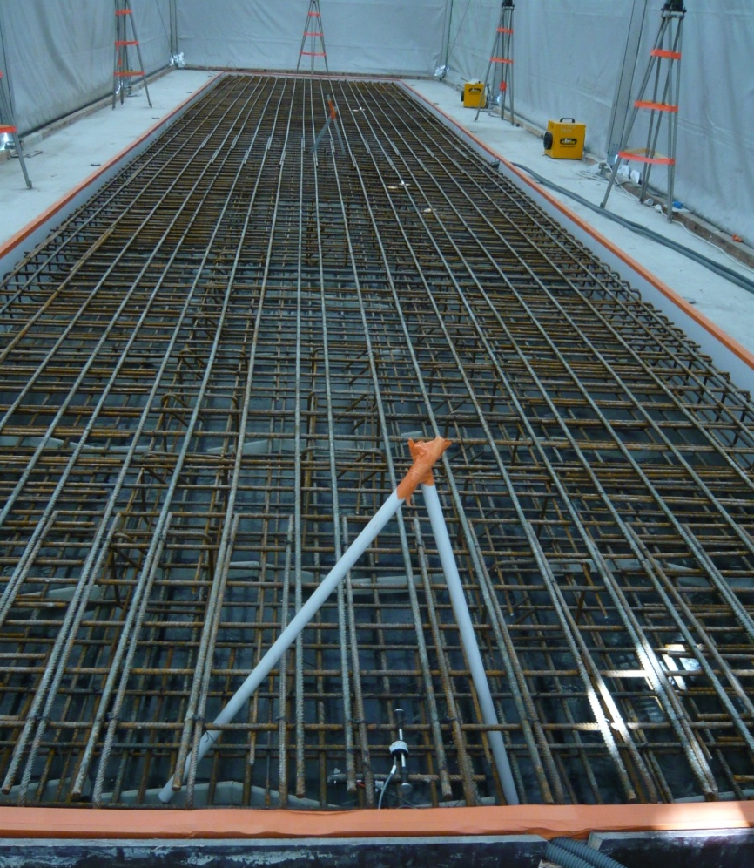
EX2 Prototype Slab
Strain gauges and thermocouples
Steelwork

Slide 19
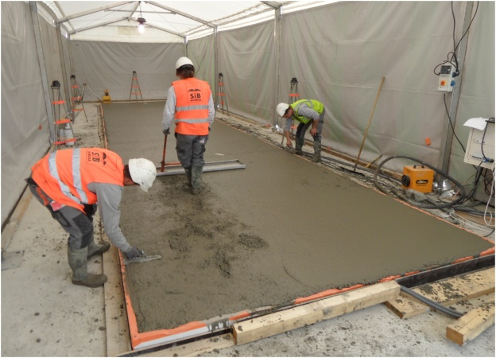
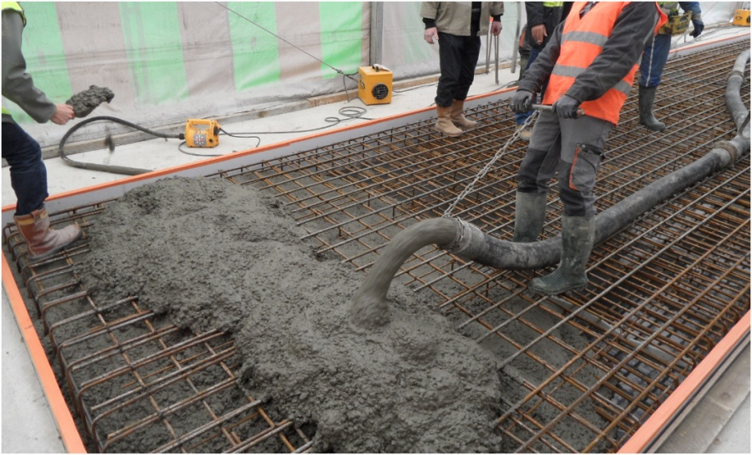
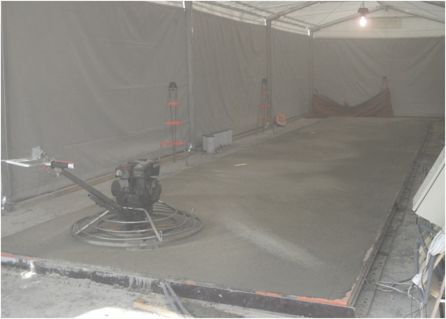
EX2 Prototype Slab
Steel and pouring
Finishing

Slide 20
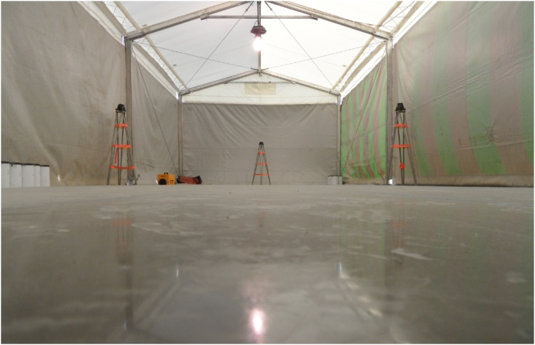
EX2 Prototype Slab
Finished slab

Slide 21
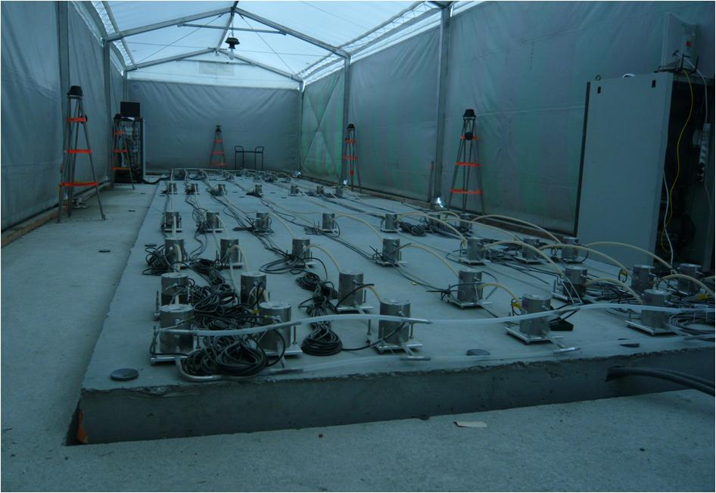
Prototype Slab Measuring Slab Shrinkage and Curling
HLS
Measurements
AT401 Laser Tracker Measurements

Slide 22
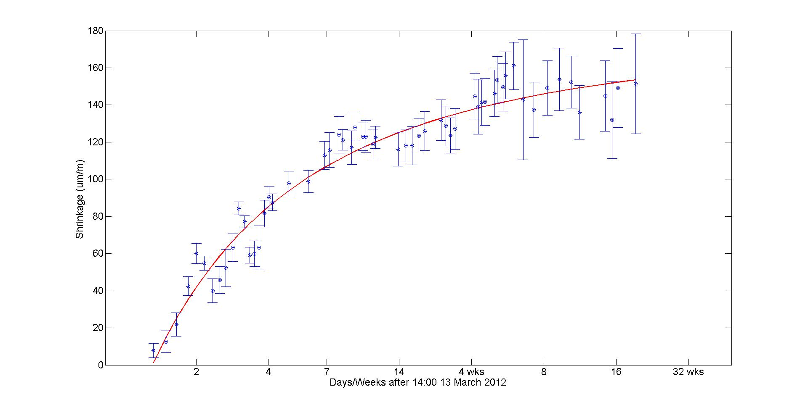
Slab Shrinkage
Asymptote less than 180 µm per m

Slide 23
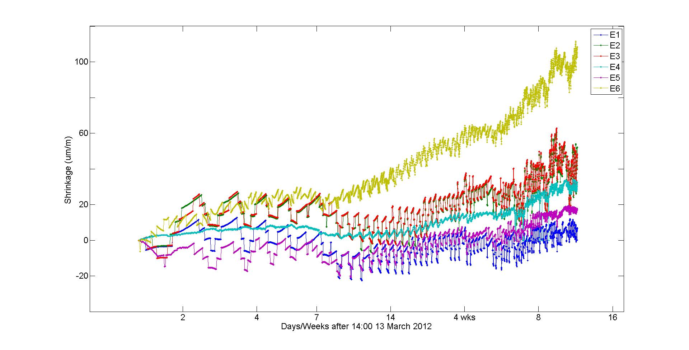
Slab Shrinkage Strain Gauges
Position of Strain Gauges
E1
Plan
View
E3
E2
E4,E6
E5
Side
View
E6
E3
E1
E2
E5
E4

Slide 24
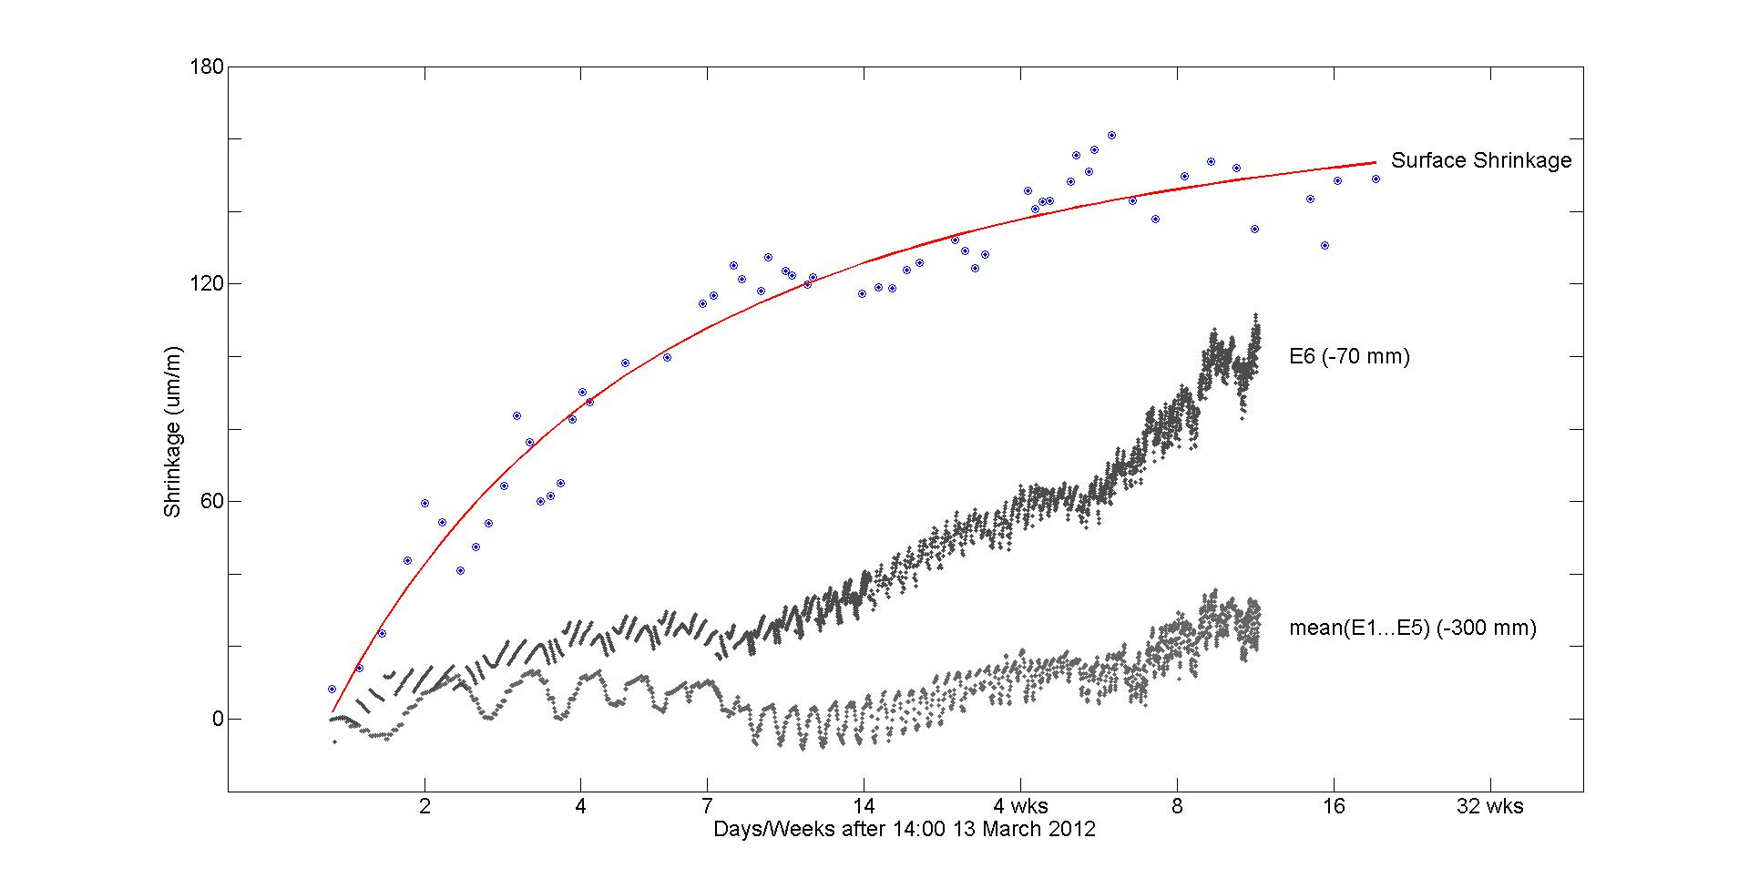
Slab Shrinkage Strain Gauges

Slide 25
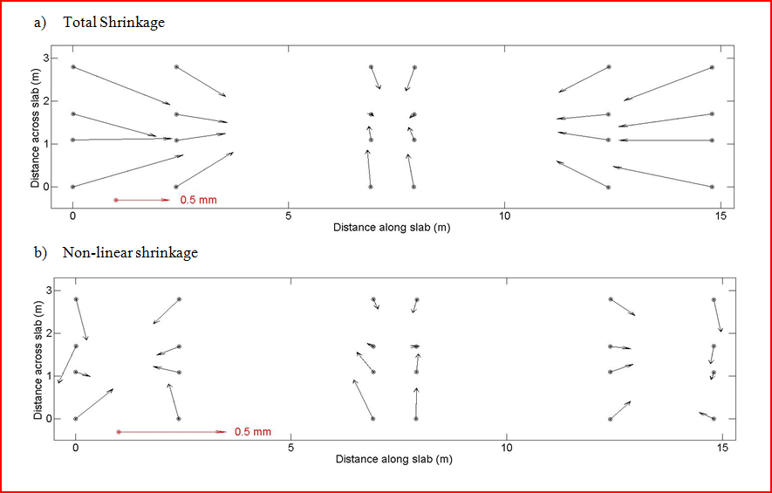
Slab Shrinkage Bitumen Layer

Slide 26
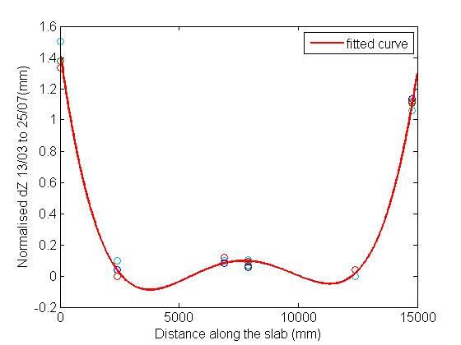
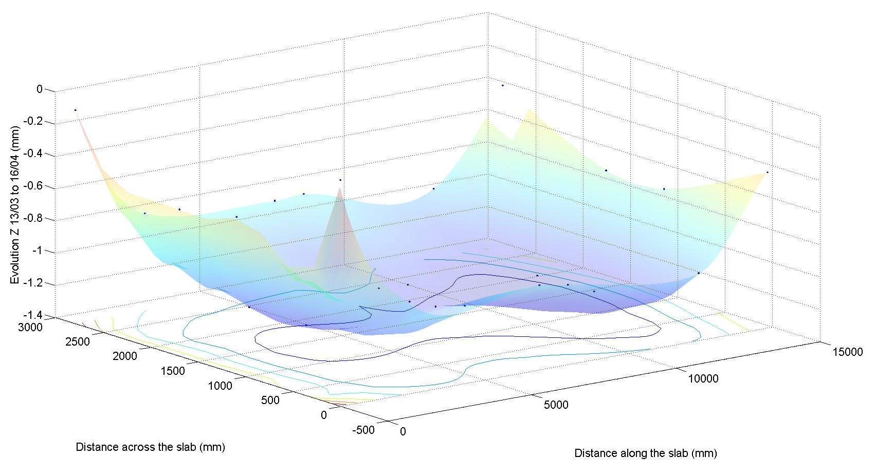
Overall Slab Curling

Slide 27
Slab Movements due to Temperature Variation
T=
Over the day air temperature varies
T=constant
Over one day the sub-surface temperature doesn’t vary significantly

Slide 28
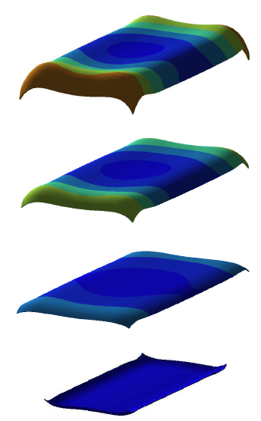
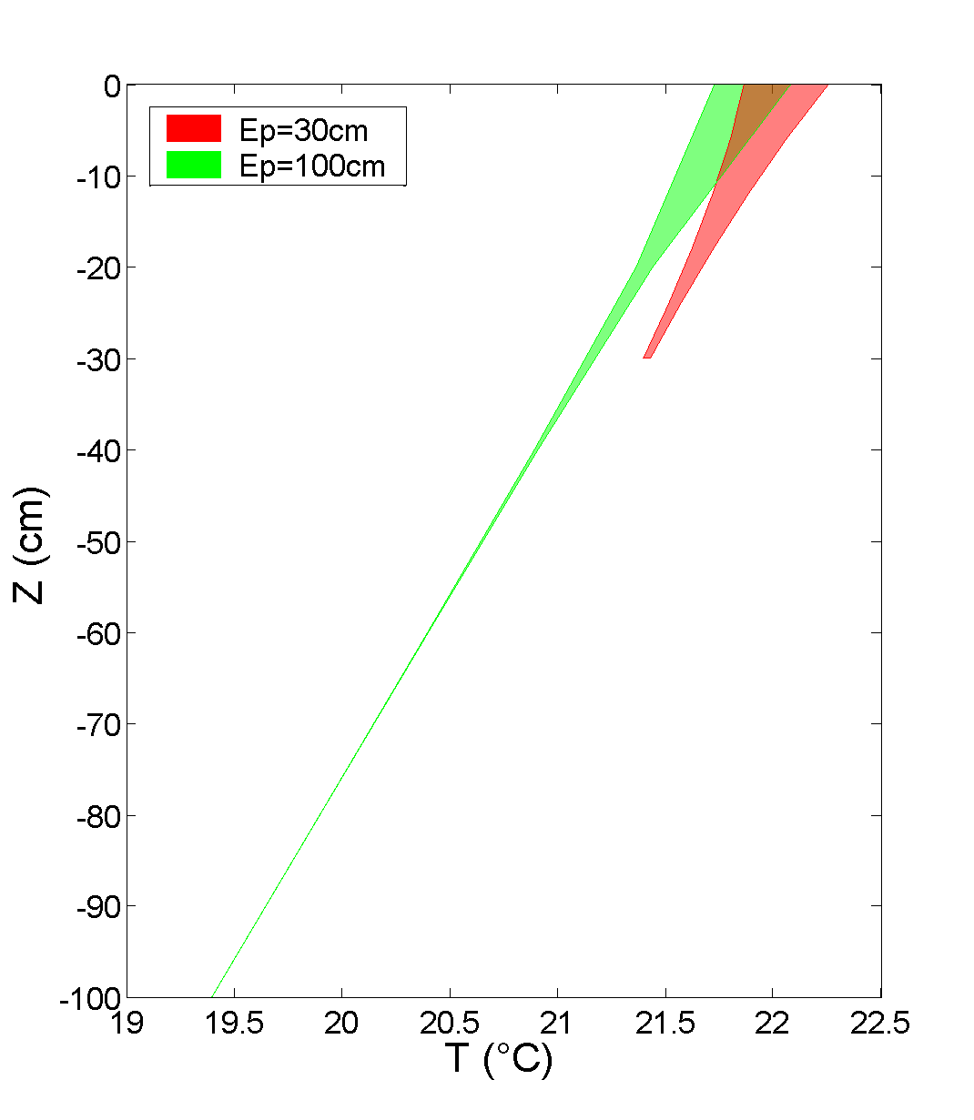
Slab Movements due to Temperature Variation

Slide 29
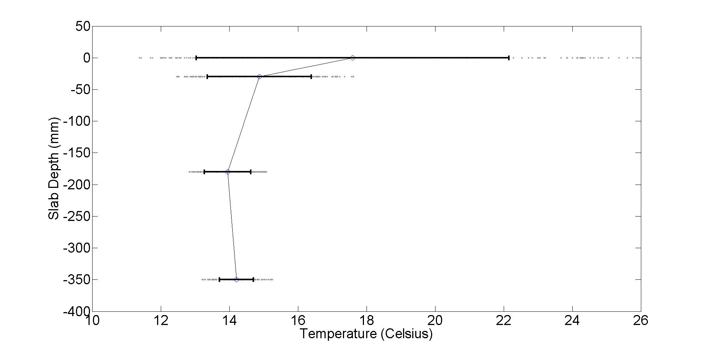
Slab Temperature Gradient Variations 23 to 29 March 2012

Slide 30
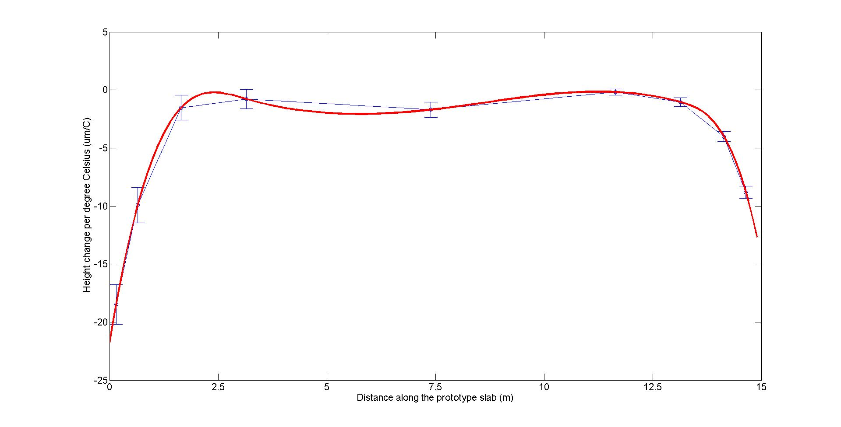
Slab Movements due to Temperature Variation
Curling up to 20 µm per °C

Slide 31
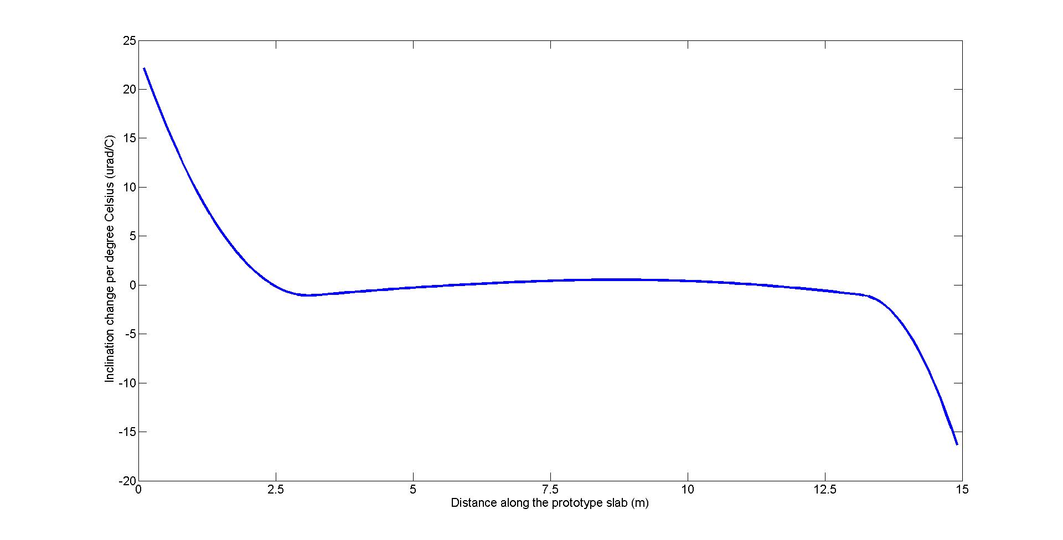
Slab Movements due to Temperature Variation
Bending up to 20 µrad per °C

Slide 32
With special thanks to the other Survey and Alignment group members …
Bruno Perret, Laurent Maleval, Noel Levet
Christophe Lefevre, Daniel Schirr-Bonnans
Also to
Emmanuel Bruas Paul Mackrill and Chantal Argoud for the photographs

