Slide 1
MQXFA06 Status And Exposed NbTi leads Repair
Dan Cheng, Joshua Herrera, Ahmet Pekedis
1/11/2021
LBNL

Slide 2
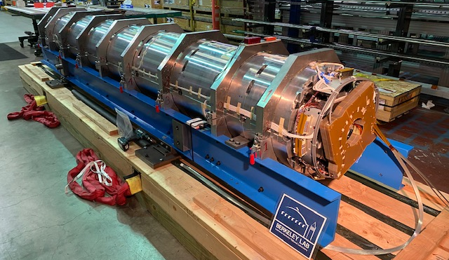
Status
Magnet shipped this weekend on Saturday (1/9)
Expected arrival at BNL either at the end of this week, or early next week

Slide 3
Additional Slides

Slide 4
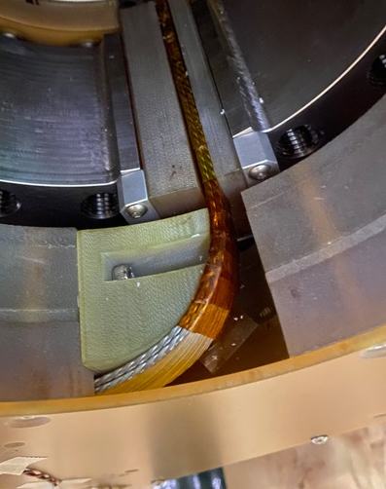
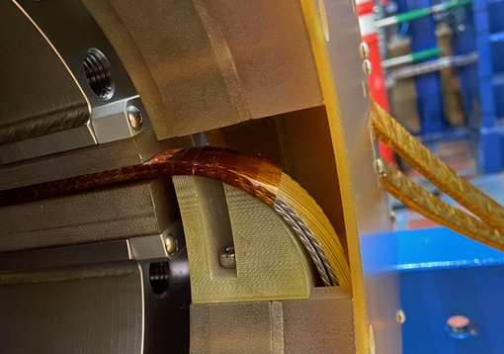
Exposed NbTi Leads
Performing the pre-shipment inspection we saw that there were two NbTi leads leading into the splice box that were partially exposed to the bore
Kapton coverage did not reach all the way into the splice box
(Note: Viewing from RE)

Slide 5
Disposition
Status
Magnet has been loaded into the shipping fixture
Preliminary causation analysis:
Kapton wrap was applied prior to the coil pack assembly; these two leads appear to be wrapped shorter than specified (18”, per WI)
Was not caught prior to the subsequent operations
We explored possible ways to protect leads without disturbing splice box and cover, but these options were not viable
Exposed leads were on the same splice box layer, so we decided to perform an off-normal task to undo cover and add insulation to the exposed leads

Slide 6
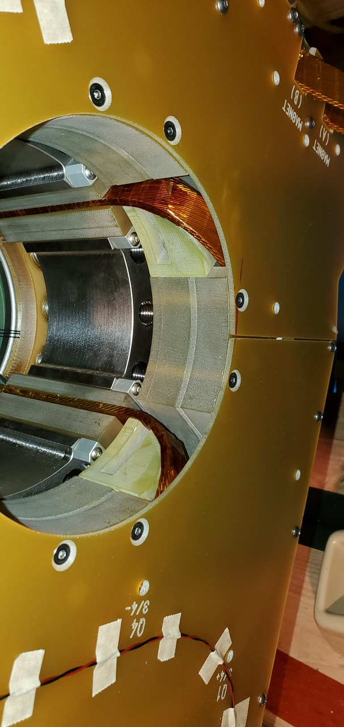
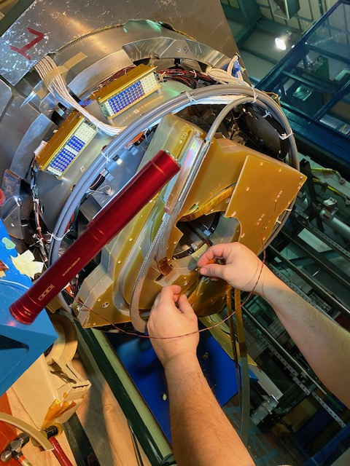
Off-Normal Work, adding Kapton to Leads
Kapton
coverage

Slide 7
NCR Triggers
WI to be revised to prevent future occurrences
Revise Coil Pack Assembly WI to add a verification point to the Kapton lead wrap
Verification point in the Splice Box WI to verify Kapton wrap of the exposed leads
Technicians state that sometimes the wrap breaks during lead routing during the splice box operations, requiring repair
Wrapping should then be verified and/or repaired after routing is performed prior to splices being made

