Slide 1
Shipment status: January 2021
M. Baldini.
01/11/2021

Slide 2
New accelerometers devices
8 new slamstick units have been purchased and
slamstick devices were shipped to BNL and LBNL.
Arriving at LBNL by Jan 13
Arriving at BNL by Jan 11
There are 3 coil crates and 4 magnet crates: each lab has a spare crate and the accelerometers that go with it are considered spare units.
 | BNL | LBNL | FNAL
slamstick | 6 | 8 | 6
CRATES | 3 | 4 | 3

Slide 3
Calibration of slamstick devices
12 devices need to be re calibrated:
5 devices were calibrated (FNAL)
7 more to go between BNL and LBNL
Each lab should take care of the calibration.
Calibration takes 5 business days.
LBNL: MQXFA06 will shipped with non-calibrated devices.
Send for calibration what need to be calibrated in the shipped packages
BNL: If possible, use calibrated devices for 213 and 215 shipment.
Since the magnet 06 will be at BNL for a while, those devices could be sent for calibration together with what is left to calibrate a BNL.

Slide 4
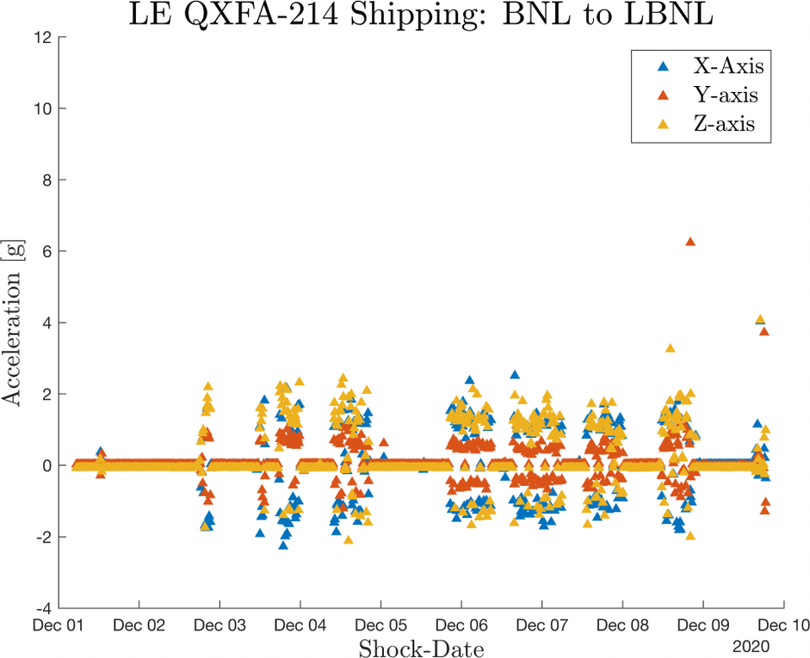
Data analysis: updates
GP1L record data each second. Sample rate max 100 Hz
Slamstick sample rate is 500 to 800 Hz. Sharp shocks and high frequency response
One device is used with triggers so only shock above 4,5 g are recorded
One device record data continuously: each data files are 10 min of data
Matlab script to analyze slamstick data in short time;
Find the highest shock for each data file
by M. Parker

Slide 5
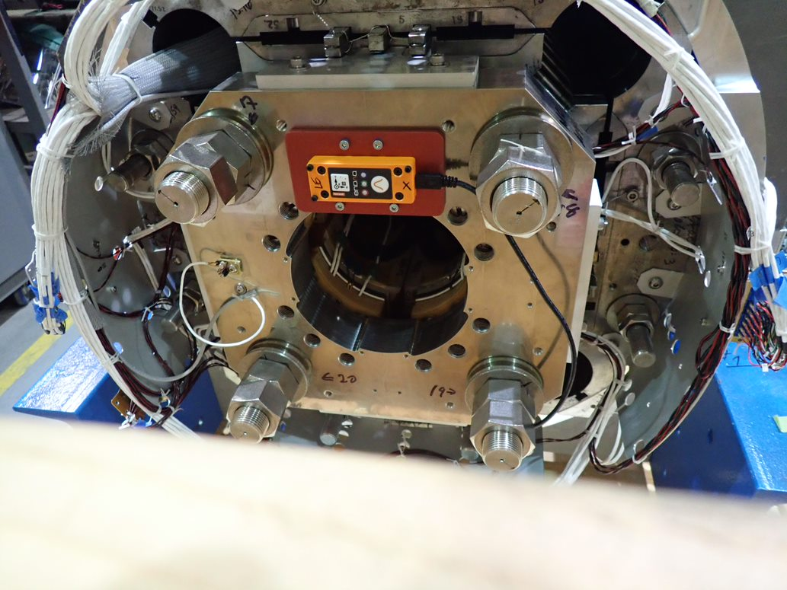
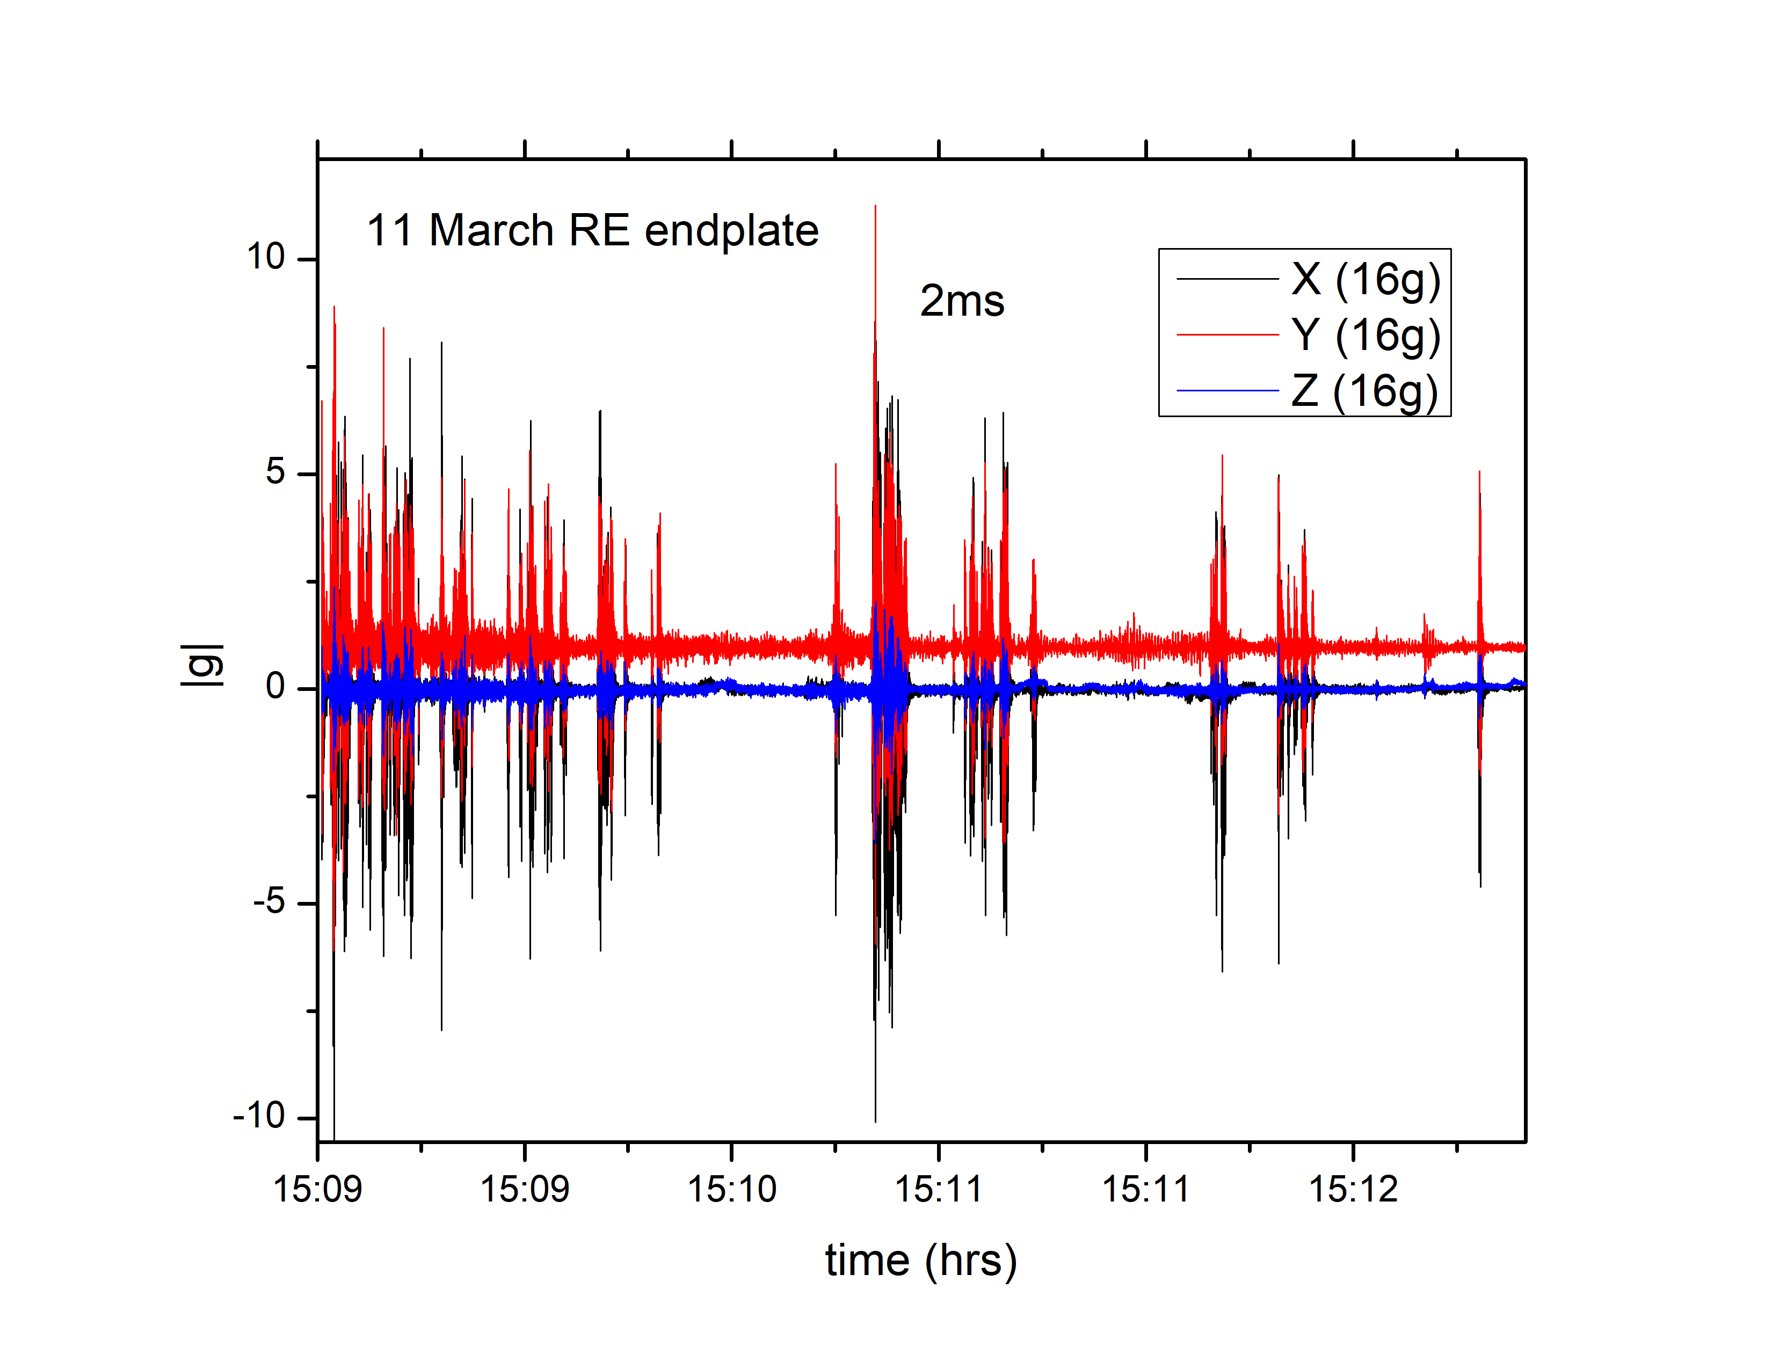
Data analysis: Magnet end plate
trip from LBNL to BNL
MQXFA04
MQXFA05
Very high sharp shocks
Origin of those shocks was not clear
Possible explanation: vibration of the red plate used for the device

Slide 6
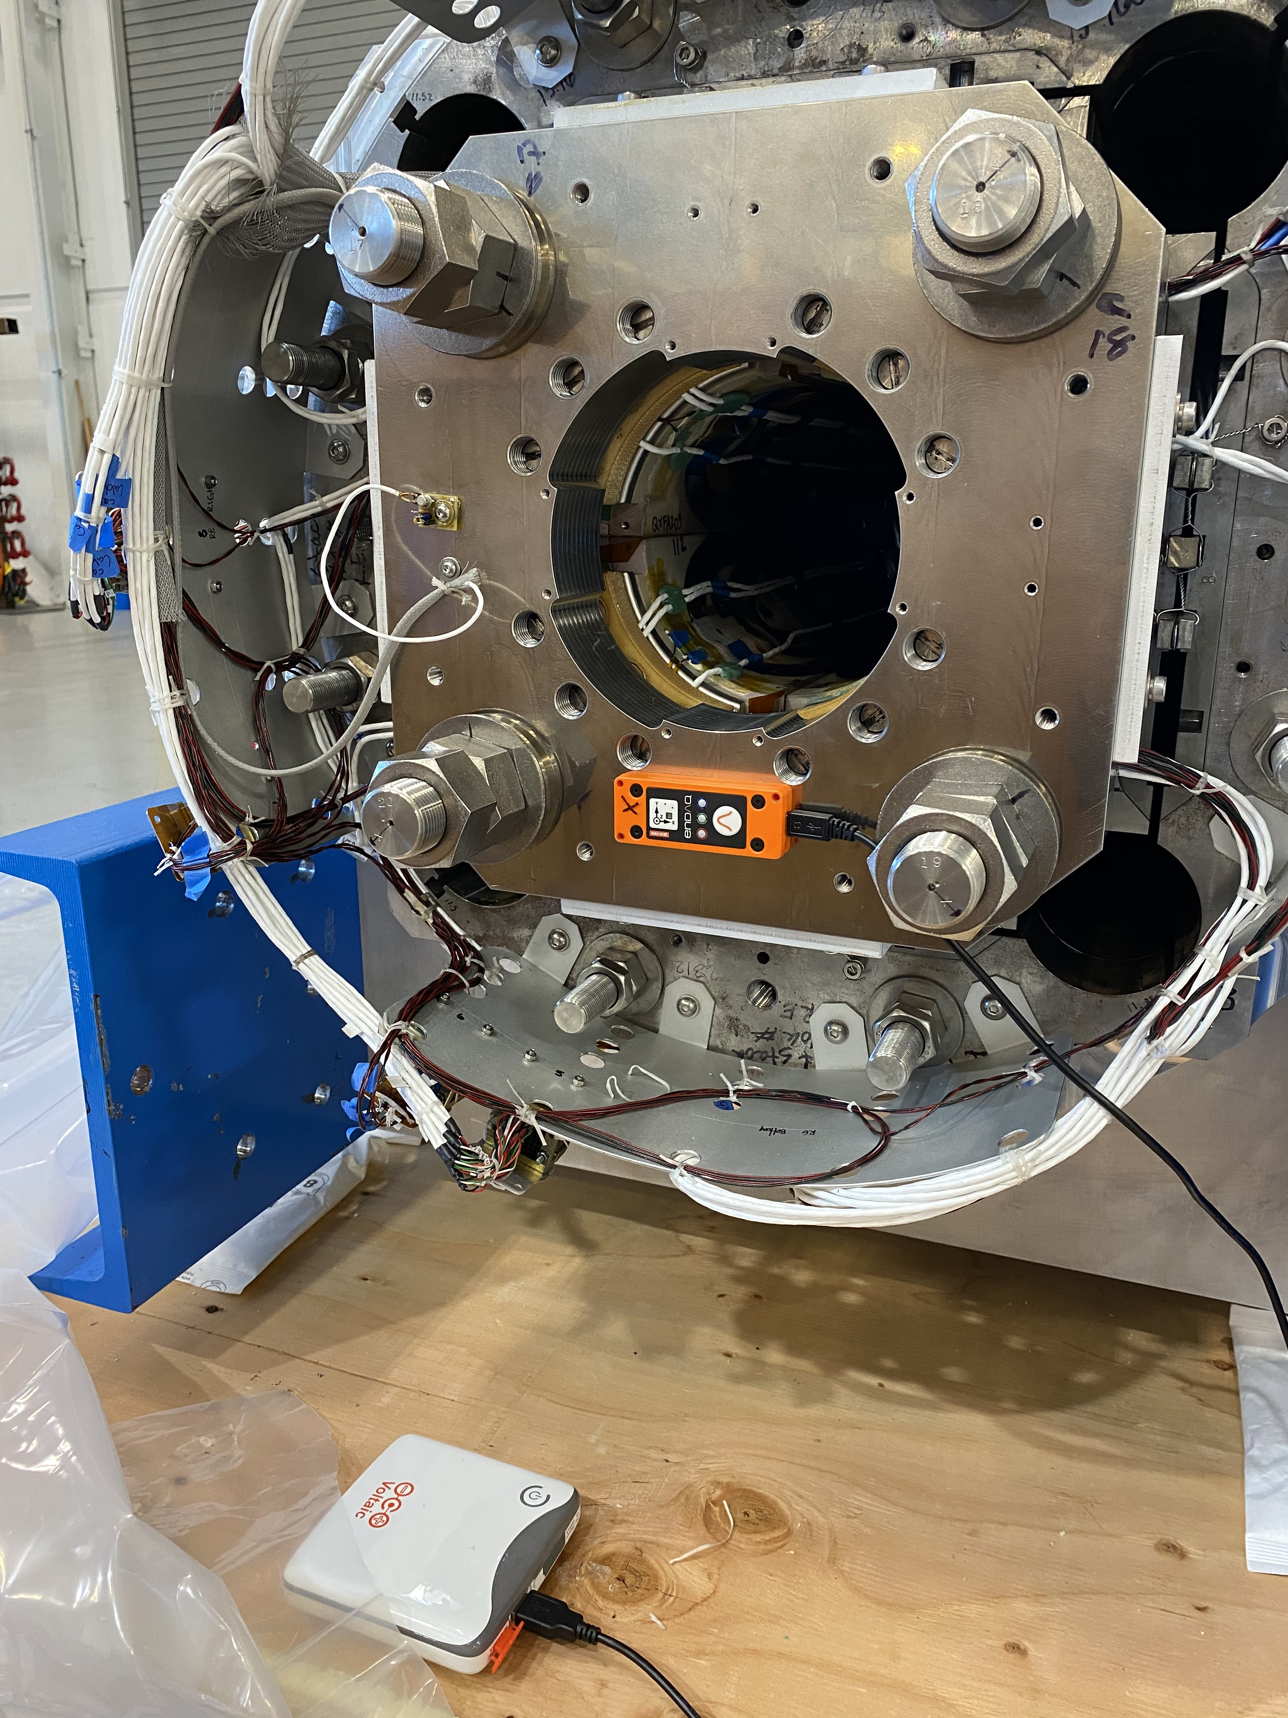
Data analysis: Magnet end plate
No plate for MQXFA04 trip to FNAL
No data recorded on the end plate device (no data above 4.5 g)
MQXFA06 has been shipped with no red plate
Data will be recorded continuously
This trip should clarify if the sharp shocks were given by the red plate vibration

Slide 7
Current shipments
MQXFA06 has been shipped Saturday
Coil 126 will be shipped over the next couple of days
Coil 213 and 215 will be shipped in 7/10 days

