Slide 1
MICE/MuCool Coupling Coil Assembly and Test
Vladimir Kashikhin

Slide 2
Outline
Coupling Coil
Coupling Coil final assembly
CC test stand equipment
Test in the FSU cryostat
CC final test
Preliminary resource estimation
Summary

Slide 3
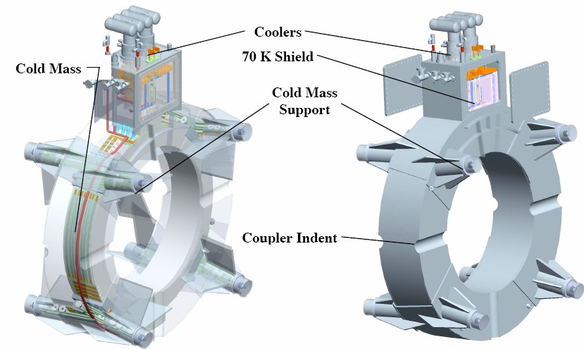
Superconducting Coupling Coil
The work on the MICE coupling solenoids was started in 2003 at Oxford University. The design that emerged in 2004 was compatible with the MICE lattice. The design that evolved was a single short superconducting magnet. The magnet cryostat length was limited by the space between the RF cavity couplers.

Slide 4
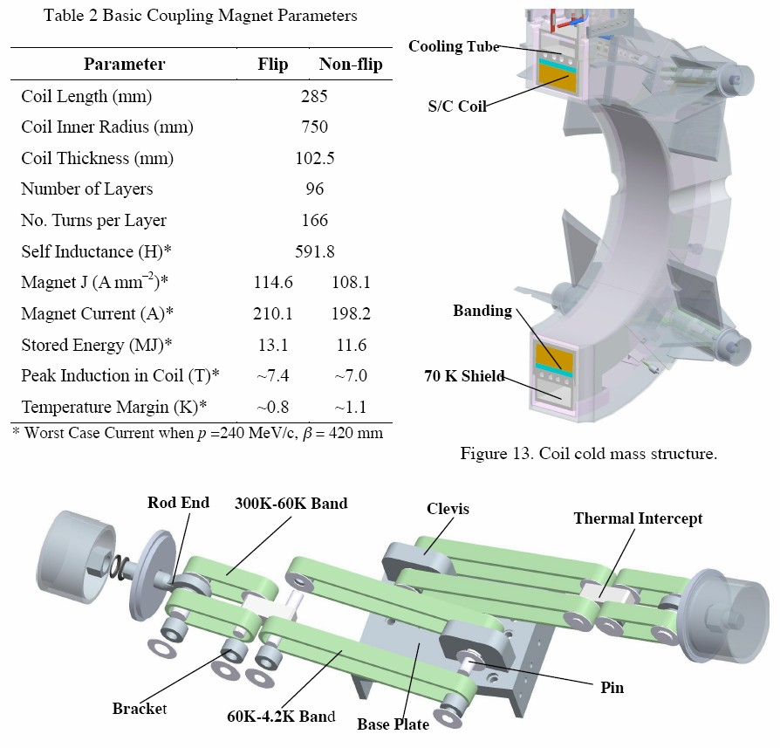
Coupling Coil Parameters

Slide 5
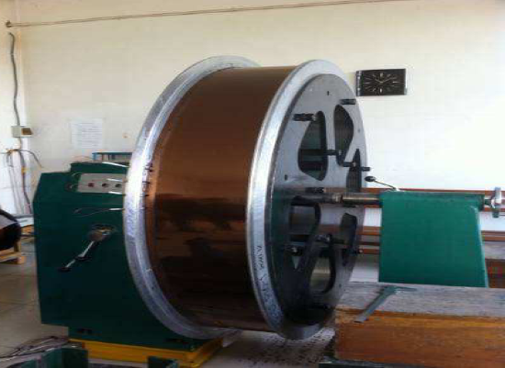
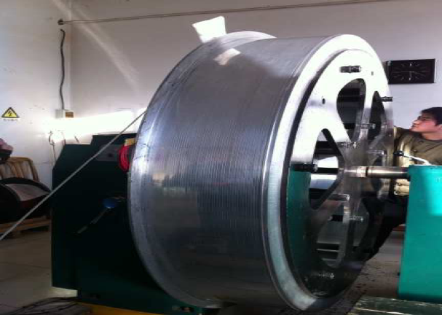
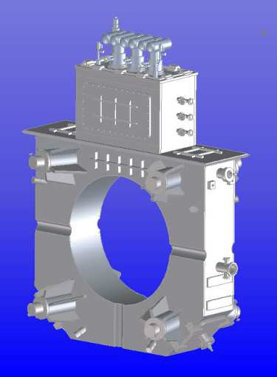
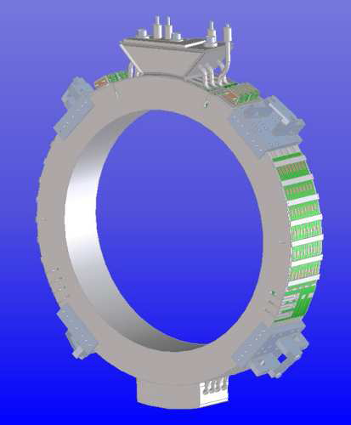
Coupling Coil Latest Design & Fabrication
3D CAD model of the latest cryostat design (left) and cold mass design (right).
Coil winding at Qi Huan Company in Beijing: finished SC coil winding (left) and finished Al banding (right).

Slide 6
CC Final Assembly
Modify the drawings and supporting documentation (LBNL) for the US industry.
Order not supplied by China parts, and materials.
Assemble the cold mass with the outer bandage ring, cooling tubes, and passive quench protection system.
Assemble the coil cold mass with the top head, including HTS current leads, cooling tubes, etc.
Put around cold mass a vacuum superinsulation.
Put the cold mass inside a vacuum vessel.
Attach and align all cold mass supports.
Weld the inner vacuum vessel ring.
Weld the top cover plate.
Check the vessel for vacuum leaks.
Pressure test.
High pot test.
Electrical test all circuits and instrumentation.
Magnetic field measurements at low current by Hall probe. Defining the coil axis position at the room temperature.

Slide 7
Preparation for the Test
Mobile cart to monitor all voltage taps and sensors.
Install the strip or cartridge heaters to have the possibility to change the cold mass temperature.
Install coil displacement sensors to monitor the coil motion under the Lorentz forces.
Install dump resistor to limit the peak voltage in the case of failure of passive quench protection system.
Prepare the quench detection and active quench protection system with the firing heater unit.
Install on the cold mass strain gages.
Protect the current leads and cold busses by additional voltage taps connected to the protection unit.
Design and fabricate the 3D Hall probe travel fixture for CC magnetic measurements.

Slide 8
Test in the FSU Cryostat
Cool down the coil.
Measure the ground insulation resistance.
Measure the coil residual resistance including all splices.
Check the quench detection and protection systems at low current using heaters.
Measure the fringe fields at low current and extrapolate measured values to the peak 240 A current.
Increase the current up to 50 A and initiate the quench by heaters. Monitor all signals. Make all signals analysis and compare with the simulation results. Analyze the possible deviations and critical parameters.
Increase current to 100 A and repeat as in 3.
Continue to increase the current by 50 A steps (up to the real quench) repeating the careful data analysis as in 3.
Train the coil until 240 A (210 A nominal+10% margin).
Investigate the coil temperature dependence using heaters.
Investigate the coil ramp rate dependence.
Warm up the coil to the room temperature and repeat all needed previous steps. Analyze the possible retraining. Repeat several thermal cycles.

Slide 9
CC Final Test
Assemble and commission the CC test stand, including cryogenics, power supply, quench detection, and instrumentation systems.
Cool down the coil from the external cryoplant . Monitor all temperature and stress sensors. Analyze the temperature field distribution and compare with the simulations. Analyze the coil displacement and adjust the support rods if needed.
Repeat all test steps shown on the Slide 5. Because of different coil position might be observed some retraining effect. Train the coil to the 240 A peak current.
Disconnect the LHe supply line. Continue coil cooling by Cryocoolers.
Repeat all test steps with Cryocoolers. Measure the magnet temperature margin by varying the coil temperature.
Check the work of quench protection system using heaters.
Measure the magnetic field map.
Transfer the coil magnetic axis position on the vacuum vessel reference points.
Transport the magnet to an experimental site.

Slide 10
Preliminary Resource Estimation
N | Task description | Tech.,FTE | DrafterFTE | Eng./Sci. FTE
1 | Final assembly | 3 | 0.5 | 2
2 | Sub-systems | 1 | 0.5 | 2
3 | Magnet tests | 1 | 0.15 | 3
4 | Fabrication and test support | 0.4 | 0.2 | 0.5
5 | Magnet commissioning | 0.1 | 0.15 | 0.5
 | Total for professionals | 5.5 | 1.5 | 8
 | Total | 15
This estimate does not include contingency for possible magnet repair, and if some parts require a redesign. There is also the risk that the delivered magnet parts and magnet design do not meet the specified parameters. The designed magnet has a very low quench margin; even a small degradation of only 1 cm of wire out of 80 km will reduce the quench current. The number of quenches for the magnet training is strongly limited by the long recovery time.

Slide 11
Summary
It is supposed that LBNL will modify all final drawings to meet the US standards.
China and WANG NMR will supply all CC parts for the final assembly.
FNAL will assemble the first CC magnet for the MuCool.
The assembly site should be defined as soon as possible to start equipment preparations.
FNAL will test the first magnet and will propose if needed some modifications. The CC test site might be close to the FSU cryostat in MTF.
Other CC magnets will be built by UK or China.
Should be organized a tight communication between LBNL-FNAL-China to avoid delays in parts delivery, and specialist visits.
The most critical path is the design and fabrication : assembly site, travelers, assembly and welding fixtures, measuring equipment, etc.

