Slide 1
Thoughts on cryostat deformation and DSS compensation.

Slide 2
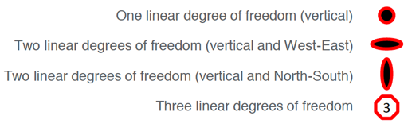
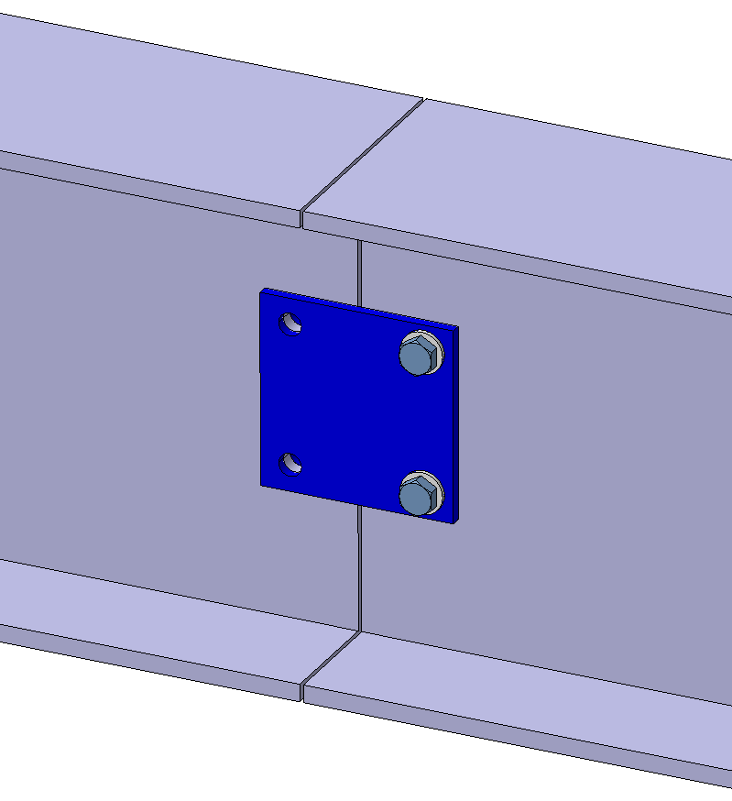
Feedthrough bracing and cooldown
3
3
3
3
3
3
3
3
3
3
Anode
12 mm
3
3
3
3
3
3
3
3
3
3
Cathode
6mm
Anode
6mm
3
3
3
3
3
3
3
3
3
3
Cathode
12 mm
3
3
3
3
3
3
3
3
3
3
Anode
Vertical support rods are pushed from vertical by 6mm and 12mm by the ground plane support bars.
The reaction force to the trollies comes from the constraining braces at the feedthrough. These allow the shrinkage N-S.
Guide plates between I-beams constrain the beams as they shrink.
Extracting the N-S runway beams may be difficult due to the load.

Slide 3
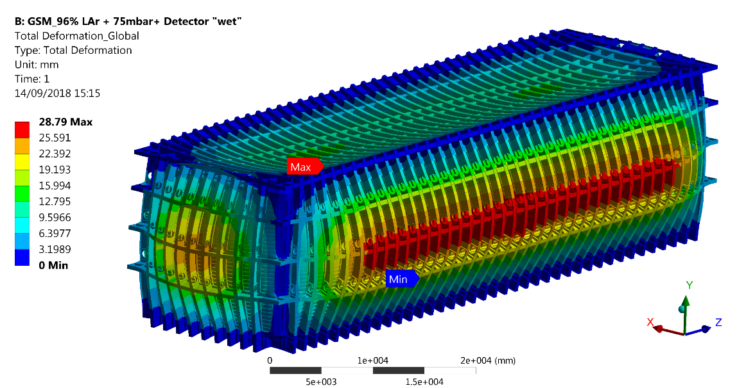
Where is the liquid level? 96% full was computed from a rectangular cryostat.
90
Expected misalignment in mm of the central APA rails because of the roof deformations during LAr filling

Slide 4
What is the plan for pre-compensation for the cryostat deformation?
Expected misalignment in mm of the central APA rails because of the roof deformations during LAr filling
12.5mm
Do we lower the ends?
Or do we raise the middle?
The height of the TCO beams and DSS depends on this?

Slide 5
How do the CPA move as the DSS beams tip?
CPA panels need to shift as the beams tip.
CPA connections must be flexible and the latches allow rotation.
The holes for the HV buss are 3/8= 9.5mm and the wire ??mm. Shifts of 12mm could be a problem. Shifts of 3mm would probably be OK.
Pins are 12.5mm and the slots 25mm so motion of +/- 6mm are permitted with no tolerance.
DSS beams will need to be slowly adjusted to position.
Shifted by 12mm
5mm Diff

