Slide 1
HV Cool Down Affects
Victor Guarino
1/13/21

Slide 2
HV Cool Down
CPA
Gaps between CPAs
Change in height and alignment with APA
Top/Bottom FC
Change in drift length
EW
Change in height

Slide 3
CPA – Gaps between CPAs
9mm gap between CPA Frames
1155mm center to center distance between CPA frames
Shrinkage between CPAs on the same DSS Beam
CPA width Shrinkage 2.4mm
Invar shrinkage .45mm
Gap between CPAs opens up ~2mm.
Shrinkage between CPAs on the separate DSS Beams
CPA width Shrinkage 2.4mm
Invar shrinkage 2.47mm
Gap between CPAs opens up ~4.8mm.

Slide 4
CPA – Changes in Height
CPA and APA heights are currently centered
After cooldown the top of the CPA/APA frames remain unchanged and shrinkage affect seen at the bottom.
Shrinkage:
CPA 24.9mm
APA 32.7mm
Difference in height at bottom 7.7mm
When warm the CPA can be raised (7.7mm/2) 3.8mm so that the CPA and APA are centered wrt each other cold

Slide 5
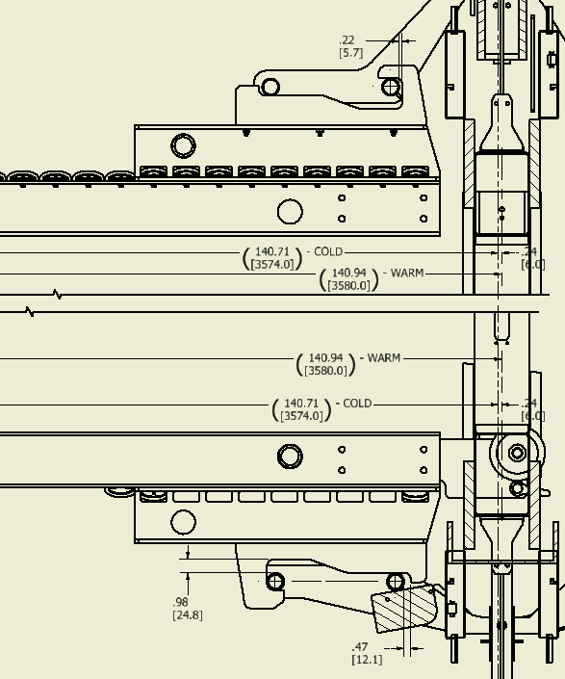
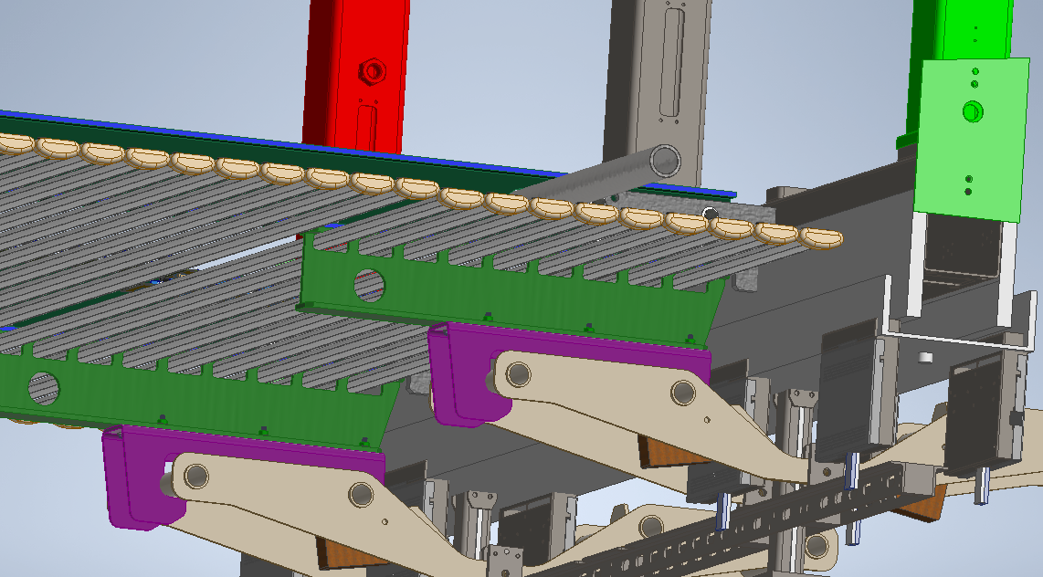
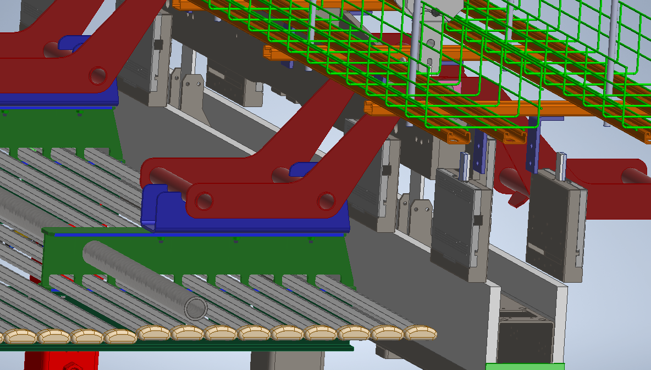
Top/Bottom FC
FC beams will shrink ~6mm in drift direction
FC’s have been made 6mm longer so that after shrinkage the drift distance is 3.574m
Warm drift distance is 3.580m

Slide 6
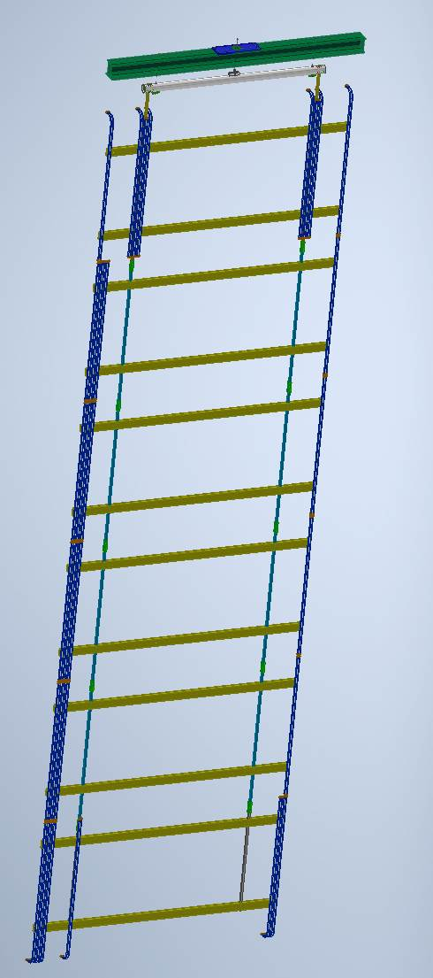
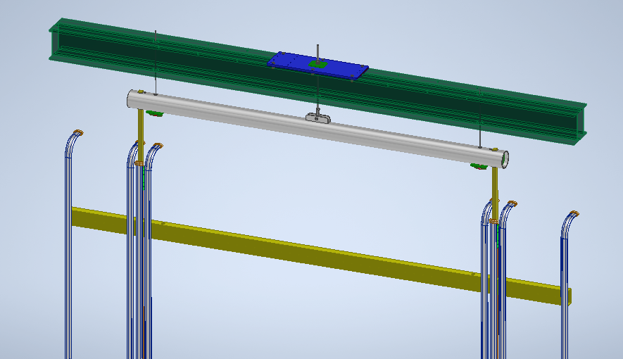
EW Support
All EW columns are identical.
EW is now center supported
FRP beams support EW and are supported on bottom flange of DSS Beam

Slide 7
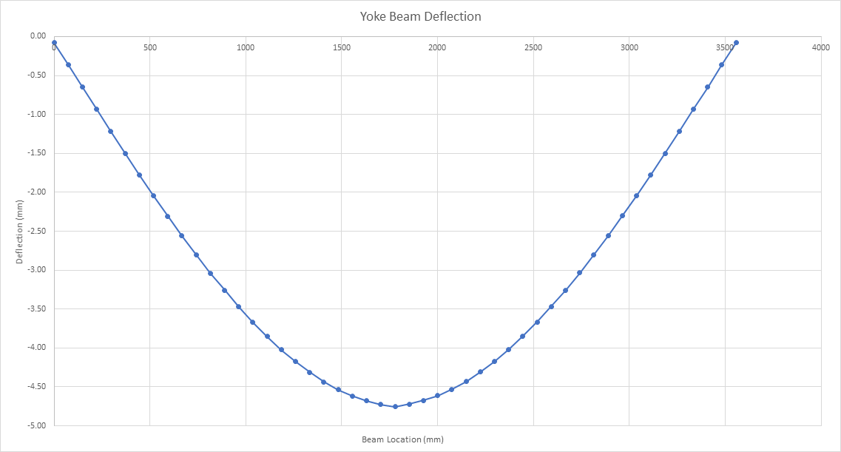
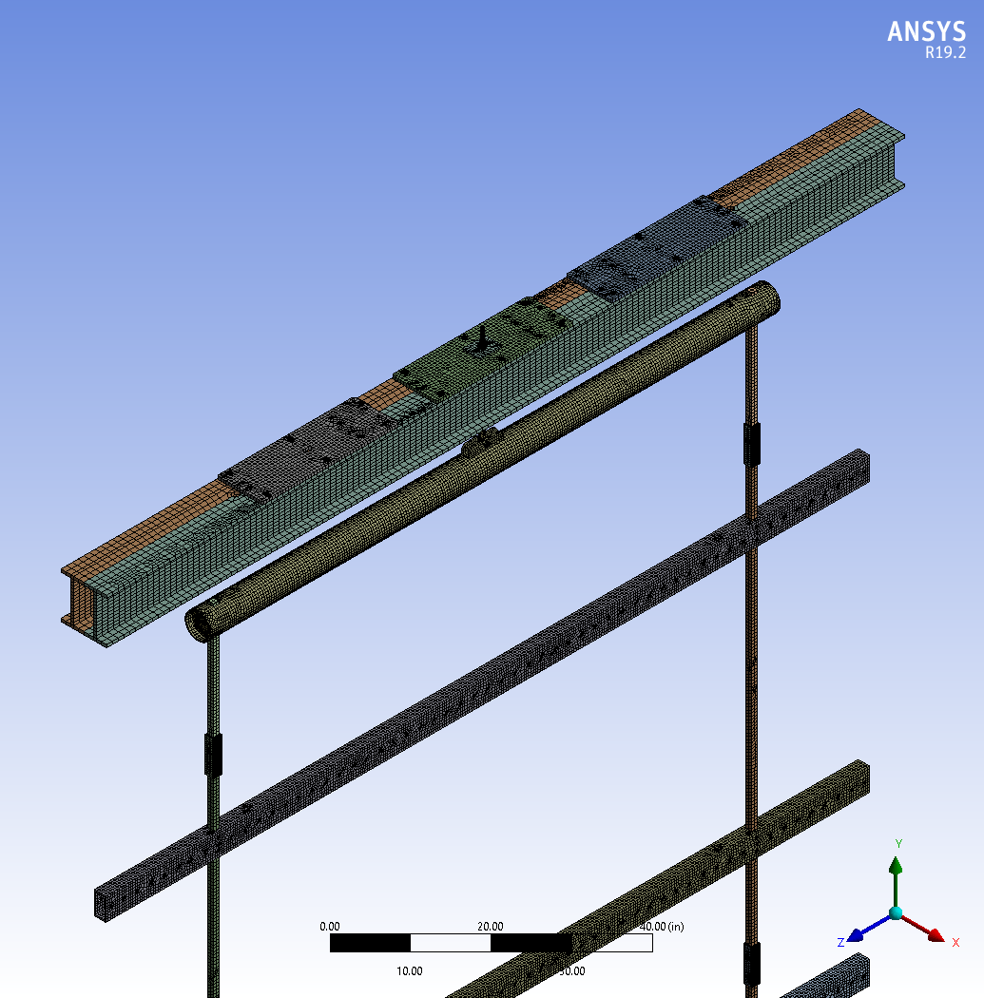
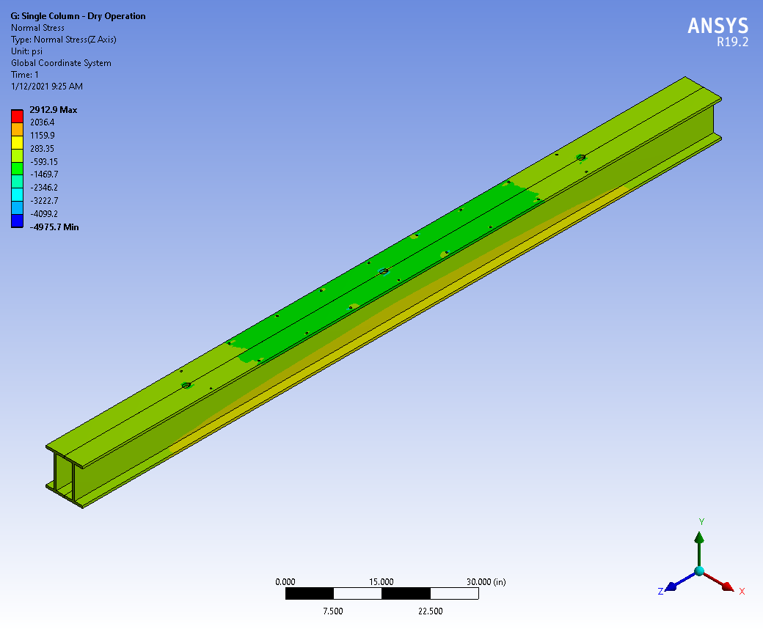
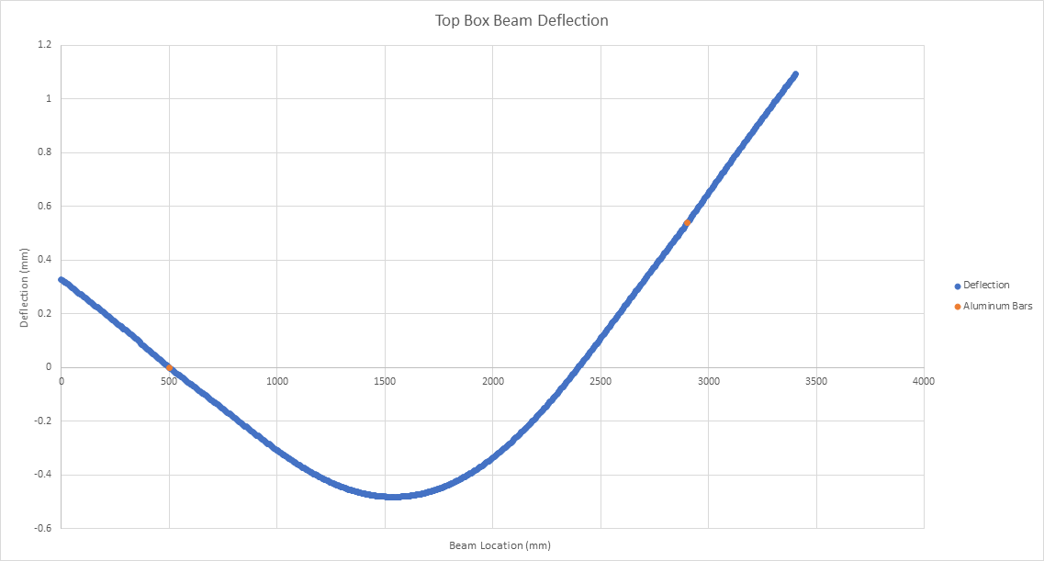
EW Support
EW support structure is a simple statically determinate structure
Empirical and 3D FEA analysis have been performed.

Slide 8
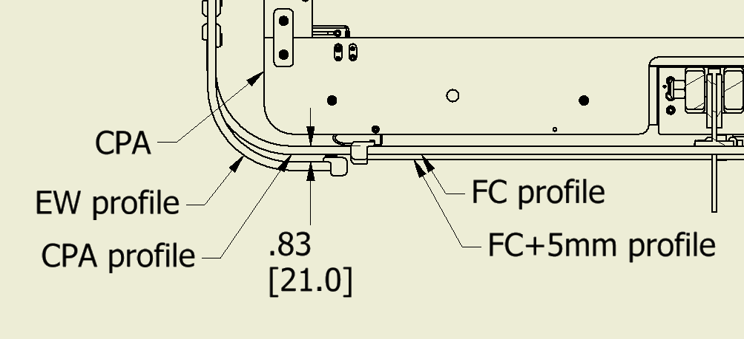
EW Support
EW longer by 21mm so that it shrinks into final alignment with top/bottom FC
Top EW profiles are aligned at the top with the FC
Bottom EW profiles are offset from bottom FC when warm and aligned when cold

Slide 9
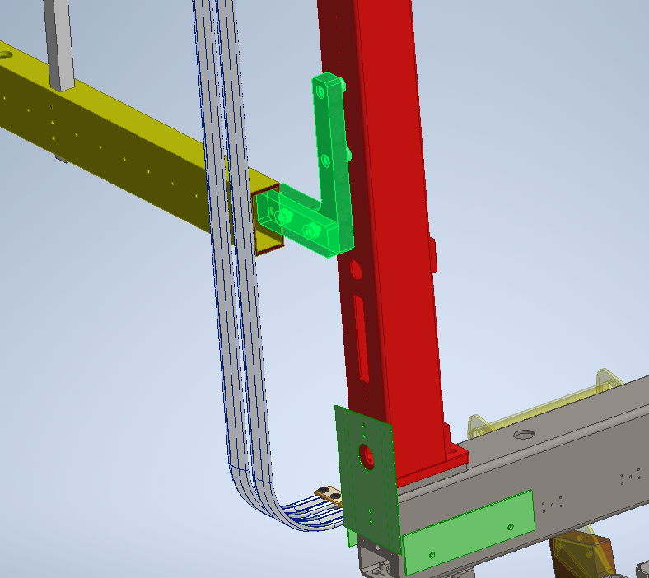
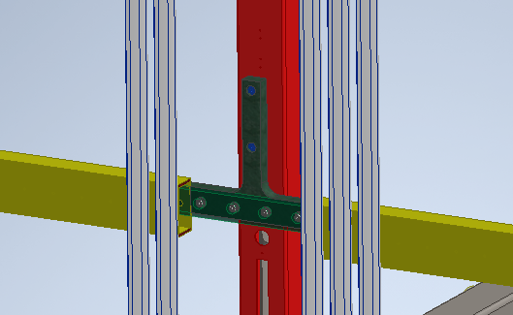
EW Restraints
EW is restrained at the bottom to the APA/CPA

Slide 10
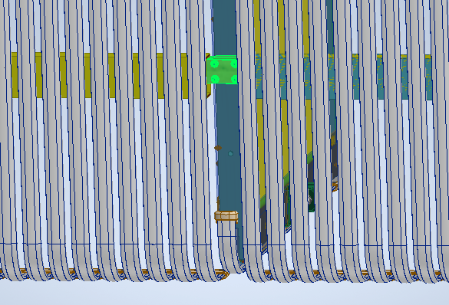
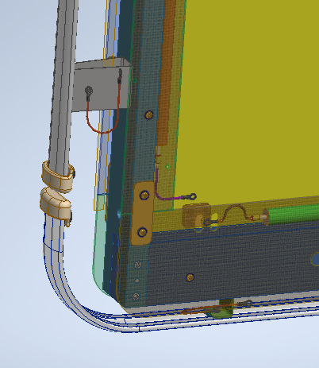
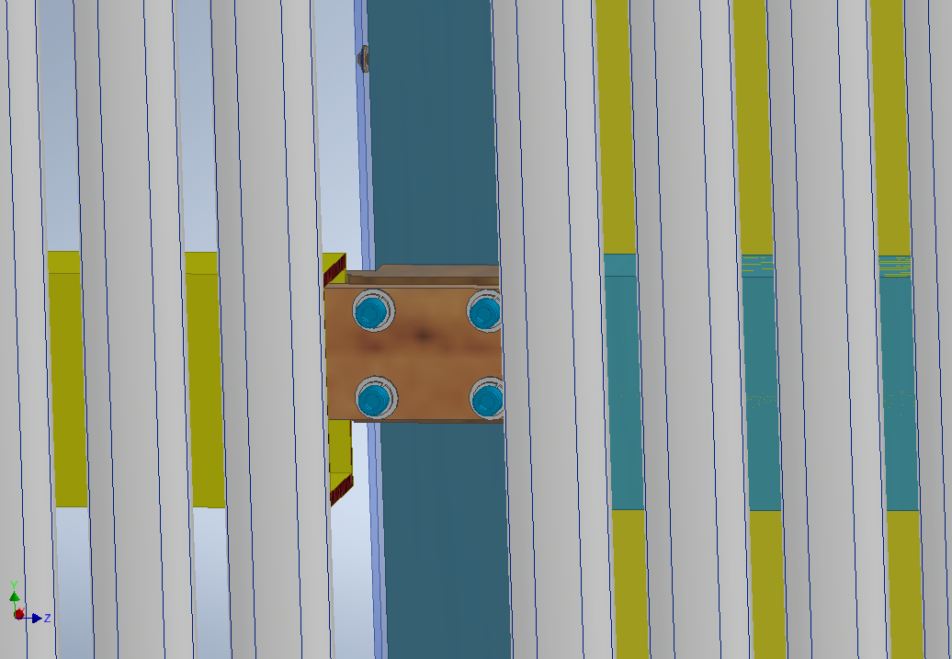
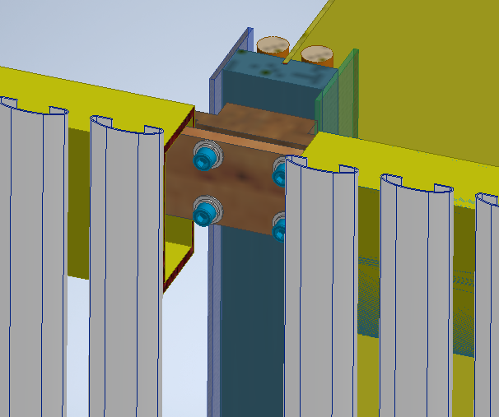
EW Restraints
EW is restrained at the bottom to the APA/CPA

Slide 11
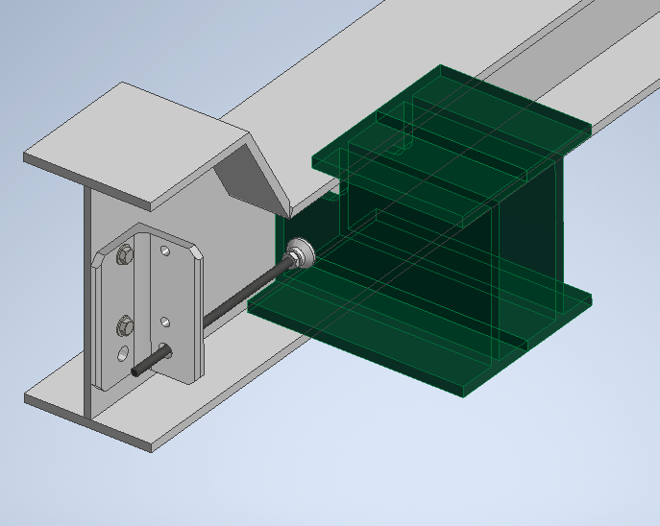
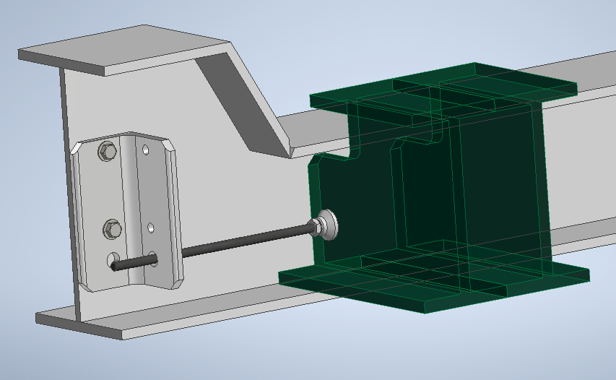
EW – TCO Pusher System

