Slide 1
HR Updates- January 27, 2021
Ilene Winston

Slide 2
HR Updates – Remote Work Policy
The purpose of the Remote Work Policy is to describes the requirements and procedures for FRA employees to conduct work remotely.
Employees who may wish to have this flexibility under our Remote Work Policy must complete the Remote Work Agreement in advance.
Occasional Telecommuting involves infrequent work by employees at locations away from their primary Fermilab worksite for reasons such as to severe weather or personal and family emergencies
Regular Telecommuting is an arrangement in which some of an employee’s duties are routinely performed away from his or her primary Fermilab worksite for one or more days a week on a routine basis. Telecommuting applies when the employee is working from a location within 100 miles or less of his or her primary Fermilab worksite. The extended arrangement of employees working away from the Fermilab during the COVID-19 pandemic falls under the Regular Telecommuting category. Although employees may be conducting all work remotely during the COVID-19 period, most employees retain an assigned workspace at their primary worksite and are expected to resume pre-COVID-19 regular or occasional telecommuting or begin telework when the COVID-19 period is over.
Long-Distance Telework (formerly Remote Duty Station) may be approved when: 1) an employee requests a domestic work location on a regular, long-term basis in another state or at a location more than 100 miles from the primary Fermilab worksite; and 2) the arrangement mutually benefits the employee and the lab. Employees may request long distance telework based on meeting the additional criteria defined in Section 5.3 of this policy. Approval for long-distance telework assignments must be reviewed and renewed annually.

Slide 3
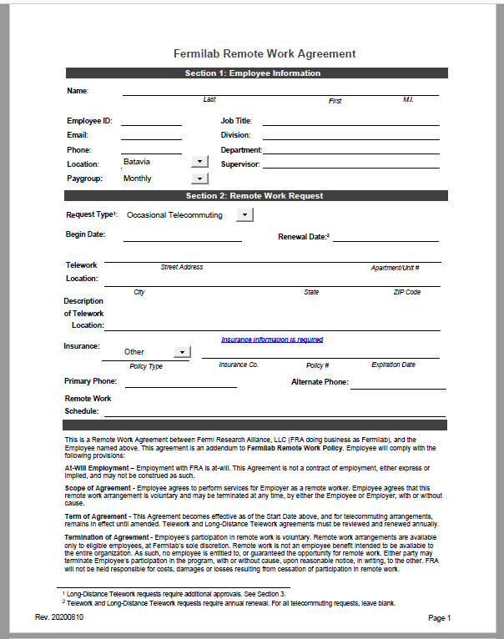
HR Updates – Remote Work Policy Work Agreement

Slide 4
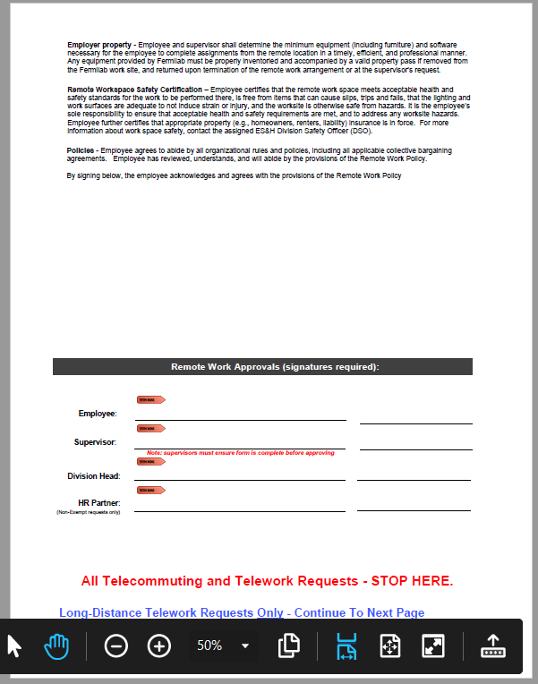
HR Updates – Remote Work Policy Work Agreement

Slide 5
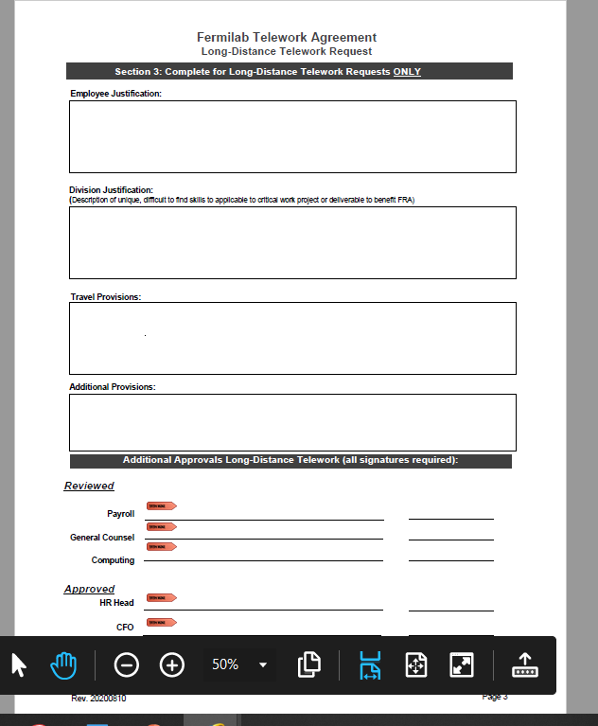
HR Updates – Remote Work Policy Work Agreement

Slide 6
WDRS Updates
Fraudulent unemployment claims have been rampant in Illinois since the onset of COVID-19 and this has been impacting Fermilab employees.
Fermilab is closely monitoring these claims and directly notifying employees of any suspicious claims from IDES (Illinois Department of Employment Security).
If you or one of your employees receive any notifications from IDES through the mail or suspect fraud, please reach out to me for information on how to address the claim.
We can provide specific guidance and additional resources to assist in resolving the claim. Please note that victims of fraudulent claims will never be responsible for paying any funds to IDES and any communication that requests payment should be disregarded.
Fraudsters often obtain a victim’s identity through data breaches and it is recommended that you monitor your credit and update your passwords at least annually to mitigate your risk. The Federal Trade Commission’s website, Identitytheft.gov, is a great starting point to report and recover from identity theft if you should any fraudulent activity.
IDES also has a website dedicated to unemployment-specific fraud. IDES’ online fraud contact form here: https://www2.illinois.gov/ides/Pages/Report-Identity-Theft.aspx#IDimage.
Or call IDES to report the fraud at 800-814-0513.

