Slide 1
PPD Department Heads Meeting ESH January 2021
Raymond Lewis, Katie Swanson & Bridget Iverson

Slide 2
COVID at the lab
Fermilab
PPD
128 Suspected
46 Confirmed
226 Quarantined
Since Jan. 1:
17 Suspected
4 Confirmed
27 Quarantined
19 Suspected
8 Confirmed
29 Quarantined
Since Jan. 1:
1 Suspected (User)
1 Confirmed
1 Quarantined

Slide 3
COVID protocol updates
Quarantine changed from 14 to 10 days. Please try to avoid close proximity work for days 10-14 onsite. Close proximity work still requiring Division Head approval.
New Executive Order requires face masks at all times unless in your own 4-walled office with the door shut, so face masks in cubicles required.
Excerpt from the OMB memo:
Appropriate masks should be worn consistently. Masks should be worn in any common areas or shared workspaces (including open floorplan office space, cubicle embankments, and conference rooms). Masks should also be worn in outdoor shared spaces when physical distancing cannot be maintained. Agencies may provide for exceptions consistent with CDC guidelines, for example when an individual is alone in an office with floor to ceiling walls and a closed door or for a limited time when eating or drinking and maintaining distancing in accordance with CDC guidelines.
9 cases of the B.1.1.7 variant reported in Illinois samples collected 12/29-1/15

Slide 4
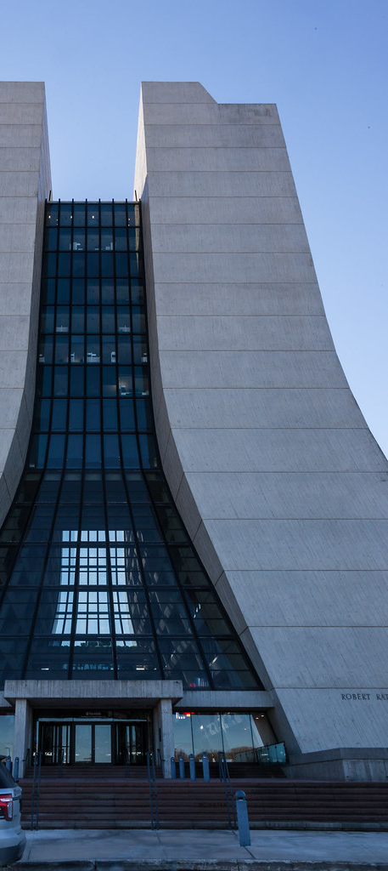
Business Travel– Arriving at Fermilab (Batavia)
Everyone (employees, visitors and contractors) traveling by commercial airline to Fermilab, Batavia for business/work-related reasons must do the following:
Quarantine for 14 10 days, if possible. Please telecommute during this time.
If quarantine is not possible:
You may access the site but are not allowed to perform any close proximity work (< 6 feet), regardless of protective measures, until results of a COVID-19 test are received.
Note: Until negative covid test results are received, business travelers must keep a minimum of 6 feet between themselves and others at all times, regardless of protective measures. COVID-19 testing is not required if this minimum distance can be maintained, and after 14 days close proximity work may be done with appropriate hazard analysis and protective measures.
A test will be administered 5 days after your arrival
If the results are negative, close proximity work may proceed (with appropriate HA, PPE, protective measures, etc.). If the result is positive, you must leave the laboratory and isolate (guidance will be provided), and contact tracing will be completed.

