Slide 1
Testing Update
Tony Earle

Slide 2
Bug hunting
Trying to track down hit continue bug which occasionally raises hit continue flag when the hit end time is less then 63
Examples of these hits were extracted from ProtoDUNE capture data using Joel Greer’s analysis tools
Created 64 tick WIB file starting from timestamp 0x11B54DA5BD3DA49 for testing
<number>

Slide 3
Single Link ZCU102 HW
Hitfinder Output
TPG Output
CR Interface Output

Slide 4
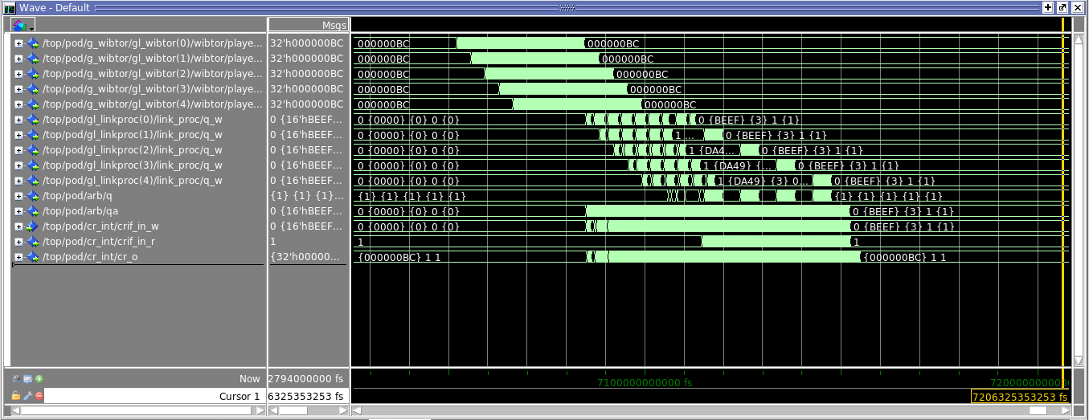
Multi-Link “Ultimate” Sim
CR Interface Output

Slide 5
Limitations
Wibulators don’t fire in sync
Can only evaluate a wire at a time due to pedestal/accumulator values
WIB tick number limitation in HW/Sim fullchain/ultimate builds due to wibulator size
Working at the moment to run data just through arbitrator test bench as that would allow simultaneous writes to all ports

