Slide 1
ArgonCube Engineering Meeting
January 22nd, 2021

Slide 2
Agenda
Light Readout – Sasha Selyunin
Charge Readout – Brooke Morrison
Module 0 Schedule – Andrew Lambert
Round Table - All

Slide 3
Module 0 Recent Progress
Functional testing enclosure for pixel boards: production at LBNL shops completed
Enclosure assembly being assembled today & testing beings
Functional testing enclosure for light tiles: production complete, assembly complete, in testing now
Top flange LAr inlet modification – welding complete?
James and I combed through Module 0 schedule this week & updated (see next slide)
Continuing tasks:
PLC
Charge tile shipment to Bern & test
Complete light readout testing
Cryogenics system regeneration
Procedure development

Slide 4
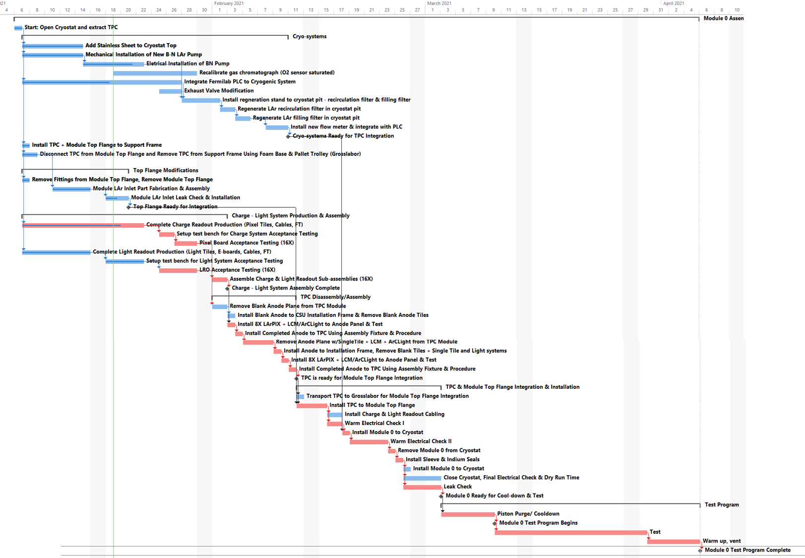
Module 0 Assembly & Test Schedule
Critical path currently flows through charge + light tile warm testing prior to TPC assembly
Cryogenic PLC development competing with this based on recent updates from Bern
Igor Kreslo (Bern) working closely with FNAL colleagues on this
Test begins March 10th

Slide 5
Module 0 Procedure Development
No. | Document Description | Status | Who? | Notes
1 | Field Cage Assembly Procedure | Complete | Francois/SLAC | Completed, used in Module 0 HV
2 | TPC Integration Procedure | Near Complete | JJ/CSU | Incorporate lessons learned from Module 0 HV assembly, pixel mapping & light mapping
3 | Pixel Board Warm Enclosure Acceptance Test (Post Shipment) | Testing | Brooke/LBNL | Dan & Armin reviewing
4 | Pixel Anode Bring-Up (Post TPC Installation to Cryostat, warm) | Testing | Brooke/LBNL | Dan & Armin reviewing
5 | Light Readout Acceptance Test (Post Construction, pre-installation) | Testing | Igor/BERN; Nikolay/JINR
6 | Light Readout Bring-Up (Post TPC Installation to Cryostat, warm) | Testing | Igor/BERN; Nikolay/JINR
7 | Integrated TPC Grounding & Noise Testing Procedure (warm) | Started | Armin/LBNL;Igor/BERN Review: Linda | Charge + Light Teams
8 | High Voltage Cable Insertion Procedure (warm) | Started | Knut/SLAC | Incorporate lessons learned from Module 0 HV assembly
9 | TPC Lifting & Installation Procedure | Started | James/FNAL;AL/LBNL | Covers TPC removal from support frame through cryostat installation

