Slide 1
ArgonCube Engineering Meeting
Lambert
01/29/2021

Slide 2
Agenda
TPC Integration & Installation – Lambert
Charge Readout Update – Mod0 – Karcher
Module 0 Schedule Update – Lambert
Round Table & AOB – all

Slide 3
Technical Scope

Slide 4
High-Level Flow Diagram
High level summary of TPC Installation Activities from receipt of TPC modules to installation into the cryostat
Green Rectangles: Items that are to be integrated together
Blue Rectangles: Integration & installation activities
Orange Hexagons: Required procedures for a given activity
Orange Diamonds: Binary decision trees
Not all interfacing systems are shown

Slide 5
TPC Integration & Installation (ND-LAr)
Integration of the ND-LAr modules and the LAr cryostat lid at the Near Site Surface Building
Coordinates effort with I&I @ Near Site for:
Near Site surface building assembly space, facility requirements, interfaces, and integration schedule
Primary deliverables of this WBS subsystem:
Integration procedures & hardware of the ND LAr modules to the LAr Cryostat Lid
Pre-Cavern Functional Verification, Electrical & Grounding Tests
Preparation of integrated ND LArTPC for transfer to Near Site Cavern
Costs: Assembly, handling, lifting fixtures, hardware, tech

Slide 6
TPC Integration & Installation (ND-LAr)
Installation of the ND-LAr modules & LAr Cryostat in the Near Site Cavern
Coordinates effort with I&I @ Near Site for:
Near Site cavern assembly space, facility requirements, interfaces, and integration schedule
Primary deliverables of this WBS subsystem:
Assembly procedures & hardware for the LAr Cryostat main body
Warm structure & cold structure
Installation procedures & hardware for the ND LAr modules to the LAr Cryostat main structure
Functional Verification (pre-final assembly), Electrical & Grounding Tests for Detector
Final assembly of cryostat and helium leak checks
Installation procedures and hardware for cryostat mezzanine and ND LAr module services
Costs: Assembly, handling, lifting fixtures, hardware, tech

Slide 7
Commissioning (ND-LAr)
Responsible for transfer to operations
Near Site Integration QA activities & QC checkouts
Lead Commissioning
Final functional checks pre-fill
Cool-down monitoring of ND-LAr TPCs and cryostat
Instrument bring-up and operational checkouts
Instrument commissioning

Slide 8
Programmatic Interfaces

Slide 9
Rough Schedule (work in progress)
FY 2021 (Preliminary Design)
WBS, cost & schedule development
Requirements & Interfaces
Integration & installation fixtures preliminary CAD
Preliminary lifting & installation procedures
Mock assembly design
FY 2022 (Final Design)
Final requirements & interfaces
Integration & installation fixtures final CAD
Final lifting & installation procedures
Mock assembly design
Mock assembly procedures
Mock assembly procurements (installation fixtures and mock components)
FY 2023
Mock assembly staging
Module row integration mock assembly
Module row to cryostat mock installation
FY 2024
Review mock assembly results
Implement final changes to integration & installation designs and procedures
PRR for integration & installation fixtures
FY 2025
Final procurements for integration/installation
FY 2026
Final procurements for integration/installation
Near Site occupancy
Stage integration and installation fixtures
Module Row Integration
Module Row Installation
FY2027
Module Row Integration
Module Row Installation
FY2028
Module Row Installation
Commissioning

Slide 10
Risks
Category | Title | Summary | Mitigation | Response
TPC Installation | Insuffient storage space for fully tested LArTPC modules that are ready for installation | IF there is insufficient storage for completed modules, THEN Module Integration Facility operations could be affected/delayed | Planned Mitigation: Find and document committed storage location at FNAL | Scale back rate of integration/testing
TPC Installation | Stored module contamination | IF fully assembled modules are not properly stored THEN they could become contaminated and require cleaning prior to installation | Planned Mitigation: Refine storage conditions for contamination. Flow these requirements to storage room (humidity, temperature, etc) Unfunded Proposed Mitigation: Store in environmentally controlled building/room, and/or design dust-proof or hermetic storage containers | Clean modules -> investigate options here
TPC Installation | LArTPC modules are damaged in transport from Module Integration Facility/Storage to Near Site | IF modules are damaged in transport to the Near Site, THEN there will be delays in the installation schedule | 1. Engineered transport containers, shipping plan 2. Utilize spare module | Return damaged module for repair OR lose a spare modue
TPC Installation | LArTPC modules are damaged during installation process | IF modules are damaged in the installation process, THEN there will be delays in the installation schedule | 1. Utilize spare module 2. Repair damaged module | Return damaged module for repair OR lose a spare modue
TPC Installation | Additional staff may be needed to deal with unforeseen issues during Near Site Installation | IF addtional staff is needed during Near Site Installation, THEN there are potential schedule delays and cost increases | TPC Installation WBS sub-system to specifically address Near Site Installation issues | Increase staffing for installation
TPC Installation | Insufficient personnel for Module checkouts during/after installation | IF there is insufficient personnal to help with module checkouts, THEN there could be schedule delays | US consortia partners make agreements for in-kind student/postdoc labor? | Increase staffing for installation

Slide 11
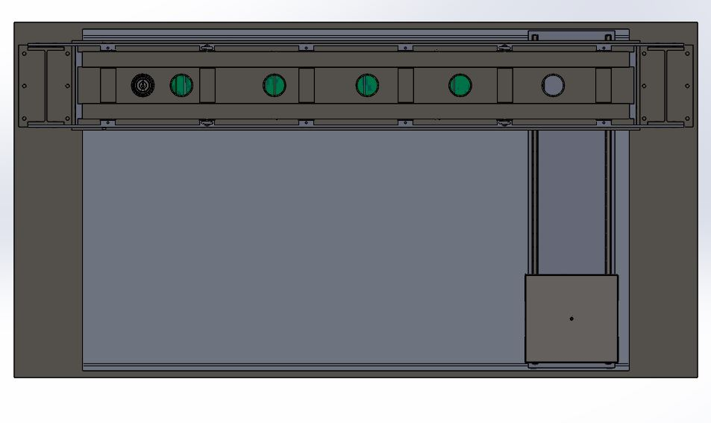
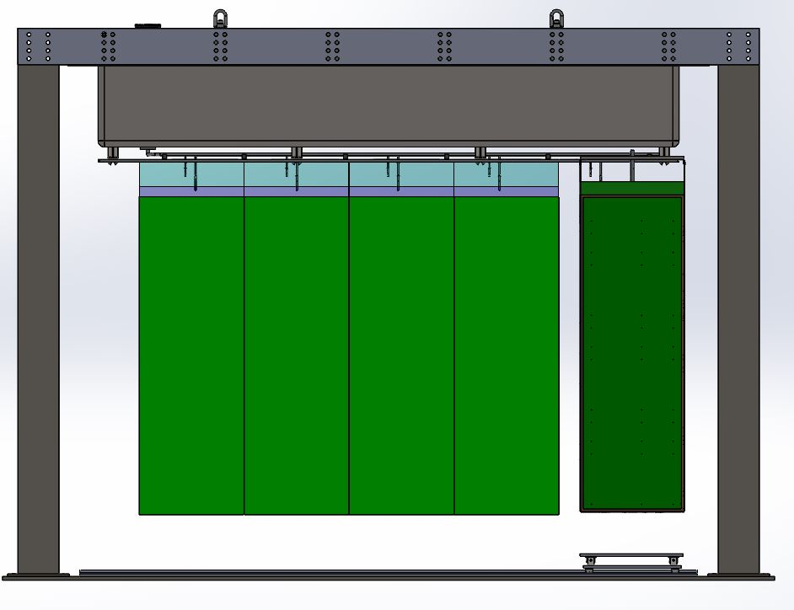
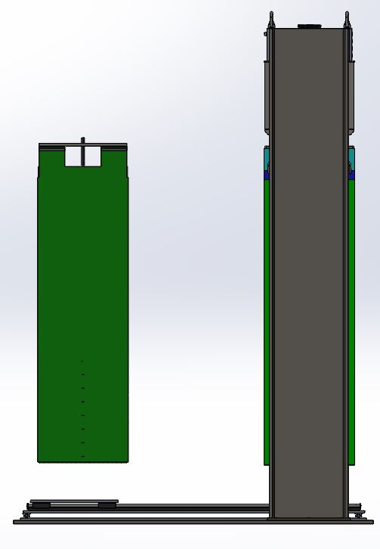
Integration Fixture Conceptual Design
**T.Rathmann
Lateral movement system using railing & bearings, driven by lead screw
Can use gearbox for reduction in lead screw RPM
Vertical movement can be accomplished via similar lead screw or six-strut system
Designing C-frame structure to grab module from top plate
Similar to DESI
FP Install

Slide 12
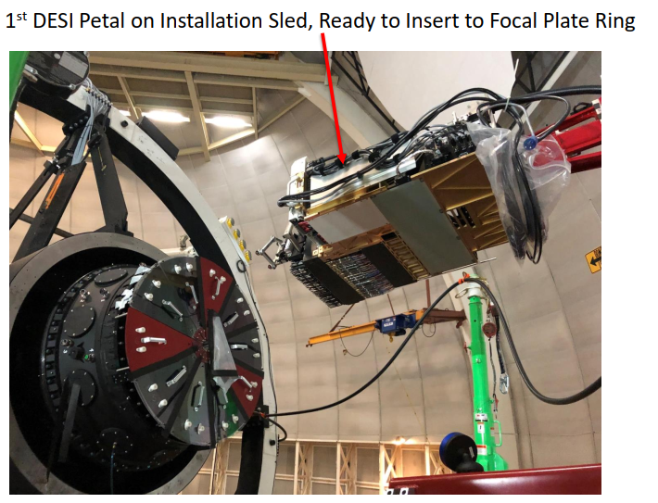
FPA Sled was used to install FP petals -> had to align to telescope, petal to petal clearance = 600 microns
**T.Rathmann

Slide 13
Summary
TPC Integration & Installation moving along
Flow diagram to outline process and get a first count of require procedures
Function verifications, high-consequence lifts, assembly procedure, etc.
ND-LAr TPC to cryostat lid integration fixture under design
Based on previous experience with installing modular assemblies with tight clearance requirements

Slide 14
Module 0 Assembly & Test Schedule
01/29/2021
Slippage due to charge readout PACMAN issues:
Problem & fix is identified and parts are in-hand
Surgery on boards to keep moving and continue with bench testing
Test Date = March 24th

