Slide 1
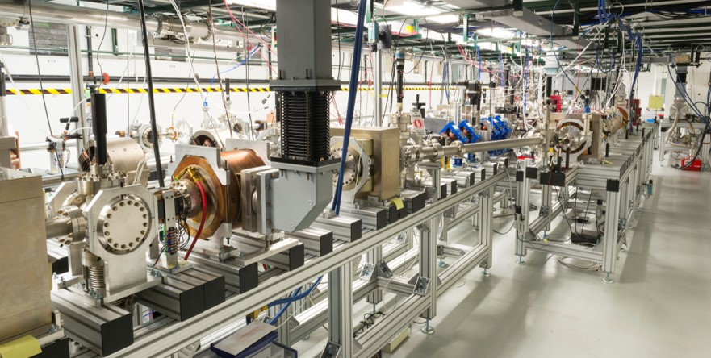

SWFA Development for an Energy Frontier Machine
Structure wakefield acceleration (SWFA)
erhtjhtyhy
John power (for C. Jing)
Argonne Wakefield Accelerator
General Accelerator R&D Test Facility
Argonne National Laboratory
Snowmass AF7-rf group miniWorkshop on Cavity Performance Frontier (Feb 16, 2021)

Slide 2
Introduction to swfa
Two Beam Acceleration – TBA
Collinear Wakefield Acceleration - CWA

Slide 3
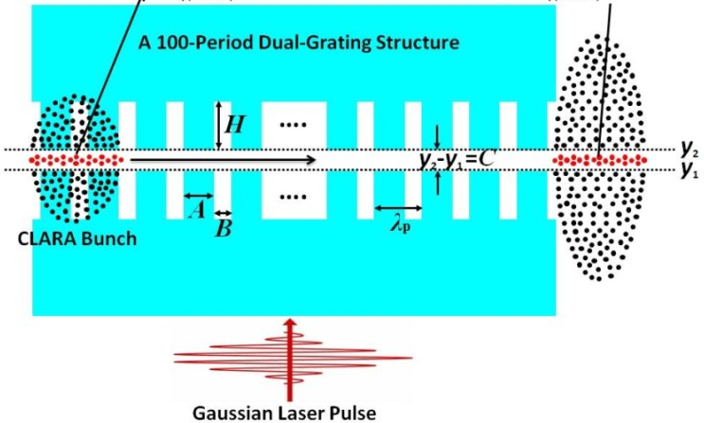
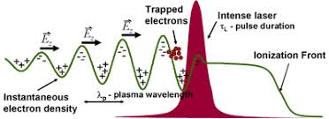
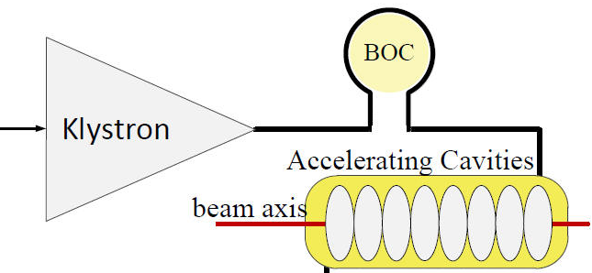
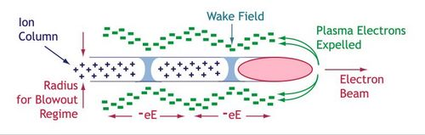
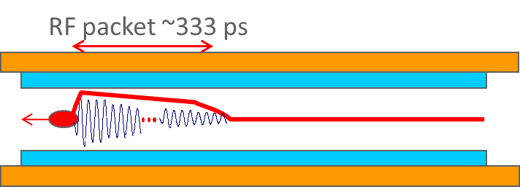
Externally Driven RF Acceleration
Advanced Acceleration Concepts
LWFA
(Laser WF Accelerator)
DLA
(Dielectric Laser Accelerator)
Laser pulse
External RF source
Energy Source
= Wakefield Acceleration
PWFA
(Plasma WF Accelerator)
SWFA
(Structure WF Accelerator)
Particle beam
RF Driven Structure
Note: there are many overlaps between beam-driven and RF structures.
Plasma
Structure
Medium

Slide 4
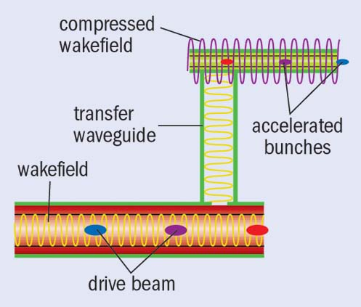
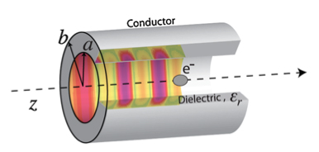

Electron beam driven wakefield acceleration
Two Types of Structure Wakefield Acceleration (SWFA)
Collinear Wakefield Acceleration
Two Beam Acceleration
drive beam
main beam
M. Rosing and W. Gai, Phys. Rev. D Vol 42, No. 5 (1990)

Slide 5
Steps, milestones, pathways and spinoffs
SWFA LC
10GeV stepping stone facility
Compact light source
1GeV high quality beam
Advanced beam manipulation techniques
50% of RF-beam efficiency
GV/m level of gradient
Cost effective, ultra- compact structures
GW level RF power
High power MW --THz sources

Slide 6
SWFA applications
High repetition rate multi-user X-ray FEL (Stepping Stone facility)
Mutli-TeV linear collider

Slide 7
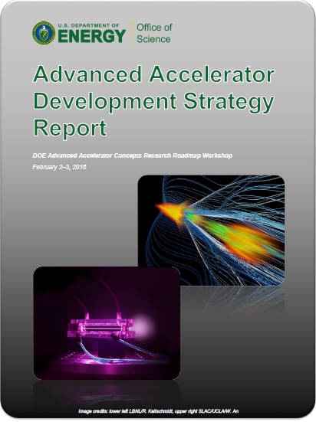
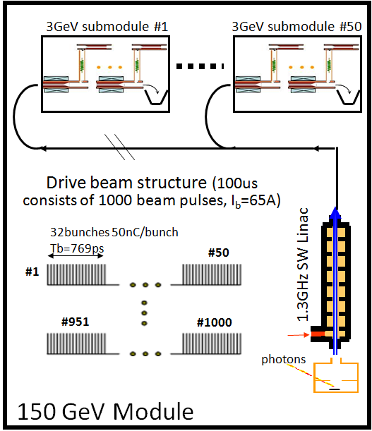
AFLC: Short-pulse swfa 3 TeV collider concept
Based on dielectric TBA technology
    LOW CONSTRUCTION COST: Dielectric structures
    HIGH EFFECTIVE GRADIENT: Short RF pulses (20ns)
    LOW OPERATING COST: Wall plug efficiency ~15%
details
Argonne Flexible linear collider
main beam booster linac
e⁻ generation
e⁺ generation
100us
100us
20 x 5 us pulses
I_{b}=6.5A
main beam structure
5us
16ns
IP
3TeV
1
10
10
1
  Modular design
  (easily staged)
    e⁺ e⁻ 267 MeV/m of loaded gradient
    (200 MeV/m effective gradient)
W. Gai, J.G. Power, and C. Jing, J. Plasma Phys., vol. 78, 339–345 (2012).

Slide 8
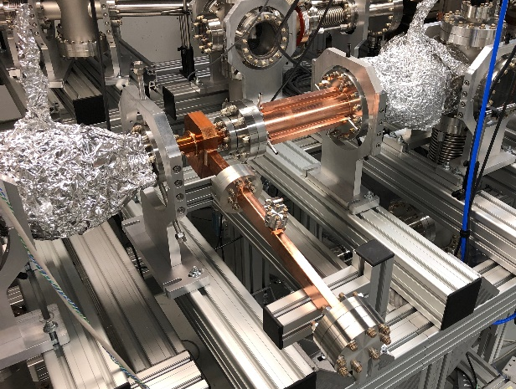
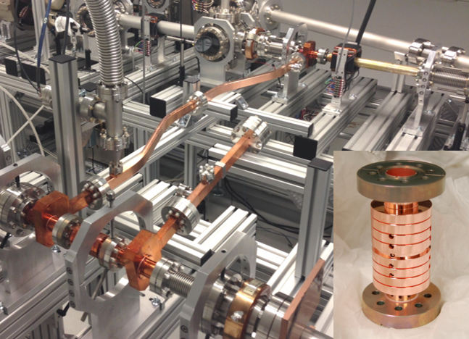
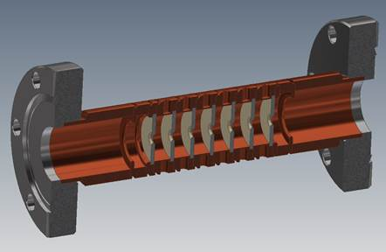
AFLC (tba)
structures
DECELERATING STRUCTURE
ACCELERATING STRUCTURE
DRIVE BEAM POWER GENERATION
ACCELERATION GRADIENT
1 GW
300 MeV/m
26 GHz
Dielectric Disk Accelerator
8
See J. Shao talk for latest progress

Slide 9


High repetition rate multi-user X-ray FEL facility
Beam Shaping + Collinear Wakefield Accelerator + SC undualtors
Low Emittance MHz injector
MHz CW
SRF linac
Low Energy Spreader
SC Undulators
Experimental End Stations
5 GeV
ANL/APS
Transformer Ratio
TR = 5 (new record)
1 GeV
PRAB 20, 061302 (2017)
PRL 120, 114801 (2018)
5 mA
Bunch Shaping
PRAB 19, 121301 (2016)
PRL 118, 104801 (2017)
Beam Shaper ~ 5 MeV
CWA
BBU control in the strong wake regime
PRSTAB 17, 091302 (2014)
PRAB 21, 031301 (2018)
Main work being done by the collaboration
9
A. Zholents et al, “A preliminary design of the collinear dielectric wakefield accelerator”, Nucl. Instrum. Meth. A829 (2016)190-193.

Slide 10


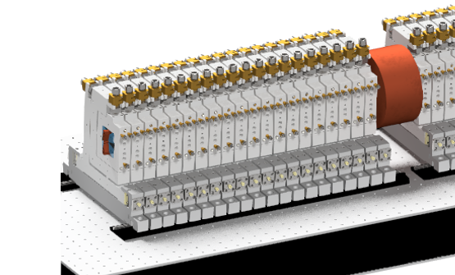
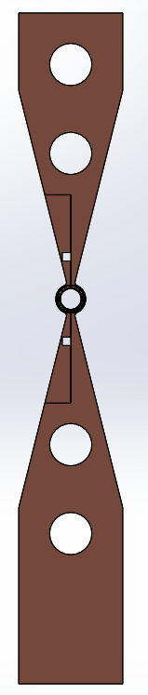
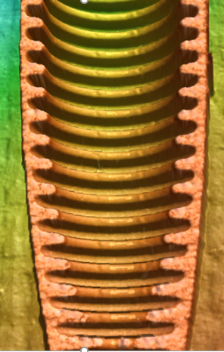
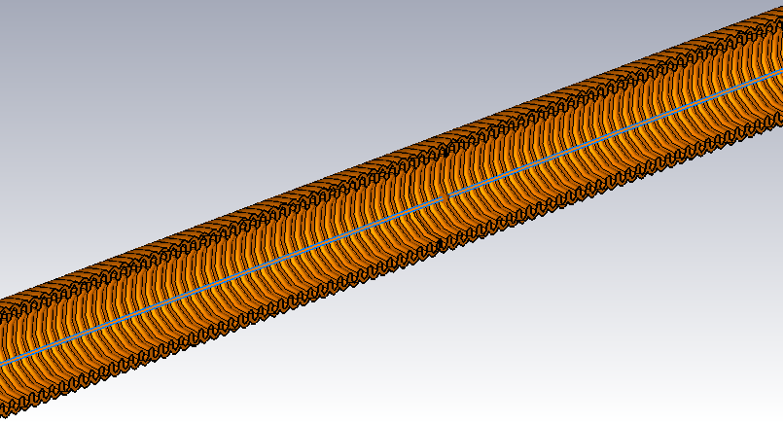
Near term goal is construction of CWA Module
straight cut
Components in the Accelerator Module
Accelerator Module
Vacuum chamber
Test samples are wire EDM cut to expose the internal corrugations for dimensional analysis
0.22 m
angular cut
0.5 m
182 GHz Corrugated Waveguide
Water in and out channels.
Assists with the increases of beam energy by ~ 50 MeV.

Slide 11
Structure wakefield test facilities
Argonne Wakefield Accelerator (AWA), FACET, ATF

Slide 12
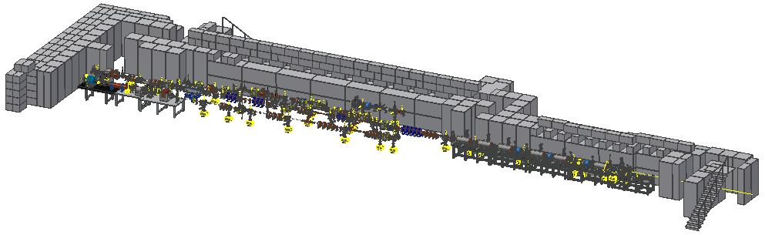
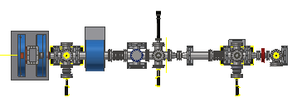

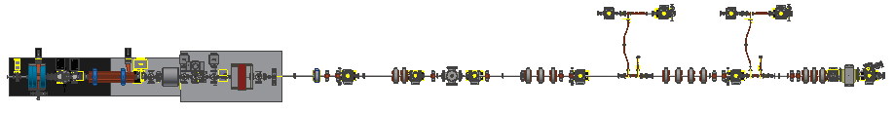
AWA facility
Highly reconfigurable beamlines
Zones 2-5 are experimental areas
Zones 2, 4, and 5 have ~ 1 m experimental area
Zones 3A & 3B are fully re-configurable
AWA Bunker
EXPERIMETNAL AREA
ACT
Drive
AWA Vacuum and Experimental Zones
Witness

Slide 13
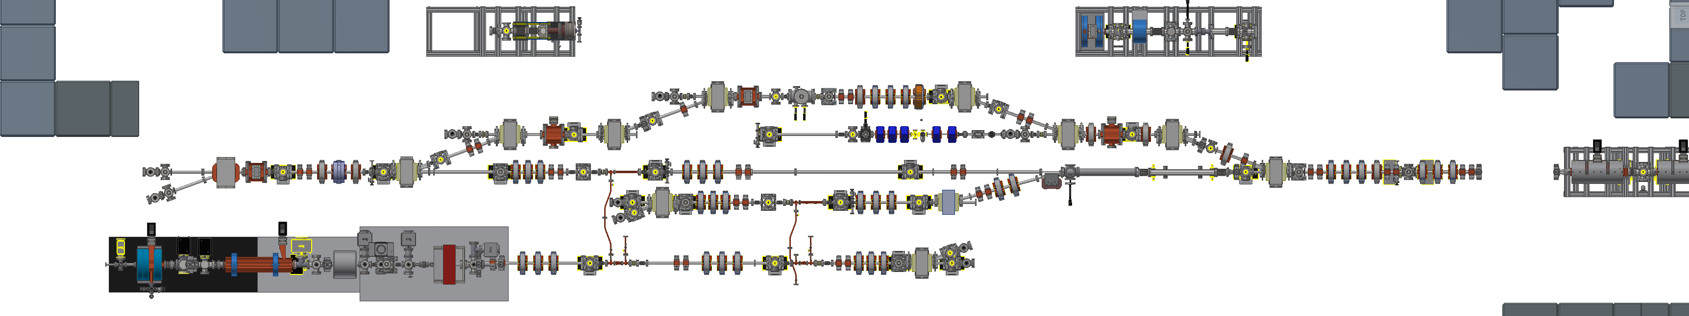
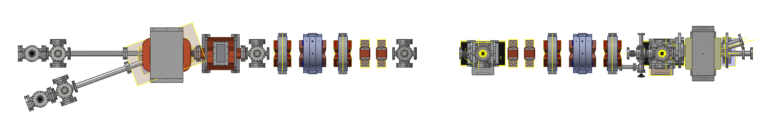
AWA facility
Experimental Areas
Advanced Accelerator Concepts
Accelerator and Beam Physics
GUN TEST STAND
Particle Sources
Upgrade to 1.5 cell RF gun with load-lock
Single-shot longitudinal phase space diagnostics
INJECTING MANIPULATED LASER
α-BBO pulse stacker
multi-splitter (train)
MLA (homogenizer)
SLM (laser long shaping)
SWFA/PWFA test areas
GUN
65 MeV drive linac
15 MeV witness linac
6d emittance repartitioning
Staging Beamline
Double Emittance Exchange Beamline
(longitudinal bunch shaping)
+
Skew Quad Beamline
(Round to Flat beam)

Slide 14
AWA capabilities - beams
Wide dynamic range
SINGLE BUNCH PARAMETERS
Beam parameters | Value | Note
Charge [nC] | 0.1 – 100 | *Have generated sub-pC beam but difficult to detect.
Energy [MeV] | 6 – 63
Rep. rate [Hz] | 0.5 – 10 | *2 Hz is nominal
Transverse laser diameter [mm] | 0.5 - 22 | *Uniform distribution (MLA)
Longitudinal laser pulse length [ps FWHM] | 0.3 | *Gaussian distribution **Flattop distribution (using α-BBO)
Bunch length [mm] | 0.1 - 3 | *High charge compression is not available
Transverse emittance [µm] | 0.5 - 240
Peak Current [kAmps] | 0.5 - 25
pancake

Slide 15
AWA capabilities - beams
Variable Machine Configurations
Operation modes | Value |  | Methods
Bunch train | Modulation frequency [GHz] | 1.3 – 10³ | Laser multi-splitter Alpha-BBO EEX+mask EEX+transverse wiggler TDC+mask (R&D)
 | Charger per bunch [nC] | <60
Longitudinal shaping | Shape | Arbitrary | EEX TDC (R&D) Laser based (R&D)
 | Charge [nC] | <5 → <20
Flat beam | Charge [nC] | <5 | Angular momentum dominated beam + skew quads
 | Emittance ratio | <150
Transverse shaping | Available type | Homogenization Dot-array Hollow | MLA optics
Notes:
Multilens array

Slide 16
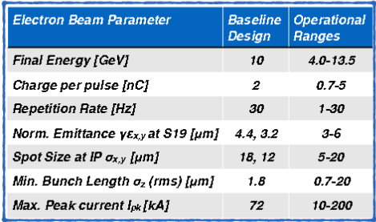
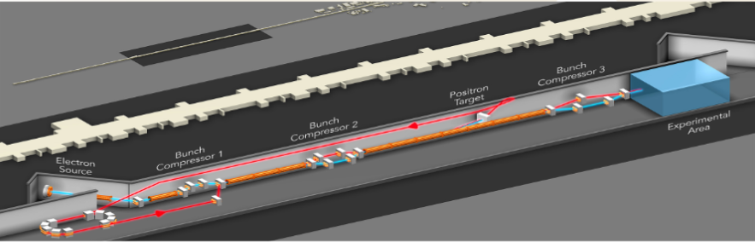
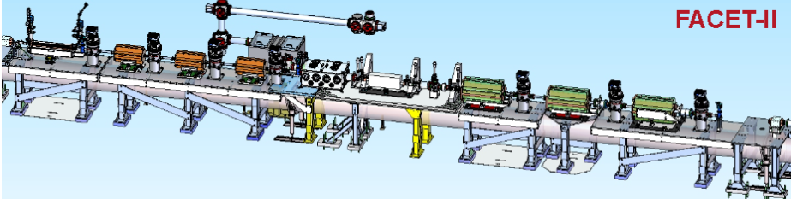
Facet-ii layout and beams
FACET-II Experimental area
Ideal for ~10 GV/m breakdown test

Slide 17
Novel Structure Development

Slide 18
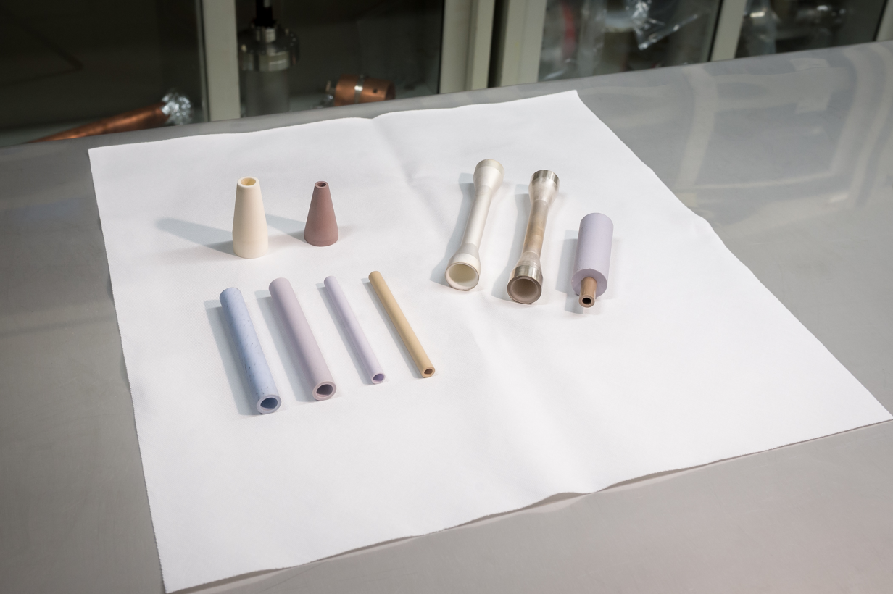
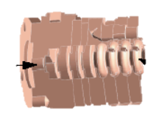


Beam-driven Structure development
METALLIC
materials
DIELECTRIC
temperature
frequency
MICROWAVE
THz

Slide 19
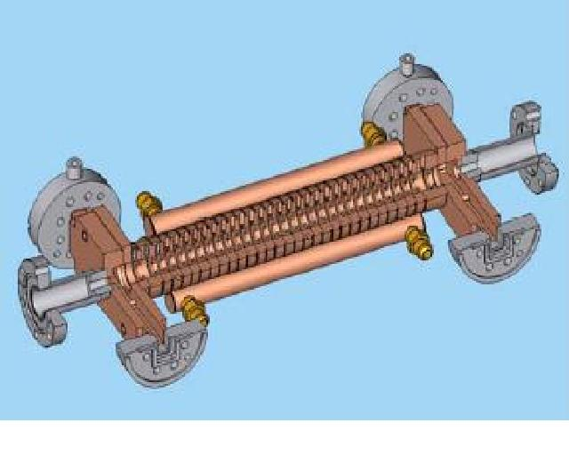
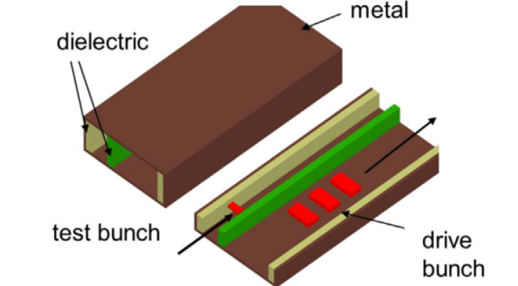
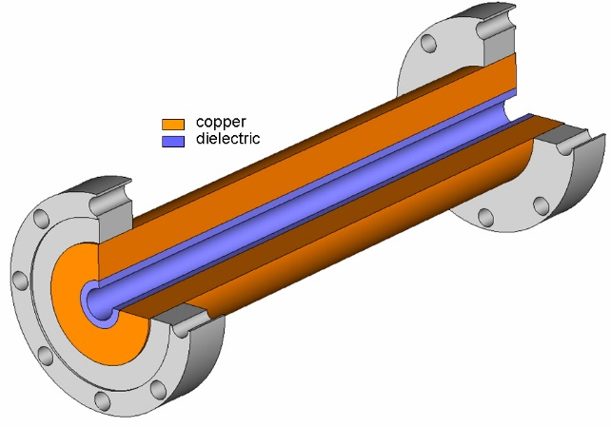
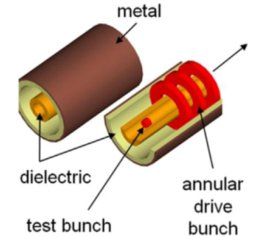
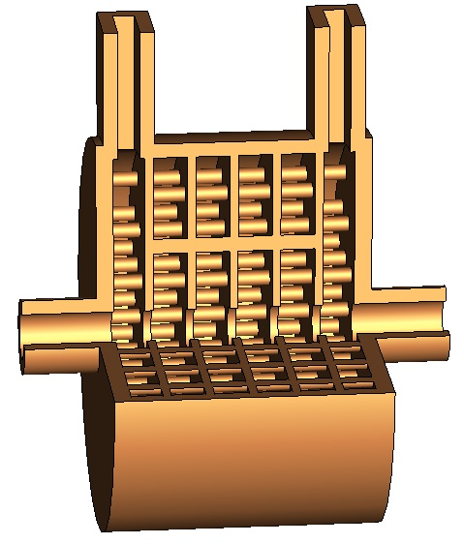
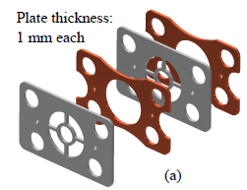
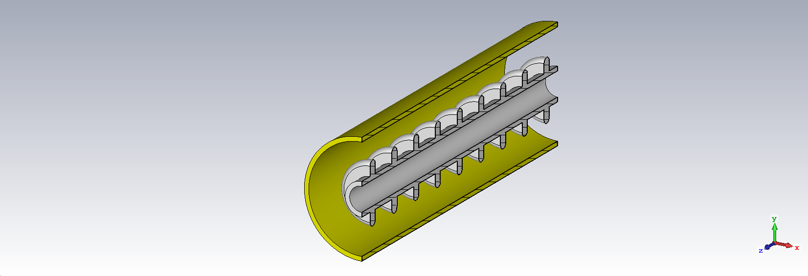
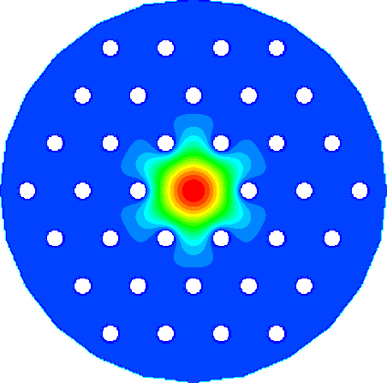
Advanced Accelerator concepts
Geometry
planar & cylindrical
Structure Development
Dielectric loaded structures
Iris loaded structures
2-channel rectangular dielectric
Dielectric disk accelerator
Coaxial dielectric
Photonic band gap structures
Meta/left-handed structures
Cryogenic Dielectric
Corrugated accelerator

Slide 20
summary

Slide 21


Final Remarks
LOI-90: Structure Wakefield Acceleration (SWFA) Development for an Energy Frontier Machine
Core Message of LOI:
  1) the SWFA roadmap presented in 2016 Advanced Accelerator Development Strategy Report needs to be updated.
  2) Taking example of the plasma wakefield community, the SWFA community need to strengthen the collaboration and coordinate the efforts in the next decade.
Key Words:
      Coherent efforts inside the SWFA community
      More visibility outside the AAC community
      More resources from funding agency

