Slide 1
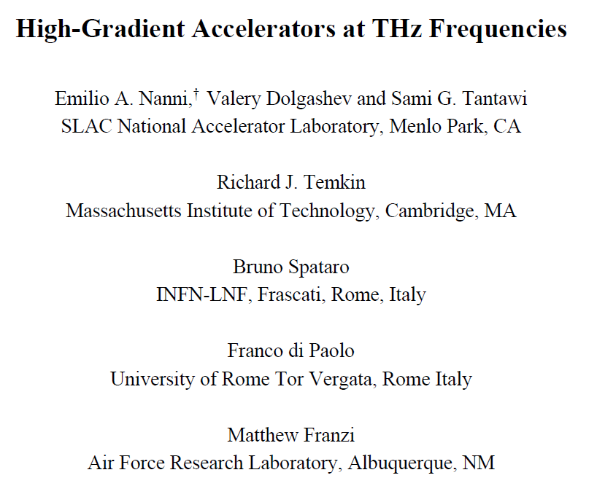
High-Gradient Accelerators at THz Frequencies
Emilio Nanni
Feb. 16, 2021

Slide 2
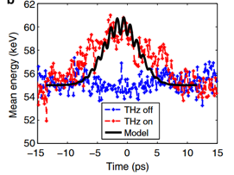
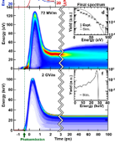
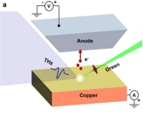
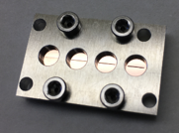
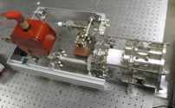
Accelerator Technology Advancements Drive Scientific Discovery from Ultrafast Dynamics at the Atomic Scale to the Energy Frontier
Next Generation THz Accelerators in Pursuit of Compactness,
Efficiency and Performance (Progress in ~5 Years):
Acceleration
Photoinjectors
<1 fs Timing; 10s fs Bunches
Toward Externally Driven GeV/m Accel.
Snively, et al., PRL (2020)
R.K. Li, et al., PRAB (2019)
Nanni et al.,
Nature Comm. 6 (2015): 8486.
Huang, W. R., et al., Nature Scientific Rep. 5 (2015).
Othman et al., APL (2020)
Impacting Diverse Scientific Mission:
High Current, High Luminosity >>10s pC, bunch trains
X-ray Generation – few to 10s pC, low emittance
Ultrafast Electron Diffraction - 100 fC, <10 fs
Precision Diagnostics and Beam Manipulation - <fs resolution

Slide 3
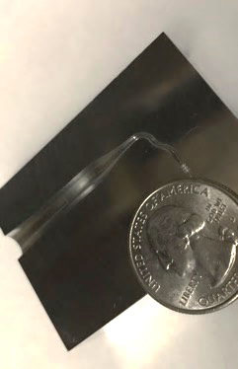
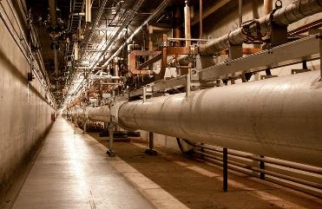
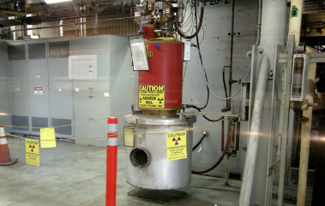
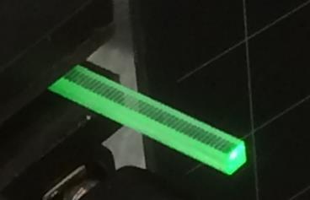
Next Generation Accelerators in Pursuit of Compactness, Efficiency and Performance
S-band Accelerators
30 MeV/m
mm-Wave/THz Accelerators
GeV/m
Klystron Source
10s MW, µs, ~3 GHz
mm-Wave/THz Sources
MW, ns, ~0.3 THz

Slide 4
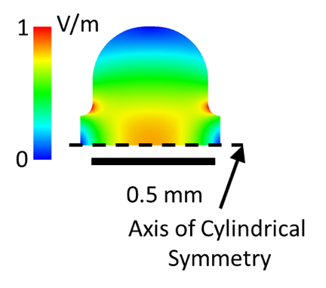
Comparison Between RF and THz Accelerators
Scaling structure design from S-band to the THz range
Parameters for 100 MeV/m Gradient
Frequency | 3 GHz | 300 GHz
Stored Energy [mJ] | 8450 | 0.013
Q-value [x1000] | 17.96 | 2.05
Shunt Impedance [MOhm/m] | 55 | 514
Max. Mag. Field [MA/m] | 0.3
Max. Electric Field [MV/m] | 210
Fill Time [ns] | 2000 | 2
Loss in 1 meter [MW] | 181 | 19
decreases by
4 orders of magnitude
Potential to operate at 10s kHz vs 100s Hz

Slide 5
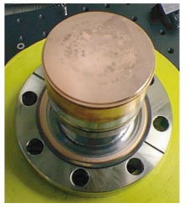
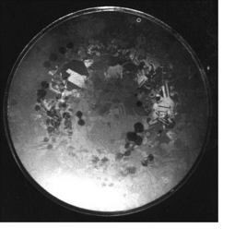
Pulsed Heating in High-Frequency Structures
Surface temperature rise during RF pulse causes damage
Surface resistivity increases as
Cavity fill time drops dramatically
3 GHz Structure
Pritzkau, et al., Phys. Rev. STAB 2002
Laurent, et al. PRSTAB 14.4 (2011): 041001
[3 GHz Structure]
300 GHz Structure
[300 GHz Structure]
Must Understand this New Regime for Frequency, Pulse Length, Stored Energy

Slide 6
mm-Wave/THz accelerators are an emerging technology for compact and efficient accelerators
Motivation for mm-Wave/THz accelerators:
  Demonstrated performance at high-gradient
  High efficiency (high shunt impedance)
  Versatile source technology (laser or e-beam sources)
  High beam power with high rep. rate and pC-scale bunches
International community has reached critical mass for rapid progress:
  MIT, DESY, SLAC, UCLA, INFN, RIKEN, Radiabeam, Tsinghua, PSI, MPQ, Cockroft, ANL, Euclid, and more….
mm-Wave/THz accelerator technology is transitioning to applications; R&D investments will push key technologies beyond TRL 4 in 5 years

Slide 7
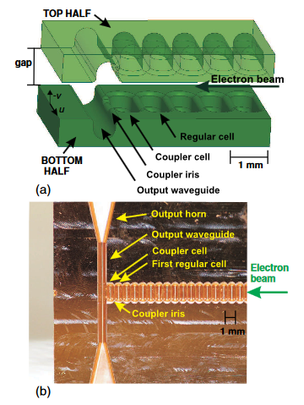
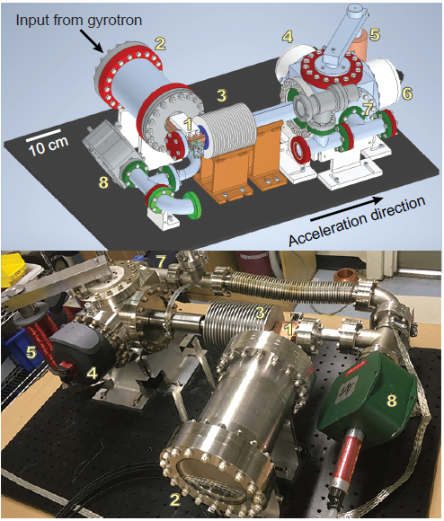
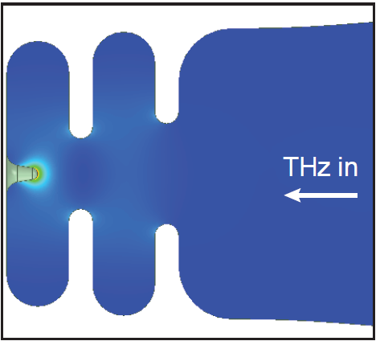
mm-Wave/THz accelerators demonstrating high gradient performance
Beam-driven and stand-alone rf sources have powered structures producing 0.3-1 GV/m fields
Many structures built and tested 100-300 GHz
Beam-driven @ FACET
RF Source Powered (110 GHz) @ MIT
THz Electron Gun
Dal Forno, Massimo, et al. PRAB 21.9 (2018): 091301.
Othman, et al. Applied Physics Letters 117.7 (2020): 073502.
Lewis et al., Manuscript in Prep.
R&D Need Next 5-years: High-Brightness injectors, 10-100 cm scale structures high gradient accelerators

Slide 8
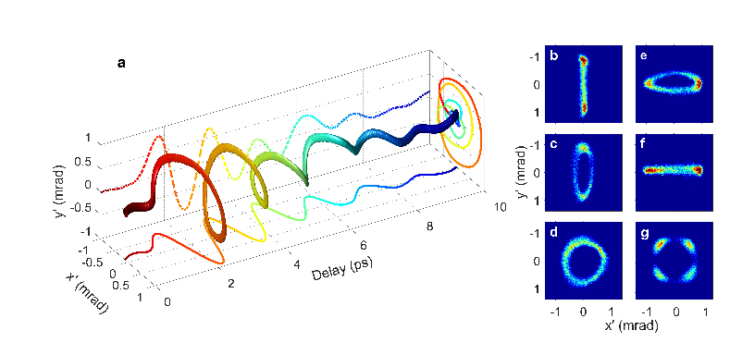
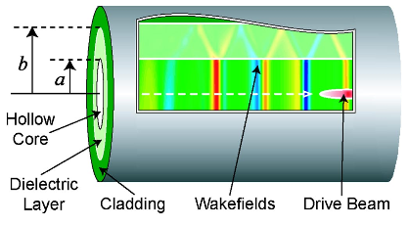
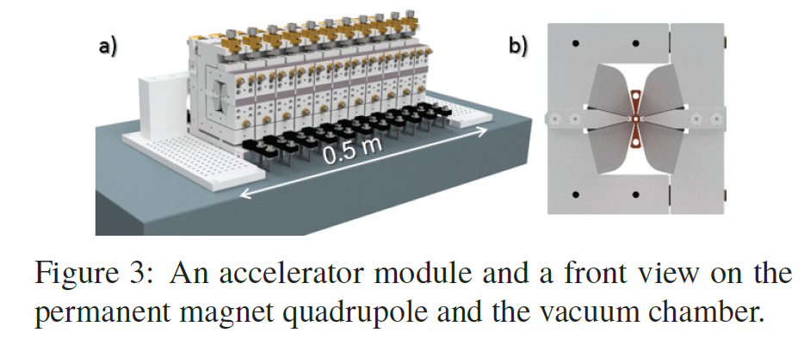
High charge (pC-scale) relativistic beams compatible with mm-Wave/THz accelerators
mm-wave/THz structures can handle pC beams for without degradation of quality, nC bunches used for generating wakefields
High rep. rate experiments (>10 kHz) can deliver high-power high-flux beams with pC bunch trains
Beam Diagnostics and Manipulation
Compression/Deflection
High-Charge Wakefield
R.K. Li, et al., PRAB (2019)
Thompson, M. C., et al. Physical review letters 100.21 (2008): 214801.
Snively, et al., PRL (2020)
Zholents, A., et al., IPAC (2018).
Zhao, Lingrong, et al. arXiv:1902.03433 (2019).
5-year R&D Potential: Improved compressors, acceleration experiments with relativistic beamlines, mm-wave/THz relativistic electron sources

Slide 9
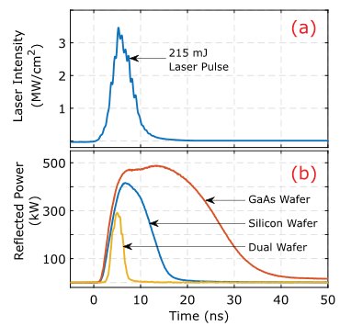
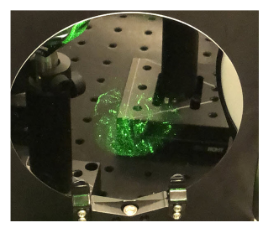
High-power switches developed to support efficient excitation of structures
Commercial MW-class gyrotrons 100-300 GHz have 50% wall-plug efficiency
Produce microsecond pulses – need quasi optics to compress/delay/distribute
High-power switch efficient(~90%) handling and coupling to accelerator
mm-Wave/THz High-Power Laser-Triggered Switches Tested with Accelerators
Kutsaev, S. V., et al. Physical Review Applied 11.3 (2019): 034052.
Enable 2-3 meter-squared footprint for RF source, modulator, and transport
Picard, Julian F., et al. Applied Physics Letters 114.16 (2019): 164102.
R&D Need Next 5-years: MW-class Compressors, Distribution and Coupling meter-scale linacs, low-loss dielectric waveguides

Slide 10
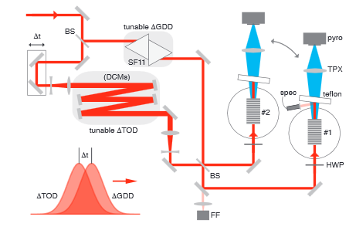
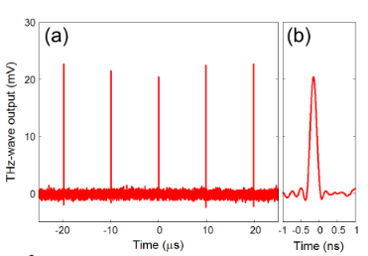
Laser-Driven THz Sources for Optimal Accelerator Performance, Compactness and High-Rep. Rate
Need nanosecond MW pulses for high-gradient and low pulsed heating
mJ narrow-band pulses demonstrated; longer wavelength optical pumps (for higher efficiency) and higher average power experiments in development
Amplification of THz pulses increase ability to integrate with existing systems
0.6 mJ Narrowband THz Pulses
High-peak power high-rep-rate Techniques
Jolly, Spencer W., et al. arXiv:1802.02508 (2018).
Moriguchi, Y., et al. Applied Physics Letters 113.12 (2018): 121103.
R&D Need Next 5-years: phase control of THz sources, higher efficiency (few % at mJ levels), higher pulse energy (few mJ), >= 1 micron for less absorption

Slide 11
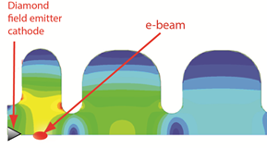
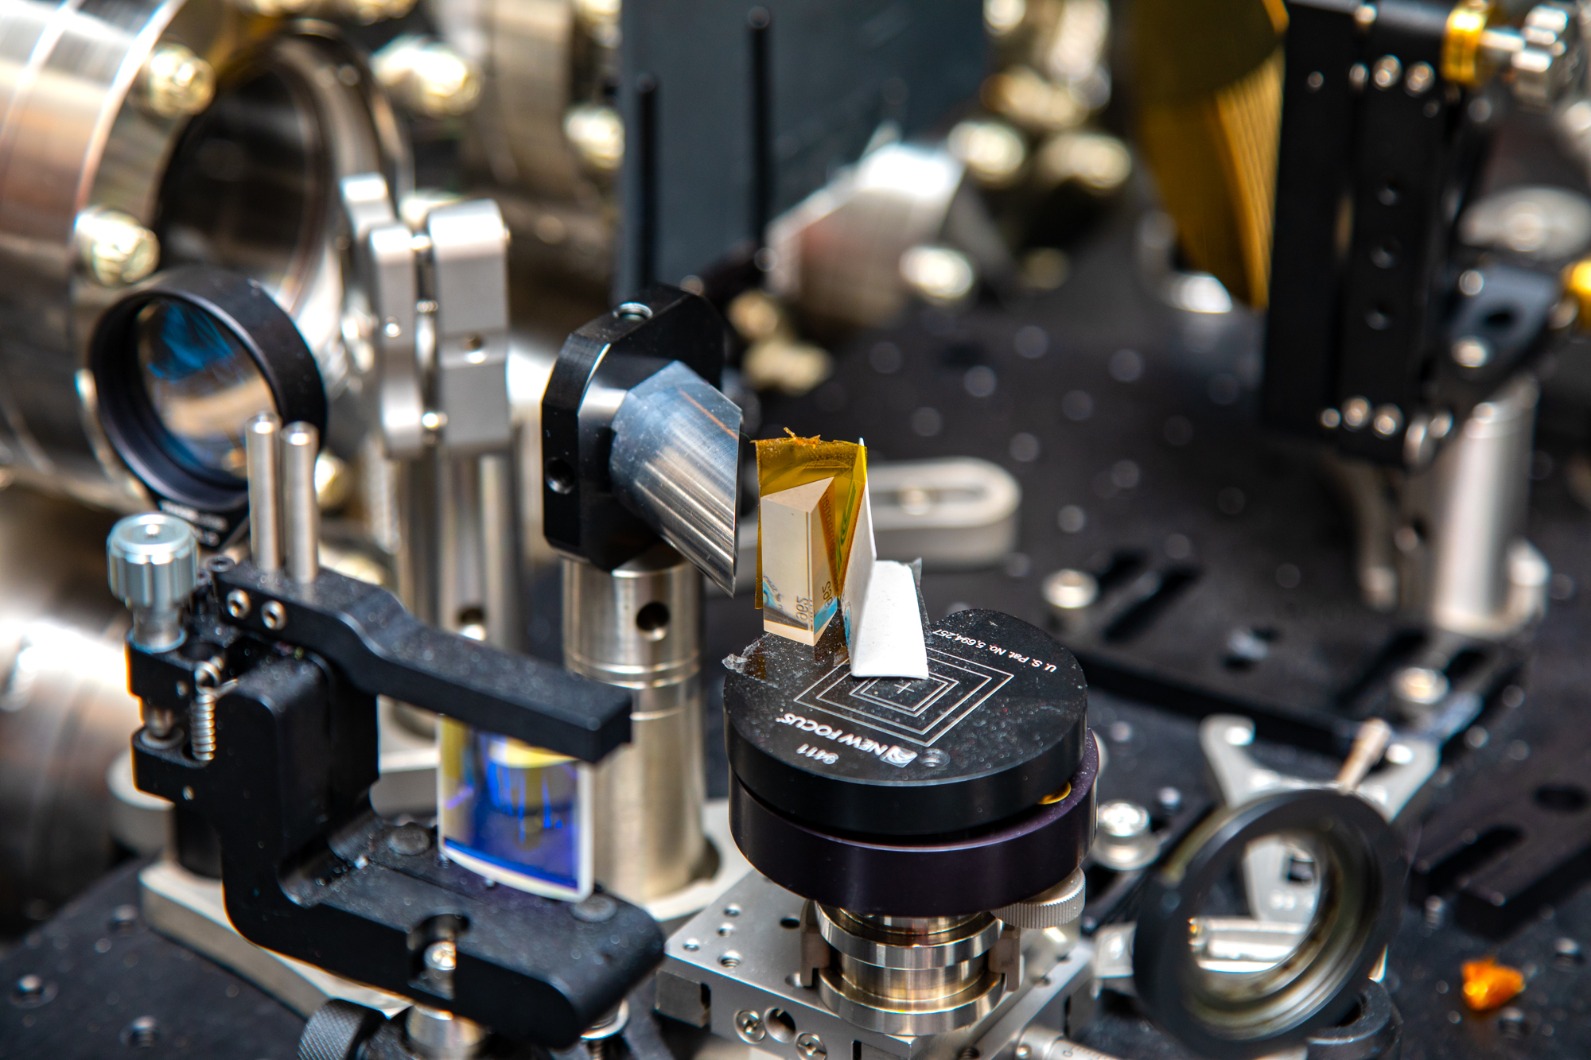
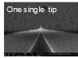
Broad Impact of THz Science and Technology
THz beam-manipulation impacting performance of today’s accelerators
Pushing forward towards a new generation of facilities by developing approaches that revolutionize performance:
High-Gradient Accelerators
High-Brightness Injectors
High Rep. Rate
THz Sources
LANL, MIT
100X increase from S-Band Gun
High rep. Rate sources
10s kHz, explore
approach to mJ pulses
GV/m fields
30X smaller

