Slide 1
Key directions for R&D of SRF cavities
Sergey Belomestnykh
mini-Workshop on Cavity Performance Frontier, 16-17 February 2021

Slide 2
LOI

Slide 3
Motivation
SRF is a critical technology for several accelerator-based frontier HEP facilities:
  HL-LHC (crab cavities)
  LBNF/DUNE/PIP-II
  Future linear (ILC) and circular (FCC-ee, CEPC) colliders
  Muon collider?
Other potential applications:
  Next generation dark sector searches (axions, dark photons…)
  Quantum computing for HEP
Synergy with other fields: Nuclear Physics (EIC, FRIB, …), Light Sources / FELs (e.g., LCLS-II/LCLS-II HE), Spallation Sources (SNS upgrade, ESS, …)
Continued improvements in cavity performance enables new scientific applications when they would have otherwise been either unachievable or too expensive

Slide 4
DOE GARD RF accelerator technology roadmap
DOE/HEP General Accelerator R&D (GARD) Program ten-year roadmap was developed by a team of leading researchers with input from the community (domestic and international) in 2017
It reflected the Particle Physics Project Prioritization Panel (P5) strategy and the subsequent HEPAP Accelerator Subpanel recommendations
The roadmap incorporated the most promising research directions for advances that enable future experimental high energy physics programs
We anticipate that the roadmap will be updated after SnowMass2021 and subsequent P5 process
https://doi.org/10.2172/1631119

Slide 5
SRF roadmaps
Two main research thrusts – two roadmaps
  High Q Frontier
  High Gradient Frontier

Slide 6
High Q Frontier main directions
Continue exploration of the effect of interstitial impurities on bulk Nb surface resistance
Study the effect of doping on Q of cavities at different frequencies (650 MHz – 3.9 GHz)
Develop fundamental understanding of the reverse field dependence of the BCS surface resistance and devise experiments towards validation of different theories
Develop understanding of mechanisms of trapping magnetic vortices and their contribution to the RF losses
Develop understanding of 'intrinsic' residual resistance and its field dependence
Ameliorate trapped vortices via innovative ideas
Develop Nb₃Sn coating on single and multi-cell cavities of different frequencies
Investigate feasibility of other materials for high Q

Slide 7
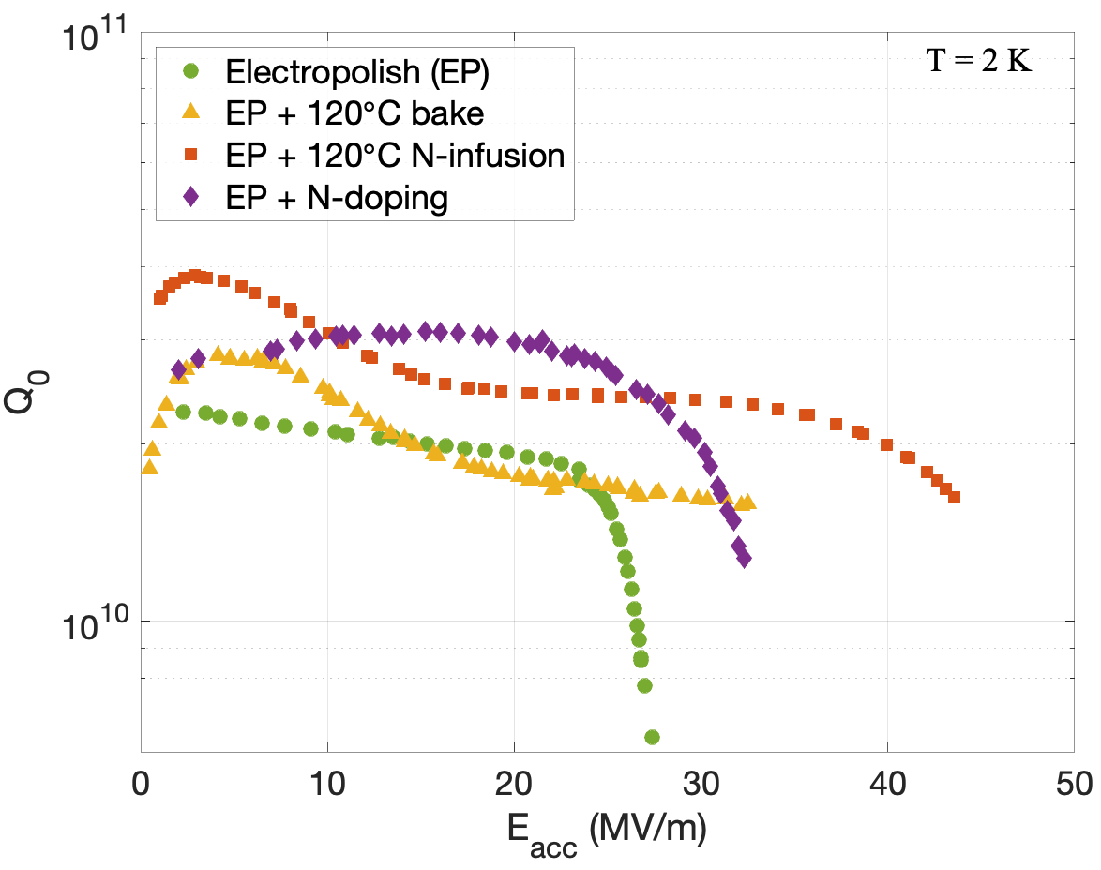
High Q Frontier today: N doping & infusion
Nitrogen doping is an established process, applied to LCLS-II and LCLS-II-HE. The recipe requires tweaking for different applications (cavity size, machine requirements, …)
Nitrogen infusion has shown huge potential for high Q and high gradient performance
  Raise cavity temperature to ~800 C (vacuum furnace) where oxide dissolves
  Lower temperature to ~120 C
  Introduce nitrogen which diffuses 10s of nm
Difficulty in reproducing results outside of FNAL

Slide 8
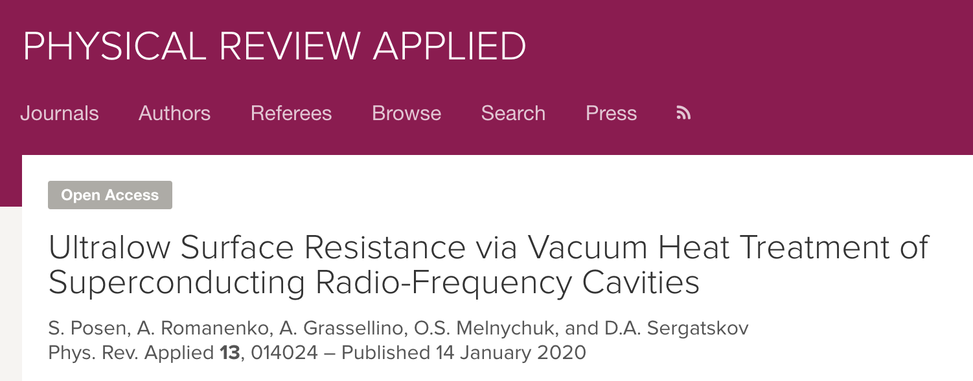
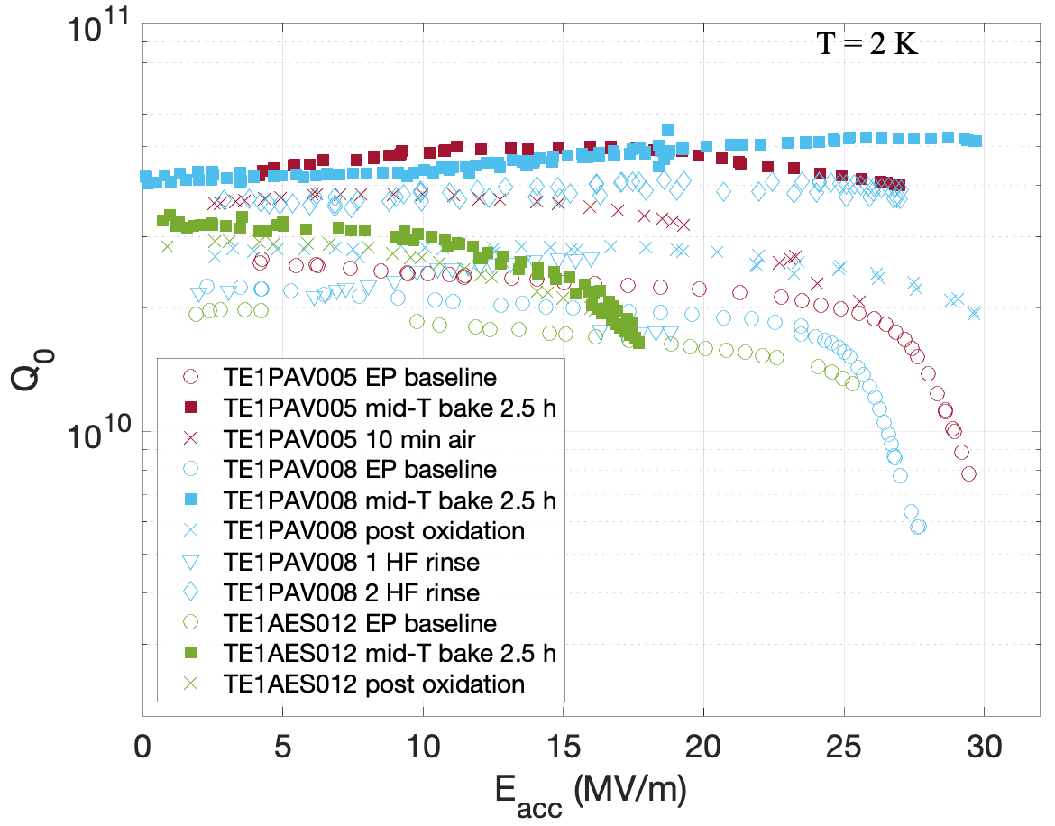
High Q Frontier today: mid-T bake
Mid-T bake: Heat treatment to temperature ~300-400 C to dissolve oxide, with cavity assembled and under vacuum
Cavities tested without exposing to air (also after exposing to air)
N-doping/infusion-like effect observed in Q vs E curves
Q₀ values of 3-4×10¹¹ were measured <1.5 K and 20 MV/m
Residual resistance of just 0.63 ± 0.06 nOhm was measured at 16 MV/m
Recent studies at IHEP (Beijing, China) on single cell and 9-cell (with simplified baking)

Slide 9


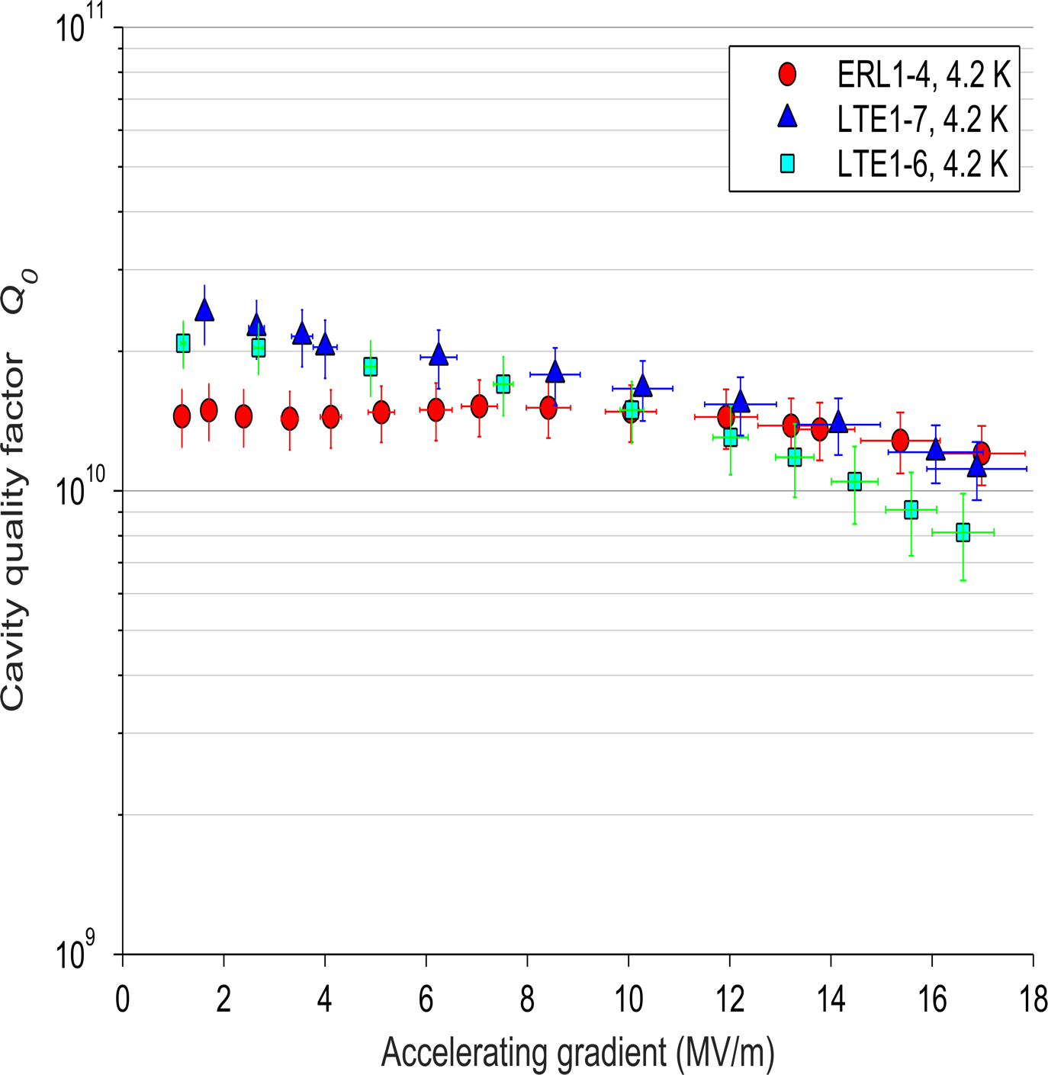
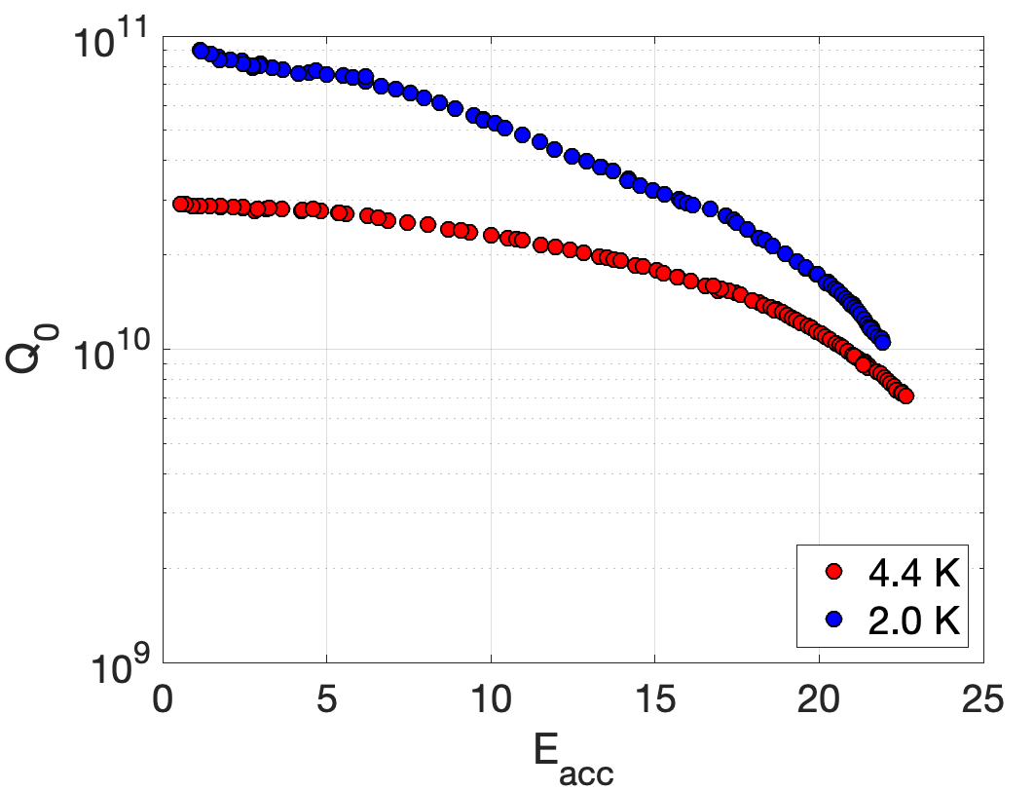
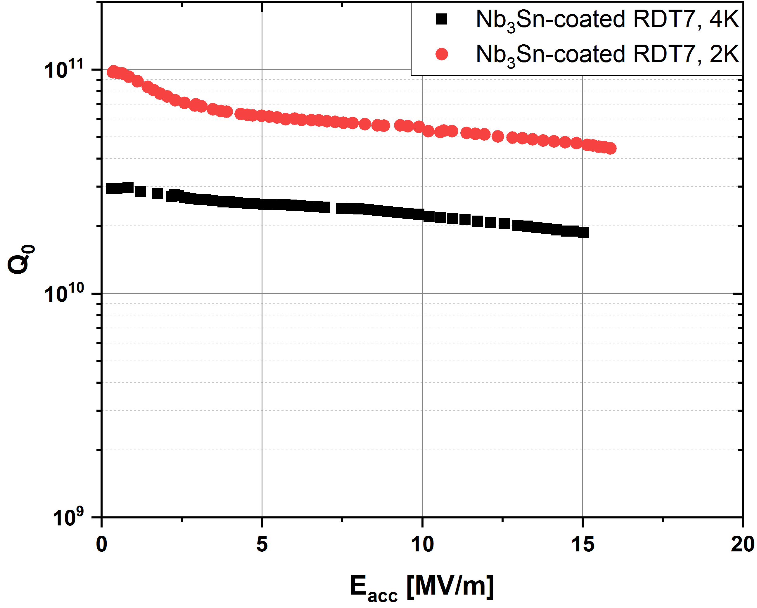
High Q Frontier today: Nb₃Sn
Good progress in Nb₃Sn cavity R&D: ~4 K operation with unprecedented Q > 10¹⁰ in CW operation achieved at 3 labs (more details in R. Porter’s talk tomorrow)
4.2 K
4 K
4.2 K
G. Ciovati, I. Parajuli, U. Pudasaini
S. Posen

Slide 10
High Gradient Frontier main directions
This R&D plan includes research into fundamental questions;
Layered structures and advanced vortex dynamics concepts;
New materials, films, and multilayers;
Development of Nb₃Sn as a practical SRF material;
Field emission mitigation;
Microphonics and Lorentz force detuning compensation R&D;
Novel SRF cavity shapes.
There will be several presentations covering some of research related to this directions
Some of the directions are common between the two roadmaps

Slide 11
High Gradient Frontier today: two-step bake
Systematic achievement of unprecedented gradients ~48-50 MV/m (~210 mT)
Performance linked to 2 effects:
  Ultra cold final EP that gives
  Additional 75ºC bake before 120ºC in situ bake

Slide 12
High Gradient Frontier today: two-step bake (2)
Observed branching behavior in cavities retested without disassembly in between (always under vacuum)
50 MV/m single cell cavity was sent around the world for verification
Some correlation found between branching cavity performance and

Slide 13
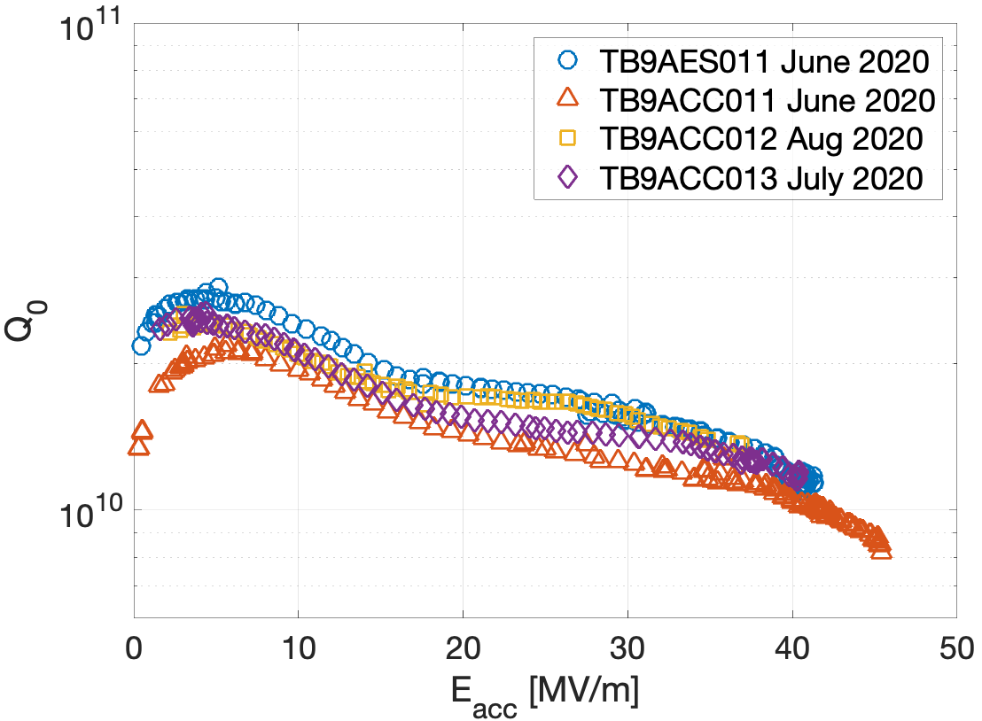
High gradient cryomodule demonstration
The new SRF advances may enable significant reduction in ILC cost:
  Flux expulsion
  Two step bake (75/120)
  Cold EP
Fermilab is in the process of refurbishing one of the old cryomodules. Supported by the ILC Cost Reduction R&D with contributions from other labs throughout the world.
Goal is to reach higher gradient than has ever been demonstrated in CM test: 38 MV/m average gradient with a stretch goal of 40 MV/m. The Q₀ goal is 1.0×10¹⁰ at 38 MV/m.
Some other CM improvements
Cavity candidates to date:
  TB9AES011 – 41.3 MV/m
  TB9ACC011 – 45.5 MV/m
  TB9ACC012 – 36.9 MV/m
  TB9ACC013 – 40.4 MV/m
  Average of 41.0 MV/m

Slide 14
Summary
Key future research directions will include
  studies pushing the performance of niobium, including doping, multi-step heat treatment, flux expulsion and flux losses
  new materials such as Nb₃Sn as well as layered structures
  fundamental studies of the physics of RF surface resistance and penetration of flux into superconductors at high fields

