Slide 1
Normal and super conducting RF R&D for muon collider
Alexej Grudiev (CERN)
On behalf of International Muon Collider Collaboration
16/02/2021
AF7-RF miniWorkshop on Cavity Performance Frontier

Slide 2
Outline
Introduction
Muon collider layout and RF
MAP scheme: proton driven muon source
RF system for muon cooling
RF system for acceleration and collider
What is not covered
Proton driver complex
LEMMA scheme: positron driven muon source

Slide 3
International Muon Collider Collaboration
Normal and super conducting RF systems

Slide 4
Muon collider and RF system challenges
Proton driven Muon Collider Concept (MAP collaboration)
RF
RF
RF
RF
RF
RF
RF
RF
RF
RF
RF
Normal conducting RF for capture and cooling
High-gradient cavities in high magnetic field
High charge, Huge beam size, Important beam losses
Peak RF power
Little synergy with other projects
Super conducting RF for acceleration
High charge, short bunch, low current
High efficiency at high gradient
Maintain beam quality
Longitudinal and transverse stability

Slide 5
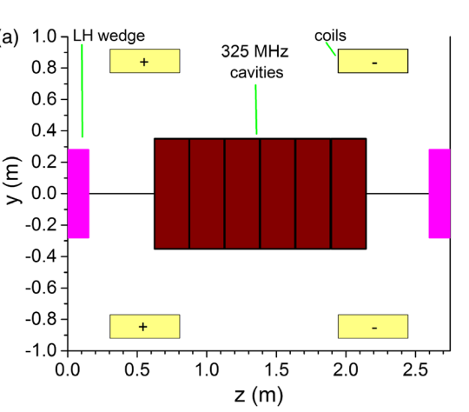
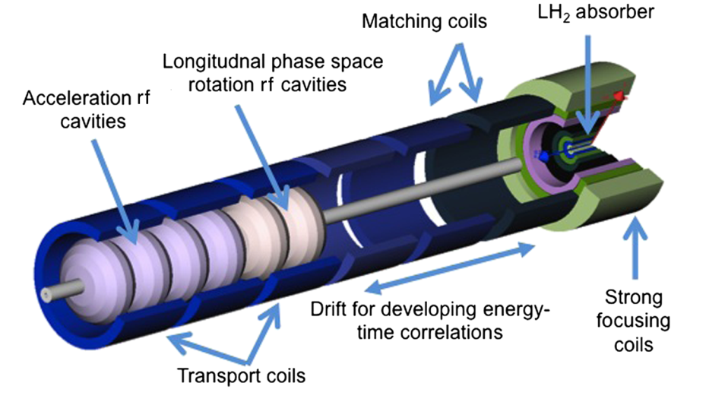
RF system for muon capture and cooling
Summarized from:
David Neuffer
Chris Rogers
Region | Length [m] | N of cavities | Frequencies [MHz] | Peak Gradient [MV/m] | Peak RF power [MW/cavity]
Buncher | 21 | 54 | 490 - 366 | 0 - 15 | 1.3
Rotator | 24 | 64 | 366 - 326 | 20 | 2.4
Initial Cooler | 126 | 360 | 325 | 25 | 3.7
Cooler 1 | 400 | 1605 | 325, 650 | 22, 30
Bunch merge | 130 | 26 | 108 - 1950 | ~ 10
Cooler 2 | 420 | 1746 | 325, 650 | 22, 30
Final Cooling | 140 | 96 | 325 - 20
Total | ~1300 | 3951 |  |  | ~4000 x ~3MW => ~12GW
It is a very large and complex RF system with high peak power

Slide 6
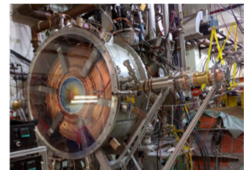
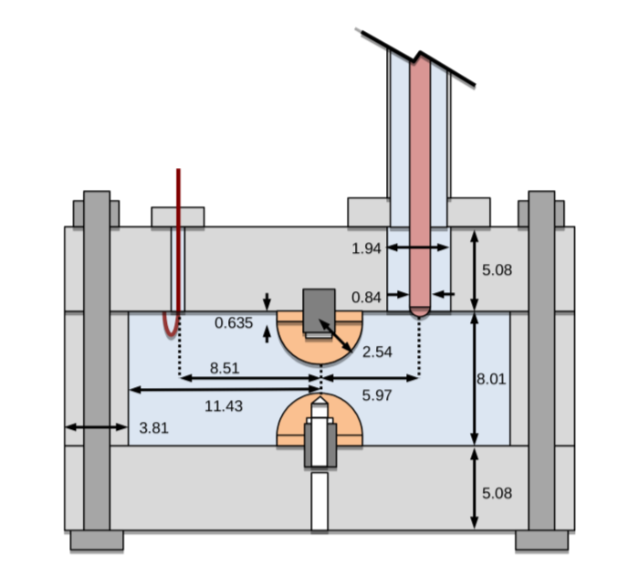
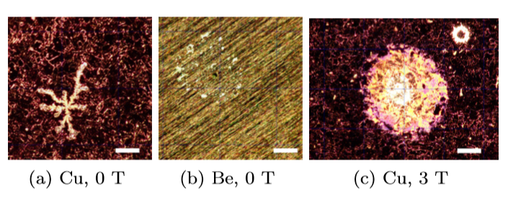
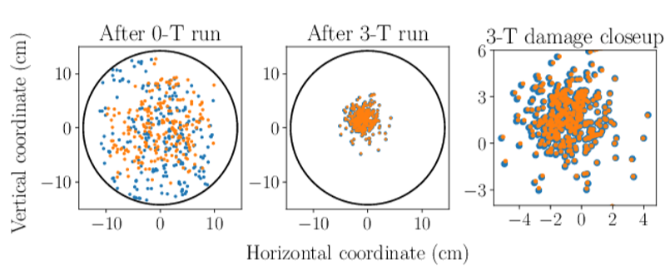
RF cavities for muon cooling
Challenges:
High Gradient
High magnetic field
High radiation
Technology far from been common
---------------------
State of the art (not complete):
MICE 200 MHz RF module prototype: 4T, 10 MV/m, 1ms@1Hz
800 MHz beryllium cavity:
3T, 50 MV/m, 30us@10Hz
Gas filled RF cavity:
Small gap, 200 MHz, >50 MV/m

Slide 7
R&D directions and test facility towards feasibility demonstration of muon cooling
Stage 1: High gradient RF test facility
Frequency: 200 - 800 MHz
Magnetic field: 0 - 5T, different field configurations
Different materials: Cu, Be, Al, …
Different temperatures: Cryogenic NC, HTS RF, …
Different gases and pressure: 0 – few Bars
Different designs
Stage 2: Prototype(s) for cooling test facility
Design of realistic cavity prototypes: frequency, beam aperture, integration
Parameters defined based on the results of Stage 1 and the (re-)design of the muon cooling complex (higher gradient,…)
May include irradiation capability to check its impact on the performance
Stage 3: Muon cooling demonstrator

Slide 8
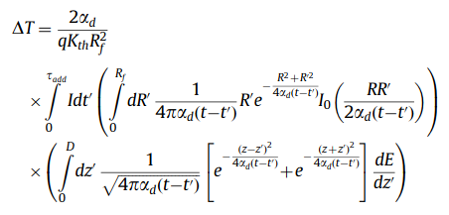
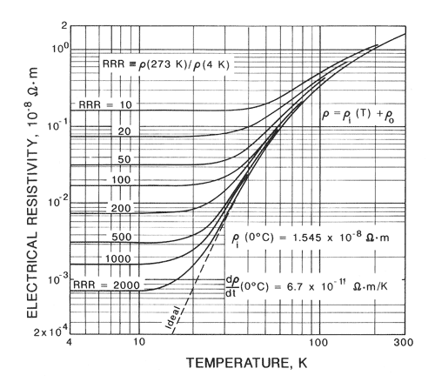
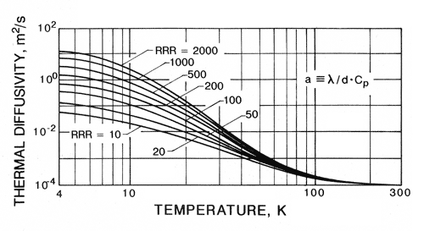
Cryogenic operation of NC cavities
RF technology challenges discussion, MC workshop, 2019 (cern.ch)
Cavities are already in the cryogenic environment of the SC solenoids
Higher gradients require even higher RF power:
V=const, G x 2 => P x 2
Low temperature reduce ohmic losses: P x 1/3 or even lower
RF breakdown (BD) strength in high magnetic field depends on thermo-mechanical properties
Field emission induced pulsed heating model predicts (PRAB 23, 072001):
Local temperature rise
Threshold: (38K for Cu@300K)
Cu
Low temperature improves thermal and mechanical properties
=> Higher BD strength
Cu

Slide 9
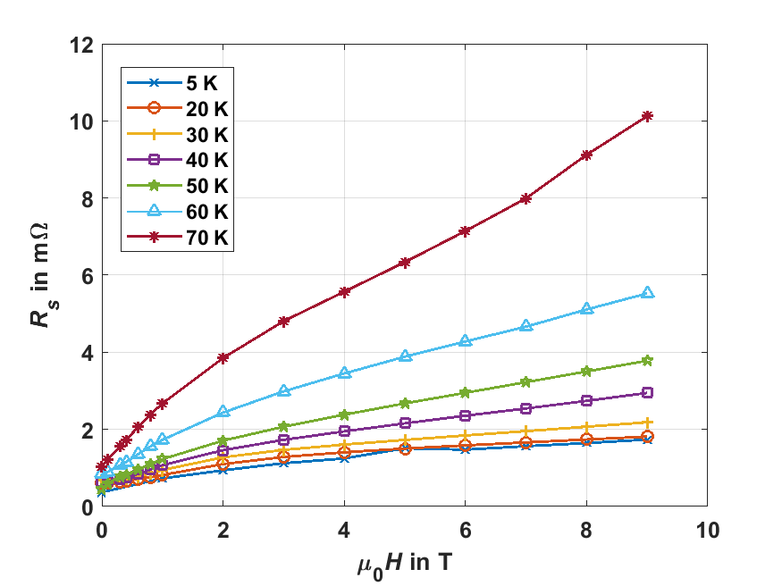
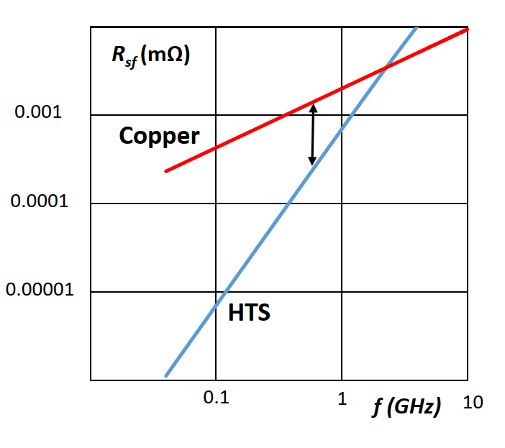
HTS for RF applications
HTS coated conductor at 8 GHz
Frequency scaling HTS vs Cu at 9 T
Cu RRR=100 @ 300 K: 25 mΩ
Cu RRR=100 @ 70 K
Cu RRR=100 @ 20 K
From: Teresa Puig – ICMAB. Developments of HTS Coated Conductors for the FCC-hh beam screen impedance mitigation

Slide 10
Initial acceleration
Limited muon lifetime requires highest possible accelerating gradient to reach higher energies
Large emittance require large acceptance
Additional voltage
Low frequency
Large aperture
Very large bunch charge: ~5x10¹² causes collective effects which must be addressed
Transmission and decay beam losses
Strong focusing magnets with large apertures
Stray magnetic fields
Low filling factor
Cryogenic NC RF might help in the linac

Slide 11
High energy acceleration
An example of parameters for CERN site implementation
Limited muon lifetime requires highest possible acceleration rate
Although the rate is defined by the magnets ramping rate, the SRF must follow
Small number of turns (~100) for very high collision energy ~10 TeV requires very high voltage: ~100 GV
It operates in quasi pulsed mode;
RF is on only during acceleration (~ 10 ms)
Transients
Longitudinal bunch compression/manipulation require additional voltage
High gradient for ‘compact’ RF system
Very large bunch charge: ~4x10¹² cause collective effects which must be mitigated
Transmission and decay beam losses

Slide 12
Collider ring
Limited muon lifetime requires smallest possible circumference
Although the circumference is defined mainly by the magnets bending radius, the SRF must follow
High gradient for ‘compact’ RF system
Main function of RF is to maintain short bunch length for high luminosity
Very large bunch charge: 2x10¹² and short bunch length: 1 mm cause strong collective effects which must be mitigated
Aperture restriction
HOM power
Transmission and decay beam losses
FCC-ee
0.2
2.4
Single bunch beam loading (energy spread):
Energy spread ~ Loss factor x Bunch charge

Slide 13
R&D directions for SRF for muon acceleration
Highest possible gradient
Pulsed operation of ~1ms (linac) -> ~10ms (RCS) may help
Resilience to beam losses and (stray) magnetic field
Design of the cavity considering
High gradient
High efficiency
Longitudinal and transverse beam dynamic requirements
…

Slide 14
Acknowledgements
I would like to acknowledge usage of material from:
MAP collaboration: Muon Accelerator Program
International Muon Collider Collaboration: Accelerator Design
Sergio Calatroni (CERN)
Thank you !

Slide 15
Spare slides

Slide 16
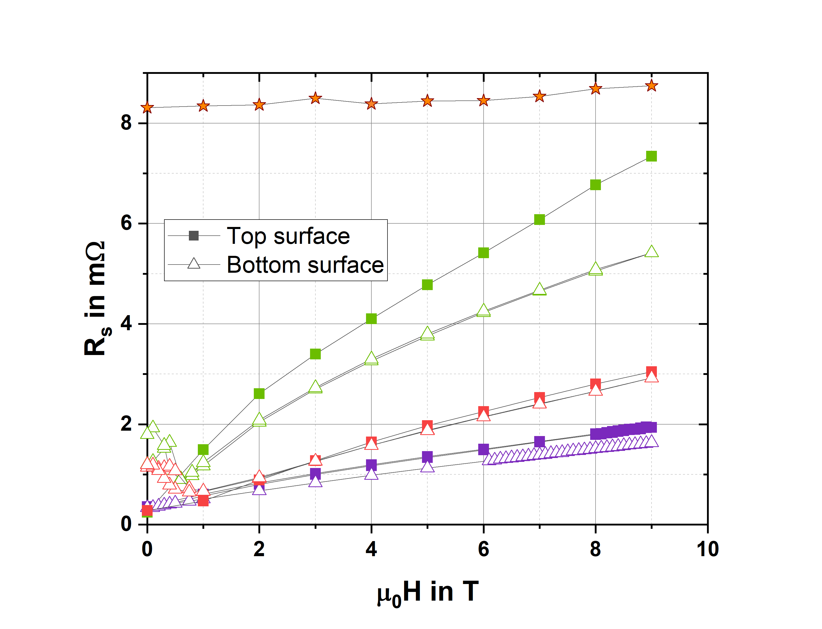
Soldering of HTS coated conductors
T = 50 K, $ν=8$ GHz
FCC Cu
CC 2
Soldered sample
Soldering mostly preserves properties
This could be used in a cavity made in sectors
Standard sample
CC 4
CC 5

