Slide 1
Challenges and opportunities of SRF theory for particle accelerators
Alex Gurevich¹ and Jim Sauls²
¹Old Dominion University, Norfolk VA
²Northwestern University, Evanston, IL
¹Supported by DOE under grant DE-SC0010087-020

Slide 2
Have the best Nb cavities reached theoretical limits?
?
Q(H) and E_{acc} of Nb cavities have been steadily improving
Are there the fundamental limits of Q(H)
and the breakdown field?
?
How close are breakdown fields to the current pairbreaking instability of the Meissner state?
Theoretical limits of H and Q at T << T_{c} and
GHz frequencies are largely unknown.
Can the fundamental limits of Q and H be
increased by materials treatments?

Slide 3
Theoretical challenges
Field limit
The widely used GL theory of dc superheating field H_{s}(T) is applicable near T_{c} but not at T << T_{c}.
Only H_{s}(0) = 0.84H_{c} at was calculated (Galaiko 1966, Catelani and Sethna, 2008; Lin and Gurevich, 2012).
at T << T_{c} and arbitrary GL parameter has not yet been calculated.
Dynamic superheating field H_{d}(T,f). How different can it be from the static H_{s}(T) at GHz frequencies?
Recent result: (Sheikhzada and Gurevich, 2020)
Q limit
BCS surface resistance R_{s}(T) vanishes at T=0. How far can the residual resistance be decreased?
Trapped vortices, subgap quasiparticles and two-level states, proximity-coupled suboxide layers.
Nonequilibrium superconductivity
Nonlinear BCS surface resistance in a nonequilibrium SC under strong rf current. Negative Q(H) slope.
Extreme dynamics and nonlinear losses of trapped vortices driven by strong rf current
Tuning SRF performance by surface nanostructuring
Increase of H_{s} and vortex penetration field by SIS multilayers and impurity gradients at the surface
Reduction of R_{s} by optimizing proximity-coupled layers and transparency of grain boundaries

Slide 4
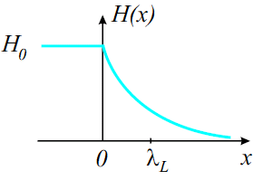
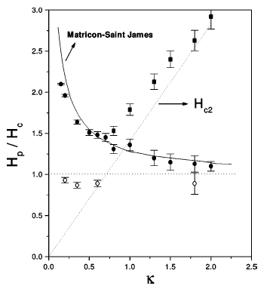
DC superheating field near T_{c}
Meissner state becomes unstable at H > H_{s} as the Cooper pairs reach the critical
pairbreaking velocity and the RF current density J_{s} = H/λ at the surface
approaches the depairing current density J_{d} = H_{s}/λ
GL region, T ≈ T_{c}: (Matricon and Saint-James, 1967, Chapman 1995)
λ
B_{s} decreases as the GL parameter κ = λ/ξ increases
No microscopic theory of H_{s}(T) at low T and
At T << T_{c}, only H_{s}(0) = 0.84H_{c} at κ >> 1 has been
calculated in the clean limit (Galaiko 1966, Catelani and Sethna, PRB 2008)
and for arbitrary impurity concentration (Lin and Gurevich, PRB 2012)
Nb
Microscopic theory gives 13% larger H_{s}(0) than the GL extrapolation

Slide 5
Surface nanostructuring to increase B_{s}
SIS multilayers Gurevich, APL. 88, 012511 (2006)
higher-T_{c}SC: Nb₃Sn, …
Nb
20-40% increase of H_{s}
Calculation of H_{s} for a
nanostructured surface
as functions of ,
and the impurity m.f.p.
is needed
dielectric layers
Smooth increase of the impurity scattering rate in a dirty
surface layer of thickness
H_{m} at the optimum thickness exceeds H_{s} of both Nb and the layer material. mT (dirty Nb layer), mT (Nb₃Sn)
Calculations of H_{s}(T) at low T and large GL parameter
based on the microscopic Eilenberger equations
Kubo et al, APL, 104, 032603 (2014); SUST, 30, 023001 (2017);
Posen, Transtrum, Catelani, Liepe, Sethna, Phys. Rev. Appl. 4, 044019 (2015); Gurevich, AIP Adv. 5, 017112 (2015)
Ngampruetikorn and Sauls, Phys Rev Research. 1, 012015 (2019)

Slide 6
Nonequilibrium SRF
Mattis-Bardeen cannot describe the field-dependent R_{s}(H) high RF fields
Numerical simulations of time-dependent equations of nonequilibrium BCS
Kinetic equations for quasiparticles and dynamic equations for SC condensate
Time-dependent GL equations for a gapped dirty superconductor
Sheikhzada and Gurevich, PRB 102, 104507 (2020)
Kramer and Watts-Tobin, PRL, 40. 1041 (1978)
Watts-Tobin, Krahenbuhl and Kramer, JLTP 42, 459 (1980)
Relaxation time of SC condensate:
Relaxation time of quasiparticles due to
inelastic electron-phonon collisions:
Relaxation time constant of quasiparticles on phonons can be much larger
than the RF period at 1-2 GHz frequencies of SRF cavities,
For Nb at 7K: ,
Nearly instantaneous reaction of the SC condensate to the RF field
Much slower relaxation of quasiparticles. Quasiparticle relaxation slows down greatly as T decreases

Slide 7
Dynamic breakdown of superconductivity
SC breakdown above H_{d} (T,f) which increases with f up to the limit:
SC pairbreaking caused by the time
averaged squared RF field

Slide 8
Dynamic superheating field
High temperatures: enhancement of H_{d} due to slow qp relaxation:
Low temperatures: T < 0.5Tc: the relaxation time increases greatly but the density of quasiparticles decreases exponentially in the dirty limit.
No effect of quasiparticles on SC breakdown if
In the clean limit the quasiparticle gap vanishes at H < H_{s},
so the dynamic superheating field may be enhanced by slow relaxation of
quasiparticles
Sheikhzada and Gurevich, PRB 102, 104507 (2020)
Lin and Gurevich, PRB 85, 054513 (2012)

Slide 9
Trapped vortex driven by RF Meissner current
A trapped elastic vortex is driven by the Lorentz force balanced by viscous drag and bending stress At H_{a} = 100-200 mT, J(0) at the surface approaches the depairing limit
:
H(t)
Typical depinning J_{c} = 10-100 kA/cm² in Nb are some 4 orders of magnitude lower than J_{d} = H_{c}/λ, = 500 MA/cm²
Pinning is too weak to stop the vortex tip above H > 0.01H_{c} = 2 mT
•
•
λ
•
•
•
At H = H_{c}, the superflow velocity of Cooper pairs reaches the critical pairbreaking value v_{c} = Δ/p_{F} and the velocity of the vortex tip is
•
•
•
•
•
•
•
•
•
•
•
2ξ
•
•
•
l
•
•
•
•
•
This yields v = 10 km/s, which exceeds the speed of sound (2-4 km/s) and v_{c} = Δ/p_{F} = 1 km/s. Vortex velocities 10-20 km/s were observed by SQUID scanning microscopy Embon et al, Nature Comm. 8, 85 (2017)
•
λ
•
•
•
•
The vortex tip can move faster than the superfluid velocity of rf current
How can a supersonic vortex tip remain connected to a subsonic elastic vortex line in the bulk?

Slide 10
What happens to the vortex core at high velocities?
Slow vortex
Fast vortex
v
v
Velocity-dependent Larkin-Ovchinnikov vortex drag:
A nearly round vortex core
Cloud of dissipative quasiparticles is
locked onto the moving core
Bardeen-Stephen vortex drag
TDGL simulations show that the fast vortex core stretches along v
A cloud of nonequilibrium quasiparticles lagging behind the moving core
Decrease of the vortex drag with v causes a jumpwise LO instability as
the local force balance breaks down at

Slide 11
Manifestations of the LO effects in SRF cavities
Since the LO critical velocity km/s is 1-2 orders of magnitude smaller than velocities of a vortex tip
at H = 10 -100 mT, the LO velocity dependence of the vortex drag can be essential in SRF cavities.
H(t)
u(z,t)
experiment
on Nb films
LO
unstable
low-T
extrapolation
Leo at al., PRB 84, 014536 (2011)
LO
stable
What happens to the vortex if its fast tip is LO-unstable while the rest of the vortex is LO-stable?
The effect of LO vortex drag velocity dependence on the field dependence of nonlinear RF losses of trapped vortices

Slide 12
Nonlinear dynamics of a trapped vortex in a random pinning potential
Numerical simulation of nonlinear dynamics of a curvilinear elastic vortex driven by strong RF current in a film
Mesoscopic effects in RF response for different pinning configurations
LO instability in the presence of random pinning
Effect of overheating
Pathirana and Gurevich, PRB 101, 064504 (2020)
and unpublished
f₀ = 22 GHz for a moderately clean Nb.

Slide 13
LO mechanism of the low-field Q(H) rise
The surface resistance Ri(H) starts decreasing with the field amplitude as the frequency increases. Calculated for different values of
Fit to the experimental data of for a 1.47 GHz Nb cavity
Ciovati, JAP 96, 1591 (2004)

Slide 14
Tuning the negative Q slope by impurities
Calculated for
Making the surface dirtier shifts the anomalous drop of the vortex surface resistance R_{i}(H) to lower fields.
May pertain to the low-field Q(H) drop observed on many Nb cavities

Slide 15
Residual surface resistance of trapped vortices
Bardeen-Stephen
Larkin-Ovchinnikov with random pinning
0.5-3 GHz
10-30 GHz
0.5-3 GHz
Pathirana and Gurevich,
(2020 unpublished)
Averaging over statistical realizations of the
pinning potential often (but not always) yields
a linear low-field dependence of Rs(H).
Pathirana and Gurevich,(2020 unpublished)
LO critical velocities: v₀ = 20-100 m/s in the frequency-dependent parameter
Quasi-static collective pinning:
Liarte et al. Phys. Rev. Appl. 10, 054057 (2018)
1d pinning simulations:
Checchin and Grassellino, Phys. Rev. Appl. 14, 044018 (2020)
v₀(T) at low temperatures T << T_{c} has not been measured, but
it is expected to be much smaller than at 0.5T_{c} < T < T_{c}

Slide 16
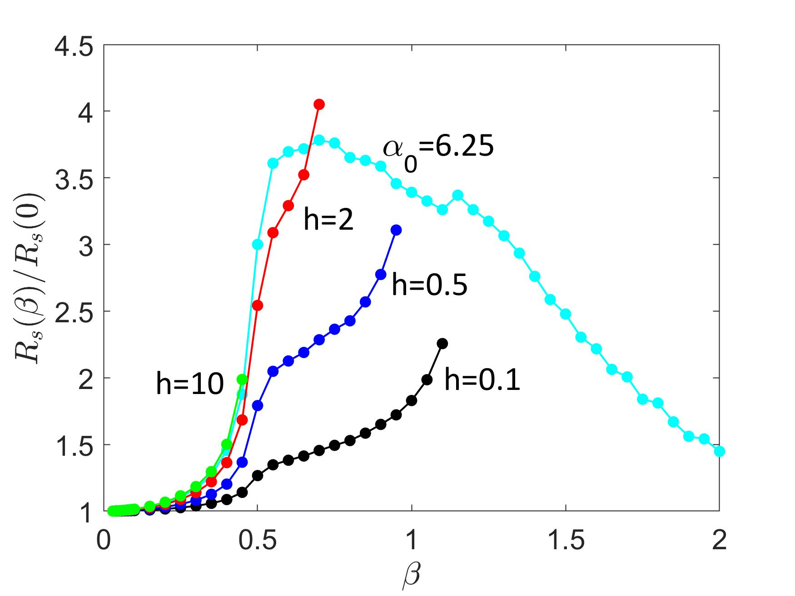
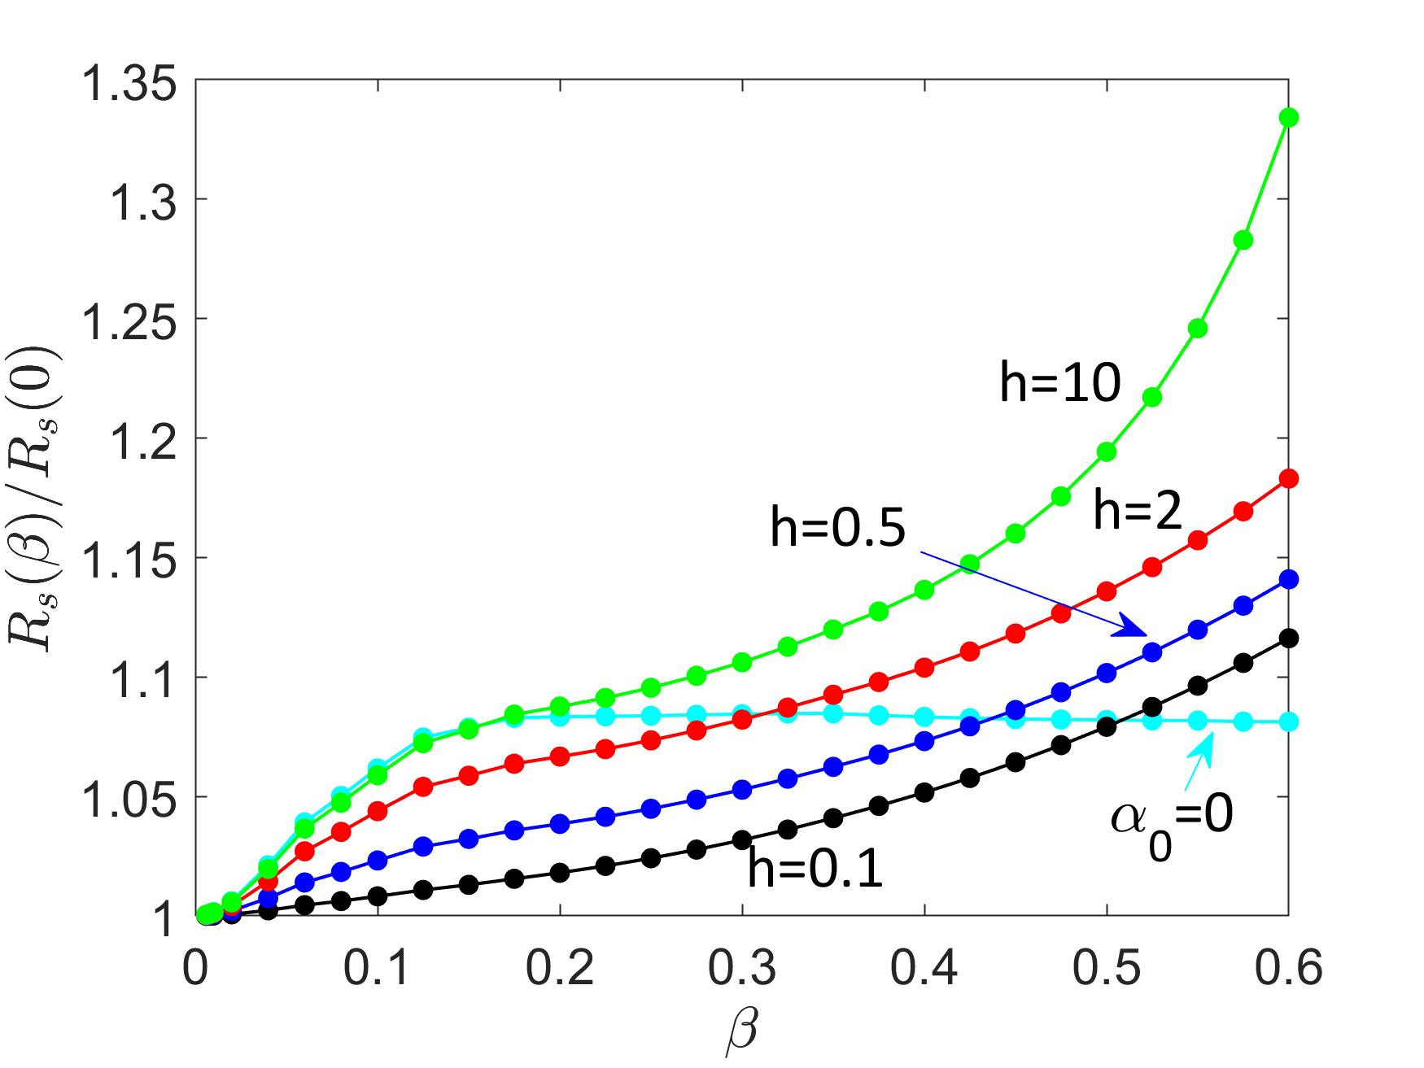
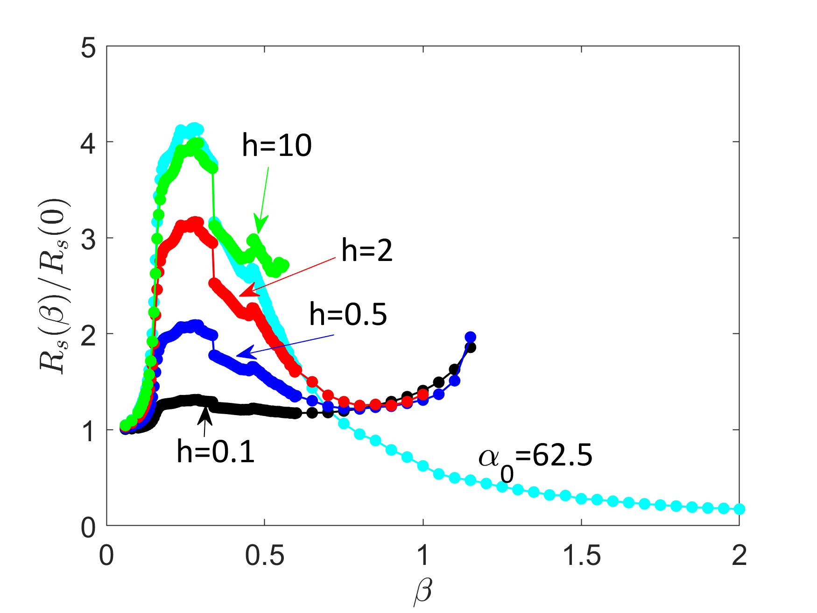
Vortex overheating effects
Pathirana and Gurevich (2021 unpublished)
Larkin-Ovchinnikov
Bardeen-Stephen
1-2 GHz
h = R_{i} /R₀ is proportional to the trapped flux
Quasi-linear dependence caused by heating
High-field upturn of R_{s}(H)
Heating mitigates the negative Q slope

Slide 17
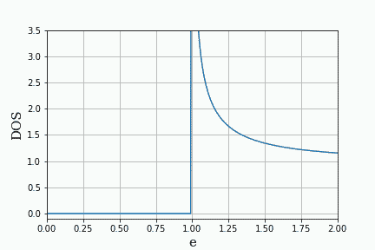
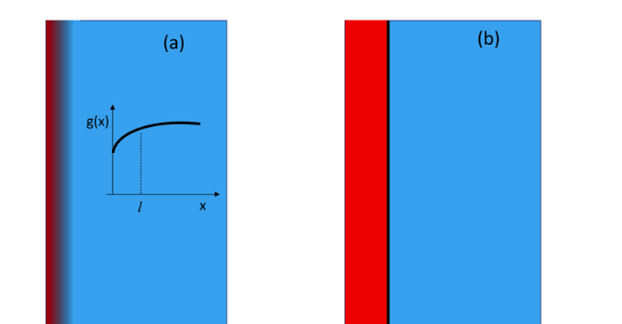
Optimizing surface resistance by pairbreaking mechanisms
Surface resistance can be reduced by RF current, surface nanostructuruing and magnetic impurities
Current-induced broadening of DOS peaks causes a negative Q(H) slope
Subgap states caused by finite quasiparticle lifetimes.
Surface layer of reduced BCS pairing constant (surface nonstoichiometry)
Proximity coupled thin normal (suboxide) layer on the surface
Small density of magnetic impurities
Gurevich, PRL 113, 087001 (2014)
Gurevich and Kubo, PRB 96, 184515 (2017)
Kubo and Gurevich, PRB 100, 064522 (2019)
Calculatioins of Rs in the dirty limit
based on the Usadel equations
DOS oscillating under RF currents
Reducing Rs by engineering an optimum DOS by surface nanostructuring and impurity management
magnetic
impurities
N
S
Current-induced DOS broadening

Slide 18
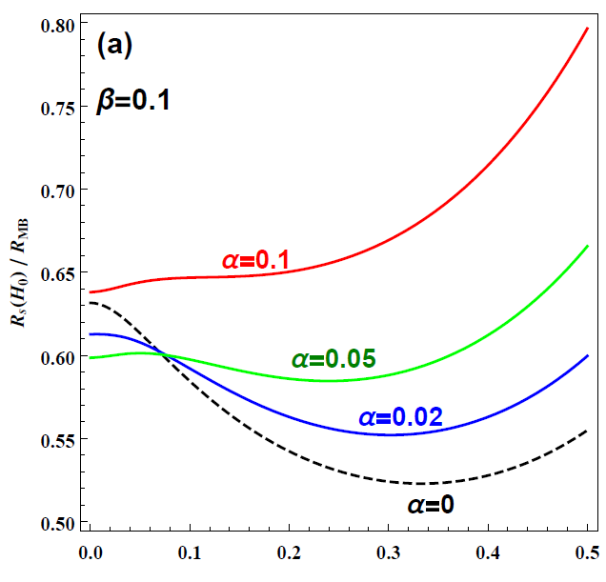
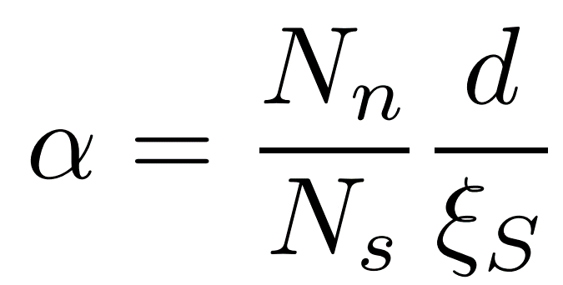
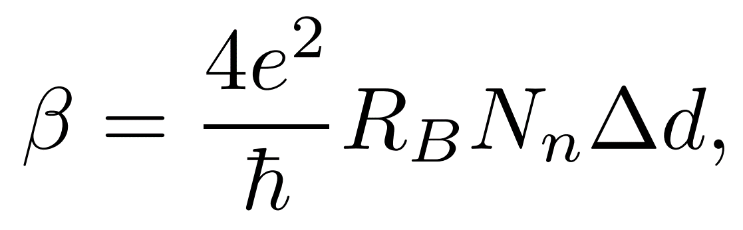
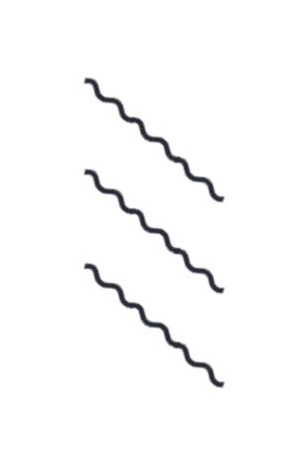
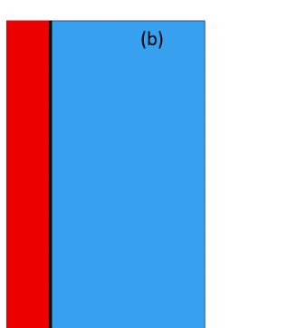



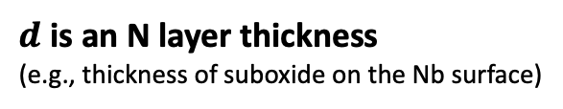
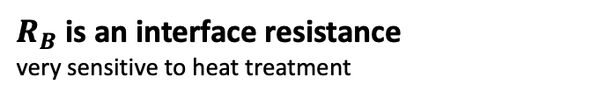

Field-dependent surface resistance R_{s}(H₀)
$d$ is an N layer thickness
(e.g., thickness of suboxide on the Nb surface)
$R_{B}$ is an interface resistance
very sensitive to heat treatment
different N-layer thickness
$$Γ=0.005$$
N thickness
barrier between N&S
$$σ_{n}$$
$$σ_{s}$$
No normal layer →
$$H_{0}/H_{c}$$
proximity effect coupling

Slide 19
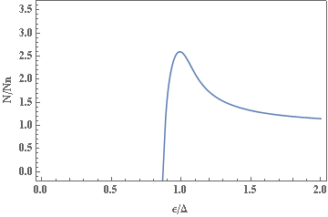
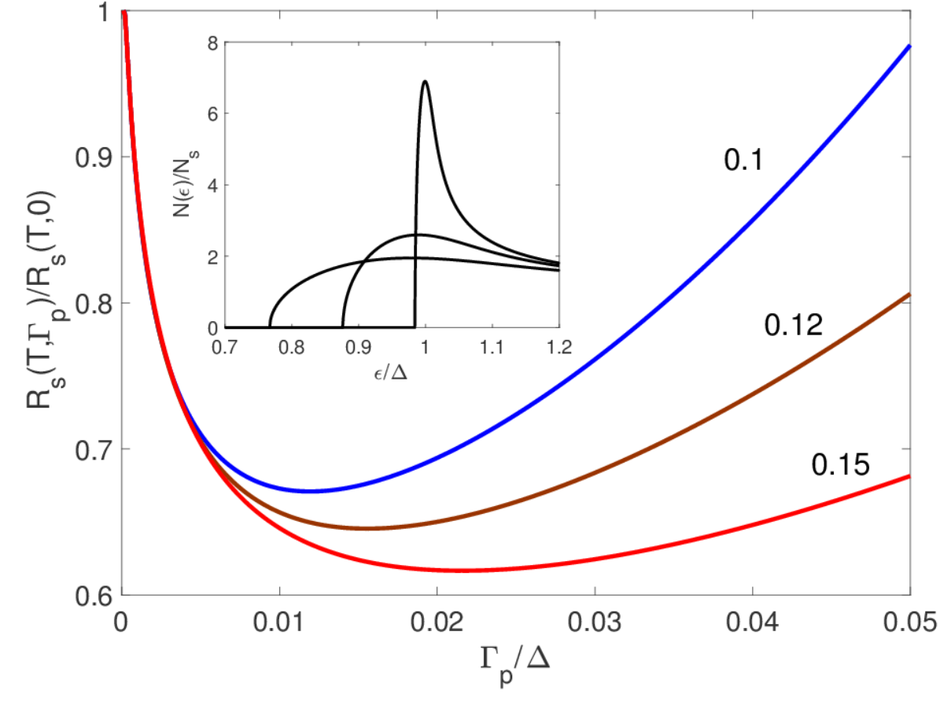

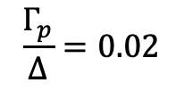



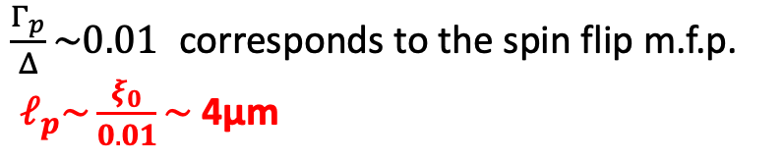
Tuning R_{s} by magnetic impurities
$$\frac{Γ_{p}}{Δ}=0.02$$
$$\left(Γ_{p}=\frac{ℏv_{F}}{2ℓ_{p}}\right)$$
magnetic
impurities
$$ℓ_{p}$$
$ℓ_{p}$ is spin flip m.f.p
$$\frac{kT}{∆}=$$
An optimum density of magnetic impurities can significantly reduce R_{s}
$\frac{Γ_{p}}{Δ}\sim 0.01$ corresponds to the spin flip m.f.p.
$ℓ_{p}\sim \frac{ξ_{0}}{0.01}\sim$ 4μm

Slide 20
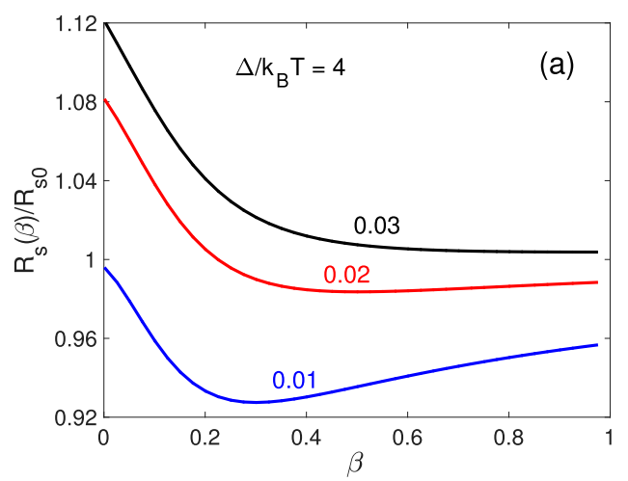

Tuning R_{s} by a proximity-coupled N layer
R_{s} can be optimized by tuning the N-layer parameters.
R_{s} can be smaller than the ideal surface without N layer
DOS with subgap states
$$Γ=$$
The resistive barrier between
N&S can be changed significantly by
materials treatments

