Slide 1
Plasma Processing for In-Situ Field Emission Mitigation of SRF Cryomodules
Martina Martinello
Cavity Performance Frontier miniWorkshop
Feb 16, 2021

Slide 2
Outline
Introduction on plasma processing
Example of plasma cleaning on SRF cavities & cryomodules
Plasma processing effort in the SRF community
Future perspective

Slide 3
Outline
Introduction on plasma processing
Example of plasma cleaning on SRF cavities & cryomodules
Plasma processing effort in the SRF community
Future perspective

Slide 4
Plasma Processing to Increase Work Function and Acc. Gradient
Plasma processing was developed at first at ORNL/SNS and focused on:
Reducing FE by increasing work function of cavity RF surface
Hydrocarbon contaminants observed on all Nb cavities
Hydrocarbons and adsorbates lower work function of Nb
Enabling operation at higher accelerating gradients
$J$: current density
E: surface electric field
$Φ$: work function
$β$: enhancement factor (10s to 100s)
A,B: constant
$$j=β\frac{AE^{2}}{Φ}e^{−B\frac{Φ^{3/2}}{βE}}$$
$$\frac{dE_{acc}}{E_{acc}}≈\frac{3}{2}\frac{dΦ}{Φ}$$
Increasing $Φ$ by 10 % means increasing E_{acc} of about 15 %
$$dj=0$$
M. Doleans et al. NIMA 812 (2016) 50-59

Slide 5
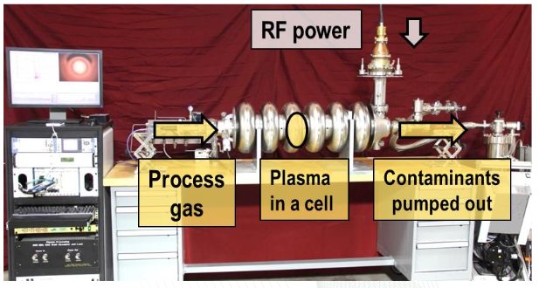
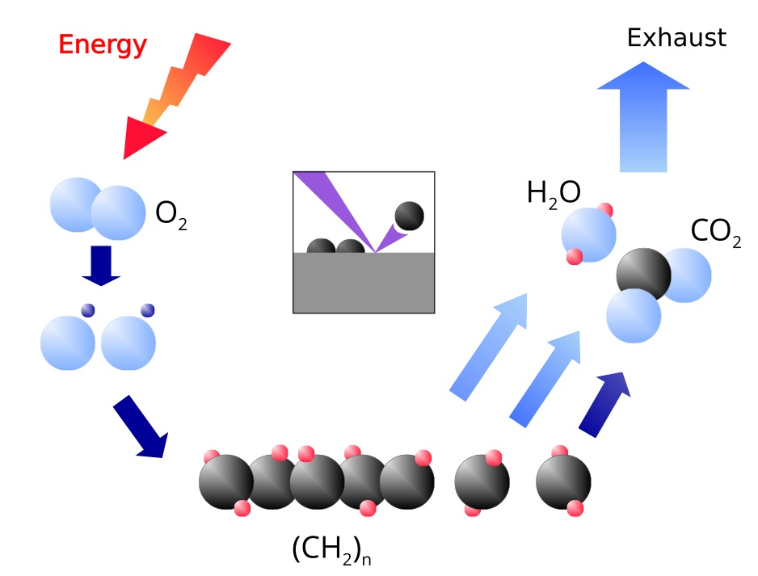
Reactive Oxygen Plasma to Remove Hydrocarbons
Oxygen plasma at room temperature (reactive environment with ions, e-, neutrals, radicals, etc.)
Volatile by-products are formed through oxidation of hydrocarbons and pumped out and monitored (RGA)
Mixture of Neon-Oxygen:
$p\sim 100−200$mTorr, 2 % $O_{2}$
$Ne$ → support gas to create very stable discharge
$O_{2}$ → cleaning agent, react with carbon forming volatile species
$$O_{2}+C_{x}H_{y}→CO+{CO}_{2}+H_{2}O$$
M. Doleans et al. NIMA 812 (2016) 50-59

Slide 6
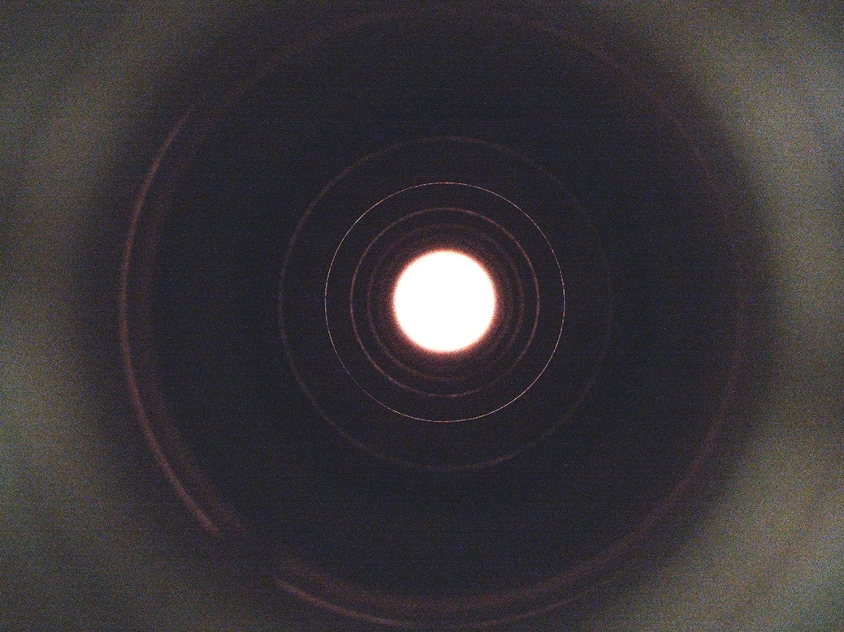
Plasma ignition in multi-cell cavities
Plasma ignition sequentially cell-by-cell by mixing RF modes to increase electric field amplitude in the desired cell*
Position of plasma monitored using RF signals only*;
* M. Doleans, J. Appl. Phys. 120, 243301 (2016);
P. Berrutti et al., J. App. Phys. 126, 023302 (2019)

Slide 7
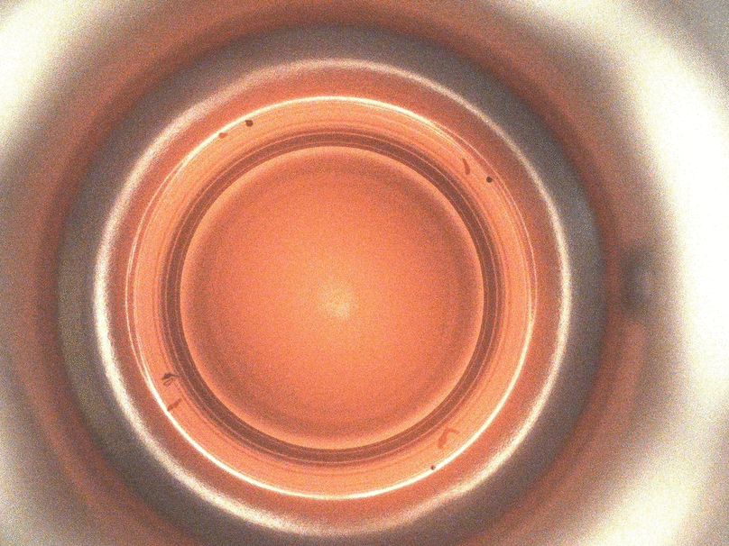
Proof of effective hydrocarbon contamination removal
Effective removal of hydrocarbon contamination with plasma cleaning
8 “dots” of permanent markers around the iris of the first cell of a 9-cell LCLS-II cavity
PU
HOM
HOM
Contamination with sharpie
FPC
Initial state
After 5 h
After 19 h

Slide 8
Outline
Introduction on plasma processing
Example of plasma cleaning on SRF cavities & cryomodules
Plasma processing effort in the SRF community
Future perspective

Slide 9
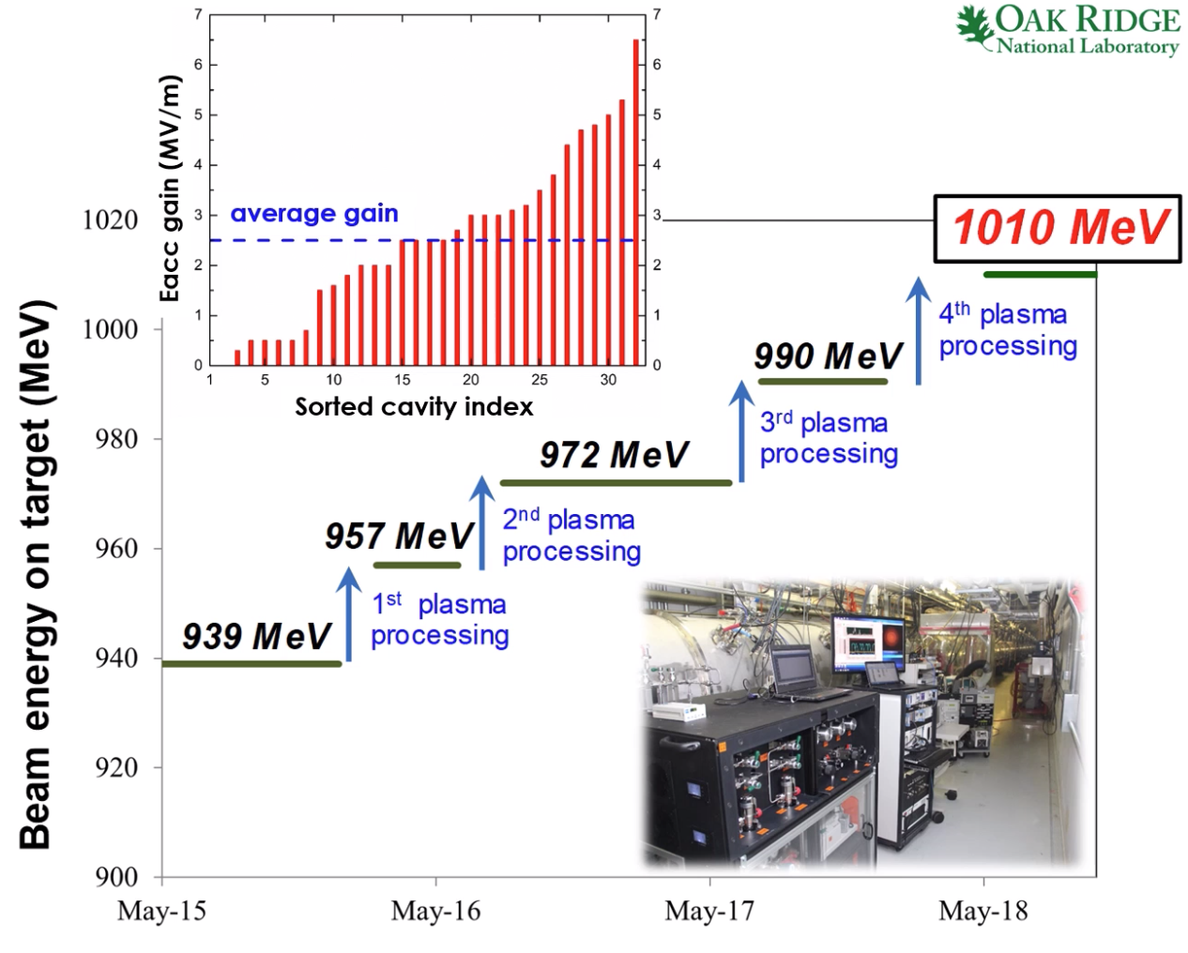
SNS beam energy improvement with plasma processing
In-situ plasma processing in linac tunnel done during SNS planned down periods on HB CMs
32 cavities plasma processed at SNS with an average Eacc increase of 2.5 MV/m
Beam energy at SNS has been sustained at 1 GeV since summer 2018
M. Doleans, invited talk LINAC 2020

Slide 10
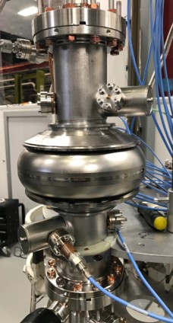
Plasma processing of N-doped cavities for LCLS-II – single-cell studies
N-doped single-cell cavity contaminated with Acquadag (carbon-based panting)
N-doped single-cell cavity with no FE
HOM couplers
No Q degradation observed in N-doped cavities after plasma processing
15 MV/m gained after plasma processing cavity contaminated with carbon
B. Giaccone et al., accepted for publication in PRAB

Slide 11
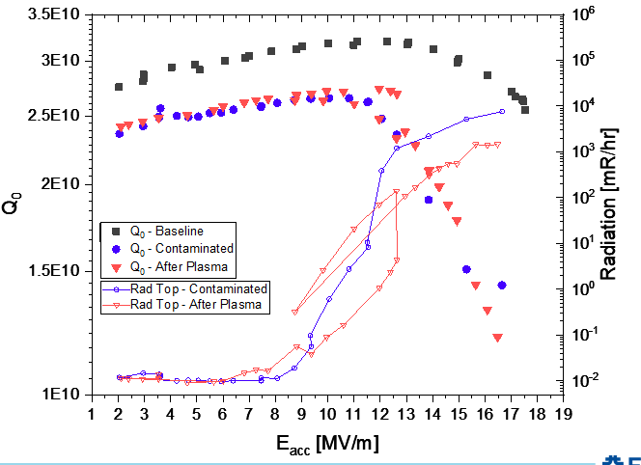
Plasma processing of N-doped cavities for LCLS-II – nine-cell studies
Naturally FE cavity from vendor
Simulated vacuum failure in clean-room
Simulated vacuum failure outside clean-room
No radiation detected after plasma processing in naturally FE cavities (1/2) and in cavity with vacuum failure in clean-room (1/1)
No significant improvement detected in cavities w vacuum failure outside cleanroom (3/3). Particle analysis show presence of metallic particles.
Ag
SS
B. Giaccone et al., accepted for publication in PRAB

Slide 12
Outline
Introduction on plasma processing
Example of plasma cleaning on SRF cavities & cryomodules
Plasma processing effort in the SRF community
Future perspective

Slide 13
Plasma processing effort in US and around the world
Plasma processing has been developed at ORNL for SNS HB 805 MHz cavities, and thanks to the successful experience is being implemented in other labs worldwide
SNS medium-beta cryomodules are being plasma processed as part of PPU to increase their accelerating gradients
FNAL in partnership with ORNL and SLAC developed plasma processing methodology for LCLS-II 1.3 GHz 9-cell cavities and will be now implemented in the LCLS-II HE vCM
FNAL is also considering to develop plasma processing for PIP-II SSR and 650 MHz cavities
Jlab is developing similar plasma processing procedure for CEBAF 7-cell 1.5GHz C100 cavities to mitigate CEBAF cryomodules degradation
MSU is developing plasma processing for FRIB 322 MHz HWR and 80.5 MHz QWR cavities
IMP is developing plasma processing for CiADS 162.5 MHz HWR

Slide 14
Plasma processing effort in US and around the world
Plasma processing has been developed at ORNL for SNS HB 805 MHz cavities, and thanks to the successful experience is being implemented in other labs worldwide
SNS medium-beta cryomodules are being plasma processed as part of PPU to increase their accelerating gradients
FNAL in partnership with ORNL and SLAC developed plasma processing methodology for LCLS-II 1.3 GHz 9-cell cavities and will be now implemented in the LCLS-II HE vCM
FNAL is also considering to develop plasma processing for PIP-II SSR and 650 MHz cavities
Jlab is developing similar plasma processing procedure for CEBAF 7-cell 1.5GHz C100 cavities to mitigate CEBAF cryomodules degradation
MSU is developing plasma processing for FRIB 322 MHz HWR and 80.5 MHz QWR cavities
IMP is developing plasma processing for CiADS 162.5 MHz HWR

Slide 15
Plasma processing effort in US and around the world
Plasma processing has been developed at ORNL for SNS HB 805 MHz cavities, and thanks to the successful experience is being implemented in other labs worldwide
SNS medium-beta cryomodules are being plasma processed as part of PPU to increase their accelerating gradients
FNAL in partnership with ORNL and SLAC developed plasma processing methodology for LCLS-II 1.3 GHz 9-cell cavities and will be now implemented in the LCLS-II HE vCM
FNAL is also considering to develop plasma processing for PIP-II SSR and 650 MHz cavities
Jlab is developing similar plasma processing procedure for CEBAF 7-cell 1.5GHz C100 cavities to mitigate CEBAF cryomodules degradation
MSU is developing plasma processing for FRIB 322 MHz HWR and 80.5 MHz QWR cavities
IMP is developing plasma processing for CiADS 162.5 MHz HWR

Slide 16
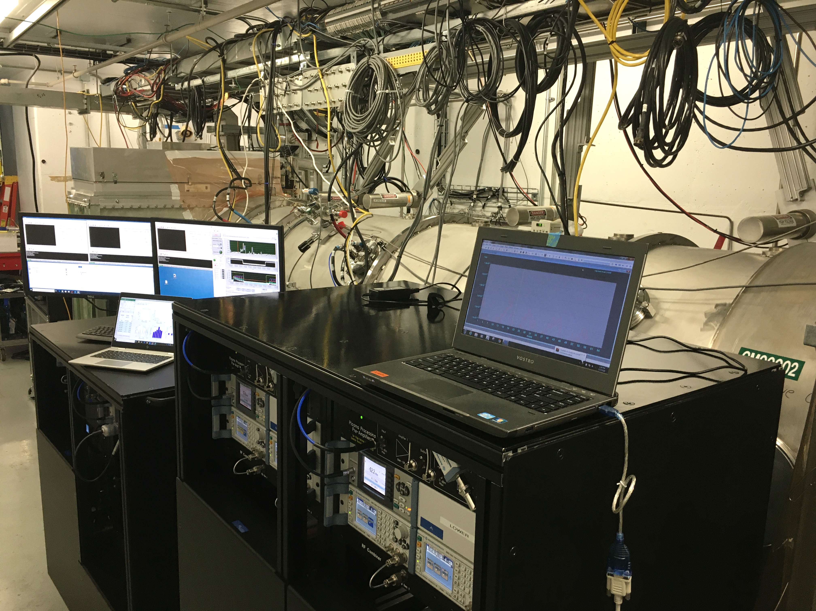
Plasma Processing for Proton Power Upgrade is underway
Medium-beta cryomodules being plasma processed as part of PPU to increase their accelerating gradients
First time medium-beta cryomodules are being plasma processed at SNS
8 high-beta cryomodules have been plasma processed before
The 3 cavities in medium-beta cryomodules plasma processed simultaneously
Cleaning of the cavities’ RF surface is observed through gas analysis
Cavities in the first plasma processed medium beta cryomodule improved by 2.5 MV/m on average
Plasma processing RF carts in front of a medium-beta cryomodule
Gas analysis during plasma processing. By-products of hydrocarbon oxidation by the neon-oxygen plasma are observed indicating cleaning of the RF surfaces.
Notes:
NTD

Slide 17
Plasma processing effort in US and around the world
Plasma processing has been developed at ORNL for SNS HB 805 MHz cavities, and thanks to the successful experience is being implemented in other labs worldwide
SNS medium-beta cryomodules are being plasma processed as part of PPU to increase their accelerating gradients
FNAL in partnership with ORNL and SLAC developed plasma processing methodology for LCLS-II 1.3 GHz 9-cell cavities and will be now implemented in the LCLS-II HE vCM
FNAL is also considering to develop plasma processing for PIP-II SSR and 650 MHz cavities
Jlab is developing similar plasma processing procedure for CEBAF 7-cell 1.5GHz C100 cavities to mitigate CEBAF cryomodules degradation
MSU is developing plasma processing for FRIB 322 MHz HWR and 80.5 MHz QWR cavities
IMP is developing plasma processing for CiADS 162.5 MHz HWR

Slide 18
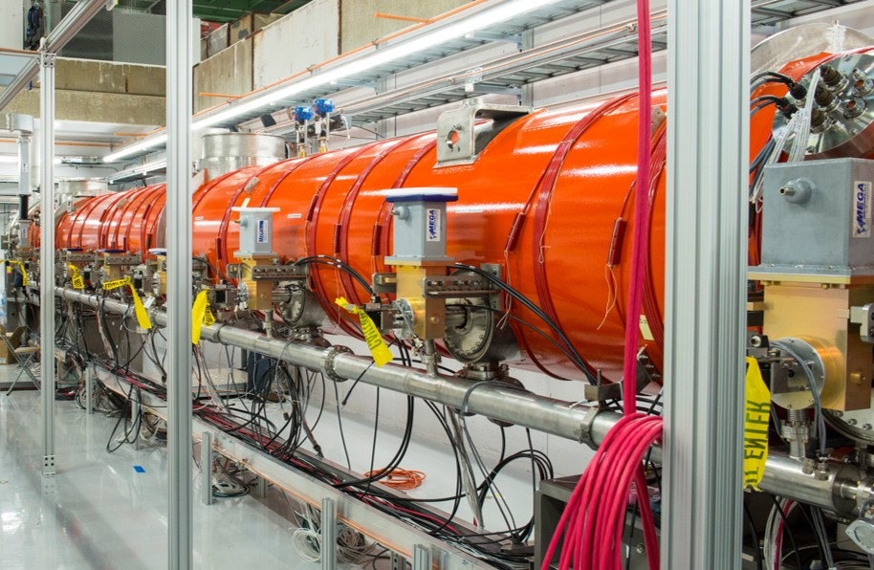
Plasma processing for LCLS-II
The Linear Coherent Light Source-II (LCLS-II) consists of 35 CM, with 8 TESLA-type $1300 MHz$ 9-cells cavities / CM
Plasma processing has been developed for these cavities, and high-Q preservation after plasma processing has been demonstrated
The methodology will be validated in-situ in a CM next summer during the LCLS-II HE vCM test at the CMTF at FNAL
If successful plasma processing might be implemented in both LCLS-II and LCLS-II HE CMs

Slide 19
Plasma processing effort in US and around the world
Plasma processing has been developed at ORNL for SNS HB 805 MHz cavities, and thanks to the successful experience is being implemented in other labs worldwide
SNS medium-beta cryomodules are being plasma processed as part of PPU to increase their accelerating gradients
FNAL in partnership with ORNL and SLAC developed plasma processing methodology for LCLS-II 1.3 GHz 9-cell cavities and will be now implemented in the LCLS-II HE vCM
FNAL is also considering to develop plasma processing for PIP-II SSR and 650 MHz cavities
Jlab is developing similar plasma processing procedure for CEBAF 7-cell 1.5GHz C100 cavities to mitigate CEBAF cryomodules degradation
MSU is developing plasma processing for FRIB 322 MHz HWR and 80.5 MHz QWR cavities
IMP is developing plasma processing for CiADS 162.5 MHz HWR

Slide 20
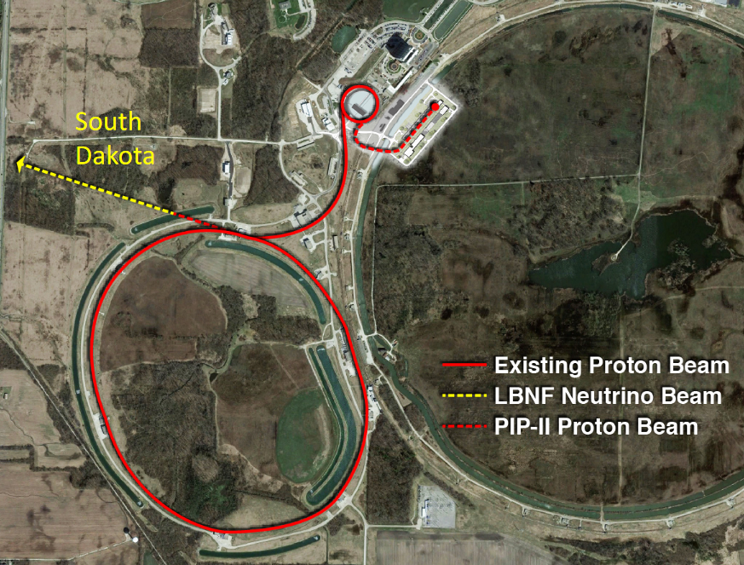
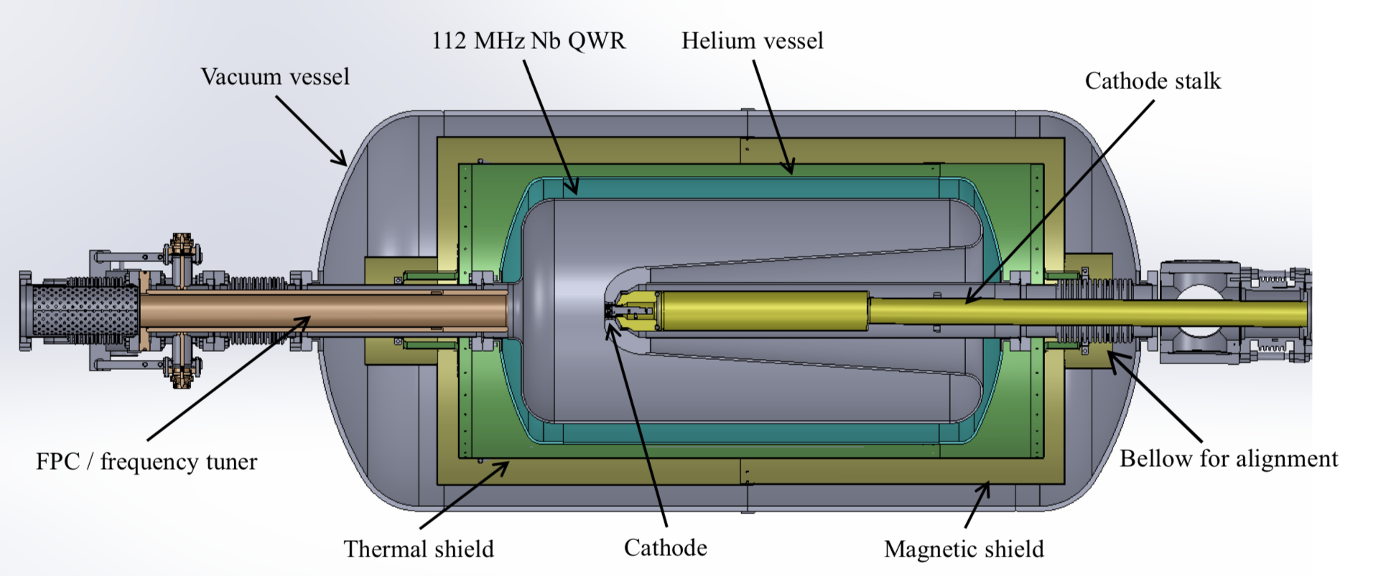
Other plasma processing efforts at FNAL
The Proton Improvement Plan-II (PIP-II) consists of HWR, SSR1, SSR2, LB650 and HB650 cavities
Plasma processing may be helpful to decrease field emission and multipacting in SSR and 650 MHz CMs
Plasma ignition has been achieved in an SSR1 cavity but further studies are needed to fully develop a plasma cleaning methodology
FNAL is also collaborating with BNL to develop plasma processing in an 112 MHz SRF gun
Plasma ignited in an SSR1 cavity
P. Berrutti, TTC 2018

Slide 21
Plasma processing effort in US and around the world
Plasma processing has been developed at ORNL for SNS HB 805 MHz cavities, and thanks to the successful experience is being implemented in other labs worldwide
SNS medium-beta cryomodules are being plasma processed as part of PPU to increase their accelerating gradients
FNAL in partnership with ORNL and SLAC developed plasma processing methodology for LCLS-II 1.3 GHz 9-cell cavities and will be now implemented in the LCLS-II HE vCM
FNAL is also considering to develop plasma processing for PIP-II SSR and 650 MHz cavities
Jlab is developing similar plasma processing procedure for CEBAF 7-cell 1.5GHz C100 cavities to mitigate CEBAF cryomodules degradation
MSU is developing plasma processing for FRIB 322 MHz HWR and 80.5 MHz QWR cavities
IMP is developing plasma processing for CiADS 162.5 MHz HWR

Slide 22
In-situ plasma processing at JLAB
The Continuous Electron Beam Accelerator Facility uses 418 SRF cavities for producing electron beams at energies up to 12 GeV.
JLAB is developing procedures and equipment for in-situ plasma processing to help mitigating CEBAF linac energy degradation.
Initial effort focuses on C100 cryomodules with follow-on effort towards processing the other cryomodule types used in CEBAF.
Initial effort is focused on using argon and 1% to 3% oxygen for removing hydrocarbons from the inner surface of the cavities. Other methods will be investigated in the future.
Information about field emission at CEBAF: R. Geng,“Particulate field emitters in CEBAF: from root-cause studies to mitigation solutions”, Invited talk at LINAC20

Slide 23
In-situ plasma processing at JLAB Status*
Two sets of RF and vacuum carts fabricated
Additional RF systems being developed for processing multiple cavities/cryomodules simultaneously in the tunnel. Each of two systems will be able to process 2 cavities at the same time.
Software developed to automate the RF and vacuum measurements and control.
Automatic software developed to ignite plasma in each of the 7 cells of a C100 cavity.
Software developed that tracks the frequency shift.
Higher plasma density leads to larger frequency shift.
Pattern of shifts for different modes used to confirm plasma location independent of using a camera. Cameras are not effective when processing a 10 m long cryomodule.
Procedures developed for processing C100 cavities in the JLAB vertical test area as well as in an off-line laboratory setting.
RF based HOM coupler breakdown Interlock has been implemented.
Have completed our first C100 cavity vertical test cycle of 2 K RF test, process, 2K RF test, process, 2K RF test with a 15% improvement in operating gradient.
Processing followed by cold test of a C100 cryomodule prior to disassembly for rebuild will occur in the spring 2021.
*Status and data provided by Tom Powers and Tiffany Ganey, from JLAB
Funding provided by SC Nuclear Physics Program through DOE SC Lab funding announcement Lab-20-2310

Slide 24
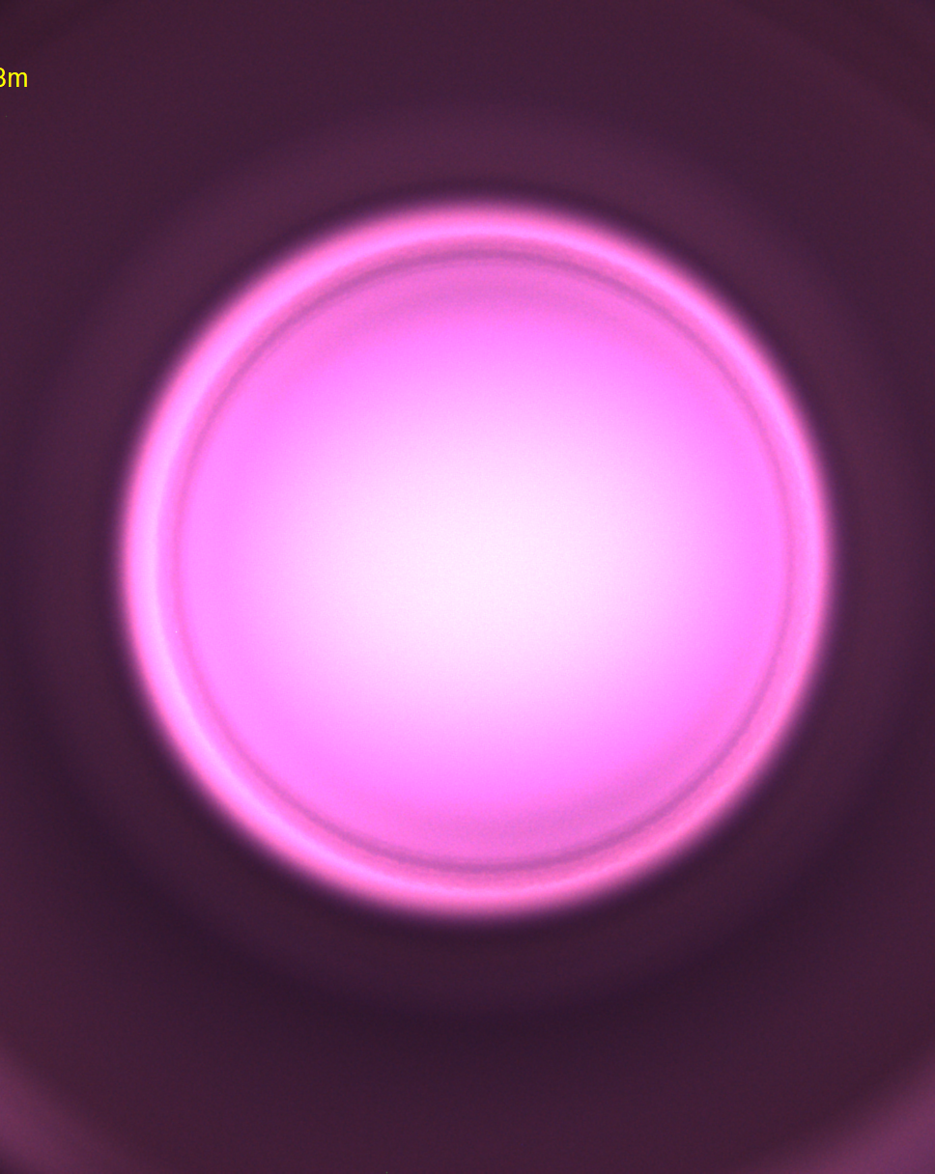
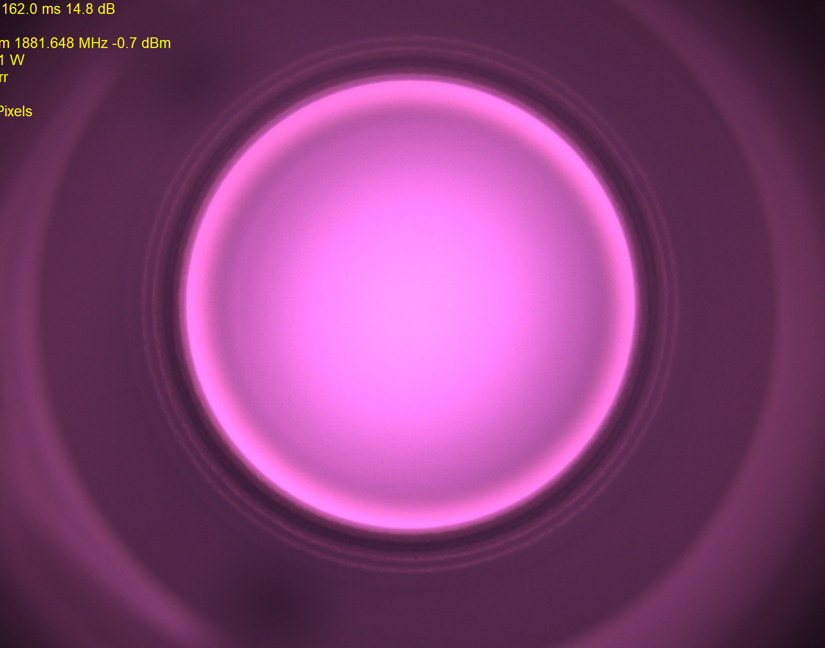
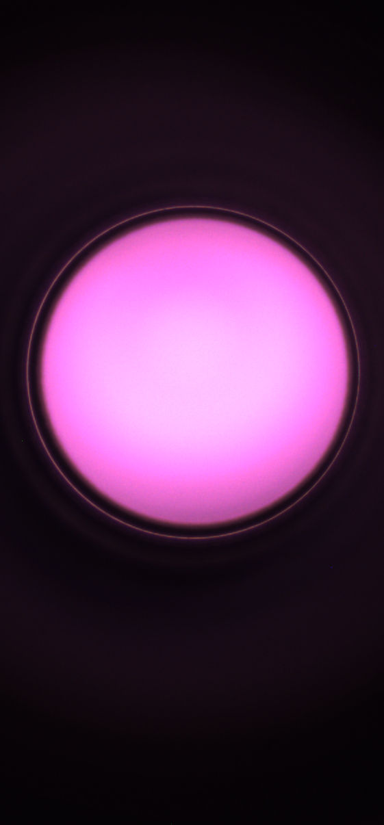
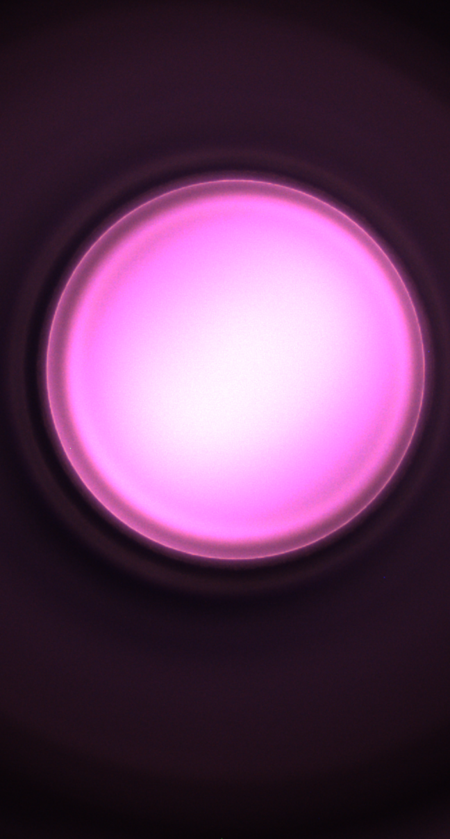
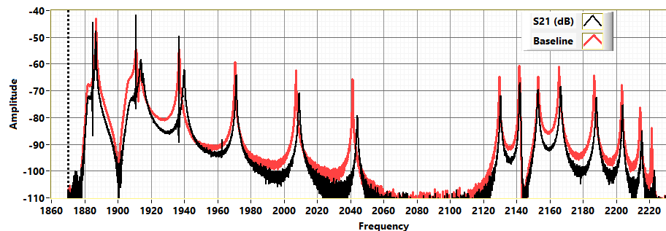
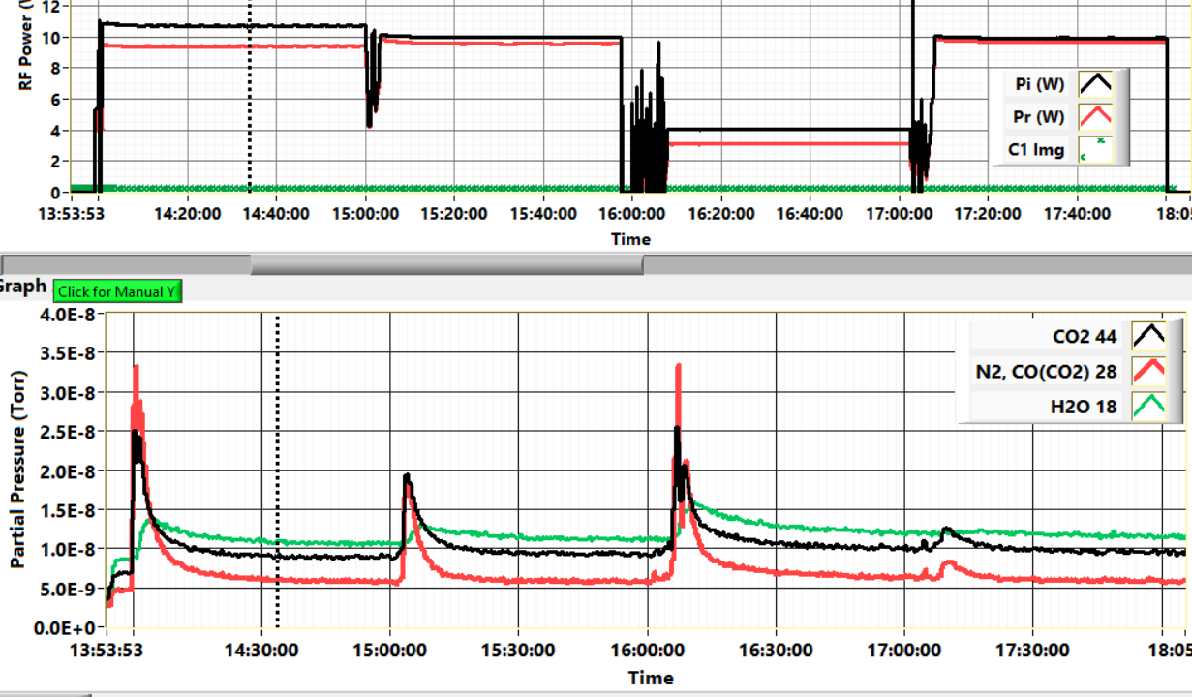
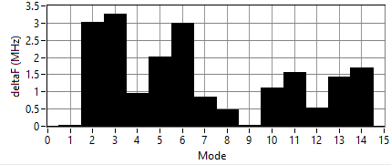
Processing Methods in JLAB Vertical Test Area
Processing done in the vertical staging area with the cavity is mounted on a vertical test stand in order to reduce cleanroom labor and improve throughput.
Argon with 1% to 3% oxygen at a pressure between 80 mTorr and 250 mTorr.
Two cells are processed at the same time by using two different frequencies. This reduces processing time by about 40%
Exhaust gas monitored using an RGA.
Cells 3/4 1/2 7 5/6
Plasma image, RF Power and partial pressure of C0₂, CO and H₂O during processing
Cavity S21 measurement and frequency shift by mode for cell 3 and 4 ignited.
*Status and data provided by Tom Powers and Tiffany Ganey, from JLAB
Funding provided by SC Nuclear Physics Program through DOE SC Lab funding announcement Lab-20-2310

Slide 25
Plasma processing effort in US and around the world
Plasma processing has been developed at ORNL for SNS HB 805 MHz cavities, and thanks to the successful experience is being implemented in other labs worldwide
SNS medium-beta cryomodules are being plasma processed as part of PPU to increase their accelerating gradients
FNAL in partnership with ORNL and SLAC developed plasma processing methodology for LCLS-II 1.3 GHz 9-cell cavities and will be now implemented in the LCLS-II HE vCM
FNAL is also considering to develop plasma processing for PIP-II SSR and 650 MHz cavities
Jlab is developing similar plasma processing procedure for CEBAF 7-cell 1.5GHz C100 cavities to mitigate CEBAF cryomodules degradation
MSU is developing plasma processing for FRIB 322 MHz HWR and 80.5 MHz QWR cavities
IMP is developing plasma processing for CiADS 162.5 MHz HWR

Slide 26
Plasma processing effort in US and around the world
Plasma processing has been developed at ORNL for SNS HB 805 MHz cavities, and thanks to the successful experience is being implemented in other labs worldwide
SNS medium-beta cryomodules are being plasma processed as part of PPU to increase their accelerating gradients
FNAL in partnership with ORNL and SLAC developed plasma processing methodology for LCLS-II 1.3 GHz 9-cell cavities and will be now implemented in the LCLS-II HE vCM
FNAL is also considering to develop plasma processing for PIP-II SSR and 650 MHz cavities
Jlab is developing similar plasma processing procedure for CEBAF 7-cell 1.5GHz C100 cavities to mitigate CEBAF cryomodules degradation
MSU is developing plasma processing for FRIB 322 MHz HWR and 80.5 MHz QWR cavities
IMP is developing plasma processing for CiADS 162.5 MHz HWR

Slide 27
Outline
Introduction on plasma processing
Example of plasma cleaning on SRF cavities & cryomodules
Plasma processing effort in the SRF community
Future perspective

Slide 28
Future perspective
Very active R&D on plasma processing in US and around the world
Successful experience of SNS cryomodules encouraging for other SRF machines
Within next couple of years plasma processing is expected to be applied in several cryomodules allowing for performance recovery and energy improvement
The technique may be optimized to be even more effective against different types of field emitters
The developing of plasma processing and other techniques for field emission abatement are crucial to push the technology forward

