Slide 1



Nb₃Sn Superconducting Radiofrequency Cavities
Presenter: Ryan Porter¹
Authors: S. Posen², M. Liepe¹, G. Eremeev², U. Pudasaini³, C.E. Reece³
¹Cornell University
²Fermi National Accelerator Laboratory
³Thomas Jefferson National Accelerator Facility
SNOWMASS Letter of Interest: SNOWMASS21-AF7_AF0_Posen-086
https://www.snowmass21.org/docs/files/summaries/AF/SNOWMASS21-AF7_AF0_Posen-086.pdf
Notes:
How to introduce myself. Feels like I need a grander entry, better at selling. Less introducing us, more salesman

Slide 2
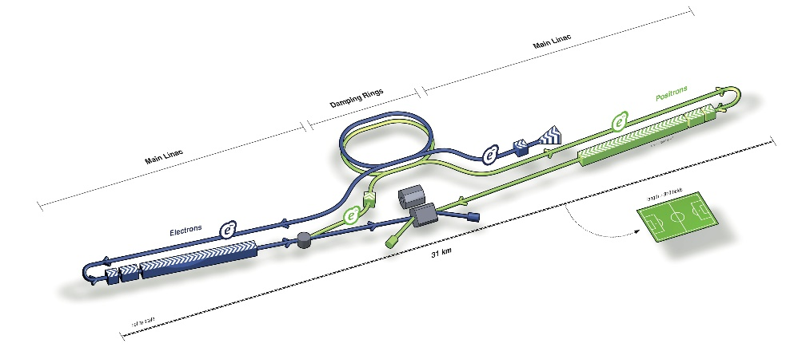
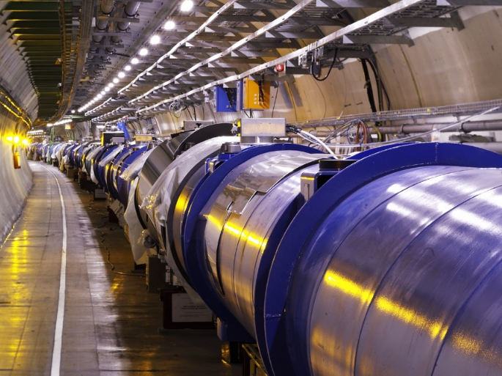
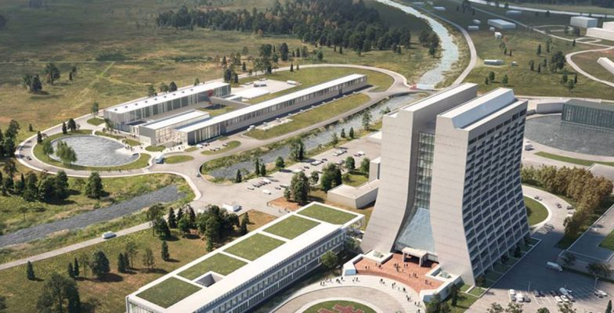
SRF Introduction
Superconducting niobium RF cavities
  Used to accelerate beams in modern accelerators
  Low losses/high energy efficiency key to modern accelerators
Gold standard for modern HEP accelerators
  LBNF/DUNE, LHC, KEKB, etc.
  Many past machines: LEP, HERA, etc
1m
ILC
Key technology for future HEP projects
  ILC, FCC-ee, CepC, HL-LHC, PIP-II,
Used in other major DOE projects:
  LCLS II, Electron-Ion Collider (EIC)
LHC
PIP-II

Slide 3
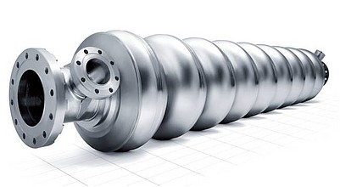
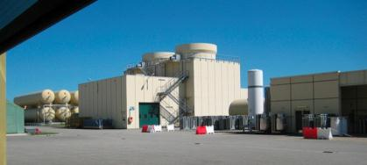
Key Figures of Merit
Accelerating Gradient
Quality Factor
Higher E_{acc}
Higher energy gain
Shorter accelerators
Higher energy reached
Higher Q
More efficient
Higher duty-cycle
Higher luminosity
Operating Temperature
2K
$$$
4K
$
Higher Operating Temperature
More efficient
Lower cost

Slide 4
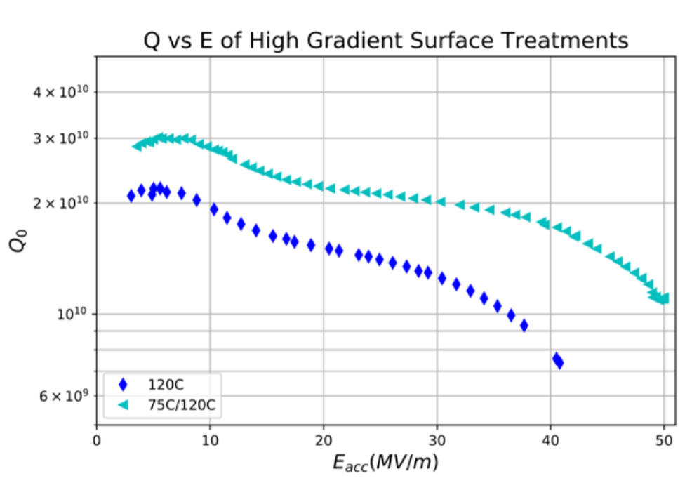
Niobium Cavities Reaching Fundamental Limits
Q limit = ????
Unknown
Limited to 2 K
operation
Need better materials for future HEP accelerators
D. Bafia et al. “Gradients of 50 MV/m in TESLA Shaped Cavities via Modified Low Temperature Bake,
in proc. of 19th Int. Conf. on RF Superconductivity (SRF2019), Dresden Germany, July 2019
E_{acc} limit ≈ 50 - 55 MV/m
Notes:
Replace with figure with overlapped AES022 + N-infused/doped cavity with higher Q but lower Eacc

Slide 5
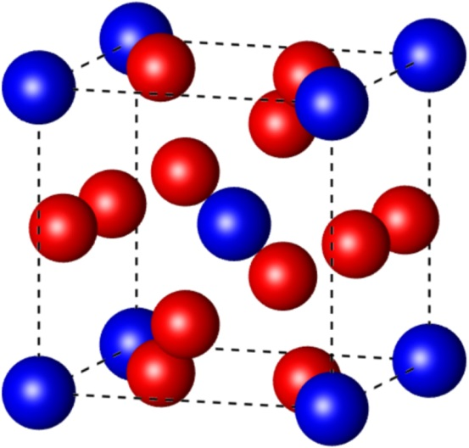
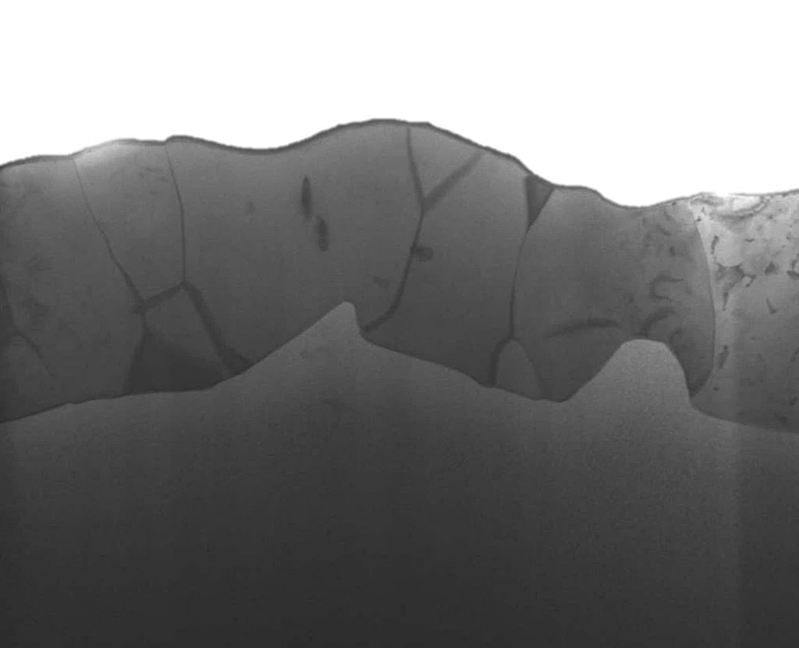
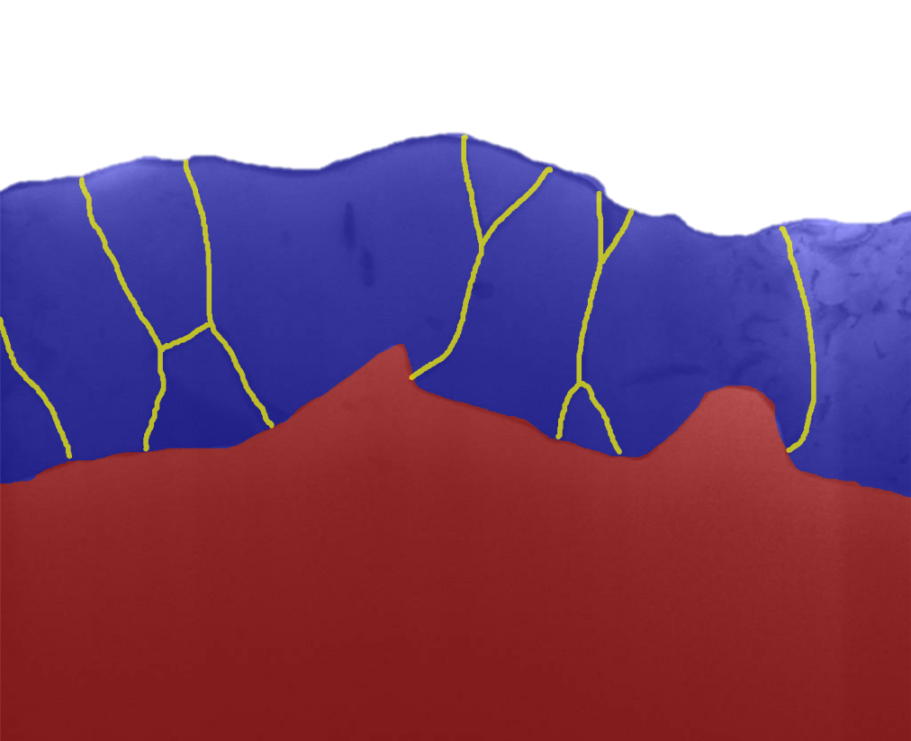
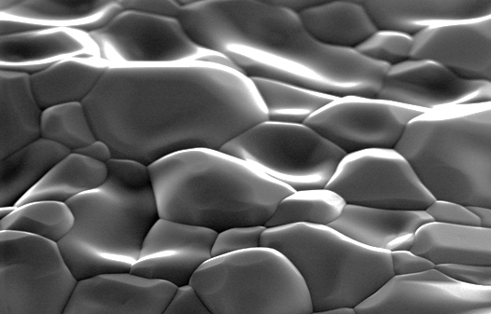
Best Material for Next-Gen SRF: Nb₃Sn
Higher critical temperature
→ Operation at 4.2 K
→ More efficient
Higher superheating field
→ Double the limit of niobium
Blue: tin
Red: niobium
RF Surface
Nb₃Sn
≈3 μm
Nb
1 μm
1 μm
2 μm

Slide 6
Potential of Nb₃Sn Cavities
Increased Accelerating Field
Lower Cooling Cost and Complexity
 | Niobium | Nb₃Sn
Superheating field | 240 mT | 420 mT
Max. E_{acc} (theoretical limit) | 55 MV/m | 100 MV/m
 | Niobium | Nb₃Sn
Critical Temperature T_{c} | 9 K | 18 K
Q₀ at 4.2 K | 6 x 10⁸ | 4 x 10¹⁰
Q₀ at 2.0 K | 4 x 10¹⁰ | >10¹¹
Higher energy reached
Shorter accelerators
Q₀ given for 1.3 GHz ILC-shape cavities
2K
$$$
4K
$
Lower cost
Higher Luminosity
  Longer pulse lengths/bunch train length
  And/or higher rep. rate

Slide 7
The Rebirth of Nb₃Sn SRF R&D
Nb₃Sn Papers at SRF Conference
DOE funds small R&D projects
Produces first good results
Early Attempts—Poor Performance
INFN
Siemens AG,
K.F Karlsruhe
(Cornell)
U. of Wuppertal
RF testing at JLAB, Cornell, SLAC, CERN…
Cornell
JLAB
FNAL
CERN
PKU, IMP, KEK…
Notes:
46 contributions at Nb3Sn Workshop

Slide 8
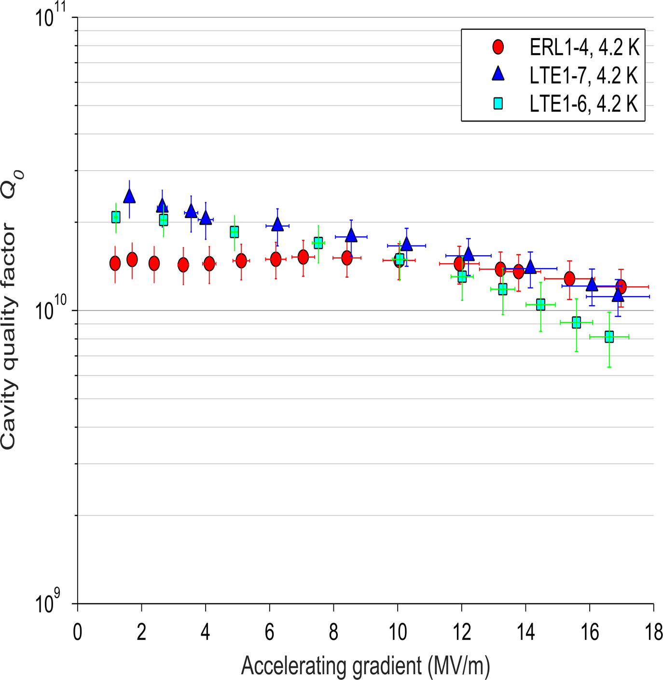
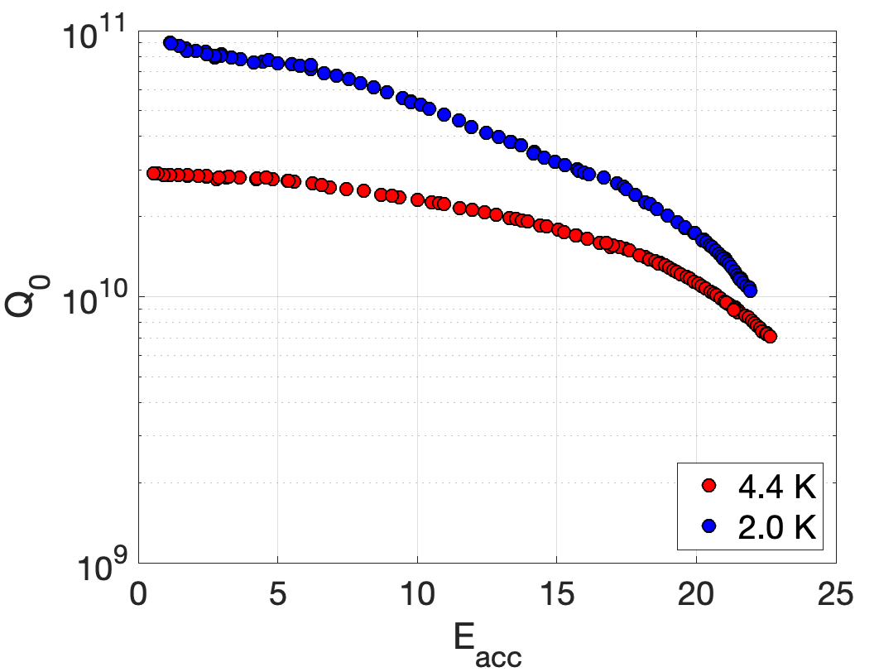
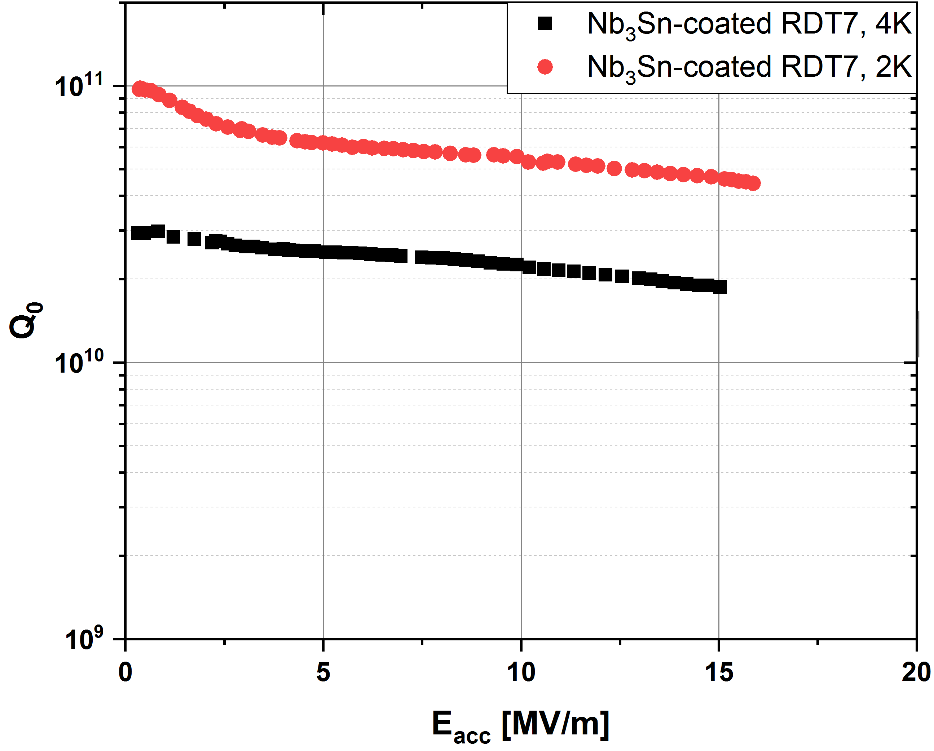
Current Nb₃Sn Cavity Performance
4.2 K
4 K
4.2 K
G. Ciovati, I. Parajuli, U. Pudasaini
Gradients up to 24 MV/m: exceeds typical operating gradient of current CW machines
4 K operation with unprecedented Q >10¹⁰ in CW operation achieved at all 3 labs

Slide 9
Moving to 4.2 K
At 2.0 K, it takes 800 W to remove 1 W of heat
Operating at 4.2 K
~1/3 power losses for same Q
At 4.2 K, you
need 250 W

Slide 10
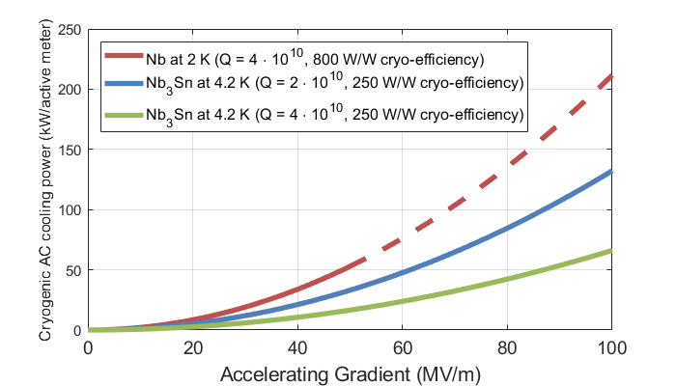
Cryo-Efficiency
1.3 GHz
Q = 4·10¹⁰
‘State of the art’ Nb at 2 K
Simpler, cheaper cryogenics at 4.2 K
1.5 - 3 x efficient than niobium!
More efficient
at ILC spec
Q = 2·10¹⁰
Q = 4·10¹⁰
Nb₃Sn at 4.2 K
Niobium
Limit
Notes:
Update to include N-infused/mid-T bake type results

Slide 11
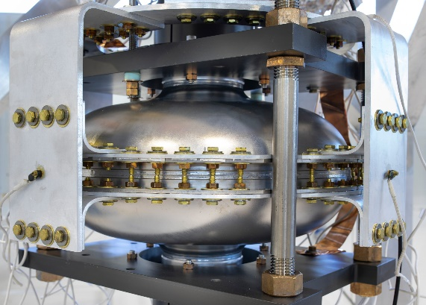
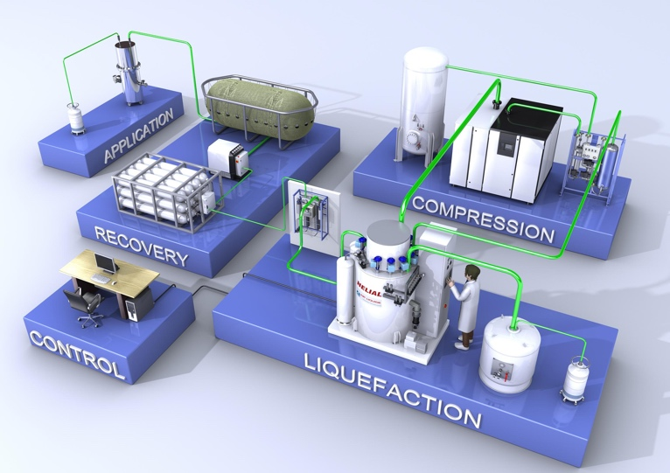

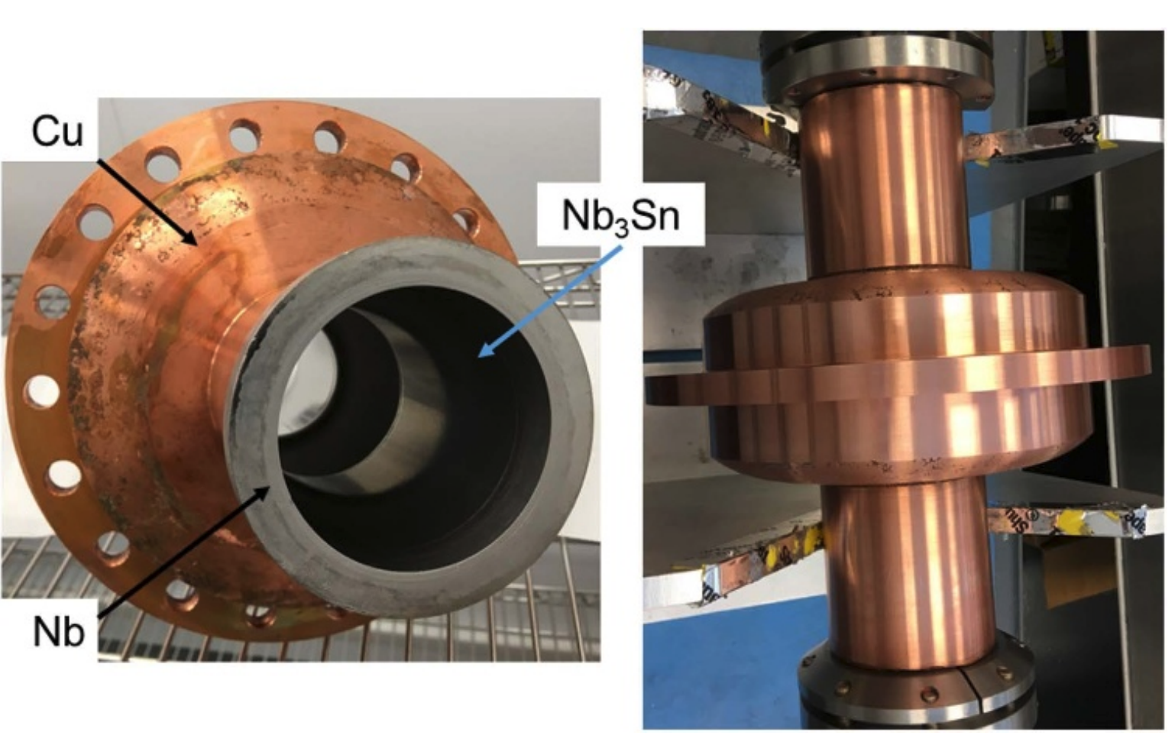

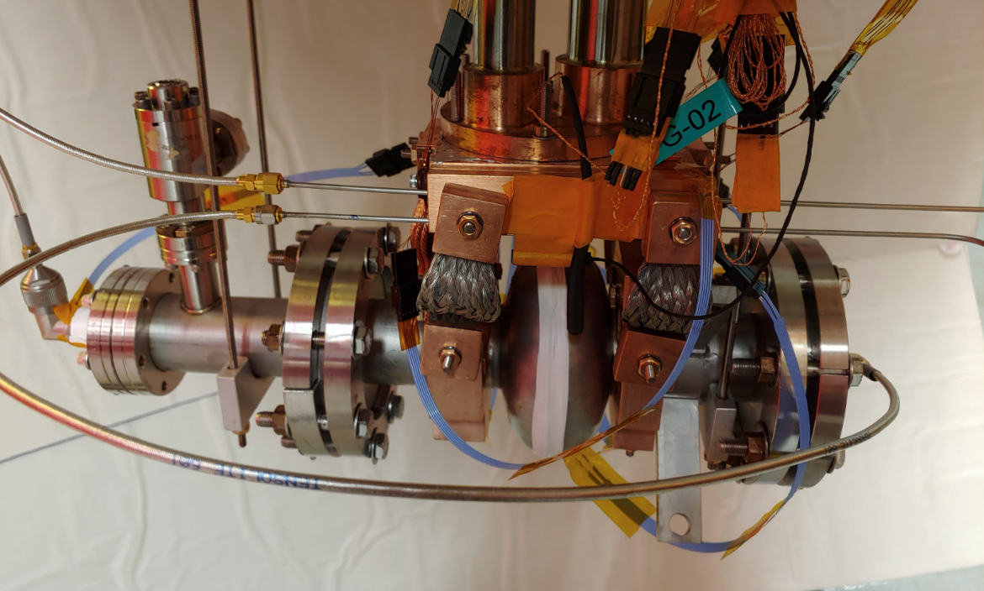
Cryocooled SRF Cavities
High efficiency enables cryocooler operation:
R.C. Dhuley et al, ﻿Supercond. Sci. Technol. 33 06LT01 (2020)
2K
4K
Turn Key Cooling
G. Ciovati et al, Supercond. Sci. Technol. 33 07LT01 (2020)
No liquid helium
Small, turn-key, affordable
Enables small scale SRF accelerators
  Compact light sources, polymer cross-linking, waste processing, etc
N. Stilin et al, ﻿arXiv:2002.11755v1 (2020)

Slide 12
Increasing Efficiency
Surface resistance at 4.2 K and 10 MV/m (Cornell single-cell)
16 nΩ
Not fundamental
Fundamental (BCS) Resistance
Can be removed
Further R&D
Q = 2·10¹⁰
4·10¹⁰+
0 nΩ

Slide 13
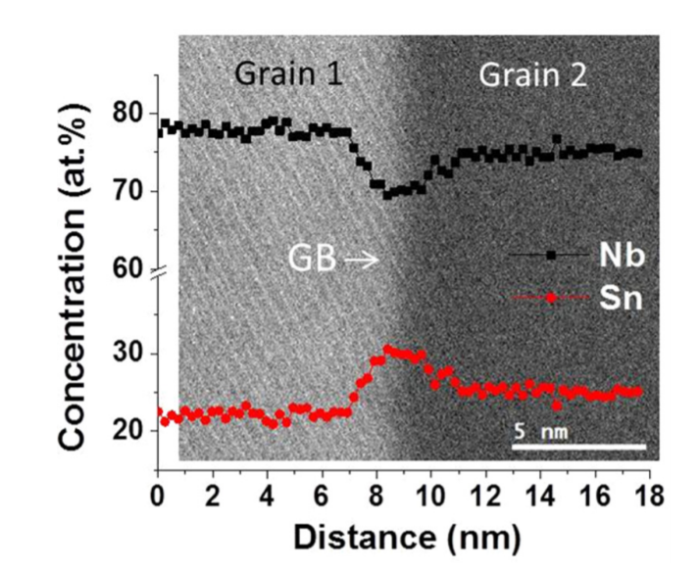
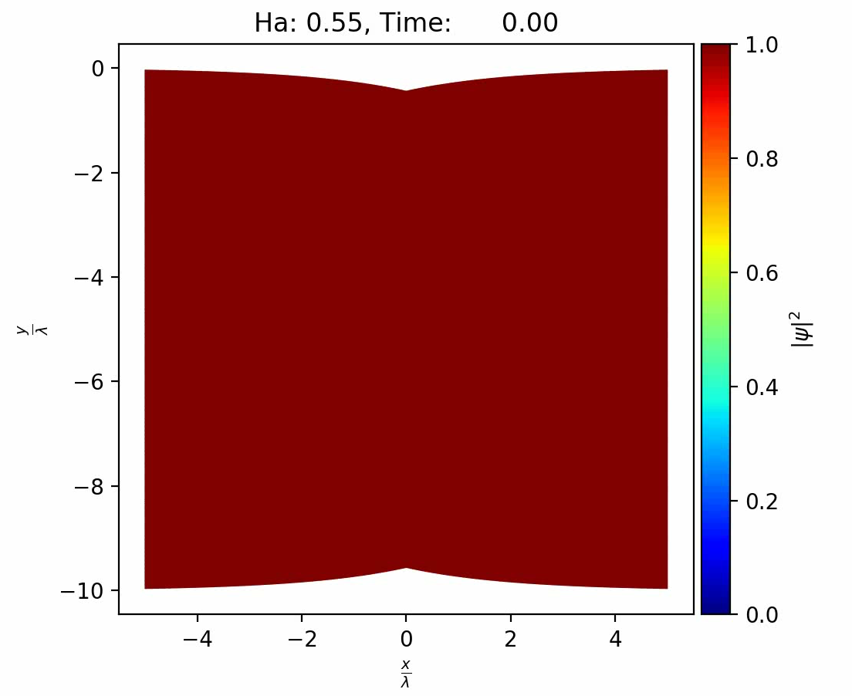
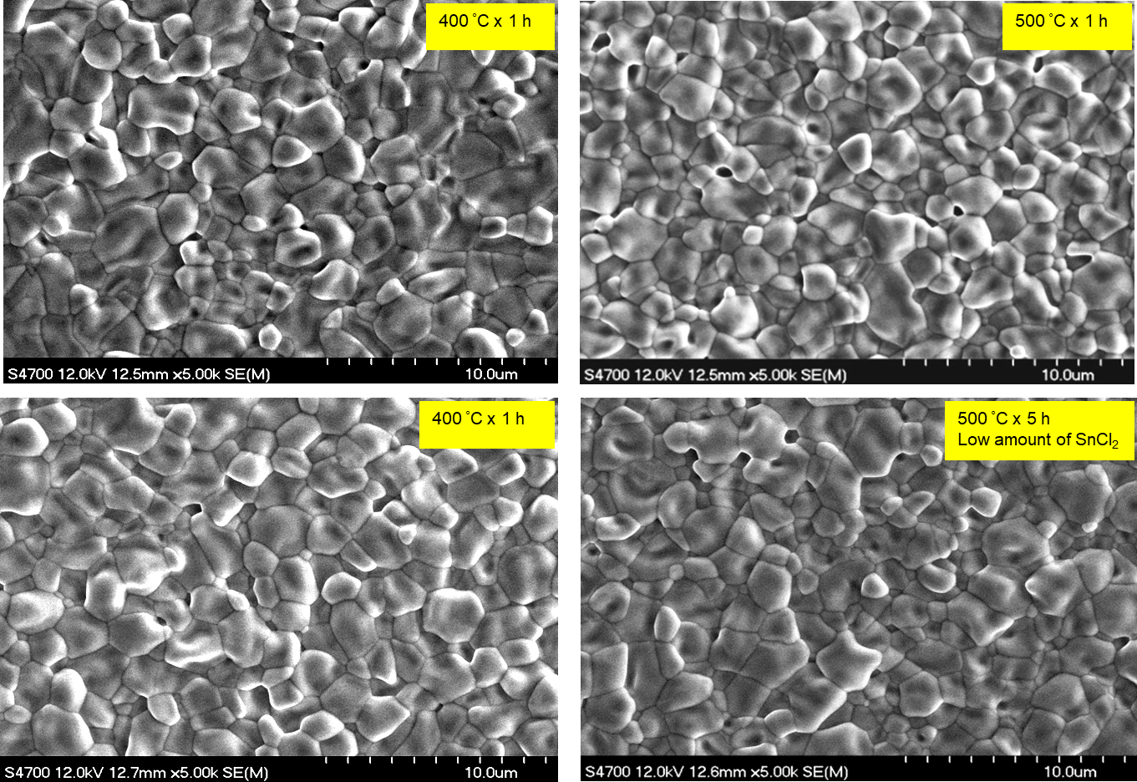

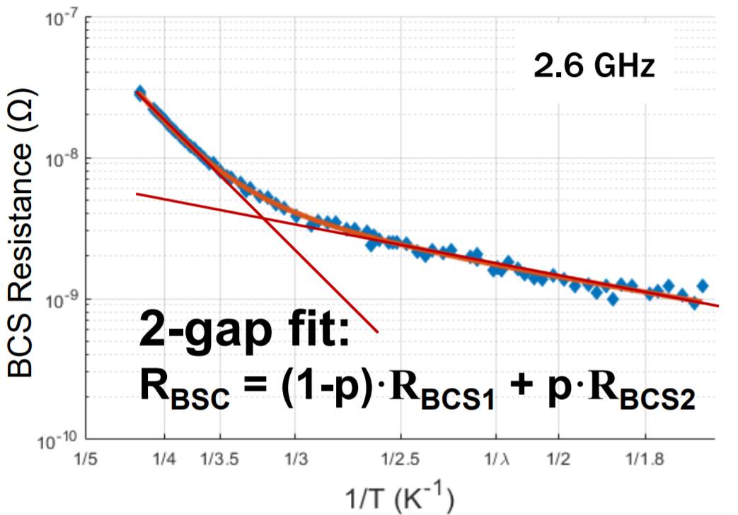
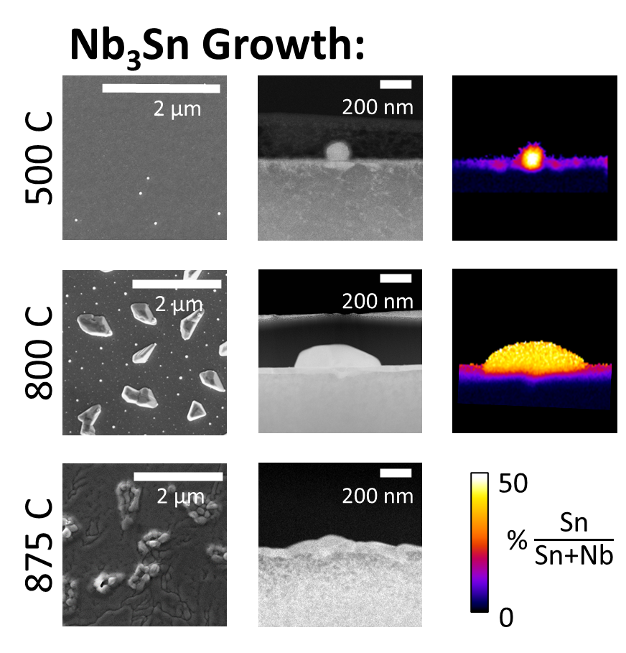
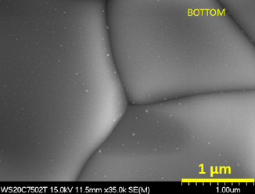
Research Highlight I: Quality factor
Sn-Segregation in Grain Boundaries + Vortex Entry:
Material Growth Studies:
J. Carlson et al, ﻿Phys Rev B 103 024516 (2021)
Coating with different nucleation profiles:
U. Pudasaini, ﻿” Nb3Sn growth in vapor diffusion: process design for large surface area coatings,” presented at Nb3SnSRF’20, Nov 2020
‘2-Gap’ BCS Analysis:
Sn Nano Residue:
R.D. Porter et. al., “High Frequency Nb3Sn Cavities,” in proc. of SRF2019, Germany, 2019
U. Pudasaini, ﻿” Nb3Sn growth in vapor diffusion: process design for large surface area coatings,” presented at Nb3SnSRF’20, Nov 2020
R. D. Porter, ﻿” Growth Studies and Optimization of Nb3Sn Coatings,” presented at Nb3SnSRF’20, Nov 2020
Notes:
W

Slide 14
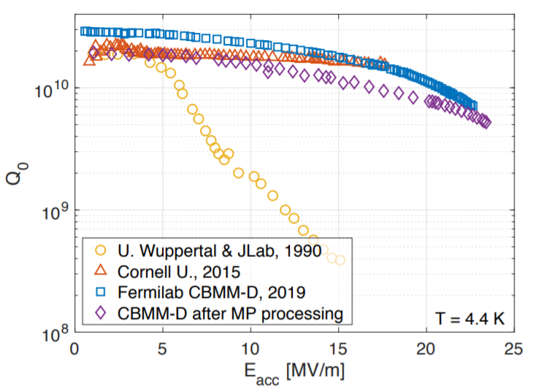
Increasing E_{acc}
Can reach 24 MV/m E_{acc}
  Meets spec for many machines!
  Could read 100 MV/m
Current
24 MV/m
Future
100 MV/m
Steady advancement over last 10 years:
Before 2013
~ 5 MV/m
2013
15 MV/m
2015
18 MV/m
2020
24 MV/m
2030
50 MV/m ???
Notes:
CBMM-D reaches higher fields after processing, but with a lower Q. I’m not sure whether to list 21 MV/m or 24 MV/m as the usable gradient.

Slide 15

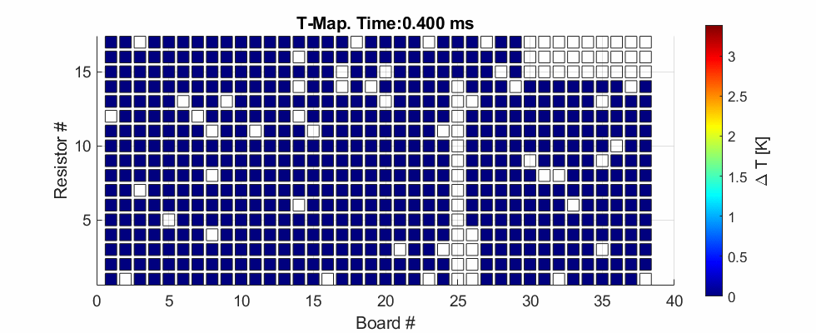

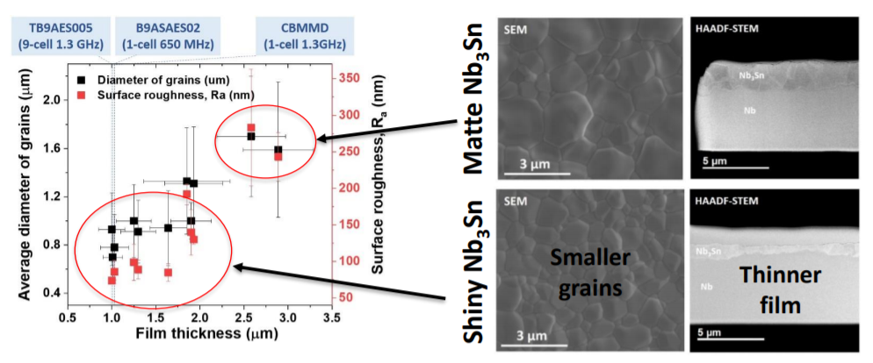
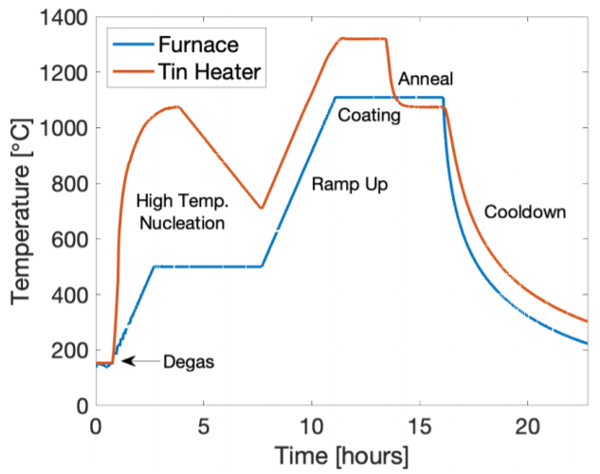
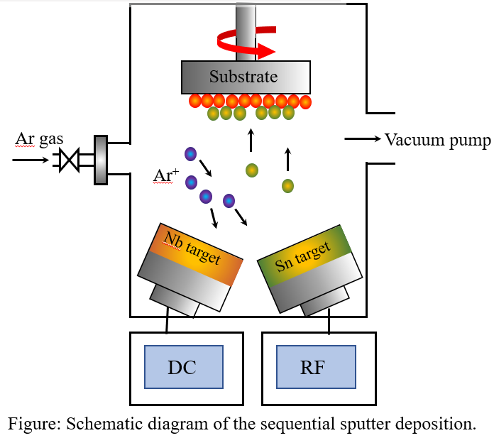
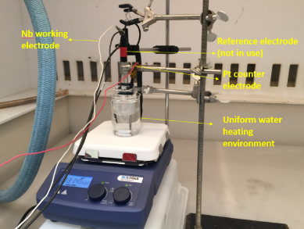

Research Highlights II: Cavity Quench
Vortex Nucleation at Grain Boundaries:
Time Resolved Quench Thermometry
Time dependent Ginzburg-Landau Simulation of Vortex Nucleation
R. D. Porter, ﻿” Surface Resistance, Frequency Dependence, and Field Limitation in Nb3Sn Cavities,” presented at Nb3SnSRF’20, Nov 2020
A. R. Pack, M. Transtrum (BYU), SRF2019, MOP017
Surface Roughness Reduction:
Material Growth Optimization and New Processes:
Vapor Deposition
Sputtering
Electrodeposition
Md. N. Sayeed, Nb3SnSRF’20, Nov 2020
Z. Sun, Nb3SnSRF’20, Nov 2020
S. Posen et. al., arXiv:2008.00599 ﻿, Aug 2020

Slide 16











Collaborations
Have built many collaborations
Unlocked skills + tools + knowledge outside our community
  Condensed matter theorists, material scientists, microscopists, chemists, and more
Provides critical expertise needed to succeed

Slide 17
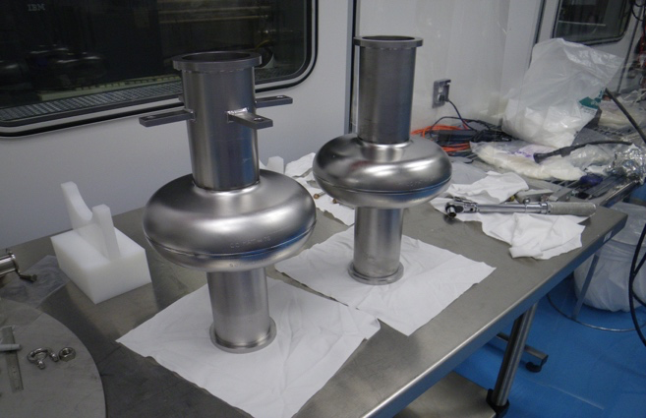
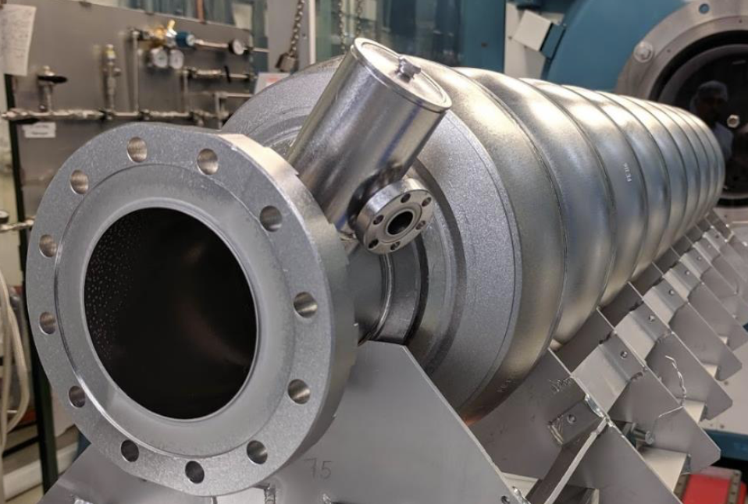
Single-cell to Multi-cell Cavities
Single-cell
Multi-cell
Used for
material
R&D
Usable in real accelerators

Slide 18
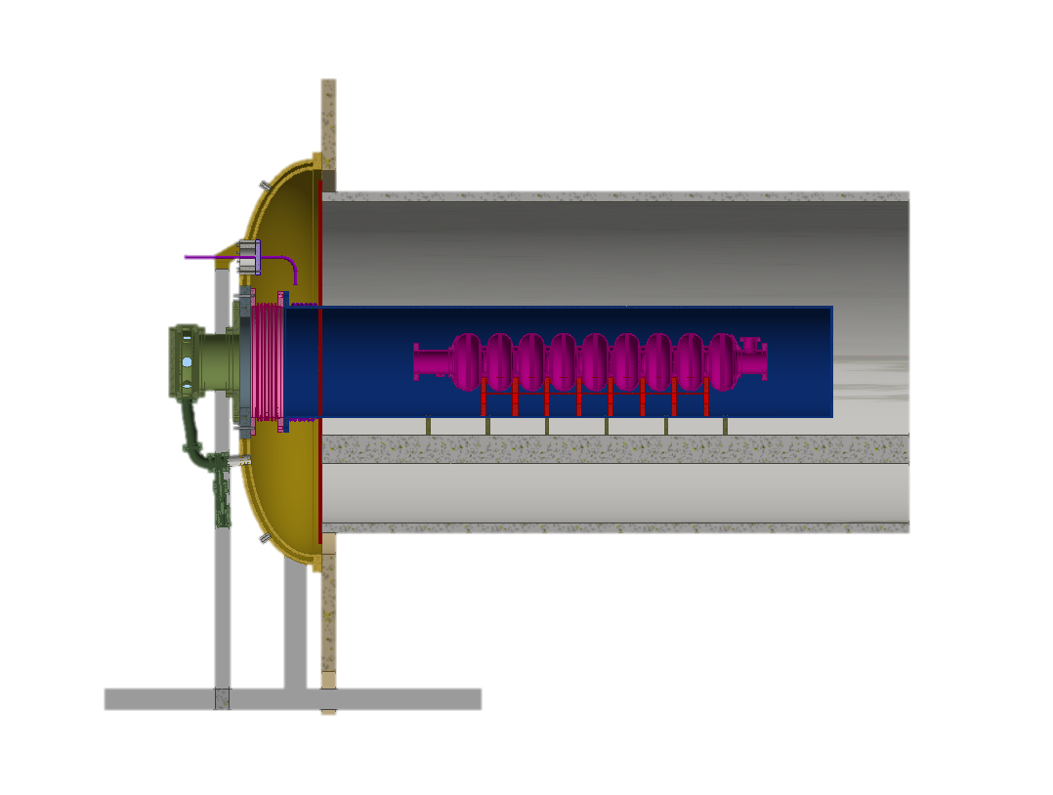
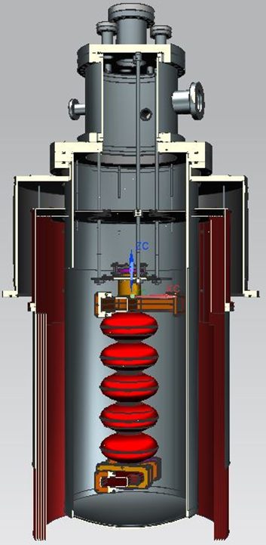
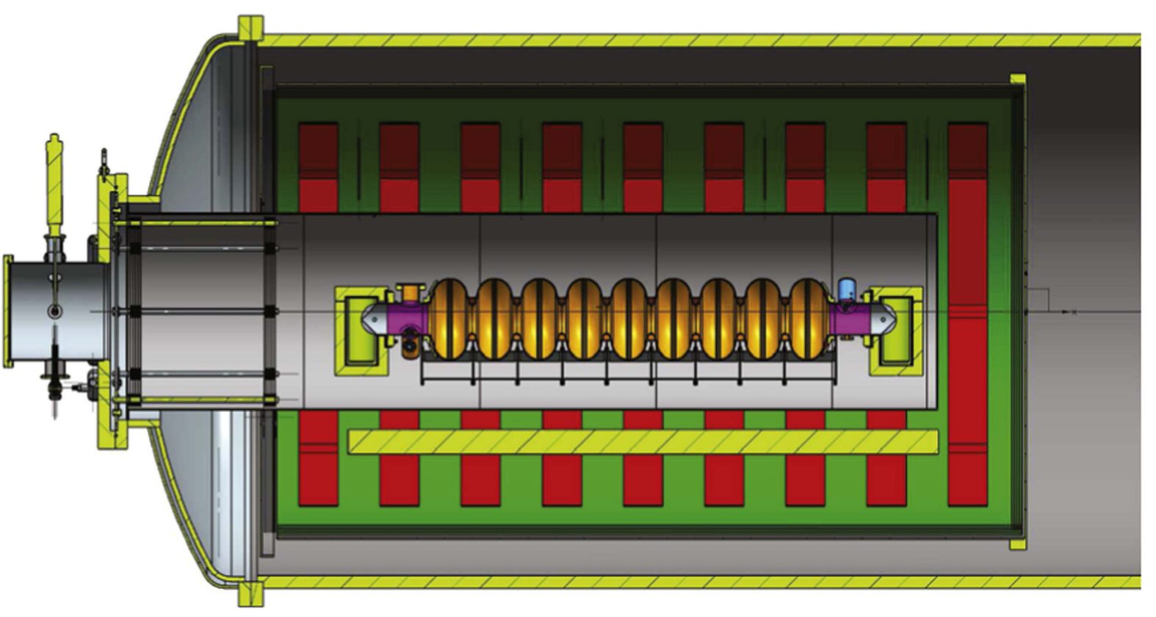
Multi-cell Coating Nb₃Sn Cavities
Soon to be completed!
“Siemens” configuration, i.e., no secondary heater for the tin source
“Wuppertal” configuration, i.e., with secondary heater for the tin source
“Wuppertal” configuration, i.e., with secondary heater for the tin source

Slide 19
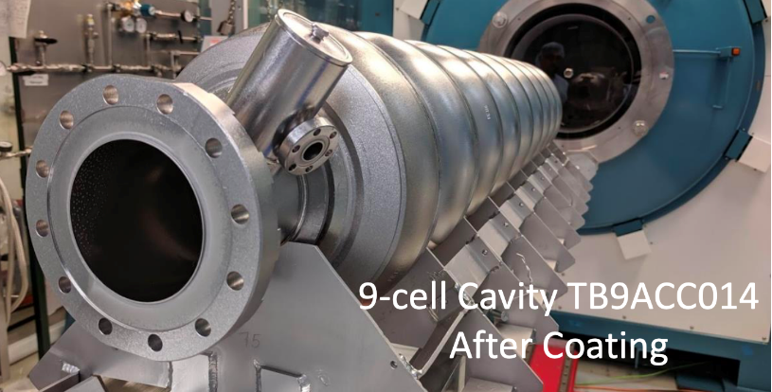
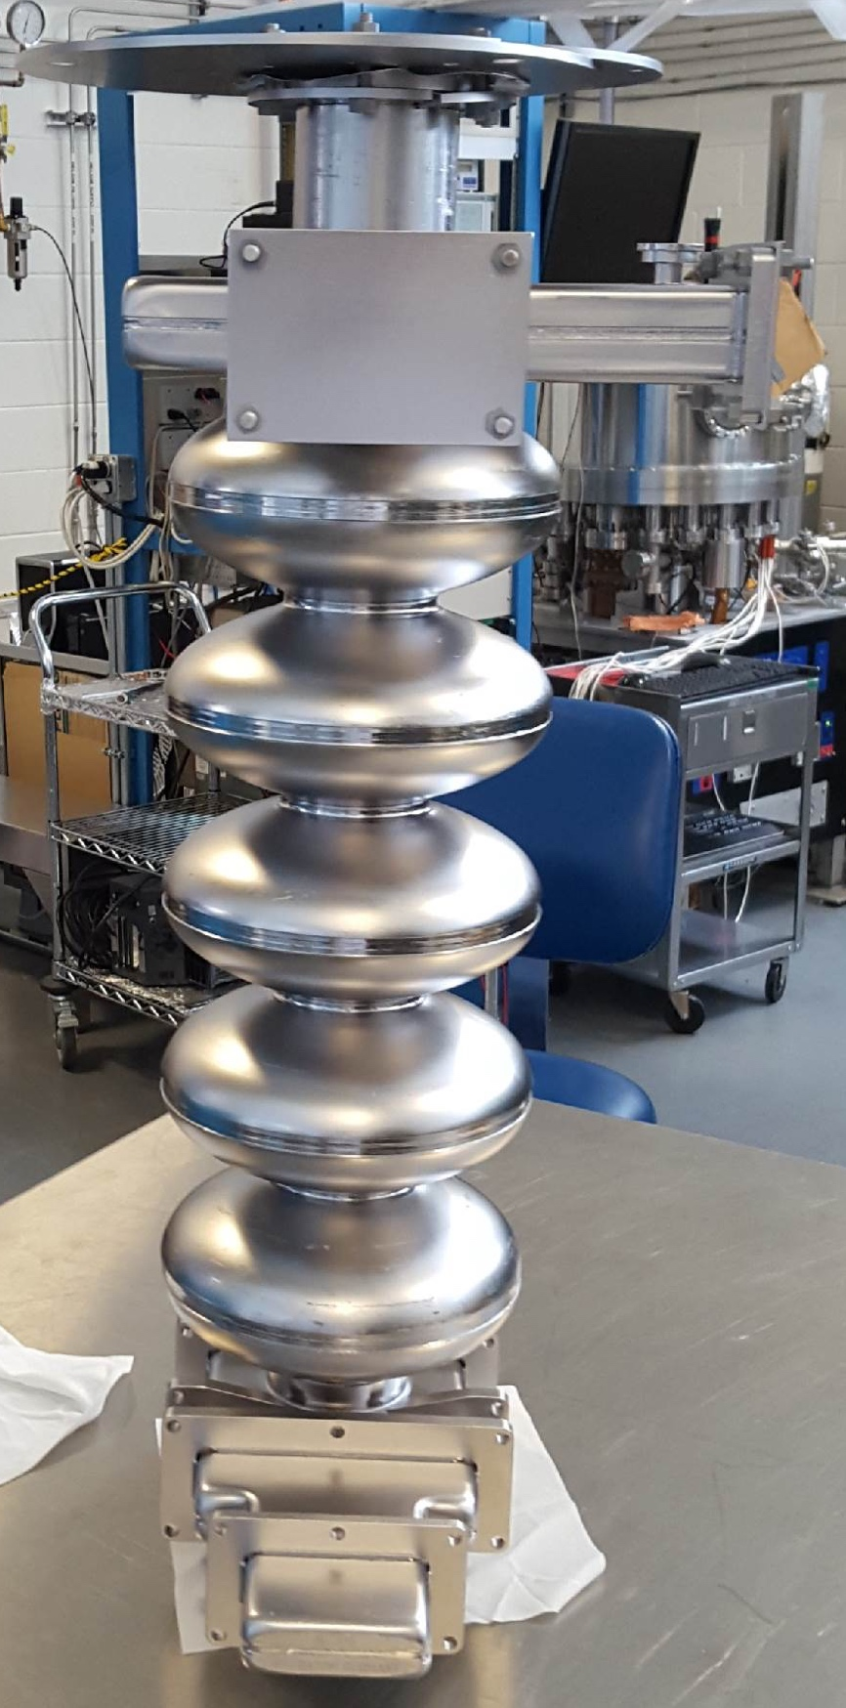
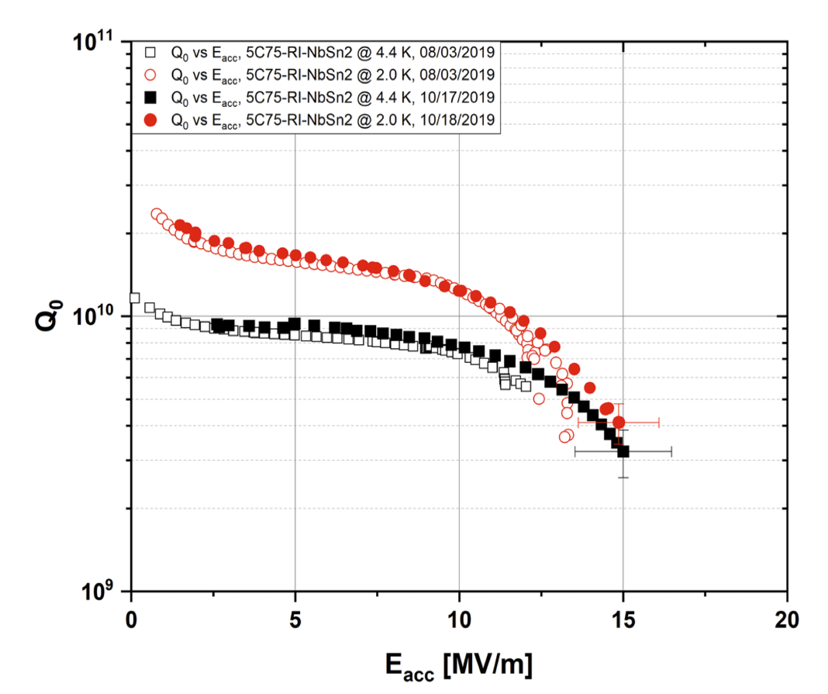
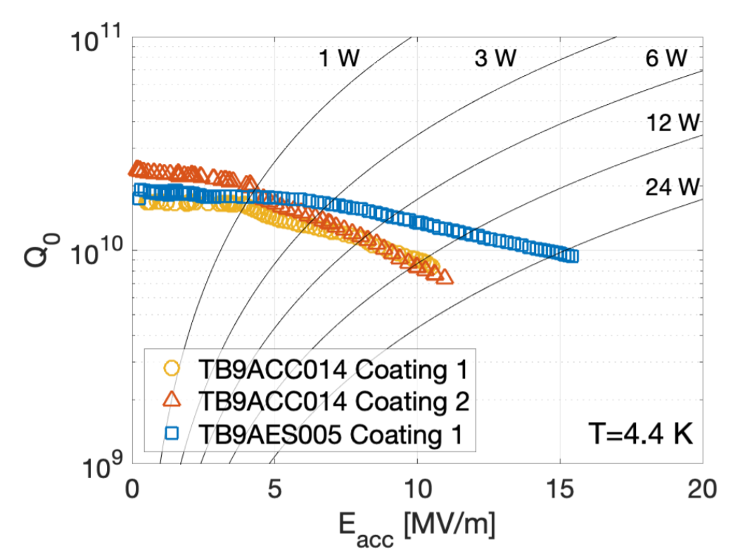
Multi-cell Nb₃Sn Cavities for Accelerator Applications
JLAB: 5-cell 1.5 GHz
FNAL: 9-cell 1.3 GHz
Nb₃Sn accelerator multi-cell cavities reaching useful gradients as high as 15 MV/m with high Q at 4.4 K!

Slide 20
Outlook
Accelerating Gradient Improvements
Before 2013
< 5 MV/m
2013
15 MV/m
2015
18 MV/m
2020
24 MV/m
2030
50 MV/m ???
Efficiency Improvements
Higher Energy
  ~2 x higher potential maximum gradients
  Nb₃Sn + Traveling Wave + Improved cell shape
  → E_{acc} > 140 MV/m (?)
16 nΩ
Can be removed
Fundamental
Q = 2·10¹⁰
4·10¹⁰
Higher Luminosity
  Lower cryogenics loses
  Lower cost
  Longer pulse lengths/bunch train length
  And/or higher rep. rate
0 nΩ

Slide 21
Conclusions
SRF key technology for current and future HEP accelerators
Niobium is great, but reaching fundamental limits
Nb₃Sn ‘game-changing’ material for SRF and HEP projects
  Meets spec for some current machines
Technology almost ready for real accelerators
  Promising early multicell-cavity results
Snowmass community should strongly endorse continued investment into Nb₃Sn SRF cavity R&D

