Slide 1
Innovative Materials and Surface Treatments for SRF Applications
M. Checchin, D. Bafia, S. Belomestnykh, G. Eremeev, B. Giaccone, A. Grassellino, M. Martinello, A. Romanenko, T. Spina, S. Posen, and G. Wu

Slide 2
Motivation
Innovative materials are interesting because they can allow for:
  Unprecedented high gradients in SRF cavities
  High Q-factor operation at 4.2 K
  High coherence in SRF based quantum bits for HEP applications
  High sensitivity detectors for BSM particles (axions, dark photons, …)
Development of CVD/ALD technique for coating SRF cavities
  versatile tool for conformal deposition of innovative materials

Slide 3
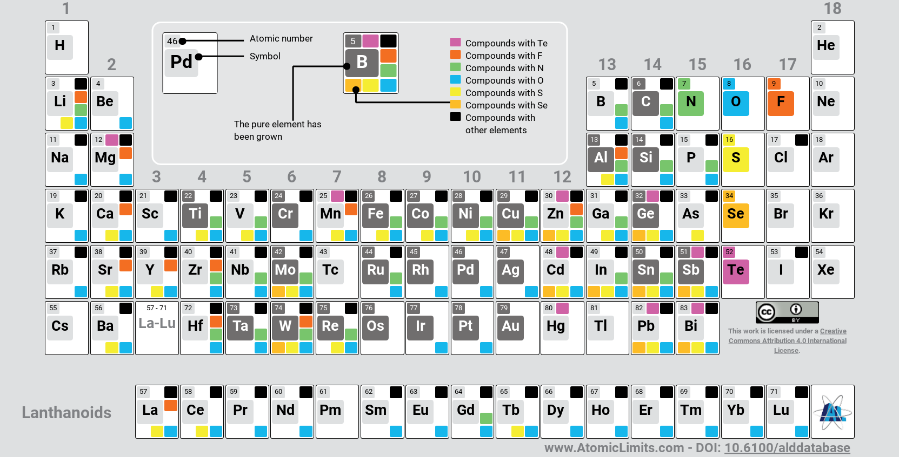
CVD and ALD techniques
CVD and ALD allow for the deposition of a large variety of materials
  The process is conformal and not line-of-sight
  Perfect for resonating structures
It allows for the deposition of metastable compounds since the reaction is kinetically driven
  E.g.: Nb3Ge can be deposited by CVD process at ~800 C without non-stoichiometric precipitates. In contrast powder reaction must be performed at ~1900 C followed by rapid T-quench to avoid formation of spurious phases.

Slide 4
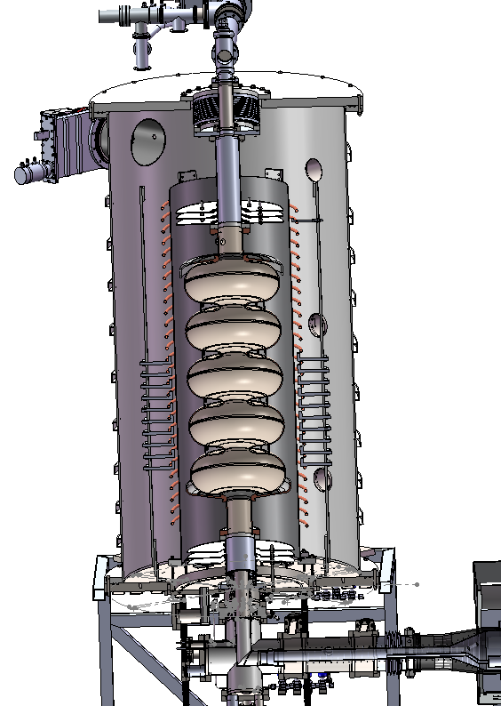
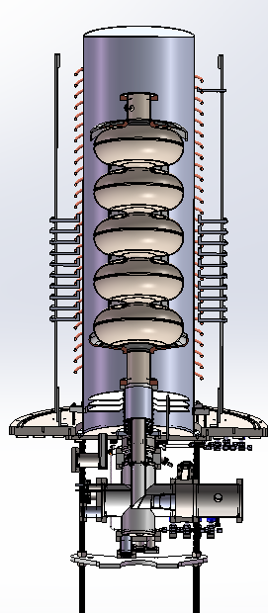
Versatile CVD/ALD reactor
Fermilab invested in the procurement of a versatile CVD/ALD system capable of depositing on meter-long accelerator cavities
Allows for a variety of different materials
  Superconductors
  Metals
  Insulators
Materials of interest:
  A15 superconductors
  Nitrides supercodncutors
  Al2O3, SiN

Slide 5
SS and SIS structures

Slide 6
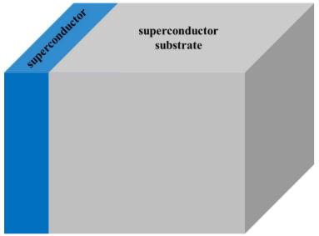
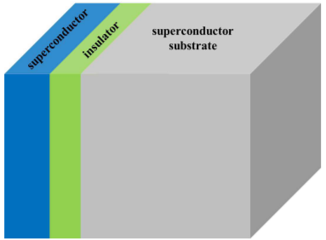
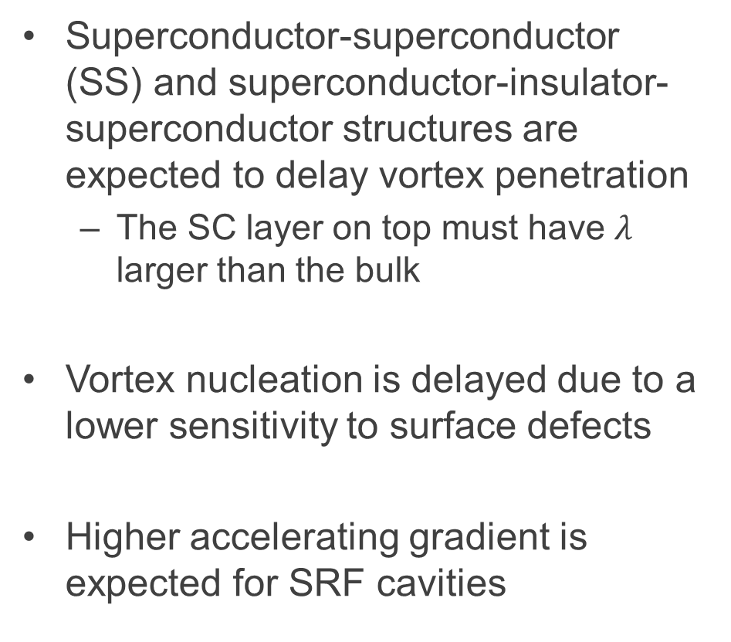
SS and SIS structures
Superconductor-superconductor (SS) and superconductor-insulator-superconductor structures are expected to delay vortex penetration
  The SC layer on top must have $λ$ larger than the bulk
Vortex nucleation is delayed due to a lower sensitivity to surface defects
Higher accelerating gradient is expected for SRF cavities
Images from T. Kubo, Supercond. Sci. Technol. 30 023001 (2017)

Slide 7
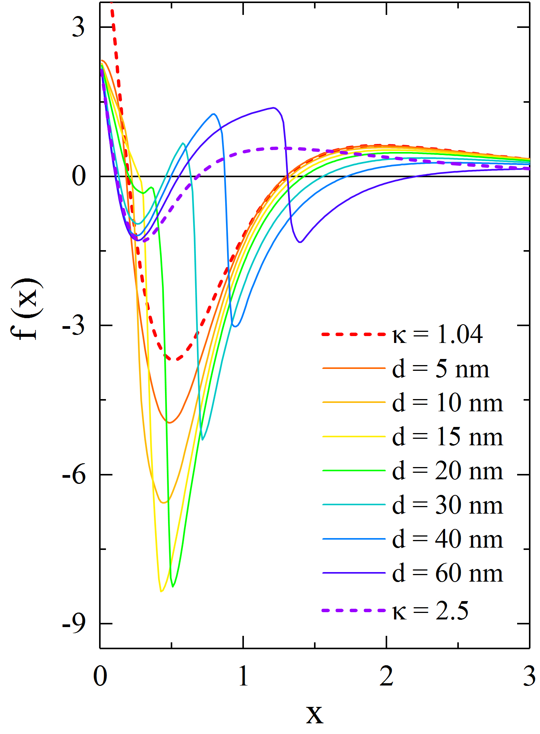
SS structures – vortex penetration delay
SS interface add an extra barrier to vortex nucleation
Top layer thickness and SC can be tuned to improve max field
BL
S-S
M. Checchin et al., in proceedings of LINAC16, MSU, East Lansing, USA (2016)
T. Kubo, Supercond. Sci. Technol. 30 023001 (2017)

Slide 8
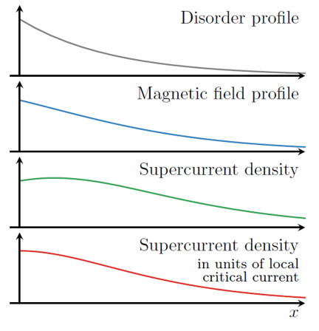
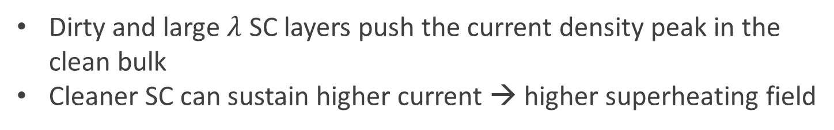
SS structures – current redistribution
Dirty and large $λ$ SC layers push the current density peak in the clean bulk
Cleaner SC can sustain higher current → higher superheating field
V. Ngampruetikorn and J. Sauls, Phys. Rev. Research 1, 012015(R) (2019)

Slide 9
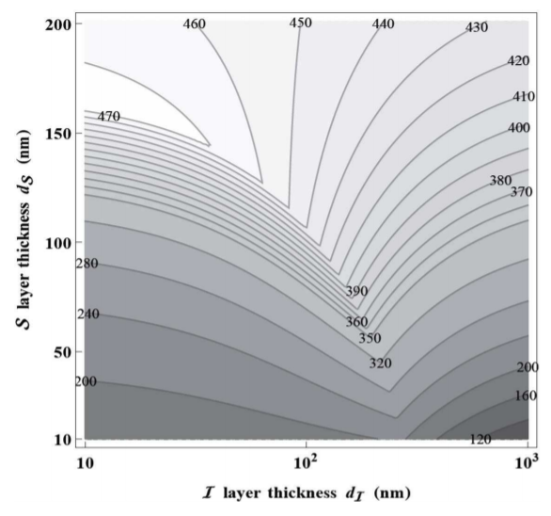
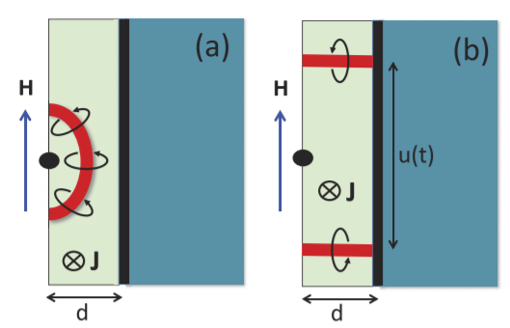
SIS structures
Nb3Sn-Insulator-Nb
Insulating layer acts as a trap for penetrating vortices
Top layer and insulating layer must be tuned to achieve the highest gradients
T. Kubo, Supercond. Sci. Technol. 30 023001 (2017)
A. Gurevich, AIP Advances 5, 017112 (2015)

Slide 10
4 K operation

Slide 11
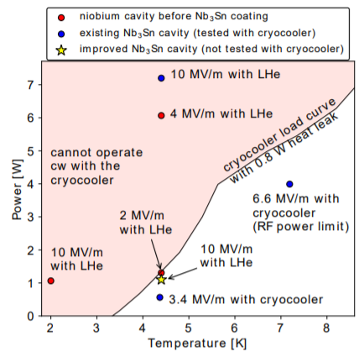
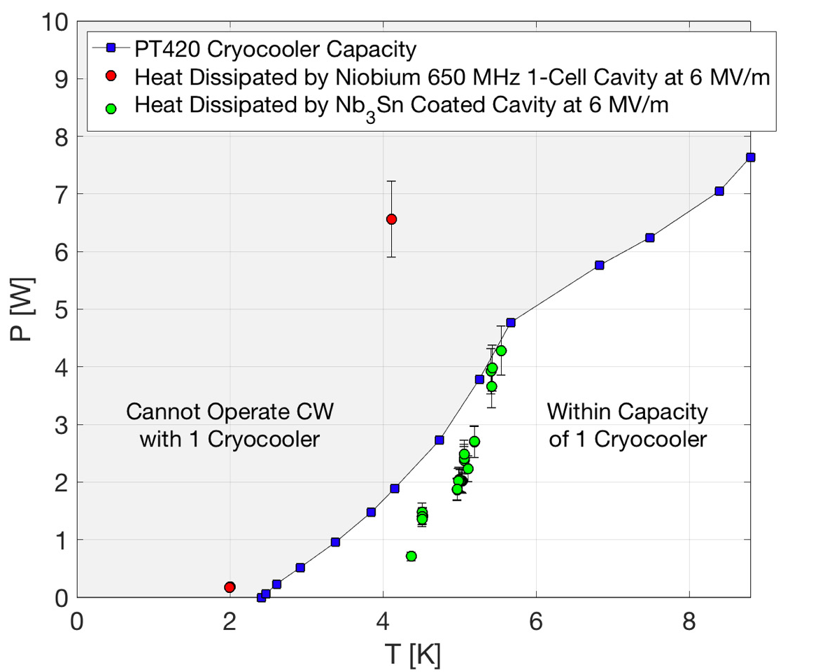
Conduction cooling of SRF cavities
CW operation with conduction cooling of Nb3Sn 650 MHz cavity was demonstrated up to 6 MV/m!
  This is allowed by the low Rs at 4.2 K due to the high Tc of Nb3Sn (~18 K)
Others A15 superconductors might allow for even higher operation CW gradients
  Nb3Ge (Tc ~ 23 K)
CVD deposition allow to deposit all the A15 phases conformally inside resonators
R C Dhuley et al Supercond. Sci. Technol. 33 06LT01 (2020)
S. Posen, et al.

Slide 12
High coherence resonators for quantum information science and sensing

Slide 13
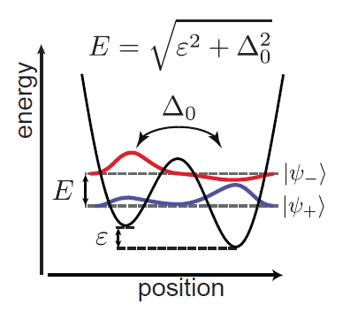
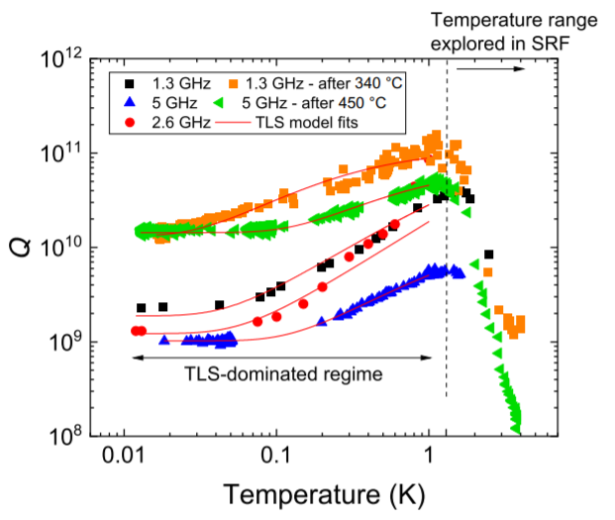
Two-level systems in bulk Nb SRF cavities
At mK temperatures losses are dominated by two-level systems Dipole moments in the oxide
  Dangling bonds
  Collective motions
  …
By removing the oxide layer Nb SRF cavities can reach Q-factors of the order of 1e10 in mK range
  QIS previous state f the art was 1e8
A. Romanenko et al. Phys. Rev. Applied 13, 034032 (2020)

Slide 14
Innovative materials to suppress TLS dissipation
The new CVD/ALD system allows for the mitigation of TLS in SRF cavities:
  High T treatment to remove oxide ( T > 800 C)
  Deposition of nm thick crystalline insulating layer to avoid further oxidation
    Al2O3
    SiN
    ...
TLS-free resonators are a transformative technology in QIS and sensing areas

Slide 15
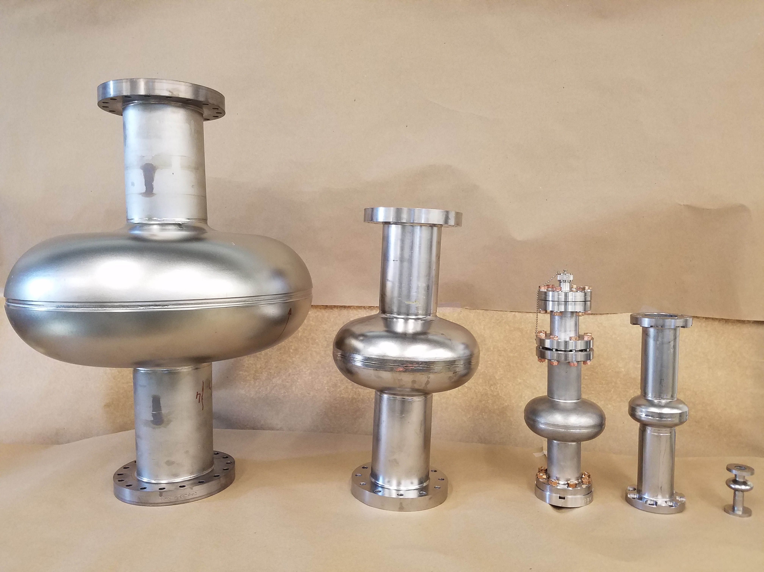
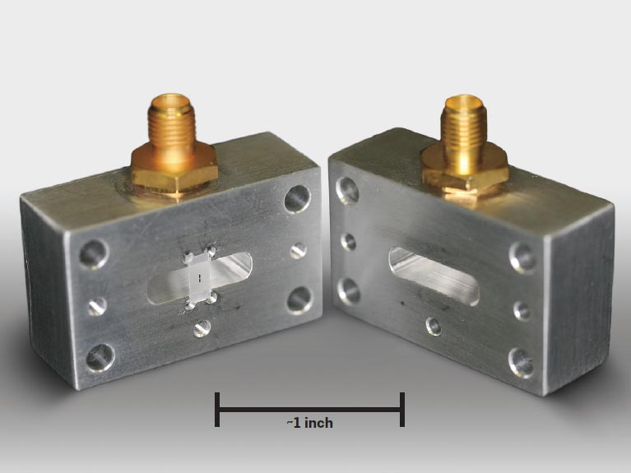
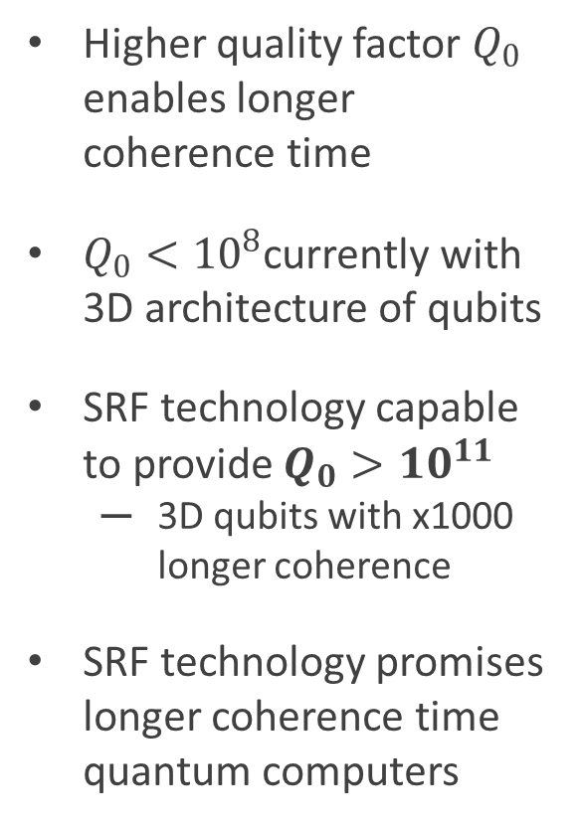
SRF technology to enable high coherence qubits
SRF resonators
Higher quality factor $Q_{0}$ enables longer coherence time
$Q_{0}<{10}^{8}$currently with 3D architecture of qubits
SRF technology capable to provide $Q_{0}>{10}^{11}$
  3D qubits with x1000 longer coherence
SRF technology promises longer coherence time quantum computers
Qubit
lifetime
> 1 s
1 - 1000 μs
1 - 100 ns
SRF technology
Transmon 3D architecture
H. Paik et al., Phys. Rev. Lett. (2011)
Cooper-pair box
Y. Nakamura et al., Nature (1999)

Slide 16
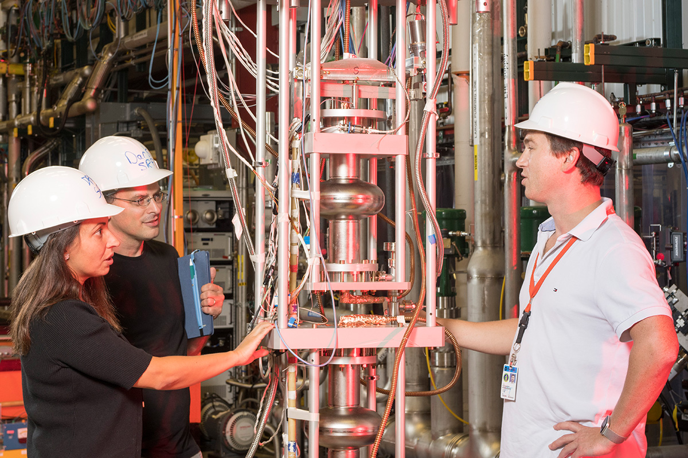
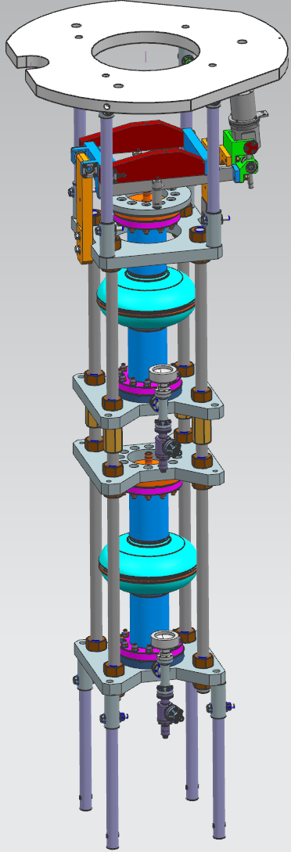
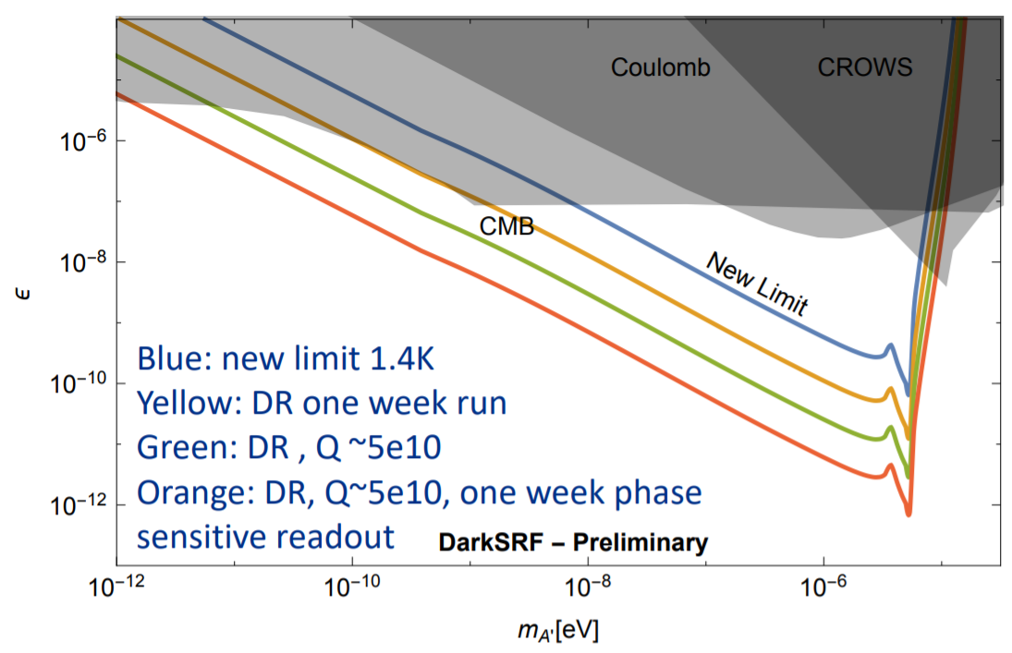
Dark photon searches
DarkSRF experiment
https://indico.physics.lbl.gov/event/939/contributions/4371/attachments/2162/2915/DarkSRF-Aspen-2.pdf
J. Jaeckel and A. Ringwald, Phys. Lett. B 659, 509 (2008)
Q_{DET}, Q_{EM} < 10⁵ so far used
Q_{DET}, Q_{EM} > 10¹⁰ SRF can offer several orders of magnitude improvement in sensitivity to χ

Slide 17
High Q-factor resonators for particles detection

Slide 18
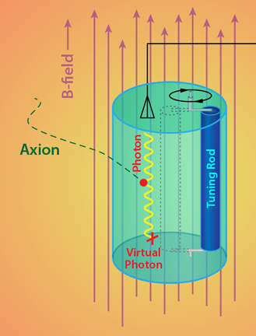
Axion searches: ADMX experiment
Frequency-tunable resonator is immersed in a multi-Tesla field
Hypothetical axion scatters on the field and converts into a photon in the resonator
High Q-factor allows for longer lived photons and therefore higher sensitivity to axions

Slide 19
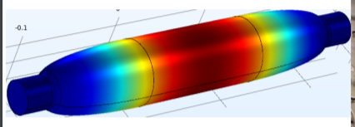
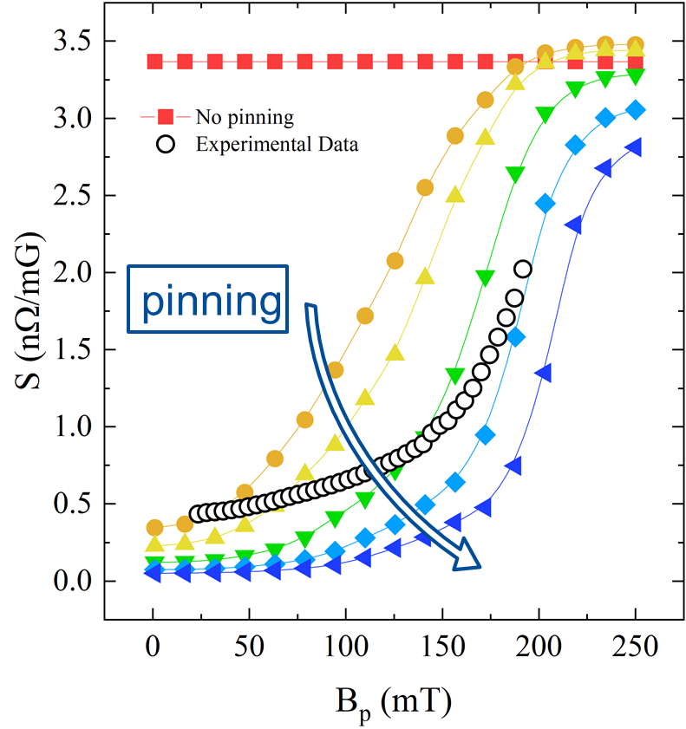
High Q-factors by means of SRF materials
High Hc2 SC materials operating in mixed state are good candidates
  Nb3Sn cavity with cigar-like shape (S. Posen)
Decrease the vortex surface resistance by add artificial pinning
  Insulating precipitates in the material
  Similar to what is done in SC magnets world
  Possible with CVD/ALD process
M. Checchin, A. Grassellino, Phys. Rev. Applied 14, 044018 (2020)

Slide 20
Thank you for the attention

